Slide 1



Slide 2
CS225: Spatial Computing
Geovisualization

Slide 3

Visual Perception
Learning Styles & Personality Types: Visual, Auditory, Kinesthetic

Slide 4
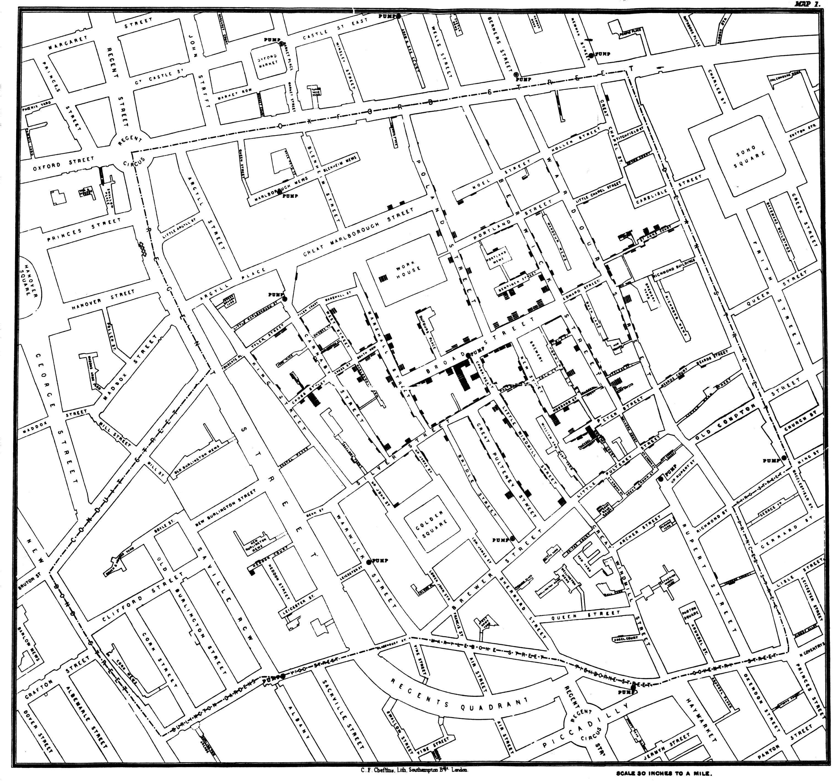
Cholera cases in the London epidemic of 1854

Slide 5
Cholera cases in the London epidemic of 1854

Slide 6
Cholera cases in the London epidemic of 1854
Broad St. Water Pump

Slide 7
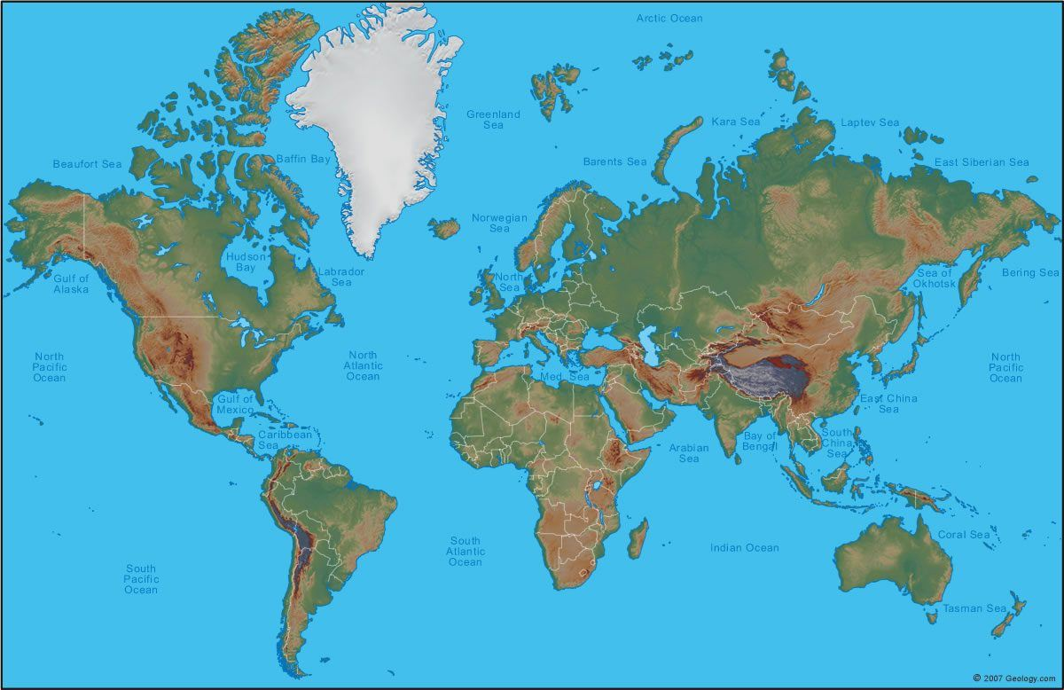
Geo-Visualization
What is the ratio between areas of Africa and Greenland?

Slide 8
Geo-Visualization
What is the ratio between areas of Africa and Greenland? 14:1

Slide 9
Map Orientation and Projections
Mapping a 3D globe on a flat 2D plane
  https://www.youtube.com/watch?v=kIID5FDi2JQ

Slide 10
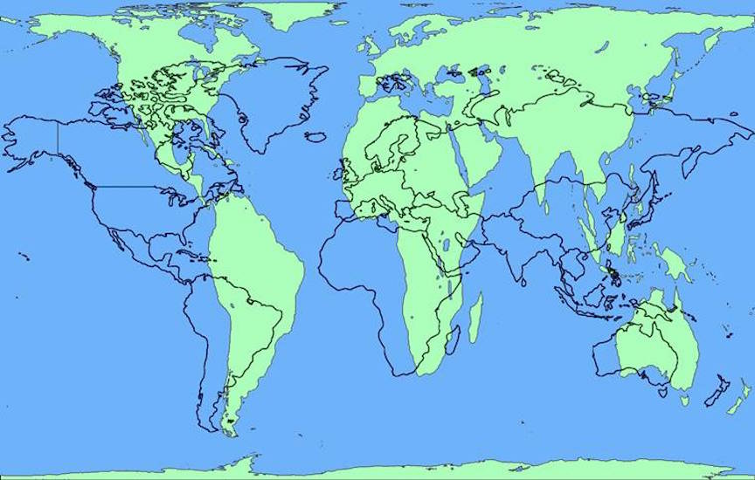
Map Orientation and Projections
Mapping a 3D globe on a flat 2D plane
  https://www.youtube.com/watch?v=kIID5FDi2JQ

Slide 11
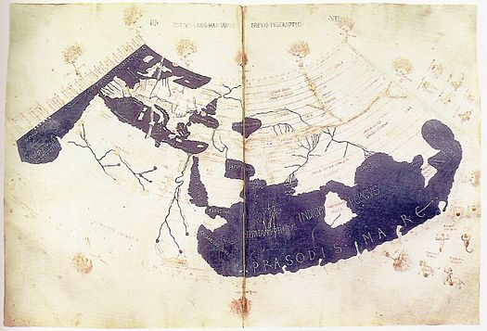

Map Orientation and Projections

Slide 12
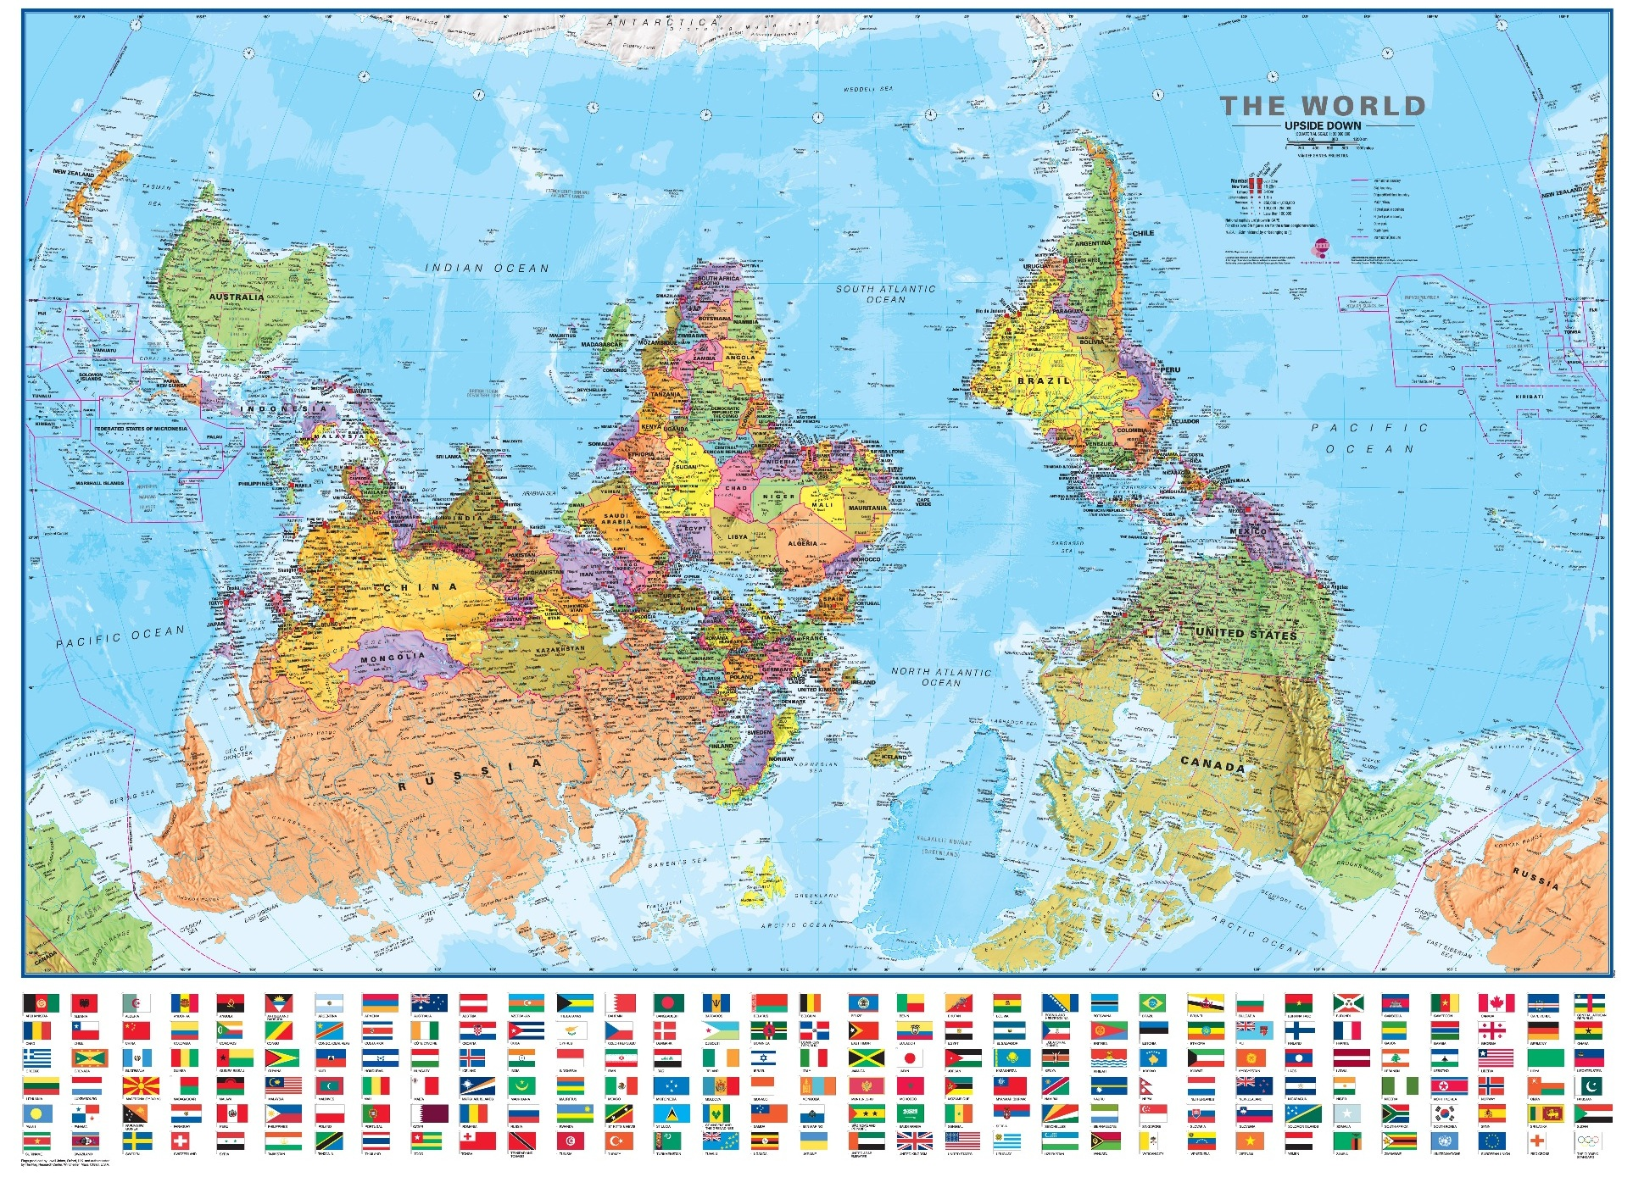
Map Orientation and Projections

Slide 13
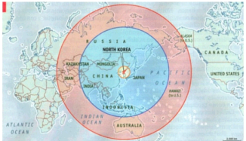

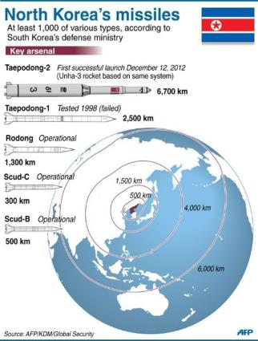
Map Orientation and Projections

Slide 14
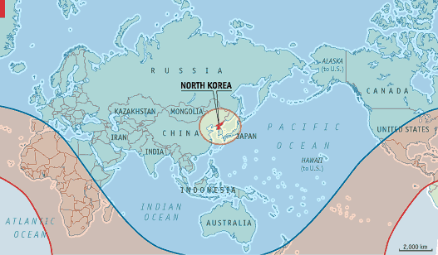
Map Orientation and Projections
Correction
Original

Slide 15
Why?
Why visualization?
  Get insights
  Come up with hypotheses
  Detect the expected, and discover the unexpected ®

Slide 16
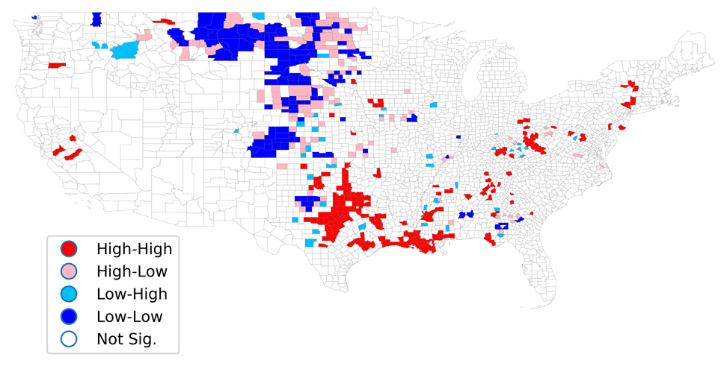
Why?
Why visualization?
  Get insights
  Come up with hypotheses
  Detect the expected, and discover the unexpected ®

Slide 17
Applications
Mapping
  With all map applications throughout history
Decision making
  E.g., disease outbreaks, crimes, etc
Real-time monitoring
  E.g., traffic, security, etc
Scientific analysis
  E.g., climate change, vegetation analysis, etc
…

Slide 18
Geo-visualization Element
Three elements
  Data: what to visualize?
  Location: where to put data?
  Visualization scheme: how to visualize?

Slide 19
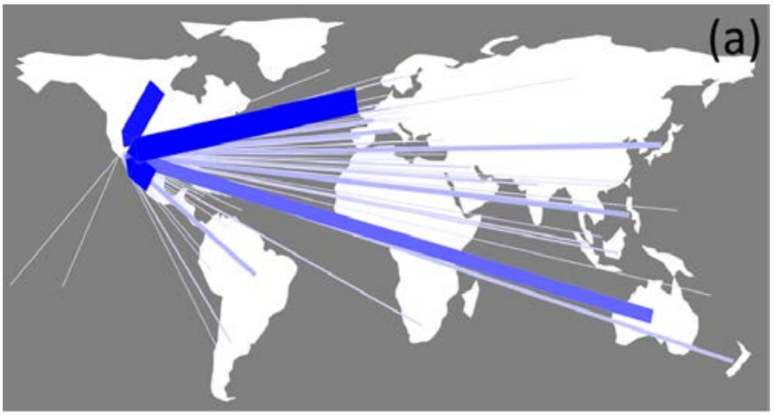
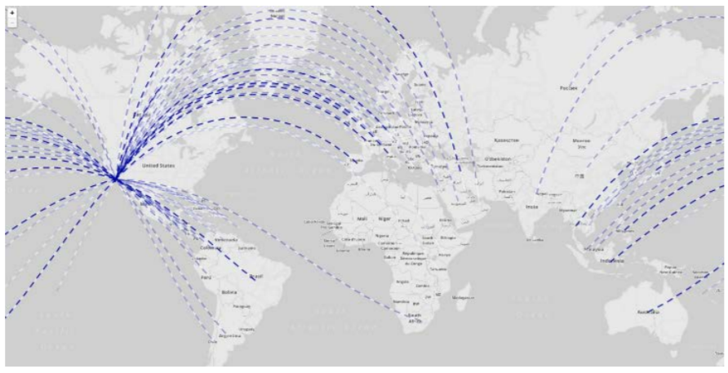
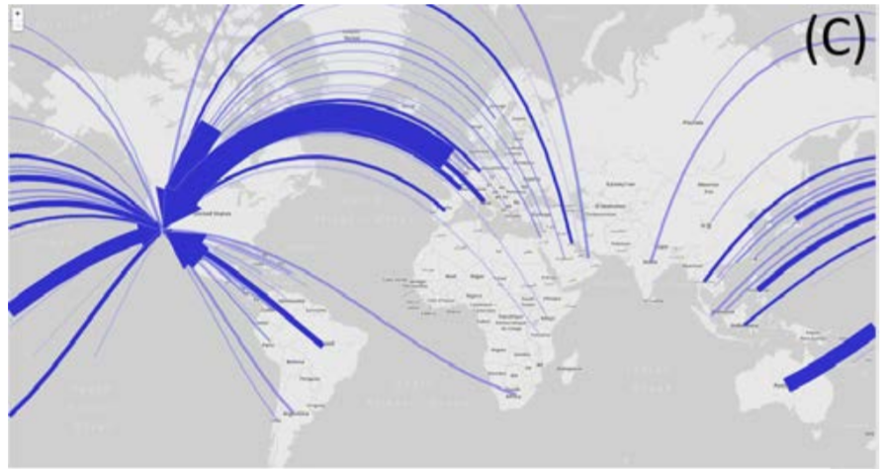
Geo-visualization Element
Three elements
  Data: what to visualize?
  Location: where to put data?
  Visualization scheme: how to visualize?

Slide 20
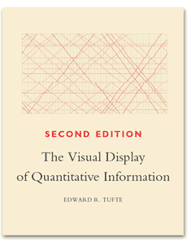
Geo-visualization Element
Three elements
  Data: what to visualize?
  Location: where to put data?
  Visualization scheme: how to visualize?

Slide 21
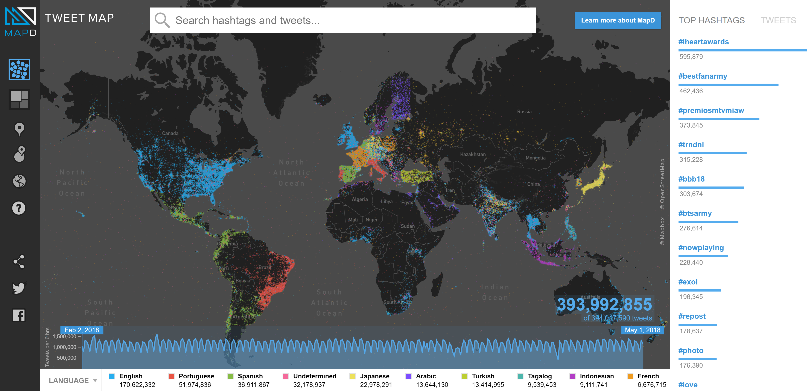
Interactive Maps
MapD interactive demos
  Tweet map: https://www.mapd.com/demos/tweetmap/

Slide 22
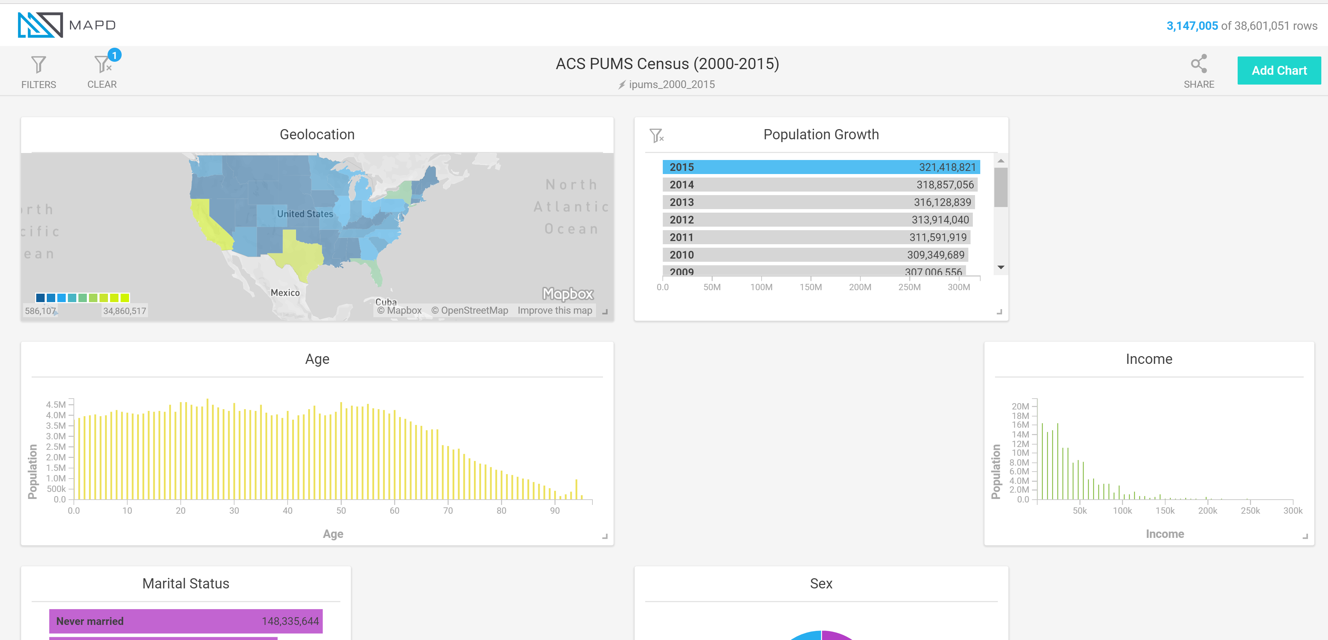
Interactive Maps
MapD interactive demos
  US Census: https://www.mapd.com/demos/census/#/dashboard?_k=uh03oy

Slide 23
Interactive Maps
Pan and Zoom (in interactive views)
  Pan: change your data focus on same spatial view level
  Zoom: change your spatial view level

Slide 24
Interactive Maps
Pan and Zoom (in interactive views)
  Pan: change your data focus on same spatial view level
  Zoom: change your spatial view level
Linking and Brushing (in multiple views)
  Linking: highlight certain part of data in all views
  Brushing: dynamic linking (linking + panning)
  This happens when you have multiple distinct views, e.g., a map, a table, and a graph, or a set of temporally partitioned views

Slide 25
Interactive Maps
Pan and Zoom (in interactive views)
  Pan: change your data focus on same spatial view level
  Zoom: change your spatial view level
Linking and Brushing (in multiple views)
  Linking: highlight certain part of data in all views
  Brushing: dynamic linking (linking + panning)
  This happens when you have multiple distinct views, e.g., a map, a table, and a graph, or a set of temporally partitioned views
Specification of interactive visualization
  200 ms response time (controversial)

Slide 26
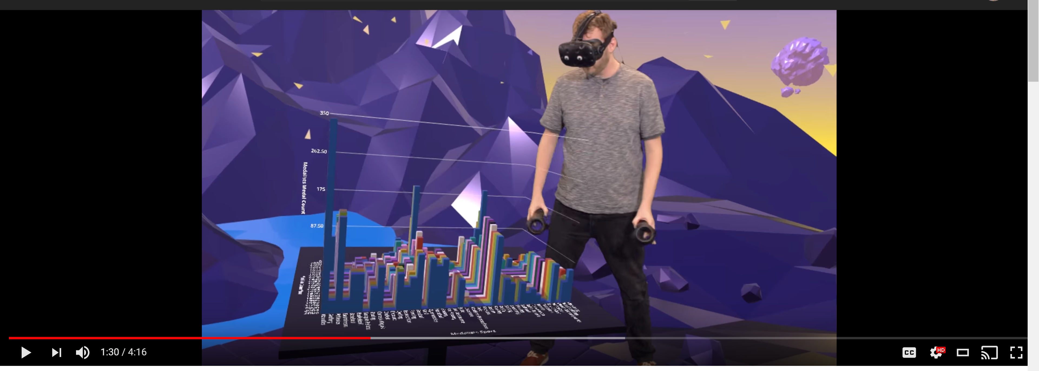
Visualization in Virtual Reality
https://www.youtube.com/watch?v=u76ww3NJFgE

Slide 27
Big Spatial Data Visualization
New challenges come with big volume data
  How to put data on the map?
  How to aggregate large data?
  How to process large data?

Slide 28
Big Spatial Data Visualization
New challenges come with big volume data
  How to put data on the map?
  How to aggregate large data?
  How to process large data?
High velocity
  High velocity data visualization exploits pre-materialization
  Still active research is on-going

Slide 29
Designing an Effective Visualization
Need to take human perception into account (orientation)

Slide 30
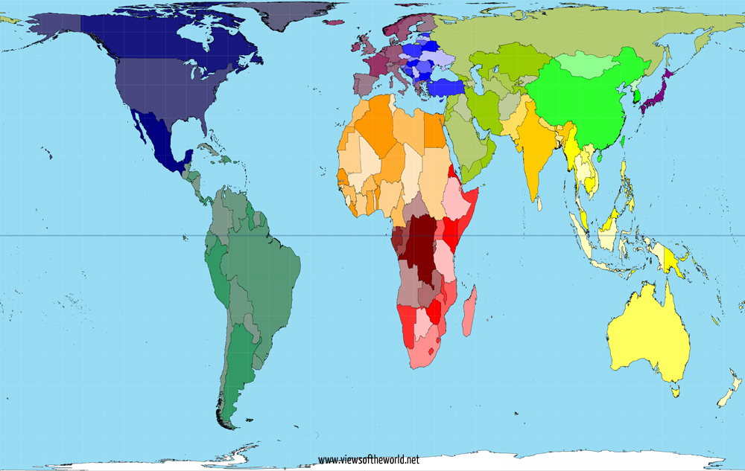
Designing an Effective Visualization
Need to take human perception into account (projection/colors)

Slide 31
Designing an Effective Visualization
Need to take human perception into account (projection)

Slide 32
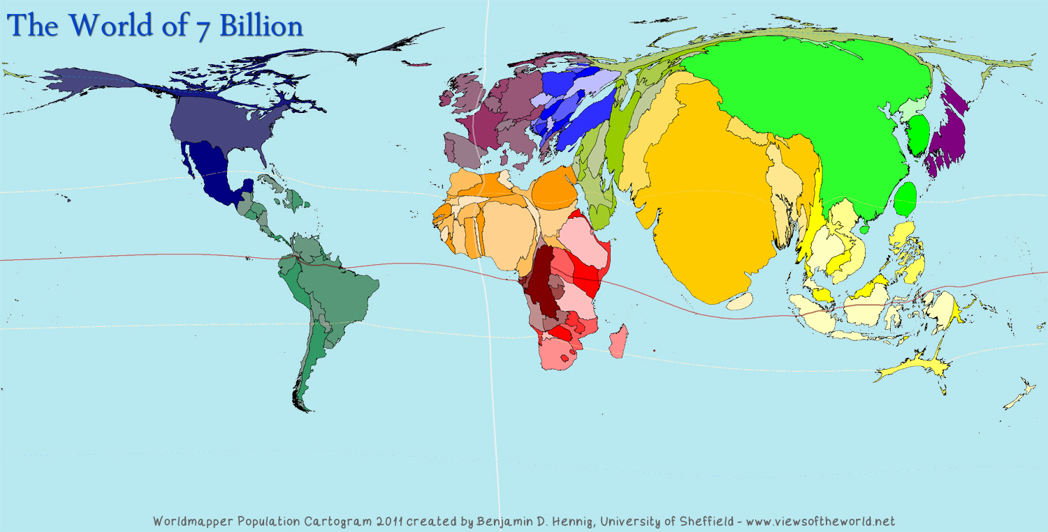
Designing an Effective Visualization
Communicate the right message

Slide 33
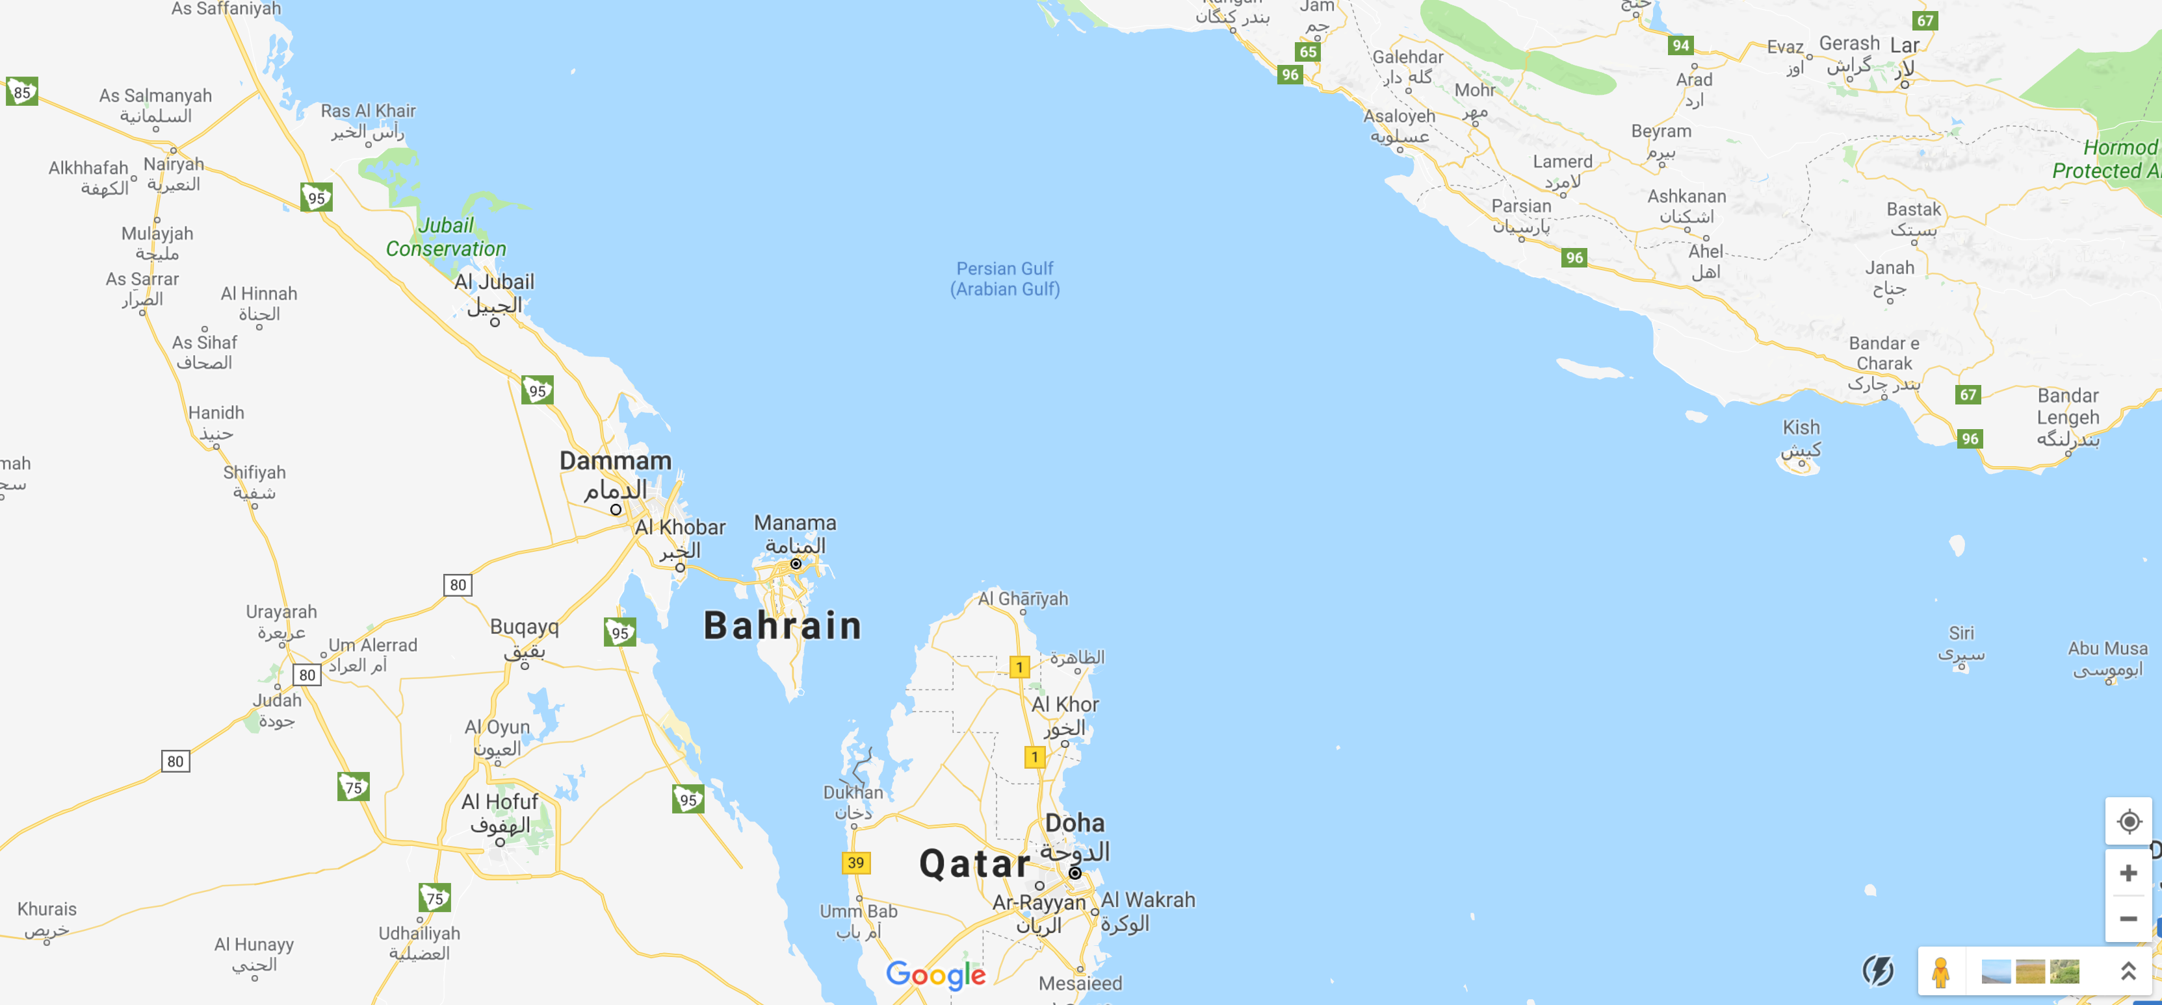
Designing an Effective Visualization
Consider conflicted entities

Slide 34
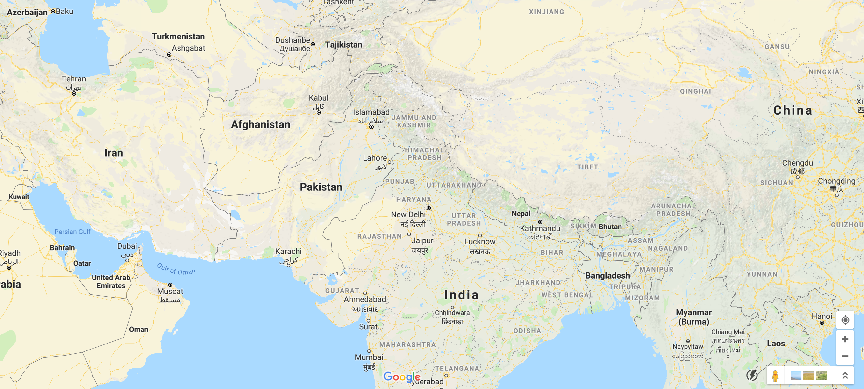
Designing an Effective Visualization
Consider conflicted entities

Slide 35
Designing an Effective Visualization
Human perception is sensitive to:
  Sizing
  Colors perception (color choice, clarity, etc)
  Conflicted entities (names, borders, etc)
  Values, e.g., population vs population density
  …

Slide 36
Designing an Effective Visualization
Human perception is sensitive to:
  Sizing
  Colors perception (color choice, clarity, etc)
  Conflicted entities (names, borders, etc)
  Values, e.g., population vs population density
  …
Visualization confusions might be caused by:
  Too many colors
  Inconsistent scales
  Wrong chart types (e.g., continuous chart on discrete data)
  …

Slide 37
Credits
Prof. Luc Anselin’s lecture
  https://www.youtube.com/watch?v=KJFSSET0Diw

