Slide 1
Parallel Algorithms:
Theory and Practice
Scheduling Parallel Computation
CS260 – Lecture 13
Yan Gu

Slide 2
parallel_for (int i=0; i<n; i++)
a[i] = f(a[i]);
How is your code actually executed on hardware?
Why analyzing work and span?

Slide 3
parallel_for (int i=0; i<n; i++)
a[i] = f(a[i]);

Slide 4
parallel_for (int i=0; i<n; i++)
a[i] = f(a[i]);

Slide 5
Treat the computation as a DAG
Function SUM(A)
If |A| = 1 then return A(1)
In Parallel
a = SUM(first half of A)
b = SUM(second half of A)
return a + b
Notes:
For completeness, here I will formally define what I mean by a write.
I do it briefly since this is not important in understanding the algorithm.
In this talk, we consider the simplest model I proposed in SPAA16, that has a large asymmetric memory, which is the NVRAM, and a small symmetric memory which is the DRAM.
The CPU can have operations to the data in small memory, read from and write to the large asymmetric memory, all in the unit of a log n-bit words.
You can go to my PhD thesis to see how the more advanced measures can be modeled, such as cache-lines, parallelism.
But here, let’s just focus on the simplest model, and count reads, writes, and operations explicitly.
(Given a graph with n vertices and m edges.)

Slide 6
Greedy scheduler
Idea: Do as much as possible on every step

Slide 7
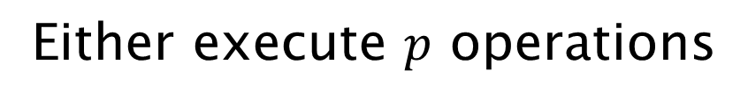
Greedy scheduler
Idea: Do as much as possible on every step
P = 3
Either execute $p$ operations

Slide 8
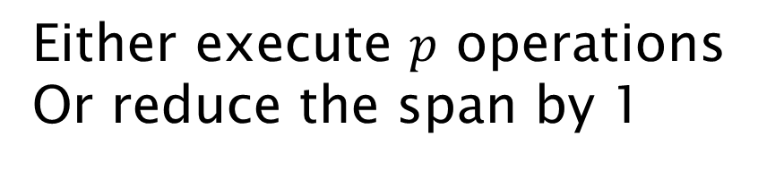
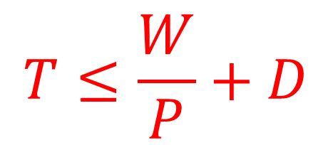
Greedy scheduler
Idea: Do as much as possible on every step
P = 3
Either execute $p$ operations
Or reduce the span by 1
$$T≤\frac{W}{P}+D$$

Slide 9
Greedy scheduler
Impractical:
Assumes processors/threads run in lockstep
Big overhead in context switching
Different operations have very different costs
P = 3

Slide 10
Work-stealing scheduler
Full details in 6.172: Performance Engineering of Software Systems (Cilk implementation)
If a processor spawns two tasks at a FORK, it continues execution with one of the spawned subtasks, and push the other subtask to the front its queue
If a processor completes a task, it tries to pull a task from the front of its own queue
If a processor finishes all tasks in its own queue, it randomly selects another processor, and steals a task from the end of the victim queue (retry if failed)
P = 3

Slide 11
Work-stealing scheduler
P = 3
P
P
P

Slide 12
Work-stealing scheduler
P = 3
P
P
P

Slide 13
parallel_for (int i=0; i<n; i++)
a[i] = f(a[i]);

Slide 14
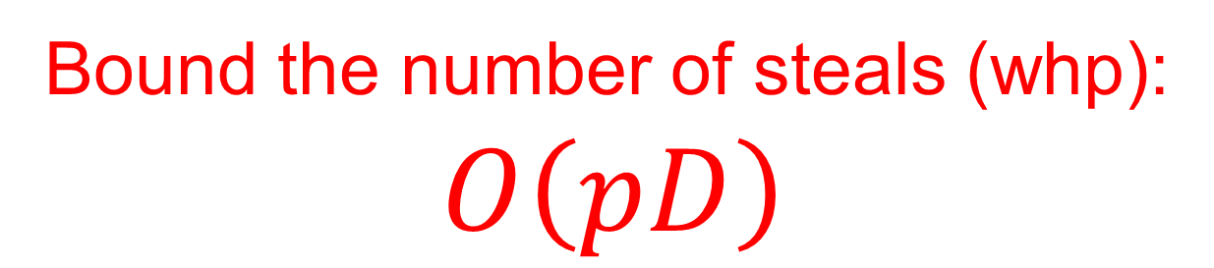
Overhead of work-stealing scheduler
Bound the number of steals (whp):
$$O\left(pD\right)$$
P = 3
P
P
P

Slide 15
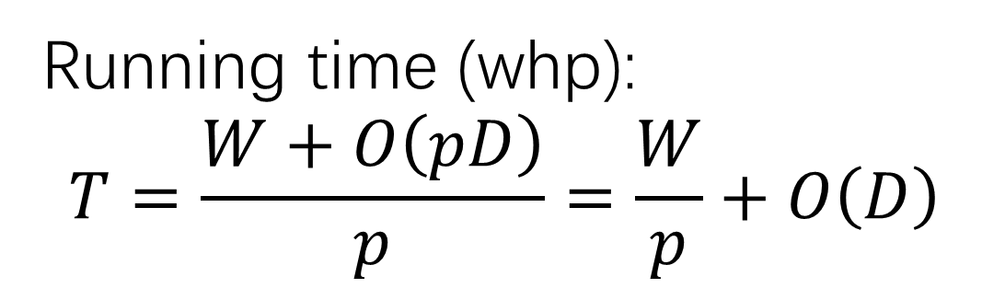
Overhead of work-stealing scheduler
Bound the number of steals (whp):
$$O\left(pD\right)$$
Running time (whp):
$$T=\frac{W+O\left(pD\right)}{p}=\frac{W}{p}+O\left(D\right)$$

Slide 16

Proof sketch
Consider one specific path
How many steals do we need to “help” to finish this path?
We want to show that $O\left(pD\right)$ steals are sufficient to steal $D$ tasks whp

Slide 17
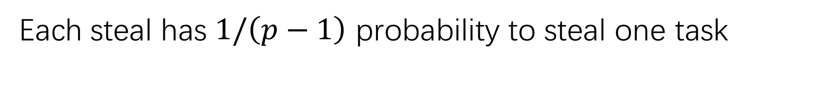
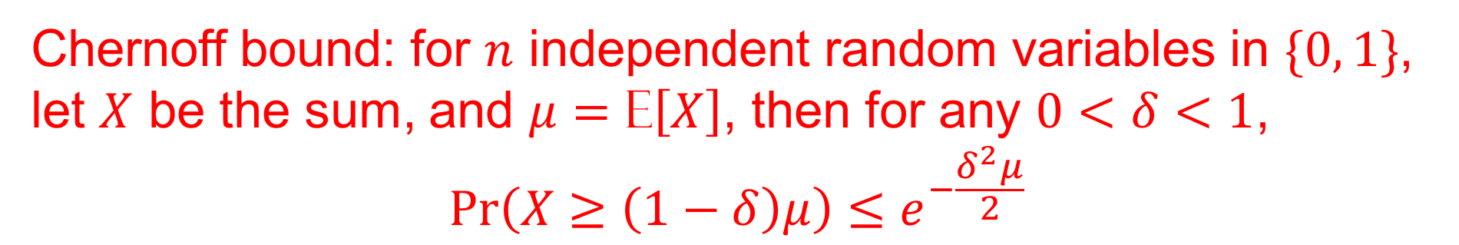
Simplest case: steals attempted one by one
Each steal has $1/\left(p−1\right)$ probability to steal one task
Chernoff bound: for $n$ independent random variables in $\{0, 1\}$, let $X$ be the sum, and $μ=\text{E}\left[X\right]$, then for any $0<δ<1$,
$$Pr\left(X≥\left(1−δ\right)μ\right)≤e^{−\frac{δ^{2}μ}{2}}$$

Slide 18
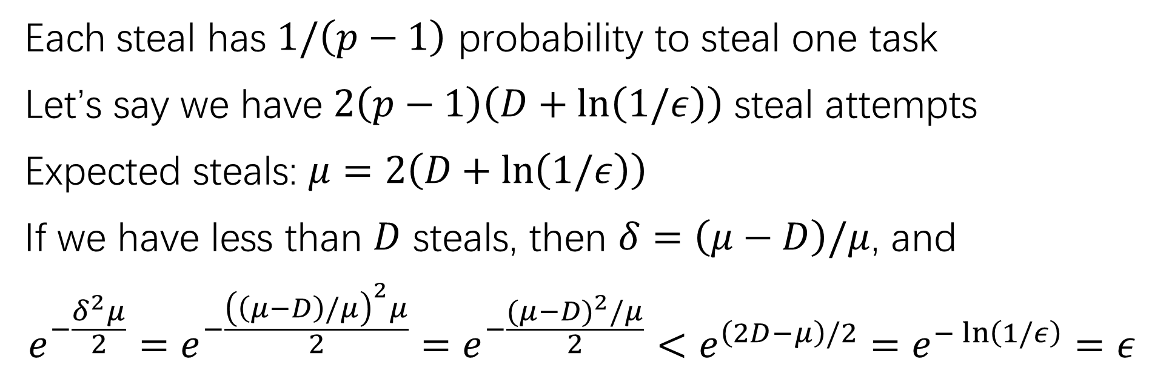
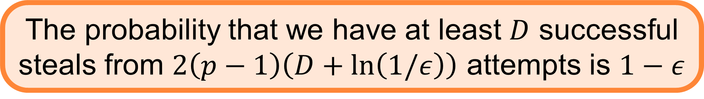
Simplest case: steals attempted one by one
Each steal has $1/\left(p−1\right)$ probability to steal one task
Let’s say we have $2\left(p−1\right)\left(D+\ln\left(1/ε\right)\right)$ steal attempts
Expected steals: $μ=2\left(D+\ln\left(1/ε\right)\right)$
If we have less than $D$ steals, then $δ=\left(μ−D\right)/μ$, and
$$e^{−\frac{δ^{2}μ}{2}}=e^{−\frac{{\left(\left(μ−D\right)/μ\right)}^{2}μ}{2}}=e^{−\frac{{(μ−D)}^{2}/μ}{2}}<e^{\left(2D−μ\right)/2}=e^{−\ln\left(1/ε\right)}=ε$$
The probability that we have at least $D$ successful steals from $2\left(p−1\right)\left(D+\ln\left(1/ε\right)\right)$ attempts is $1−ε$
$$Pr\left(X≥\left(1−δ\right)μ\right)≤e^{−\frac{δ^{2}μ}{2}}$$

Slide 19
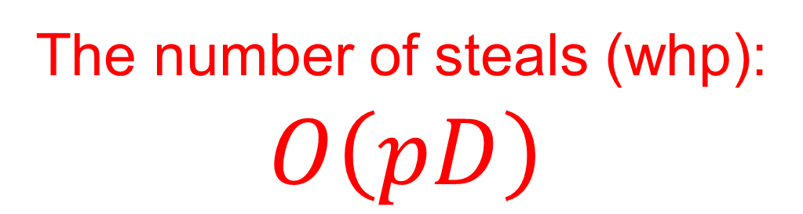
Overhead of work-stealing scheduler
The number of steals (whp):
$$O\left(pD\right)$$
Running time (whp):
$$T=\frac{W+O\left(pD\right)}{p}=\frac{W}{p}+O\left(D\right)$$
Notes:
For completeness, here I will formally define what I mean by a write.
I do it briefly since this is not important in understanding the algorithm.
In this talk, we consider the simplest model I proposed in SPAA16, that has a large asymmetric memory, which is the NVRAM, and a small symmetric memory which is the DRAM.
The CPU can have operations to the data in small memory, read from and write to the large asymmetric memory, all in the unit of a log n-bit words.
You can go to my PhD thesis to see how the more advanced measures can be modeled, such as cache-lines, parallelism.
But here, let’s just focus on the simplest model, and count reads, writes, and operations explicitly.
(Given a graph with n vertices and m edges.)

Slide 20
Successful steals can be expensive
The number of steals (whp):
$$O\left(pD\right)$$
Physical communication between two processors
Can lead to considerably more cache misses
Coarsening will not increase #SuccSteal
Notes:
For completeness, here I will formally define what I mean by a write.
I do it briefly since this is not important in understanding the algorithm.
In this talk, we consider the simplest model I proposed in SPAA16, that has a large asymmetric memory, which is the NVRAM, and a small symmetric memory which is the DRAM.
The CPU can have operations to the data in small memory, read from and write to the large asymmetric memory, all in the unit of a log n-bit words.
You can go to my PhD thesis to see how the more advanced measures can be modeled, such as cache-lines, parallelism.
But here, let’s just focus on the simplest model, and count reads, writes, and operations explicitly.
(Given a graph with n vertices and m edges.)

Slide 21
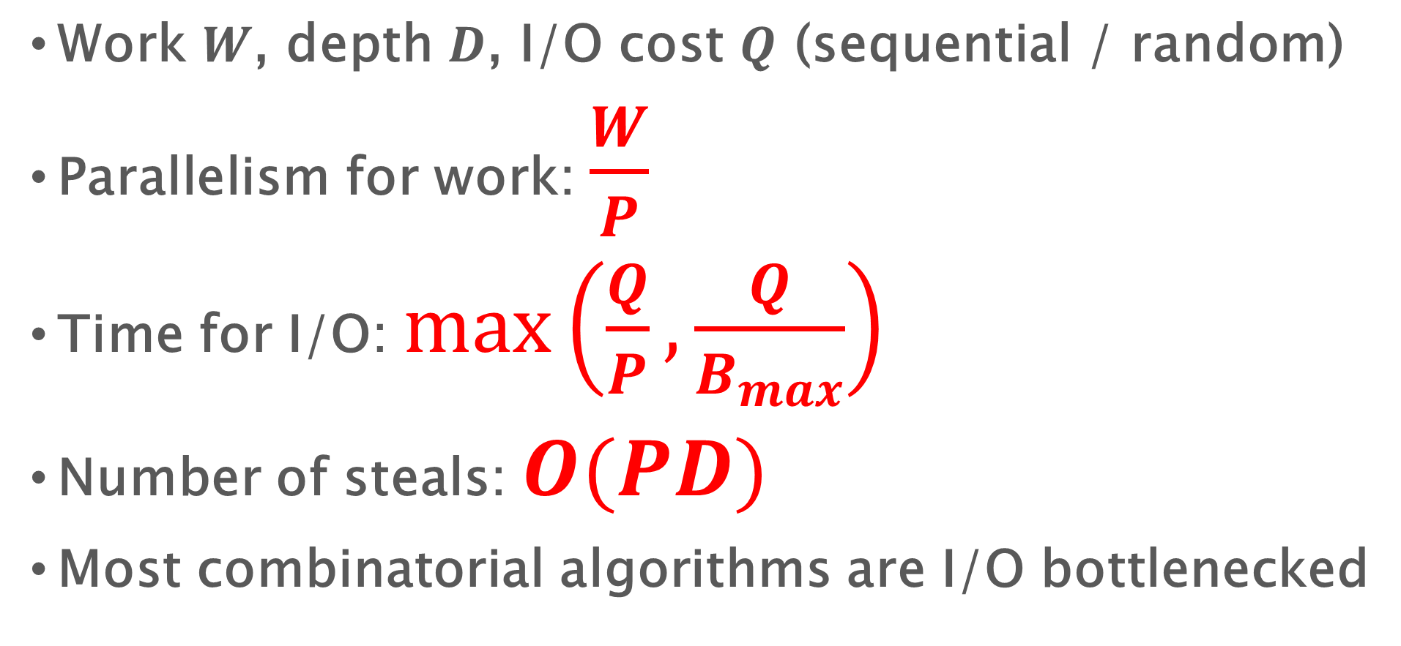
Design and Analysis of Parallel Algorithms
Work $W$, depth $D$, I/O cost $Q$ (sequential / random)
Parallelism for work: $\frac{W}{P}$
Time for I/O: $max\left(\frac{Q}{P},\frac{Q}{B_{max}}\right)$
Number of steals: $O(PD)$
Most combinatorial algorithms are I/O bottlenecked

