Slide 1
Parallel Algorithms:
Theory and Practice
Full Analysis of Work-Stealing Scheduler
CS260 – Lecture 13
Yan Gu

Slide 2
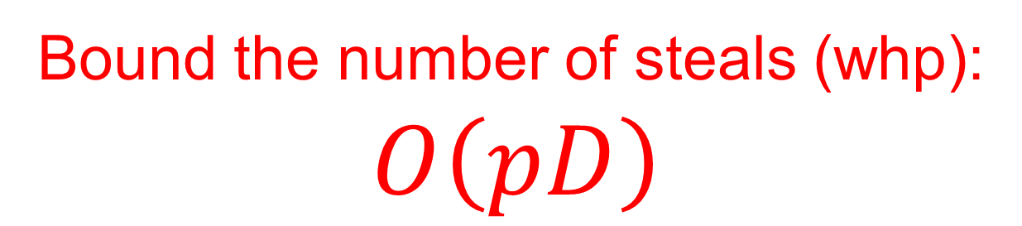
Overhead of work-stealing scheduler
Bound the number of steals (whp):
$$O\left(pD\right)$$
P = 3
P
P
P

Slide 3
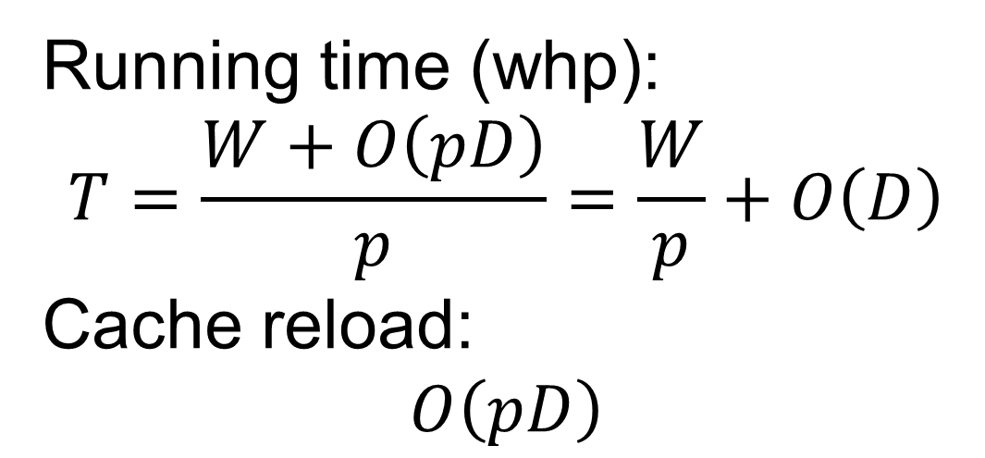
Overhead of work-stealing scheduler
Bound the number of steals (whp):
$$O\left(pD\right)$$
Running time (whp):
$$T=\frac{W+O\left(pD\right)}{p}=\frac{W}{p}+O\left(D\right)$$
Cache reload:
$$O\left(pD\right)$$

Slide 4
Assumptions
Steals come asynchronously
Multiple steals can be made to the same thread, and one wins (adversarially)
A successful steal from thread A would not block two consecutive steals from another thread B

Slide 5
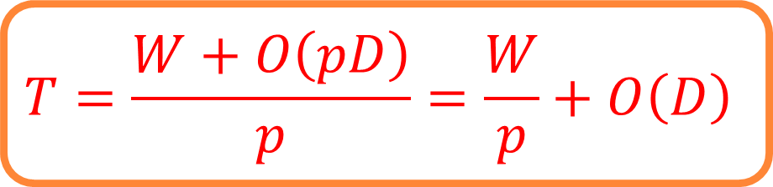
Proof outline
Consider one specific path
Left child: executed directly after the previous node
Right child:
Stolen by another thread
Executed when the current thread finishes the left side
Join node: executed when all previous nodes are finished
$$T=\frac{W+O\left(pD\right)}{p}=\frac{W}{p}+O\left(D\right)$$

Slide 6

Proof outline
Consider one specific path
Consider the worst case:
All nodes are right child
All of them need to be stolen
We want to show that $O\left(pD\right)$ steals are sufficient to steal $D$ tasks whp

Slide 7
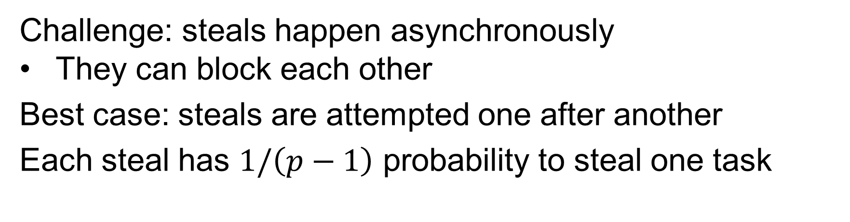
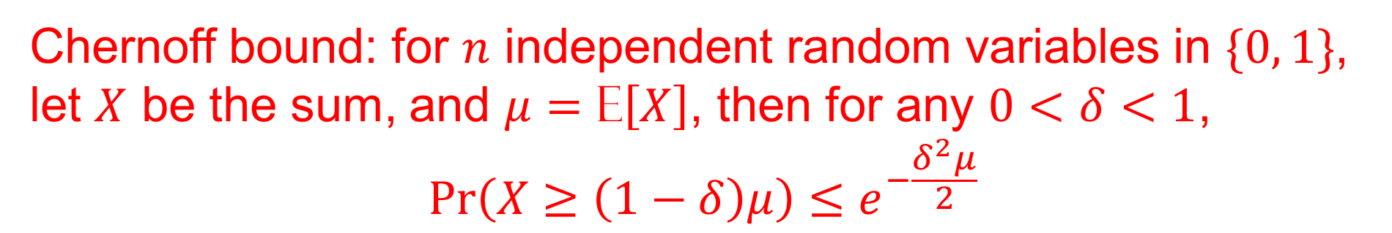
How many steals do we need?
Challenge: steals happen asynchronously
They can block each other
Best case: steals are attempted one after another
Each steal has $1/\left(p−1\right)$ probability to steal one task
Chernoff bound: for $n$ independent random variables in $\{0, 1\}$, let $X$ be the sum, and $μ=\text{E}\left[X\right]$, then for any $0<δ<1$,
$$Pr\left(X≥\left(1−δ\right)μ\right)≤e^{−\frac{δ^{2}μ}{2}}$$

Slide 8
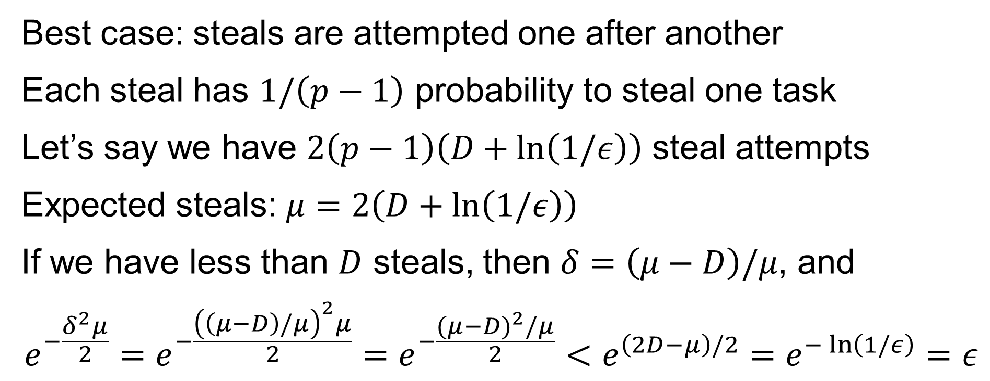
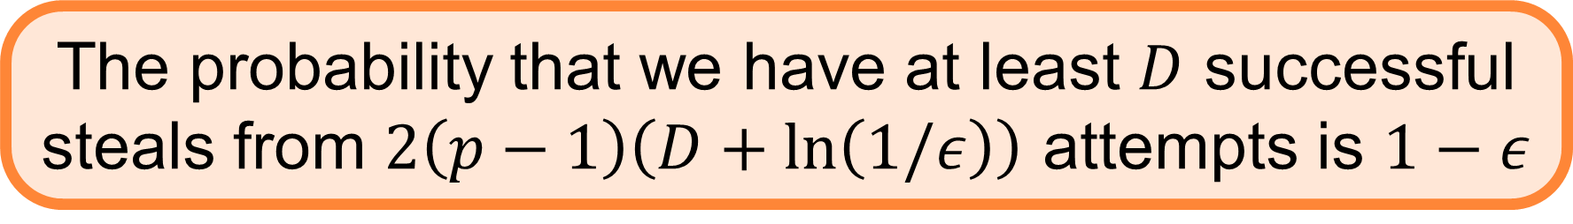
How many steals do we need?
Best case: steals are attempted one after another
Each steal has $1/\left(p−1\right)$ probability to steal one task
Let’s say we have $2\left(p−1\right)\left(D+\ln\left(1/ε\right)\right)$ steal attempts
Expected steals: $μ=2\left(D+\ln\left(1/ε\right)\right)$
If we have less than $D$ steals, then $δ=\left(μ−D\right)/μ$, and
$$e^{−\frac{δ^{2}μ}{2}}=e^{−\frac{{\left(\left(μ−D\right)/μ\right)}^{2}μ}{2}}=e^{−\frac{{(μ−D)}^{2}/μ}{2}}<e^{\left(2D−μ\right)/2}=e^{−\ln\left(1/ε\right)}=ε$$
The probability that we have at least $D$ successful steals from $2\left(p−1\right)\left(D+\ln\left(1/ε\right)\right)$ attempts is $1−ε$
$$Pr\left(X≥\left(1−δ\right)μ\right)≤e^{−\frac{δ^{2}μ}{2}}$$

Slide 9
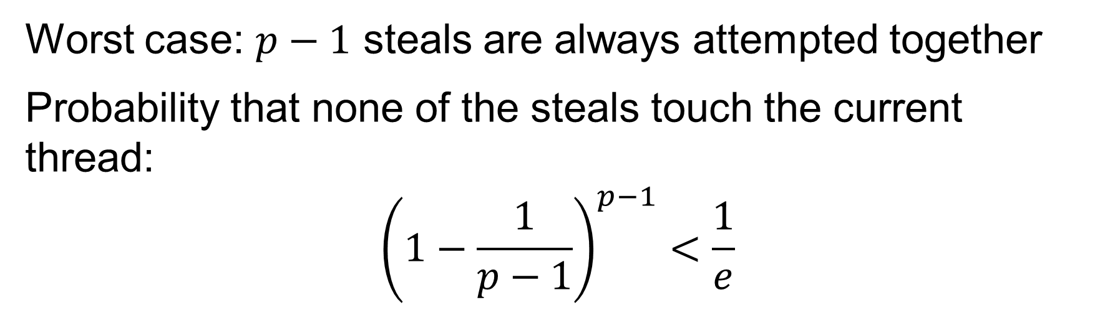
How many steals do we need?
Worst case: $p−1$ steals are always attempted together
Probability that none of the steals touch the current thread:
$${\left(1−\frac{1}{p−1}\right)}^{p−1}<\frac{1}{e}$$

Slide 10
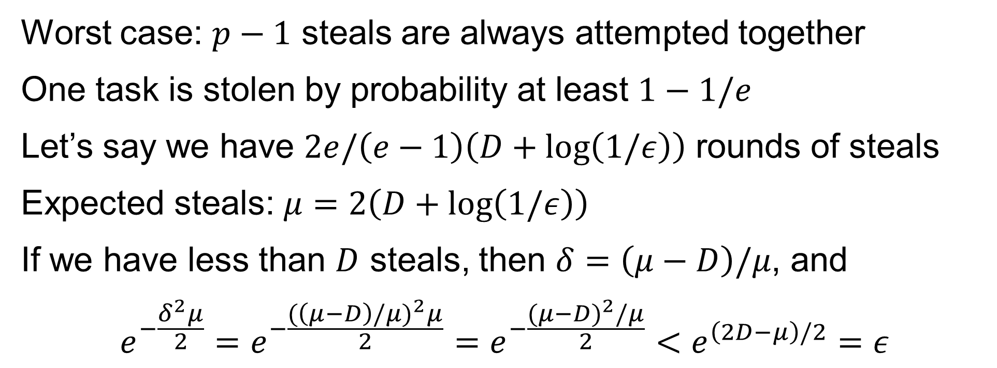
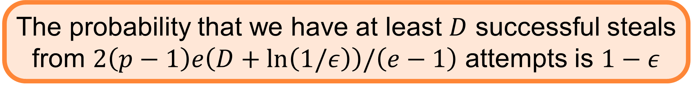
How many steals do we need?
Worst case: $p−1$ steals are always attempted together
One task is stolen by probability at least $1−1/e$
Let’s say we have $2e/\left(e−1\right)\left(D+\log\left(1/ε\right)\right)$ rounds of steals
Expected steals: $μ=2\left(D+\log\left(1/ε\right)\right)$
If we have less than $D$ steals, then $δ=\left(μ−D\right)/μ$, and
$$e^{−\frac{δ^{2}μ}{2}}=e^{−\frac{{(\left(μ−D\right)/μ)}^{2}μ}{2}}=e^{−\frac{{(μ−D)}^{2}/μ}{2}}<e^{\left(2D−μ\right)/2}=ε$$
The probability that we have at least $D$ successful steals from $2\left(p−1\right)e\left(D+\ln\left(1/ε\right)\right)/\left(e−1\right)$ attempts is $1−ε$

Slide 11
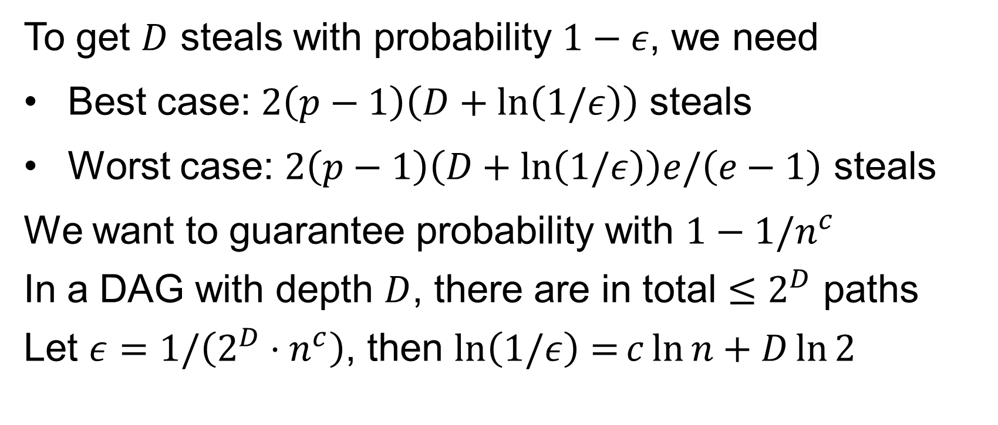
How many steals do we need?
To get $D$ steals with probability $1−ε$, we need
Best case: $2\left(p−1\right)\left(D+\ln\left(1/ε\right)\right)$ steals
Worst case: $2\left(p−1\right)\left(D+\ln\left(1/ε\right)\right)e/\left(e−1\right)$ steals
We want to guarantee probability with $1−1/n^{c}$
In a DAG with depth $D$, there are in total $≤2^{D}$ paths
Let $ε=1/\left(2^{D}⋅n^{c}\right)$, then $\ln\left(1/ε\right)=c\ln{n}+D\ln{2}$
$O\left(pD\right)$ steals are sufficient for all possible paths whp

Slide 12
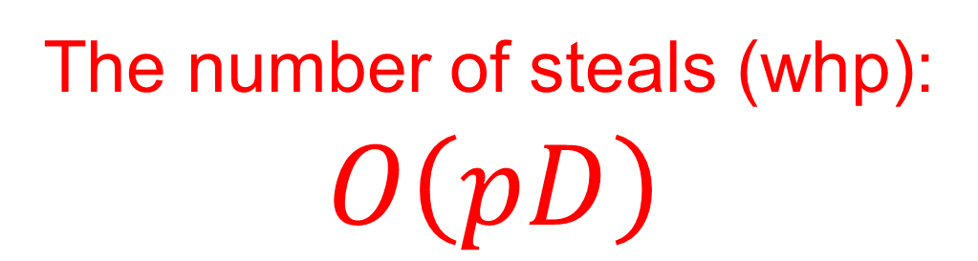
Overhead of work-stealing scheduler
The number of steals (whp):
$$O\left(pD\right)$$
Running time (whp):
$$T=\frac{W+O\left(pD\right)}{p}=\frac{W}{p}+O\left(D\right)$$
Cache reload:
$$O\left(pD\right)$$
Notes:
For completeness, here I will formally define what I mean by a write.
I do it briefly since this is not important in understanding the algorithm.
In this talk, we consider the simplest model I proposed in SPAA16, that has a large asymmetric memory, which is the NVRAM, and a small symmetric memory which is the DRAM.
The CPU can have operations to the data in small memory, read from and write to the large asymmetric memory, all in the unit of a log n-bit words.
You can go to my PhD thesis to see how the more advanced measures can be modeled, such as cache-lines, parallelism.
But here, let’s just focus on the simplest model, and count reads, writes, and operations explicitly.
(Given a graph with n vertices and m edges.)

