Slide 1
Parallel Algorithms:
Theory and Practice
CS260 – Lecture 1
Yihan Sun

Slide 2
CS260: Parallel algorithms Lecture 1
Why parallel algorithms?
About the course
Warm-up

Slide 3
When we study algorithms, what are we doing
Learning existing algorithms
  Know how to solve existing well-defined problems
Design new algorithms
  Model real-world problems and design new algorithms
  Variants of existing algorithms
  Combinations of existing algorithms
Analyze algorithms
  Time complexity, space complexity, correctness, how accurate it is, …
  Computational model, prove bounds and correctness, …
Implement algorithms
  Programming-friendly algorithms
  Implementation-level optimizations

Slide 4








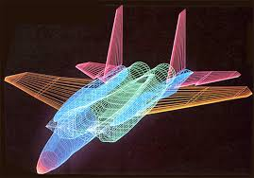
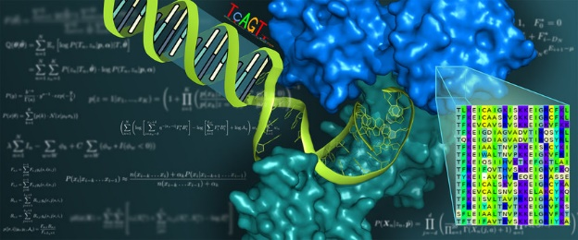


Why parallelism? Everyone wants performance!%aa
Database /
Data warehouses
Data mining /
Data science
Machine learning /
Artificial intelligence
Get Faster!
Many, many others
Computer graphics / computational geometry
Computational biology
Notes:
Before I start I would like to briefly introduce myself and my research. In computer science, we study algorithms and solutions for different applications, with different objectives and constrains, but almost every one wants performance! In the past, there is a rather trivial way to make your code faster, which is that you rely on the development of hardware. Roughly speaking you put your code there and wait for 1.5 years, your code runs faster by twice. But all of a sudden this bonus stopped. In the past ten years, the frequency of CPU improved by no more than twice. Even considering other aspects, it still became hard to improve the single-core performance.
That’s why we need parallelism! Exactly, parallelism moved into the mainstream of processor design at this point, and now, multicore devices are prevalent!
Now, parallelism is no longer limited to those expensive, high-end computers. These multi-core devices are in your office, on your desk, and even in your pocket! Although light-weighted, they are still powerful!
For example, a multicore machine can have terabytes of memory, which is more than enough for many applications of interest, and more than 100 available working threads, which implies a great a amount of parallelism. Even you don’t have such a machine, there are also online services that we can use, making parallelism applicable and affordable. So parallelism is getting more and more important and powerful nowadays. My research solves problems using such multi-core parallelism, both in theory and in practice.

Slide 5
Why performance? Time is money!
Analyzing a social network to provide real-time services (e.g, recommendation and advertising) - slow algorithms makes your information out-of-date
Answering queries from users (e.g., web searching and smart home) – slow algorithms makes users impatient and unhappy
Playing games, watching videos, video meetings, … - slow algorithms freeze the screen
Less time also means using less other recourse, like power

Slide 6
Time is money, it buys other things
There are many things more important than performance in programming
  Compatibility, functionality, reliability, correctness, debuggability, robustness, … and more
Performance is the currency of computing. You can often “buy” needed properties with performance.
  For an iterative numerical algorithm, spending more time means better accuracy
  For a learning algorithm, training for more time means better model
Better performance means to get better results in a limited amount of time

Slide 7
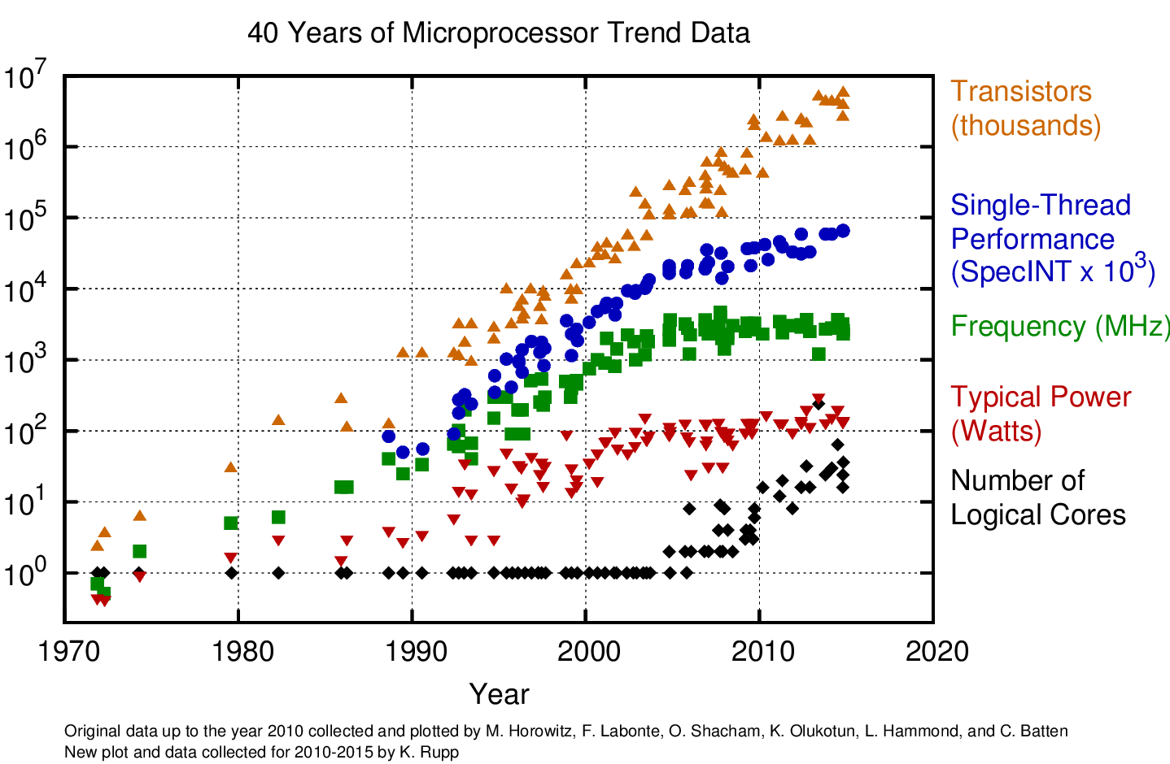
Ways to Make Code Faster
Solution 1: Wait… wait for better hardware
Makes sense 20 years ago
Writing parallel code is hard
Parallel speedup is not significant
Hardware improvement is stable

Slide 8
Ways to Make Code Faster
Solution 1: Wait… wait for better hardware, but:
Harder and harder to improve single-core performance

Slide 9
Ways to Make Code Faster
Multi-core machines came out right in time
Now, your laptop, desktop, smart phone, … are all multi-core
Multi-core programming became easier - relatively

Slide 10


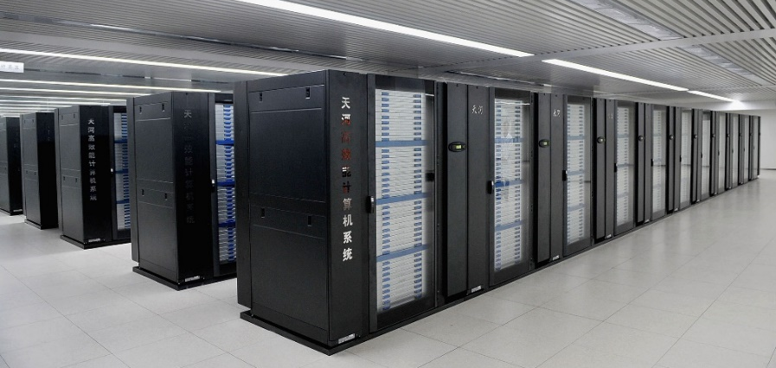
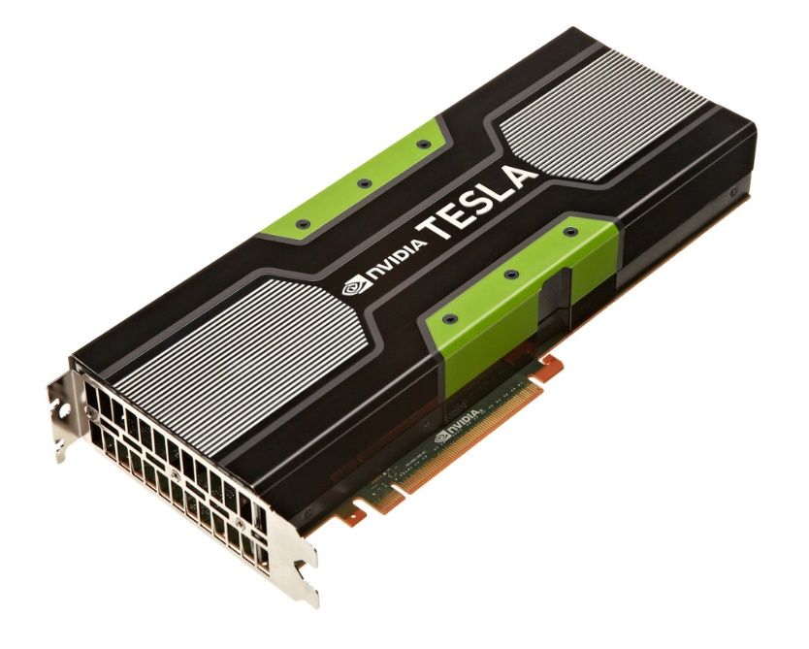


Ways to Make Code Faster: Parallelism
Shared-memory Multi-core Parallelism
Notes:
Before I start I would like to briefly introduce myself and my research. In computer science, we study algorithms and solutions for different applications, with different objectives and constrains, but almost every one wants performance!
Nowadays, an effective way to get your code faster is to use parallelism. There are many forms of parallelism in the world, and my talk will focus on the shared memory multi-core parallelism.
With the advent and prevalence of multi-core devices, parallelism is no longer limited to those expensive high-end computers, but can be light weighted and affordable. You can find such devices in your office, on your desk, and even in your pocket. Although light-weighted, they are still powerful.
For example, a multicore machine can have terabytes of memory, which is more than enough for many applications of interest, and more than 100 available working threads, which implies a great a amount of parallelism. Actually, when data fits in memory, we can expect very good performance from this multi-core shared-memory parallelism, because of smaller overhead in memory access compared to other forms of parallelism, so it’s also especially good for I/O intensive applications.

Slide 11
What you will learn in this course
Shared-memory Multi-core Parallelism
Multiple processors collaborate to get a task done
Notes:
Before I start I would like to briefly introduce myself and my research. In computer science, we study algorithms and solutions for different applications, with different objectives and constrains, but almost every one wants performance!
Nowadays, an effective way to get your code faster is to use parallelism. There are many forms of parallelism in the world, and my talk will focus on the shared memory multi-core parallelism.
With the advent and prevalence of multi-core devices, parallelism is no longer limited to those expensive high-end computers, but can be light weighted and affordable. You can find such devices in your office, on your desk, and even in your pocket. Although light-weighted, they are still powerful.
For example, a multicore machine can have terabytes of memory, which is more than enough for many applications of interest, and more than 100 available working threads, which implies a great a amount of parallelism. Actually, when data fits in memory, we can expect very good performance from this multi-core shared-memory parallelism, because of smaller overhead in memory access compared to other forms of parallelism, so it’s also especially good for I/O intensive applications.

Slide 12
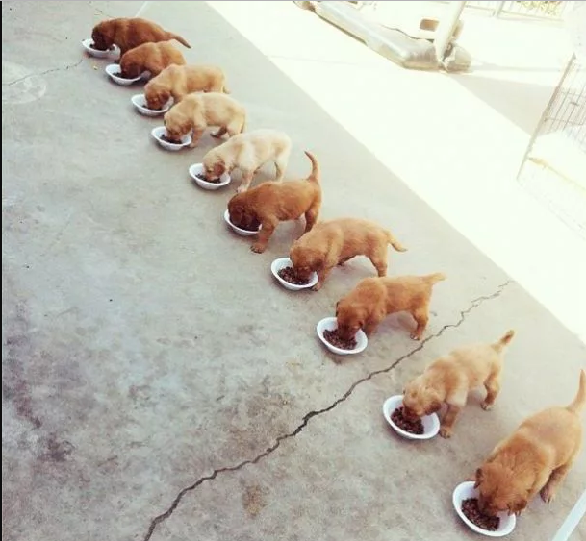
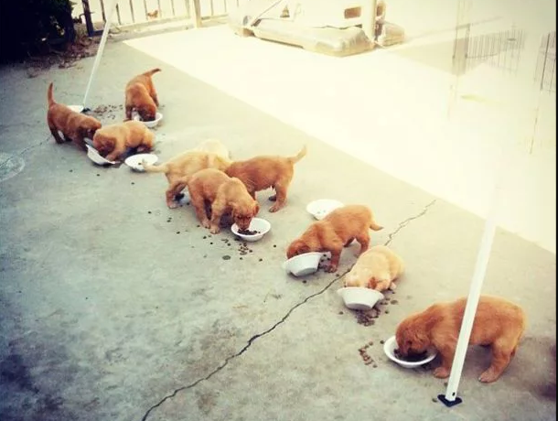
Multi-core Programming: Theory and Practice
Data Race: Two or more processors are accessing the same memory location, and at least one of them is writing
Memory leaking: memory which is no longer needed is not released
Deadlock: a state in which each member of a group is waiting for another member, including itself, to take action, such as releasing a lock
Zombie process: a process that has completed execution but still has an entry in the process table
Missing the 10th dog! Did it become a zombie???
Data Race
Deadlock!
Theory
Practice
Memory leaking!
(Pictures from 9gag.com)
Notes:
But to have both is not easy. Theories are always efficient and elegant, but when trying to bring them into reality, it’s easy to make it a mess. As you can see, there is always a gap between theory and practice. this gap is especially significant for parallel computing because,
parallel programming itself is hard. Usually only well-trained programmers can handle parallelism. If you’ve ever been tortured by parallel programming, you might get this joke: even if you want to get “parallel programming is hard” in parallel, it’s very likely you get this.

Slide 13
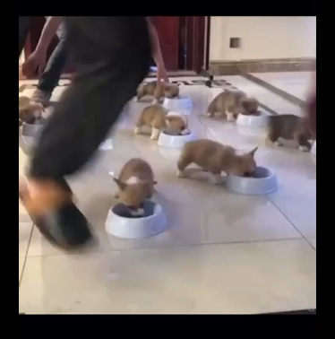
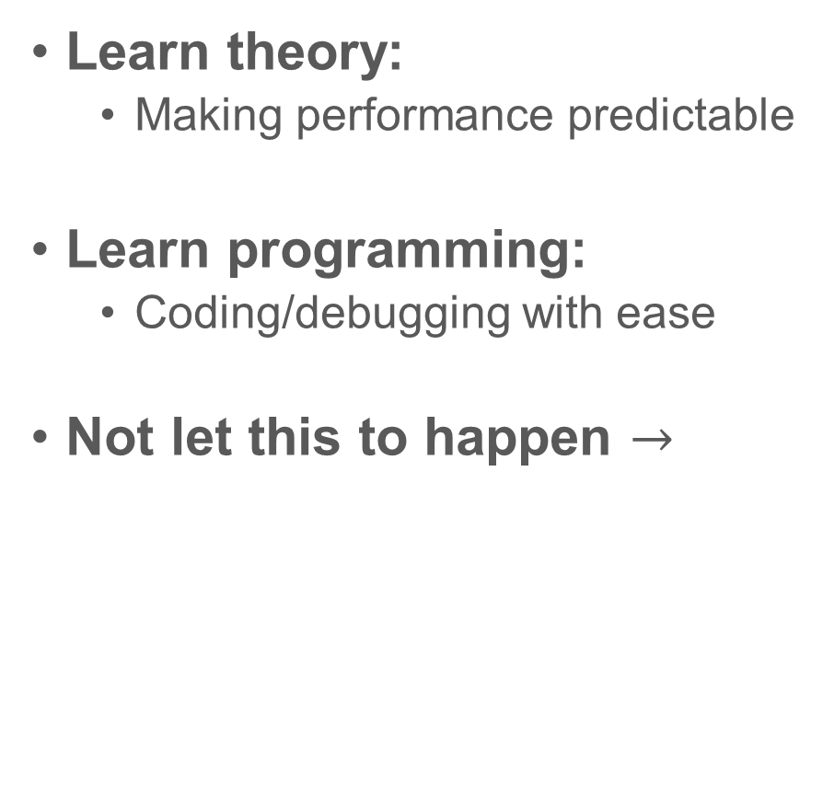
Multi-core Programming: Theory and Practice
Learn theory:
  Making performance predictable
Learn programming:
  Coding/debugging with ease
Not let this to happen $→$

Slide 14
About the Course
In theory:
  Many parallel algorithms, their analysis and cost bound
  How to design parallel algorithms
  Algorithms with theoretical bounds
In practice:
  Algorithms with practical consideration (e.g., I/O efficiency)
  How to write high-performance code
  Code that is easy to write and debug

Slide 15
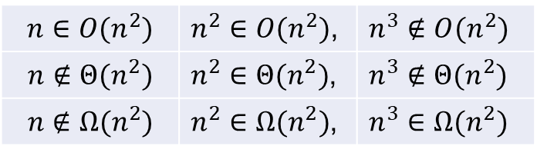
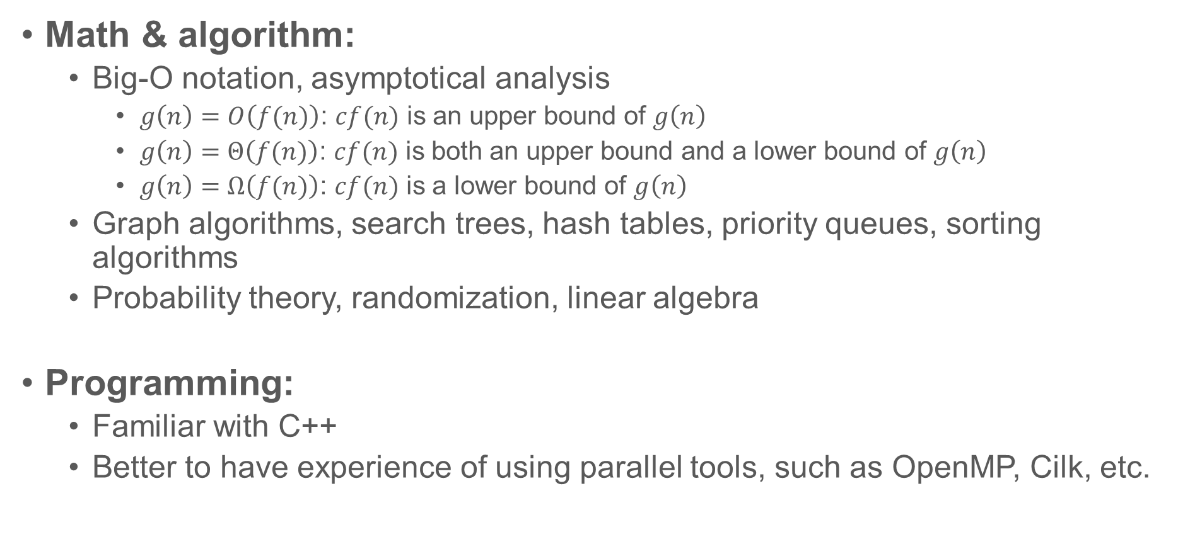
Prerequisites
Math & algorithm:
  Big-O notation, asymptotical analysis
    $g\left(n\right)=O\left(f(n)\right)$: $cf(n)$ is an upper bound of $g\left(n\right)$
    $g\left(n\right)=Θ\left(f(n)\right)$: $cf(n)$ is both an upper bound and a lower bound of $g\left(n\right)$
    $g\left(n\right)=Ω\left(f(n)\right)$: $cf(n)$ is a lower bound of $g\left(n\right)$
  Graph algorithms, search trees, hash tables, priority queues, sorting algorithms
  Probability theory, randomization, linear algebra
Programming:
  Familiar with C++
  Better to have experience of using parallel tools, such as OpenMP, Cilk, etc.
$$n∈O(n^{2})$$ | $n^{2}∈O(n^{2})$, | $n^{3}∉O(n^{2})$
$$n∉Θ(n^{2})$$ | $n^{2}∈Θ(n^{2})$, | $n^{3}∉Θ(n^{2})$
$$n∉Ω(n^{2})$$ | $n^{2}∈Ω(n^{2})$, | $n^{3}∈Ω(n^{2})$

Slide 16
Grade
Paper Reading - 10%.
Homework - 40% (5% bonus).
Course Project - 30%.
Final Exam - 20%.
Class Participation - 5% bonus.

Slide 17
Paper Reading
On the course website, there are a list of related papers for each topic
You need to choose three papers (from similar topics) and submit reviews for the three papers
  Recommended length: ~3 pages
  Printed out and submit after class
You can submit your review at any time during the quarter (deadline is at the end of week 10)
  E.g., you can directly submit your review after the lecture

Slide 18
Homework
There will be 3 homework sets.
There are programming problems – start earlier
No hand-writing (using LaTeX is recommended)
You have five late days to use throughout the quarter
  Including homework, course project proposal, and final report
  Let me know before you use it
The programming part gives you 5% bonus when you get very good performance or write good “report” to analyze the experiments

Slide 19
Homework – collaboration policy
Discussion with other students, using books or online resources are allowed, after you have thought about the problems on your own.
You must cite your collaborators and resources fully and completely
  Alice explained to me the definition of work in Problem 1
  I used Wikipedia site https://xxxx about Master theorem for Problem 3
Most importantly: you must write up your solution independently: close the book and all of your notes, and with no one else helping you when you are writing your final answers.

Slide 20
Course Project
Simple implementations about the algorithms learned in the class
Three topics: sorting algorithms, tree algorithms, graph algorithms
  You can choose one of these topics
  Larger teams (2-3 students) or other topics are allowed, but
    Must talk to the lecturer before submitting the proposal
    Significantly higher standard applies
What you can do
  Design new algorithms
  Experimental evaluations
  Prove new results
Project proposal due at the end of Week 5
Project presentation at Week 10

Slide 21
Final Exam
Take-home exam
You have 24 hours to finish it
No discussion/collaboration with other students
You can still use course slides and the Internet, but again you need to cite all the sources you used

Slide 22
Class Participation (up to 5 points)
Answering questions in the class will earn you extra points
  Just tell me your name after each class
Other ways to earn points
  Give good suggestions about the course or point out typos/unclear things in the slides or homework assignments
  If your homework is selected as the sample solution

Slide 23
Office Hour
Wednesday 2:00pm-3:00pm

Slide 24
Course Server
The department provides a server for use
  If you are a regular UCR student and enrolled in the course, you will receive an account automatically (your cs account)
  If you are a GPP student from Extension, or if you are a former UCR student taking a course through Extension, you can email systems@cs.ucr.edu mentioning your enrollment in the course, and provide your UCR NetID, Extension ID, and a Gmail address. The department will set up an account for you.
Detailed instructions to access the machine are available in Homework 1. Let me know if you have any questions about it.
You can use other machines you have access with (better with more than 10 cores).

Slide 25
In general
I want you to learn and know something new from the course
  It is encouraged to combine what you learned in class with your own interest/research
  A lot of things ongoing – they won’t be hard. They are coordinating to help you understand the content in class

Slide 26
Course Website: https://www.cs.ucr.edu/~yihans/teaching/palgo.html

Slide 27
Warm-up: reduce
Compute the sum of values in an array

Slide 28
Warm-up: the reduce algorithm
Compute the sum of all values in an array (using $p$ processors)
1
+
2
+
3
4
+
5
+
6
7
+
8
6
+
15
+
15
36
Sum(A, n) {
int B[p];
for processor i (i=0..p-1) {
for (j=i*n/p to i*n/p+p) B[i] += A[j];
}
sync all processors;
for (j = 0 to p) ret += B[i];
return ret; }
What if:
We do not know the number of available processors?
The number of processors is O(n)?

Slide 29

Problems
Can’t assume we know the number of processors $p$ ahead of time
Algorithm must have good performance (parallelism) for any given $p$ (which even dynamically changes)
Dealing with system-level issues is error-prone – makes parallel programming notoriously hard

Slide 30
Scheduler: the key to make parallel algorithm design easy

Slide 31

Scheduler
Program
The program generate threads (tasks)
The scheduler maps each thread to a processor (e.g., whenever a processor is available)
Scheduler

Slide 32

Scheduler
Consider it as a complier. Programmers then only need to focus on high-level algorithm design
Code in high-level language
Generate parallel tasks and their dependency
Complier
Scheduler
Executable machine code
Parallel execution order using $p$ processors
We always assume an effective scheduler
We design algorithms only focusing on generating parallel tasks

Slide 33
Warm-up
Compute the sum (reduce) of all values in an array
1
2
3
4
5
6
7
8
+
+
+
+
3
+
7
11
+
15
10
26
+
36
reduce(A, n) {
if (n == 1) return A[0];
if (n is odd) n=n+1;
parallel_for i=1 to n/2
B[i]=A[2i]+A[2i+1];
return reduce(B, n/2); }
reduce(A, n) {
if (n == 1) return A[0];
In parallel:
L = reduce(A, n/2);
R = reduce(A + n/2, n-n/2);
return L+R;
}

Slide 34
How to evaluate the running time (time complexity) of a parallel algorithm
(without knowing how many processors can be used)

Slide 35
Cost model: work-depth
For all computations, draw a DAG
  A->B means that B can be performed only when A has been finished
Work: the total number of operations
Depth (span): the longest length of chain
It only shows the dependency of operations in the algorithm

Slide 36
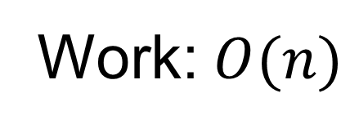
Cost model: work-depth
1
2
3
4
5
6
7
8
+
+
+
+
3
+
7
11
+
15
10
26
Work: $O(n)$
+
36
Work: The total number of operations in the algorithm
  Sequential running time when the algorithm runs on one processor
  Work-efficiency: the work is (asymptotically) no more than the best (optimal) sequential algorithm
  Goal: make the parallel algorithm efficient when a small number of processor are available

Slide 37
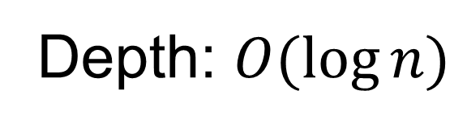
Cost model: work-depth
1
2
3
4
5
6
7
8
+
+
+
+
3
+
7
11
+
15
10
26
Depth: $O(\log{n})$
+
36
Depth (span): The longest dependency chain
  Total time required if there are infinite number of processors
  Polylog-depth
  Goal: make the parallel algorithm faster and faster when more and more processors are available - scalability

Slide 38
How do work and depth relate to the real execution and running time?

Slide 39
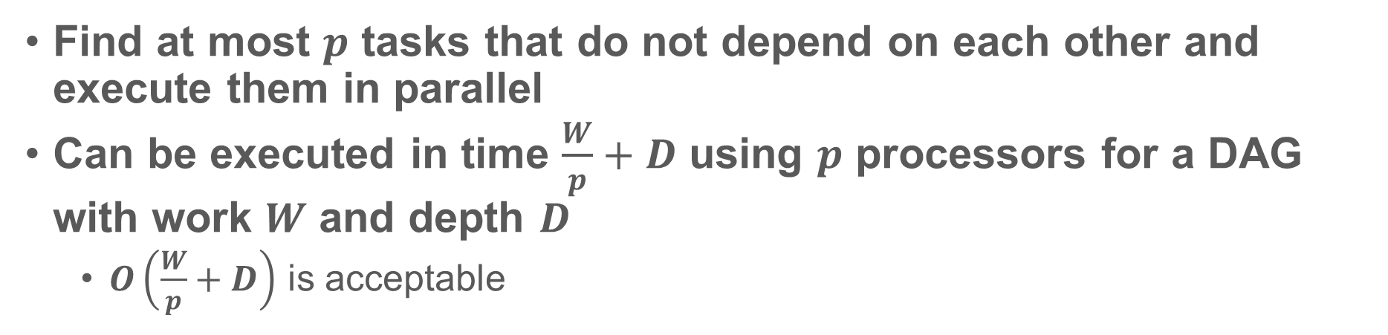
Reduce – how to schedule it?
Round 1
Round 2
1
2
3
4
5
6
7
8
+
+
+
+
Round 3
3
+
7
11
+
15
Round 4
10
26
+
36
Find at most $p$ tasks that do not depend on each other and execute them in parallel
Can be executed in time $\frac{W}{p}+D$ using $p$ processors for a DAG with work $W$ and depth $D$
  $O\left(\frac{W}{p}+D\right)$ is acceptable

Slide 40
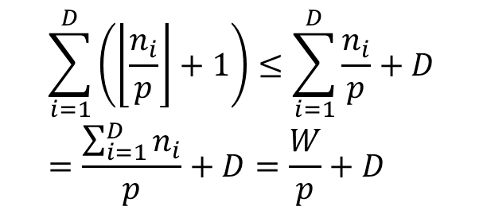
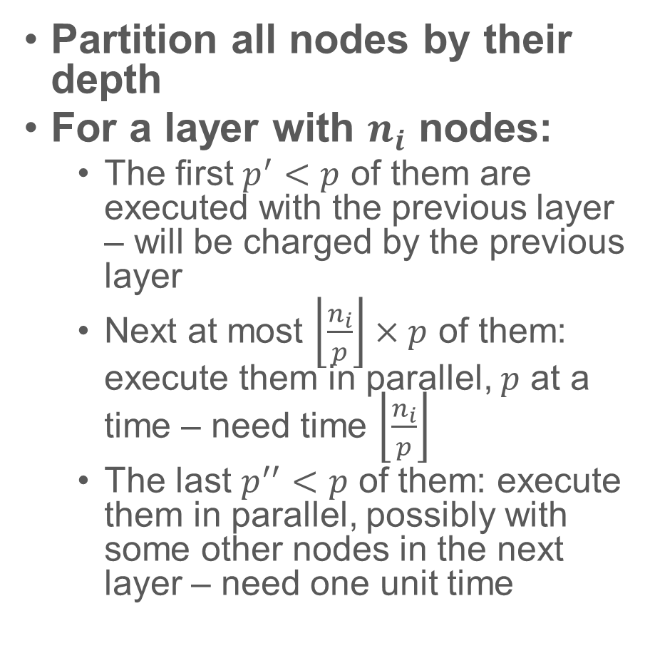
How to schedule it?
1
2
Partition all nodes by their depth
For a layer with $n_{i}$ nodes:
  The first $p^{′}<p$ of them are executed with the previous layer – will be charged by the previous layer
  Next at most $\left\lfloor \frac{n_{i}}{p}\right\rfloor ×p$ of them: execute them in parallel, $p$ at a time – need time $\left\lfloor \frac{n_{i}}{p}\right\rfloor$
  The last $p^{′′}<p$ of them: execute them in parallel, possibly with some other nodes in the next layer – need one unit time
3
4
5
6
7
8
$$\sum_{i=1}^{D}{\left(\left\lfloor \frac{n_{i}}{p}\right\rfloor +1\right)}≤\sum_{i=1}^{D}{\frac{n_{i}}{p}}+D=\frac{\sum_{i=1}^{D}{n_{i}}}{p}+D=\frac{W}{p}+D$$

Slide 41
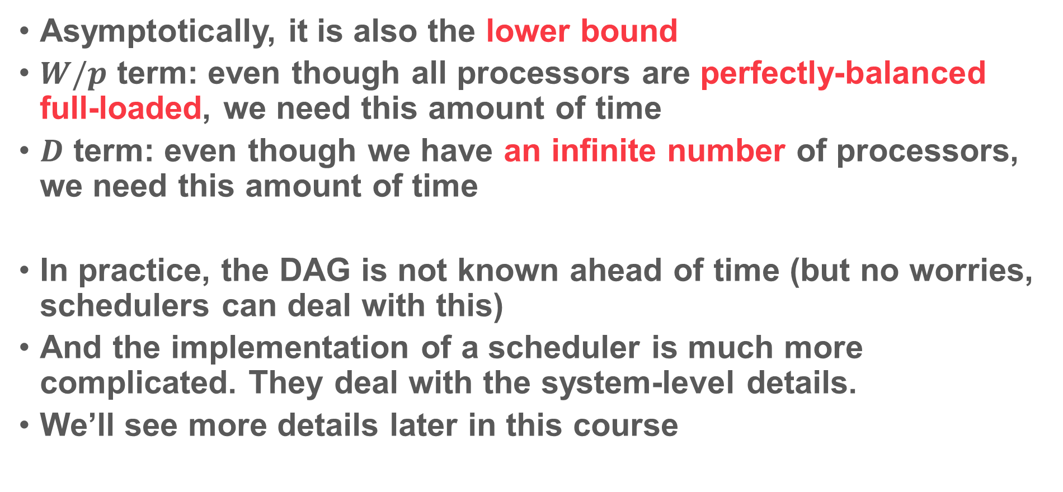
$W/p+D$: How good is it?
Asymptotically, it is also the lower bound
$W/p$ term: even though all processors are perfectly-balanced full-loaded, we need this amount of time
$D$ term: even though we have an infinite number of processors, we need this amount of time
In practice, the DAG is not known ahead of time (but no worries, schedulers can deal with this)
And the implementation of a scheduler is much more complicated. They deal with the system-level details.
We’ll see more details later in this course

Slide 42
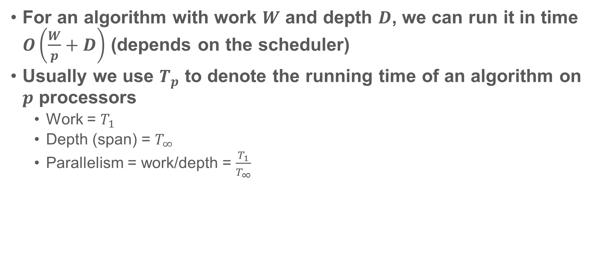
Work-depth model
For an algorithm with work $W$ and depth $D$, we can run it in time $O\left(\frac{W}{p}+D\right)$ (depends on the scheduler)
Usually we use $T_{p}$ to denote the running time of an algorithm on $p$ processors
  Work = $T_{1}$
  Depth (span) = $T_{∞}$
  Parallelism = work/depth = $\frac{T_{1}}{T_{∞}}$

Slide 43
Homework 1 out
You have more than two weeks to work on it
There are programming problems – better to start early
Due date: 22nd Jan.

Slide 44
Next class
No class/office hours on Wednesday.
Scan algorithm
Computational models: PRAM, fork-join, etc.
Divide-and-conquer, solve recurrence
Parallel programming tools

