Slide 1
Parallel Algorithms:
Theory and Practice
Locality and I/O-Efficient Parallel Algorithms
CS260 – Lecture 13
Yan Gu

Slide 2
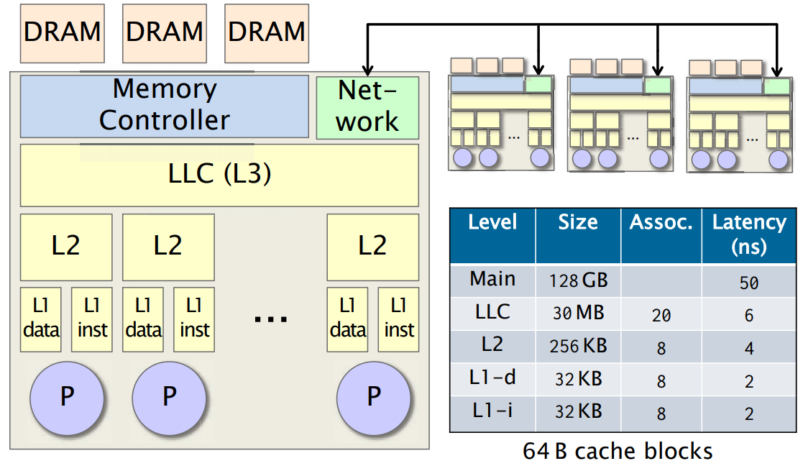

Slide 3


Last week - The I/O model
The I/O model has two special memory transfer instructions:
  Read transfer: load a block from slow memory
  Write transfer: write a block to slow memory
The complexity of an algorithm on the I/O model (I/O complexity) is measured by:
#(read transfers) + #(write transfers)
Slow Memory
Fast Memory
CPU
1
0
$$M/B$$
1
$$B$$
Notes:
There are two memory transfer instructions.
You can either read a block from the slow memory, or write a block to it.
To think about it, you can assume the fast memory to be the main memory and the slow memory to be the disk.
Disks are arranged with block size of several KB.
In another case, the fast memory can be the cache and the slow memory be the main memory.
In this case, the block size is the size of a cache line.
The complexity of an algorithm on the EM model (I/O complexity) is measured by the overall number of read transfers plus write transfers.
(In asymmetric setting, )
//, and once you want to do I/O from the disk, you either load a whole block from the disk to the main memory or write a whole block from the main memory

Slide 4

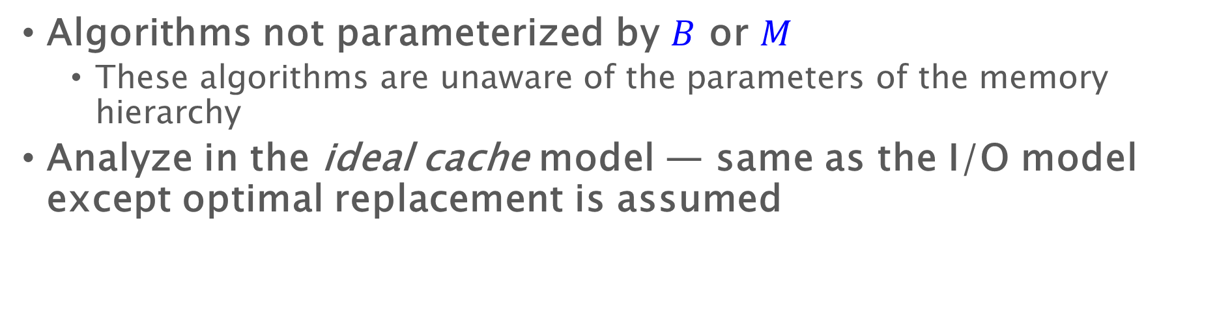

Cache-Oblivious Algorithms
Algorithms not parameterized by $B$ or $M$
  These algorithms are unaware of the parameters of the memory hierarchy
Analyze in the ideal cache model — same as the I/O model except optimal replacement is assumed
Slow Memory
Fast Memory
CPU
1
0
$$M/B$$
1
$$B$$

Slide 5
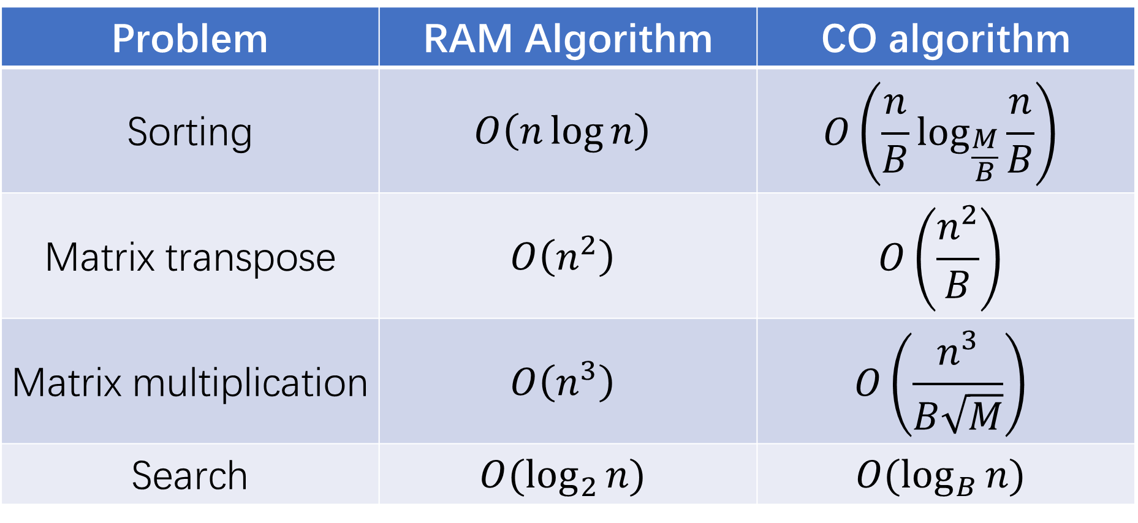
Cache-oblivious algorithms
Problem | RAM Algorithm | CO algorithm
Sorting | $$O\left(n\log{n}\right)$$ | $$O\left(\frac{n}{B}\log_{\frac{M}{B}}{\frac{n}{B}}\right)$$
Matrix transpose | $$O\left(n^{2}\right)$$ | $$O\left(\frac{n^{2}}{B}\right)$$
Matrix multiplication | $$O\left(n^{3}\right)$$ | $$O\left(\frac{n^{3}}{B\sqrt{M}}\right)$$
Search | $$O(\log_{2}{n})$$ | $$O(\log_{B}{n})$$

Slide 6
Matrix transpose - cache-oblivious algorithm

Slide 7
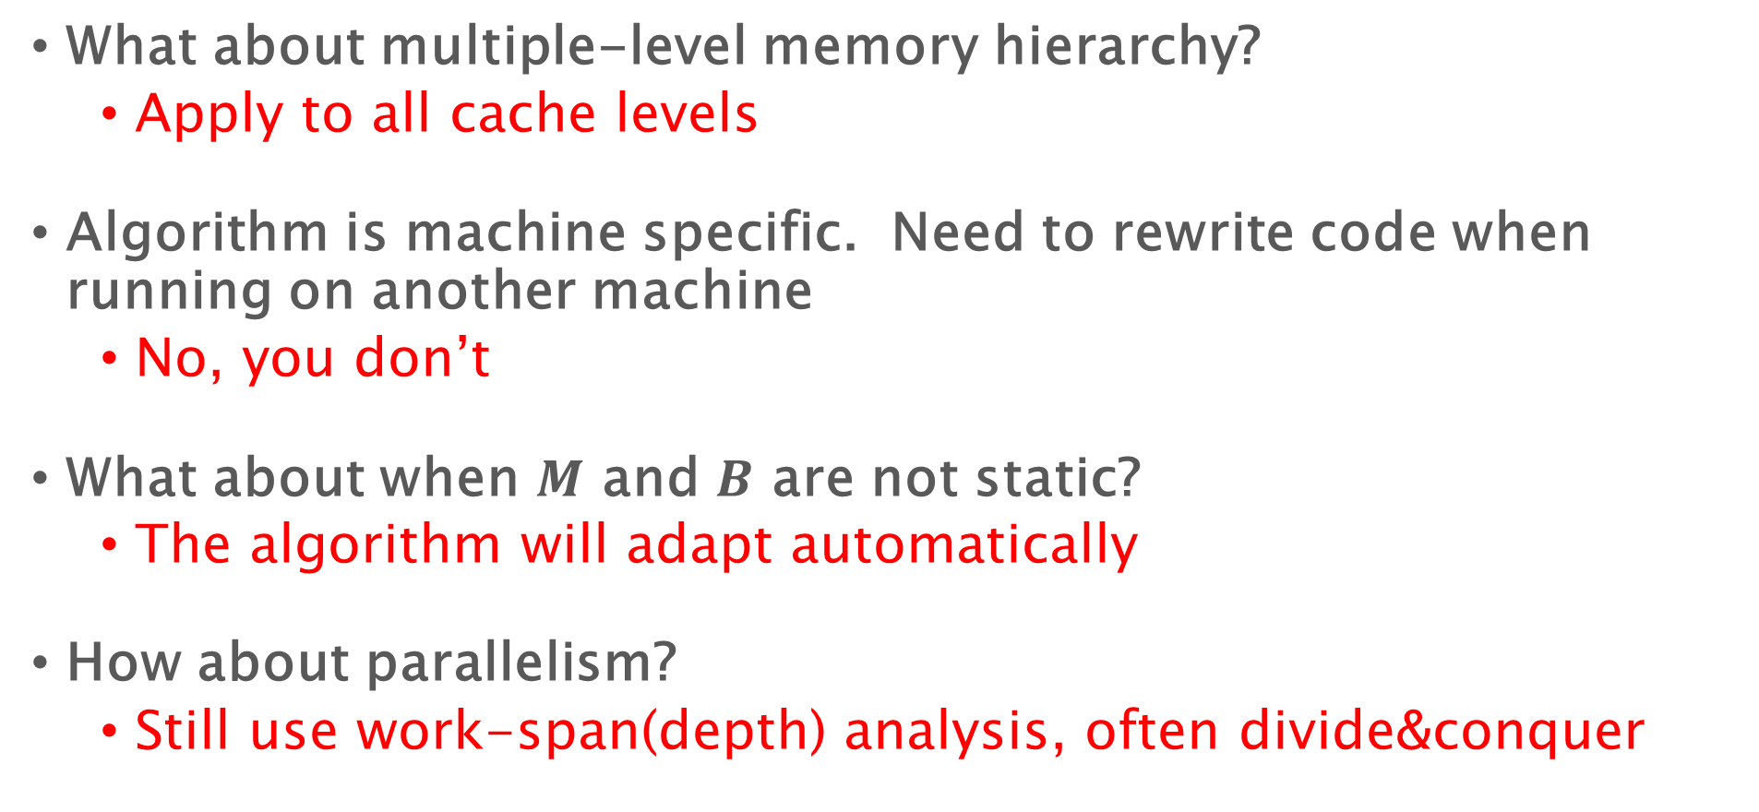
Problems of I/O model and I/O algorithms
What about multiple-level memory hierarchy?
  Apply to all cache levels
Algorithm is machine specific. Need to rewrite code when running on another machine
  No, you don’t
What about when $M$ and $B$ are not static?
  The algorithm will adapt automatically
How about parallelism?
  Still use work-span(depth) analysis, often divide&conquer

Slide 8
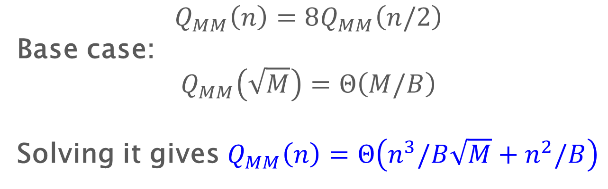
Recursive Matrix Multiplication
Compute 8 submatrix products recursively
Z₁₁ := X₁₁Y₁₁ + X₁₂Y₂₁
Z₁₂ := X₁₁Y₁₂ + X₁₂Y₂₂
Z₂₁ := X₂₁Y₁₁ + X₂₂Y₂₁
Z₂₂ := X₂₁Y₁₂ + X₂₂Y₂₁
Z₁₁
Z₁₂
X₁₁
X₁₂
Y₁₁
Y₁₂
:=
Z₂₁
Z₂₂
X₂₁
X₂₂
Y₂₁
Y₂₂
$$Q_{MM}\left(n\right)=8Q_{MM}\left(n/2\right)$$
Base case:
$$Q_{MM}\left(\sqrt{M}\right)=Θ\left(M/B\right)$$
Solving it gives $Q_{MM}\left(n\right)=Θ\left(n^{3}/B\sqrt{M}+n^{2}/B\right)$
Notes:
Implementation: remember the base case

Slide 9
Static layout example
recurse
H
0
D
1
L
2
3
6
9
12
B
F
J
N
A
C
E
G
I
K
M
O
4
5
7
8
10
11
13
14
H
D
L
B
A
C
F
E
G
J
I
K
N
M
O

Slide 10
Last week – cache-oblivious algorithms
Problem | RAM Algorithm | CO algorithm
Sorting | $$O\left(n\log{n}\right)$$ | $$O\left(\frac{n}{B}\log_{\frac{M}{B}}{\frac{n}{B}}\right)$$
Matrix transpose | $$O\left(n^{2}\right)$$ | $$O\left(\frac{n^{2}}{B}\right)$$
Matrix multiplication | $$O\left(n^{3}\right)$$ | $$O\left(\frac{n^{3}}{B\sqrt{M}}\right)$$
Search | $$O(\log_{2}{n})$$ | $$O(\log_{B}{n})$$

Slide 11
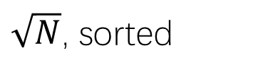
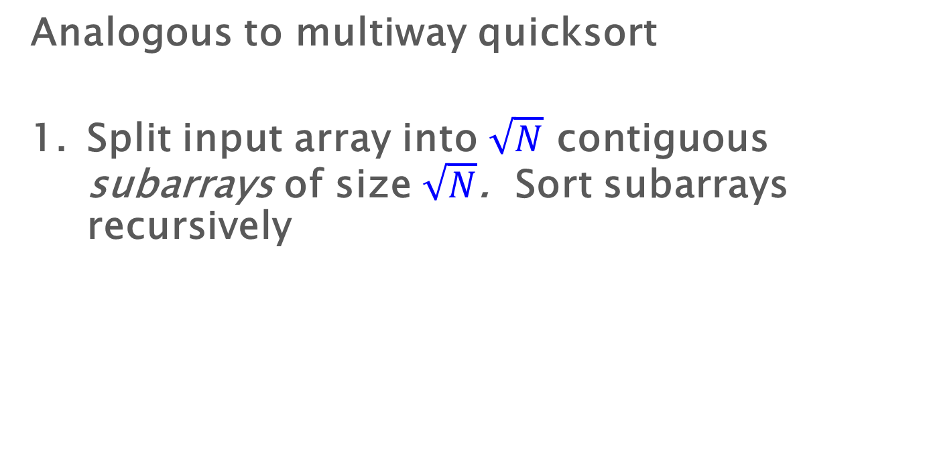

Sample-sort outline
Analogous to multiway quicksort
Split input array into $\sqrt{N}$ contiguous subarrays of size $\sqrt{N}$. Sort subarrays recursively
…
$\sqrt{N}$, sorted
$$N$$

Slide 12
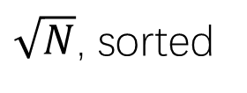
Sample-sort outline
Analogous to multiway quicksort
Split input array into $\sqrt{N}$ contiguous subarrays of size $\sqrt{N}$. Sort subarrays recursively
$\sqrt{N}$, sorted
…

Slide 13




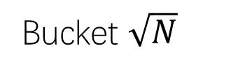
Sample-sort outline
Choose $\sqrt{N}−1$ “good” pivots $p1≤p2≤…≤p_{\sqrt{N}−1}$
Distribute subarrays into buckets, according to pivots
$\sqrt{N}$, sorted
…
Size $≈\sqrt{N}$
$$≤p_{1}≤$$
$$≤p2≤…≤p_{\sqrt{N}−1}≤$$
Bucket 1
Bucket 2
Bucket $\sqrt{N}$

Slide 14

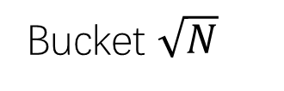

Sample-sort outline
Recursively sort the buckets
Copy concatenated buckets back to input array
$$≤p_{1}≤$$
$$≤p2≤…≤p_{\sqrt{N}−1}≤$$
Bucket 1
Bucket 2
Bucket $\sqrt{N}$
sorted

Slide 15
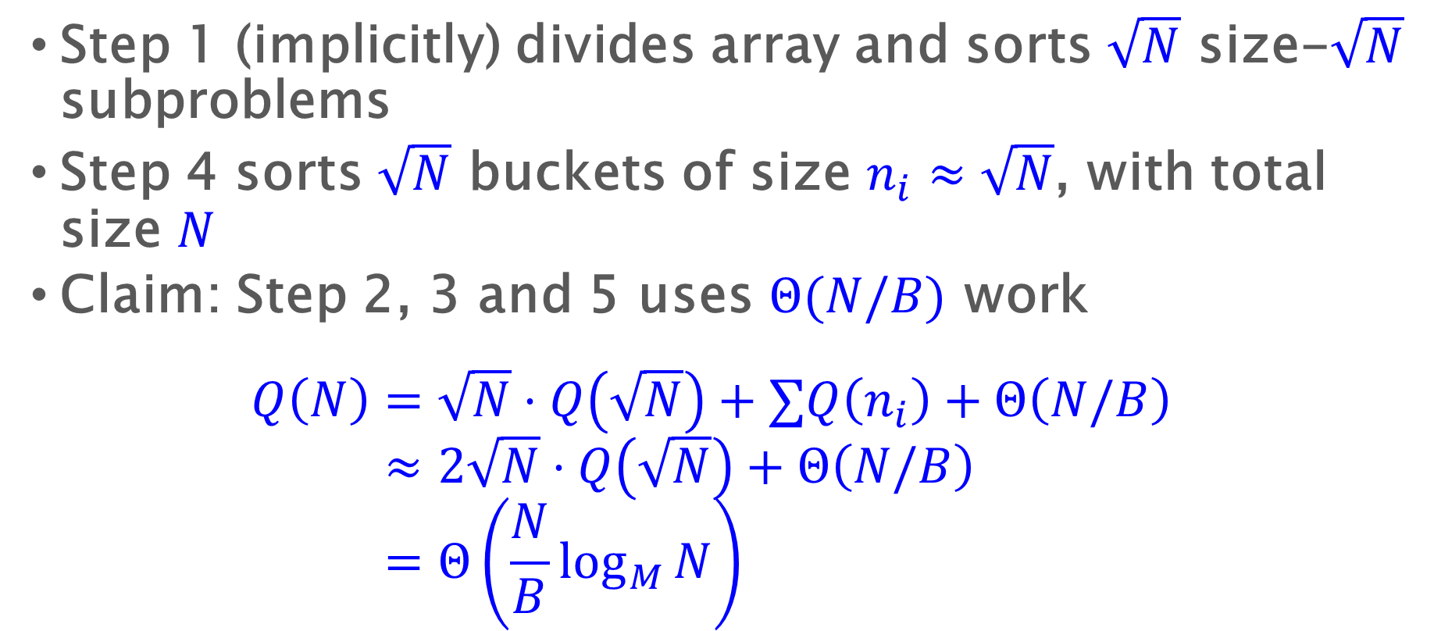
Sample-sort analysis sketch
Step 1 (implicitly) divides array and sorts $\sqrt{N}$ size-$\sqrt{N}$ subproblems
Step 4 sorts $\sqrt{N}$ buckets of size $n_{i}≈\sqrt{N}$, with total size $N$
Claim: Step 2, 3 and 5 uses $Θ(N/B)$ work
$$Q\left(N\right)=\sqrt{N}⋅Q\left(\sqrt{N}\right)+∑Q\left(n_{i}\right)+Θ\left(N/B\right) \\ ≈2\sqrt{N}⋅Q\left(\sqrt{N}\right)+Θ\left(N/B\right) \\ =Θ\left(\frac{N}{B}\log_{M}{N}\right)$$

Slide 16
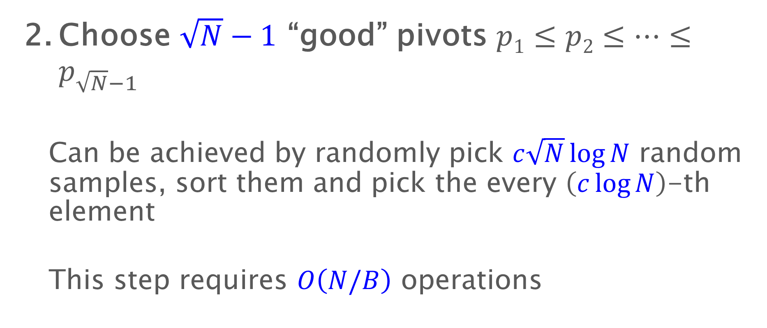
Sample-sort outline
Choose $\sqrt{N}−1$ “good” pivots $p1≤p2≤…≤p_{\sqrt{N}−1}$
  Can be achieved by randomly pick $c\sqrt{N}\log{N}$ random samples, sort them and pick the every $\left(c\log{N}\right)$-th element
  This step requires $O\left(N/B\right)$ operations

Slide 17
Sample-sort outline
Choose $\sqrt{N}−1$ “good” pivots $p1≤p2≤…≤p_{\sqrt{N}−1}$
Distribute subarrays into buckets, according to pivots
$\sqrt{N}$, sorted
…
Size $≈\sqrt{N}$
$$≤p_{1}≤$$
$$≤p2≤…≤p_{\sqrt{N}−1}≤$$
Bucket 1
Bucket 2
Bucket $\sqrt{N}$

Slide 18
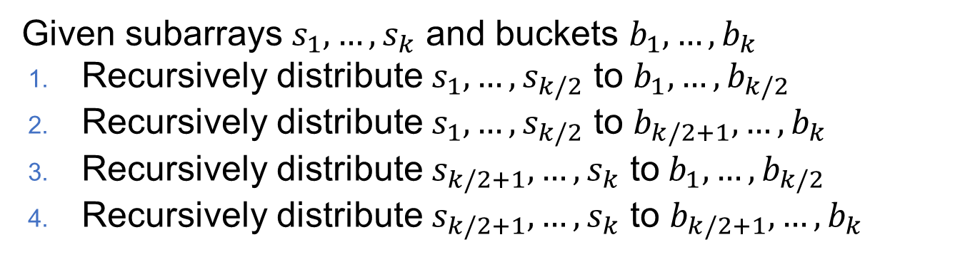
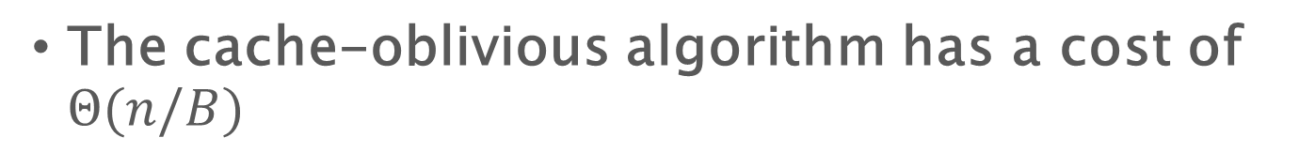
Transposing elements to buckets
Given subarrays $s_{1},…,s_{k}$ and buckets $b_{1},…,b_{k}$
Recursively distribute $s_{1},…,s_{k/2}$ to $b_{1},…,b_{k/2}$
Recursively distribute $s_{1},…,s_{k/2}$ to $b_{k/2+1},…,b_{k}$
Recursively distribute $s_{k/2+1},…,s_{k}$ to$b_{1},…,b_{k/2}$
Recursively distribute $s_{k/2+1},…,s_{k}$ to $b_{k/2+1},…,b_{k}$
The cache-oblivious algorithm has a cost of $Θ(n/B)$

Slide 19
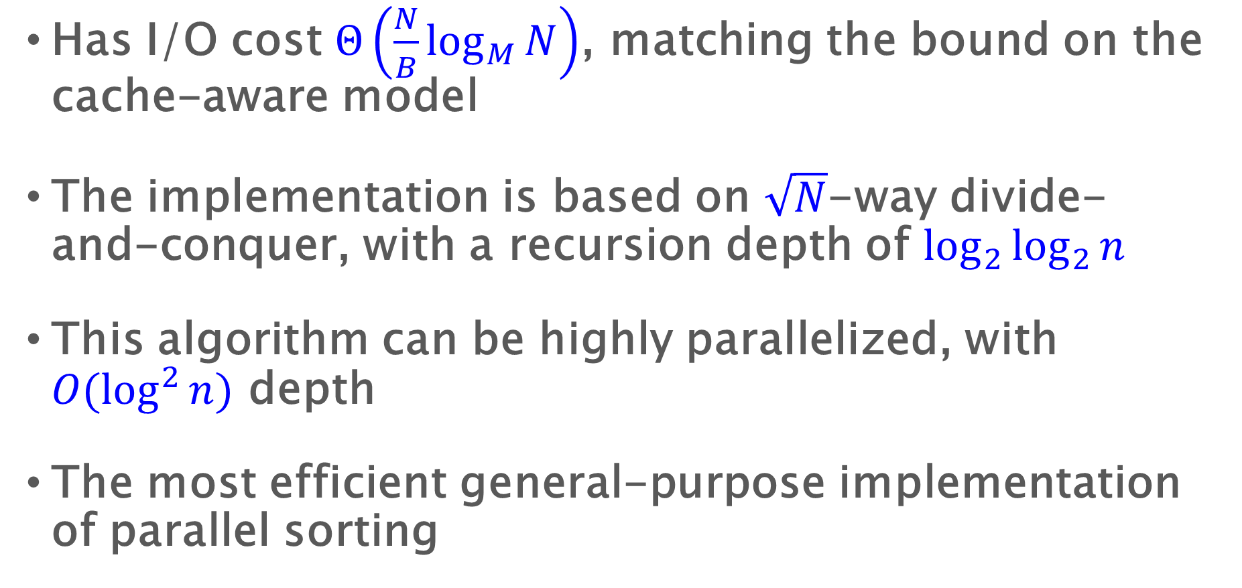
Summary for Cache-Oblivious Sorting
Has I/O cost $Θ\left(\frac{N}{B}\log_{M}{N}\right)$, matching the bound on the cache-aware model
The implementation is based on $\sqrt{N}$-way divide-and-conquer, with a recursion depth of $\log_{2}{\log_{2}{n}}$
This algorithm can be highly parallelized, with $O(\log^{2}{n})$ depth
The most efficient general-purpose implementation of parallel sorting

Slide 20
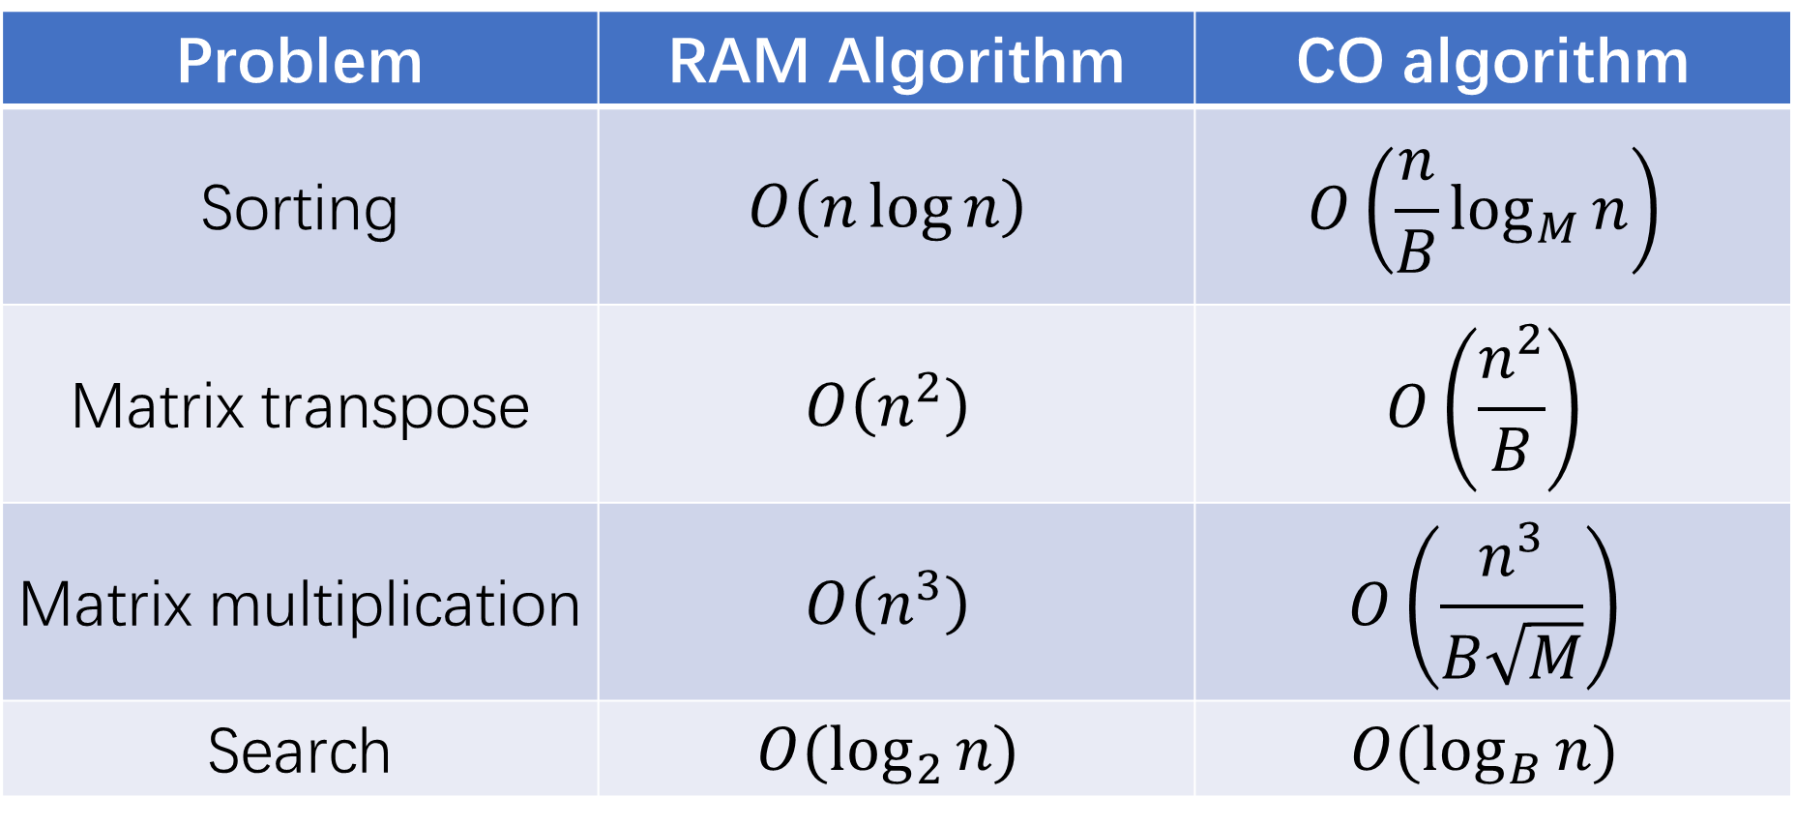
Cache-oblivious algorithms
Problem | RAM Algorithm | CO algorithm
Sorting | $$O\left(n\log{n}\right)$$ | $$O\left(\frac{n}{B}\log_{M}{n}\right)$$
Matrix transpose | $$O\left(n^{2}\right)$$ | $$O\left(\frac{n^{2}}{B}\right)$$
Matrix multiplication | $$O\left(n^{3}\right)$$ | $$O\left(\frac{n^{3}}{B\sqrt{M}}\right)$$
Search | $$O(\log_{2}{n})$$ | $$O(\log_{B}{n})$$

Slide 21
Summary

Slide 22
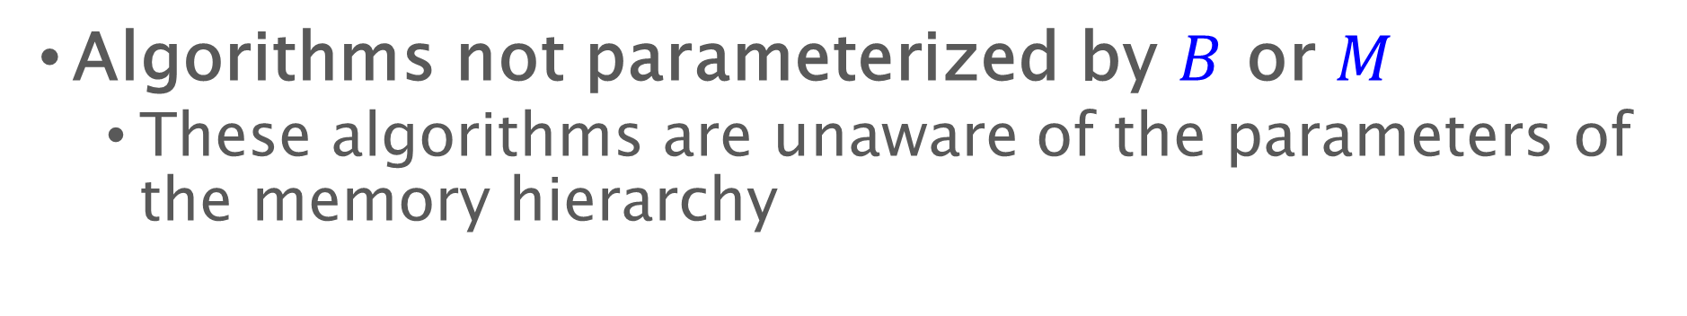
Cache-Oblivious Algorithms
Algorithms not parameterized by $B$ or $M$
  These algorithms are unaware of the parameters of the memory hierarchy
Slow Memory
Fast Memory
CPU
1
0
$$M/B$$
1
$$B$$

Slide 23
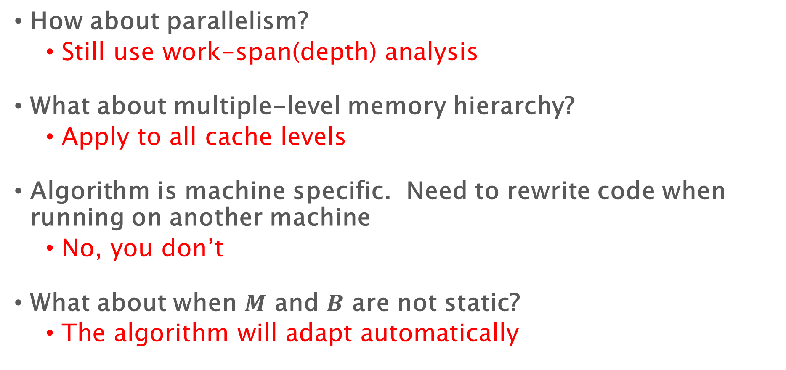
Problems of I/O model and I/O algorithms
How about parallelism?
  Still use work-span(depth) analysis
What about multiple-level memory hierarchy?
  Apply to all cache levels
Algorithm is machine specific. Need to rewrite code when running on another machine
  No, you don’t
What about when $M$ and $B$ are not static?
  The algorithm will adapt automatically

Slide 24

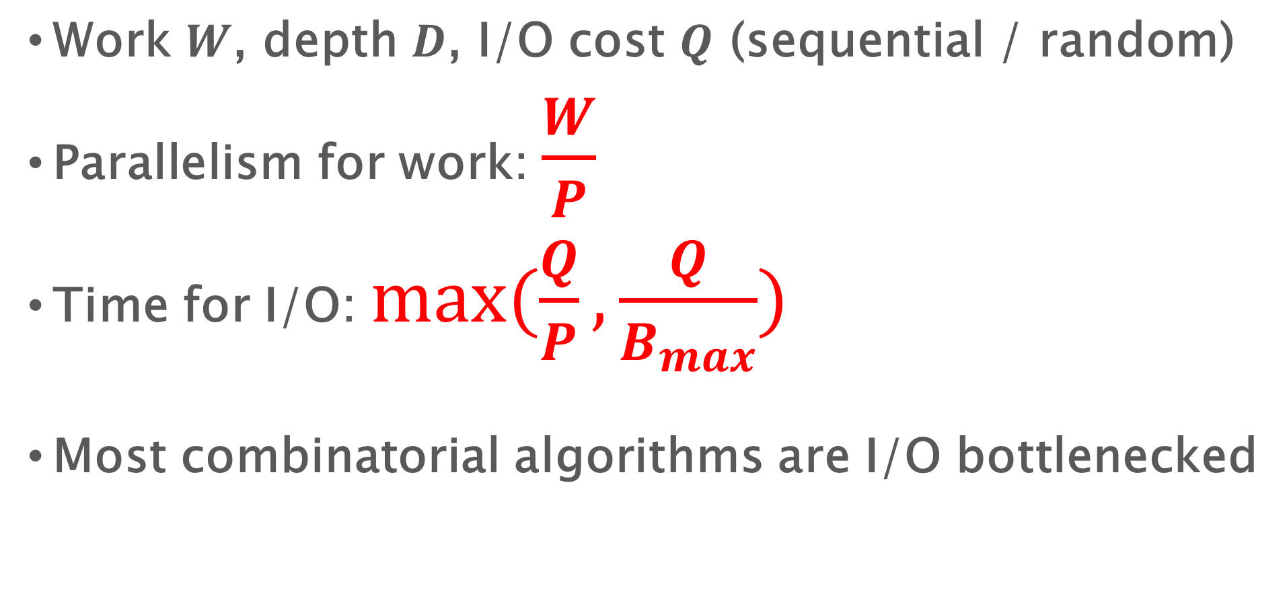
Design and Analysis of Parallel Algorithms
Work $W$, depth $D$, I/O cost $Q$ (sequential / random)
Parallelism for work: $\frac{W}{P}$
Time for I/O: $max(\frac{Q}{P},\frac{Q}{B_{max}})$
Most combinatorial algorithms are I/O bottlenecked
What about $D$?

