Slide 1
Parallel Algorithms:
Theory and Practice
Locality and I/O-Efficient Parallel Algorithms
CS260 – Lecture 11
Yan Gu

Slide 2
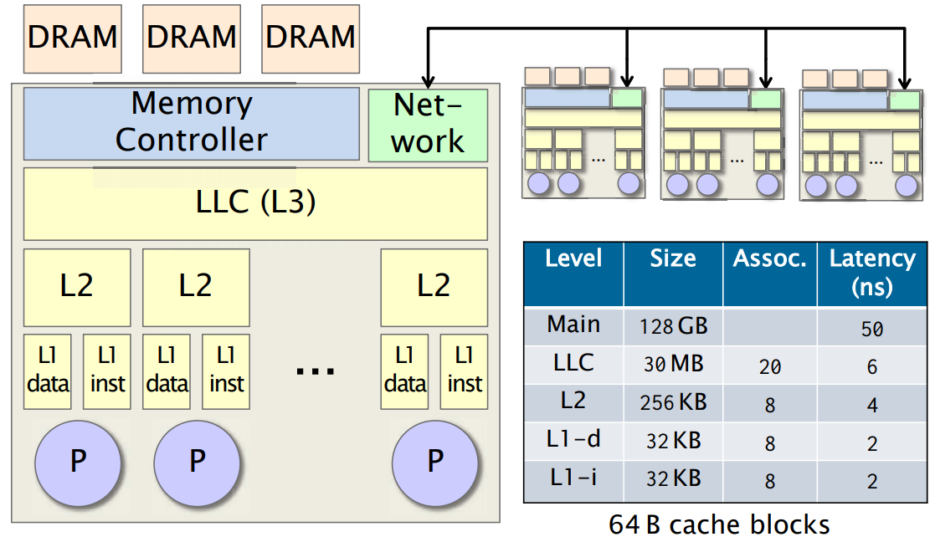

Slide 3



Last week - The I/O model
Two-level memory hierarchy:
  A small memory (fast memory, cache) of fixed size $M$
  A large memory (slow memory) of unbounded size
Both are partitioned into blocks of size $B$
Instructions can only apply to data in primary memory, and are free
Slow Memory
Fast Memory
CPU
0
$$M/B$$
$$B$$
Notes:
The External Memory model is usually used to measure the complexity of input and output, and assumes that a computer has a two-level memory hierarchy:
a small memory that has a fixed size 𝑀, and
An unbounded-size large memory
Both levels are partitioned into blocks of size 𝐵.
[click] The CPU can only freely access and process the data on fast memory.
Remember, any data access and computation is totally free if all the data are already in the fast memory.
To use the data on slow memory,

Slide 4
Last week - The I/O model
The I/O model has two special memory transfer instructions:
  Read transfer: load a block from slow memory
  Write transfer: write a block to slow memory
The complexity of an algorithm on the I/O model (I/O complexity) is measured by:
#(read transfers) + #(write transfers)
Slow Memory
Fast Memory
CPU
1
0
$$M/B$$
1
$$B$$
Notes:
There are two memory transfer instructions.
You can either read a block from the slow memory, or write a block to it.
To think about it, you can assume the fast memory to be the main memory and the slow memory to be the disk.
Disks are arranged with block size of several KB.
In another case, the fast memory can be the cache and the slow memory be the main memory.
In this case, the block size is the size of a cache line.
The complexity of an algorithm on the EM model (I/O complexity) is measured by the overall number of read transfers plus write transfers.
(In asymmetric setting, )
//, and once you want to do I/O from the disk, you either load a whole block from the disk to the main memory or write a whole block from the main memory

Slide 5
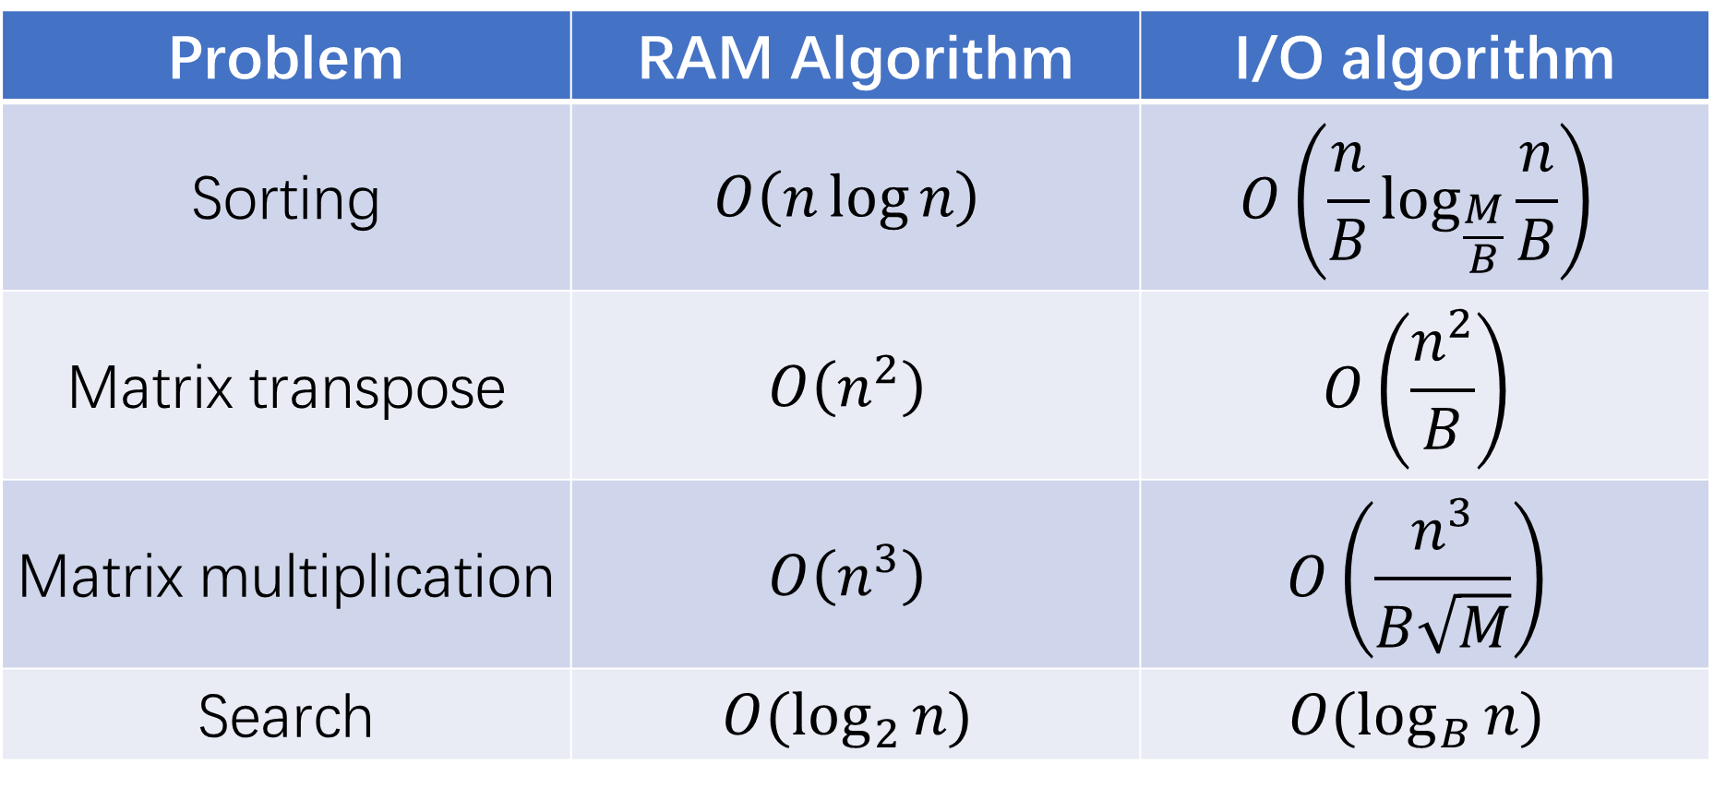
Last week - I/O-efficient algorithms
Problem | RAM Algorithm | I/O algorithm
Sorting | $$O\left(n\log{n}\right)$$ | $$O\left(\frac{n}{B}\log_{\frac{M}{B}}{\frac{n}{B}}\right)$$
Matrix transpose | $$O\left(n^{2}\right)$$ | $$O\left(\frac{n^{2}}{B}\right)$$
Matrix multiplication | $$O\left(n^{3}\right)$$ | $$O\left(\frac{n^{3}}{B\sqrt{M}}\right)$$
Search | $$O(\log_{2}{n})$$ | $$O(\log_{B}{n})$$

Slide 6





Last week - Multi-way mergesort on the EM model
Recursively merge $M/B$ sorted lists, in $\log_{M/B}{n/M}$ rounds
$$n$$
$$\log_{M/B}{n/M}$$
$$n/(M/B)$$
$$M^{2}/B$$
$$M$$
Notes:
As the name multi-way mergesort suggests, it partitions the input into M/B lists, recursively sorts them, and merge these lists together.
[Click] Once the list has less than M elements, it will fully fit into the fast memory and it is free on the EM model.
Therefore, the recursion needs log base M/B of n/M rounds.
In this talk we ignore all the rounding issues here. We assume all results are integers. I refer you to our paper for explicit analysis.
The partition process is easy. The hard part is, how to merge multiple lists instead of two lists.

Slide 7
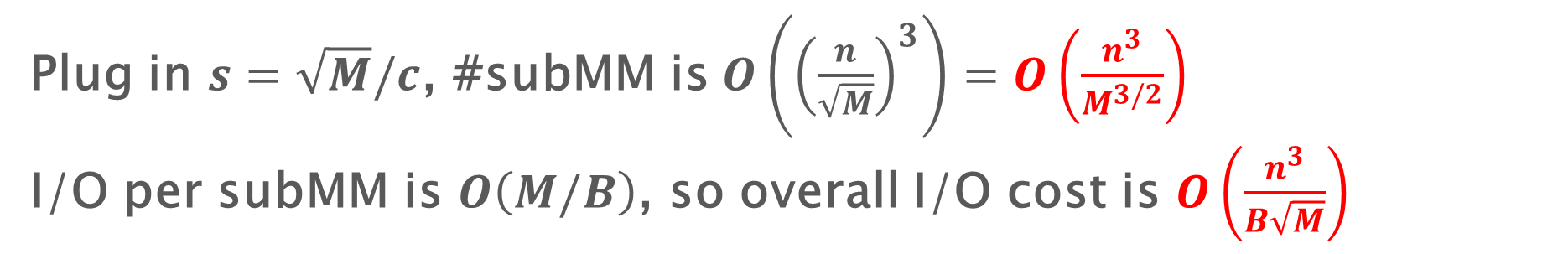
Last week - Tiling MatMul
Z
X
Y
:=
for i = 1 to N/s do
for j = 1 to N/s do
for k = 1 to N/s do
for i’ = (i-1)*s+1 to i*s do
for j’ = (j-1)*s+1 to j*s do
for k’ = (k-1)*s+1 to k*s do
Z[i’][j’] += X[i’][k’] * Y[k’][j’]
Plug in $s=\sqrt{M}/c$, #subMM is $O\left({\left(\frac{n}{\sqrt{M}}\right)}^{3}\right)=O\left(\frac{n^{3}}{M^{3/2}}\right)$
I/O per subMM is $O\left(M/B\right)$, so overall I/O cost is $O\left(\frac{n^{3}}{B\sqrt{M}}\right)$

Slide 8
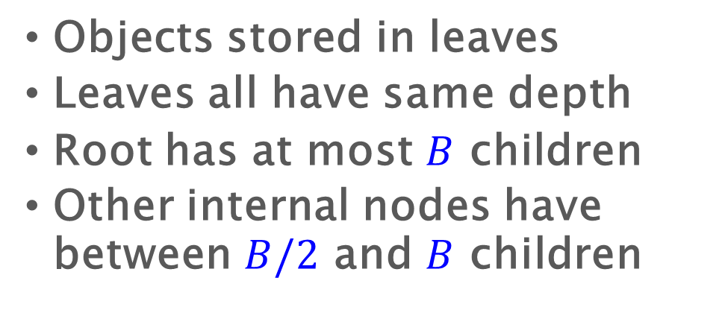
Last week - B-tree/(2,3)-tree
Objects stored in leaves
Leaves all have same depth
Root has at most $B$ children
Other internal nodes have between $B/2$ and $B$ children
B
18
35
6
10
25
43
50
1
2
4
10
12
15
18
21
25
28
35
37
50
51
53
6
8
43
45

Slide 9
Last week - B-tree search
Compare search key against partitioning keys and move to proper child.
Cost is O(height * node size)
Search for 21
18
35
6
10
25
43
50
1
2
4
10
12
15
18
21
25
28
35
37
50
51
53
6
8
43
45

Slide 10
Last week - I/O-efficient algorithms
Problem | RAM Algorithm | I/O algorithm
Sorting | $$O\left(n\log{n}\right)$$ | $$O\left(\frac{n}{B}\log_{\frac{M}{B}}{\frac{n}{B}}\right)$$
Matrix transpose | $$O\left(n^{2}\right)$$ | $$O\left(\frac{n^{2}}{B}\right)$$
Matrix multiplication | $$O\left(n^{3}\right)$$ | $$O\left(\frac{n^{3}}{B\sqrt{M}}\right)$$
Search | $$O(\log_{2}{n})$$ | $$O(\log_{B}{n})$$

Slide 11
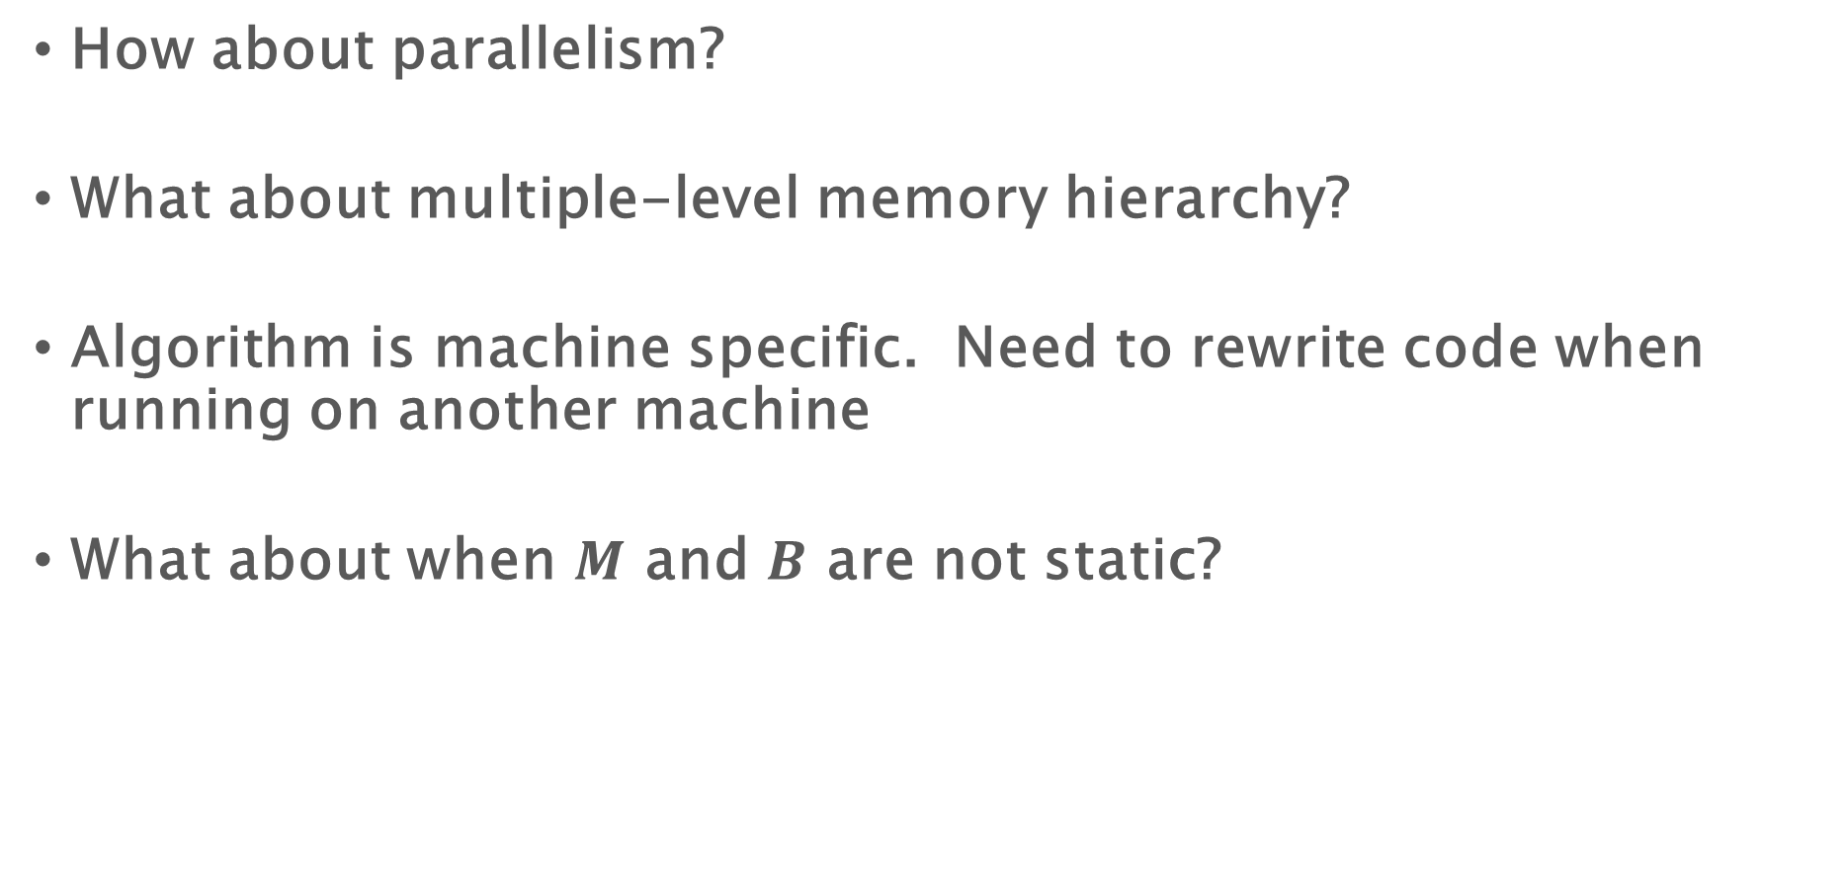
Problems of I/O model and I/O algorithms
How about parallelism?
What about multiple-level memory hierarchy?
Algorithm is machine specific. Need to rewrite code when running on another machine
What about when $M$ and $B$ are not static?

Slide 12
Parallel Algorithms:
Theory and Practice
Cache-Oblivious Algorithms
CS260 – Lecture 12
Yan Gu

Slide 13
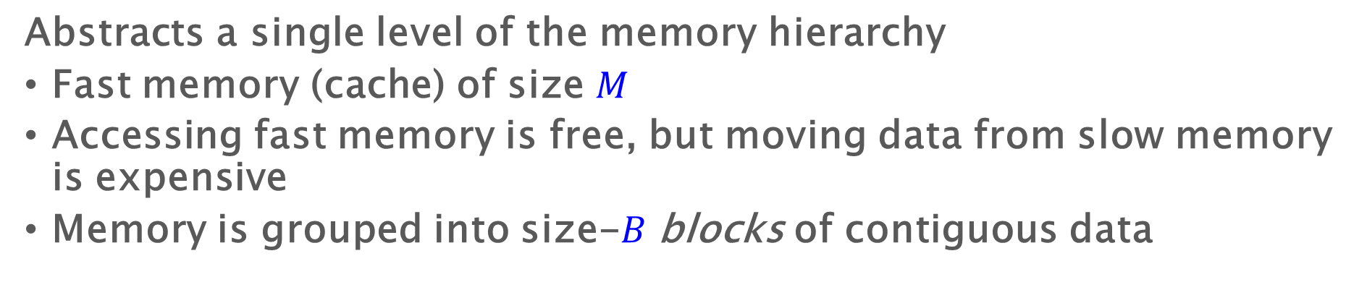


The I/O model
Abstracts a single level of the memory hierarchy
Fast memory (cache) of size $M$
Accessing fast memory is free, but moving data from slow memory is expensive
Memory is grouped into size-$B$ blocks of contiguous data
Slow Memory
Fast Memory
CPU
1
0
$$M/B$$
1
$$B$$
Cost: the number of block transfers (or I/Os) from slow memory to fast memory

Slide 14
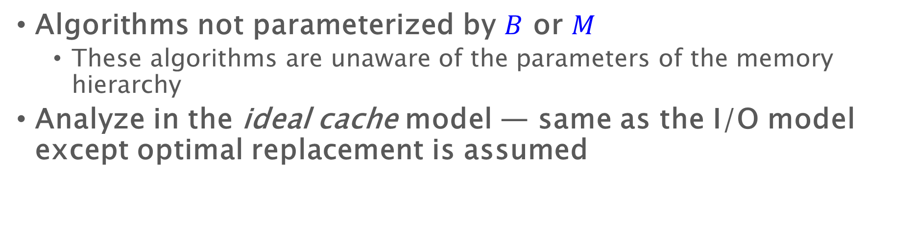
Cache-Oblivious Algorithms
Algorithms not parameterized by $B$ or $M$
  These algorithms are unaware of the parameters of the memory hierarchy
Analyze in the ideal cache model — same as the I/O model except optimal replacement is assumed
Slow Memory
Fast Memory
CPU
1
0
$$M/B$$
1
$$B$$
Question: how do I know or analyze based on ideal cache-replacement policy?

Slide 15
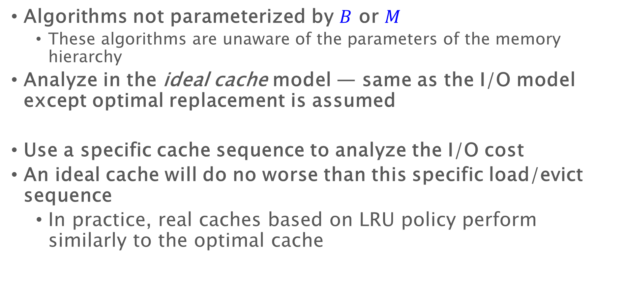
Cache-Oblivious Algorithms
Algorithms not parameterized by $B$ or $M$
  These algorithms are unaware of the parameters of the memory hierarchy
Analyze in the ideal cache model — same as the I/O model except optimal replacement is assumed
Use a specific cache sequence to analyze the I/O cost
An ideal cache will do no worse than this specific load/evict sequence
  In practice, real caches based on LRU policy perform similarly to the optimal cache

Slide 16

Cache-oblivious algorithms
Problem | RAM Algorithm | CO algorithm
Sorting | $$O\left(n\log{n}\right)$$ | $$O\left(\frac{n}{B}\log_{\frac{M}{B}}{\frac{n}{B}}\right)$$
Matrix transpose | $$O\left(n^{2}\right)$$ | $$O\left(\frac{n^{2}}{B}\right)$$
Matrix multiplication | $$O\left(n^{3}\right)$$ | $$O\left(\frac{n^{3}}{B\sqrt{M}}\right)$$
Search | $$O(\log_{2}{n})$$ | $$O(\log_{B}{n})$$

Slide 17
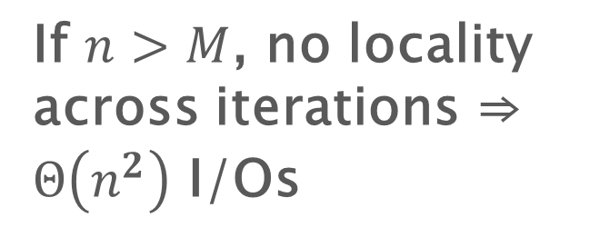
Matrix transpose
If $n>M$, no locality across iterations ⇒ $Θ\left(n^{2}\right)$ I/Os
1 2 3 4 5
2
3
4
5
for i = 1 to N do
for j = i+1 to N do
swap(A[i][j], A[j][i])
The simplest implementation is not I/O efficient assuming the matrix is stored in row-major

Slide 18
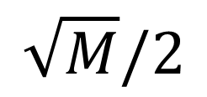
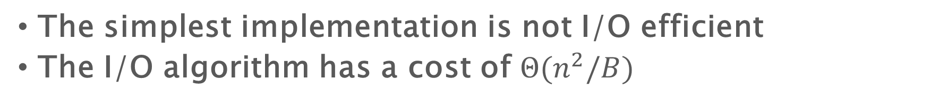
Matrix transpose - I/O algorithm
$$\sqrt{M}/2$$
1
2
2
The simplest implementation is not I/O efficient
The I/O algorithm has a cost of $Θ(n^{2}/B)$

Slide 19
Matrix transpose - cache-oblivious algorithm

Slide 20
Matrix transpose - cache-oblivious algorithm

Slide 21
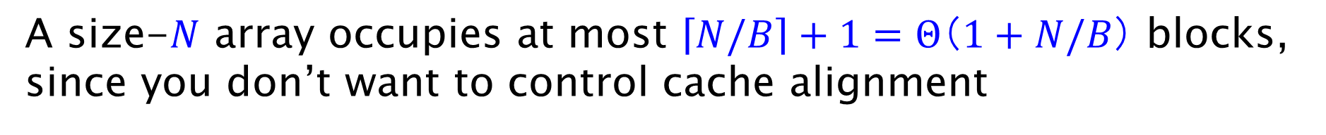
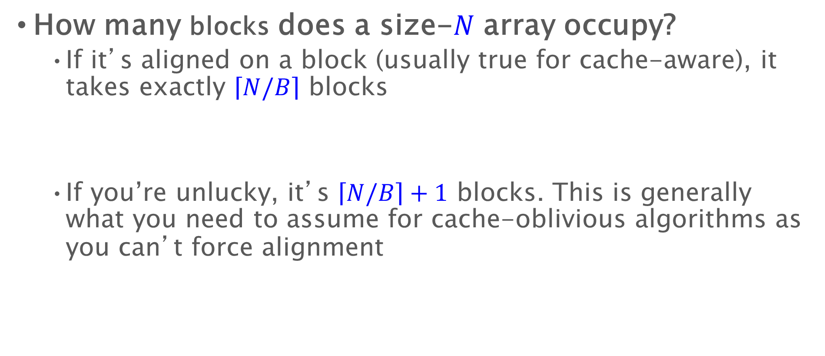
Array storage
How many blocks does a size-$N$ array occupy?
  If it’s aligned on a block (usually true for cache-aware), it takes exactly $\left\lceil N/B\right\rceil$ blocks
  If you’re unlucky, it’s $\left\lceil N/B\right\rceil +1$ blocks. This is generally what you need to assume for cache-oblivious algorithms as you can’t force alignment
block
A size-$N$ array occupies at most $\left\lceil N/B\right\rceil +1=Θ（1+N/B）$ blocks, since you don’t want to control cache alignment

Slide 22
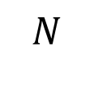
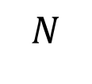
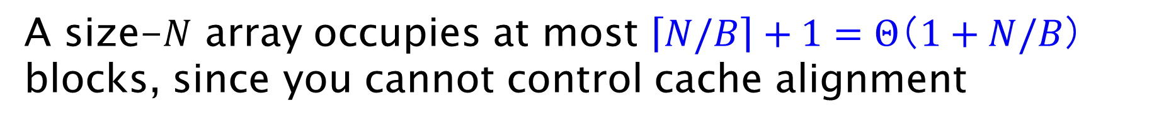
Matrix transpose - Cache-oblivious algorithm
the matrix
layout of matrix in slow memory
…
$$N$$
…
$$N$$
A size-$N$ array occupies at most $\left\lceil N/B\right\rceil +1=Θ（1+N/B）$ blocks, since you cannot control cache alignment

Slide 23
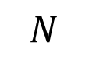
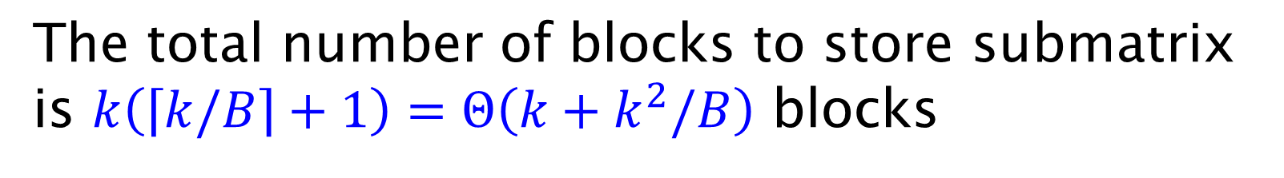


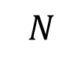
Matrix transpose - cache-oblivious algorithm
the matrix
layout of matrix in slow memory
$$k$$
…
$$k$$
$$N$$
…
$$N$$
The total number of blocks to store submatrix is $k\left(\left\lceil k/B\right\rceil +1\right)=Θ（k+k^{2}/B）$ blocks

Slide 24
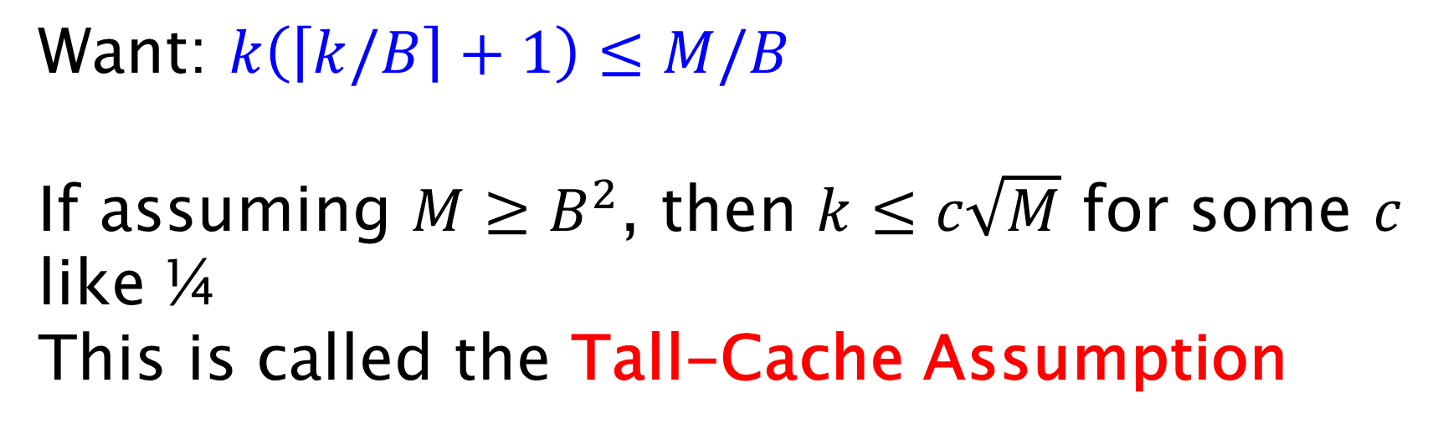
Matrix transpose - cache-oblivious algorithm
Want: $k\left(\left\lceil k/B\right\rceil +1\right)≤M/B$
If assuming $M≥B^{2}$, then $k≤c\sqrt{M}$ for some $c$ like ¼
This is called the Tall-Cache Assumption
The total number of blocks to store submatrix is $k\left(\left\lceil k/B\right\rceil +1\right)=Θ（k+k^{2}/B）$ blocks

Slide 25
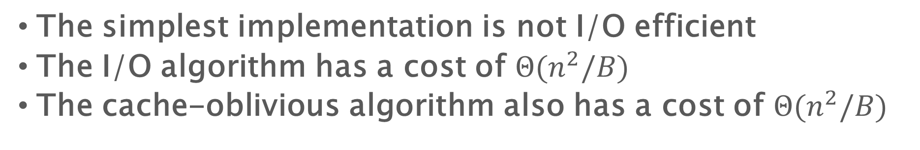
Matrix transpose - cache-oblivious algorithm
The simplest implementation is not I/O efficient
The I/O algorithm has a cost of $Θ(n^{2}/B)$
The cache-oblivious algorithm also has a cost of $Θ(n^{2}/B)$
Notes:
In place

Slide 26
Cache-Oblivious Algorithms
Algorithms not parameterized by $B$ or $M$
  These algorithms are unaware of the parameters of the memory hierarchy
Analyze in the ideal cache model — same as the I/O model except optimal replacement is assumed
Use a specific cache sequence to analyze the I/O cost
An ideal cache will do no worse than this specific load/evict sequence
  In practice, real caches based on LRU policy perform similarly to the optimal cache

Slide 27
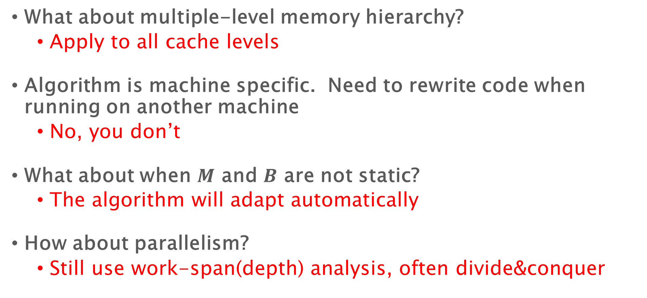
Problems of I/O model and I/O algorithms
What about multiple-level memory hierarchy?
  Apply to all cache levels
Algorithm is machine specific. Need to rewrite code when running on another machine
  No, you don’t
What about when $M$ and $B$ are not static?
  The algorithm will adapt automatically
How about parallelism?
  Still use work-span(depth) analysis, often divide&conquer

Slide 28
Last week – cache-oblivious algorithms
Problem | RAM Algorithm | CO algorithm
Sorting | $$O\left(n\log{n}\right)$$ | $$O\left(\frac{n}{B}\log_{\frac{M}{B}}{\frac{n}{B}}\right)$$
Matrix transpose | $$O\left(n^{2}\right)$$ | $$O\left(\frac{n^{2}}{B}\right)$$
Matrix multiplication | $$O\left(n^{3}\right)$$ | $$O\left(\frac{n^{3}}{B\sqrt{M}}\right)$$
Search | $$O(\log_{2}{n})$$ | $$O(\log_{B}{n})$$

Slide 29
Matrix Multiplication
Consider standard iterative matrix-multiplication algorithm
Z
X
Y
:=
Where $X$, $Y$, and $Z$ are $N×N$ matrices
for i = 1 to N do
for j = 1 to N do
for k = 1 to N do
Z[i][j] += X[i][k] * Y[k][j]
$Θ(N3)$ computation in RAM model. What about I/O?

Slide 30
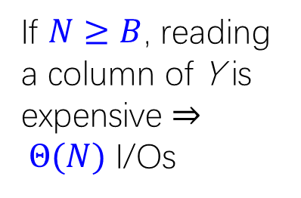
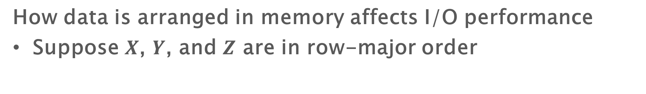
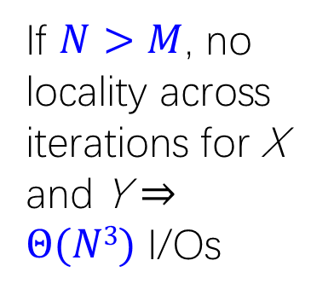
How Are Matrices Stored?
How data is arranged in memory affects I/O performance
Suppose $X$, $Y$, and $Z$ are in row-major order
Z
X
Y
:=
for i = 1 to N do
for j = 1 to N do
for k = 1 to N do
Z[i][j] += X[i][k] * Y[k][j]
If $N>M$, no locality across iterations for X and Y ⇒ $Θ(N3)$ I/Os
If $N≥B$, reading a column of Y is expensive ⇒ $Θ(N)$ I/Os

Slide 31
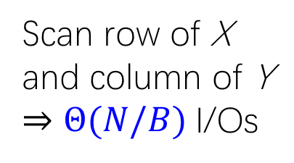
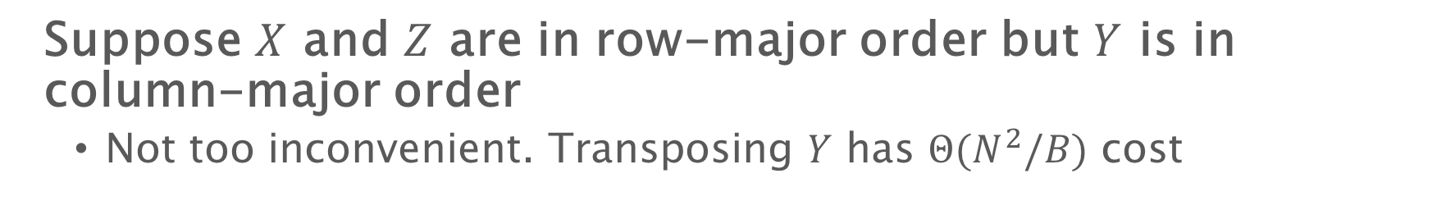

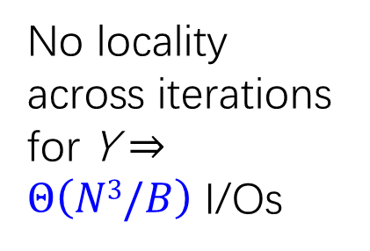
How Are Matrices Stored?
Suppose $X$ and $Z$ are in row-major order but $Y$ is in column-major order
  Not too inconvenient. Transposing $Y$ has $Θ(N^{2}/B)$ cost
Z
X
Y
:=
for i = 1 to N do
for j = 1 to N do
for k = 1 to N do
Z[i][j] += X[i][k] * Y[k][j]
No locality across iterations for Y ⇒ $Θ\left(N3/B\right)$ I/Os
Scan row of X and column of Y ⇒ $Θ(N/B)$I/Os
We can do much better than $Θ(N3/B)$ I/Os, even if all matrices are row-major

Slide 32
Tiling
Z
X
Y
:=
for i = 1 to N/s do
for j = 1 to N/s do
for k = 1 to N/s do
for i’ = (i-1)*s+1 to i*s do
for j’ = (j-1)*s+1 to j*s do
for k’ = (k-1)*s+1 to k*s do
Z[i’][j’] += X[i’][k’] * Y[k’][j’]
Plug in $s=\sqrt{M}/c$, #subMM is $O\left({\left(\frac{n}{\sqrt{M}}\right)}^{3}\right)=O\left(\frac{n^{3}}{M^{3/2}}\right)$
I/O per subMM is $O\left(M/B\right)$, so overall I/O cost is $O\left(\frac{n^{3}}{B\sqrt{M}}\right)$

Slide 33
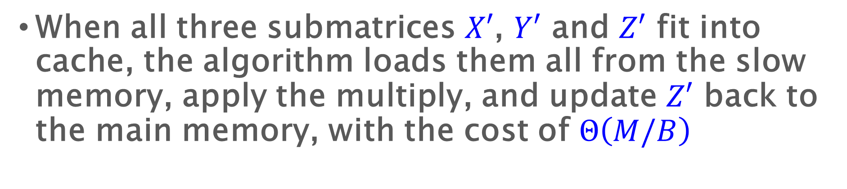
Recursive Matrix Multiplication
Compute 8 submatrix products recursively
Z₁₁ := X₁₁Y₁₁ + X₁₂Y₂₁
Z₁₂ := X₁₁Y₁₂ + X₁₂Y₂₂
Z₂₁ := X₂₁Y₁₁ + X₂₂Y₂₁
Z₂₂ := X₂₁Y₁₂ + X₂₂Y₂₁
Z₁₁
Z₁₂
X₁₁
X₁₂
Y₁₁
Y₁₂
:=
Z₂₁
Z₂₂
X₂₁
X₂₂
Y₂₁
Y₂₂
When all three submatrices $X′$, $Y′$ and $Z′$ fit into cache, the algorithm loads them all from the slow memory, apply the multiply, and update $Z′$ back to the main memory, with the cost of $Θ\left(M/B\right)$
Notes:
Implementation: remember the base case

Slide 34
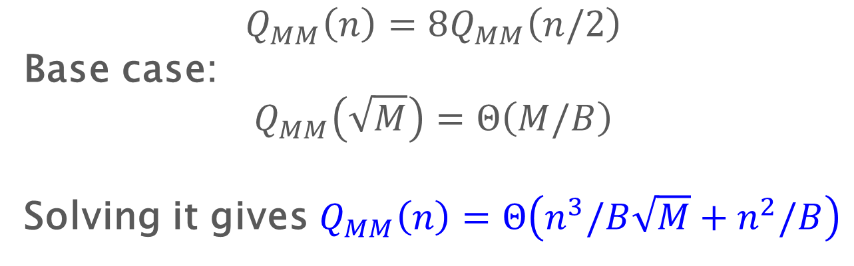
Recursive Matrix Multiplication
Compute 8 submatrix products recursively
Z₁₁ := X₁₁Y₁₁ + X₁₂Y₂₁
Z₁₂ := X₁₁Y₁₂ + X₁₂Y₂₂
Z₂₁ := X₂₁Y₁₁ + X₂₂Y₂₁
Z₂₂ := X₂₁Y₁₂ + X₂₂Y₂₁
Z₁₁
Z₁₂
X₁₁
X₁₂
Y₁₁
Y₁₂
:=
Z₂₁
Z₂₂
X₂₁
X₂₂
Y₂₁
Y₂₂
$$Q_{MM}\left(n\right)=8Q_{MM}\left(n/2\right)$$
Base case:
$$Q_{MM}\left(\sqrt{M}\right)=Θ\left(M/B\right)$$
Solving it gives $Q_{MM}\left(n\right)=Θ\left(n^{3}/B\sqrt{M}+n^{2}/B\right)$
Notes:
Implementation: remember the base case

Slide 35
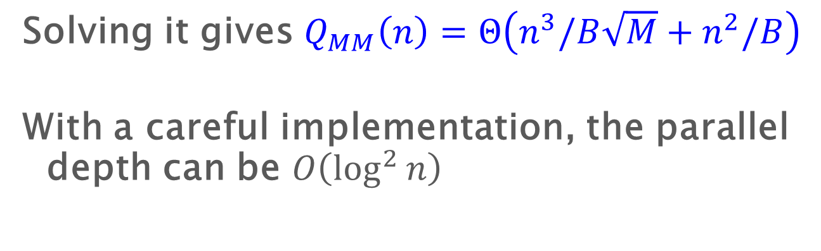
Recursive Matrix Multiplication
Compute 8 submatrix products recursively
Z₁₁ := X₁₁Y₁₁ + X₁₂Y₂₁
Z₁₂ := X₁₁Y₁₂ + X₁₂Y₂₂
Z₂₁ := X₂₁Y₁₁ + X₂₂Y₂₁
Z₂₂ := X₂₁Y₁₂ + X₂₂Y₂₁
Z₁₁
Z₁₂
X₁₁
X₁₂
Y₁₁
Y₁₂
:=
Z₂₁
Z₂₂
X₂₁
X₂₂
Y₂₁
Y₂₂
Solving it gives $Q_{MM}\left(n\right)=Θ\left(n^{3}/B\sqrt{M}+n^{2}/B\right)$
With a careful implementation, the parallel depth can be $O\left(\log^{2}{n}\right)$
Notes:
Gap between I/O cost and arithmetic operations
Implementation: remember the base case

Slide 36
Algorithms Similar to Matrix Multiplication
Linear algebra:
  Gaussian elimination, LU decomposition, triangular system solver, QR decomposition
Dynamic Programming:
  Floyd-Warshall for APSP, edit distance (longest common sequences), 1D clustering, and many applications in molecular biology and geology (e.g. protein folding/ editing, many structure problems)
Notes:
Implementation: remember the base case

Slide 37
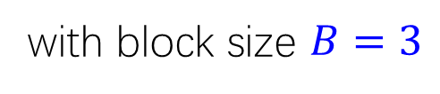
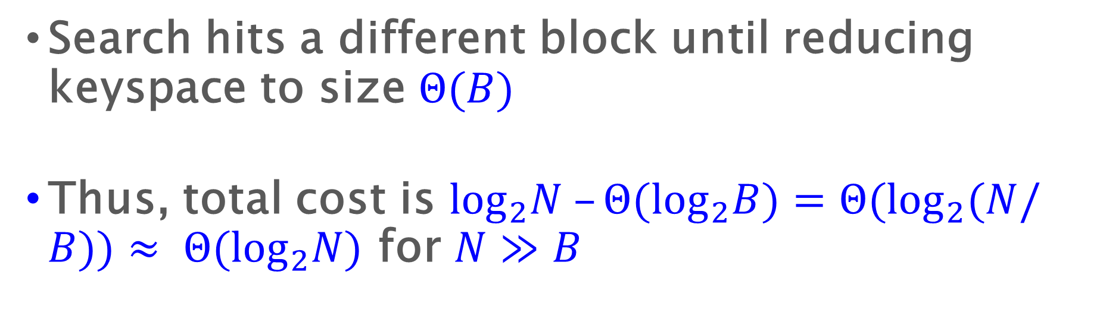
Searching: binary search is bad
A
B
D
H
A
B
C
D
E
F
G
H
I
J
K
L
M
N
O
Example: binary search for element A
with block size $B=3$
Search hits a different block until reducing keyspace to size $Θ(B)$
Thus, total cost is $\log_{2}N –Θ(\log_{2}B)=Θ(\log_{2}(N/B))≈ Θ(\log_{2}N)$ for $N≫B$

Slide 38


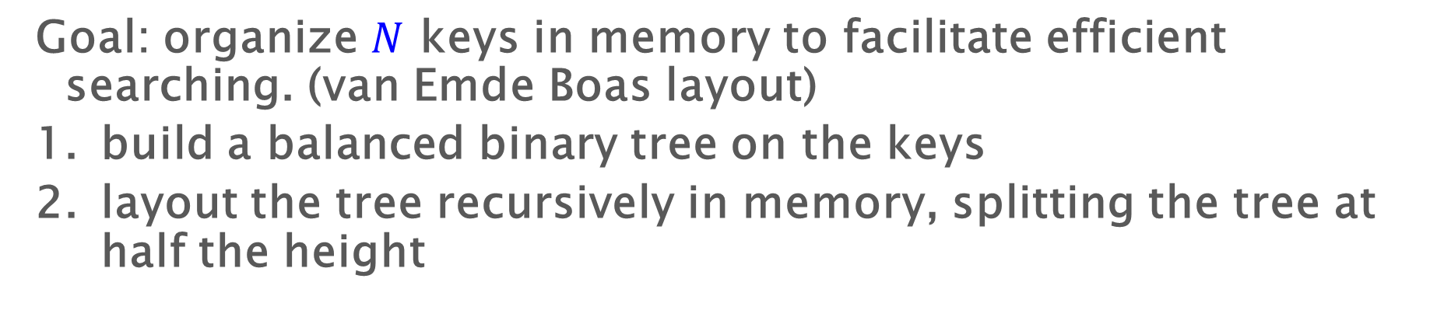



Static cache-oblivious searching
Goal: organize $N$ keys in memory to facilitate efficient searching. (van Emde Boas layout)
build a balanced binary tree on the keys
layout the tree recursively in memory, splitting the tree at half the height
$$\sqrt{N}$$
$$N$$
$$\sqrt{N}$$
…
memory layout
$$N$$
$$\sqrt{N}$$

Slide 39
Static layout example
recurse
H
0
D
1
L
2
3
6
9
12
B
F
J
N
A
C
E
G
I
K
M
O
4
5
7
8
10
11
13
14
H
D
L
B
A
C
F
E
G
J
I
K
N
M
O

Slide 40

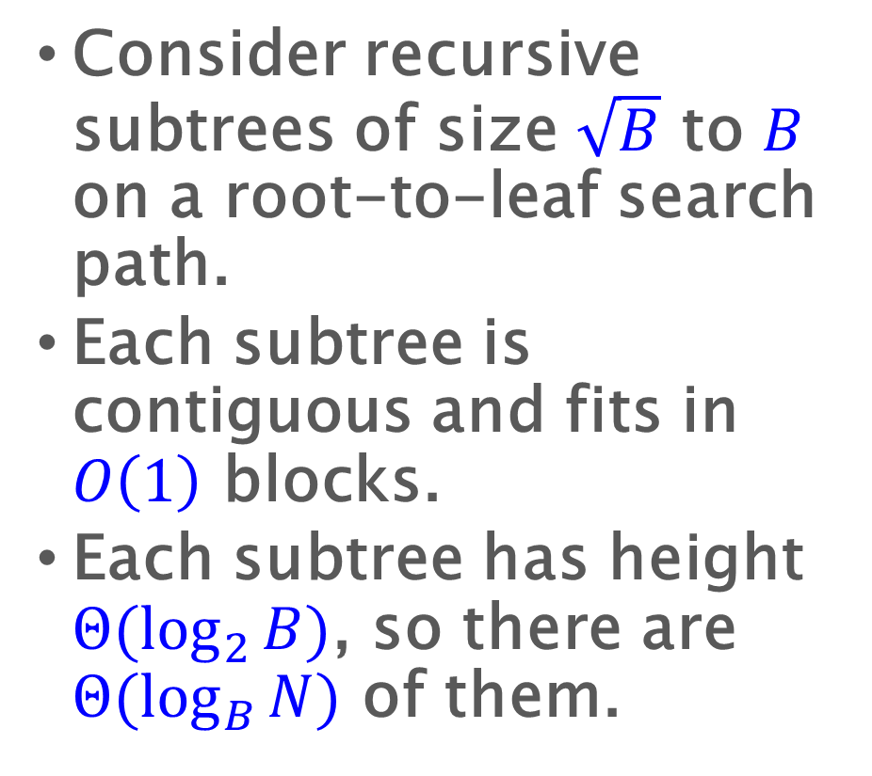
Cache-oblivious searching: Analysis I
Consider recursive subtrees of size $\sqrt{B}$ to $B$ on a root-to-leaf search path.
Each subtree is contiguous and fits in $O\left(1\right)$ blocks.
Each subtree has height $Θ(\log_{2}{B})$, so there are $Θ(\log_{B}{N})$ of them.
size-$O(B)$ subtree
…
memory
size-B block

Slide 41
Cache-oblivious searching: Analysis I
Consider recursive subtrees of size $\sqrt{B}$ to $B$ on a root-to-leaf search path.
Each subtree is contiguous and fits in $O\left(1\right)$ blocks.
Each subtree has height $Θ(\log_{2}{B})$, so there are $Θ(\log_{B}{N})$ of them.
size-$O(B)$ subtree
…
memory
size-B block

Slide 42

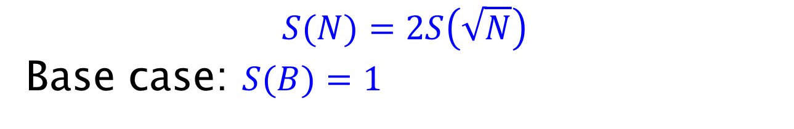

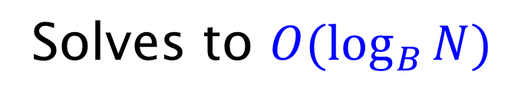



Cache-oblivious searching:
Analysis II
$$\sqrt{N}$$
$$N$$
$$\sqrt{N}$$
…
memory layout
$$N$$
$$\sqrt{N}$$
Analyze using a recurrence
$$S(N)=2S\left(\sqrt{N}\right)$$
Base case: $S(B)=1$
Solves to $O(\log_{B}{N})$

Slide 43
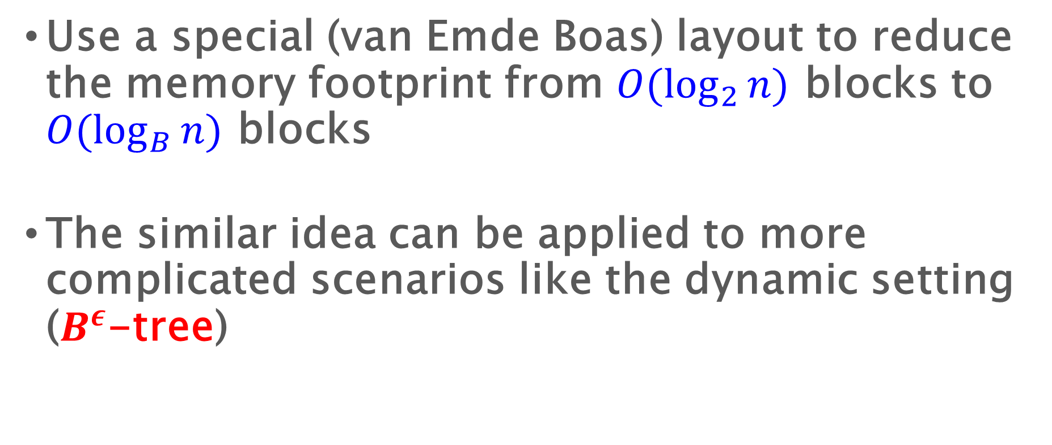
Summary for cache-oblivious searching
Use a special (van Emde Boas) layout to reduce the memory footprint from $O(\log_{2}{n})$ blocks to $O(\log_{B}{n})$ blocks
The similar idea can be applied to more complicated scenarios like the dynamic setting ($B^{ε}$-tree)

Slide 44
Last week – cache-oblivious algorithms
Problem | RAM Algorithm | CO algorithm
Sorting | $$O\left(n\log{n}\right)$$ | $$O\left(\frac{n}{B}\log_{\frac{M}{B}}{\frac{n}{B}}\right)$$
Matrix transpose | $$O\left(n^{2}\right)$$ | $$O\left(\frac{n^{2}}{B}\right)$$
Matrix multiplication | $$O\left(n^{3}\right)$$ | $$O\left(\frac{n^{3}}{B\sqrt{M}}\right)$$
Search | $$O(\log_{2}{n})$$ | $$O(\log_{B}{n})$$

Slide 45
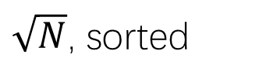
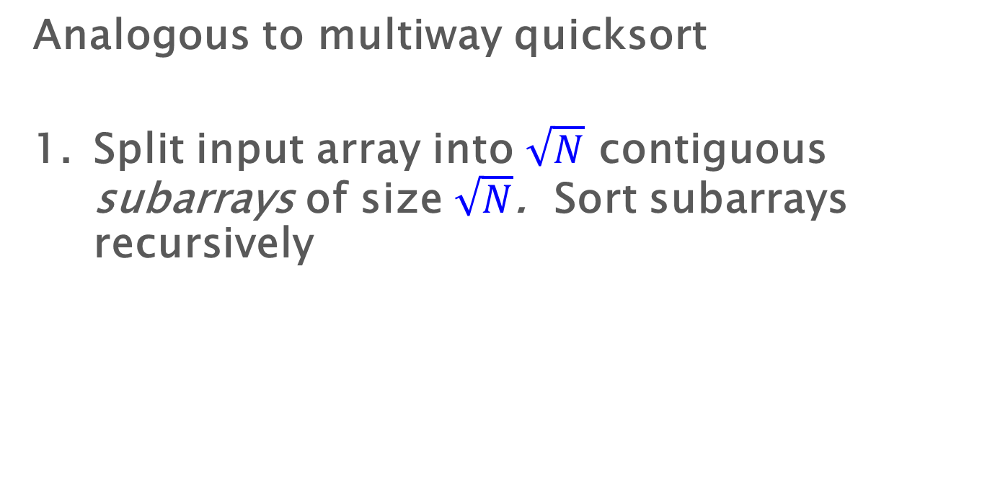

Sample-sort outline
Analogous to multiway quicksort
Split input array into $\sqrt{N}$ contiguous subarrays of size $\sqrt{N}$. Sort subarrays recursively
…
$\sqrt{N}$, sorted
$$N$$

Slide 46
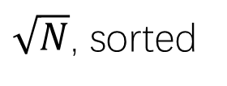
Sample-sort outline
Analogous to multiway quicksort
Split input array into $\sqrt{N}$ contiguous subarrays of size $\sqrt{N}$. Sort subarrays recursively
$\sqrt{N}$, sorted
…

Slide 47




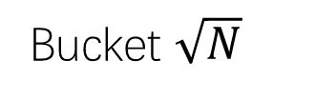
Sample-sort outline
Choose $\sqrt{N}−1$ “good” pivots $p1≤p2≤…≤p_{\sqrt{N}−1}$
Distribute subarrays into buckets, according to pivots
$\sqrt{N}$, sorted
…
Size $≈\sqrt{N}$
$$≤p_{1}≤$$
$$≤p2≤…≤p_{\sqrt{N}−1}≤$$
Bucket 1
Bucket 2
Bucket $\sqrt{N}$

Slide 48

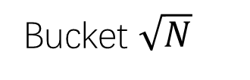

Sample-sort outline
Recursively sort the buckets
Copy concatenated buckets back to input array
$$≤p_{1}≤$$
$$≤p2≤…≤p_{\sqrt{N}−1}≤$$
Bucket 1
Bucket 2
Bucket $\sqrt{N}$
sorted

Slide 49
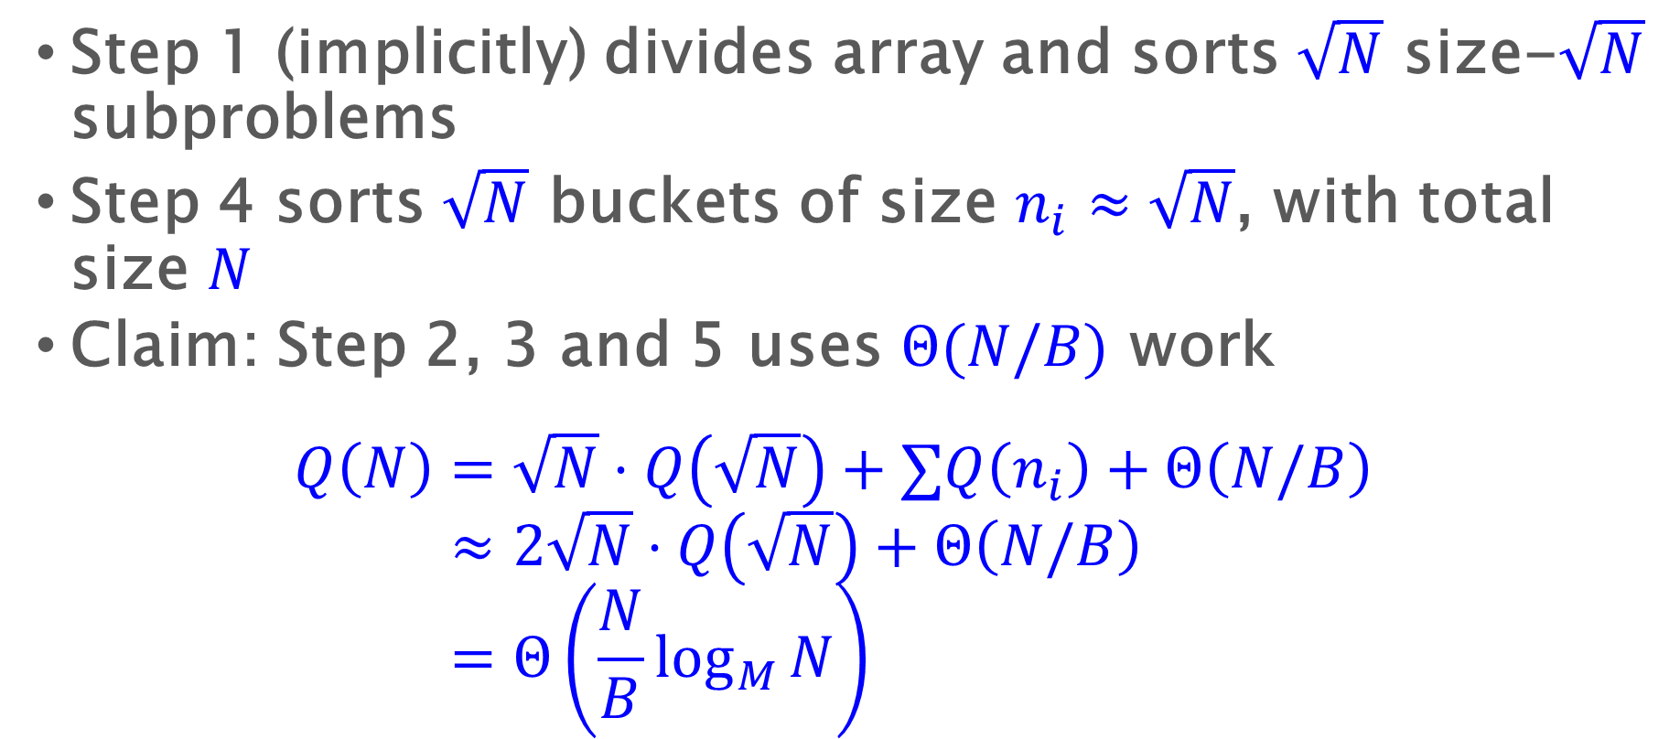
Sample-sort analysis sketch
Step 1 (implicitly) divides array and sorts $\sqrt{N}$ size-$\sqrt{N}$ subproblems
Step 4 sorts $\sqrt{N}$ buckets of size $n_{i}≈\sqrt{N}$, with total size $N$
Claim: Step 2, 3 and 5 uses $Θ(N/B)$ work
$$Q\left(N\right)=\sqrt{N}⋅Q\left(\sqrt{N}\right)+∑Q\left(n_{i}\right)+Θ\left(N/B\right) \\ ≈2\sqrt{N}⋅Q\left(\sqrt{N}\right)+Θ\left(N/B\right) \\ =Θ\left(\frac{N}{B}\log_{M}{N}\right)$$

Slide 50
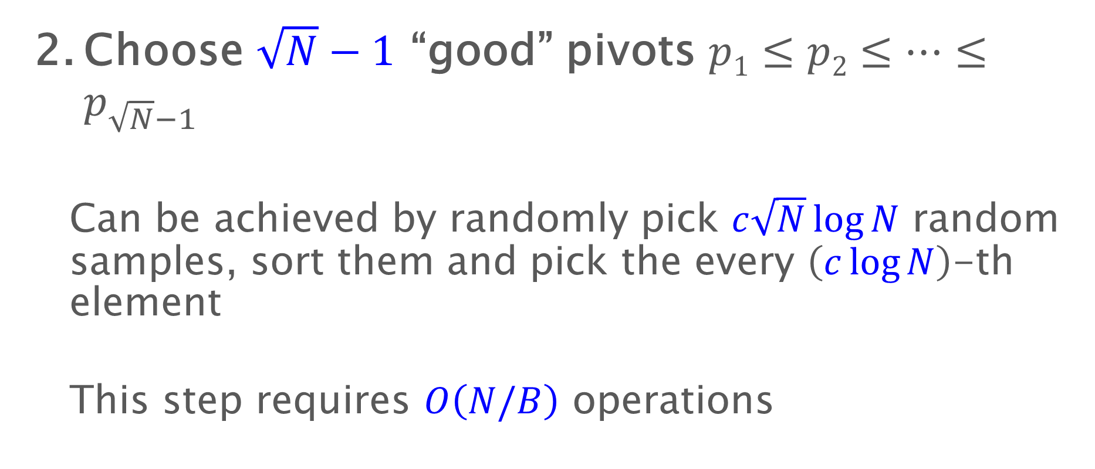
Sample-sort outline
Choose $\sqrt{N}−1$ “good” pivots $p1≤p2≤…≤p_{\sqrt{N}−1}$
  Can be achieved by randomly pick $c\sqrt{N}\log{N}$ random samples, sort them and pick the every $\left(c\log{N}\right)$-th element
  This step requires $O\left(N/B\right)$ operations

Slide 51
Sample-sort outline
Choose $\sqrt{N}−1$ “good” pivots $p1≤p2≤…≤p_{\sqrt{N}−1}$
Distribute subarrays into buckets, according to pivots
$\sqrt{N}$, sorted
…
Size $≈\sqrt{N}$
$$≤p_{1}≤$$
$$≤p2≤…≤p_{\sqrt{N}−1}≤$$
Bucket 1
Bucket 2
Bucket $\sqrt{N}$

Slide 52
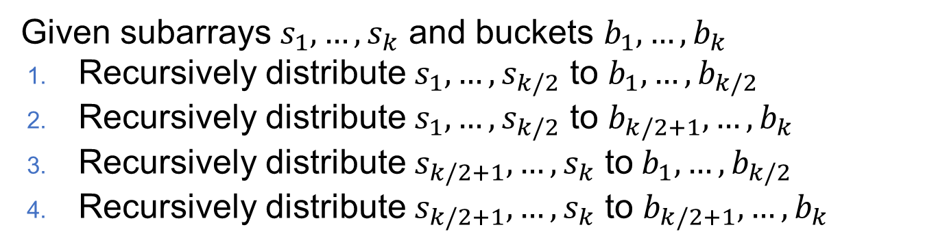

Transposing elements to buckets
Given subarrays $s_{1},…,s_{k}$ and buckets $b_{1},…,b_{k}$
Recursively distribute $s_{1},…,s_{k/2}$ to $b_{1},…,b_{k/2}$
Recursively distribute $s_{1},…,s_{k/2}$ to $b_{k/2+1},…,b_{k}$
Recursively distribute $s_{k/2+1},…,s_{k}$ to$b_{1},…,b_{k/2}$
Recursively distribute $s_{k/2+1},…,s_{k}$ to $b_{k/2+1},…,b_{k}$
The cache-oblivious algorithm has a cost of $Θ(n/B)$

Slide 53

Summary for Cache-Oblivious Sorting
Has I/O cost $Θ\left(\frac{N}{B}\log_{M}{N}\right)$, matching the bound on the cache-aware model
The implementation is based on $\sqrt{N}$-way divide-and-conquer, with a recursion depth of $\log_{2}{\log_{2}{n}}$
This algorithm can be highly parallelized, with $O(\log^{2}{n})$ depth
The most efficient general-purpose implementation of parallel sorting

Slide 54

Cache-oblivious algorithms
Problem | RAM Algorithm | CO algorithm
Sorting | $$O\left(n\log{n}\right)$$ | $$O\left(\frac{n}{B}\log_{M}{n}\right)$$
Matrix transpose | $$O\left(n^{2}\right)$$ | $$O\left(\frac{n^{2}}{B}\right)$$
Matrix multiplication | $$O\left(n^{3}\right)$$ | $$O\left(\frac{n^{3}}{B\sqrt{M}}\right)$$
Search | $$O(\log_{2}{n})$$ | $$O(\log_{B}{n})$$

Slide 55
Summary

Slide 56

Cache-Oblivious Algorithms
Algorithms not parameterized by $B$ or $M$
  These algorithms are unaware of the parameters of the memory hierarchy
Slow Memory
Fast Memory
CPU
1
0
$$M/B$$
1
$$B$$

Slide 57

Problems of I/O model and I/O algorithms
How about parallelism?
  Still use work-span(depth) analysis
What about multiple-level memory hierarchy?
  Apply to all cache levels
Algorithm is machine specific. Need to rewrite code when running on another machine
  No, you don’t
What about when $M$ and $B$ are not static?
  The algorithm will adapt automatically

Slide 58


Design and Analysis of Parallel Algorithms
Work $W$, depth $D$, I/O cost $Q$ (sequential / random)
Parallelism for work: $\frac{W}{P}$
Time for I/O: $max(\frac{Q}{P},\frac{Q}{B_{max}})$
Most combinatorial algorithms are I/O bottlenecked
What about $D$?

