Slide 1
Parallel Algorithms: Theory and Practice Locality and I/O-Efficient Parallel Algorithms
CS260 – Lecture 11
Yan Gu

Slide 2
Last week – Tree algorithms
Augmented trees
Every tree node stores an “augmented value” represent some information about the whole subtree
Sum of values, max values, another tree, etc.
Use it for fast range sums
Consider define the key, value, augmented value, map function and reduce function

Slide 3

Last week – Tree algorithms
Case study: applications using parallel trees
Interval tree
Key: left endpoint, value: right endpoint
Augmented value as the max of right endpoint
Map function: $\left(k,v\right)↦v$, reduce function: $\left(v_{1},v_{2}\right)↦max⁡(v_{1}v_{2})$
Answer stabbing query

Slide 4
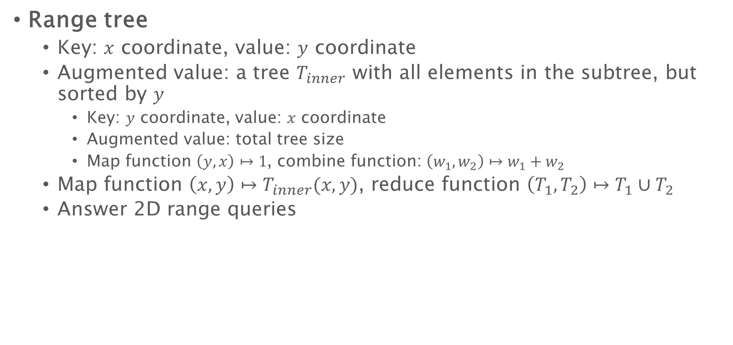
Last week – Tree algorithms
Range tree
Key: $x$ coordinate, value: $y$ coordinate
Augmented value: a tree $T_{inner}$ with all elements in the subtree, but sorted by $y$
Key: $y$ coordinate, value: $x$ coordinate
Augmented value: total tree size
Map function $\left(y,x\right)↦1$, combine function: $\left(w_{1},w_{2}\right)↦w_{1}+w_{2}$
Map function $\left(x,y\right)↦T_{inner}(x,y)$, reduce function $\left(T_{1},T_{2}\right)↦T_{1}∪T_{2}$
Answer 2D range queries

Slide 5
Last week – Tree algorithms
Index searching
Inverted index in a tree
Key: word, value: a tree of its documents
Query: lookup/union/intersection inner trees
Update: keep the original version using path-copying
Similar ideas can be applied to dynamic graph processing
Other options for MVCC: version chains (linked lists of versions)
Depend on applications and optimization goals

Slide 6
Parallel Algorithms: Theory and Practice Locality and I/O-Efficient Parallel Algorithms
CS260 – Lecture 11
Yan Gu

Slide 7
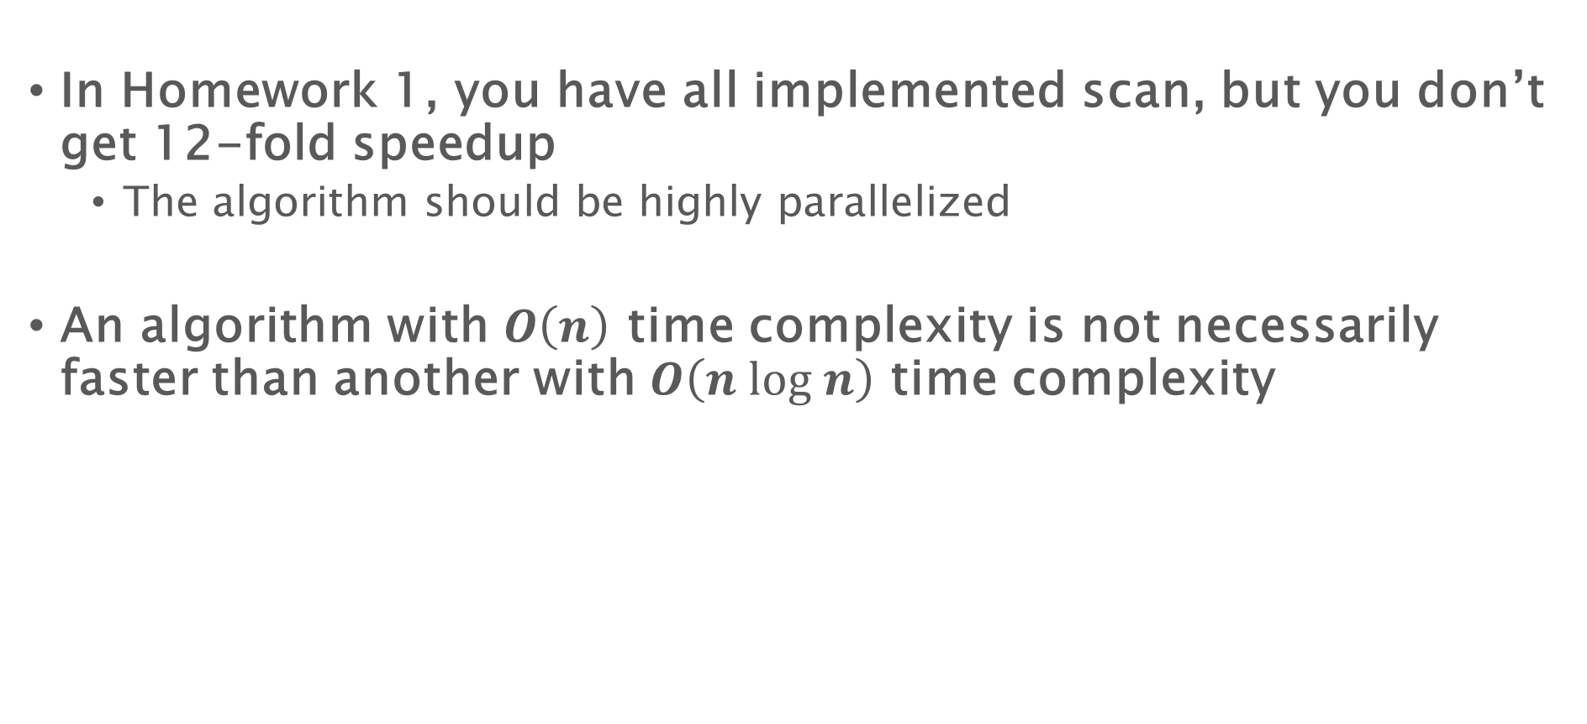
Is theory useful?
In Homework 1, you have all implemented scan, but you don’t get 12-fold speedup
The algorithm should be highly parallelized
An algorithm with $O\left(n\right)$ time complexity is not necessarily faster than another with $O\left(n log n\right)$ time complexity

Slide 8
Is theory useful?
cilk_for (int i = 0; i < n; i++) A[i] = A[i] + 1;
cilk_for (int i = 0; i < n; i++) A[i] = A[(long long)(i)*4323 % n] + 1;
cilk_for (int i = 0; i < n; i++) A[i] = (long long)(i)*4323 % n + 1;
n=10^9
time: 0.17225
time: 2.88519
time: 0.68664
Random access is 12.78x more expensive than a sequential access

Slide 9
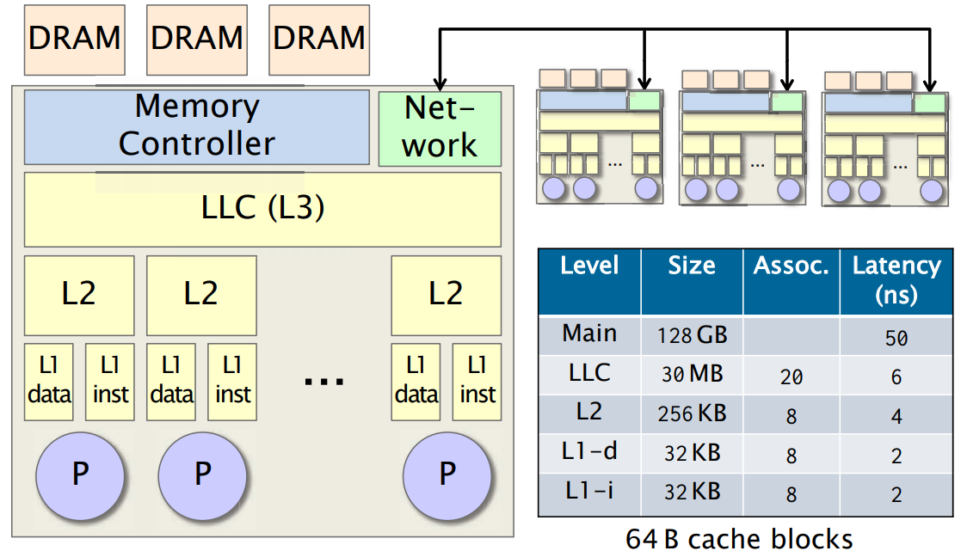

Slide 10



The I/O model
Two-level memory hierarchy:
A small memory (fast memory, cache) of fixed size $M$
A large memory (slow memory) of unbounded size
Both are partitioned into blocks of size $B$
Instructions can only apply to data in primary memory, and are free
Slow Memory
Fast Memory
CPU
0
$$M/B$$
$$B$$
Notes:
The External Memory model is usually used to measure the complexity of input and output, and assumes that a computer has a two-level memory hierarchy:
a small memory that has a fixed size 𝑀, and
An unbounded-size large memory
Both levels are partitioned into blocks of size 𝐵.
[click] The CPU can only freely access and process the data on fast memory.
Remember, any data access and computation is totally free if all the data are already in the fast memory.
To use the data on slow memory,

Slide 11
The I/O model
The I/O model has two special memory transfer instructions:
Read transfer: load a block from slow memory
Write transfer: write a block to slow memory
The complexity of an algorithm on the I/O model (I/O complexity) is measured by:
#(read transfers) + #(write transfers)
Slow Memory
Fast Memory
CPU
1
0
$$M/B$$
1
$$B$$
Notes:
There are two memory transfer instructions.
You can either read a block from the slow memory, or write a block to it.
To think about it, you can assume the fast memory to be the main memory and the slow memory to be the disk.
Disks are arranged with block size of several KB.
In another case, the fast memory can be the cache and the slow memory be the main memory.
In this case, the block size is the size of a cache line.
The complexity of an algorithm on the EM model (I/O complexity) is measured by the overall number of read transfers plus write transfers.
(In asymmetric setting, )
//, and once you want to do I/O from the disk, you either load a whole block from the disk to the main memory or write a whole block from the main memory

Slide 12
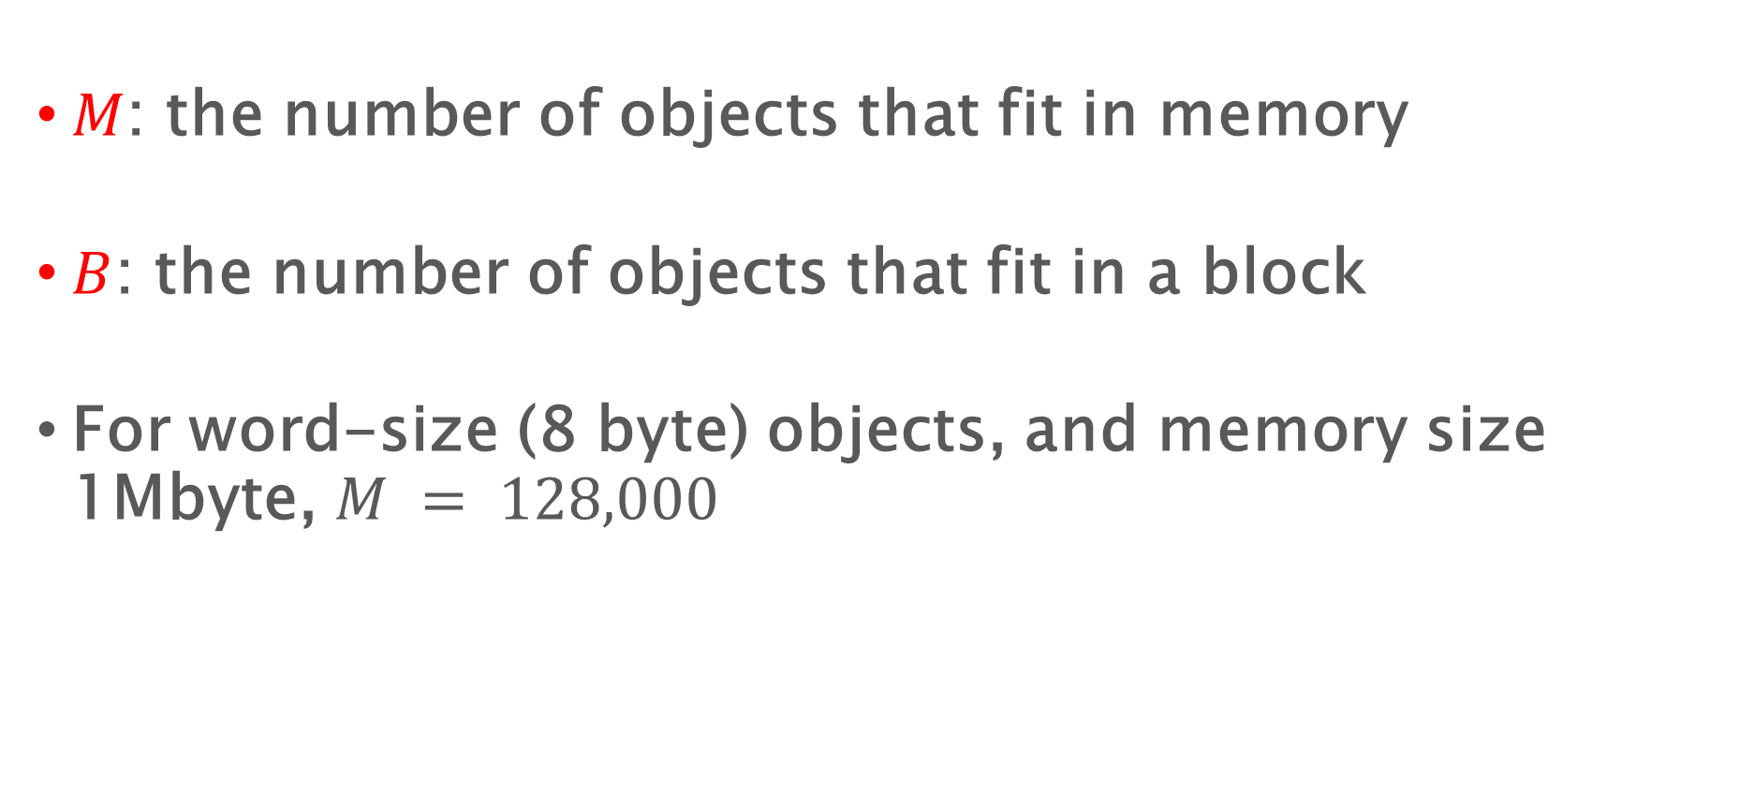
Notation Clarification
$M$: the number of objects that fit in memory
$B$: the number of objects that fit in a block
For word-size (8 byte) objects, and memory size 1Mbyte, $M = 128,000$

Slide 13
Why a 2-Level Hierarchy?
It’s simpler than considering the multi-level hierarchy
A single level may dominate the runtime of the application, so designing an algorithm for that level may be sufficient
Considering a single level exposes the algorithmic difficulties — generalizing to a multilevel is often similar
We’ll see cache-oblivious algorithms later as a way of designing for multi-level hierarchies

Slide 15
Why care I/O model?
Most parallel (combinatorial) algorithms are I/O bottlenecked
Have an upper bound on speedup
Need to consider I/O optimizations during algorithm design
Many “classic” algorithms are suboptimal regarding I/O

Slide 16

CS 260-001 in Spring 2020

Slide 17
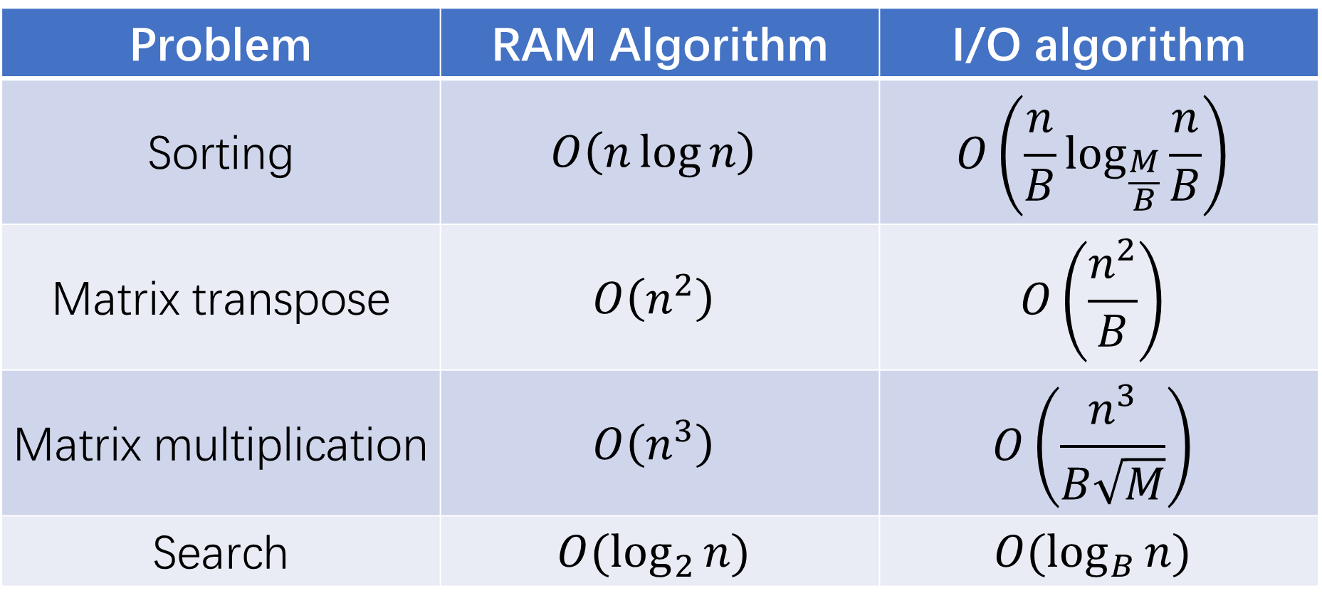
I/O-efficient algorithms
Problem | RAM Algorithm | I/O algorithm
Sorting | $$O\left(n\log{n}\right)$$ | $$O\left(\frac{n}{B}\log_{\frac{M}{B}}{\frac{n}{B}}\right)$$
Matrix transpose | $$O\left(n^{2}\right)$$ | $$O\left(\frac{n^{2}}{B}\right)$$
Matrix multiplication | $$O\left(n^{3}\right)$$ | $$O\left(\frac{n^{3}}{B\sqrt{M}}\right)$$
Search | $$O(\log_{2}{n})$$ | $$O(\log_{B}{n})$$

Slide 18
A regular 2-way mergesort
Recursively split into the problem size into half, until it is sufficiently small
6
3
7
2
7
8
2
5
4
9
0
8
1
2
1
7
6
3
7
2
7
8
2
5
4
9
0
8
1
2
1
7
6
3
7
2
7
8
2
5
4
9
0
8
1
2
1
7
6
3
7
2
7
8
2
5
4
9
0
8
1
2
1
7
Notes:
The simplest case is called 2-way mergesort.
Initially we a list of n elements.
(click) Recursively split into the problem size into half, until it is sufficiently small.

Slide 19

A regular 2-way mergesort
Recursively merge the sorted lists, in $\log_{2}{n}$ rounds
0
1
1
2
2
2
3
4
5
6
7
7
7
8
8
9
2
2
3
5
6
7
7
8
0
1
1
2
4
7
8
9
2
3
6
7
2
5
7
8
0
4
8
9
1
1
2
7
3
6
2
7
7
8
2
5
4
9
0
8
1
2
1
7
Notes:
Then we first sort these small lists.
After this, we recursively merge the sorted lists, in log base 2 of n rounds.
(to merge 2 lists?)

Slide 20

How to merge two lists?
I/O per level: $O\left(\frac{n}{B}\right)$
Number of levels: $\log_{2}{n}$
Overall I/O cost: $O\left(\frac{n}{B}\log{n}\right)$
Temporal space
List 1:
1
3
6
7
6
1
2
List 2:
2
5
7
8
3
5
Output list:
1
2
3
5
6
7
7
8
Notes:
It is actually pretty easy.
We assume that the 2 lists are sorted, which is done in the previous level.
(click) We just compare the smallest elements from the lists in a small temporal space, output the smaller one, and continue.
This is the 2-way mergesort.

Slide 21
Multi-way mergesort on the EM model
Proposed by Aggarwal and Vitter in 1988
Goal: minimizing the number of memory transfers
Notes:
Now I’m going to introduce the classic multi-way mergesort.
This is not our new algorithm, but it is important to understand this algorithm first to better understand our new algorithm.
Remember that in the EM model, we only care about minimizing the number of memory transfers, and this is the reason we merge in multi-way instead of 2-way.

Slide 22





Multi-way mergesort on the EM model
Recursively merge $M/B$ sorted lists, in $\log_{M/B}{n/M}$ rounds
$$n$$
$$\log_{M/B}{n/M}$$
$$n/(M/B)$$
$$M^{2}/B$$
$$M$$
Notes:
As the name multi-way mergesort suggests, it partitions the input into M/B lists, recursively sorts them, and merge these lists together.
[Click] Once the list has less than M elements, it will fully fit into the fast memory and it is free on the EM model. Therefore, the recursion needs log base M/B of n/M rounds.
In this talk we ignore all the rounding issues here. We assume all results are integers. I refer you to our paper for explicit analysis.
The partition process is easy. The hard part is, how to merge multiple lists instead of two lists.

Slide 23
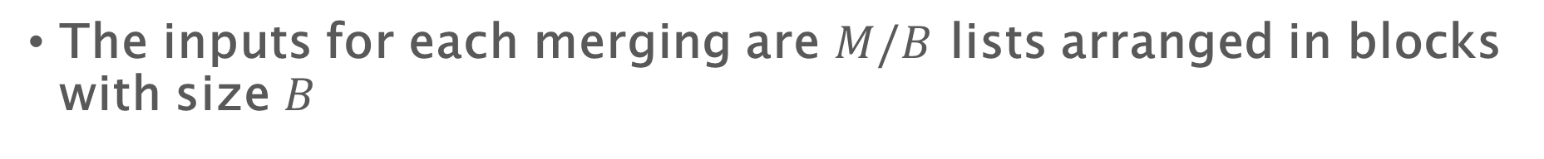


Multi-way mergesort on the EM model
The inputs for each merging are $M/B$ lists arranged in blocks with size $B$
Output List:
Fast memory (cache)
$$B$$
List 1:
3
4
5
6
8
9
List 2:
1
2
3
4
7
8
List $M/B$:
0
4
6
8
8
9
Notes:
For each merge process, the inputs are M/B lists arranged in block with size B.
We assume we have a fast memory with size M, marked as the yellow region.
(Initially,)

Slide 24
Multi-way mergesort on the EM model
Each list has one block in primary memory, and the minimum element is selected and appended to the output
Output List:
Fast memory (cache)
List 1:
6
8
9
3
4
5
List 2:
4
7
8
1
2
3
0
4
6
Output buffer:
0
1
2
List $M/B$:
8
8
9
Notes:
The first block of all lists are loaded to the cache using M/B memory transfers.
[Clik] The smallest element in the cache will be selected and output. When we have B elements, we write them together to the memory (using a write transfer).

Slide 25
Multi-way mergesort on the EM model
Each list has one block in primary memory, and the minimum element is selected and appended to the output
Output List:
Fast memory (cache)
0
1
2
List 1:
6
8
9
3
4
5
List 2:
4
7
8
4
7
8
3
4
6
Output buffer:
3
List $M/B$:
8
8
9
Notes:
Using a write-transfer. [click]
The last elements in the blocks are marked as grey here. [click] Once these elements are output, the next block in this list will be loaded to the memory.
[Click] We keep doing this until all elements are processed.

Slide 26

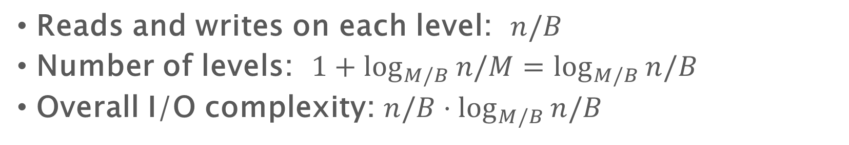
I/O complexity for multi-way merge sort on EM model
Reads and writes on each level: $n/B$
Number of levels: $1+\log_{M/B}{n/M}=\log_{M/B}{n/B}$
Overall I/O complexity: $n/B⋅\log_{M/B}{n/B}$
$$n$$
$$\log_{M/B}{N/M}$$
$$n/(M/B)$$
$$M^{2}/B$$
$$M$$
Notes:
Let’s analyze the I/O complexity for this merge sort.
The number of reads and writes on each level is clearly n/B, since each element is loaded in block once and written back in block once.
The total number of levels are log based M/B of n/B, and the overall I/O complexity is just the product of these two terms.
Okay, this is the classic multi-way mergesort.
(In this algorithm, we use the same number of read transfers and write transfers.
So now the question is, how can we do better on asymmetric setting? And this will be our new algorithm.)

Slide 27
I/O-efficient algorithms
Problem | RAM Algorithm | I/O algorithm
Sorting | $$O\left(n\log{n}\right)$$ | $$O\left(\frac{n}{B}\log_{\frac{M}{B}}{\frac{n}{B}}\right)$$
Matrix transpose | $$O\left(n^{2}\right)$$ | $$O\left(\frac{n^{2}}{B}\right)$$
Matrix multiplication | $$O\left(n^{3}\right)$$ | $$O\left(\frac{n^{3}}{B\sqrt{M}}\right)$$
Search | $$O(\log_{2}{n})$$ | $$O(\log_{B}{n})$$

Slide 28
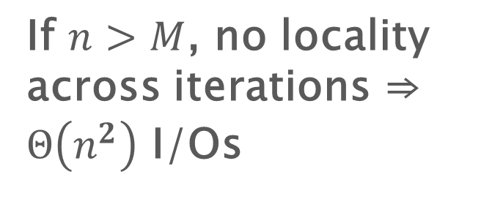
Matrix transpose
If $n>M$, no locality across iterations ⇒ $Θ\left(n^{2}\right)$ I/Os
1 2 3 4 5
2
3
4
5
for i = 1 to N do
for j = i+1 to N do
swap(A[i][j], A[j][i])
The simplest implementation is not I/O efficient assuming the matrix is stored in row-major

Slide 29
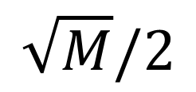

Matrix transpose - I/O algorithm
$$\sqrt{M}/2$$
1
2
2
The simplest implementation is not I/O efficient
The I/O algorithm has a cost of $Θ(n^{2}/B)$

Slide 30
Matrix Multiplication
Consider standard iterative matrix-multiplication algorithm
Z
X
Y
:=
Where $X$, $Y$, and $Z$ are $N×N$ matrices
for i = 1 to N do
for j = 1 to N do
for k = 1 to N do
Z[i][j] += X[i][k] * Y[k][j]
$Θ(N3)$ computation in RAM model. What about I/O?

Slide 31
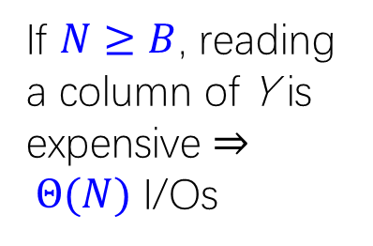
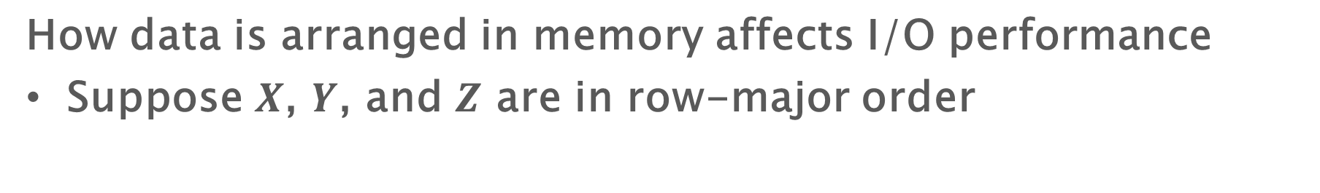
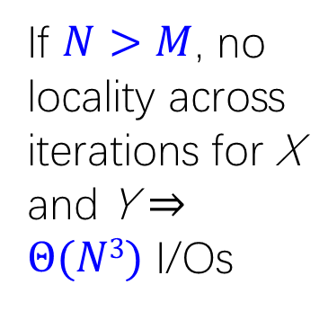
How Are Matrices Stored?
How data is arranged in memory affects I/O performance
Suppose $X$, $Y$, and $Z$ are in row-major order
Z
X
Y
:=
for i = 1 to N do
for j = 1 to N do
for k = 1 to N do
Z[i][j] += X[i][k] * Y[k][j]
If $N>M$, no locality across iterations for X and Y ⇒ $Θ(N3)$ I/Os
If $N≥B$, reading a column of Y is expensive ⇒ $Θ(N)$ I/Os

Slide 32
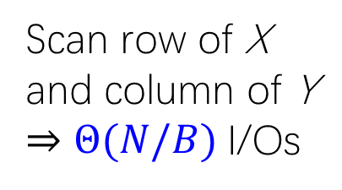


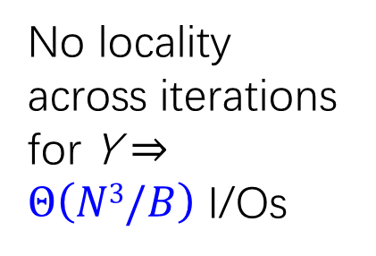
How Are Matrices Stored?
Suppose $X$ and $Z$ are in row-major order but $Y$ is in column-major order
Not too inconvenient. Transposing $Y$ has $Θ(N^{2}/B)$ cost
Z
X
Y
:=
for i = 1 to N do
for j = 1 to N do
for k = 1 to N do
Z[i][j] += X[i][k] * Y[k][j]
No locality across iterations for Y ⇒ $Θ\left(N3/B\right)$ I/Os
Scan row of X and column of Y ⇒ $Θ(N/B)$I/Os
We can do much better than $Θ(N3/B)$ I/Os, even if all matrices are row-major

Slide 33
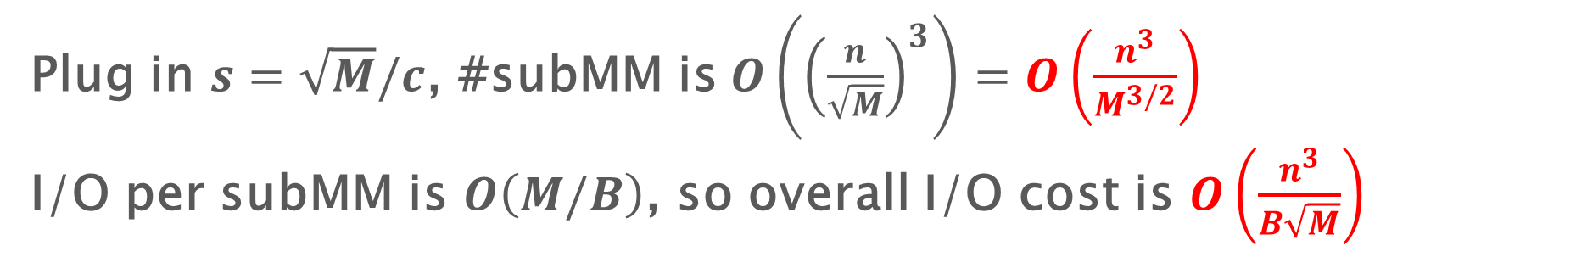
Tiling
Z
X
Y
:=
for i = 1 to N/s do
for j = 1 to N/s do
for k = 1 to N/s do
for i’ = (i-1)*s+1 to i*s do
for j’ = (j-1)*s+1 to j*s do
for k’ = (k-1)*s+1 to k*s do
Z[i’][j’] += X[i’][k’] * Y[k’][j’]
Plug in $s=\sqrt{M}/c$, #subMM is $O\left({\left(\frac{n}{\sqrt{M}}\right)}^{3}\right)=O\left(\frac{n^{3}}{M^{3/2}}\right)$
I/O per subMM is $O\left(M/B\right)$, so overall I/O cost is $O\left(\frac{n^{3}}{B\sqrt{M}}\right)$

Slide 34
I/O-efficient algorithms
Problem | RAM Algorithm | I/O algorithm
Sorting | $$O\left(n\log{n}\right)$$ | $$O\left(\frac{n}{B}\log_{\frac{M}{B}}{\frac{n}{B}}\right)$$
Matrix transpose | $$O\left(n^{2}\right)$$ | $$O\left(\frac{n^{2}}{B}\right)$$
Matrix multiplication | $$O\left(n^{3}\right)$$ | $$O\left(\frac{n^{3}}{B\sqrt{M}}\right)$$
Search | $$O(\log_{2}{n})$$ | $$O(\log_{B}{n})$$

Slide 35
B-Trees
A B-tree is a type of search tree ((a,b)-tree) designed optimized for memory performance
Common approach for storing searchable, ordered data on disks, e.g., databases, filesystems
Updates: Insert/Delete
Queries
Search: is the element there
Successor/Predecessor: find the nearest key
Range query: return all objects with keys within a range
…

Slide 36
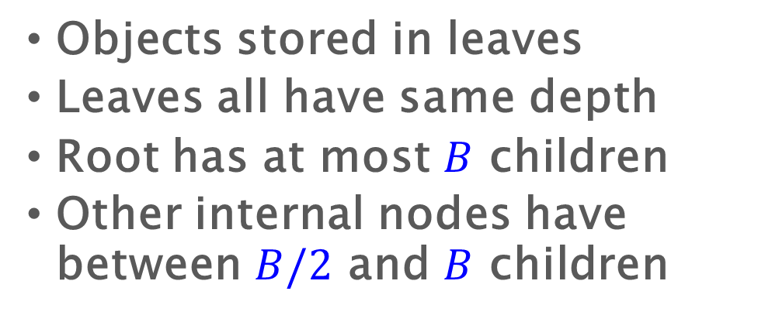
B-tree/(2,3)-tree
Objects stored in leaves
Leaves all have same depth
Root has at most $B$ children
Other internal nodes have between $B/2$ and $B$ children
B
18
35
6
10
25
43
50
1
2
4
10
12
15
18
21
25
28
35
37
50
51
53
6
8
43
45

Slide 37
B-tree search
Compare search key against partitioning keys and move to proper child.
Cost is O(height * node size)
Search for 21
18
35
6
10
25
43
50
1
2
4
10
12
15
18
21
25
28
35
37
50
51
53
6
8
43
45

Slide 38
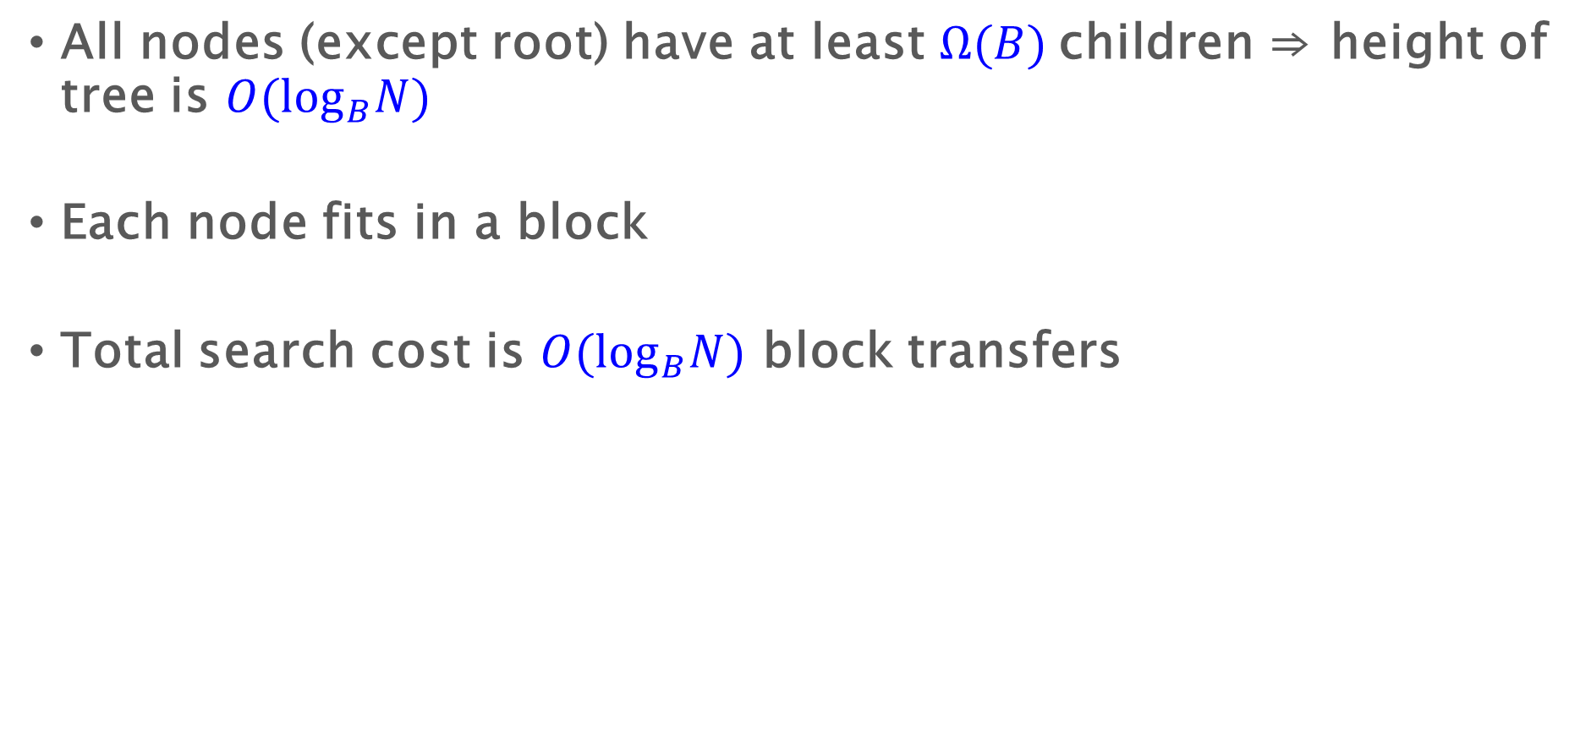
B-tree analysis - Search
All nodes (except root) have at least $Ω(B)$children ⇒ height of tree is $O(\log_{B}N)$
Each node fits in a block
Total search cost is $O(\log_{B}N)$ block transfers

Slide 39
B-tree insert
Search for where the key should go
If there’s room, put it in
Insert 23
18
35
6
10
25
43
50
1
2
4
10
12
15
18
21
23
25
28
35
37
50
51
53
6
8
43
45

Slide 40
B-tree insert
Search for where the key should go
If there’s no room, split the node
Splits may propagate up tree
Insert 24
18
35
6
10
25
25
23
43
50
1
2
4
10
12
15
18
21
23
25
28
35
37
50
51
53
6
8
23
24
43
45

Slide 41
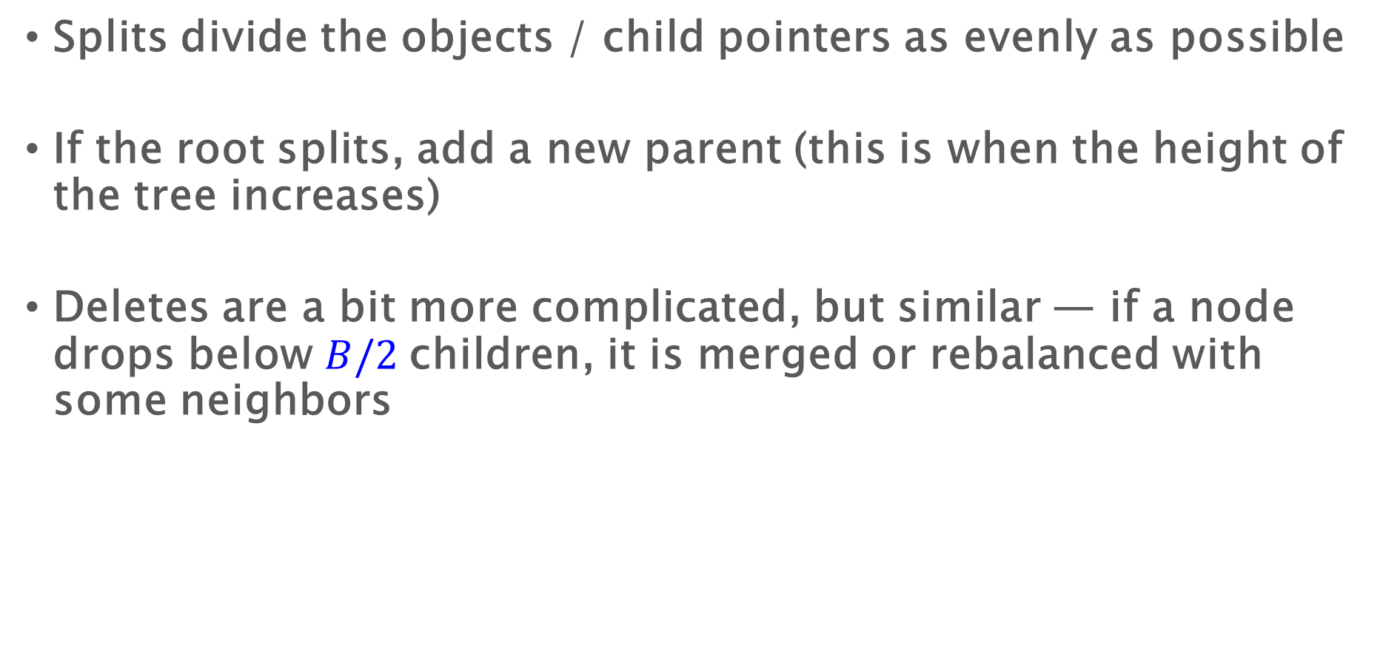
B-tree inserts
Splits divide the objects / child pointers as evenly as possible
If the root splits, add a new parent (this is when the height of the tree increases)
Deletes are a bit more complicated, but similar — if a node drops below $B/2$children, it is merged or rebalanced with some neighbors

Slide 42
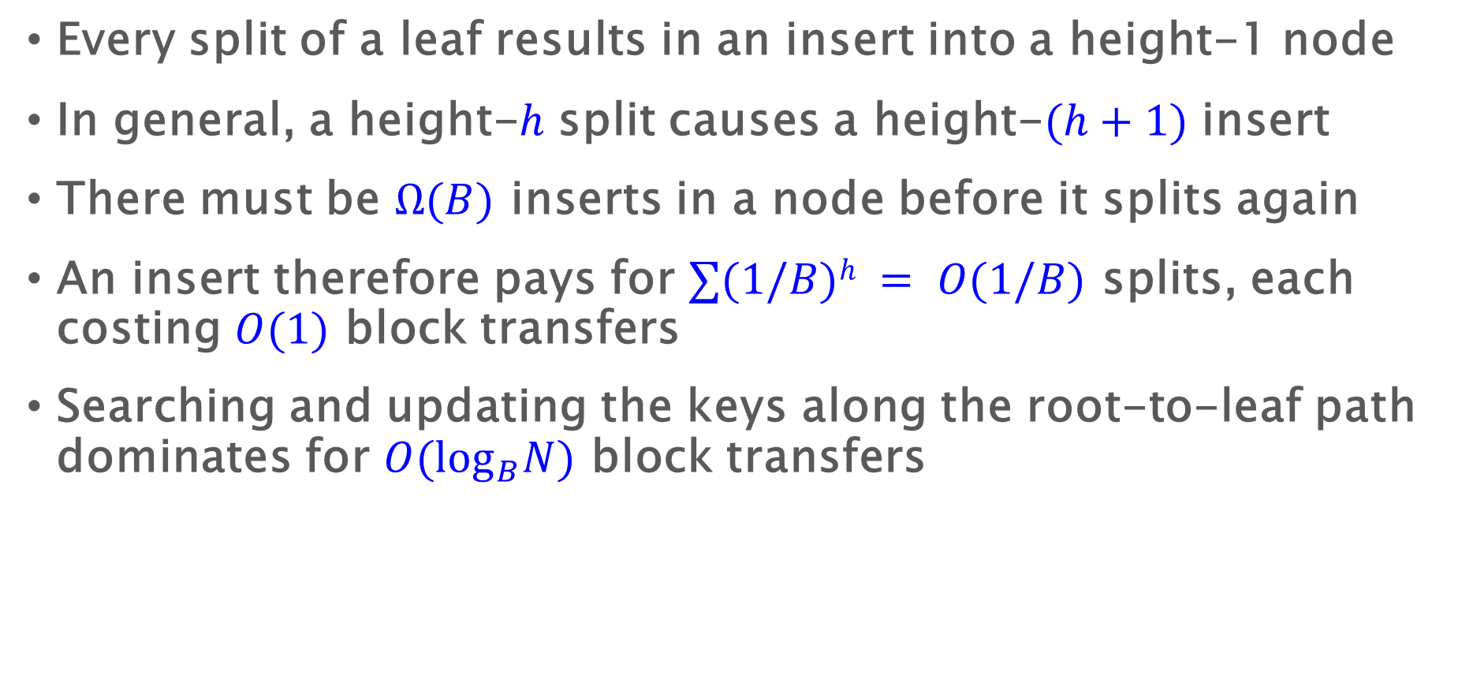
B-tree analysis - Insert (and delete)
Every split of a leaf results in an insert into a height-1 node
In general, a height-$h$ split causes a height-$(h+1)$ insert
There must be $Ω(B)$ inserts in a node before it splits again
An insert therefore pays for $∑(1/B)h = O(1/B)$ splits, each costing $O(1)$ block transfers
Searching and updating the keys along the root-to-leaf path dominates for $O(\log_{B}N)$ block transfers

Slide 43
I/O-efficient algorithms
Problem | RAM Algorithm | I/O algorithm
Sorting | $$O\left(n\log{n}\right)$$ | $$O\left(\frac{n}{B}\log_{\frac{M}{B}}{\frac{n}{B}}\right)$$
Matrix transpose | $$O\left(n^{2}\right)$$ | $$O\left(\frac{n^{2}}{B}\right)$$
Matrix multiplication | $$O\left(n^{3}\right)$$ | $$O\left(\frac{n^{3}}{B\sqrt{M}}\right)$$
Search | $$O(\log_{2}{n})$$ | $$O(\log_{B}{n})$$

Slide 44
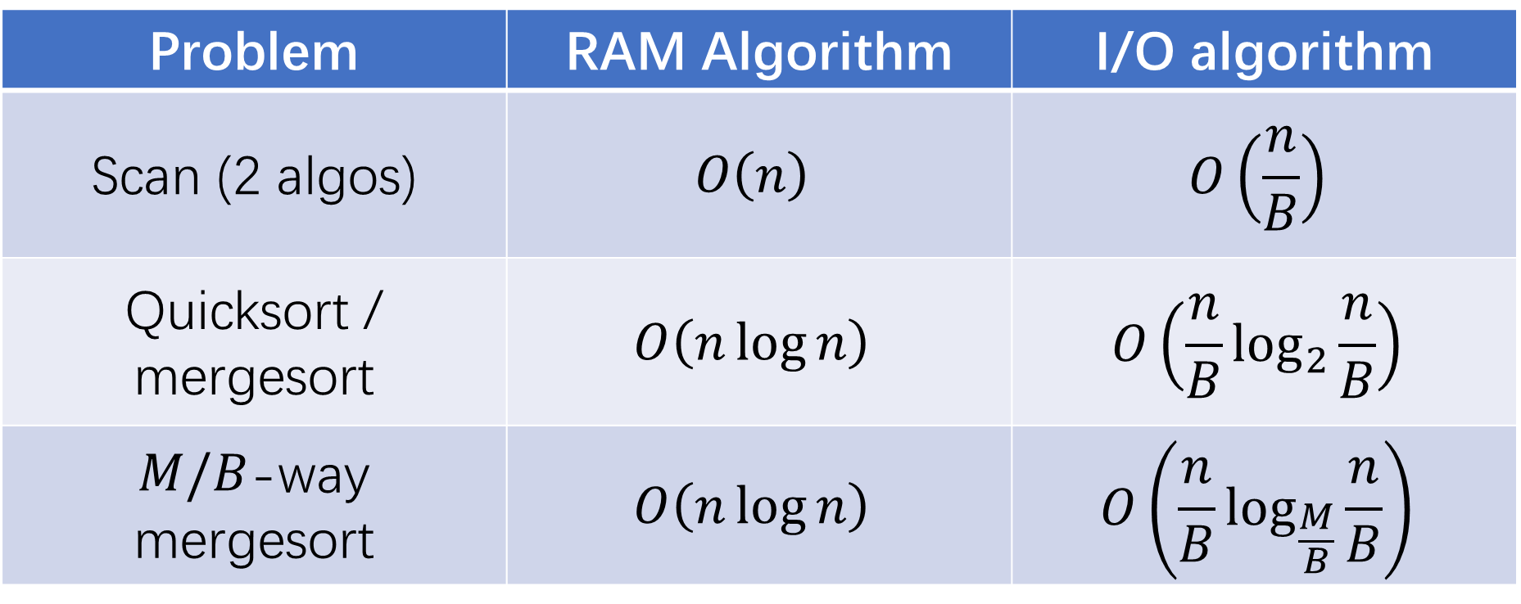
Previous parallel algorithms
Problem | RAM Algorithm | I/O algorithm
Scan (2 algos) | $$O\left(n\right)$$ | $$O\left(\frac{n}{B}\right)$$
Quicksort / mergesort | $$O\left(n\log{n}\right)$$ | $$O\left(\frac{n}{B}\log_{2}{\frac{n}{B}}\right)$$
$M/B$-way mergesort | $$O\left(n\log{n}\right)$$ | $$O\left(\frac{n}{B}\log_{\frac{M}{B}}{\frac{n}{B}}\right)$$

Slide 45
Summary

Slide 47


The I/O model
Two-level memory hierarchy:
A small memory (fast memory, cache) of fixed size $M$
A large memory (slow memory) of unbounded size
Both are partitioned into blocks of size $B$
Instructions can only apply to data in primary memory, and are free
Slow Memory
Fast Memory
CPU
$$M/B$$
$$B$$
Notes:
The External Memory model is usually used to measure the complexity of input and output, and assumes that a computer has a two-level memory hierarchy:
a small memory that has a fixed size 𝑀, and
An unbounded-size large memory
Both levels are partitioned into blocks of size 𝐵.
[click] The CPU can only freely access and process the data on fast memory.
Remember, any data access and computation is totally free if all the data are already in the fast memory.
To use the data on slow memory,

Slide 48
The I/O model
The I/O model has two special memory transfer instructions:
Read transfer: load a block from slow memory
Write transfer: write a block to slow memory
The complexity of an algorithm on the I/O model (I/O complexity) is measured by:
#(read transfers) + #(write transfers)
Slow Memory
Fast Memory
CPU
1
0
$$M/B$$
1
$$B$$
Notes:
There are two memory transfer instructions.
You can either read a block from the slow memory, or write a block to it.
To think about it, you can assume the fast memory to be the main memory and the slow memory to be the disk.
Disks are arranged with block size of several KB.
In another case, the fast memory can be the cache and the slow memory be the main memory.
In this case, the block size is the size of a cache line.
The complexity of an algorithm on the EM model (I/O complexity) is measured by the overall number of read transfers plus write transfers.
(In asymmetric setting, )
//, and once you want to do I/O from the disk, you either load a whole block from the disk to the main memory or write a whole block from the main memory

Slide 49
I/O-efficient algorithms
Problem | RAM Algorithm | I/O algorithm
Sorting | $$O\left(n\log{n}\right)$$ | $$O\left(\frac{n}{B}\log_{\frac{M}{B}}{\frac{n}{B}}\right)$$
Matrix transpose | $$O\left(n^{2}\right)$$ | $$O\left(\frac{n^{2}}{B}\right)$$
Matrix multiplication | $$O\left(n^{3}\right)$$ | $$O\left(\frac{n^{3}}{B\sqrt{M}}\right)$$
Search | $$O(\log_{2}{n})$$ | $$O(\log_{B}{n})$$

Slide 50
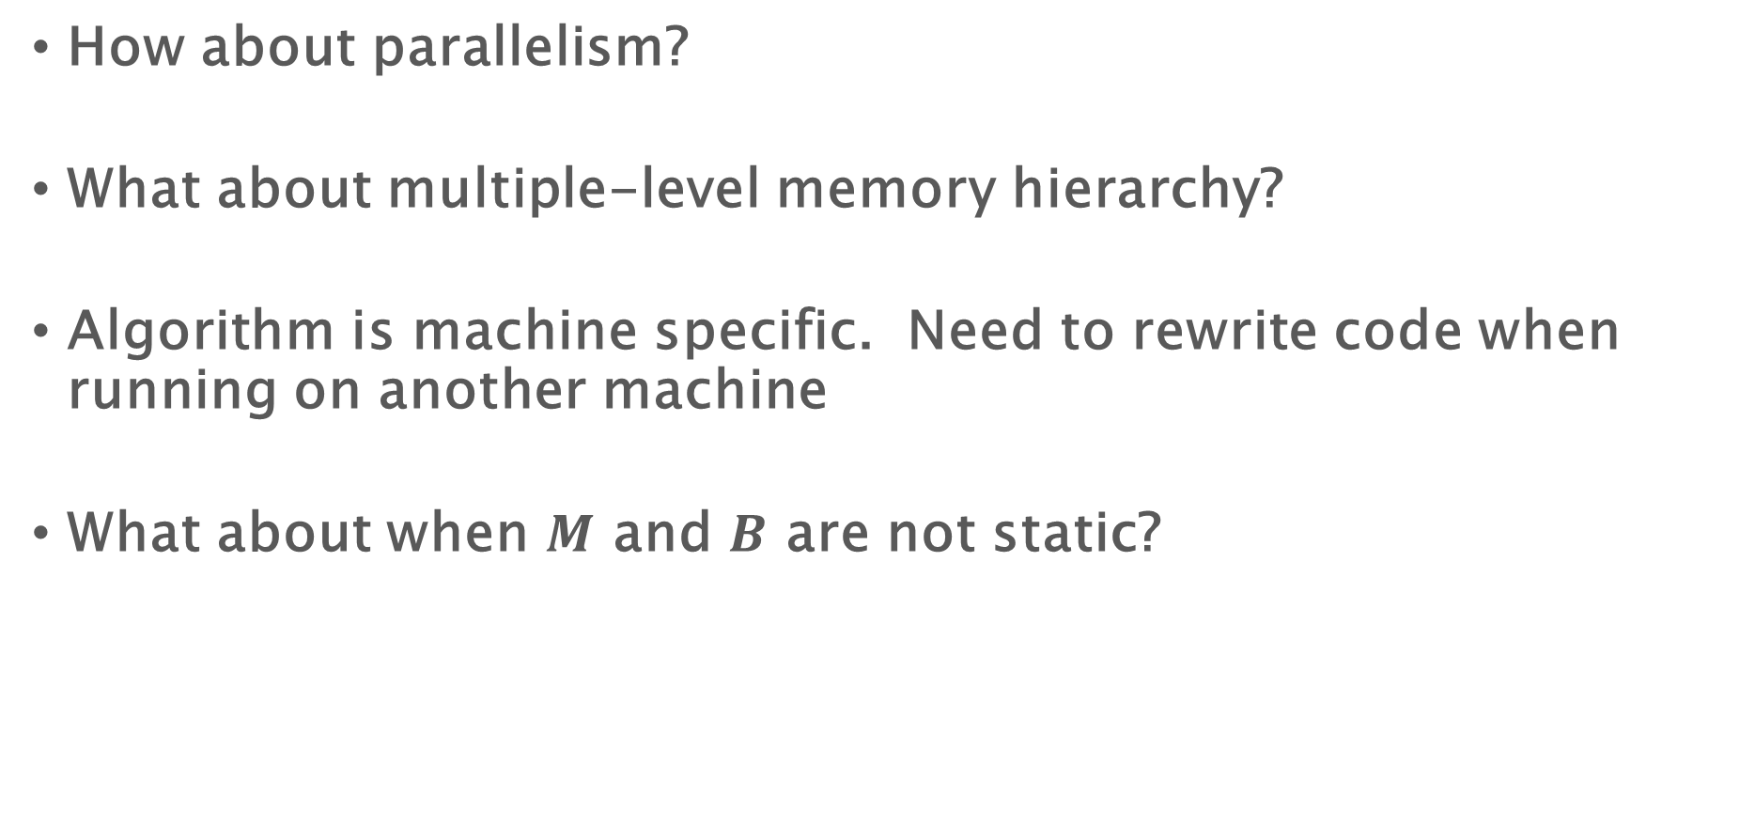
Not all…
How about parallelism?
What about multiple-level memory hierarchy?
Algorithm is machine specific. Need to rewrite code when running on another machine
What about when $M$ and $B$ are not static?

Slide 51
Course Project

Slide 52
Course Project
You can see the feedback online in ilearn
If there’s no feedback, it generally means that it’s a good topic to look at
For some of them if it’s too hard/too simple, I left my comments. You are encouraged to talk to me, or at least send me an email
Very interesting topics from many of you
But be aware of the time and plan ahead
Can lead to very interesting results and learn a lot during the process

Slide 53
Homework 3
Will be out tonight
Still due March 9
Two problems including a (long) programming problem
The instructions in HW3 may help you in your course project

Slide 54
Reserve the server
https://docs.google.com/spreadsheets/d/10SFx5MpHWlEeYsyExnkftLJMw1XS1nd7M2h-bAh6pa4/edit?usp=sharing
When you need final numbers, you can reserve a slot.
Write down your NetID in the corresponding slot.
Always check if anyone else has reserved the computer before you start running experiments on the machine.
If you are not reserving, it means that you don't mind others using the machine at the same time.
Generally be mindful that almost everyone in the class are using this machine, and do not reserve it for longer than you need
Reserve the machine at least 2 hours in advance
Reserve the machine if you will use for more than 15 minutes
Don't reserve for just debugging. Try to debug locally or with allowing others for using the machine
Don't reserve more than 2 hours at a time
Coordinate with each other - you will know each other's NetID by the spreadsheet, or using "top"

