Slide 1
Discussion Class (Dynamic Programming)
CS 141

Slide 2
Smartest Student
N students
T seats in the plane
Maximum cumulative weight of students, W
Task: Maximize the total smartness on the plane

Slide 3
Bad Ideas
Run 0/1 knapsack on N students
  Sort students based on smartness
  Sort students based on weight
Sorting would have helped if this was a greedy algorithm

Slide 4
How to do memorization
Problem statement already helps with the approach
i = list of student in the class
j = number of student in the plane
k = cumulative weight of the selected students
We want to find/store the optimal smartness for a given (i, j, k)

Slide 5
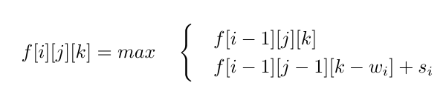
Recursion

Slide 6
Base Cases
0 <= i <= N
0 <= j <= T
0 <= j <= i
k <= w_1 + w_2 + …. w_i
If i =0 or j = 0 or k = 0, f[i][j][k] = 0

Slide 7
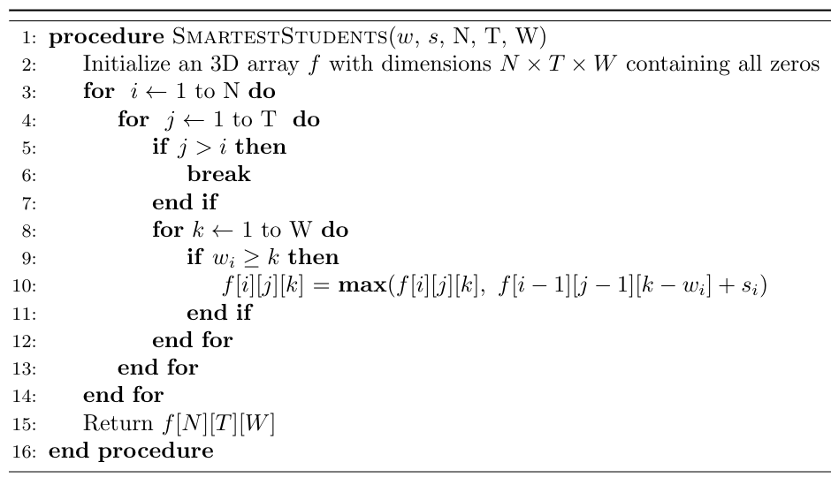
Algorithm

Slide 8
Morse COde
Given,
Morse code string
Value array containing the value of all the chars
Maximize the total value of the interpretation of the given string

Slide 9
Morse Code
Given hint is to use f[i] to denote the highest value using first i elements in X
For position i, we will use Check function to check last few chars
  If there is a matching char, we use the value of the char to maximize the current position

Slide 10
Check Function
check(X, i, j, c)
X is the Morse string
i,j are index in string
Char c
Function return true if substring X[i,j] is the Morse code of the char C

Slide 11
Recursion Step
Say for position i, char j
  len(j) is the length of the char j
if check(X, i-len(j), i, j) is true, we would use the value from f[i – len(j)]
  f[i] = max (f[i] , f[i – len(j)] + v[j])

Slide 12
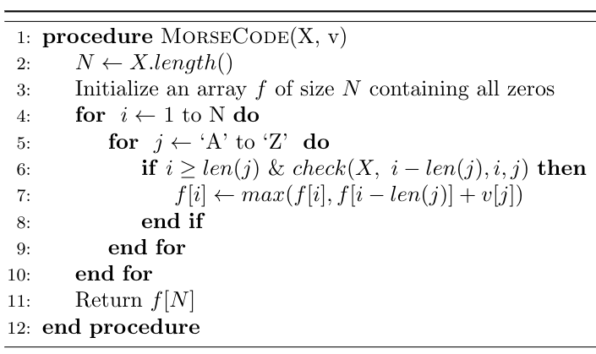
Algorithm

