Slide 1
CS141 WEEK 4: DISCUSSION
GREEDY ALGORITHMS

Slide 2
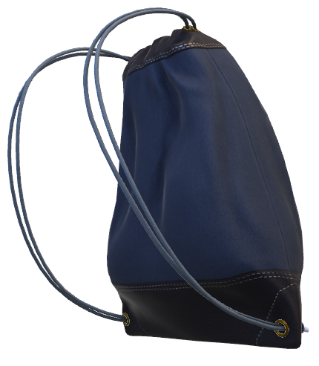

Help the Thief
Vibranium: 2 lbs Price: $50K/lbs
Gold: 5 lbs
Price: $10K/lbs
Capacity: 10lbs
Goal is to steal as much as you can.
All the metals are in powder/dust.
Silver: 8 lbs Price: $8K/lbs

Slide 3
Greedy Method
Applied to optimization problems
Adds items to the solution one-by-one
  e.g.: Adding one metal at a time to solution
Always choose the current best solution
  e.g.: Pick the metal with the highest value/weight ratio
No backtracking
Not necessarily optimal
Need to prove the optimality

Slide 4
Prove the optimality of greedy Algorithm
Greedy choice: The greedy choice is made every step
Optimal Substructure: Optimal solution to the big problem contains the optimal solution to the sub-problem
  After making the first choice
    The final best solution = first choice + best solution for the rest of the input
    We can solve the same optimization problem recursively

Slide 5
Help the Thief: Solution
Limited space or capacity and need to maximize value
Should consider value per unit of space
Solution:
  Calculate the value/unit of space
  Fill the knapsack with the all or maximum space
  left in knapsack with the most valued item
  Repeat Step 2 unit until bag is full or no items are left
2lbs of Vibranium Space left: 8lbs Current Value: $100k
5lbs of Gold Space left: 3lbs Current Value: $150k
3lbs of Silver Space left: 0lbs Current Value: $174k
Vibranium: 2 lbs Price: $50K/lbs
Gold: 5 lbs
Price: $10K/lbs
Silver: 8 lbs Price: $8K/lbs
Capacity: 10lbs
Goal is to steal as much as you can.
All the metals are in powder/dust.

Slide 6
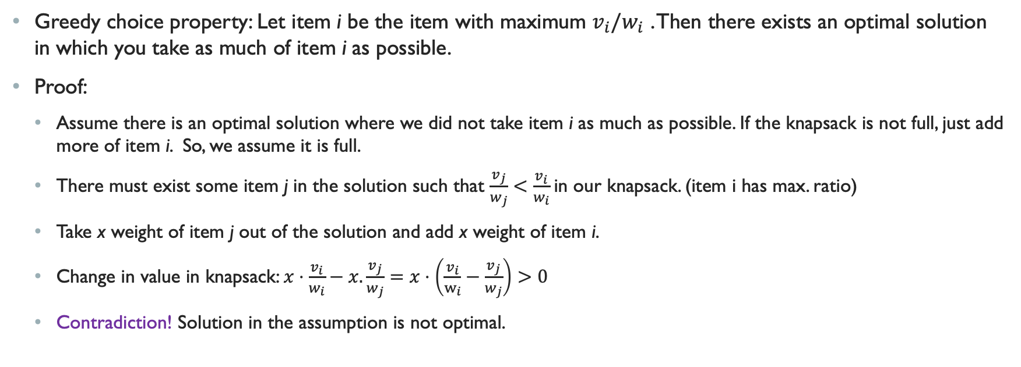
FRACTIONAL KNAPSACK: GREEDY choice property
Greedy choice property: Let item i be the item with maximum $v_{i}/w_{i}$ . Then there exists an optimal solution in which you take as much of item i as possible.
Proof:
  Assume there is an optimal solution where we did not take item i as much as possible. If the knapsack is not full, just add more of item i. So, we assume it is full.
  There must exist some item j in the solution such that $\frac{v_{j}}{w_{j}}<\frac{v_{i}}{w_{i}}$in our knapsack. (item i has max. ratio)
  Take x weight of item j out of the solution and add x weight of item i.
  Change in value in knapsack: $x⋅\frac{v_{i}}{w_{i}}−x.\frac{v_{j}}{w_{j}}=x⋅\left(\frac{v_{i}}{w_{i}}−\frac{v_{j}}{w_{j}}\right)>0$
  Contradiction! Solution in the assumption is not optimal.

Slide 7
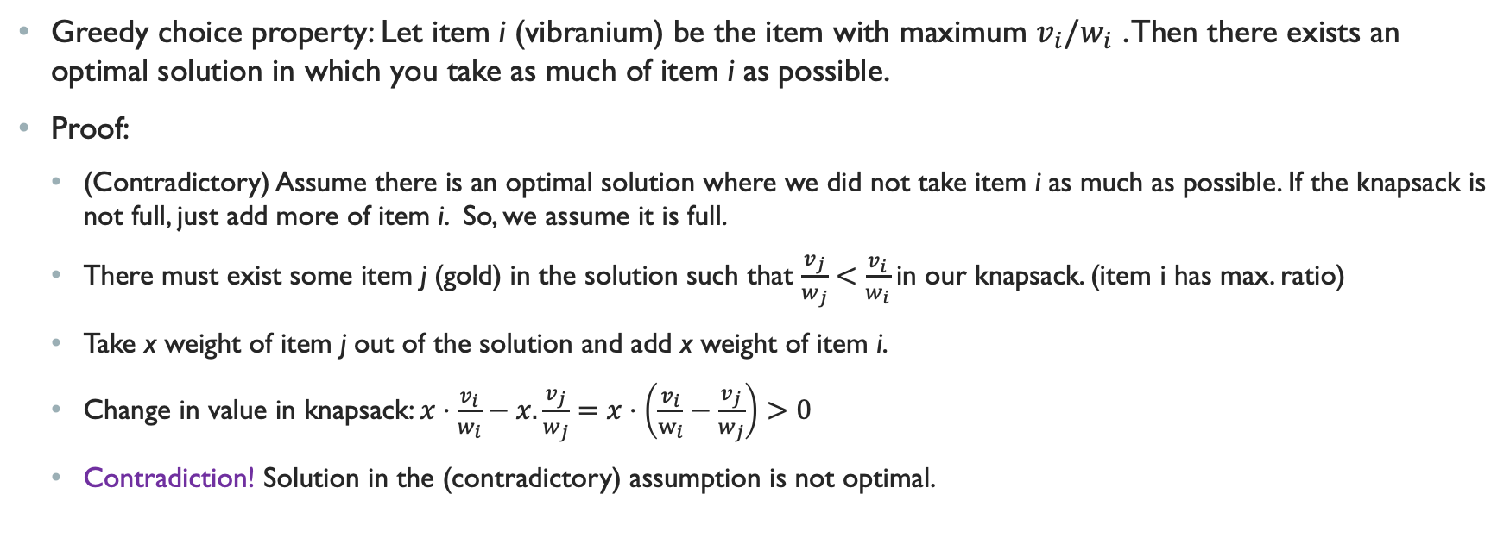
FRACTIONAL KNAPSACK: GREEDY choice property
Greedy choice property: Let item i (vibranium) be the item with maximum $v_{i}/w_{i}$ . Then there exists an optimal solution in which you take as much of item i as possible.
Proof:
  (Contradictory) Assume there is an optimal solution where we did not take item i as much as possible. If the knapsack is not full, just add more of item i. So, we assume it is full.
  There must exist some item j (gold) in the solution such that $\frac{v_{j}}{w_{j}}<\frac{v_{i}}{w_{i}}$in our knapsack. (item i has max. ratio)
  Take x weight of item j out of the solution and add x weight of item i.
  Change in value in knapsack: $x⋅\frac{v_{i}}{w_{i}}−x.\frac{v_{j}}{w_{j}}=x⋅\left(\frac{v_{i}}{w_{i}}−\frac{v_{j}}{w_{j}}\right)>0$
  Contradiction! Solution in the (contradictory) assumption is not optimal.

Slide 8
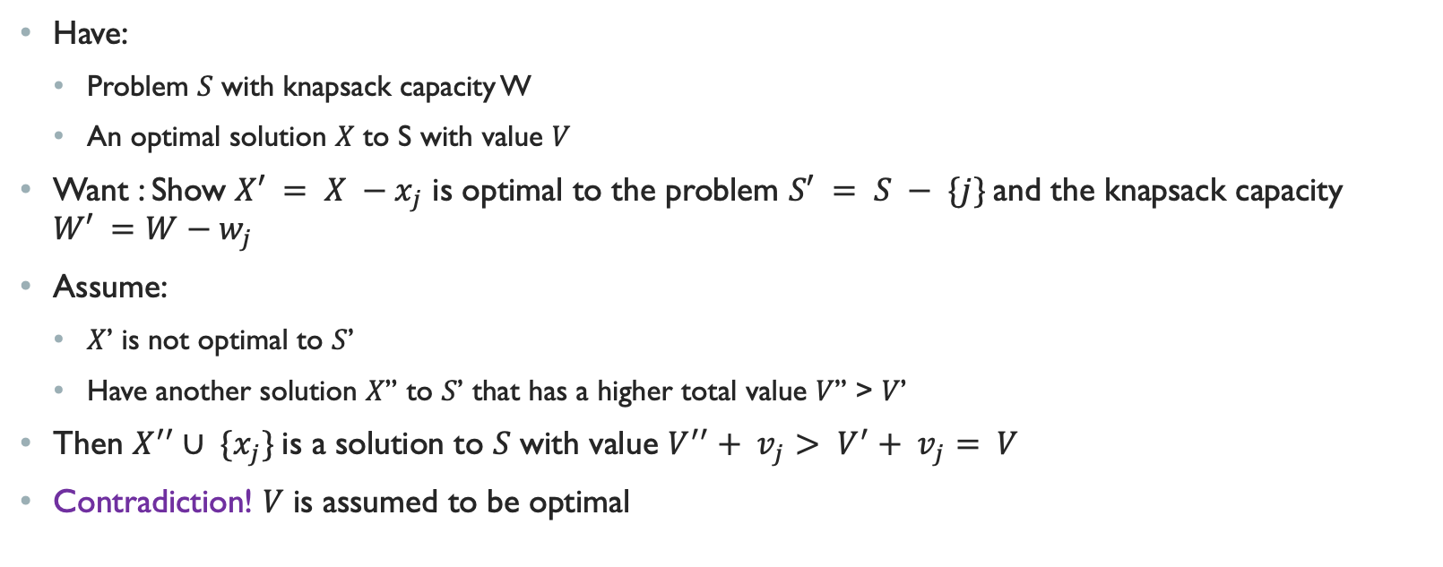
FRACTIONAL KNAPSACK: OPTIMAL SUBSTRUCTURE
Have:
  Problem 𝑆 with knapsack capacity W
  An optimal solution 𝑋 to S with value 𝑉
Want : Show $X′ = X −x_{j}$ is optimal to the problem $S′ = S − \{j\}$and the knapsack capacity $W′ =W−w_{j}$
Assume:
  𝑋’ is not optimal to 𝑆’
  Have another solution 𝑋’’ to 𝑆’ that has a higher total value 𝑉’’ > 𝑉’
Then $X^{′′}∪ \{x_{j}\}$is a solution to 𝑆 with value $V^{′′}+ v_{j}> V^{′}+ v_{j}= V$
Contradiction! 𝑉 is assumed to be optimal

Slide 9
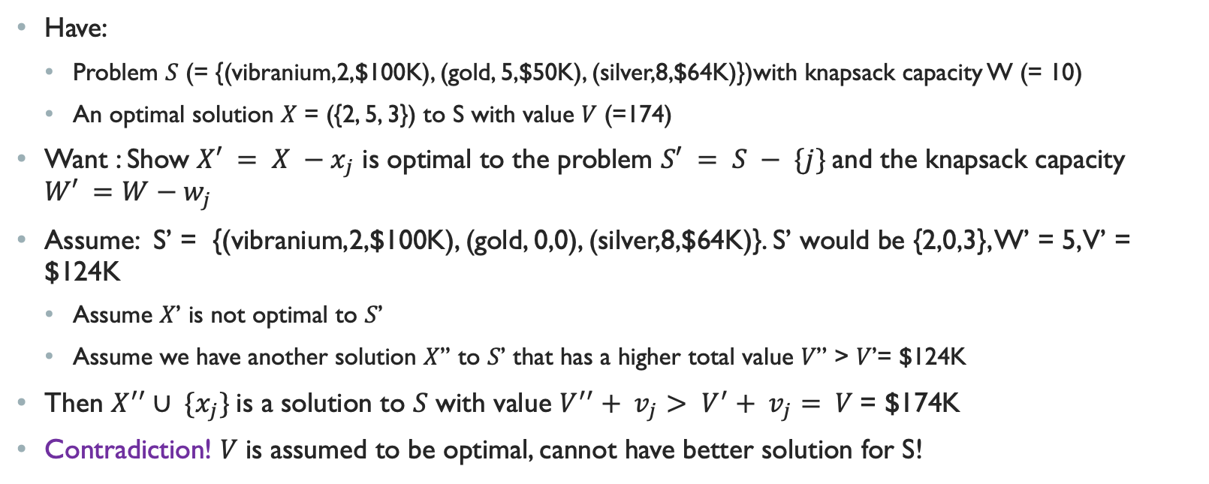
FRACTIONAL KNAPSACK: OPTIMAL SUBSTRUCTURE
Have:
  Problem 𝑆 (= {(vibranium,2,$100K), (gold, 5,$50K), (silver,8,$64K)})with knapsack capacity W (= 10)
  An optimal solution 𝑋 = ({2, 5, 3}) to S with value 𝑉 (=174)
Want : Show $X′ = X −x_{j}$ is optimal to the problem $S′ = S − \{j\}$and the knapsack capacity $W′ =W−w_{j}$
Assume: S’ = {(vibranium,2,$100K), (gold, 0,0), (silver,8,$64K)}. S’ would be {2,0,3}, W’ = 5, V’ = $124K
  Assume 𝑋’ is not optimal to 𝑆’
  Assume we have another solution 𝑋’’ to 𝑆’ that has a higher total value 𝑉’’ > 𝑉’= $124K
Then $X^{′′}∪ \{x_{j}\}$is a solution to 𝑆 with value $V^{′′}+ v_{j}> V^{′}+ v_{j}= V$= $174K
Contradiction! 𝑉 is assumed to be optimal, cannot have better solution for S!

Slide 10
Help the Thief (Again?!?)
Vibranium
2 bars of 1lb each
Price: $50K/lbs
There are items are not in powder/dust
Need to take an item as a whole or not
This is known as 1/0 knapsack
Gold:
1 bar of 5 lbs
Price: $10K/lbs
Silver:
2 bar of 4 lbs each Price: $8K/lbs

Slide 11

Help the Thief (Again?!?)
Let’s use the old method
2 -1 lb Vibranium Space left: 8lbs, Current Value: $100k
1 -5 lb Gold Space left: 3lbs, Current Value: $150k
Can’t fit anything else
What about this plan?
2 -1 lb Vibranium Space left: 8lbs, Current Value: $100k
2 -4 lbs Silver Space left: 0lbs, Current Value: $164k
Optimal Substructure? IF we can find an optimal solution for problem S, then that solution contains solution to subproblems of S
Greedy Choice? NO!!!
Vibranium
2 bars of 1lb each
Price: $50K/lbs
Gold:
1 bar of 5 lbs
Price: $10K/lbs
Silver:
2 bar of 4 lbs each Price: $8K/lbs

Slide 12
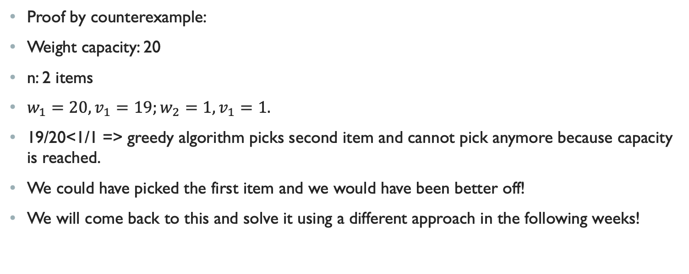
0-1 KNAPSACK: NOT GREEDY!
Proof by counterexample:
Weight capacity: 20
n: 2 items
$w_{1}=20, v_{1}=19;w_{2}=1,v_{1}=1.$
19/20<1/1 => greedy algorithm picks second item and cannot pick anymore because capacity is reached.
We could have picked the first item and we would have been better off!
We will come back to this and solve it using a different approach in the following weeks!

Slide 13
HUFFMAN Codes
Input
Output
Takes input a set of characters along with their frequencies
Outputs variable-length encoding for each character
Prefix free: No encoding of two different characters is the prefix of the other
  Uniquely decodable
Optimal: Gives the shortest possible encoding for a given character-occurrence set
Used in lossless data compression
Taken from: https://en.wikipedia.org/wiki/Huffman_coding

Slide 14
HUFFMAN CODES: EXAMPLE
A:9
B:21
E:13
K:4
L:5
M:15
S:2
CHARACTER | # OCCURENCE
A | 9
B | 21
E | 13
K | 4
L | 5
M | 15
S | 2
6
1.
S:2
K:4

Slide 15
HUFFMAN CODES: EXAMPLE
A:9
B:21
E:13
K:4
L:5
M:15
S:2
CHARACTER | # OCCURENCE
A | 9
B | 21
E | 13
K | 4
L | 5
M | 15
S | 2
2.
11
L:5
6
S:2
K:4

Slide 16
HUFFMAN CODES: EXAMPLE
A:9
B:21
E:13
K:4
L:5
M:15
S:2
CHARACTER | # OCCURENCE
A | 9
B | 21
E | 13
K | 4
L | 5
M | 15
S | 2
20
3.
A:9
11
L:5
6
S:2
K:4

Slide 17
HUFFMAN CODES: EXAMPLE
A:9
B:21
E:13
K:4
L:5
M:15
S:2
CHARACTER | # OCCURENCE
A | 9
B | 21
E | 13
K | 4
L | 5
M | 15
S | 2
28
4.
E:13
M:15
20
A:9
11
L:5
6
S:2
K:4

Slide 18
HUFFMAN CODES: EXAMPLE
A:9
B:21
E:13
K:4
L:5
M:15
S:2
CHARACTER | # OCCURENCE
A | 9
B | 21
E | 13
K | 4
L | 5
M | 15
S | 2
28
41
5.
E:13
M:15
20
B:21
A:9
11
L:5
6
S:2
K:4

Slide 19
HUFFMAN CODES: EXAMPLE
A:9
B:21
E:13
K:4
L:5
M:15
S:2
CHARACTER | # OCCURENCE
A | 9
B | 21
E | 13
K | 4
L | 5
M | 15
S | 2
69
28
41
6.
E:13
M:15
20
B:21
A:9
11
L:5
6
S:2
K:4

Slide 20
HUFFMAN CODES: EXAMPLE
A:9
B:21
E:13
K:4
L:5
M:15
S:2
CHARACTER | # OCCURENCE
A | 9
B | 21
E | 13
K | 4
L | 5
M | 15
S | 2
69
28
41
7.
E:13
M:15
20
B:21
A:9
11
L:5
6
S:2
K:4

Slide 21
HUFFMAN CODES: EXAMPLE
69
1
0
CHARACTER | # OCCURENCE | ENCODING
A | 9 | 100
B | 21 | 11
E | 13 | 00
K | 4 | 10111
L | 5 | 1010
M | 15 | 01
S | 2 | 10110
28
41
0
0
1
1
E:13
M:15
20
B:21
0
1
A:9
11
0
1
L:5
6
0
1
S:2
K:4

Slide 22
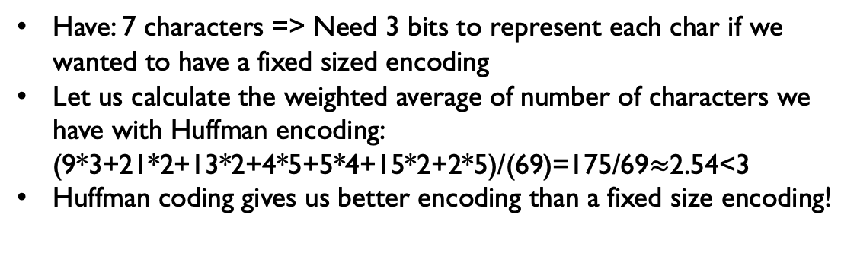
HUFFMAN CODES are optimal!
Have: 7 characters => Need 3 bits to represent each char if we wanted to have a fixed sized encoding
Let us calculate the weighted average of number of characters we have with Huffman encoding: (9*3+21*2+13*2+4*5+5*4+15*2+2*5)/(69)=175/69$≈$2.54<3
Huffman coding gives us better encoding than a fixed size encoding!
CHARACTER | # OCCURENCE | ENCODING
A | 9 | 100
B | 21 | 11
E | 13 | 00
K | 4 | 10111
L | 5 | 1010
M | 15 | 01
S | 2 | 10110

Slide 23
ANY QUESTIONS?

