Slide 1
Embedding-Based Placement of Processing element Networks on FPGAs for Physical Model Simulation
Bailey Miller*, Frank Vahid*, Tony Givargis**
*Univ. of California, Riverside
**Univ. of California, Irvine
Intern at SpaceX
Supported by the NSF (CNS1016792, CPS1136146), and Semiconductor Research Corporation (GRC 2143.001)

Slide 2
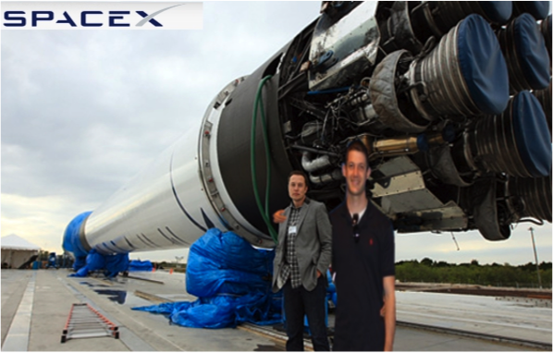

Slide 3
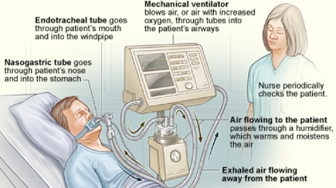
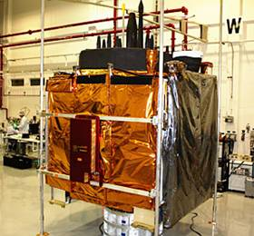
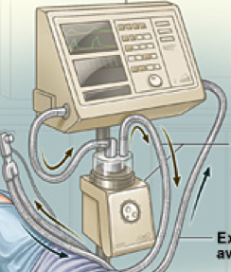

Models of physical world that run in real-time
Test cyber-physical systems
http://www.nhlbi.nih.gov/
Transducer
models
Environment
model
Physical mockup
Digital mockup

Slide 4
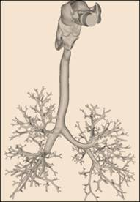
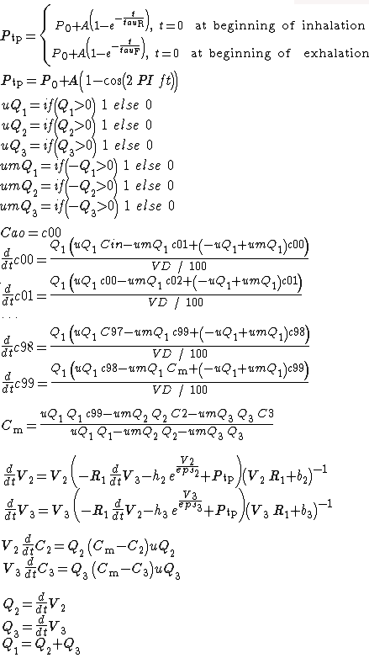
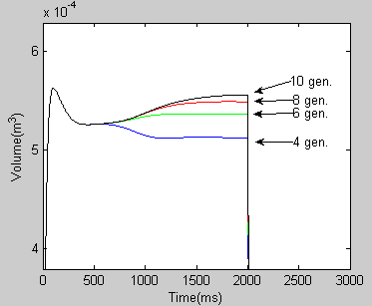
Issue: Real-time achieved via inaccuracy
V[1],R[1]
“2-3 minutes to simulate one breath accurately”
V[2],R[2]
V[7],R[7]
Weibel lung complexity
4 gen: 32 ODEs
6 gen: 128 ODEs
8 gen: 512 ODEs
10 gen: 2048 ODEs

Slide 5
Earlier results
1490
1522
1430
1184
PC(1)
PC(4)
1000
GPU
900
HLS / FPGAs
800
700
600
500
Performance (ms)
400
300
Speedup vs real-time
PC(1): 0.8x
PC(4): 3.1x
GPU: 1.6x
HLS/FPGA: 3.2x
200
100
0
Weibel
Neuron
Weibel + gas
Hemodynamic
Weibel + hemo
Parallel computations +
Neighbor communication
→ Seem like great match for FPGAs
Frank Vahid, UCR 5

Slide 6
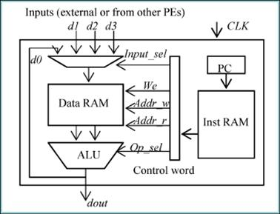
Network of synchronized PEs on FPGAs
PE
General Processing Element
Iterative ODE solver (Euler/RK4)
0.1 ms / 0.01 ms timestep
1 PE: 300 MHz
FPGA
Digital mockup
PE
PE

Slide 7
Earlier results
1490
1522
PC(1)
1430
PC(4)
GPU
HLS
1184
General PEs
1000
900
800
Speedup vs real-time
PC(1): 0.8x
PC(4): 3.1x
GPU: 1.6x
HLS: 3.2x
General PE: 4.9x
700
600
Performance (ms)
500
400
300
200
100
0
Weibel
Neuron
Weibel + gas
Hemodynamic
weibel + hemo

Slide 8
Current work
Problem: More PEs → Lower frequency
Lost ODEs/sec due to freq drop
Real ODEs/sec
11-gen Weibel model, Virtex6 240T FPGA, general PEs
FPGA
FPGA
DSP
INST
MEM
DATA
MEM
Inter-PE critical path
Internal PE critical path
Notes:
The bottom-left figure shows how place and route does increasingly more poor at meeting timing constraints for larger PE networks.
The bottom-right figure shows:
BLUE: The actual ODEs/sec throughput for the implementations of the design points in the bottom left figure.
RED: The ODEs/sec throughput that was lost because place/route introduced critical paths into the design.
BLUE+RED: The total theoretical ODEs/sec throughput that would be possible if the frequency wasn’t impacted by place/route (Assuming 1 PE on Xilinx Virtex6 can run no faster than 300MHz)

Slide 9
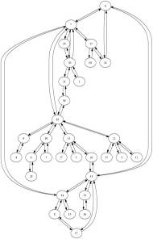
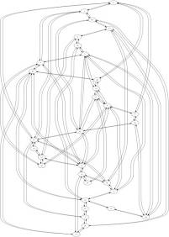
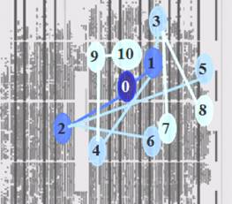
Earlier approach
Phase
10K iterations
Maps ODEs to virtual PEs using simulated annealing
150K iterations
1
2
Convert virtual PEs to physical circuits using FPGA place-route

Slide 10
This work: Main idea
Use physical model structure to avoid using FPGA placement (Phase 2)
Graph embedding: Map guest graph to host graph, minim. max wire length
Guest
Virtual PEs
FPGA
Host
Physical PEs

Slide 11
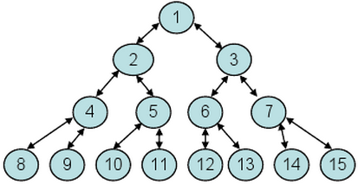
Phase 2 – Map virtual PEs to physical PEs
Guest
…
Embedding algorithm
H-tree embedding
Linear embedding
Direct map embedding
FPGA
FPGA
FPGA
Host
2
1
3
Frank Vahid, UCR 11
[1] Zienicke, P. 1990. Embeddings of Treelike Graphs into 2-Dimensional Meshes. (WG '90).
[2] Aleliunas, R., and Rosenberg, A.L. 1982. On Embedding Rectangular Grids in Square Grids. (Computers ‘82).
[3] Berman, F., and Snyder, L. 1987. On mapping parallel algorithms into parallel architectures, (PDC, ‘87).

Slide 12
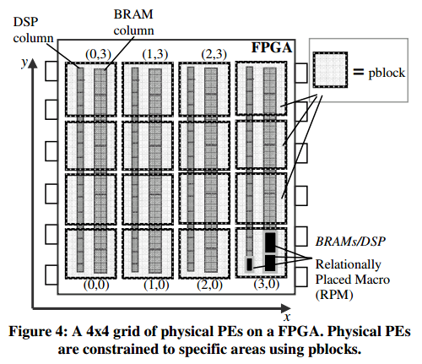
2D grid of physical PEs
Bypass FPGA placement
FPGA
EqP1
EqV1
EqP4
EqV4
EqP6
EqV6
(Phase 1: May require "graph folding" first to reduce #PEs)
EqP2
EqV2
EqP3 EqV3
EqP2
EqV2
EqP1
EqV1
EqP2
EqV2
EqP4
EqV4
EqP5
EqV5
EqP6
EqV6
EqP7
EqV7
EqP5
EqV5
EqP7
EqV7

Slide 13
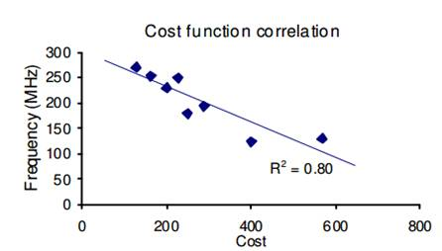
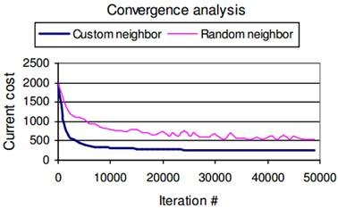
Compare/backup: Simulated annealing
Cost function:
C = w1*sum + w2*max + w3*gaps
Sum = sum of wire distances
Max = max wire length (Euclidean dist.)
Gaps = wires across architectural features
Neighbor function:
Swap PEs based on distance to neighbors
FPGA
FPGA
P2
P1
P1
Notes:
This slide details the custom cost and neighbor functions for the SA approach.
The top right correlation plot just shows that higher cost = lower frequency.
The bottom right graph shows that our custom neighbor is better than random swapping.
The neighbor function algorithm goes like this:
1. Select a random pe (P1)
2. Average the edges connected to P1 to find an area in the grid that places P1 as close as possible to P1’s neighbors (Circled Region)
3. Average the edges of all pes in Circled Region. Select the pe (P2) from Circled Region that has neighbors closest to P1.
4. Swap P1 with P2

Slide 14
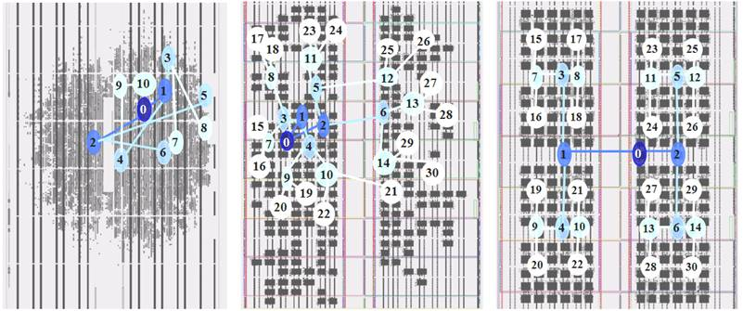
Results
4 generations shown
5 generations shown
5 generations shown
Simulated annealing placement
No placement strategy
Embedding placement
Notes:
Xilinx tools must trade off between area/power. With no extra placement constraints, place/route creates a more dense design optimized for power. With placement constraints, place/route can’t optimize for power as well, since we have forced the tool to spread the design out and use more space in the chip (same # of LUTS, just spread out more).

Slide 15
Results
Not routable
2D Neuron model - 256PE – Xilinx Virtex6
Strategy | # LUTS | # BRAM | #DSP | Equivalent LUTs
None | 58362 | 512 | 256 | 306682
SA | 58567 | 512 | 256 | 306887
Embed | 58569 | 512 | 256 | 306889
Strategy | Total power (mW) | Dynamic power (mW) | Static power (mW)
None | 15525 | 8744 | 6481
SA | 16604 | 10013 | 6590
Embed | 19859 | 12999 | 6859
No impact on size
20% more power
Using Xilinx XPower Analyzer

Slide 16


Results/Conclusions
Graph emb. gives additional speedup
  FPGAs: Fastest cost-effective execution of physical models
  http://www.youtube.com/watch?v=ThUKVhqoA3Q
Future
  Manycore device
  Beyond testing CPS
    Implement end-products
Speedup vs real-time (avg)
PC(1): 0.8x
PC(4): 3.1x
GPU: 1.6x
HLS: 3.2x
General PE: 4.9x
Grph emb(GPE): 11.2x
Custom PE: 6.1x
Heterog PE: 34.5x
(Grph emb(HPE): 48.5x)
Speedup / dollar
Heterog PE
3.0x better than PC(4)
4.5x better than GPU
CPU (I7-950 + Intel X58 board): $480
GPU(GTX460 + I3-540 + H55 board): $380
FPGA (Xilinx Virtex6 240T-2 board): $1800
http://www.meti.com/

Slide 17
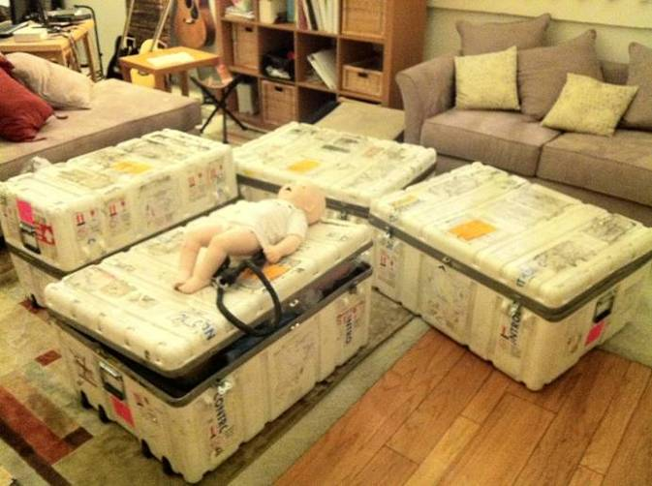
Questions?
Frank Vahid, UCR 17

