Slide 1
PatentsSearcher: A Novel Portal to Search and Explore Patents
Vagelis Hristidis, Florida International University, Miami
Eduardo Ruiz, Florida International University , Miami
Alejandro Hernández, Florida International University , Miami
Fernando Farfán, University of Michigan, Ann Arbor
Ramakrishna Varadarajan, University of Wisconsin, Madison

Slide 2
Key factors in patents search system
Coverage: what patent and non-patent (e.g., legal state information) databases are included, from what countries or unions, and how up-to-date the data is.
Discovery and ranking: how well does the system locate relevant patents or applications, and how these are ranked.
Other features and analytics: For instance, Delphion provides an interface to visually view the references among the patents of a result, or cluster the patents.

Slide 3
Ranking in Existing Patents Search Systems
By Date (USPTO)
Traditional IR: tf-idf
Latent Semantic Analysis
  Limitation: View patent as a generic document. Special properties of patents collection not fully exploited

Slide 4
Special Properties of Patents
Organized into classes and subclasses.
Have links to other patents and external publications.
Organized into various sections (abstract, claims, description and images).
Use specific legal wording in the claims section. Patent claims have references to other claims, that is, claims can be viewed as a graph.

Slide 5
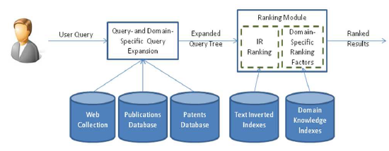
Discovery and Ranking in PatentsSearcher – Query Module

Slide 6
Query- and Domain-Specific Query Expansion Module
Inputs list of keywords
Outputs set of synonymous or tightly relevant keywords or phrases
E.g., query {web ranking} is expanded as {(web, 1.0), (ranking, 1.0), (documents, 0.3), (pages, 0.25), (search,0.22)}.
For each relevant word, a weight is assigned denoting its semantic distance to the source keyword, for the specific query.
Query Context is defined using
  Result patents
  relevant publications
  Web documents
Use adaptation of Rocchio work on pseudo-relevance feedback.

Slide 7
Domain-specific Ranking Factors Module
Patents are organized into classes and subclasses: Increased relevance to patents of same class. If a class has many results then it becomes important for query and its patents may be more relevant.
Patents have links to external publication and to other patents: A patent with many query-specific citations is better than a patent with few citations.
Patents organized into various sections (abstract, claims, description and images): A word in abstract better than in description
Patents use specific legal wording in the claims section. Claims can be viewed as a graph: If two query words appear in two linked claims is better than if they appear on two disconnected claims.

Slide 8
Other Features of PatentsSearcher

Slide 9
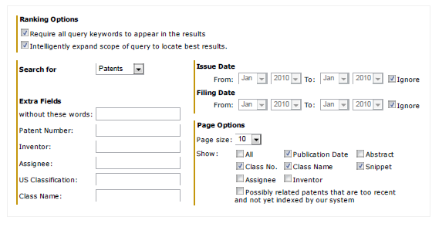
Advanced Query Interface
In addition to patents, user may search for the most relevant Classes, Assignees or Inventors
Capability to view very recent, un-indexed patents or applications

Slide 10
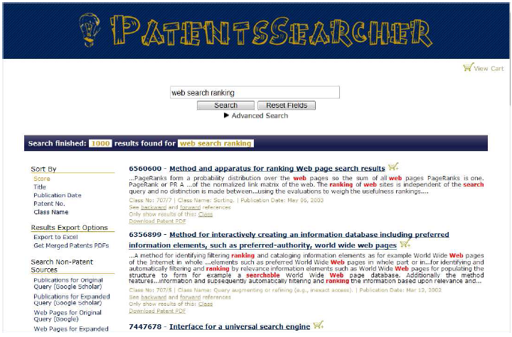
Results Presentation and Navigation
Re-sort results by Date, Title, and so on
Filter results by class, assignee, and inventor
Export results to Excel, PDF, or concatenated PDF
Preview first three pages of patent as tooltip (beta testing phase)

Slide 11
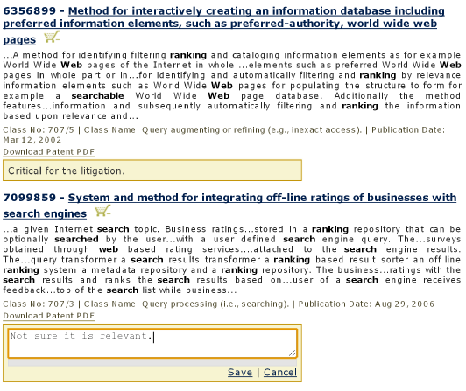
Patent Cart
A patent added to the cart by clicking the shopping cart icon next to it.
User can then add some notes for each item in cart
Export the information in the cart in Excel or PDF format.

Slide 12
Thank you!
NSF IIS-0811922
Kauffman Foundation for Entrepreneurship

Slide 13
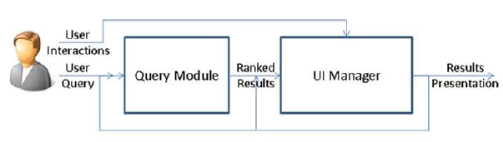
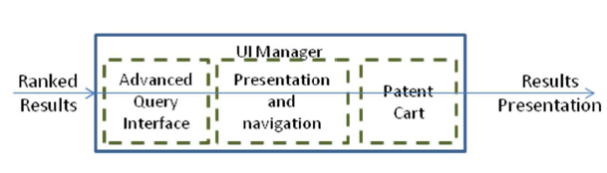
Overall PatentsSearcher Architecture

