Slide 1
An Access Cost-Aware Approach for Object Retrieval over Multiple Sources
Benjamin Arai, UC Riverside
Gautam Das, UT Arlington
Dimitrios Gunopulos, U of Athens
Vagelis Hristidis, Florida International U
Nick Koudas, U of Toronto

Slide 2
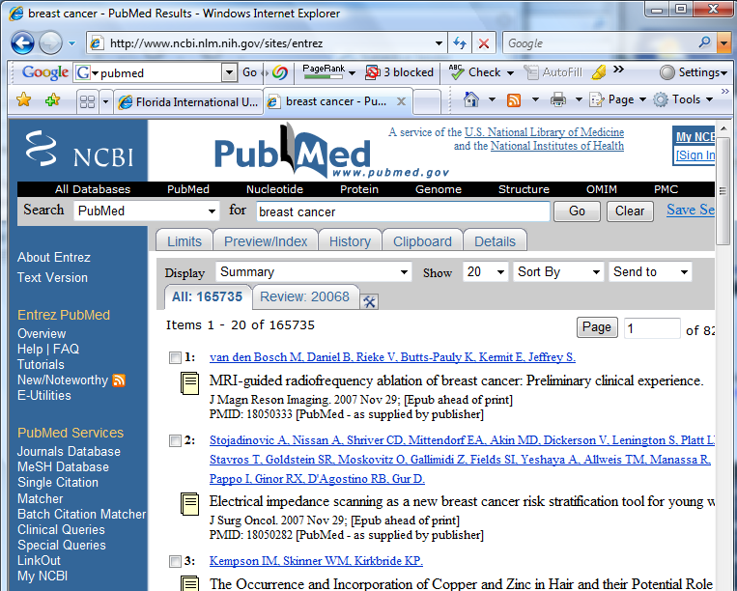
Motivating Example – Single-source Optimal Access Strategy
PubMed Dataset – 17 million publications
User searches papers that mention “cancer” and also cite a paper that contains the phrase “genetic propensity” in its title.
Not supported by advanced search interface.
User looking for 5 satisfying papers, given that “cancer” returns more than two million papers.
What is best retrieval strategy?

Slide 3
Motivating Example – Multi-source Optimal Access Strategy
Commercial legal research sources (e.g., LexisNexis, Westlaw) offer pay-per-search data services.
Each source has distinct access cost (e.g., latency, per-object monetary cost)
Their public interfaces allow conditions like filing date range, but not keyword.
User looking for 5 cases including “civil” and “riverside”.
What is best retrieval strategy?

Slide 4
Challenges
Source selection: which source(s) to retrieve objects from.
Object selection. how many objects to retrieve from each selected source.
Cost may be in the form of money, bandwidth, etc.
Looking for any-k satisfying objects; don’t care about ranking.

Slide 5
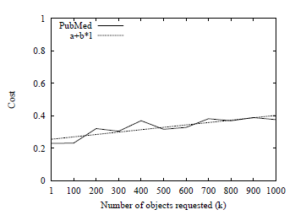
Source Access Cost Model
We assume each source has a cost function, monotonic on # items l retrieved.
Well accepted cost model:
fixed per-access overhead a
Per-item cost b
Cost_{i}(l) = a_{i} + b_{i} · l
Other cost models also supported
Cost Function for PubMed:
Average cost (seconds) to retrieve 1 to 1000 publication ids from the PubMed online database for query “cancer”.
Use PubMed ESearch online access system.
a = 0.2752 sec, b = 0.0003 sec

Slide 6
Assumptions
Cost of retrieving l objects from source S_{i} is Cost_{i}(l), monotone (increasing) on l.
E.g., Costi(l) = a_{i} + b_{i} · l, a_{i}: access overhead cost, b_{i}: per-object access cost.
GetNext_{i}(l): request l new objects from source S_{i}
Query satisfying probability p_{i}(Q) of an object from S_{i}. Statistics about objects stored in a source. Leverage existing techniques to sample query-independently during pre-processing.
p_{i}(Q) unavailable in some problem variants.

Slide 7
Problem Variants
Single Source, Query Satisfaction Probability (SSQSP): Given any-k query Q, data source S_{i} with access cost Cost_{i}(l), and query satisfaction probability p_{i}(Q), find best access strategy.
Single Source, No Distribution Data (SSNDD): Given Q, Cost_{i}(l), and no query satisfaction information, find best access strategy.
Multi Source, Query Satisfaction Probability (MSQSP): Given Q, S₁, . . . , S_{q} with Cost_{i}(l), p_{i}(Q), find best access strategy.
Multi Source, No Distribution Data (MSNDD): Given Q, S₁, . . . , S_{q} with Cost_{i}(l), and no query satisfaction information, find best access strategy.

Slide 8
Example – 3 Sources, Any-10 Query
Sample source overheads, per-object costs and probabilities for sources S1, S2, and S3.
1st Iteration:
Expected # retrieved objects for any-10 satisfying for S1,S3: 1000
Cost₁(1000) = 300 + 1 × 1000 = 1300
Cost₃(1000) = 100+2×1000 = 2100
2nd iteration (assume we retrieved 9 satisfying objects in 1st)
Expected # retrieved objects for any-1 satisfying for S1,S3: 100
Cost₁(100) = 300 + 1 × 100 = 400
Cost3(100) = 100 + 2 × 100 = 300
 | S1 | S2 | S3
Access Overhead (a) | 300 | 1 | 100
Per-object Overhead (b) | 1 | 1 | 2
Query Satisfaction Probability (p) | 1% | 0% | 1%

Slide 9
P-SSQSP: Probabilistic Algorithm for SSQSP
Estimate # objects to be retrieved to complete query with given probability (e.g., 95%)
Probability that exactly s satisfying objects contained in next l objects computed using binomial distribution
Probability that Q satisfied by retrieving l objects given by cumulative binomial distribution
Pick minimum l such that P(Q completed) > x%.
Drawback: how can x be estimated?

Slide 10
DP-SSQSP: Dynamic Programming Algorithm for SSQSP
Computes optimal access strategy, i.e. how many objects to retrieve at each step.
Optimality intuitively because it takes into account the cost incurred when next step does not complete the query (does not retrieve all any-k objects).

Slide 11
DP-SSQSP (cont’d) – key formulas
C(n′, l): optimal expected cost of completing Q given that n′ satisfying objects have been retrieved so far, and l objects will be retrieved in next step
C(n′): optimal expected cost to complete Q given that n′ satisfying objects have been retrieved so far.
Note recursion!
P(s sat in l retr): probability that exactly s satisfying objects contained in l retrieved objects

Slide 12
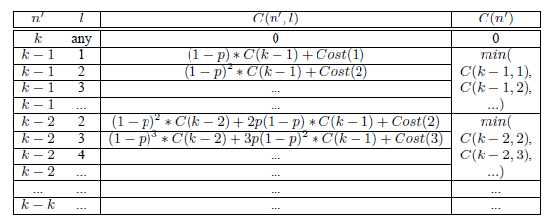
DP-SSQSP (cont’d) – handle recursion
Dynamic Programming Table:
Find the l ∈ N value for which the following equation produces the minimum C(n′).
Can use analytical (derivative) or numerical methods.

Slide 13
DP-SSQSP (cont’d) – Lookup table
For performance, we precompute a table specifying optimal # retrieved objects given # remaining requested satisfying objects.
E.g., Lookup table for p = 0.01, k = 3, Cost(l) = 10+1 · l
k-n’ | l
1 | 42
2 | 91
3 | 144

Slide 14
Multiple Sources Variants P-MSQSP: Probabilistic Algorithm for MSQSP
At every step compute # l_{i} of objects to retrieve from each source to complete the query with probability x%.
Pick source S_{i} with minimum access cost Cost_{i}(l_{i}) to do the next retrieval of l_{i} objects.

Slide 15
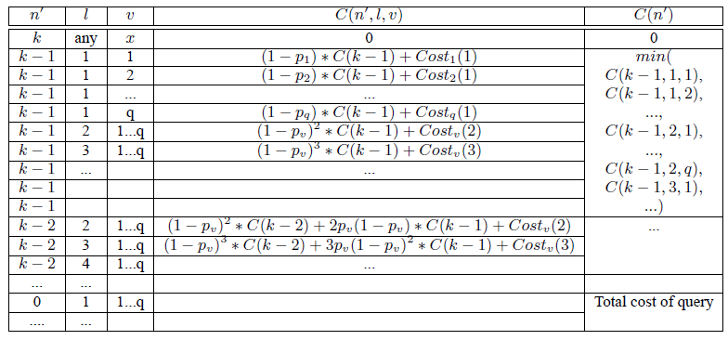
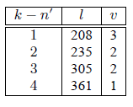
DP-MSQSP: Dynamic Programming Algorithm for MSQSP
Additional variable in dynamic programming: source id v
Dynamic Programming table
Lookup table: for each n′ value, the lookup table stores the source id v, in addition to the number l of objects to retrieve

Slide 16
DP-MSQSP (cont’d)
Find l to minimize
where C(n′) is the expected cost of completing Q given that n′ satisfying objects have been retrieved so far, and the next access will be at source S_{v} and will retrieve l objects.

Slide 17
Experiments - Datasets
IMDB (Internet Movie Database)
236,627 titles
Extracted a list of keywords describing each movie
25 queries, e.g., “based-on-novel”, “revenge”, with frequency 1% to 5%
Retrieve movies in alphabetical order
Westlaw legal cases
60,000 case filings for the state of California over a two-month period
25 queries, e.g., “copyright”, “trustee” with frequency 0.1% to 1.0%
retrieve objects in random order

Slide 18
Single-Source Experiments – Baseline algorithms
BAR (Base-AdaptStep-a/b): retrieve a/b objects from source in first round, doubling the sample size each round
BAK(Base-AdaptStep-k): retrieve k objects from source in first round, doubling the retrieval size each round
BFR (Base-FixedStep-a/b): retrieve a/b objects from the source as a fixed-step process
Optimal: Assume an oracle says how far the k-th satisfying result is.

Slide 19
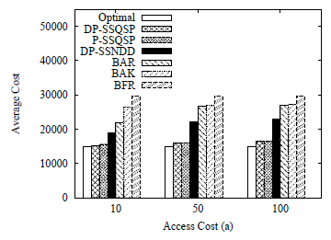
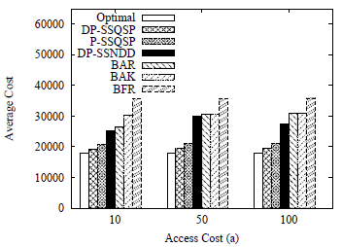
Experiments -Cost
k=25, IMDB k=100, IMDB

Slide 20
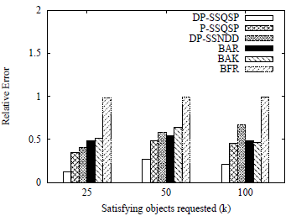
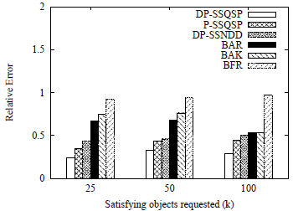
Experiments – Relative Error
Relative error in cost= (Cost − Optimal) / Optimal
k=25, IMDB k=100, IMDB

Slide 21
Experiments – Compute Lookup tables
Time (seconds) to generate dynamic programming tables for single and multiple source data sets.

Slide 22
Related work
GIOSS, CORI create collection selection index. Each source ranked per query based on an object ranking algorithm.
Mihaila et al. 2001 present a framework to discover and combine Internet sources to answer complex queries.
Do not address problem of determining the optimal number of objects to retrieve from a selected source or subsequent accesses.
Top-k and probabilistic top-k algorithms mostly focus on vertically partitioned sources. In our setting it is horizontally partitioned.
Fuhr 1999 require precision-recall graph of each source to compute optimal number of retrieved tuples from each source.
Probing, sampling sources to predict utility.

Slide 23
Conclusions
Presented cost-aware approach to source and object selection
Dynamic programming algorithms
Exploit cost access characteristics of sources
Single or multiple sources

Slide 24
Thank you!
ACKNOWLEDGMENTS:
Gautam Das was supported by NSF grants 0916277, 0845644 and 0812601, a grant from Dept of Education, and unrestricted gifts from Microsoft Research and Nokia Research.
Dimitrios Gunopulos was supported by NSF, and by the SemsorGrid4Env, Health-e-Child, and MODAP projects funded by the European Commission.
Vagelis Hristidis was supported by NSF grants IIS-0811922, IIS-0952347, and DHS grant 2009-ST-062-000016.

Slide 25
Variants where no distribution data is known
For the problems SSNDD (Single-Source, No Distribution Data) and MSNND (Multi-Source, No Distribution Data), where no information on the distribution of query satisfying objects is available, we modify our dynamic programming algorithms to “learn” the distribution from the objects retrieved during query execution.

Slide 26
DP-SSQSP - complexity
To complete the Lookup table
Space: O(k)
Time: O(k·l_{max} ·(k − n′)) l_{max}: number of points computed in order to find the minimum

