Slide 1
Information Discovery on Vertical Domains
Vagelis Hristidis
Assistant Professor
School of Computing and Information Sciences
Florida International University (FIU), Miami

Slide 2
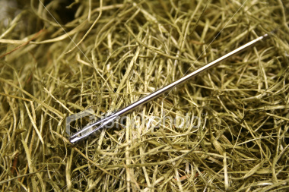
Need for Information Discovery
Amount of available data increases
Needle in the haystack problem
Some applications:
  Web
  Desktop search
  Data Warehousing
  Bibliographic database
  Homes, cars search, e.g., realtor.com, autotrader.com
  Scientific domains, e.g.,
    genes, proteins, publications in biology,
    elements and interactions of components in chemistry
    Patient hospitalizations, physician info, procedure outcomes in hospitals

Slide 3
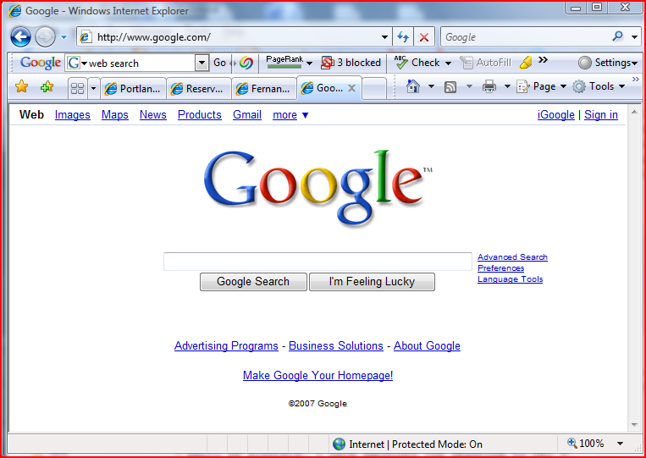
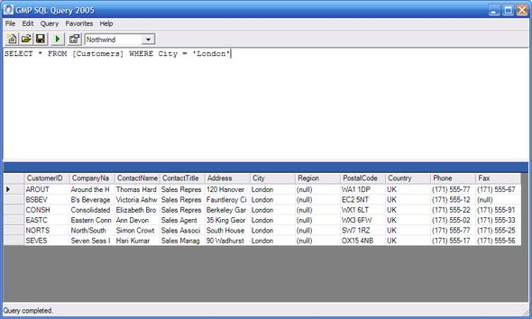
Strengths and Limitations of Current Approaches
Web Search
  + Scalability
  + Handle free text
  + Exploit content and link structure to achieve ranking
  + Simple keyword queries
  - Limited query expressive power
  - Generic, domain-independent ranking algorithms
  - Return pages, not answers
Database Querying
  + Efficient
  + Handle structured data
  + Well-defined theory and answers
  - Must learn query language, e.g. SQL
  - No automatic ranking of results
Keyword Search in Databases
+ Simple keyword queries
+ exploit links (e.g., primary-foreign keys)
- Generic ranking – typically size of result
- No domain semantics

Slide 4
Research Objective
Allow effective and efficient information discovery on vertical domains
Strategy:
  Exploit associations between entities
  Model domain semantics, e.g., patient entity is critical for medical practitioner, but not for biologist
  Model users of a domain
  Use knowledge of domain experts,and existing knowledge structures (e.g., domain ontologies)
  Exploit user feedback
  Go beyond plain keyword search. Explore best search interface for each domain, e.g., faceted search

Slide 5
Specific Domains Studied (or being studied)
Products marketplace
Biological databases
Clinical databases
Bibliographic
Patents

Slide 6
Specific Domains Studied (or being studied)
Products marketplace
Biological databases
Clinical databases
Bibliographic
Patents

Slide 7
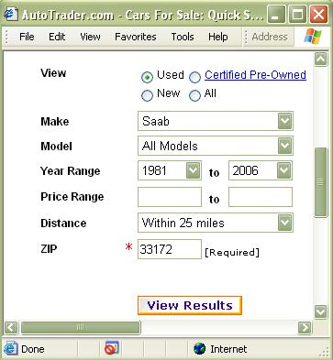
Products Marketplace
Project started while visiting Microsoft Research at Redmond, in Summer 2003
SQL Returns Unordered Sets of Results
Overwhelms Users of Information Discovery Applications
How Can Ranking be Introduced, Given that ALL Results Satisfy Query?

Slide 8
Products Marketplace (cont’d)
Example – Realtor Database
House Attributes: Price, City, Bedrooms, Bathrooms, SchoolDistrict, Waterfront, BoatDock, Year
Query: City =`Seattle’ AND Waterfront = TRUE
Too Many Results!
Intuitively, Houses with lower Price, more Bedrooms, or BoatDock are generally preferable

Slide 9
Products Marketplace (cont’d)
Rank According to Unspecified Attributes [VLDB’04,TODS’06]
Score of a Result Tuple t depends on
Global Score: Global Importance of Unspecified Attribute Values
  E.g., Newer Houses are generally preferred
Conditional Score: Correlations between Specified and Unspecified Attribute Values
  E.g., Waterfront → BoatDock
  Many Bedrooms → Good School District

Slide 10
Products Marketplace (cont’d)
Key Problems
Given a Query Q, How to Combine the Global and Conditional Scores into a Ranking Function.
Use Probabilistic Information Retrieval (PIR).
How to Calculate the Global and Conditional Scores.
Use Query Workload and Data.

Slide 11
Products Marketplace (cont’d)
Other Projects
Select the best attributes to output – attribute ordering problem [SIGMOD’06]
  E.g., Color is important for sports cars but not much for family cars
Product Advertising: Select best attributes to display for a product to maximize its visibility among its competitors [ICDE’08, TKDE’09]
  Use past query workload
  Maximize number of past queries for which the product is returned

Slide 12
Specific Domains Studied (or being studied)
Products marketplace
Biological databases
Clinical databases
Bibliographic
Patents

Slide 13
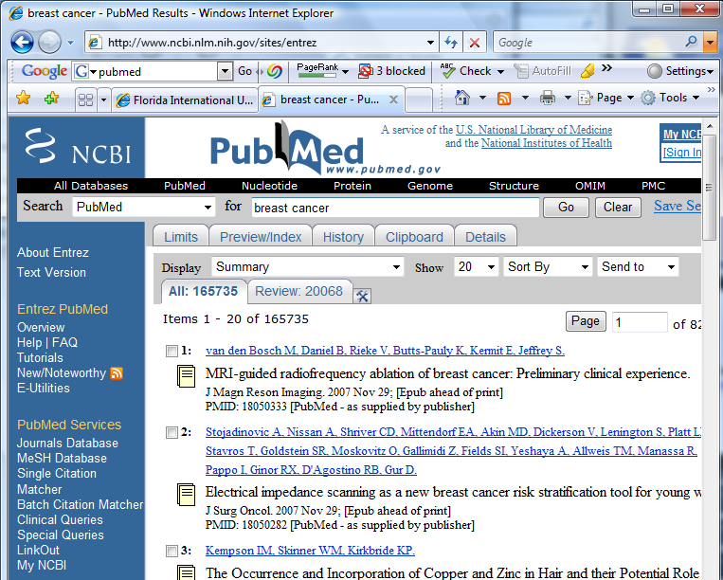
Biological Databases [EDBT’09]
With University of Maryland
Intuitive but powerful query language, based on soft (ranking) and hard (pruning) filters
Goal is to improve the user experience of users of PubMed
Exploit associations between entities (genes, proteins, publications)
Example of Query: Find the most important publications on “cancer” that are related to the “TNF” gene through a protein.

Slide 14
Results Navigation in PubMed with BioNav [ICDE’09, TKDE’10]
With SUNY Buffalo.
Most publications in PubMed annotated with Medical Subject Headings (MeSH) terms.
Present results in MeSH tree.
Propose navigation model and smart expansion techniques that may skip tree levels.

Slide 15
BioNav: Exploring PubMed Results
MESH (313)
Query Keyword: prothymosin
Number of results: 313
Navigation Tree stats:
  # of nodes: 3941
  depth: 10
  total citations: 30897
Big tree with many duplicates!
Amino Acids, Peptides, and Proteins (310)
Proteins (307)
Nucleoproteins (40)
Histones (15)
4 more nodes
45 more nodes
2 more nodes
Biological Phenomena, … (217)
Cell Physiology (161)
Cell Growth Processes (99)
15 more nodes
3 more nodes
Genetic Processes (193)
Gene Expression (92)
Transcription, Genetic (25)
1 more node
10 more nodes
95 more nodes
Static Navigation Tree
for query “prothymosin”

Slide 16
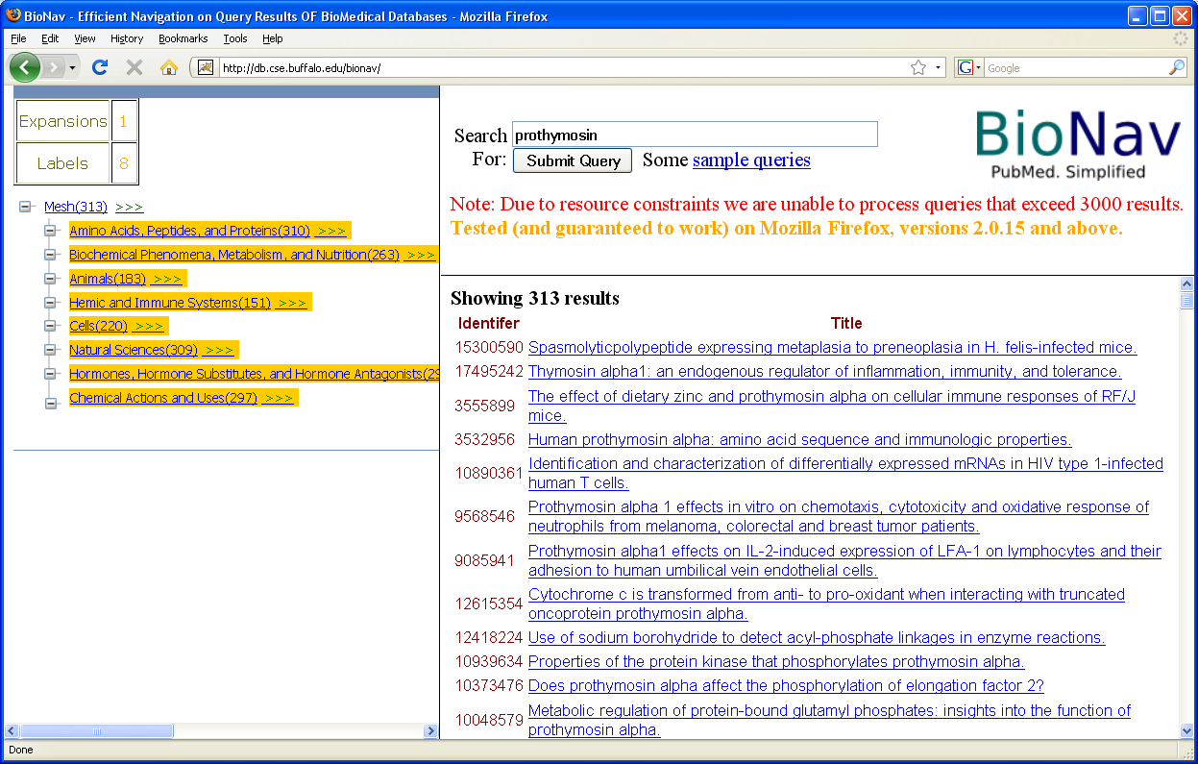
BioNav: Exploring PubMed Results
Reveal to the user a selected set of descendent concepts that:
Collectively contain all results
Minimize the expected user navigation cost
Not all children of the root are necessarily revealed as in static navigation.

Slide 17
BioNav Evaluation

Slide 18
Specific Domains Studied (or being studied)
Products marketplace
Biological databases
Clinical databases
Bibliographic
Patents

Slide 19
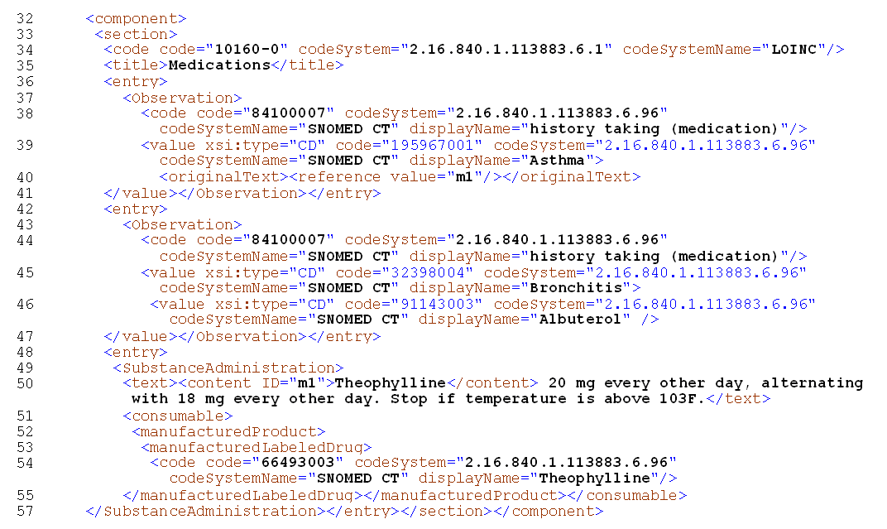
XOntoRank: Use Ontologies to Search Electronic Medical Records [ICDE’09]
With Miami Children’s Hospital, Indiana University School of Medicine, IBM Almaden.
Latest EMR format: HL7 CDA – XML-based
Algorithm to enhance keyword search using ontological knowledge (e.g., SNOMED)

Slide 20
SAMPLE CDA FRAGMENT

Slide 21
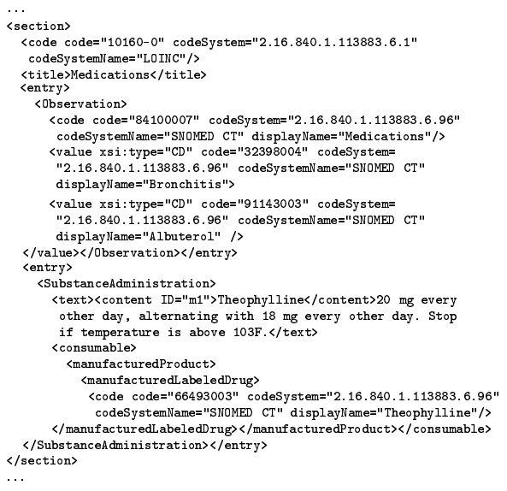
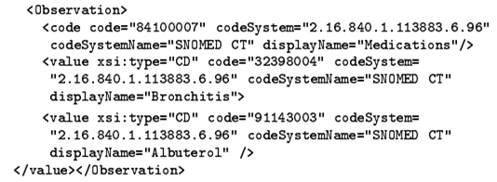
XOntoRank: Example 1
q = {“bronchitis”, “albuterol”}
result =
Observation
code
value
Bronchitis
value
Albuterol

Slide 22
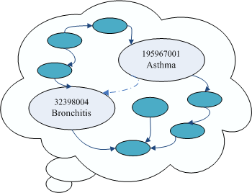
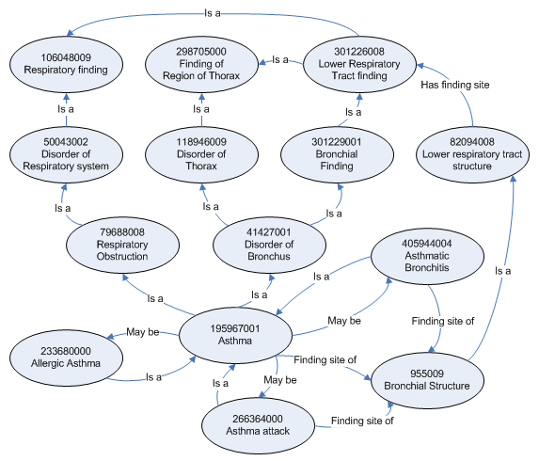
XOntoRank: Example 2
q = {“asthma”, “albuterol”}
result = ???

Slide 23

XOntoRank
A CDA node may be associated to a query keyword w through ontology.
XOntoRank first assigns scores to ontological concepts
  OntoScore OS(): Semantic relevance of a concept c in the ontology to a query keyword w.
Then, given these scores, assign Node Scores NS() to document nodes
Other aggregation functions are possible.

Slide 24
Computing OntoScore of Concept Given Query Keyword
Three ways to view the ontology graph:
  As an unlabeled, undirected graph.
  As a taxonomy.
  As a complete set of relationships.

Slide 25
Authority Flow Ranking in EMRs
Query: “pericardial effusion”
A subset of the electronic health record dataset.
Work under submission.

Slide 26
ObjectRank on EMRs: Authority Flow Ranking
Schema of the EMR dataset

Slide 27
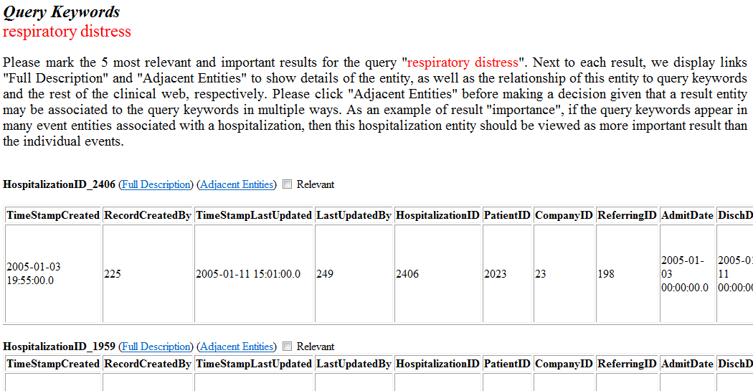
User Study

Slide 28
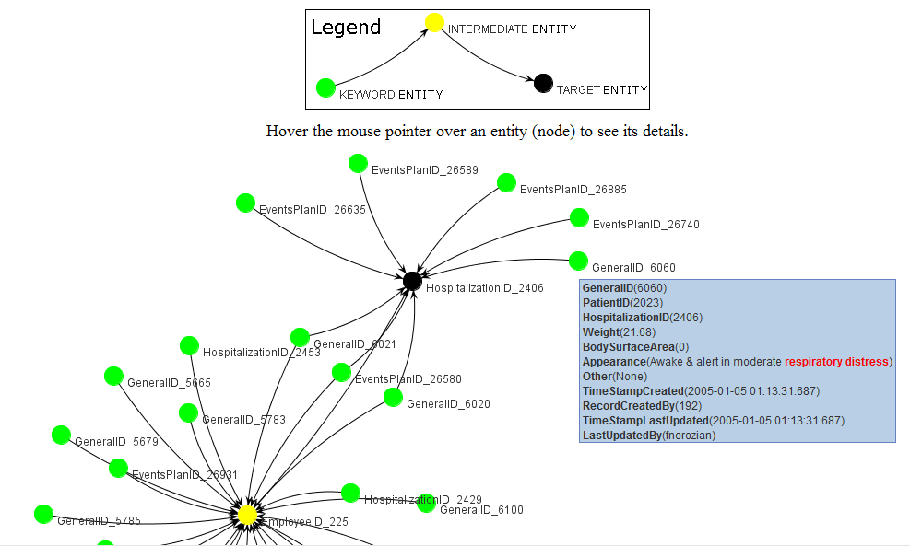
Explaining Subgraph

Slide 29
User Study Results
  Mean Sensitivity Mean Specificity
BM25: Traditional Information Retrieval Ranking Function
CO: Clinical ObjectRank (Authority Flow)

Slide 30
Other challenges of Searching EMRs [NSF Symposium on Next Generation of Data Mining ’07]
Entity and Association Semantics
Negative Statements
Personalization
Treatment of Time and Location Attributes
Free Text Embedded in CDA Document

Slide 31
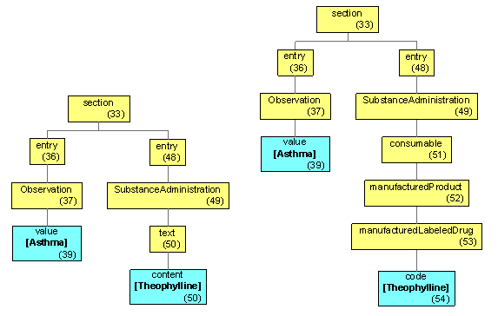
Syntax vs. Semantics in Schema
Example – query “Asthma Theophylline”
More details at [Hristidis et al. NSF Symposium on Next Generation of Data Mining ’07]

Slide 32
Specific Domains Studied (or being studied)
Products marketplace
Biological databases
Clinical databases
Bibliographic
Patents

Slide 33
Bibliographic Databases
Work started while at UCSD
Exploit citations link structure to create query specific ranking [VLDB’04, TODS’08]
Demo available for Database literature at http://dbir.cs.fiu.edu/BibObjectRank

Slide 34
Bibliographic Databases (cont’d)
Query Reformulation
Work with U of Maryland [ICDE’08]
Based on user selected results
  Perform query expansion – add/change weight of query keywords
  Adjust authority flow weights
Currently working on applying these ideas to queries on PubMed.

Slide 35
Explaining Query Results – Explaining Subgraph
Target Object: “Modeling Multidimensional databases” paper.
Explaining Subgraph Creation
BFS in reverse direction from target object.
BFS in forward direction from base set objects (authority sources).
Subgraph contains all nodes/edges traversed in forward direction.
Compute explaining authority flow along each edge by eliminating the authority leaving the subgraph (iterative procedure).
Structure-based reformulation: High-flow edges in explaining subgraph receive weight boost.
Notes:
FIU

Slide 36
Specific Domains Studied (or being studied)
Products marketplace
Biological databases
Clinical databases
Bibliographic
Patents

Slide 37
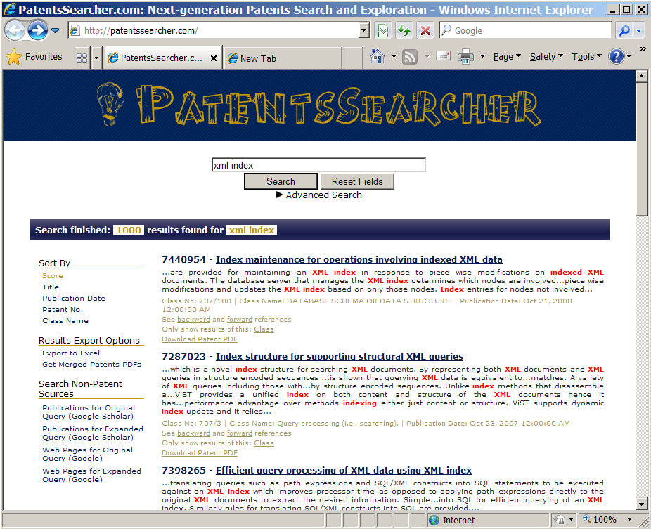
Search Patents
Special characteristics of patents:
Patents are organized into classes and subclasses.
Patents have links to external publications and to other patents.
Patents are organized to various sections (abstract, claims, description and images).
Patents use specific legal wording in the claims section. Further, claims have references to other claims, that is, claims can be viewed as a graph.
Demo at PatentsSearcher.com

Slide 38
End - Thank You
For more information, please go to:
http://ww.cis.fiu.edu/~vagelis
Supported by
  NSF CAREER, 2010-2015
  NSF grant IIS- 0811922: III-CXT-Small: Information Discovery on Domain Data Graphs, 2008-2011
  DHS grant 2009-ST-062-000016: Information Delivery and Knowledge Discovery for Hurricane Disaster Management, 2009-2011

Slide 39
Extra Slides

Slide 40
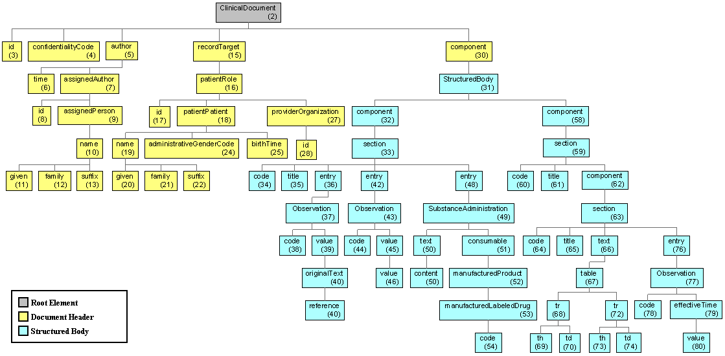
CDA Document – Tree View

