Slide 1

CADS: A Collaborative Adaptive Data Sharing Platform
Vagelis Hristidis Eduardo Ruiz

Slide 2
Motivation
Many application domains where users collaborate and share domain-specific information.
  Disaster Management
  News
  Scientific Networks
Annotation (tagging) of shared data necessary for effective searching and to support advanced applications
Current information sharing tools allow users to share and annotate documents.
Limitation: Users annotate in ad-hoc way, with very basic support from system (e.g., predefined templates in Google Base).
  Consequences:
    Increased user effort
    Ineffective annotation
    Schema explosion

Slide 3
CADS Objectives
CADS stands for Collaborative Adaptive Data Sharing platform
  Facilitates effective and effortless data annotation at insertion-time
  Leverages these annotations at query-time
Learns with time the information demand which is then used to create adaptive insertion and query forms.

Slide 4
Motivating Example
BULLETIN HURRICANE GUSTAV INTERMEDIATE ADVISORY NUMBER 31A
NWS TPC/NATIONAL HURRICANE CENTER MIAMI FL AL072008 600 AM CDT MON SEP 01 2008
EYE OF GUSTAV NEARING THE LOUISIANA COAST...HURRICANE FORCE WINDS OVER PORTIONS OF SOUTHEASTERN LOUISIANA...A HURRICANE WARNING REMAINS IN EFFECT FROM JUST EAST OF HIGH ISLAND TEXAS EASTWARD TO THE MISSISSIPPI-ALABAMA BORDER...INCLUDING THE CITY OF NEW ORLEANS AND LAKE PONTCHARTRAIN. PREPARATIONS TO PROTECT LIFE AND PROPERTY SHOULD HAVE BEEN COMPLETED.A TROPICAL STORM WARNING REMAINS IN EFFECT FROM EAST OF THE MISSISSIPPI-ALABAMA BORDER TO THE OCHLOCKONEE RIVER. …

Slide 5
Motivating Example
BULLETIN HURRICANE GUSTAV INTERMEDIATE ADVISORY NUMBER 31A
NWS TPC/NATIONAL HURRICANE CENTER MIAMI FL AL072008 600 AM CDT MON SEP 01 2008
EYE OF GUSTAV NEARING THE LOUISIANA COAST...HURRICANE FORCE WINDS OVER PORTIONS OF SOUTHEASTERN LOUISIANA...A HURRICANE WARNING REMAINS IN EFFECT FROM JUST EAST OF HIGH ISLAND TEXAS EASTWARD TO THE MISSISSIPPI-ALABAMA BORDER...INCLUDING THE CITY OF NEW ORLEANS AND LAKE PONTCHARTRAIN. PREPARATIONS TO PROTECT LIFE AND PROPERTY SHOULD HAVE BEEN COMPLETED.A TROPICAL STORM WARNING REMAINS IN EFFECT FROM EAST OF THE MISSISSIPPI-ALABAMA BORDER TO THE OCHLOCKONEE RIVER. …
Possible structured annotation
Attribute Name | Attribute Value
Storm Name | Gustav
Advisory Number | 31/A
Advisory Time | 600 AM
Advisory Date | Sep 01 2008
Storm Location | Louisiana/Texas/ Mississippi
Warnings | Hurricane / Tropical Storm
Storm Category | 3
Document Type | Advisory
Fatalities | No
Not in document.

Slide 6
Motivating Example
BULLETIN HURRICANE GUSTAV INTERMEDIATE ADVISORY NUMBER 31A
NWS TPC/NATIONAL HURRICANE CENTER MIAMI FL AL072008 600 AM CDT MON SEP 01 2008
EYE OF GUSTAV NEARING THE LOUISIANA COAST...HURRICANE FORCE WINDS OVER PORTIONS OF SOUTHEASTERN LOUISIANA...A HURRICANE WARNING REMAINS IN EFFECT FROM JUST EAST OF HIGH ISLAND TEXAS EASTWARD TO THE MISSISSIPPI-ALABAMA BORDER...INCLUDING THE CITY OF NEW ORLEANS AND LAKE PONTCHARTRAIN. PREPARATIONS TO PROTECT LIFE AND PROPERTY SHOULD HAVE BEEN COMPLETED.A TROPICAL STORM WARNING REMAINS IN EFFECT FROM EAST OF THE MISSISSIPPI-ALABAMA BORDER TO THE OCHLOCKONEE RIVER. …
Q1: Storm Name = ‘Gustav’ AND Warnings like ‘hurricane’
Q2: Storm Name = ‘Gustav’ AND Storm Category > 2
Q3: Document Type = ‘advisory’ AND Location = ‘Louisiana’
AND Date FROM 08/31/2008 TO 09/30/2008

Slide 7
CADS Workflow & Architecture
CADS Architecture
CADS Workflow

Slide 8
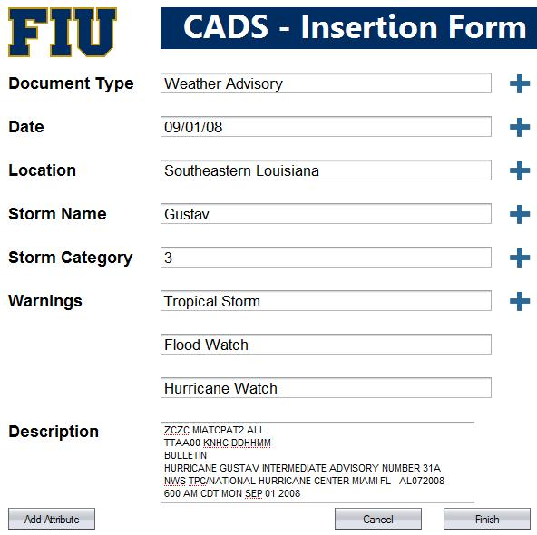
CADS – Adaptive Insertion Form
A producer submits a new document to be included in the repository.
CADS creates an adaptive insertion form with the most probable attributes.
User fills this form with the required information and submits it

Slide 9
CADS – Adaptive Insertion Form
Used attributes trigger additional suggestions.
Form suggests mappings with previously specified attributes.
Form employs IE techniques to extract attribute values.
Quality of annotations depends on the reliability of the users.

Slide 10
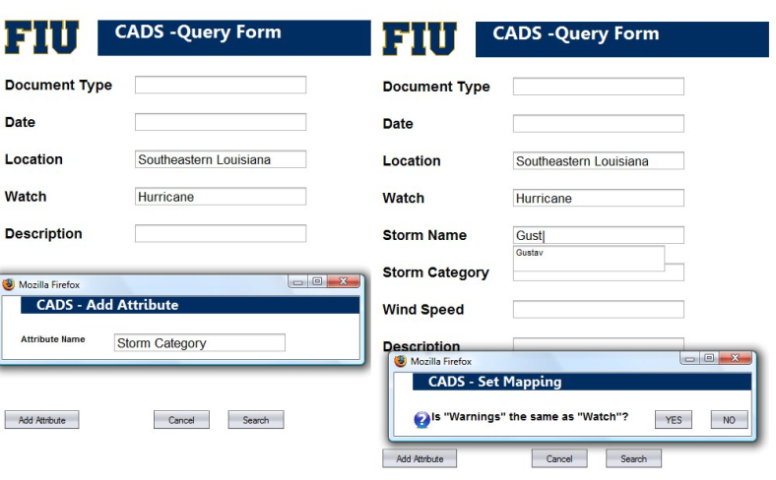
CADS – Adaptive Query Form
Initially the query form specifies some default attributes.
User adds new attributes and values.
These events trigger more related attributes.
Query form proposes mappings between attributes.
System executes query and ranks results.

Slide 11
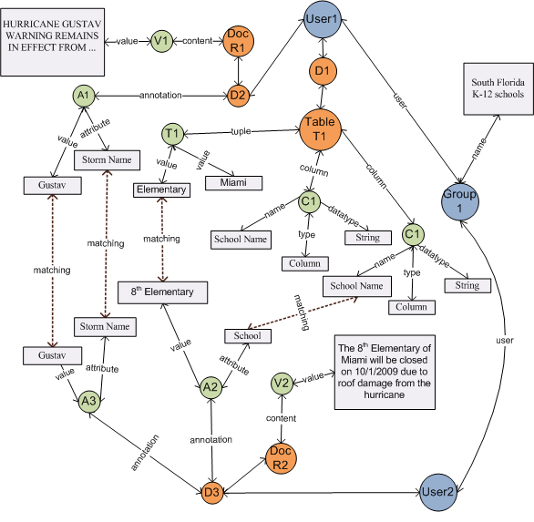
CADS Graph
Used to personalize suggestions and ranking.
Contains data instances, annotations, matchings, users and groups.
User Affinity.
Combine FolkRank [Hotho et al. 2006] with Similarity Flooding [Melnik et al. 2002] for node ranking.

Slide 12
CADS – Challenges
Discover best ⟨attribute name, attribute value⟩ candidates for a newly inserted document.
Matching of attribute names and attribute values across queries and inserted documents.
  Value
  Confidence
  Avoid overwhelming user
Storage of annotation data.
Discover best conditions to suggest in adaptive query forms.
Ranking query results.
  Annotations vs. content
  Community information
  Missing Annotations

Slide 13
Insertion: Attributes Suggestion
Score(A)
I(A,W,G)
C(A,W,d)
Information Value I(A, W): how useful attribute A is, given the query workload W
Confidence C(A,d,W): probability that A is relevant to d directly or through W

Slide 14
Query: Attributes Suggestion
Score(A)
U(A)
Corr(A,F)
Use Affinity U(A): the relevance degree of user u to attribute A.
Correlation Corr(A,F) between A and the selected conditions F.

Slide 15
Conclusions
CADS is a Collaborative Adaptive Data Sharing platform.
In CADS annotation and integration occur at both the data insertion (production) and querying (consumption) actions.
We believe that CADS has a great potential to improve many collaboration environments.

