Slide 1



Leaky Buddies: Cross-Component Covert Channels on Integrated CPU-GPU Systems
Sankha Baran Dutta
Hoda Naghibijouybari
Nael Abu-Ghazaleh
Andres Marquez
Kevin Barker
48th International Symposium of Computer Architecture – ISCA 2021
Notes:
In this video I am going to talk about our work that demonstrates for the first time end to end covert channel attacks across different components in a heterogeneous environment (CPU to integrated GPU).

Slide 2

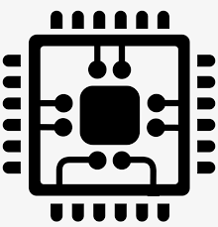


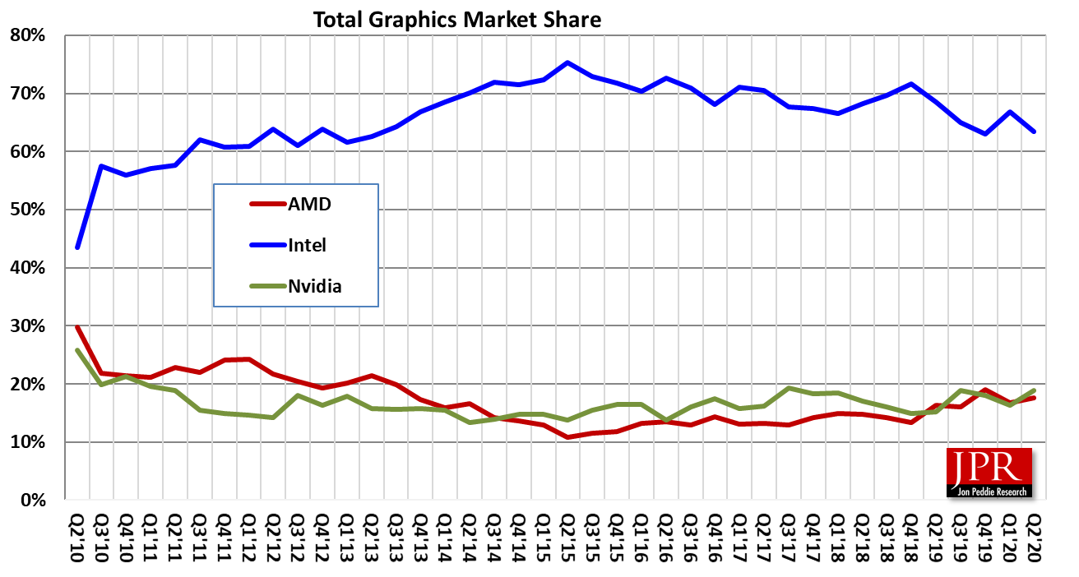
Modern Computers are Heterogeneous
CPUs, GPUs, NPUs, accelerators, Mobile SoCs, etc.
Cloud, Mobile, Desktop, HPC, etc.
Integrated GPUs common in modern architectures.
Intel based GPU > 60% of the total GPU market
Notes:
(KP) Modern computing devices are increasingly heterogeneous as we can see different computing components in the same chip.
(KP) Heterogeneous architectures are currently ubiquitous and can be seen in different platforms like cloud, mobile, desktop, high performance computing, etc.
(KP) In a heterogenous environment, Integrated GPUs are commonplace in modern computing devices: they provide graphics and multimedia acceleration without cost and size of a GPU card
(KP) In fact, Intel based integrated GPUs account for more than 60% of the total GPU market share.

Slide 3
Research Question -- Are Microarchitectural attacks possible in heterogeneous environments?
Our Contribution
First Covert channel attacks in heterogeneous environment
  One component to another: GPU to CPU and vice versa
Conducted two end-to-end attacks in both directions:
  PRIME+PROBE covert channel on Last level cache (LLC)
  Contention based covert channel on ring bus
Several new challenges to overcome in Heterogeneous Environments!
Notes:
So The research question we have if microarchitectural attacks are possible in this heterogenous environment.
(KP) We develop the first covert channel attacks in a heterogeneous environment.
Our covert channel attack is across components from GPU to CPU and vice versa.
We demonstrated 2 end to end attacks across components.
The first attack is a PRIME+PROBE based attack on Last level cache .
Another attack is a contention based on the shared components like ring bus
(KP) We had to solve several new challenges imposed by the heterogeneous environment

Slide 4


Microarchitectural Timing attacks
Sharing resources (e.g., among cores) enables contention
Contention is detectable through timing or otherwise
Prime + Probe Cache Timing attacks
Attacker fills a cache set A by own data (Prime).
Data gets replaced by another application.
Attacker access the same data and measures time (Probe).
Longer time stamp indicates cache eviction.
Shared Cache set A
Shared Cache set A
Shared Cache set A
Prime
Probe
Notes:
Let me give you some background on microarchitectural timing attacks.
(KP) Heterogeneous environment leads to sharing of different resources for example the last level caches, ring bus, etc.
(KP) Sharing of this resources leads to contention among the resources.
(KP) Now let’s see the working principle of prime and probe based cache timing attacks
In the prime step, the attacker fills the shared cache set A by their own data.
(KP) Then the data in the cache set gets replaced by a victim application.
(KP) In the probe step, the attacker again accesses the same data evicted by the victim application and measures the access time.
(KP)A longer time stamp indicates cache eviction revealing the victim’s access pattern.

Slide 5




What is Covert Channel?
Use contention to communicate
Two collaborating malicious app: trojan and spy
Apps Share sensitive data over shared resources indirectly.
No direct communication channel exist, or the channel may be monitored
Trojan
Communicating sensitive data through shared resources
Spy
No direct communication among processes
Gallery App
Weather App
Notes:
Now let’s see how we use contention based covert channel work
(KP) where malicious applications communicate when there is no direct way for them to do so
(KP) In covert channel there are 2 collaborating malicious app known as trojan and spy.
(KP) Trojan is the sender that sends sensitive data to spy through some applications over shared resources indirectly.
(KP) The malicious apps communicate covertly though some shared resource as there could be no direct communication channel that exist or the direct channel may be monitored.

Slide 6
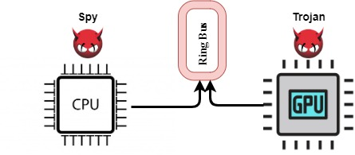
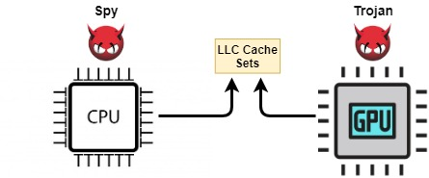
Where can contention be created?
1
2
Shared Microarchitectural state
e.g., use PRIME+PROBE
Shared buses/ports
Contention based
We develop two bi-directional covert channel attacks: one on shared LLC, and one on the ring bus
Notes:
Here is our threat model and the architectural resources where we used to create the attacks
(KP) The trojan gets located on the GPU and the spy on the CPU -- this is the first attack where the two sides are not computationally the same
Components in a heterogeneous system can share microarchitectural state or interconnect/ports. We show attacks on both types of resources.
The first attack is a prime and probe based attack using shared microarchitectural state (the shared last level cache.)
(KP)The second attack is a contention based attack on shared busses or ports like the ring bus.
Though our picture shows trojan on GPU and spy on CPU, we also demonstrate attacks in the opposite direction; please see paper for details

Slide 7
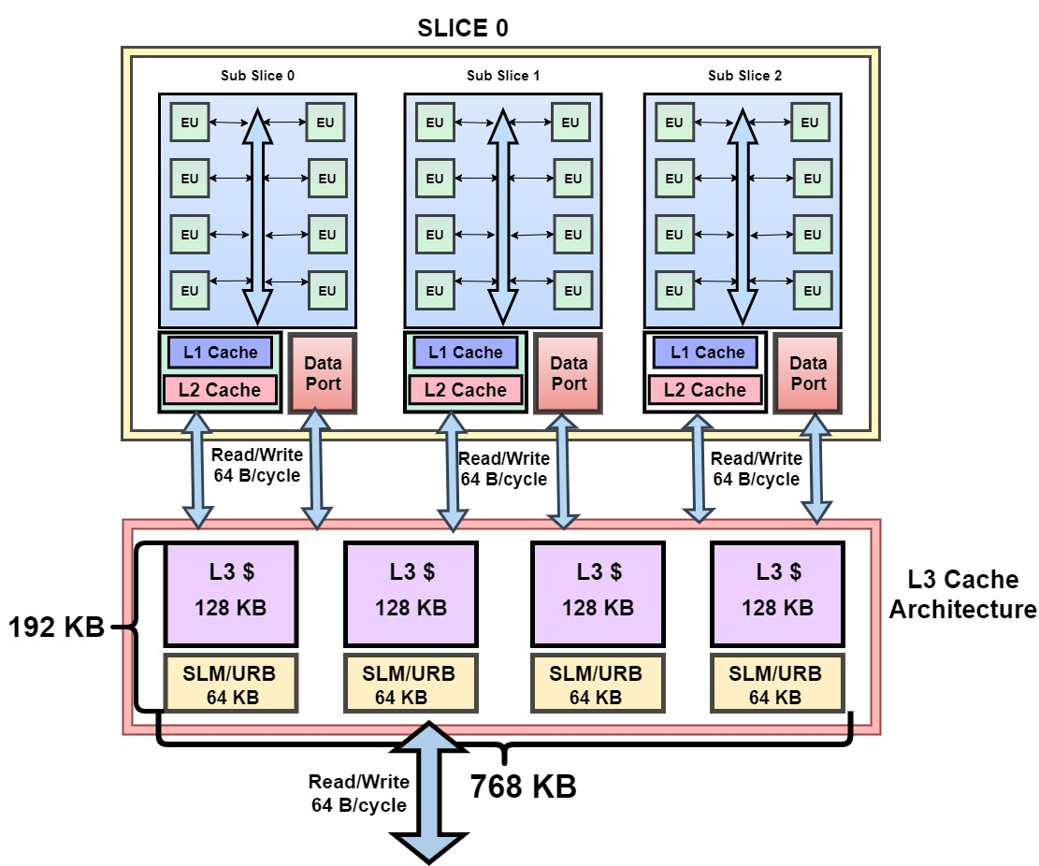
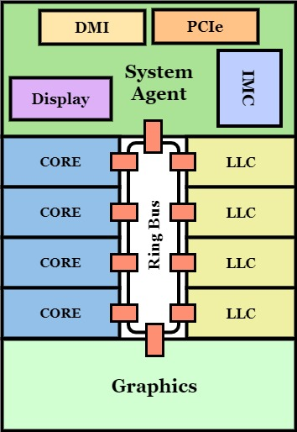
Our Attack Environment
Intel GPU
Intel SoC
Integrated GPU on die with CPU cores.
GPU and CPU share ring bus
Also share Last Level Cache (LLC)
Intel GPUs have slices and sub-slices.
Each sub-slices have 8 execution units (EUs).
L1 and L2 caches are private and used for graphics purposes.
L3 is a general-purpose cache.
Notes:
Here we will demonstrate our attacks on an integrated CPU GPU environment, which is the common configuration of most consumer processors
(KP) CPU cores and iGPU are tightly coupled in the same die.
(KP) GPU shares the Last Level Cache (LLC), data bus, ram with the CPU and OpenCL is used for general purpose computing on iGPU.
(KP) Intel integrated GPUs are divided into slices and sublices. The diagram shows a slice with 3 subslices.
(KP) Each sub-slices consists of 8 execution units doing the computation.
(KP) Integrated GPUs have L1 and L2 private caches that is used for graphics only.
(KP) L3 private cache used both for graphics and general purpose computing on the GPU

Slide 8
Attack in homogeneous vs heterogeneous environment
Traditionally microarchitectural attacks were explored in homogeneous environment.
Similar view
Dissimilar view
LLC
LLC
Heterogeneous environment
Homogeneous environment
Private cache
GPU Private cache
Private cache
Private cache
CPU Core
CPU Core
CPU Core
GPU
Spy
Trojan
Spy
Trojan
Homogenous environment have similar view of system, e.g cache.
Heterogeneous attack faces new set of challenges.
Notes:
Let’s understand the covert channel attack vs in heterogeneous environment
(KP) Traditionally Microarchitectural attacks have been explored and demonstrated in a homogeneous environment – both spy and trojan run on identical resources (e.g., cores or hardware threads).
(KP) as you can see on the left hand figure.
(KP) The homogeneous environment have similar view of the system for example the cache hierarchy and architecture which changes in a heterogeneous environment.
(KP) Our attack which is on the right hand side)is in heterogeneous environment and introduces new set of challenges

Slide 9

What are the challenges?
Lack of user timer in OpenCL.
Solution: Custom timer
Reverse Engineering LLC from GPU
Solution: Shared Virtual Memory and Zero copy memory
Asymmetric view of LLC from GPU cache hierarchy
  GPU caches have high associativity; evictions from GPU cause self-interference in LLC
Solution: GPU cache hierarchy reverse engineering
Notes:
Now let’s see the challenges we encountered during our attack
(KP) The first challenge is the absence of a user level hardware timer that is an integral part in timing based microarchitectural attacks.
Our solution is to develop a custom timer without interfering with the attack.
(KP) The second challenge is to reverse engineer the LLC from GPU as GPU comes with their own paging mechanism.
Our solution is to use the shared virtual memory and zero copy memory.
(KP) GPU L3 cache has an asymmetric view of the llc
(KP) Specifically, the GPU caches have higher associativity than LLC. So a careful eviction is required to avoid self-interference.
Our solution is to reverse engineer the cache hierarchy to derive conflict sets that avoid self-interference

Slide 10
Overview of LLC based CPU-GPU Covert Channel Attack
Spy
LLC Sets
Trojan launched in GPU and Spy in CPU.
Asynchronous communication.
Three separate LLC sets used.
GPU initiates Ready to send signal over S_{A}.
CPU replies with Read to receive signal over S_{B} .
GPU send the bit over S_{C}.
S_{A}
Ready to send
CPU
S_{B}
GPU
Ready to receive
S_{C}
Bit Send
Trojan
Attack in opposite direction also demonstrated
Notes:
Now we are going so get a birds-eye view of the LLC attack.
(KP) Trojan is launched in GPU and spy in CPU.
(KP) We communicate asynchronously since the two sides are so different
(KP) and for that we are using 3 separate LLC sets.
(KP) First the GPU initiates ready to send signal over cache set SA
(KP) The CPU replies back with a ready to receive signal over cache set SB.
(KP) Finally the GPU send the bit over cache set SC.
(KP) We also build a channel in the opposite direction; please check the paper for details

Slide 11
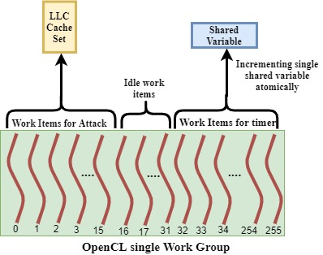
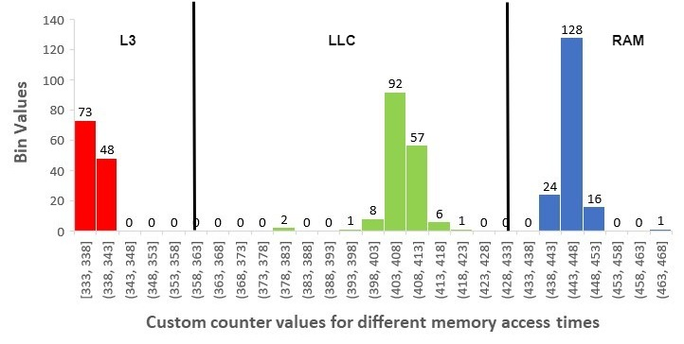
Challenge: Lack of Timer
Solution : Building custom timer
Build counter in Shared memory
  Separate ports, no interference
Maximum number of threads (256) per block launched
One warp (32 threads) for attack
Remaining warps used for counter.
Notes:
Timer is integral in a cache based timing attack to discriminate between a cache hit and miss.
OpenCL doesn’t provide a user accessible timer interface
(KP) Solution : Building custom timer using Shared memory (the scratchpad memory on the GPU processors) leveraging GPU parallelism
(KP) Shared memory has dedicated ports, avoiding port sharing interference with attack memory accesses
(KP) We use 256 threads which is the maximum allowed in a workgroup
(KP) One warp is used for the attack (16 of 32 threads).
(KP) Rest of the threads for incrementing timer variable in shared memory
(KP) The graph shows the measured time distribution for accesses to different levels of the cache hierarchy; they are clearly detectable.

Slide 12
Challenge: LLC reverse engineering from GPU
Challenge 1: GPU has different Virtual Address mapping
Solution: Shared Virtual Memory and Zero copy buffers
  Shared Virtual Memory: GPU and CPU share page tables on attack process
    Same Virtual addresses
  Zero copy buffers: Physical addresses are shared across the components.
    Map to same Physical addresses
LLC reverse engineering transparent across the components.
Notes:
(KP)GPUs come with separate virtual address space and address mapping from CPU.
(KP)our solution is to use shared virtual memory and zero copy buffers
(KP) We avoid this problem by using shared virtual memory which is possible for any attacker process
Shared virtual memory enables the page tables to be transparent across CPU and GPU as page tables get shared.
(KP) Zero copy buffers allows physical addresses to be shared across the components. This allows to map to same physical addresses.
(KP) This process allows the attacker to conduct the LLC reverse engineering experiment in CPU and to use that on GPU.

Slide 13
Challenge: Asymmetric view of memory and different cache hierarchy
Challenge 2: GPU has different cache hierarchy
  Inclusiveness? high associativity; L3 cache
Solution:
Reverse engineered L3 cache inclusiveness
Create conflict sets that avoid self-interference
Notes:
Our second challenge has to do with the quirks of the GPU cache hierarchy.
(KP) GPU caches have different cache hierarchy with unknown inclusiveness property and have higher associativity compared to the LLC and CPU private caches.
(KP)Our solution is to reverse engineer the L3 cache inclusiveness
(KP)Due to non-uniform cache associativity we need to create targeted conflict sets through reverse engineering that would avoid self-interference at the LLC level. I’ll show you more in the next slide.

Slide 14
Why Cache inclusiveness is important in microarchitectural attacks?
Timing attacks takes advantages of the cache inclusiveness.
Hits and misses can be observed at higher level.
Lower-Level Cache
Spy and trojan launched on Core 0 and 1
Trojan first accesses it’s data.
Data gets cached at all levels.
Next the spy accesses it’s data.
Lies in the same lower-level cache set as the trojan.
Evicts trojan data from all cache levels due to inclusiveness.
Trojan’s subsequent access time shows data miss.
Higher level
cache
Higher level
cache
Spy
CPU
Core 0
CPU
Core 1
Trojan
Covert Channel in traditional set-up
GPU L3 inclusiveness?
Notes:
Before going into the GPU cache inclusiveness let us understand the importance of cache inclusiveness in the microarchitectural timing attacks
(KP)Timing attacks utilizes the cache inclusiveness as it allows data to be back-invalidated when evicted from lower level. That is, if we replace data from the LLC, it would be replaced from core caches (or GPU caches)
(KP) Hits and misses can be observed at higher level if the attack medium is lower level cache like LLC.
(KP) Here we are going to see covert channel in a traditional set up.
(KP) At first Spy and trojan launched on core 0 and 1.
(KP) Trojan first accesses it’s private data (KP) which causes the data to get cached at every cache levels.
(KP) Next the spy accesses it’s own set of private data.
(KP) This data lies in the same cache set at the lower level as the trojan.
(KP) This causes eviction of the trojan data from all cache levels due to inclusiveness property.
(KP) subsequent accesses by trojan process would show a data miss.
(KP) We need to figure out the inclusiveness property of the GPU L3 cache

Slide 15
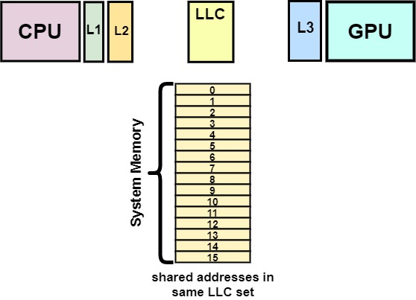
Challenge: Reverse engineering GPU L3 cache inclusiveness
1
2
Shared buffer is created.
GPU accesses data in step
Data gets cached at all level.
CPU flushes data in step
Clears data from all levels of caches.
GPU again accesses data in step
3
1
2
3
Notes:
Here we are going to see the GPU L3 inclusiveness reverse engineering experiment.
(KP) At first a shared buffer is created.
(KP)GPU first access the shared data in step 1.
(KP)Data gets cached in every level as caches are cold.
(KP)CPU accesses same data and then flushes it out in step 2
(KP)This allows the shared data to get cleared from all levels of caches.
(KP)GPU accesses the data again in step 3.
The data is fetched from GPU L3 and not from main memory proving that the GPU L3 is non-inclusive of the LLC

Slide 16
Challenge: Fetching target data from LLC
P_{A}
L3 cache requires explicit eviction due to non-inclusiveness.
Target address set needs to serviced from LLC.
Accessing target addresses T_{A} causes caching in LLC and GPU L3.
Determined set of pollution addresses P_{A}.
Pollution address set P_{A} evicts target addresses T_{A} from the L3 cache.
Subsequent T_{A} requests would be serviced from LLC.
Careful selection of P_{A} required to avoid self-interference at LLC.
P_{A}
T_{A}
T_{A}
LLC Cache set
GPU L3 Cache set
Notes:
In this slide we are going to present a snapshot of our second challenge.
(KP)Due to non-inclusiveness property of the GPU L3 cache, target addresses requires explicit eviction from the L3 cache as we are creating contention at the LLC level.
(KP)So the target addresses gets serviced from the LLC.
(KP)Access target addresses TA causes it to get cached in both LLC and GPU L3.
(KP)So we determined set of pollution addresses PA.
(KP)This set of pollution addresses PA evict the target addresses from the L3 cache.
(KP)Subsequent target address requests would be serviced from LLC
(KP)Careful selection of pollution addresses PA is required to avoid self-interference at the LLC.
Oblivious selection of the pollution addresses would cause the addresses to end up in the same cache set as the target addresses in the LLC.

Slide 17
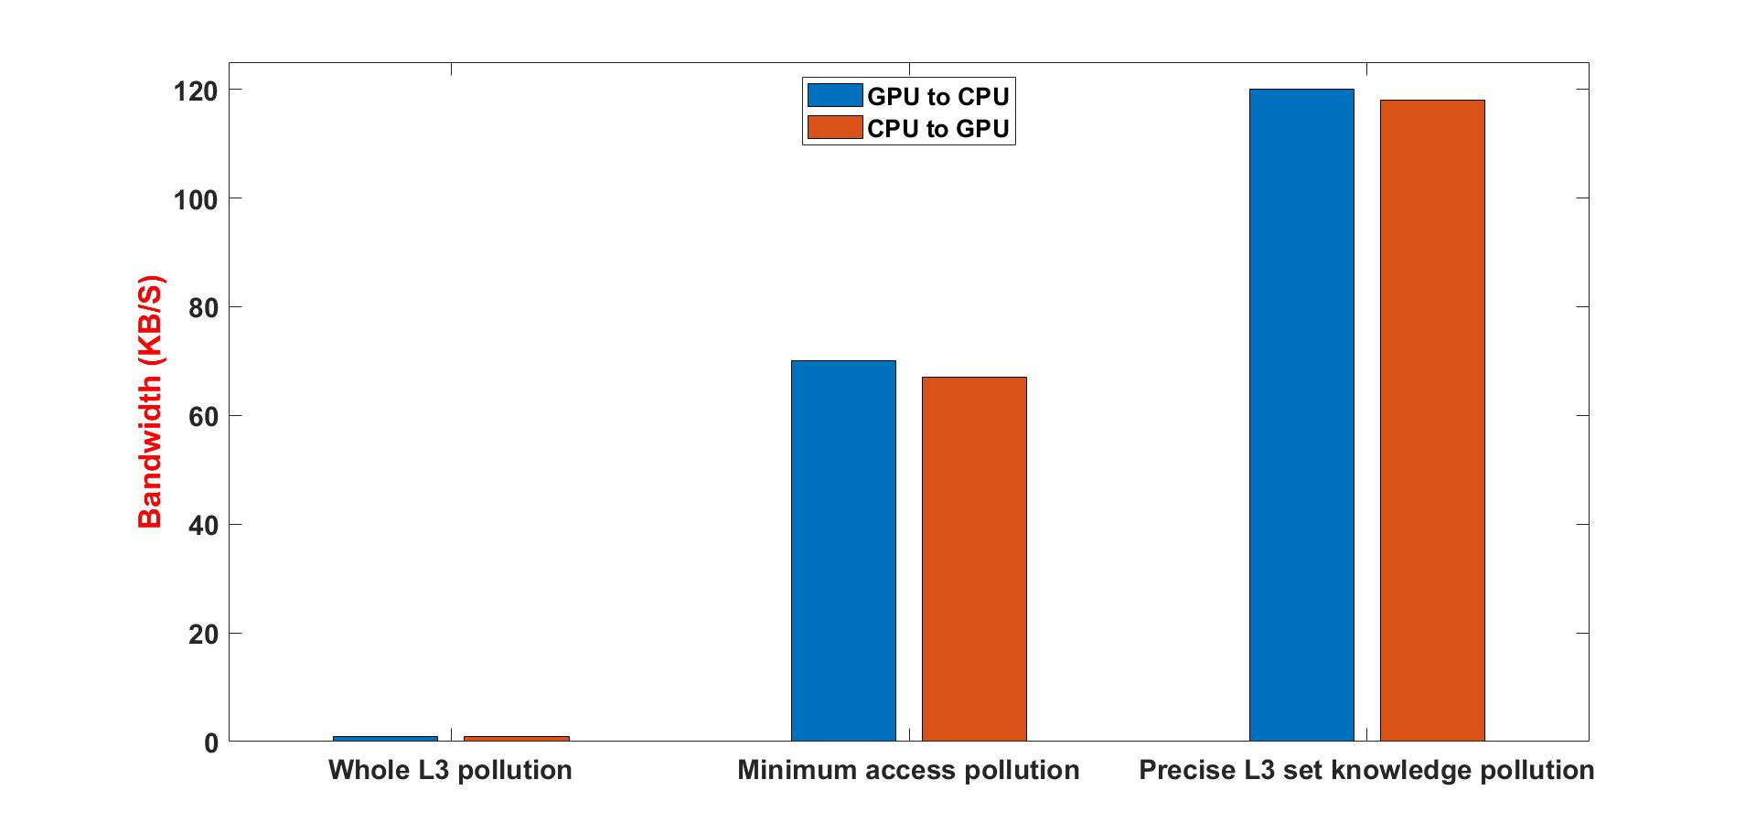
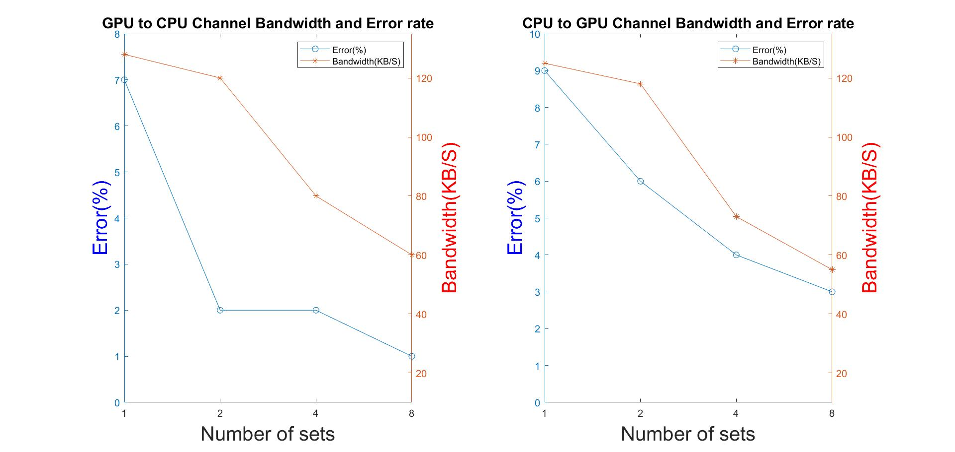
Cache Based Covert Channel Evaluation
GPU-CPU:
Bandwidth: 120 kb/s
Error: 2%
CPU-GPU:
Bandwidth: 118 kb/s
Error: 6%
Notes:
Now we are going to evaluate our cache based covert channel attacks.
As mentioned earlier that we were able to create a bidirectional attack.
In GPU to CPU based covert channel, we achieved a bandwidth of 120bkps and error rate of 2 percent.
And our CPU to GPU based covert channel achieved a bandwidth of 118 kbps and error rate of 6 percent.

Slide 18
Overview of Contention based Covert Channel
LLC
CPU DATA
GPU DATA
Trojan in GPU and Spy in CPU.
Both accesses data simultaneously.
Gets cached in non-overlapping LLC sets.
Subsequent accesses causes contention.
Contention
GPU
Ring Bus
CPU
Trojan
Spy
Notes:
Here I am going to discuss about our contention based covert channel created at shared bus level.
(KP) Trojan is located on GPU and spy on CPU.
(KP) Both the processes accesses their own set of data simultaneously.
(KP) The data sets were carefully chosen so that they get cached in different non-overlapping cache sets at the LLC level.
(KP) Subsequent accesses by the processes causes contention at the bus level.

Slide 19
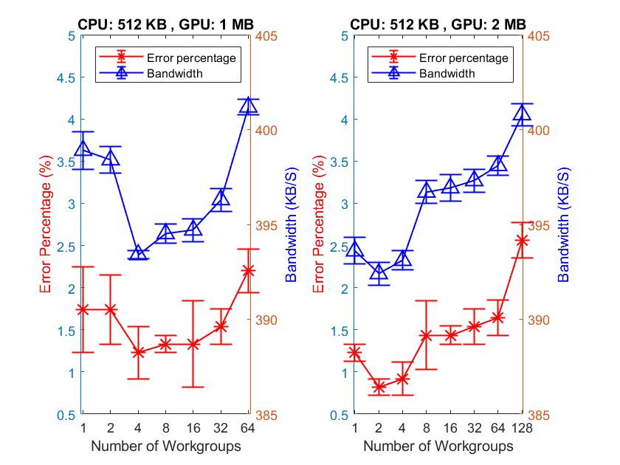
Contention Based Covert Channel Evaluation
Highest Bandwidth : 400 kb/s
Overall error: 2%
Lowest Error: 0.8%
Notes:
Next we are going to discuss about the evaluation of contention based covert channel attacks.
(KP) In our contention based channel the highest bandwidth of 400 kbps
(KP) Our overall error rate is 2 percent
(KP) and the lowest error rate we achieved is 0.8%

Slide 20
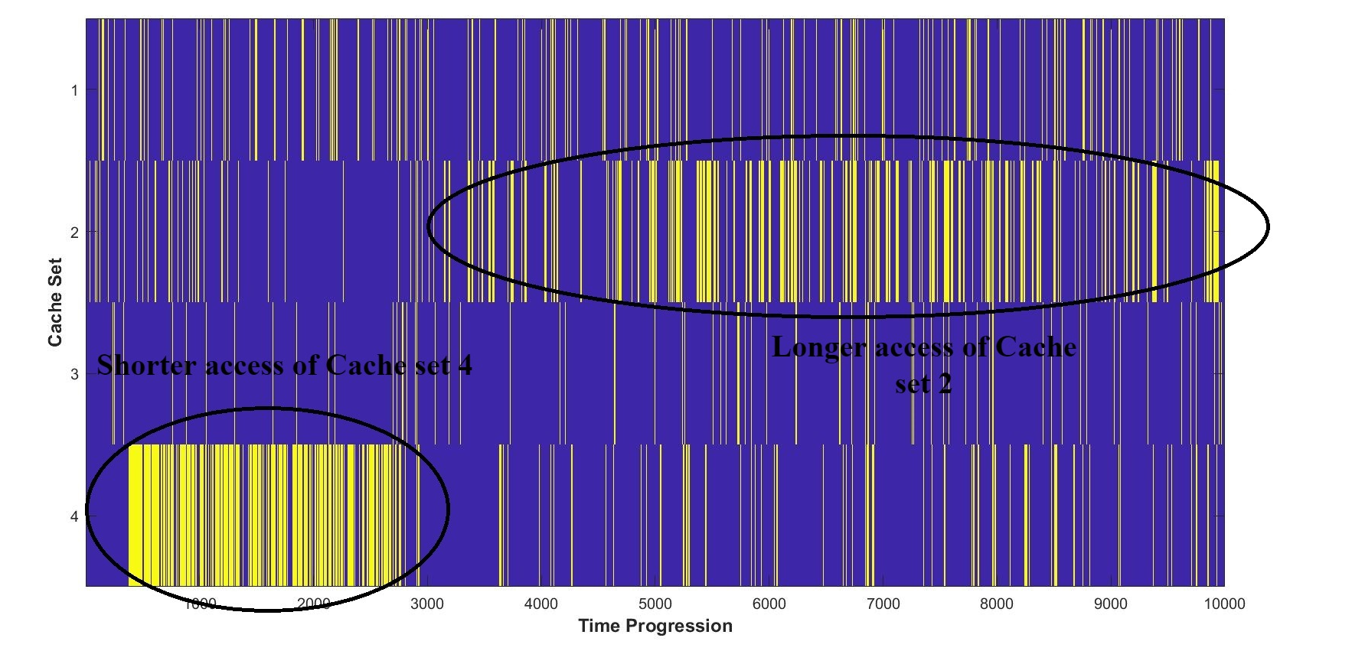
Proof-of-concept Side Channel: Tracking User’s
Cache Activity
Monitoring LLC set activities in parallel from GPU.
Cache miss distribution shown over a time period.
Both high and low frequency accesses are captured.
Notes:
We have also presented a proof-of-concept side channel attack where we are tracking the user’s cache activity in CPU from GPU
(KP) We monitored cache activities of CPU in parallel from GPU side.
(KP) Cache miss distribution over a period of time which we call memorygram.
The X axis shows a time progression
The Y axis shows user’s cache set activity executing on CPU that is monitored from GPU.
Each vertical yellow line represents cache miss on that particular time step.
(KP) From the result we can see that we are able to capture both the high and low frequency access.
Cache set 4 depicts a high frequency user’s activity from time stamp 500 to 3000
Cache set 2 depicts a low frequency user’s activity from time step 3000 to 10000.

Slide 21
Concluding Remarks
First microarchitectural covert channel attacks spanning components in a SoC.
Improves our understanding about cross-component microarchitectural timing attacks.
Overcame set of challenges
1. Disparate computational models
2. Memory views across components.
Demonstrated two attacks
1. Prime + Probe on LLC.
2. Contention based on shared resources.
As heterogeneous systems continue to proliferate, important to study their security properties
Notes:
In conclusion
(KP) We demonstrated first microarchitectural covert channel attack that span across components in a SoC.
(KP) Through our attack we are able to refine our knowledge about the cross-components microarchitectural timing attacks in modern heterogeneous environment.
(KP) We overcame set of challenges that arose due to disparate computational models and memory views across the components.
(KP) We demonstrated 2 kinds of attacks.
The first is the prime+probe based LLC attack and the second is the contention based attack on shared resources like the ring bus.
(KP) Trough our work we demonstrated that with the escalation of this heterogenous architectures, exploration of their security properties is also crucial.

Slide 22
THANK YOU
Notes:
At the very end I would like to thank you for providing us the opportunity to present our work in such a coveted platform. Thank you.

