Slide 1
RIC: Relaxed Inclusion Caches for Mitigating LLC Side-Channel Attacks
Nael Abu-Ghazaleh, University of California, Riverside
Mehmet Kayaalp, IBM Research
Khaled N. Khasawneh, University of California, Riverside
Hodjat Asghari Esfeden, University of California, Riverside
Jesse Elwell, Vencore Labs
Dmitry Ponomarev, Binghamton University
Aamer Jaleel, NVIDIA

Slide 2
Cache Side Channel
28 1e 4c 24
09 bf 15 82
30 6f 53 d9
a4 49 2d 0e
f2 85 5c 06
6a 91 4e 0c
c4 fc da a8
d5 37 e9 9c
SubBytes
S-Box
Set-associative cache
sets
ways

Slide 3
Flush+Reload Attack
Core 1
Core 2
Victim
Attacker
1- Flush each line in the critical data
2- Victim accesses critical data
3- Reload critical data (measure time)
L1-I
L1-D
L1-I
L1-D
L2
L2
Shared L3
Cache
Evicted
Time
sets
ways

Slide 4
Prime+Probe: L1 Attack
2-way SMT core
1- Prime each cache set
2- Victim accesses critical data
Victim
Attacker
3- Probe each cache set (measure time)
L1-I
L1-D
L2
L1 Cache
Evicted
Time
sets
ways

Slide 5
Prime+Probe: LLC Attack
CPU1
CPU2
Victim
Attacker
1- Prime each cache set
2- Victim accesses critical data
3- Probe each cache set (measure time)
Back-invalidations
L1-I
L1-D
L1-I
L1-D
L2
L2
Evict critical data
Shared L3
Inclusive
Next access of the victim brings in critical data from memory
To L1-D, L2, and L3; evicting attacker’s data from L3
Attacker detects accesses by looking at L3 state
Back-invalidation from inclusiveness makes critical accesses visible to attacker

Slide 6
Operation of Inclusive Caches
Invalidated in L1
Victim
Attacker
L1 miss!
L1
L1
Visible access to LLC
LLC
Back-Invalidation

Slide 7
Relaxed Inclusion Caches
Stays in L1
Victim
Attacker
L1 hit!
L1
L1
No visible access to LLC
LLC
Read only

Slide 8
Cache Inclusiveness
Inclusive: Each cache line in local cache exists also in shared cache
If not in shared cache, it cannot be in ANY local caches
Provides snoop filtering: no unnecessary cache traffic
Non-inclusive: Save cache space by not duplicating data
For a cache miss, need to snoop all other local
Extra snoop filtering hardware is required to eliminate unnecessary cache traffic
 | Inclusive | Non-inclusive
Shared cache hit | Copy | Copy
Shared cache evict | Evict from all local caches | Do nothing
Shared cache miss | Go to memory | Snoop local caches
Data duplication | All local data | Some local data

Slide 9
Relaxed Inclusion Caches
Snoop filtering benefit is not relevant in some cases
If the data cannot be in any other local cache (private)
If the data cannot be in a modified state in any other local cache (read-only)
If the data is read-only, there is no problem
Even if another cache has a copy, we can still ignore it
If the data is thread-private, and the thread is pinned to a core
If we schedule the thread somewhere else, we need to write back the modified data from the local cache
 | Inclusive | Non-inclusive | Relaxed Inclusion Caches
Shared cache hit | Copy | Copy | Copy
Shared cache evict | Evict from all local caches | Do nothing | Do nothing if read-only or thread-private
Shared cache miss | Go to memory | Snoop local caches | Go to memory
Data duplication | All local data | Some local data | Only shared writable local data

Slide 10
RIC Implementation
System software can manage relaxed-inclusion bit on a page basis
Existing page table entry permissions extended to mark RIC data
Read-only or thread private
A single bit added per cache line
The relaxed-inclusion bit is copied from TLB on a cache fill
Minimal hardware overhead

Slide 11
Security Analysis
In RIC, the attacker cannot evict victim’s data
But the victim can still evict its own data
If the critical data fits in the local cache, side channel is eliminated
Critical accesses for AES with different local cache sizes

Slide 12
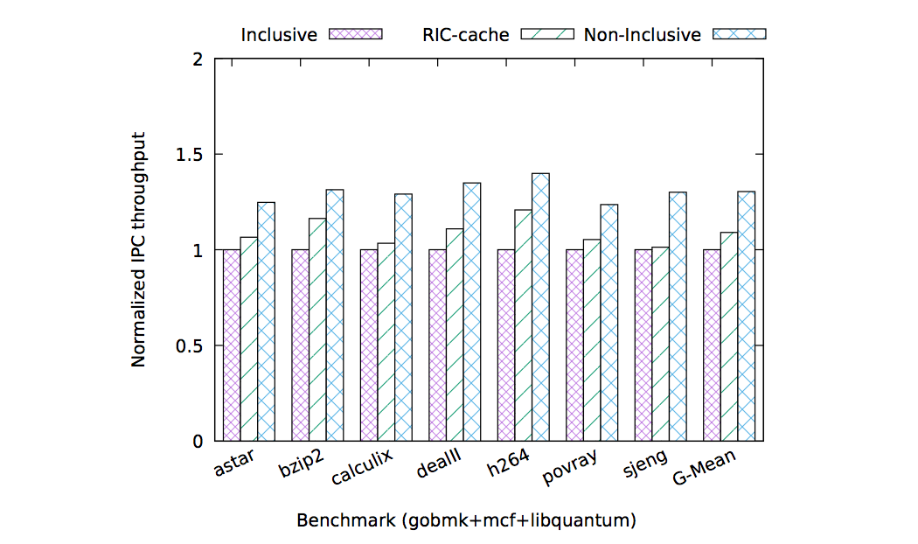
Performance Analysis
RIC eliminates data duplication for all read-only and thread-private data, increasing effective cache size
e.g. all instructions can be evicted from LLC
Parameters
4 cores
32KB 4-way L1D, L1I
256KB 8-way L2
4 MB 16-way shared L3

Slide 13
Reduction in Back-invalidates
Notes:
This figure shows that the percentage of back invalidates eliminated by RIC is fairly constant across the benchmarks (more elimination in 2MB LLC > we have more replacement in 2MB LLC, so we have more elimination by RIC in this case).

Slide 14
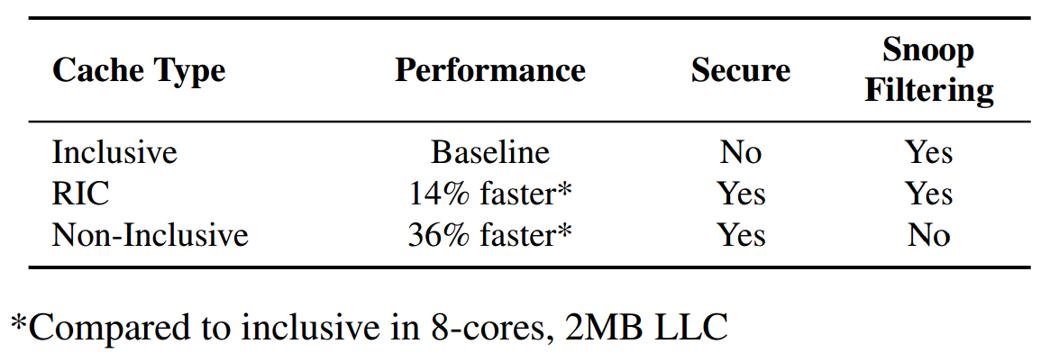
RIC Results Summary

Slide 15
Conclusion
Inclusive LLCs allow attackers to monitor victim’s critical accesses
But efficient because they enable snoop filtering
RIC relaxes this property to eliminate the side channel
While retaining snoop filtering
RIC is a simple mechanism that improves performance compared to inclusive caches

