Slide 1
Rendered Insecure:
GPU Side Channel Attacks
are Practical
Hoda Naghibijouybari, Ajaya Neupane, Zhiyun Qian
and Nael Abu-Ghazaleh
University of California, Riverside

Slide 2
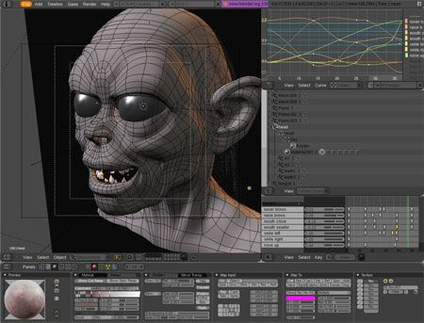


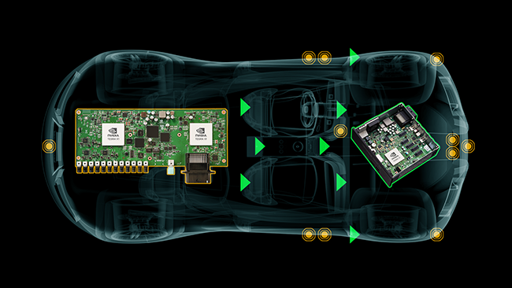
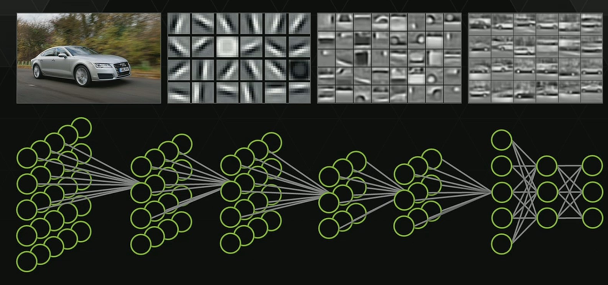

Graphics Processing Units
Optimize the performance of graphics and multi-media heavy workloads
Integrated on data centers and clouds to accelerate a range of computational applications

Slide 3
Motivation
GPUs often process sensitive data
Trends to improve multiprogramming on GPUs
Are side channels a threat?
  Covert channels shown
  Some side channels, but not general

Slide 4
Outline
Background: GPU architecture and Programming Interfaces
Threat Model and Leakage Vectors
Side Channel Attacks:
Graphics-Graphics: Website Fingerprinting, Keystroke Timing attack
CUDA-CUDA: Neural Network model recovery
CUDA-Graphics: Website Fingerprinting
Mitigation

Slide 5
GPU Architecture: massive paralleism

Slide 6
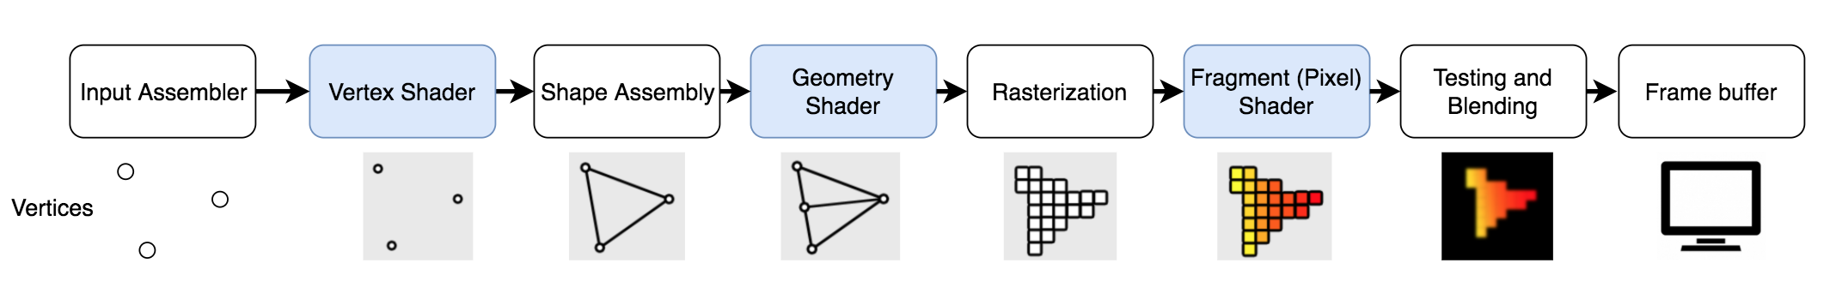
GPU Programming Interfaces
Computation: CUDA and OpenCL
Graphics: OpenGL and WebGL
Programmable steps of Graphics pipeline which are executed on SMs

Slide 7
Increasingly designed for sharing

Slide 8
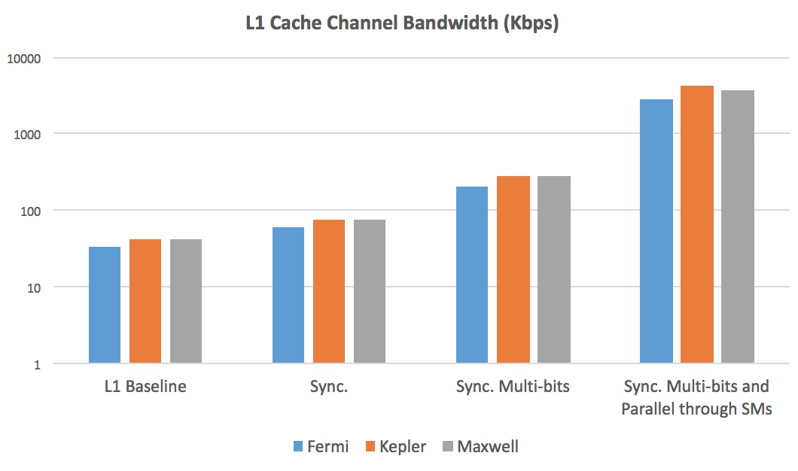
Prior work—covert channels on GPUs
12.9 x
3.8 x
1.7 x
Error-free bandwidth of over 4 Mbps
Constructing and Characterizing Covert Channels on GPUs [Micro 2017]
Colocate Spy and Trojan
Construct the Channels
Remove Noise

Slide 9
Finer grain microarchitectural channels
CPU
GPU
Concurrent apps not possible in all scenarios (e.g. Graphics and CUDA)
Possible on different
cores / same core
Co-location
Prime+Probe
Flush+Reload
…
Difficult (many active threads and small caches)
No flush instruction
D-cache attacks
Control flow
based attacks
I-cache attack
branch prediction attacks
SIMT computational model limits this leakage
No branch prediction

Slide 10

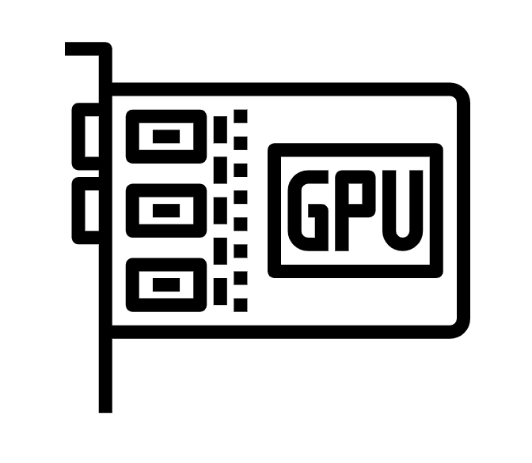

Threat Model
Programming Interfaces
Example Applications
GPU rendering
(Web Browsers, …)
GPU Accelerated Computations
(DNN, Encryption, …)
CUDA/OpenGL Spy
on
CUDA/OpenGL Victim
Key challenges:
How can attacker co-locate with victim
What leakage can be measured?
CUDA Spy
on
CUDA Victim
GPU Accelerated Computations
(DNN, Encryption, …)

Slide 11
Leakage Vectors
1
Memory allocation API : Exposes the amount of available physical memory on the GPU
GPU hardware performance counters: memory, instruction, multiprocessor, cache and texture metrics.
2
3
Timing operations: measuring the time of memory allocation events

Slide 12






Graphics-Graphics Attack Overview
OpenGL Spy
App
Screen
Rendering

Slide 13
Graphics-Graphics Side Channel (Co-location)
Reverse engineering the co-location of two concurrent applications:
Graphics App1
CPU Code
GPU Code (vertex and fragment shaders)
Two graphics applications whose workloads do not exceed the GPU hardware resources can colocate concurrently.
Graphics App2
CPU Code
GPU Code (vertex and fragment shaders)
CPU Code:
Read the pixel colors from framebuffer and decode the information
GPU Code (fragment shader):
Use OpenGL extensions to read ThreadID, WarpID, SMID and clock of each fragment (pixel/thread) on the GPU and encode this information in the color of each pixel.
glReadPixels(…);
SMID = float(gl_SMIDNV)/3.0;
clock = float(clock2x32ARB().y)/4294967295.0;
ThreadID = float(gl_ThreadInWarpNV)/32.0;
color = vec4(0, ThreadID ,SMID, clock);

Slide 14

Attack 1: Website Fingerprinting
Current versions of web browsers utilize the GPU to accelerate the rendering process.
A content-related pattern (depending on the size and shape of the object) of memory allocations is performed on the GPU.
Uploading objects as Textures to the GPU
Rendering

Slide 15
GPU memory allocation trace
OpenGL: query
“GPU_MEMORY_INFO_CURRENT_AVAILABLE_VIDMEM_NVX”
Same attack can be done by a CUDA spy using CUDA API:
“cudaMemGetInfo”

Slide 16
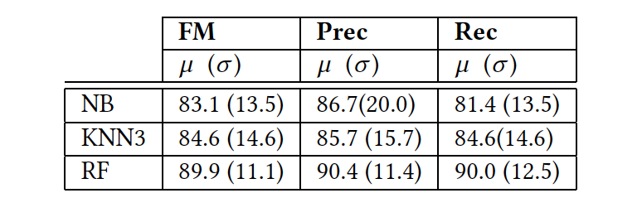
Classification Results
The classification results for Memory API based website fingerprinting attack on 200 Alexa Top Websites:
  Gaussian Naive Bayes (NB)
  K-Nearest Neighbor with 3 neighbors (KNN-3)
  Random Forest with 100 estimators (RF)

Slide 17
Attack 2: Keystroke Timing
Record the timing of memory allocation events
Password bar is rendered at constant rate, when user is not typing
Password bar is rendered when user types a character
6-character password

Slide 18
Keystroke timing: Ground Truth vs. GPU
The probability density of the normalized measurement error with 250 key presses/timing samples
The inter-keystroke timing for 25 pairs of characters being typed

Slide 19
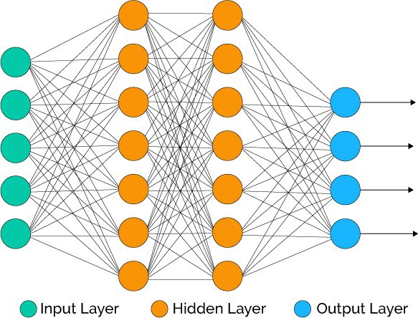
CUDA-CUDA: Attack overview
CUDA App
CUDA Spy
App

Slide 20
CUDA-CUDA Side Channel
Colocation:
Multi-Process Service (MPS) on NVIDIA GPUs allows execution of concurrent kernels from different processes on the GPU
Leakage:
Monitoring GPU Performance Counters provided by NVIDIA profiling tools
MPI Process A
MPI Process B
MPS Client Context A
MPS Client Context B
Many to one context
Server CUDA Context
MPI Service Process
Concurrent
Scheduler
Concurrent
Scheduler
Time-Sliced
Scheduler
Processors
GPU

Slide 21
Attack 3: Neural Network Model Recovery
Victim: A CUDA-implemented back-propagation (Rodinia benchmark)
Spy: Launches several hundred consecutive CUDA kernels
Methodology:
Colocate: Reverse engineer GPU hardware schedulers to colocate on each SM
Create contention: Different threads (or warps) utilize different hardware resources in parallel to create contention
Measure: Collecting one vector of performance counter values from each spy kernel

Slide 22
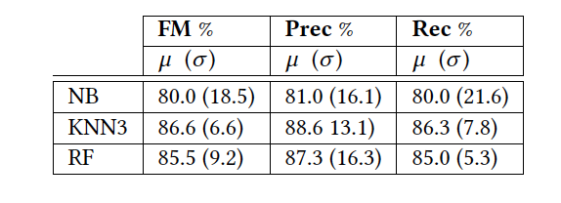
Results
The classification results for identifying the number of neurons through the side channel attack:
Input layer size varying in the range between 64 and 65536 neurons collecting 10 samples for each input size

Slide 23
CUDA-Graphics Side Channel
Colocation (reverse engineering):
Fine-grained interleaving execution (not concurrent) of CUDA kernels and graphics operations on the GPU
Leakage:
Memory API
  From CPU, so concurrent execution
GPU Performance Counters sampling after every frame by a short CUDA kernel
Result: Classification accuracy of 93% for 200 Alexa top websites

Slide 24
Mitigation
Limiting the rate of the calls
Limiting the precision of returned information
Combined
(Rate limiting at 4MB granularity)

Slide 25
Disclosure
We have reported all of our findings to NVIDIA:
  CVE 2018-6260, security notice
Patch: offers system administrators the option to disable access to performance counters from user processes
  Main issue is backward compatibility
Later reported to Intel and AMD; working on replicating attacks there.

Slide 26
Conclusion
Side channels on GPUs
  Fine grain channels impractical?
…between two concurrent applications on GPUs:
  A series of end-to-end GPU attacks on both graphics and computational stacks, as well as across them.
Mitigations based on limiting the rate and precision are effective
Future work: Multi-GPU systems; integrated GPU systems

