Slide 1
Designing Secure Processors in the Age of Spectre and Meltdown
Nael Abu-Ghazaleh
University of California, Riverside nael@cs.ucr.edu

Slide 2
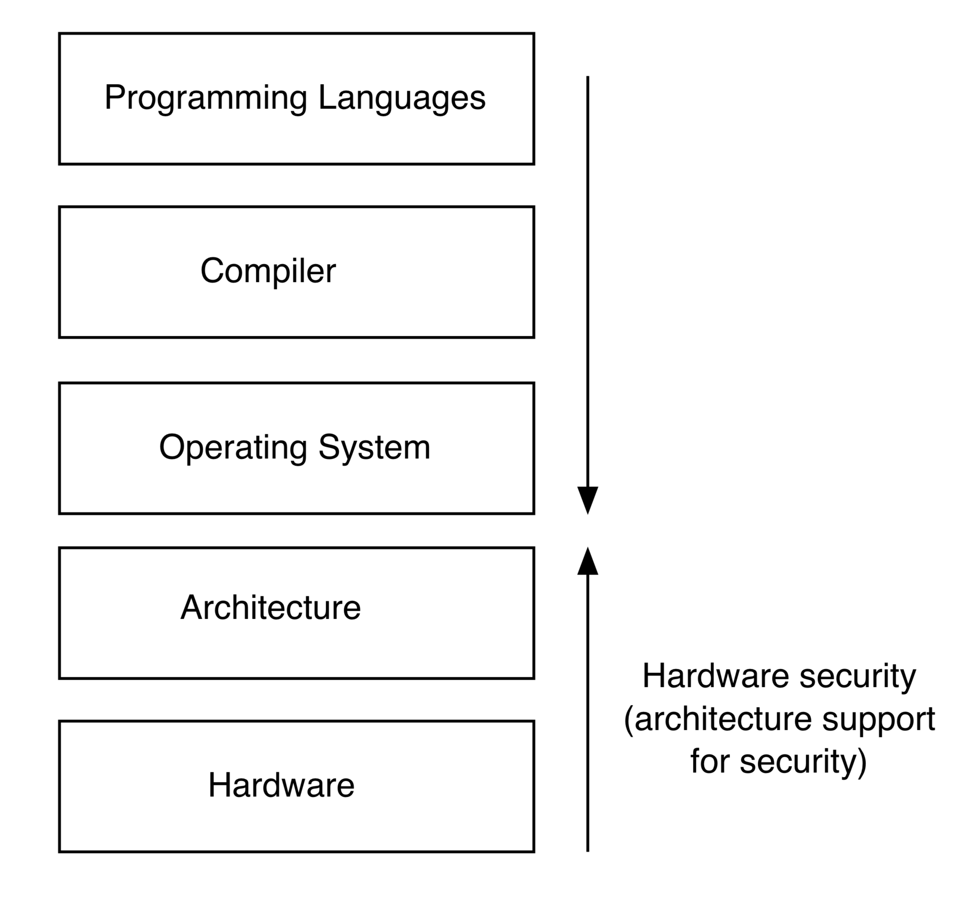
Architecture support for security
What hardware
Vulnerabilities are
Exploitable by software?
What support can we
offer to improve software
Security?

Slide 3
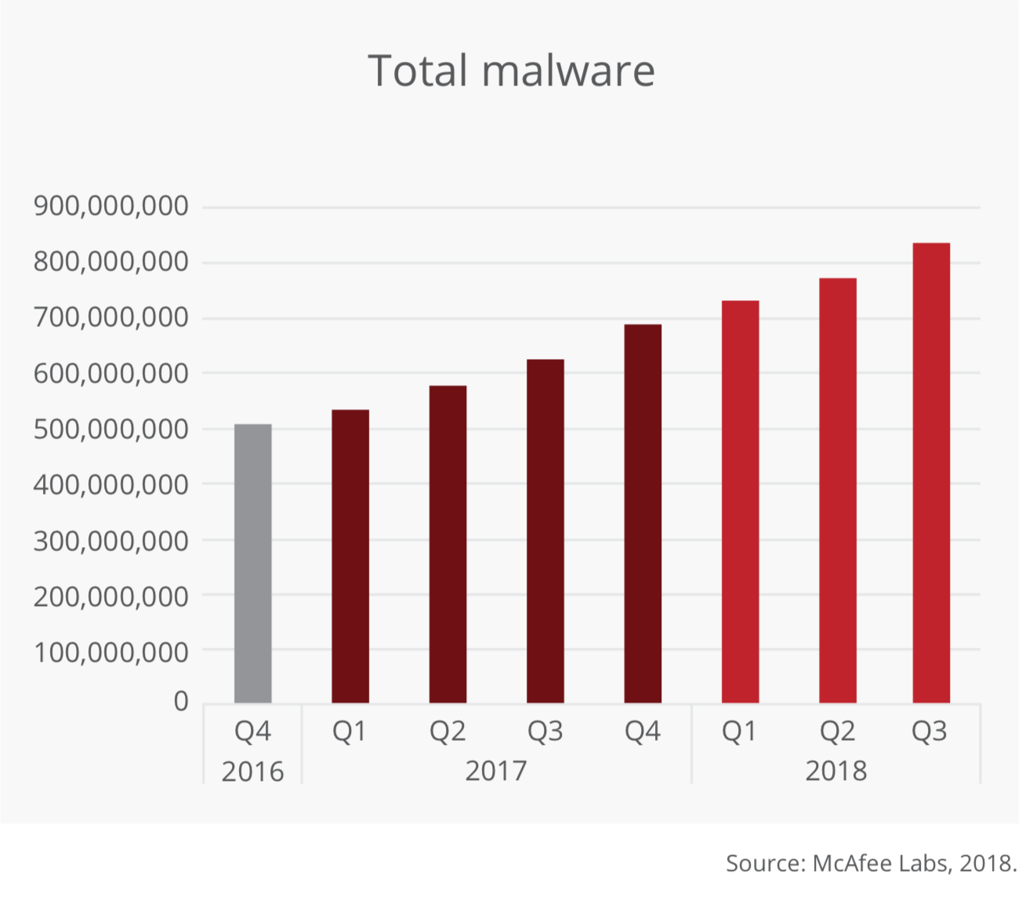
Malware is Everywhere!
Over 350,000 malware registered every day!
Notes:
The problem is that there is a lot of malware
These are what we see these days, but they are not always visible
Lets jump to what attackers really wants?

Slide 4
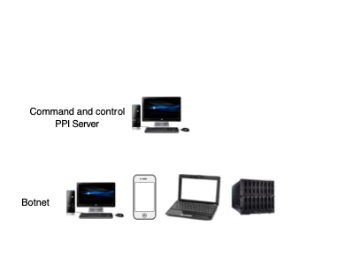
What motivates attackers? One cross-section

Slide 5


Slide 6
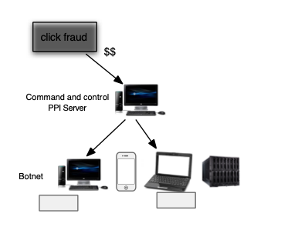

Slide 7
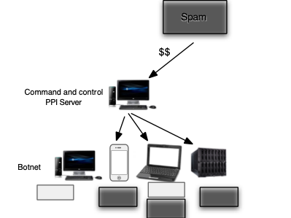
Installs: 80-100 USD per 1000 machines (US); 7-8 USD per 1000 machines (Asia)
  Source: Cabalerro et al. “Measuring pay-per-install...” Usenix 2011

Slide 8
Underground Malware Economy
Segmented supply chain
E.g., pay-per-exploit ~2013:
  Good guys/bug bounty programs (Google, pwn2own, iDefense, Zdi, …): 2-25K
  Black market: 250K+ for a good zero day
Good guys pay more now, but probably also black market
Bad guys motivated to protect their investments
  Malware continues to become more sophisticated
  …making defense more difficult

Slide 9

New application spaces
Security no longer just about information
Cloud is ubiquitous
Machine learning everywhere
New threat models

Slide 10


Slide 11
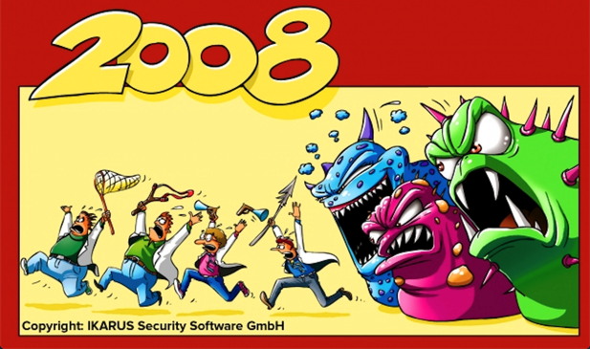

Slide 12
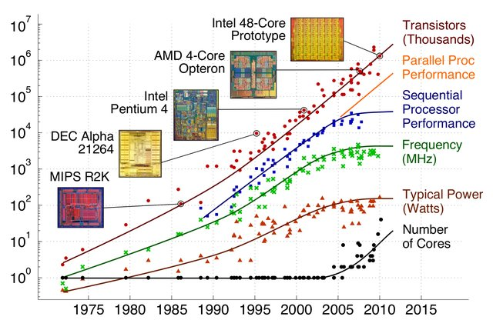
What’s going on in Architecture?
Circa 2010
Moore’s law still here
  barely (10nm->7nm->?)
Dennard’s scaling ended
  Power wall
We have transistors, but we can’t power them
  Dark silicon
  Can be used for important applications such as security

Slide 13
Opportunities: Architecture & Security?
Vulnerabilities originating in architecture
  Side and covert channels
  Speculation attacks
  Fault injection
  Hardware trojans, …
Attacks
Defenses rooted in architecture
  Do no harm
    Avoid vulnerabilities in architecture/HW
  Help software
    Security abstractions/mechanisms
    Computational support for expensive defenses
Defenses

Slide 14
Overview—Spectulative execution attacks
Attack flavor--Speculation attacks
  Overview, and SpectreRSB
Defense flavor
  Do no harm: Keep speculation, but prevent vulnerability
    SafeSpec: close the speculative side channels
    SpecCFI: prevent malicious speculation

Slide 15


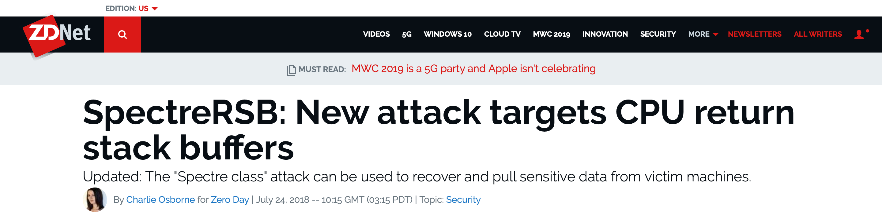
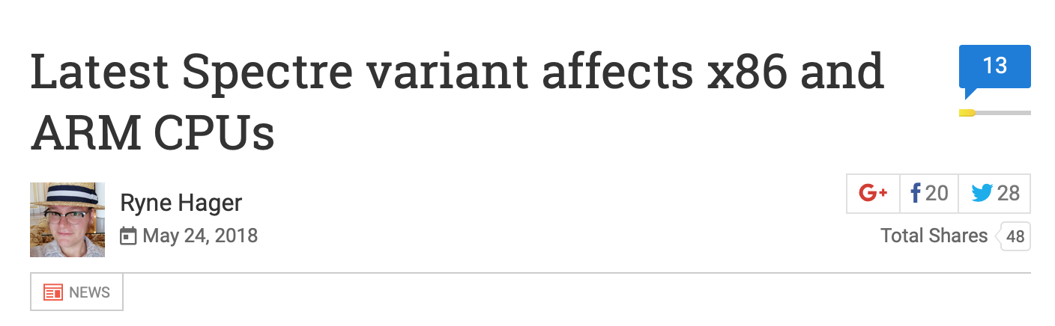
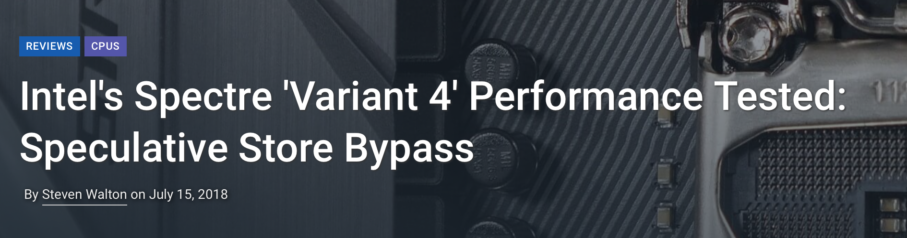

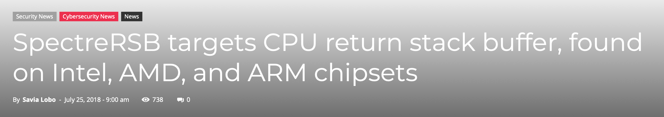
New Vulnerabilities in Modern
Processors
Spectre v1/v2/Meltdown(v3)
Spectre v1.1
Spectre v1.2
SGXpectre
Speculative store bypass (v4)
SpectreNG
SpectreRSB(v5?)
/ ret2spec
NetSpectre
MDS/RIDL/Zombieload
Jan 2018
May 2018
July 2018
Aug 2018
May 2019

Slide 16
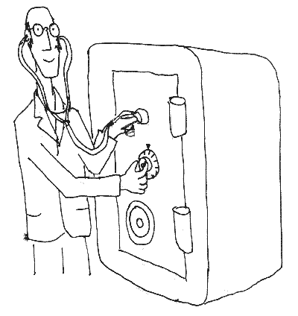
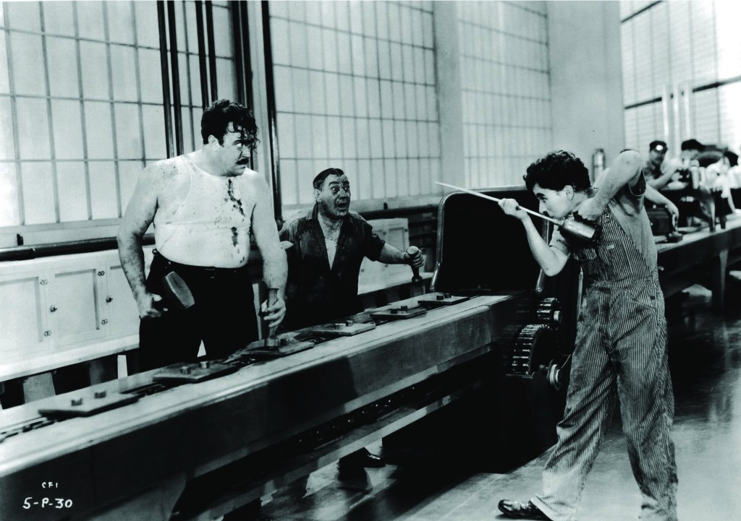
Attack Ingredients
Side Channel
Speculative Execution
Reg
Write
Data
Memory
ALU
Reg
Read
Fetch
Notes:
Speculative executions which occers on pipelined processors.. And if you are curious this is a picture from a move called Charly chapplen modern time → it is a good movie that you can watch on netflix

Slide 17
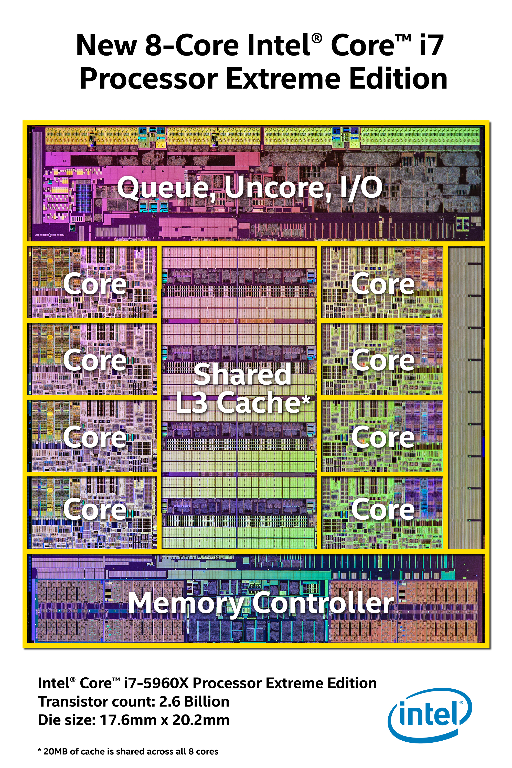
Side Channel Attacks
Running programs share resources
What one process does can affect the other

Slide 18

Cache Side Channel Attacks
Access to the data inside the cache is fast
Loading data from memory is slow
Exploits timing differences that are introduced by the caches
  Flush and reload
  Prime and probe
  …

Slide 19
Side Channel: Flush and Reload Attack
CPU1
CPU2
1- Flush each line in the critical data
2- Victim accesses critical data
Victim
Attacker
3- Reload critical data (measure time)
L1-I
L1-D
L1-I
L1-D
L2
L2
Shared L3
Cache
Evicted
Time
sets
ways

Slide 20

Ingredient 2: Speculative Execution

Slide 21
Speculative Execution
Cycle 1
Cycle 2
Cycle 3
Cycle 4
Cycle 5
Cycle 6
Cycle 7
Cycle 8
add $r1,r2
Fetch
Decode
Execute
Memory
Write back
beq $r1,$r3,#16
Fetch
Decode
Execute
Memory
Write back
stall?
add $r3,$r2
Fetch
Decode
Execute
Memory
Write back
Modern processors are super-pipelined and superscalar
  May take up to several hundred cycles to resolve a branch

Slide 22
Speculative Execution (Correct guess)
Cycle 1
Cycle 2
Cycle 3
Cycle 4
Cycle 5
Cycle 6
Cycle 7
Cycle 8
add $r1,r2
Fetch
Decode
Execute
Memory
Write back
beq $r1,$r3,#16
Fetch
Decode
Execute
Memory
Write back
add $r3,$r2
Speculative
Fetch
Decode
Execute
Memory
Write back
Right guess

Slide 23
Speculative Execution (Wrong guess) .
Cycle 1
Cycle 2
Cycle 3
Cycle 4
Cycle 5
Cycle 6
Cycle 7
Cycle 8
add $r1,r2
Fetch
Decode
Execute
Memory
Write back
beq $r1,$r3,#16
Fetch
Decode
Execute
Memory
Write back
sub $r3,$r2
Speculative
Fetch
Decode
Execute
Memory
Write back
Wrong guess
add $r3,$r2
Fetch
Decode
Execute
Memory
Write back
Cleaning up for miss-speculation:
- Remove squashed instructions affect on architectural state
- Doesn't remove squashed instructions affects on microarchitectural state
Notes:
In fact when we wait the lost opportunity could be 200 cycles or more.. Threrefore, to take advantage of this oprrutunity we use speculation
What is spculaiton ? We simply guess what is the results of the branch -- > if we guess correctly then we manage to fill the pipline and if we do not guess correctly then we romve the effect and we havent lose anything because anyway we would have been waiting .
(20-25 stages on intel's processors)

Slide 24
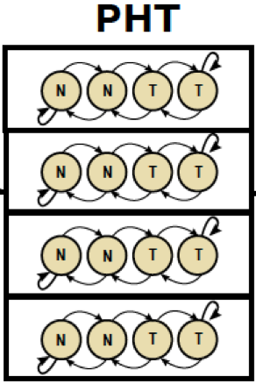
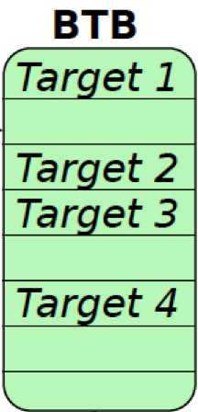
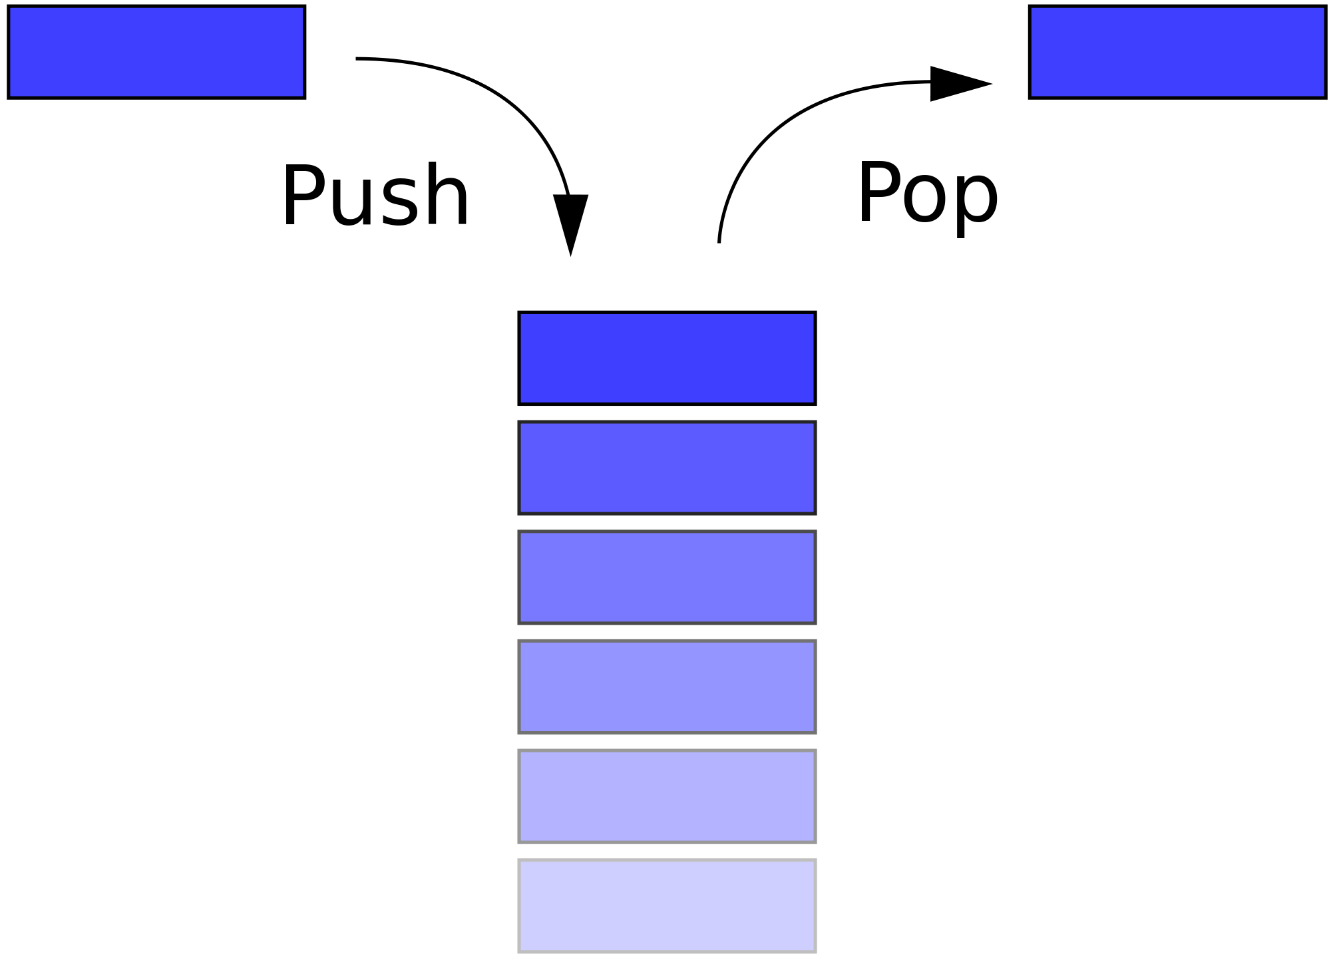
Microarchitectural Prediction Structures
Directional
Predictor
Target
Predictor
Return Address
Predictor
RSB
Jump over ASLR: Micro 2016
BranchScope, ASPLOS 2018
SpectreRSB (Spectre v5), WOOT’18
Notes:
You don’t really have to know the details
BTB: for branches that are indirect (means the location that they jump to is a variable not an imidate )
then I use something called the target predictor
PHT: try to guess wither we are taking a branch or not taking it, this is called directional predctor
RSB: Finally for return instructions, becouase they don’t follow privouse history .. So think about a printf statement , just beucae it return to the current palace at this call does not mean that it will return to it in the next call. So we use something called the resturn stack buffer which keeps the address of the call to use as prediction.
The original spectre paper showld attacks on the first two companents and my attack actually targets the last component the RSB.

Slide 25
Return Stack Buffers (RSB)
Software Stack
0X00000010
main(){
call fun1;
add r2,r3;
return; }
0X00000011
0X00000012
0X00000013
fun2
0X00000042
0X00000040
fun1(){
call fun2;
add r2,r3;
return;}
arguments
0X00000041
fun1
0X00000012
arguments
0X00000042
main
0X00000080
arguments
0X00000043
RSB
0X00000055
fun2(){
return;
}
0X00000056
0X00000042
0X00000012
0X00000080

Slide 26

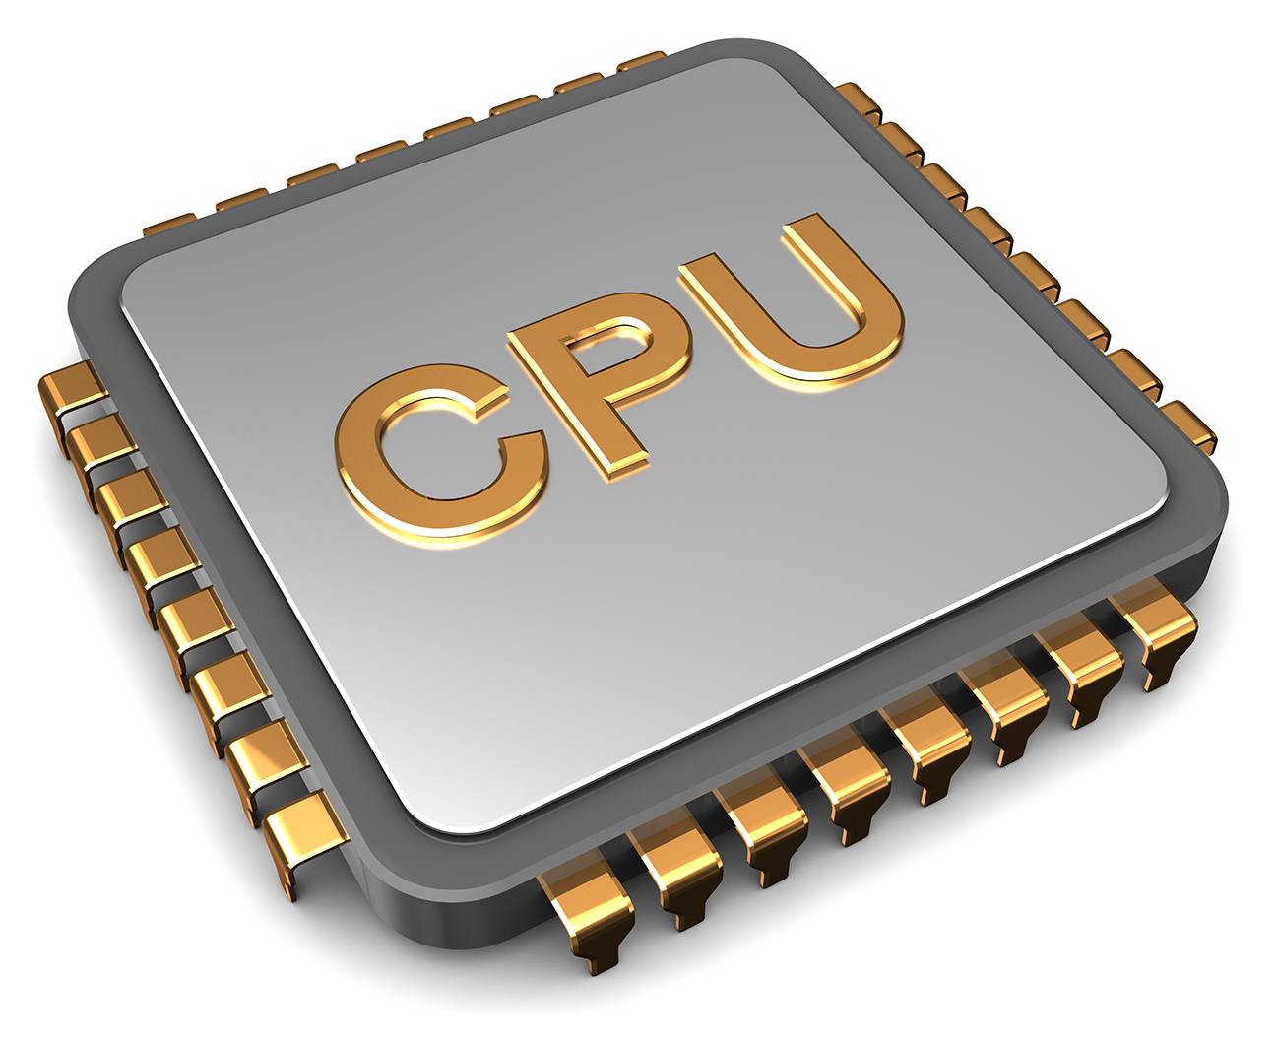
Return Stack Buffers (RSB)
Software Stack
0X00000010
main(){
call fun1;
add r2,r3;
return;
}
0X00000011
0X00000012
0X00000013
Memory request
fun2
0X00000042
0X00000040
fun1(){
call fun2;
add r2,r3;
return;
}
arguments
0X00000041
fun1
0X00000012
arguments
0X00000042
main
0X00000080
arguments
0X00000043
RSB
popRSB
0X00000055
fun2(){
return;
}
0X00000056
0X00000042
0X00000012
0X00000080

Slide 27
Return Stack Buffers (RSB)
Software Stack
0X00000010
main(){
call fun1;
add r2,r3;
return;
}
0X00000011
0X00000012
0X00000013
Memory response
0X00000042
?=
0X00000042
0X00000040
fun1(){
call fun2;
add r2,r3;
return;
}
fun2
arguments
0X00000041
fun1
0X00000012
arguments
0X00000042
main
0X00000080
arguments
0X00000043
RSB
0X00000055
fun2(){
return;
}
0X00000056
0X00000012
0X00000080

Slide 28
Return Stack Buffers (RSB)
Software Stack
0X00000010
main(){
call fun1;
add r2,r3;
return;
}
0X00000011
0X00000012
0X00000013
Memory response
0X00000042
?=
0X00000042
0X00000040
fun1(){
call fun2;
add r2,r3;
return;
}
if predicted (RSB value) == actual (software stack value)
Continue execution → gained performance
else
Squash speculative instructions → No performance loss
0X00000041
fun1
0X00000012
arguments
0X00000042
main
0X00000080
arguments
0X00000043
RSB
0X00000055
fun2(){
return;
}
0X00000056
0X00000012
0X00000080

Slide 29


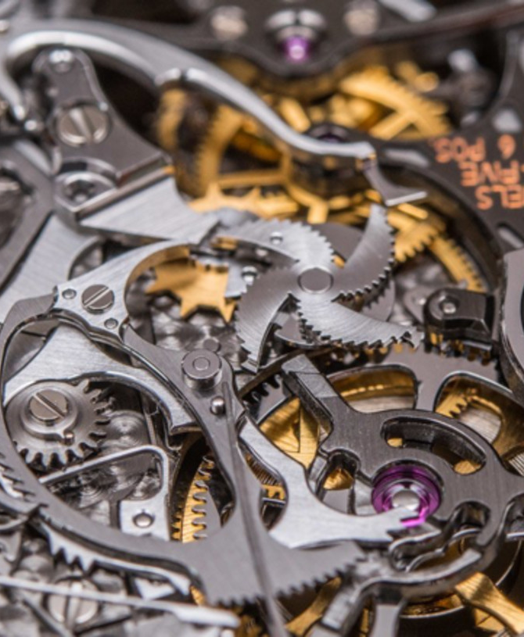
Putting all Together– Attacks!

Slide 30
SpectreRSB Attack Steps
Speculative instructions leave side-effects in micro-architectural structures such as caches
Force
mis-speculation
Read unauthorized data
Leak it (side channel)
Validation and permission checks are performed deep in the pipeline

Slide 31

SpectreRSB Example
0X00000010
main(){
call speculative;
check_array();
return;
}
Cache
Software Stack
0X00000011
assuming
secret = 1
array[1]
0X00000012
0X00000013
Memory request
0X00000040
Speculative(){
call pollute;
secret = kernel_mem;
array[secret];
}
pollute
0X00000042
arguments
0X00000041
speculative
0X00000012
0X00000042
arguments
main
0X00000080
arguments
pollute(){
pop_software_stack;
return;
}
RSB
0X00000055
popRSB
0X00000056
0X00000042
0X00000057
0X00000012
0X00000080

Slide 32
SpectreRSB Example
0X00000010
main(){
call speculative;
check_array();
return;
}
Cache
Software Stack
0X00000011
assuming
secret = 1
array[1]
0X00000012
0X00000013
Memory response
0X00000040
Speculative(){
call pollute;
secret = kernel_mem;
array[secret];
}
0X00000042
?=
0X00000041
Mis-speculation
speculative
0X00000012
0X00000042
arguments
main
0X00000080
arguments
pollute(){
pop_software_stack;
return;
}
RSB
0X00000055
0X00000056
0X00000057
0X00000012
0X00000080

Slide 33

SpectreRSB Example
0X00000010
main(){
call speculative;
check_array();
return;
}
Cache
Software Stack
0X00000011
assuming
secret = 1
array[1]
0X00000012
0X00000013
Memory response
0X00000040
check_array(){
Time(array[0]);
Time(array[1]);
}
Speculative(){
call pollute;
secret = kernel_mem;
array[secret];
}
Time
0X00000012
0X00000041
0X00000042
main
0X00000080
secret value = 1
arguments
pollute(){
pop_software_stack;
return;
}
RSB
0X00000055
0X00000056
0X00000057
0X00000012
0X00000080

Slide 34
SafeSpec [DAC’19]
Shadow
state
Committed
state
update
update
update
Fetch
Decode
...
Commit
Mis-speculation
speculative
Processor pipeline
Notes:
Use SpectreRSB examples as demonstration for shadow structures
Use temporary structures (Shadow) to hold any state that is produced speculatively

Slide 35
SafeSpec [DAC’19]
Shadow
state
move
Committed
state
annul
annul
annul
Fetch
Decode
...
Commit
Squash
Processor pipeline
Notes:
Use SpectreRSB examples as demonstration for shadow structures
Use temporary structures (Shadow) to hold any state that is produced speculatively

Slide 36
SafeSpec Example
0X00000010
main(){
call speculative;
check_array();
return;
}
Software Stack
Shadow cache
Cache
0X00000011
assuming
secret = 1
array[1]
0X00000012
0X00000013
Memory request
0X00000040
Speculative(){
call pollute;
secret = kernel_mem;
array[secret];
}
pollute
0X00000042
arguments
0X00000041
speculative
0X00000012
0X00000042
arguments
main
0X00000080
arguments
pollute(){
pop_software_stack;
return;
}
RSB
0X00000055
popRSB
0X00000056
0X00000042
0X00000057
0X00000012
0X00000080

Slide 37
SafeSpec Example
0X00000010
main(){
call speculative;
check_array();
return;
}
Software Stack
Shadow cache
Cache
0X00000011
assuming
secret = 1
array[1]
0X00000012
0X00000013
Memory response
0X00000040
Speculative(){
call pollute;
secret = kernel_mem;
array[secret];
}
0X00000042
?=
0X00000041
Mis-speculation
speculative
0X00000012
0X00000042
arguments
main
0X00000080
arguments
if predicted (RSB value) == actual (software stack value)
Continue execution → Move shadow cache state to cache state (on commit stage)
else
Squash speculative instructions → Annul shadow cache state
pollute(){
pop_software_stack;
return;
}
RSB
0X00000055
0X00000056
0X00000057
0X00000012
0X00000080

Slide 38

SafeSpec Example
0X00000010
main(){
call speculative;
check_array();
return;
}
Software Stack
Shadow cache
Cache
0X00000011
assuming
secret = 1
0X00000012
0X00000013
Memory response
0X00000040
Speculative(){
call pollute;
secret = kernel_mem;
array[secret];
}
Time
check_array(){
Time(array[0]);
Time(array[1]);
}
0X00000012
0X00000041
0X00000042
main
0X00000080
Attack failed
arguments
pollute(){
pop_software_stack;
return;
}
RSB
0X00000055
0X00000056
0X00000057
0X00000012
0X00000080

Slide 39
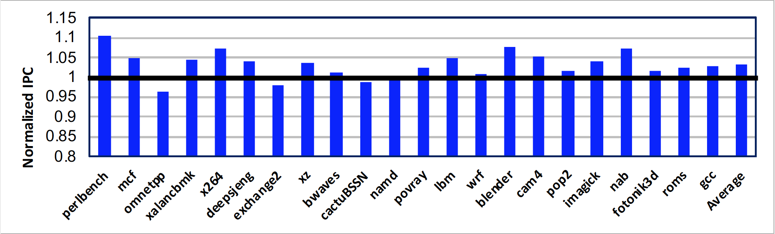
Implementation and Results
Integrated SafeSpec to MARSSx86
Evaluated the performance using SPEC2017
Baseline

Slide 40
Force mis-speculation: Spectre V2
Victim
Attacker
Branch Target Buffer
Address tag | Target
jmp
jmp
A:
A:
A
C
B:
B:
C:
C:
Spectre
gadget
Result: when victim executes, CPU uses injected target to start speculative execution at an address of attacker’s choice!

Slide 41






Intuition
Branch Predictor (BPU)
Branch
Target
BHSR
0x10
A
0x20
B
PC
0x10
jmp
rax
…
0x20
Victim
Attacker
Victim’s Control Flow Graph
0x10
A
0x20

Slide 42
Control Flow Integrity (CFI)
State of the art solution to mitigate Control-Flow Hijacking attacks
    Software: LLVM, GCC, Android, Microsoft, etc..
    Hardware: Intel Control-flow Enforcement Technology (CET) and ARM Branch target Indicators (BTI)
Idea: software execution must follow only legal paths within a control-flow graph (CFG) determined ahead of time
Implementation requires:
  1- Compute CFG of the program
  2- Regulate the control-flow transfers while program is executing
Can’t prevent spectre attacks since the regulation happen after instructions commits
Notes:
Because of its effectiveness against control-flow
hijacking attacks, CFI has been adopted by both commodity
software and hardware.

Slide 43



SpecCFI
Compiler
Mov rbx,23
Add rax,1
Jmp rbx
...
t1
t5
t2
...
Jmp rbx
CFI_check
...
Similar to CFI
CFG
construction
t4
t3
Valid Target Set
Forward-edge
Backward-edge
Speculative
regulation
at run-time
RSB
In contrast to CFI
CFI_check
CFI_check
Shadow RSB
Notes:
Any CFI mechanism consists of two abstract components: the (often static) analysis component that recovers the Control-Flow Graph (CFG) of the application (at different levels of precision) and the dynamic enforcement mechanism that restricts control flows according to the generated CFG.
For normal programs, this
results in negligible performance degradation since it only
prevents speculation with mismatching CFI labels, which will
most likely result in misspeculation. By stopping misspeculation,
we benefit from avoiding cache pollution and other
resource waste during misspeculation.

Slide 44
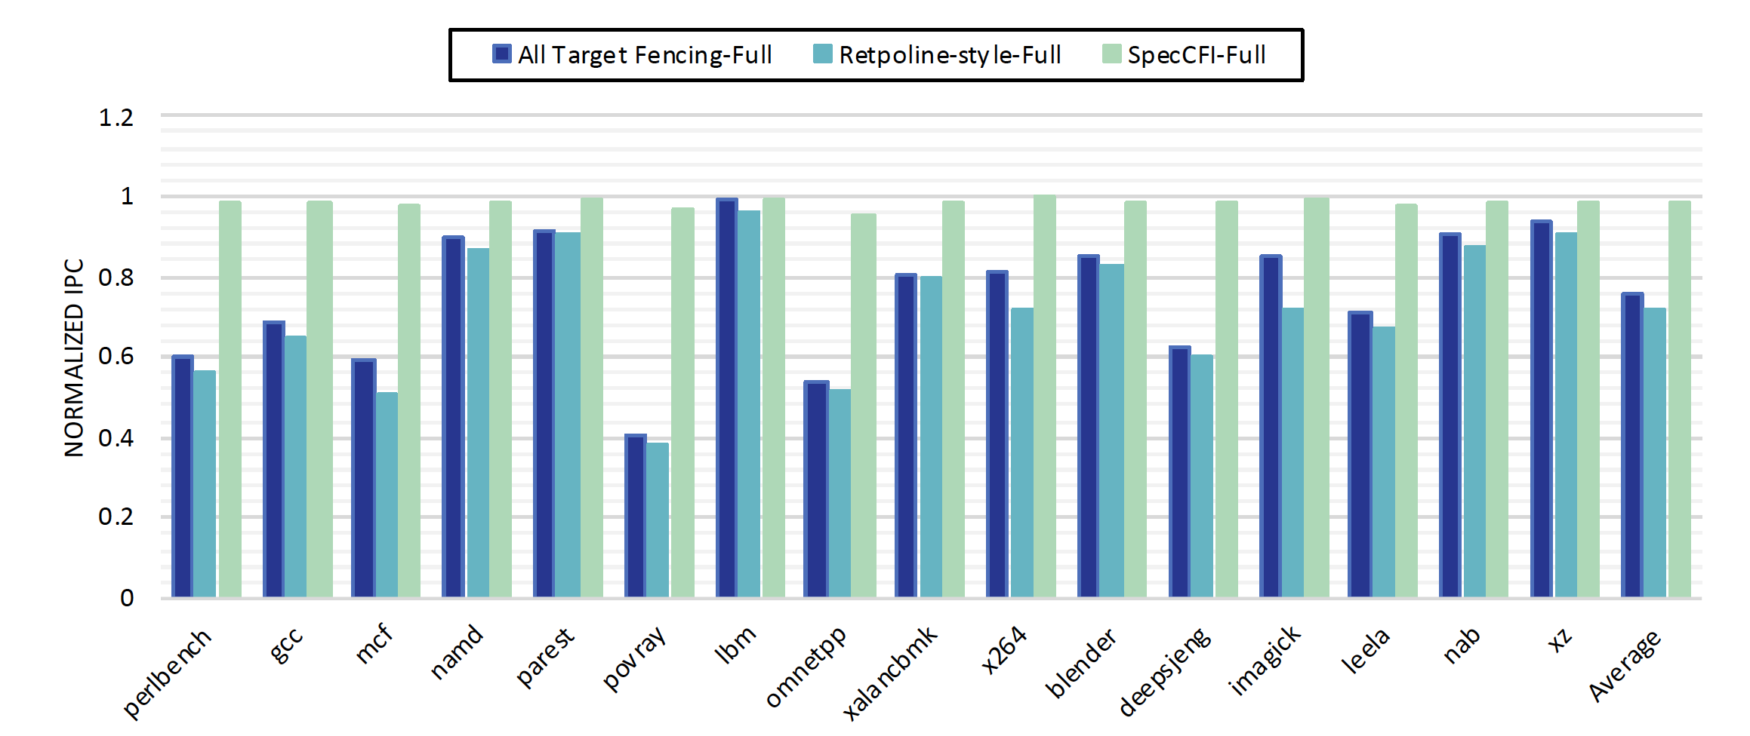
Performance Impact
Notes:
Because of its effectiveness against control-flow
hijacking attacks, CFI has been adopted by both commodity
software and hardware.

Slide 45
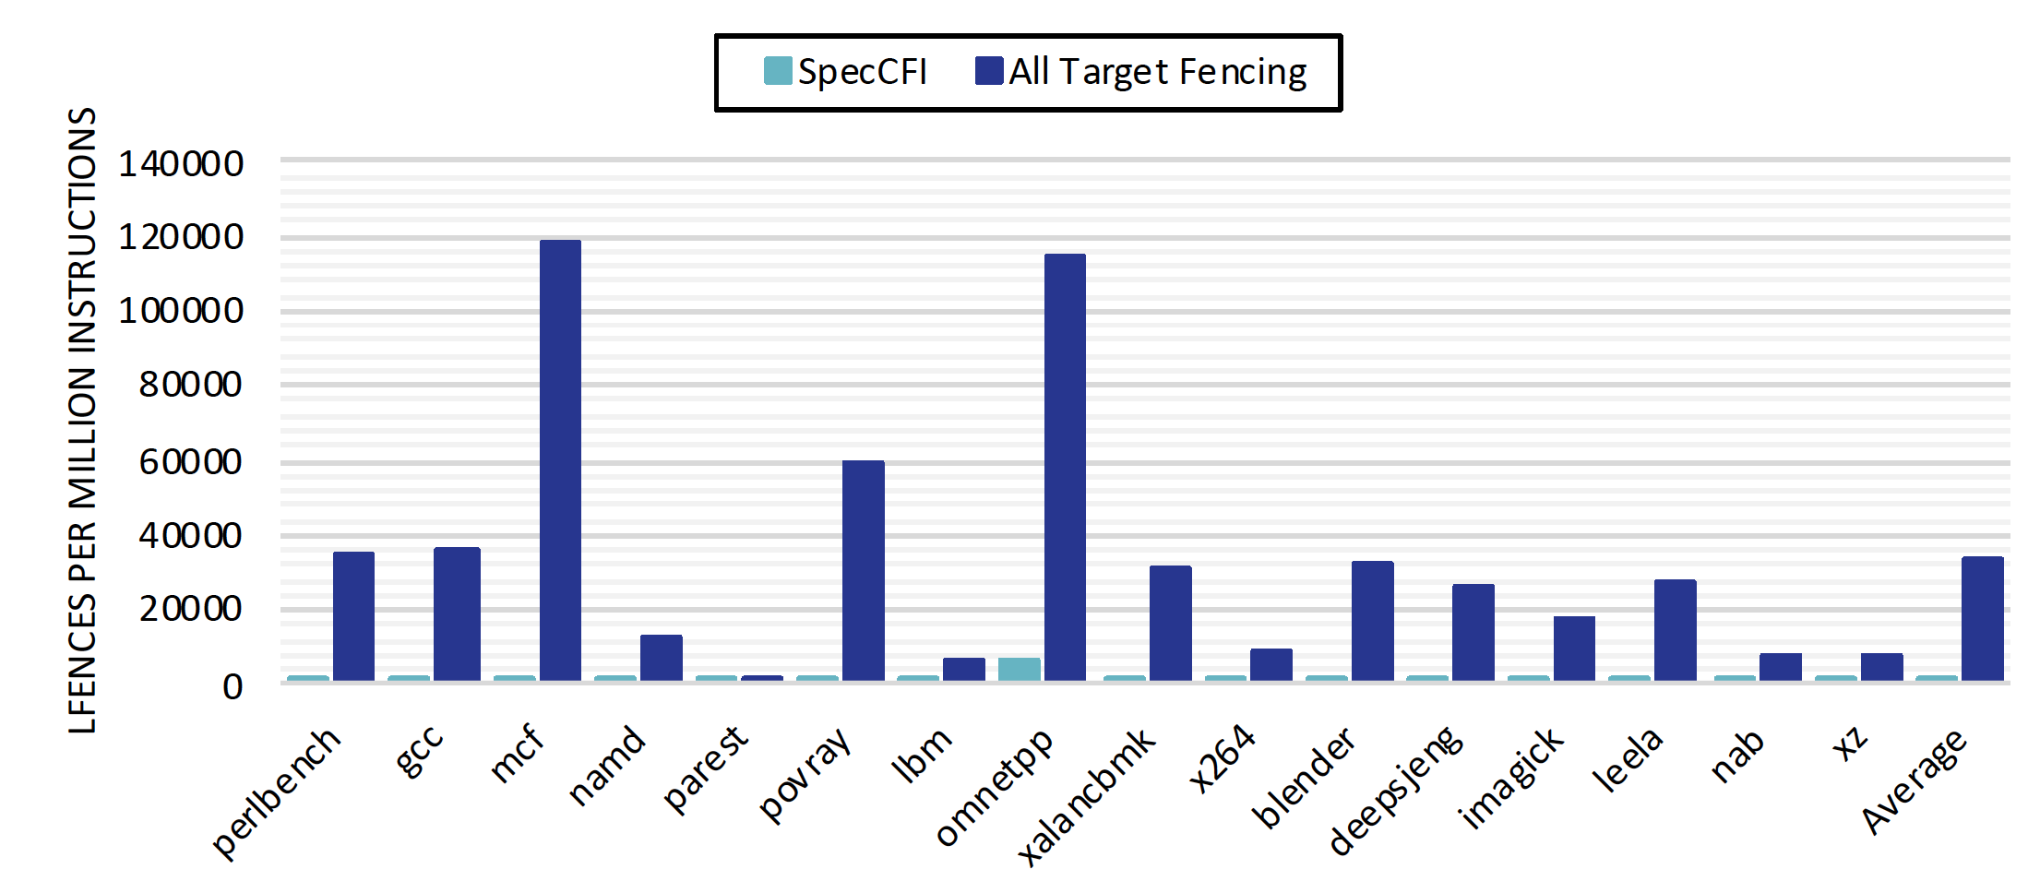
Number of Inserted Fences
Notes:
Because of its effectiveness against control-flow
hijacking attacks, CFI has been adopted by both commodity
software and hardware.

Slide 46
Concluding Remarks
SpecCFI is a complete defense against mis-speculation targeting BTB and RSB
SpecCFI interduce the idea of using CFI as a defense against speculation attacks
  Verifying forward-edge
  Verifying backward-edge
SpecCFI has little impact on performance, and with minimal hardware complexity
Combined with recent proposals to mitigate Spectre-PHT, we believe SpecCFI mitigates the threat from known speculation attacks
Notes:
Because of its effectiveness against control-flow
hijacking attacks, CFI has been adopted by both commodity
software and hardware.
of CFI on the instructions in the speculative path labels match protecting against Spectre-BTB attacks
backward-edge using a unified shadow call stack, protecting against Spectre-RSB attacks

Slide 47
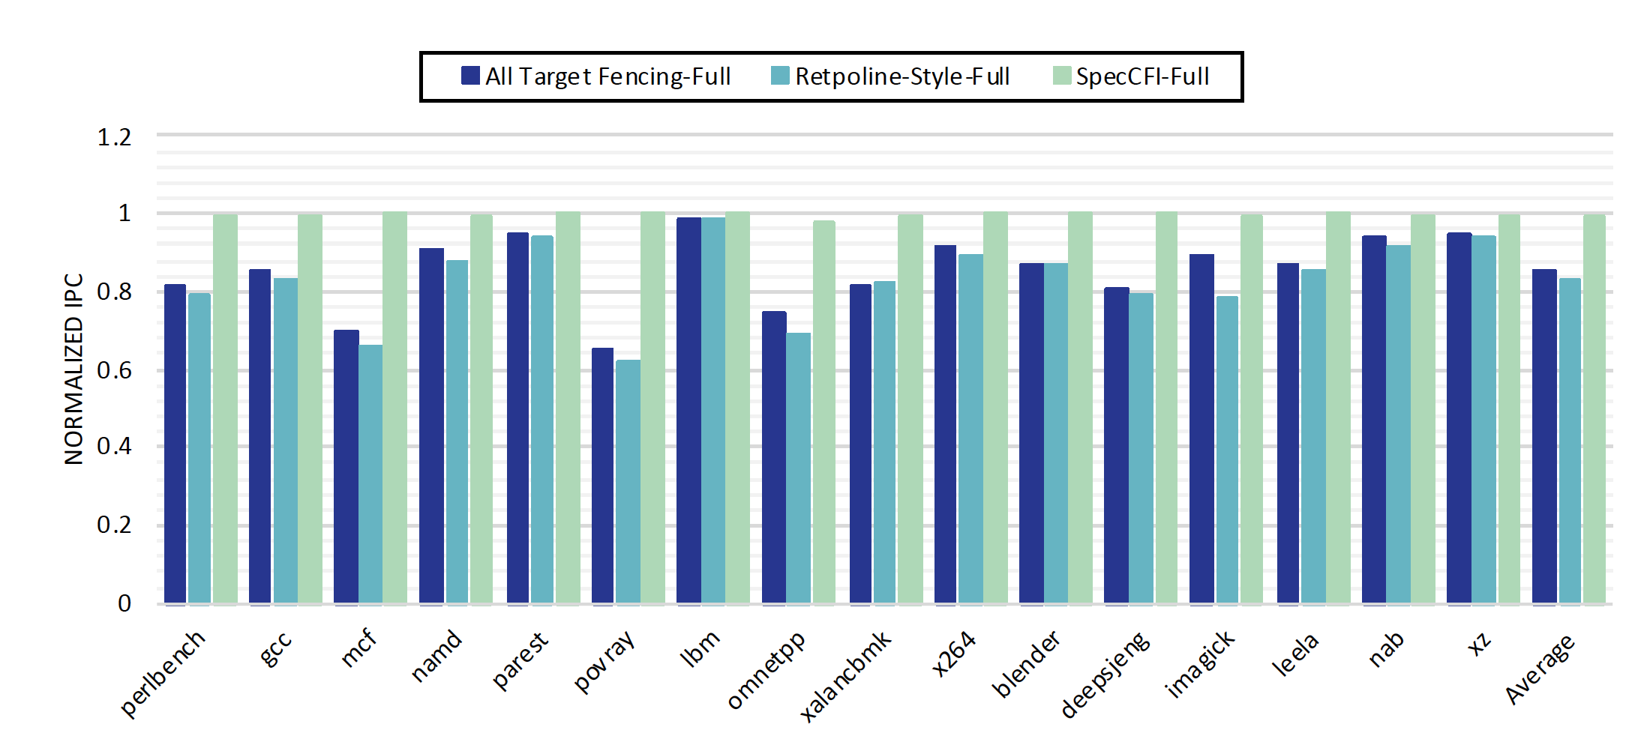
Relaxed Fences Performance
Notes:
Because of its effectiveness against control-flow
hijacking attacks, CFI has been adopted by both commodity
software and hardware.

Slide 48
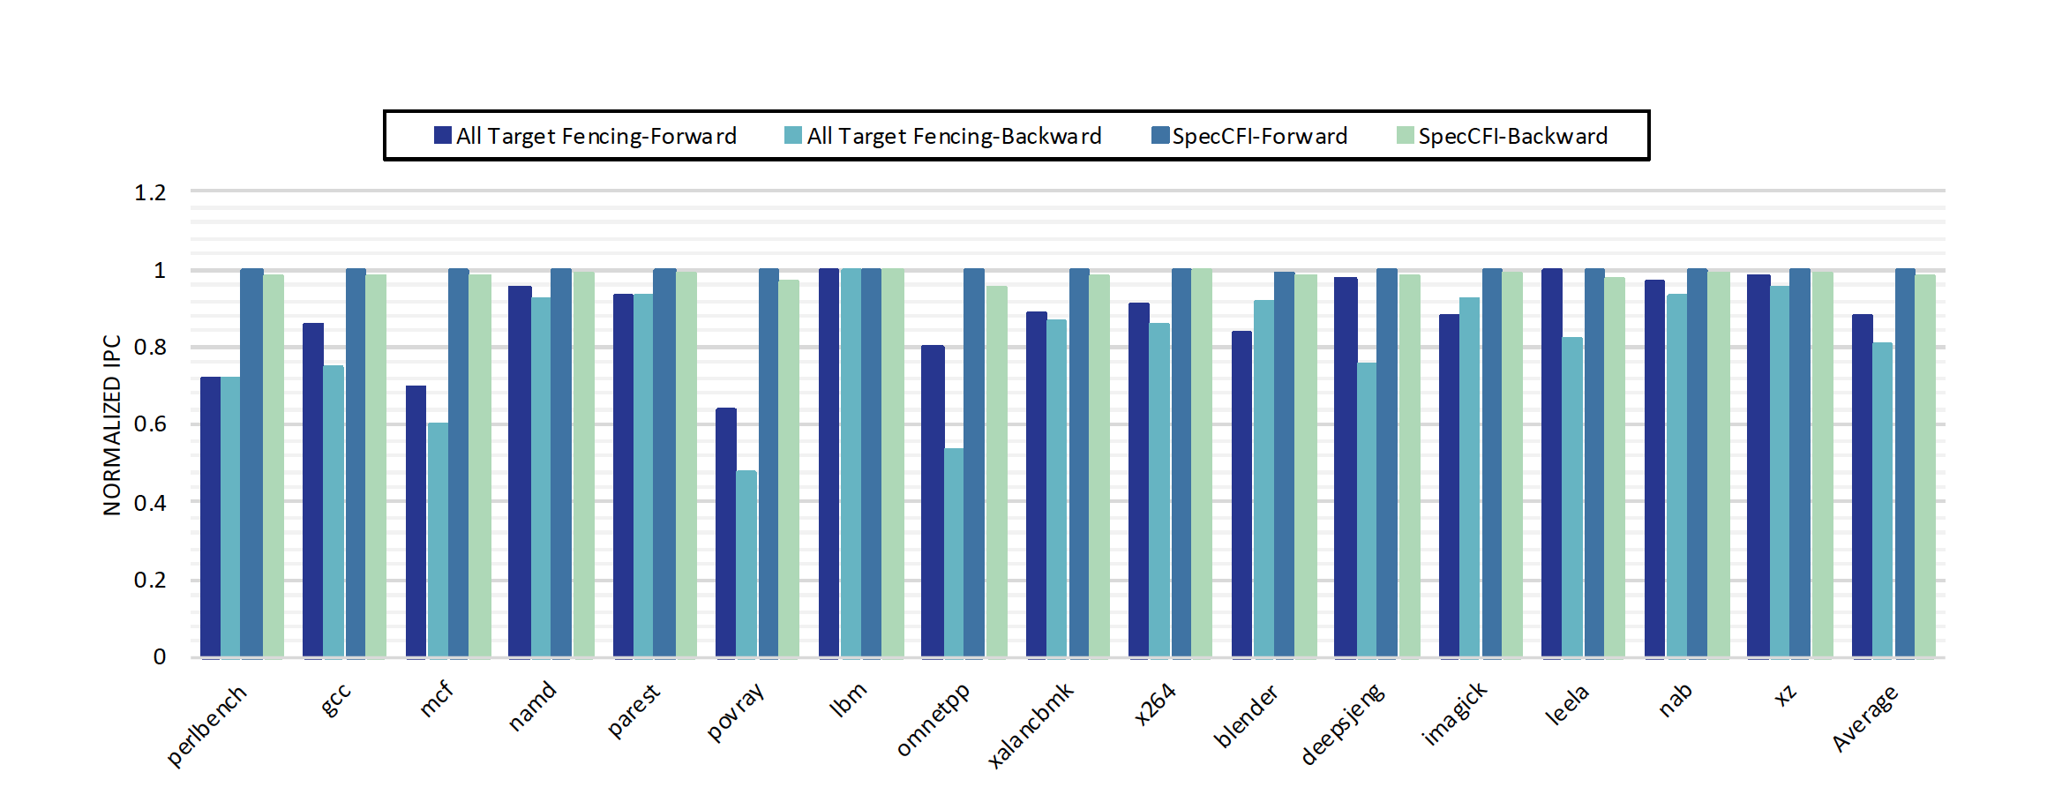
Overhead Breakdown
Notes:
Because of its effectiveness against control-flow
hijacking attacks, CFI has been adopted by both commodity
software and hardware.

Slide 49
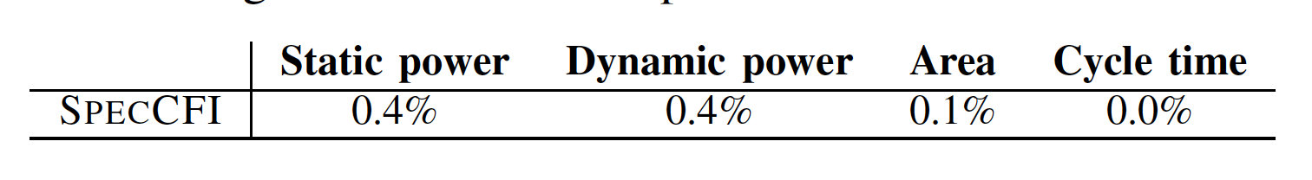
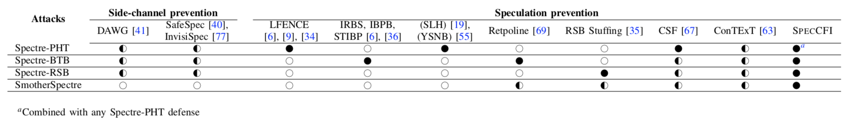
Implementation Overhead
Notes:
Because of its effectiveness against control-flow
hijacking attacks, CFI has been adopted by both commodity
software and hardware.

Slide 50

Architecture support for defenses

Slide 52


Traditional Software Malware Detection
Static malware detection
  Search for signatures in the executable
  Can detect all known malware with no false alarms
  Can be evaded by new malware and obfuscated malware
Dynamic malware detection
  Monitors the behavior of the program
  Can detect unknown malware
  High performance overhead (not practical)

Slide 53
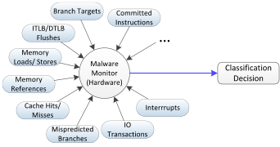
Hardware Malware Detectors (HMDs)
Use Machine Learning: detect malware as computational anomaly
Use low-level features
collected from the hardware
Can be always-on without adding performance overhead
Notes:
Qualcomm Snap the dragon

Slide 54
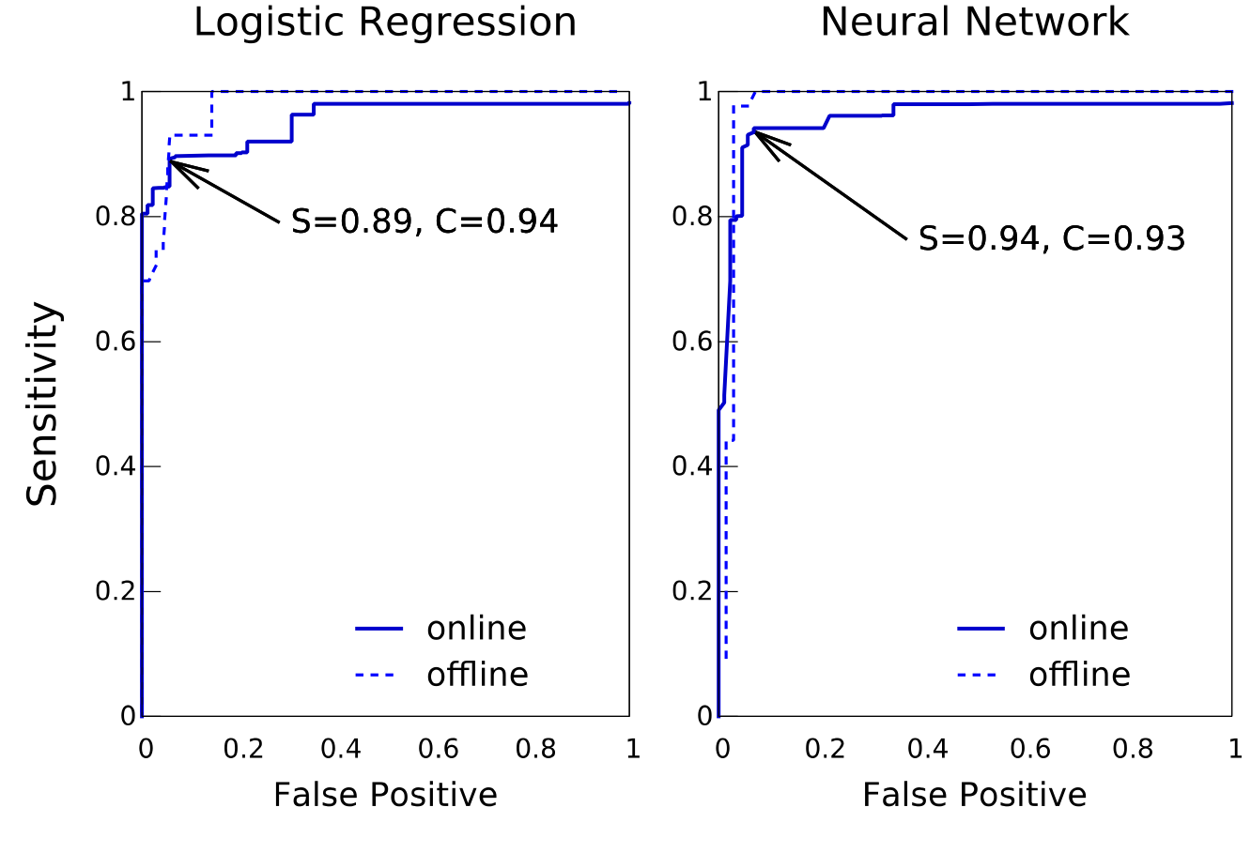
Results
HPCA 2015 - San Francisco, CA

Slide 55
Malware Aware Processors
Instruction Cache
Physical Register File
Exception Unit
ROB & Architectural Register File
Issue
MAP
Instruction Fetch
Rename/Decode
Branch Prediction
Functional Units
MMU
Data Cache
Notes:
Collect sub-semantic features
Have a simple machine learning engine
Check executing program in real-time

Slide 56
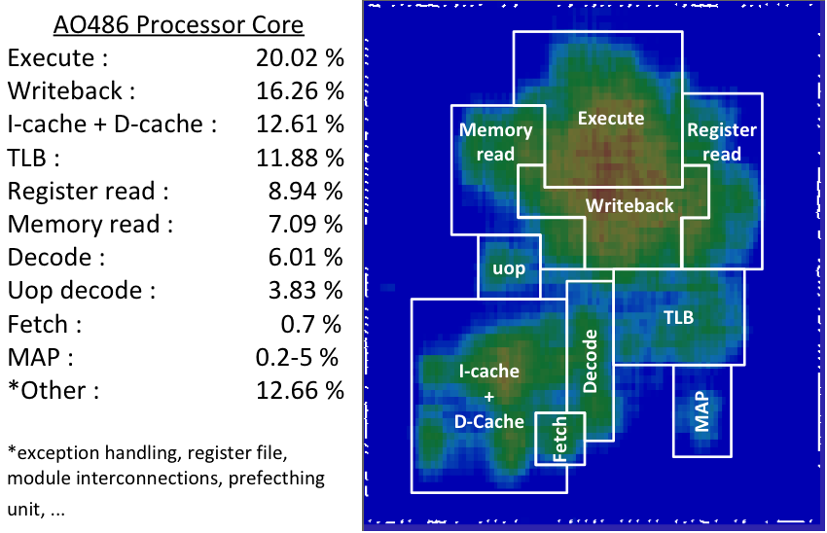
MAP FPGA Implementation

Slide 57
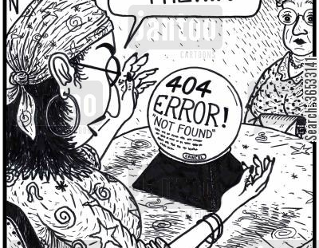
Future of secure processors

Slide 58
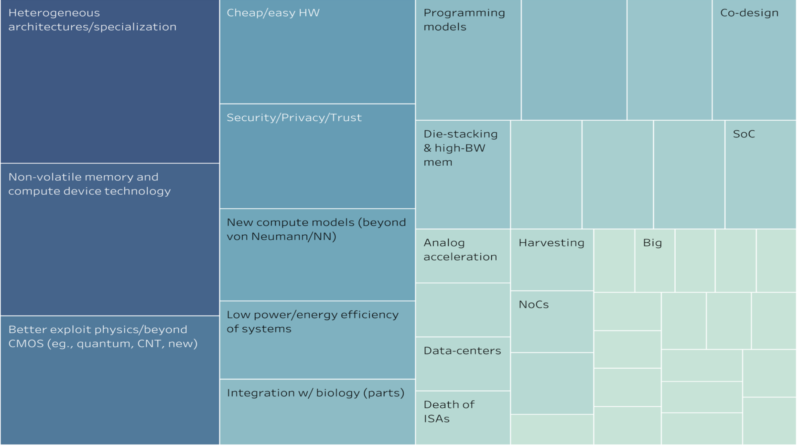
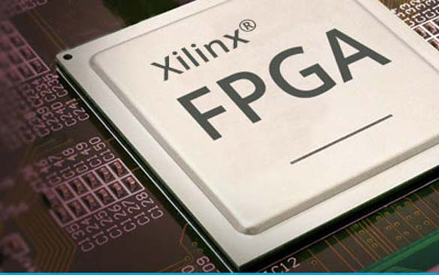
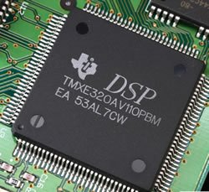

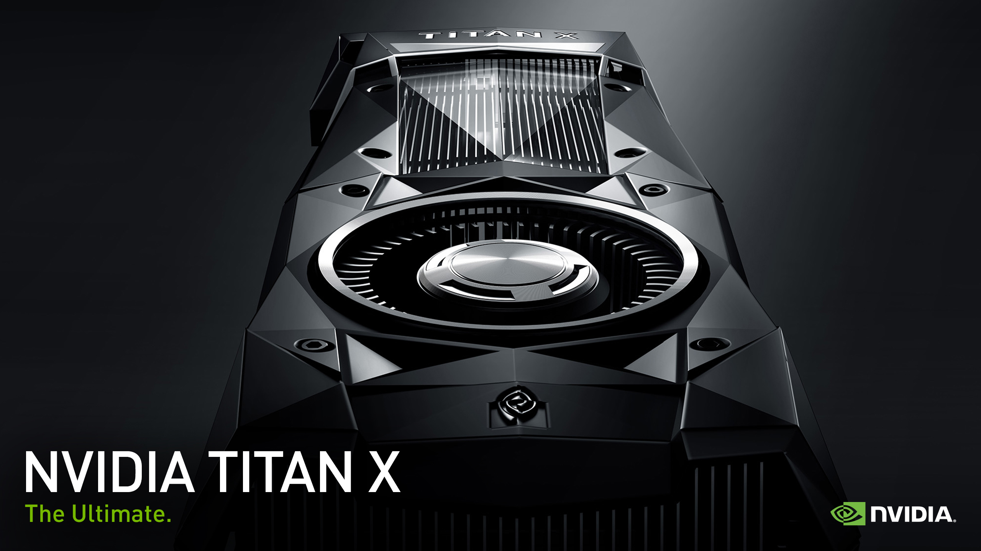
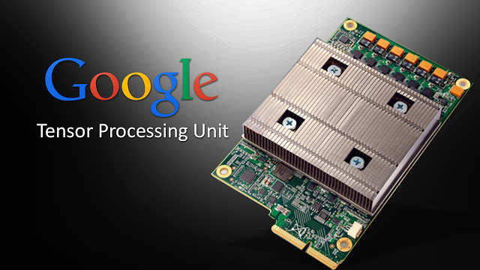
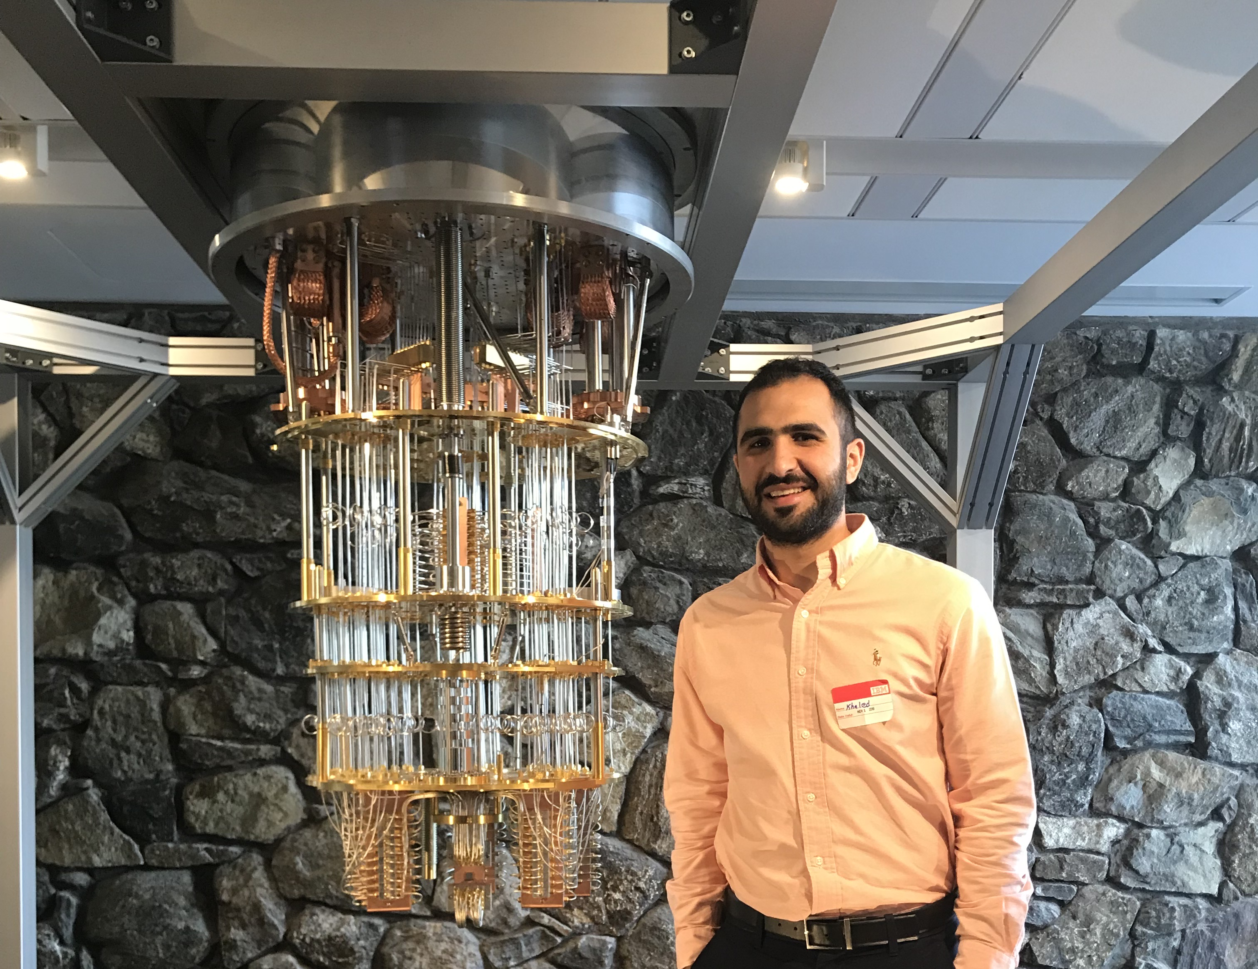

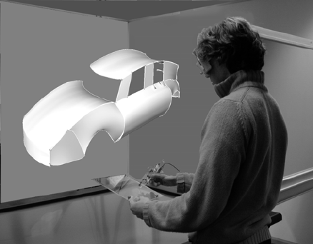

Some Trends (Arch2030)
Acceptance of Moore’s law ending
Specialization happening at scale
Machine learning important workload
Cloud is ubiquitous
3D devices, quantum, and DNA computing
Notes:
inflection point of changes in terms of computer architecture
Earlier I have showed you the trends in computer architecture in 2010 .. as a results of those trends we are now at different place in computer terms of architecture .. Recently there was this computer architecture 2030 vision workshop were leaders in computer architecture got together and predicted what is going to happen .. And we are at an inflection point of changes in terms of computer architecture because of the end of moores law.. Computing models are changing we are investing in specialization at scale,.. the cloud is becoming ubiquitous.. We see that machine learning is becoming an important workload specialty in smart systems.

Slide 59
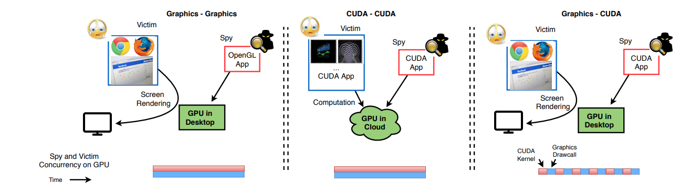
Not just the CPU

Slide 60
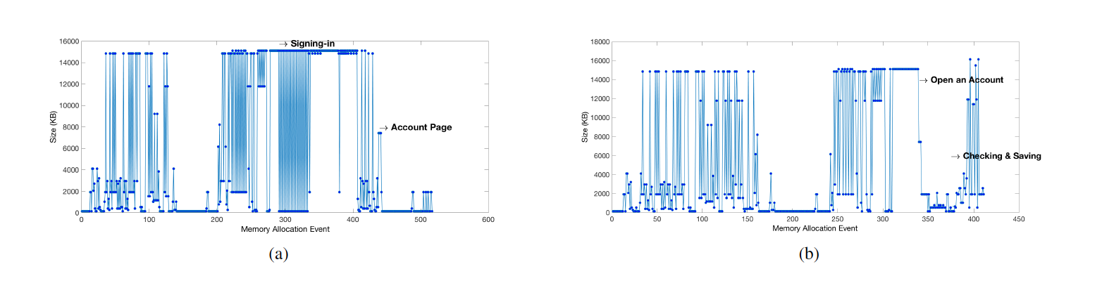
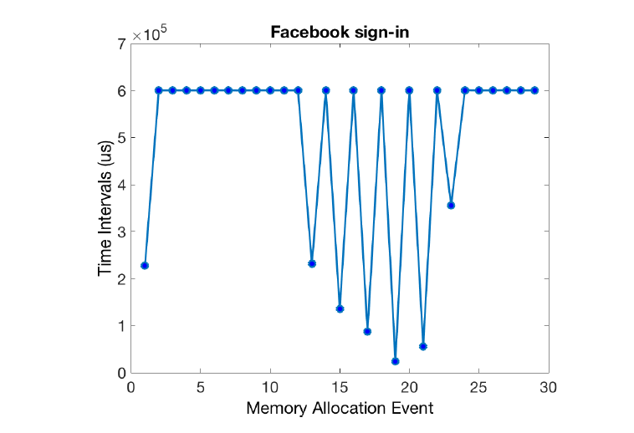
Side and covert channels are everywhere!
“Rendered Insecure: GPU side channel attacks are practical!”, to appear
in CCS 2018 – vulnerability reported to Nvidia, AMD and Intel

Slide 61
Conclusions/Summary
Security traditionally considered a software problem to be solved in software
…but we see that architectures can be a source of vulnerability
  Architectures must be designed with security in mind
  …but they can also offer security mechanisms for software
Meltdown/Spectre will force a seismic rethinking of how to design speculative CPUs
  Will be played out over the next few years…

