Slide 1
CS 202 Advanced OS
WAFL: Write Anywhere File System

Slide 2
WAFL: Write anywhere File Systems
Presentation credit: Mark Claypool from WPI.

Slide 3
Introduction
In general, an appliance is a device designed to perform a specific function
Distributed systems trend has been to use appliances instead of general purpose computers. Examples:
routers from Cisco and Avici
network terminals
network printers
New type of network appliance is an Network File System (NFS) file server

Slide 4
Introduction : NFS Appliance
NFS File Server Appliance file systems have different requirements than those of a general purpose file system
NFS access patterns are different than local file access patterns
Large client-side caches result in fewer reads than writes
Network Appliance Corporation uses a Write Anywhere File Layout (WAFL) file system

Slide 5
Introduction : WAFL
WAFL has 4 requirements
Fast NFS service
Support large file systems (10s of GB) that can grow (can add disks later)
Provide high performance writes and support Redundant Arrays of Inexpensive Disks (RAID)
Restart quickly, even after unclean shutdown
NFS and RAID both strain write performance:
NFS server must respond after data is written
RAID must write parity bits also

Slide 6
Outline
Introduction (done)
Snapshots : User Level (next)
WAFL Implementation
Snapshots: System Level
Performance
Conclusions

Slide 7
Introduction to Snapshots
Snapshots are a copy of the file system at a given point in time
WAFL’s “claim to fame”
WAFL creates and deletes snapshots automatically at preset times
Up to 255 snapshots stored at once
Uses Copy-on-write to avoid duplicating blocks in the active file system
Snapshot uses:
Users can recover accidentally deleted files
Sys admins can create backups from running system
System can restart quickly after unclean shutdown
Roll back to previous snapshot

Slide 8
User Access to Snapshots
Example, suppose accidentally removed file named “todo”:
spike% ls -lut .snapshot/*/todo -rw-r--r-- 1 hitz 52880 Oct 15 00:00 .snapshot/nightly.0/todo -rw-r--r-- 1 hitz 52880 Oct 14 19:00 .snapshot/hourly.0/todo -rw-r--r-- 1 hitz 52829 Oct 14 15:00 .snapshot/hourly.1/todo -rw-r--r-- 1 hitz 55059 Oct 10 00:00 .snapshot/nightly.4/todo -rw-r--r-- 1 hitz 55059 Oct 9 00:00 .snapshot/nightly.5/todo
Can then recover most recent version:
spike% cp .snapshot/hourly.0/todo todo
Note, snapshot directories (.snapshot) are hidden in that they don’t show up with ls

Slide 9
Snapshot Administration
The WAFL server allows commands for sys admins to create and delete snapshots, but typically done automatically
At WPI, snapshots of /home:
7:00 AM, 10:00, 1:00 PM, 4:00, 7:00, 10:00, 1:00 AM
Nightly snapshot at midnight every day
Weekly snapshot is made on Sunday at midnight every week
Thus, always have: 7 hourly, 7 daily snapshots, 2 weekly snapshots
claypool 32 ccc3=>>pwd
/home/claypool/.snapshot
claypool 33 ccc3=>>ls
hourly.0/ hourly.3/ hourly.6/ nightly.2/ nightly.5/ weekly.1/
hourly.1/ hourly.4/ nightly.0/ nightly.3/ nightly.6/
hourly.2/ hourly.5/ nightly.1/ nightly.4/ weekly.0/

Slide 10
Outline
Introduction (done)
Snapshots : User Level (done)
WAFL Implementation (next)
Snapshots: System Level
Performance
Conclusions

Slide 11
WAFL File Descriptors
Inode based system with 4 KB blocks
Inode has 16 pointers
For files smaller than 64 KB:
Each pointer points to data block
For files larger than 64 KB:
Each pointer points to indirect block
For really large files:
Each pointer points to doubly-indirect block
For very small files (less than 64 bytes), data kept in inode instead of pointers

Slide 12
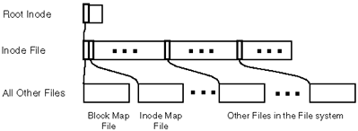
WAFL Meta-Data
Meta-data stored in files
Inode file – stores inodes
Block-map file – stores free blocks
Inode-map file – identifies free inodes

Slide 13
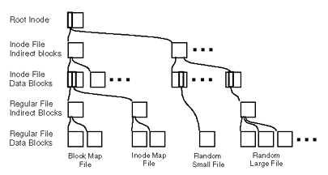
Zoom of WAFL Meta-Data (Tree of Blocks)
Root inode must be in fixed location
Other blocks can be written anywhere

Slide 14
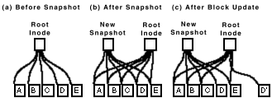
Snapshots (1 of 2)
Copy root inode only, copy on write for changed data blocks
Over time, old snapshot references more and more data
blocks that are not used
Rate of file change determines how many snapshots
can be stored on the system

Slide 15
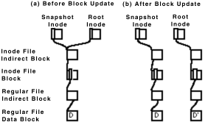
Snapshots (2 of 2)
When disk block modified, must modify indirect pointers as well
Batch, to improve I/O performance

Slide 16
Consistency Points (1 of 2)
In order to avoid consistency checks after unclean shutdown, WAFL creates a special snapshot called a consistency point every few seconds
Not accessible via NFS
Batched operations are written to disk each consistency point
In between consistency points, data only written to RAM

Slide 17
Consistency Points (2 of 2)
WAFL use of NVRAM (NV = Non-Volatile):
(NVRAM has batteries to avoid losing during unexpected poweroff)
NFS requests are logged to NVRAM
Upon unclean shutdown, re-apply NFS requests to last consistency point
Upon clean shutdown, create consistency point and turnoff NVRAM until needed (to save batteries)
Note, typical FS uses NVRAM for write cache
Uses more NVRAM space (WAFL logs are smaller)
Ex: “rename” needs 32 KB, WAFL needs 150 bytes
Ex: write 8KB needs 3 blocks (data, inode, indirect pointer), WAFL needs 1 block (data) plus 120 bytes for log
Slower response time for typical FS than for WAFL

Slide 18
Write Allocation
Write times dominate NFS performance
Read caches at client are large
5x as many write operations as read operations at server
WAFL batches write requests
WAFL allows write anywhere, enabling inode next to data for better perf
Typical FS has inode information and free blocks at fixed location
WAFL allows writes in any order since uses consistency points
Typical FS writes in fixed order to allow fsck to work

Slide 19
Outline
Introduction (done)
Snapshots : User Level (done)
WAFL Implementation (done)
Snapshots: System Level (next)
Performance
Conclusions

Slide 20
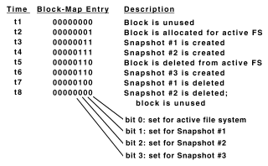
The Block-Map File
Typical FS uses bit for each free block, 1 is allocated and 0 is free
Ineffective for WAFL since may be other snapshots that point to block
WAFL uses 32 bits for each block

Slide 21
Creating Snapshots
Could suspend NFS, create snapshot, resume NFS
But can take up to 1 second
Challenge: avoid locking out NFS requests
WAFL marks all dirty cache data as IN_SNAPSHOT. Then:
NFS requests can read system data, write data not IN_SNAPSHOT
Data not IN_SNAPSHOT not flushed to disk
Must flush IN_SNAPSHOT data as quickly as possible

Slide 22
Flushing IN_SNAPSHOT Data
Flush inode data first
Keeps two caches for inode data, so can copy system cache to inode data file, unblocking most NFS requests (requires no I/O since inode file flushed later)
Update block-map file
Copy active bit to snapshot bit
Write all IN_SNAPSHOT data
Restart any blocked requests
Duplicate root inode and turn off IN_SNAPSHOT bit
All done in less than 1 second, first step done in 100s of ms

Slide 23
Outline
Introduction (done)
Snapshots : User Level (done)
WAFL Implementation (done)
Snapshots: System Level (done)
Performance (next)
Conclusions

Slide 24
Performance (1 of 2)
Compare against NFS systems
Best is SPEC NFS
LADDIS: Legato, Auspex, Digital, Data General, Interphase and Sun
Measure response times versus throughput
(Me: System Specifications?!)

Slide 25
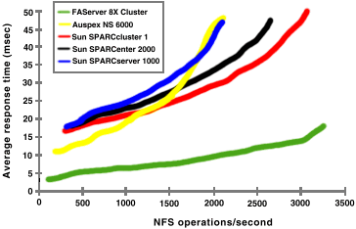
Performance (2 of 2)
(Typically, look for “knee” in curve)

Slide 26
NFS vs. New File Systems
Remove NFS server as bottleneck
Clients write directly to device

Slide 27
Conclusion
NetApp (with WAFL) works and is stable
Consistency points simple, reducing bugs in code
Easier to develop stable code for network appliance than for general system
Few NFS client implementations and limited set of operations so can test thoroughly

