Slide 1
Advanced Operating Systems
(CS 202)
Scheduling (2)

Slide 2
Today: CPU Scheduling
What should the scheduler algorithm do?
  Are the ad hoc schedulers ok?
  What do commercial OS’ do?
  Lottery and Stride scheduling
Scheduling activations
  User level vs. Kernel level scheduling of threads
  Can be thought of as extensibility for scheduling
  May skip and give you a quick summary
How do we schedule on emerging machines?
  Multicores/many-cores? Decade of wasted cores
  Cloud, embedded-- Hawk

Slide 3
Lottery Scheduling

Slide 4
Unix Scheduler
The canonical Unix scheduler uses a MLFQ
  3-4 classes spanning ~170 priority levels
    Timesharing: first 60 priorities
    System: next 40 priorities
    Real-time: next 60 priorities
    Interrupt: next 10 (Solaris)
Priority scheduling across queues, RR within a queue
  The process with the highest priority always runs
  Processes with the same priority are scheduled RR
Processes dynamically change priority
  Increases over time if process blocks before end of quantum
  Decreases over time if process uses entire quantum

Slide 5
Problems with Traditional schedulers
Priority systems are ad hoc: highest priority wins
Try to support fair share by adjusting priorities with a feedback loop
  Works over long term
  highest priority still wins but now the priorities are changing
Priority inversion: high-priority jobs can be blocked behind low-priority jobs
Schedulers are complex and difficult to control

Slide 6
Lottery scheduling
Elegant way to implement proportional share scheduling
Priority determined by the number of tickets each thread has:
  Priority is the relative percentage of all of the tickets whose owners compete for the resource
Scheduler picks winning ticket randomly, gives owner the resource
Tickets can be used for a variety of resources

Slide 7
Example
Three threads
  A has 5 tickets
  B has 3 tickets
  C has 2 tickets
If all compete for the resource
  B has 30% chance of being selected
If only B and C compete
  B has 60% chance of being selected

Slide 8
Its fair
Lottery scheduling is probabilistically fair
If a thread has a t tickets out of T
  Its probability of winning a lottery is p = t/T
  Its expected number of wins over n drawings is np
    Binomial distribution
    Variance σ² = np(1 – p)

Slide 9
Fairness (II)
Coefficient of variation of number of wins σ/np = √((1-p)/np)
  Decreases with √n
Number of tries before winning the lottery follows a geometric distribution
As time passes, each thread ends receiving its share of the resource

Slide 10
Ticket transfers
How to deal with dependencies?
  Explicit transfers of tickets from one client to another
Transfers can be used whenever a client blocks due to some dependency
  When a client waits for a reply from a server, it can temporarily transfer its tickets to the server
    Server has no tickets of its own
  Server priority is sum of priorities of its active clients
    Can use lottery scheduling to give service to the clients
Similar to priority inheritance
  Can solve priority inversion

Slide 11
Ticket inflation
Lets users create new tickets
  Like printing their own money
  Counterpart is ticket deflation
  Lets mutually trusting clients adjust their priorities dynamically without explicit communication
Currencies: set up an exchange rate
  Enables inflation within a group
  Simplifies mini-lotteries (e.g., for mutexes)

Slide 12
Example (I)
A process manages three threads
  A has 5 tickets
  B has 3 tickets
  C has 2 tickets
It creates 10 extra tickets and assigns them to process C
  Why?
  Process now has 20 tickets

Slide 13
Example (II)
These 20 tickets are in a new currency whose exchange rate with the base currency is 10/20
The total value of the processes tickets expressed in the base currency is still equal to 10

Slide 14
Compensation tickets (I)
I/O-bound threads are likely get less than their fair share of the CPU because they often block before their CPU quantum expires
Compensation tickets address this imbalance

Slide 15
Compensation tickets (II)
A client that consumes only a fraction f of its CPU quantum can be granted a compensation ticket
  Ticket inflates the value of all client tickets by 1/f until the client starts gets the CPU

Slide 16
Example
CPU quantum is 100 ms
Client A releases the CPU after 20ms
  f = 0.2 or 1/5
Value of all tickets owned by A will be multiplied by 5 until A gets the CPU
Is this fair?
  What if A alternates between 1/5 and full quantum?

Slide 17
Compensation tickets (III)
Compensation tickets
  Favor I/O-bound—and interactive—threads
  Helps them getting their fair share of the CPU

Slide 18
IMPLEMENTATION
On a MIPS-based DECstation running Mach 3 microkernel
  Time slice is 100ms
    Fairly large as scheme does not allow preemption
Requires
  A fast RNG
  A fast way to pick lottery winner

Slide 19
Example
Three threads
  A has 5 tickets
  B has 3 tickets
  C has 2 tickets
List contains
  A (0-4)
  B (5-7)
  C (8-9)
Search time is O(n)
where n is list length

Slide 20
Optimization – use tree
4
≤
>
A
7
≤
>
RB Tree used in Linux
Completely fair scheduler(CFS)
--not lottery based
B
C

Slide 21
Long-term fairness (I)

Slide 22
Short term fluctuations
For
2:1
ticket
alloc.
ratio

Slide 23
Discussion
Opinions of the paper and contributions?
  Fairness not great
    Mutex 1.8:1 instead of 2:1
    Multimedia apps 1.9:1.5:1 instead of 3:2:1
  Can we exploit the algorithm?
    Consider also indirectly – processes getting kernel cycles by using high priority kernel services
  Real time? Multiprocessor?
  Short term unfairness
    Later this lead to stride scheduling from same authors

Slide 24
Stride scheduling
Deterministic version of lottery scheduling
Mark time virtually (counting passes)
  Each process has a stride: number of passes between being scheduled
  Stride inversely proportional to number of tickets
  Regular, predictable schedule
Can also use compensation tickets
Similar to weighted fair queuing
  Linux CFS is similar

Slide 25

Stride Scheduling – Basic Algorithm
Client Variables:
Tickets
  Relative resource allocation
Strides (
  Interval between selection
Pass (
  Virtual index of next selection
- minimum ticket allocation
Select Client with Minimum Pass
Advance Client’s Pass by Client’s Stride
Slide and example from Dong-hyeon Park

Slide 26
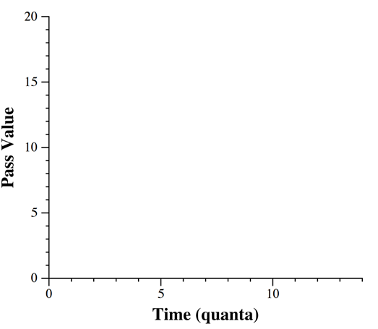
Stride Scheduling – Basic Algorithm
3:2:1 Allocation
∆ - A (stride = 2)
○ - B (stride = 3)
□ - C (stride = 6)
Time 1:
2
3
6
+2
Time 2:
4
3
6

Slide 27
Stride Scheduling – Basic Algorithm
3:2:1 Allocation
∆ - A (stride = 2)
○ - B (stride = 3)
□ - C (stride = 6)
Time 1:
2
3
6
+2
Time 2:
4
3
6
+3
Time 3:
4
6
6

Slide 28
Stride Scheduling – Basic Algorithm
3:2:1 Allocation
∆ - A (stride = 2)
○ - B (stride = 3)
□ - C (stride = 6)
Time 1:
2
3
6
+2
Time 2:
4
3
6
+3
Time 3:
4
6
6
+2
Time 4:
6
6
6

Slide 29
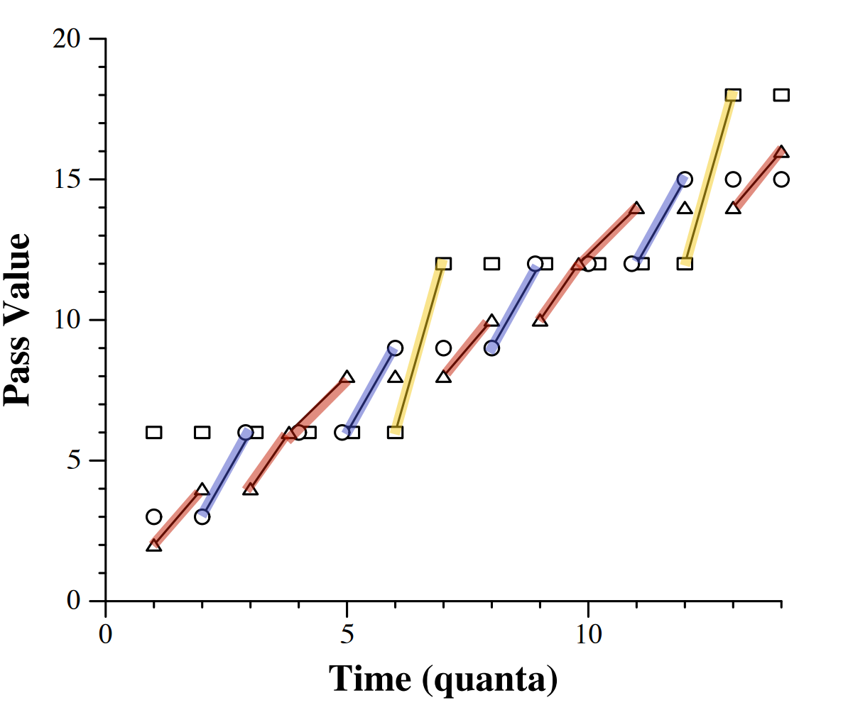
Stride Scheduling – Basic Algorithm
3:2:1 Allocation
∆ - A (stride = 2)
○ - B (stride = 3)
□ - C (stride = 6)
Time 1:
2
3
6
+2
Time 2:
4
3
6
+3
Time 3:
4
6
6
+2
Time 4:
6
6
6
…

Slide 30
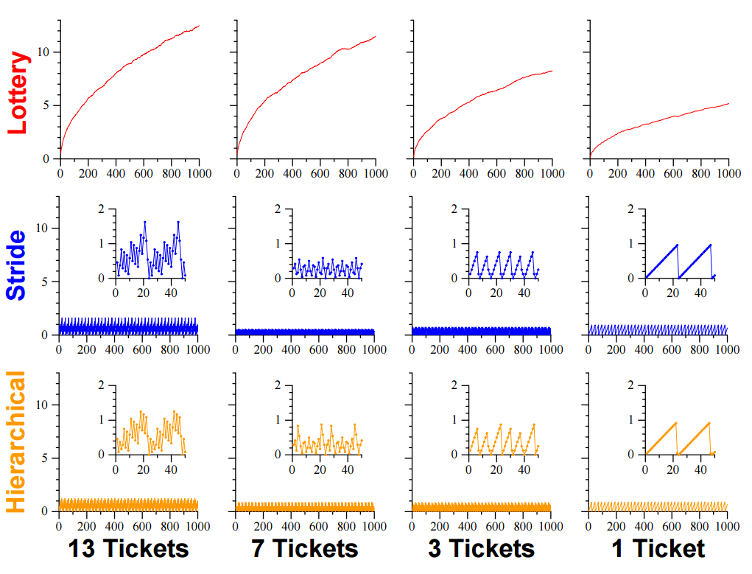
Throughput Error Comparison
Error is independent of the allocation time in stride scheduling
Absolute Error (quanta)
Hierarchical stride scheduling has more balance distribution of error between clients.
Time (quanta)

Slide 31
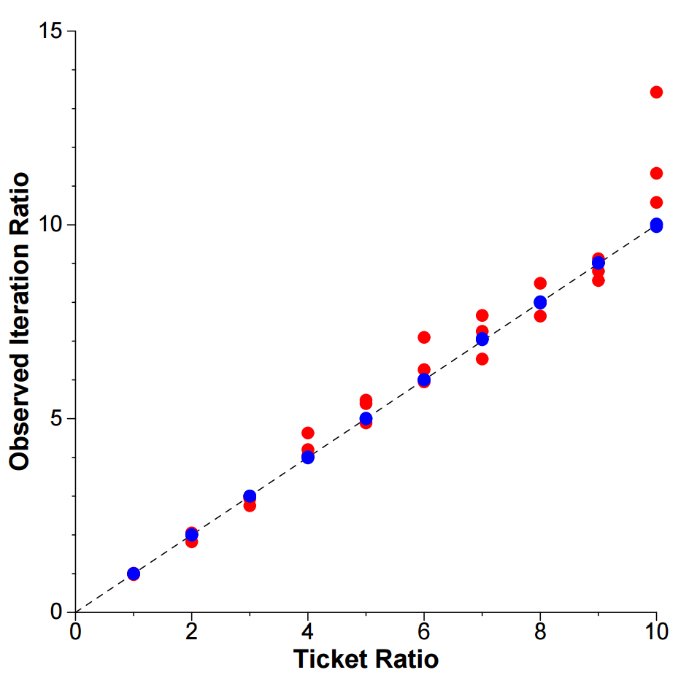
Accuracy of Prototype Implementation
Lottery Scheduler
Stride Scheduler
Lottery and Stride Scheduler implemented on real-system.
Stride scheduler stayed within 1% of ideal ratio.
Low system overhead relative to standard Linux scheduler.

Slide 32
Linux scheduler
Went through several iterations
Currently CFS
  Fair scheduler, like stride scheduling
  Supersedes O(1) scheduler: emphasis on constant time scheduling –why?
  CFS is O(log(N)) because of red-black tree
  Is it really fair?
What to do with multi-core scheduling?

Slide 33
Scheduler Activations brewer

Slide 34
Context
Neither user level threads nor kernel level threads work ideally
  User level threads have application information
    They are also cheap
    But not visible to kernel
  Kernel level threads
    Expensive
    Lack application information

Slide 35
Idea
Abstraction: threads in a shared address space
  Others possible?
Can be implemented in two ways
  Kernel creates and dispatches threads
    Expensive and inflexible
  User level
    One kernel thread for each virtual processor

Slide 36
User level on top of kernel threads
Each application gets a set of virtual processors
  Each corresponds to a kernel level thread
User level threads implemented in user land
  Any user thread can use any kernel thread (virtual processor)
    Fast thread creation and switch – no system calls
    Fast synchronization!
  What happens when a thread blocks?
  Any other issues?

Slide 37
Goals (from paper)
Functionality
  No processor idles when there are ready threads
  No priority inversion (high priority thread waiting for low priority one) when its ready
  When a thread blocks, the processor can be used by another thread
Performance
  Closer to user threads than kernel threads
Flexibility
  Allow qpplication level customization or even a completely different concurrency model

Slide 38
Problems
User thread does a blocking call?
  Application loses a processor!
Scheduling decisions at user and kernel not coordinated
  Kernel may de-schedule a thread at a bad time (e.g., while holding a lock)
  Application may need more or less computing
Solution?
  Allow coordination between user and kernel schedulers

Slide 39
Scheduler activations
Allow user level threads to act like kernel level threads/virtual processors
Notify user level scheduler of relevant kernel events
  Like what?
Provide space in kernel to save context of user thread when kernel stops it
  E.g., for I/O or to run another application

Slide 40
Kernel upcalls
New processor available
  Reaction? Run time picks user thread to use it
Activation blocked (e.g., for page fault)
  Reaction? Runtime runs a different thread on the activation
Activation unblocked
  Activation now has two contexts
  Running activation is preempted – why?
Activation lost processor
  Context remapped to another activation
What do these accomplish?

Slide 41
Runtime->Kernel
Informs kernel when it needs more resources, or when it is giving up some
Could involve the kernel to preempt low priority threads
  Only kernel can preempt
Almost everything else is user level!
  Performance of user-level, with the advantages of kernel threads!

Slide 42
Preemptions in critical sections
Runtime checks during upcall whether preempted user thread was running in a critical section
  Continues the user thread using a user level context switch in this case
    Once lock is released, it switches back to original thread
    Keep track of critical sections using a hash table of section begin/end addresses

Slide 43
Discussion
Summary:
  Get user level thread performance but with scheduling abilities of kernel level threads
  Main idea: coordinating user level and kernel level scheduling through scheduler activations
Limitations
  Upcall performance (5x slowdown)
  Performance analysis limited
Connections to exo-kernel/spin/microkernels?

