Slide 1
OS Extensibility: Spin, Exo-kernel and L4
Some slides from Hakim Weatherspoon

Slide 2
More simply
Monolithic
safe
fast
micro kernel
DOS
extensible

Slide 3
Need for Extensibility
Buffer Pool Management In DBs (*)
  LRU, prefetch (locality Vs suggestion), flush (commit)
Shared Virtual Memory (+)
  use a page fault to retrieve page from disk / another processor

Slide 4
Examples (cont.)
Concurrent Checkpointing (+)
  Overlap checkpointing and program being checkpointed
  Change rights to R-only on dirty pages
  Copy each page and reset rights
  Allow reads; Use write faults to {copy, reset rights, restart}
* OS Support for Database Management (Stonebraker)
+ Virtual Memory Primitives for User Programs (Andrew W. Appel and Kai Li)

Slide 5
Examples (cont.)
Feedback for file cache block replacement
[Implementation and Performance of Application-Controlled File Caching - Pei Cao, et al.]

Slide 6
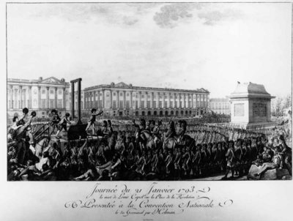
Down with monarchy!
French Revolution - Execution of Louis XVI

Slide 7
Extensibility
Problem: How?
Add code to OS
  how to preserve isolation?
  … without killing performance?
What abstractions?
  General principle: mechanisms in OS, policies through the extensions
  What mechanisms to expose?

Slide 8
Extensible Kernels
SPIN (SOSP 1995): kernel extensions (imported) safely specialize OS services
  Extensions dynamically linked into OS kernel
  Safety ensured by Programming Language facilities
Exokernel (SOSP 1995): safely exports machine resources
  Kernel only multiplexes hardware resources (Aegis)
  Higher-level abstractions in Library OS (ExOS)
  Secure binding, Visible resource revocation, Abort
  Apps link with the LibOS of their choice
Notes:
Extensibility, Safety and Performance

Slide 9
Spin Approach to extensibility
Co-location of kernel and extension
  Avoid border crossings
  But what about protection?
Language/compiler forced protection
  Strongly typed language
    Protection by compiler and run-time
    Cannot cheat using pointers
  Logical protection domains
    No longer rely on hardware address spaces to enforce protection – no boarder crossings
Dynamic call binding for extensibility

Slide 10
SPIN mechanisms/Toolbox

Slide 11
Logical protection domains
Modula-3 safety and encapsulation mechanisms
  Type safety, automatic storage management
  Objects, threads, exceptions and generic interfaces
Fine-grained protection of objects using capabilities. An object can be:
  Hardware resources (e.g., page frames)
  Interfaces (e.g., page allocation module)
  Collection of interfaces (e.g., full VM)
Capabilities are language supported pointers

Slide 12
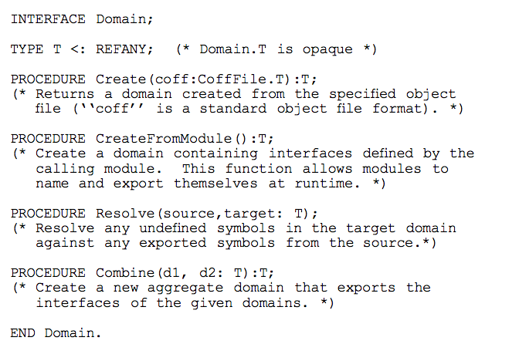
Logical protection domains -- mechanisms
Create:
  Initialize with object file contents and export names
Resolve:
  Names are resolved between a source and a target domain
    Once resolved, access is at memory speeds
Combine
  To create an aggregate domain
This is the key to spin – protection, extensibility and performance

Slide 13
Protection Model (I)
All kernel resources are referenced by capabilities [tickets]
SPIN implements capabilities directly through the use of pointers
Compiler prevents pointers to be forged or dereferenced in a way inconsistent with its type at compile time:
  No run time overhead for using a pointer

Slide 14
Protection Model (II)
A pointer can be passed to a user-level application through an externalized reference:
  Index into a per-application table of safe references to kernel data structures
Protection domains define the set of names accessible to a given execution context

Slide 15
Spin
File
System
CPU scheduler
File
System
Memory manager
Memory manager
Network
CPU scheduler
spin
IPC, Address
Spaces, …
Hardware, managed by OS

Slide 16
Spin Mechanisms for Events
Spin extension model is based on events and handlers
  Which provide for communication between the base and the extensions
Events are routed by the Spin Dispatcher to handlers
  Handlers are typically extension code called as a procedure by the dispatcher
  One-to-one, one-to-many or many-to-one
    All handlers registered to an event are invoked
      Guards may be used to control which handler is used

Slide 17
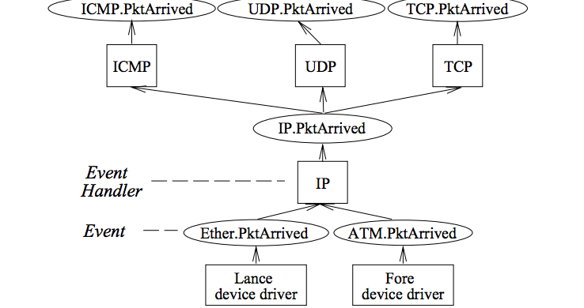
Event example

Slide 18
Putting it All together

Slide 19
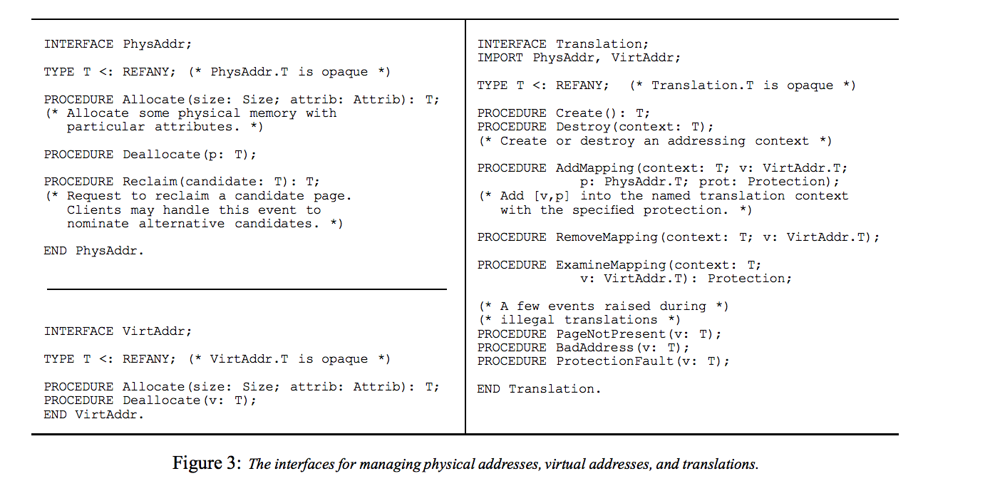
Default Core services in SPIN
Memory management (of memory allocated to the extension)
  Physical address
    Allocate, deallocate, reclaim
  Virtual address
    Allocate, deallocate
  Translation
    Create/destory AS, add/remove mapping
  Event handlers
    Page fault, access fault, bad address

Slide 20
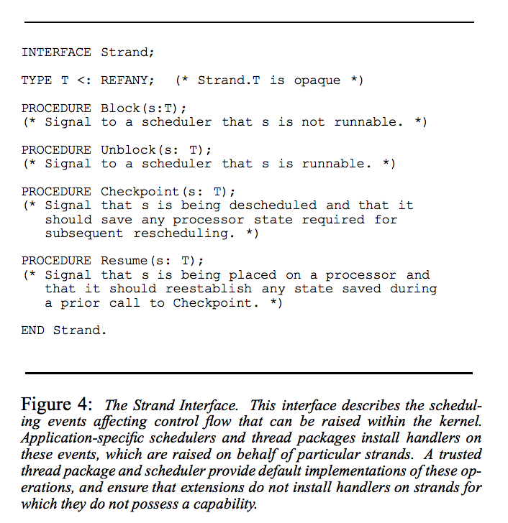
CPU Scheduling
Spin abstraction: strand
  Semantics defined by extension
Event handlers
  Block, unblock, checkpoint, resume
Spin global scheduler
  Interacts with extension threads package

Slide 21
Experiments
Don’t worry, I wont go through them
In the OS community, you have to demonstrate what you are proposing
  They built SPIN, extensions and applications that use them
  Focus on performance and size
    Reasonable size, and substantial performance advantages even relative to a mature monolithic kernel

Slide 22
Conclusions
Extensibility, protection and performance
  compiler features and run-time checks
  Instead of hardware address spaces
  …which gives us performance—no border crossing
Who are we trusting? Consider application and Spin
  How does this compare to Exo-kernel?
Concern about resource partitioning?
  Each extension must be given its resources
  No longer dynamically shared (easily)
  Parallels to Virtualization?

Slide 23
ExoKernel

Slide 24
Motivation for Exokernels
Traditional centralized resource management cannot be specialized, extended or replaced
Privileged software must be used by all applications
Fixed high level abstractions too costly for good efficiency
Exo-kernel as an end-to-end argument

Slide 25
Exokernel Philosophy
Expose hardware to libraryOS
  Not even mechanisms are implemented by exo-kernel
    They argue that mechanism is policy
Exo-kernel worried only about protection not resource management

Slide 26
Design Principles
Track resource ownership
Ensure protection by guarding resource usage
Revoke access to resources
Expose hardware, allocation, names and revocation
Basically validate binding, then let library manage the resource

Slide 27
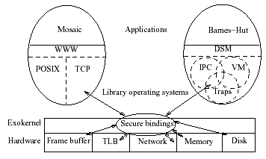
Exokernel Architecture

Slide 28
Separating Security from Management
Secure bindings – securely bind machine resources
Visible revocation – allow libOSes to participate in resource revocation
Abort protocol – break bindings of uncooperative libOSes

Slide 29
Secure Bindings
Decouple authorization from use
Authorization performed at bind time
Protection checks are simple operations performed by the kernel
Allows protection without understanding
Operationally – set of primitives needed for applications to express protection checks

Slide 30
Example resource
TLB Entry
  Virtual to physical mapping done by library
  Binding presented to exo-kernel
  Exokernel puts it in hardware TLB
  Process in library OS then uses it without exo-kernel intervention

Slide 31
Implementing Secure Bindings
Hardware mechanisms: TLB entry, Packet Filters
Software caching: Software TLB stores
Downloaded Code: invoked on every resource access or event to determine ownership and kernel actions

Slide 32
Exokernel vs Microkenels vs VM
Exokernel defines only a low-level interface.
A microkernel also runs almost everything on user-level, but has fixed abstractions.
A VM emulates the whole machine, doesn’t provide direct access.

Slide 33
Downloaded Code Example: (DPF) Downloaded Packet Filter
Eliminates kernel crossings
Can execute when application is not scheduled
Written in a type safe language and compiled at runtime for security
Uses Application-specific Safe Handlers which can initiate a message to reduce round trip latency

Slide 34
Visible Resource Revocation
Traditionally resources revoked invisibly
Allows libOSes to guide de-allocation and have knowledge of available resources – ie: can choose own ‘victim page’
Places workload on the libOS to organize resource lists

Slide 35
Abort Protocol
Forced resource revocation
Uses ‘repossession vector’
Raises a repossession exception
Possible relocation depending on state of resource

Slide 36
Managing core services
Virtual memory:
  Page fault generates an upcall to the library OS via a registered handler
  LibOS handles the allocation, then presents a mapping to be installed into the TLB providing a capability
  Exo-kernel installs the mapping
  Software TLBs

Slide 37
Managing CPU
A time vector that gets allocated to the different library operating systems
  Allows allocation of CPU time to fit the application
Revokes the CPU from the OS using an upcall
  The libOS is expected to save what it needs and give up the CPU
  If not, things escalate
  Can install revocation handler in exo-kernel

Slide 38
Putting it all together
Lets consider an exo-kernel with downloaded code into the exo-kernel
When normal processing occurs, Exo-kernel is a sleeping beauty
When a discontinuity occurs (traps, faults, external interrupts), exokernel fields them
  Passes them to the right OS (requires book-keeping) – compare to SPIN?
  Application specific handlers

Slide 39
Evaluation
Again, a full implementation
How to make sense from the quantitative results?
  Absolute numbers are typically meaningless given that we are part of a bigger system
    Trends are what matter
Again, emphasis is on space and time
  Key takeaway→ at least as good as a monolithic kernel

Slide 40
Questions and conclusions
Downloaded code – security?
  Some mention of SFI and little languages
  SPIN is better here?
SPIN vs. Exokernel
  Spin—extend mechanisms; some abstractions still exist
  Exo-kernel: securely expose low-level primitives (primitive vs. mechanism?)
Microkernel vs. exo-kernel
  Much lower interfaces exported
  Argue they lead to better performance
  Of course, less border crossing due to downloadable code

Slide 41
How have such designs influenced current OS?
Kernel modules
Virtualization
Containers
Specialized OS

Slide 42
On Microkernel construction (L3/4)

Slide 43
L4 microkernel family
Successful OS with different offshoot distributions
  Commercially successful
    OKLabs OKL4 shipped over 1.5 billion installations by 2012
      Mostly qualcomm wireless modems
      But also player in automative and airborne entertainment systems
    Used in the secure enclave processor on Apple’s A7 chips
      All iOS devices have it! 100s of millions

Slide 44
Big picture overview
Conventional wisdom at the time was:
  Microkernels offer nice abstractions and should be flexible
  …but are inherently low performance due to high cost of border crossings and IPC
  …because they are inefficient they are inflexible
This paper refutes the performance argument
  Main takeaway: its an implementation issue
    Identifies reasons for low performance and shows by construction that they are not inherent to microkernels
      10-20x improvement in performance over Mach
Several insights on how microkernels should (and shouldn’t) be built
  E.g., Microkernels should not be portable

Slide 45
Paper argues for the following
Only put in anything that if moved out prohibits functionality
Assumes:
  We require security/protection
  We require a page-based VM
  Subsystems should be isolated from one another
  Two subsystems should be able to communicate without involving a third

Slide 46
Abstractions provided by L3
Address spaces (to support protection/separation)
  Grant, Map, Flush
  Handling I/O
Threads and IPC
  Threads: represent the address space
  End point for IPC (messages)
  Interrupts are IPC messages from kernel
    Microkernel turns hardware interrupts to thread events
Unique ids (to be able to identify address spaces, threads, IPC end points etc..)

Slide 47
Debunking performance issues
What are the performance issues?
  Switching overhead
    Kernel user switches
    Address space switches
    Threads switches and IPC
  Memory locality loss
    TLB
    Caches

Slide 48
Mode switches
System calls (mode switches) should not be expensive
  Called context switches in the paper
Show that 90% of system call time on Mach is “overhead”
  What? Paper doesn’t really say
    Could be parameter checking, parameter passing, inefficiencies in saving state…
  L3 does not have this overhead

Slide 49
Thread/address space switches
If TLBs are not tagged, they must be flushed
  Today? x86 introduced tags but they are not utilized
If caches are physically indexed, no loss of locality
  No need to flush caches when address space changes
Customize switch code to HW
Empirically demonstrate that IPC is fast

Slide 50
Review: End-to-end Core i7 Address Translation
L2, L3, and
main memory
CPU
32/64
L2, L3, and
main memory
Result
Virtual address (VA)
36
12
VPN
VPO
L1
hit
L1
miss
32
4
TLBT
TLBI
L1 d-cache
(64 sets, 8 lines/set)
TLB
hit
TLB
miss
...
...
L1 TLB (16 sets, 4 entries/set)
9
9
9
9
40
12
40
6
6
VPN1
VPN2
VPN3
VPN4
PPN
PPO
CT
CI
CO
Physical
address
(PA)
CR3
PTE
PTE
PTE
PTE
Page tables

Slide 51
Tricks to reduce the effect
TLB flushes due to AS switch could be very expensive
  Since microkernel increases AS switches, this is a problem
  Tagged TLB? If you have them
  Tricks with segments to provide isolation between small address spaces
    Remap them as segments within one address space
    Avoid TLB flushes

Slide 52
Memory effects
Chen and Bershad showed memory behavior on microkernels worse than monolithic
Paper shows this is all due to more cache misses
Are they capacity or conflict misses?
  Conflict: could be structure
  Capacity: could be size of code
Chen and Bershad also showed that self-interference more of a problem than user-kernel interference
Ratio of conflict to capacity much lower in Mach
  → too much code, most of it in Mach

Slide 53
Conclusion
Its an implementation issue in Mach
Its mostly due to Mach trying to be portable
Microkernel should not be portable
  It’s the hardware compatibility layer
  Example: implementation decisions even between 486 and Pentium are different if you want high performance
  Think of microkernel as microcode

Slide 54
Extra SLIDES-- FYI

Slide 55
Aegis and ExOS
Aegis exports the processor, physical memory, TLB, exceptions, interrupts and a packet filter system
ExOS implements processes, virtual memory, user-level exceptions, interprocess abstractions and some network protocols
Only used for experimentation

Slide 56
Aegis Implementation Overview
Multiplexes the processor
Dispatches Exceptions
Translates addresses
Transfers control between address spaces
Multiplexes the network

Slide 57
Processor Time Slices
CPU represented as a linear vector of time slices
Round robin scheduling
Position in the vector
Timer interrupts denote beginning and end of time slices and is handled like an exception

Slide 58
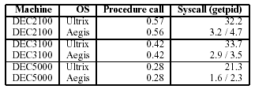
Null Procedure and System Call Costs

Slide 59
Aegis Exceptions
All hardware exceptions passed to applications
Save scratch registers into ‘save area’ using physical addresses
Load exception program counter, last virtual address where translation failed and the cause of the exception
Jumps to application specified program counter where execution resumes

Slide 60
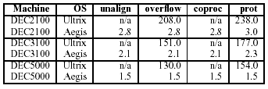
Aegis vs. Ultrix Exception Handling Times

Slide 61
Address Translation
Bootstrapping through ‘guaranteed mapping’
Virtual addresses separated into two segments: Normal data and code Page tables and exception code

Slide 62
Protected Control Transfer
Changes program counter to value in the callee
Asynchronous calling process donates remainder of time slice to callee’s process environment – Synchronous calls donate all remaining time slices
Installs callee’s processor context (address-context identifier, address-space tag, processor status word)
Transfer is atomic to processes
Aegis will not overwrite application visible registers

Slide 63

Protected Control Transfer Times Compared with L3

Slide 64
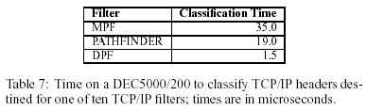
Dynamic Packet Filter (DPF)
Message demultiplexing determines which application a message should be delivered to
Dynamic code generation is performed by VCODE
Generates one executable instruction in 10 instructions

Slide 65
ExOS: A Library Operating System
Manages operating system abstractions at the application level within the address space of the application using it
System calls can perform as fast as procedure calls

Slide 66
IPC Abstractions
Pipes in ExOS use a shared memory circular buffer
Pipe’ uses inline read and write calls
Shm shows times of two processes to ‘ping-pong’ – simulated on Ultrix using signals
Lrpc is single threaded, does not check permissions and assumes a single function is of interest

Slide 67
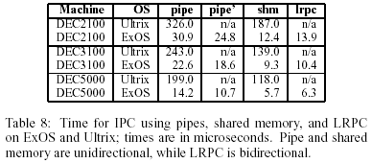
IPC Times Compared to Ultrix

Slide 68
Application-level Virtual Memory
Does not handle swapping
Page tables are implemented as a linear vector
Provides aliasing, sharing, enabling disabling caching on a per page basis, specific page-allocation and DMA

Slide 69
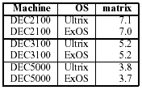
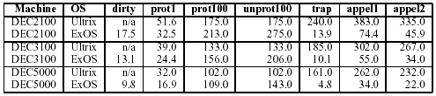
Virtual Memory Performance

Slide 70
Application-Specific Safe Handlers (ASH)
Downloaded into the kernel
Made safe by code inspection, sandboxing
Executes on message arrival
Decouples latency critical operations such as message reply from scheduling of processes

Slide 71
ASH Continued
Allows direct message vectoring – eliminating intermediate copies
Dynamic integrated layer processing – allows messages to be aggregated to a single point in time
Message initiation – allows for low-latency message replies
Control initiation – allows general computations such as remote lock acquisition

Slide 72

Roundtrip Latency of 60-byte packet

Slide 73
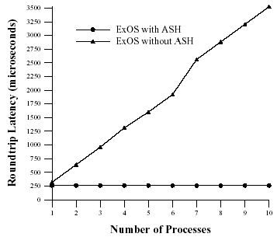
Average Roundtrip Latency with Multiple Active Processes on Receiver

Slide 74

Extensible RPC
Trusted version of lrpc called tlrpc which saves and restores callee-saved registers

Slide 75

Extensible Page-table Structures
Inverted page tables

Slide 76
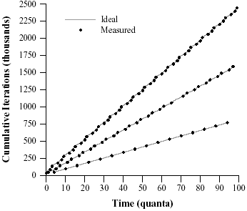
Extensible Schedulers
Stride scheduling

Slide 77
Conclusions
Simplicity and limited exokernel primitives can be implemented efficiently
Hardware multiplexing can be fast and efficient
Traditional abstractions can be implemented at the application level
Applications can create special purpose implementations by modifying libraries

