Slide 1
Advanced Operating Systems (CS 202) Extensible Operating Systems

Slide 2
Our first paper discussion
Research is a conversation advanced by different papers
We’ll try to get a sense of the conversation
…which spans multiple papers
…typically read one or two, and I will fill in other threads
Some conversations are old classics ☺
To learn something useful, we need to think about how they inform the present

Slide 3
Operating System Organization
The bigger conversation…
In the 70s and 80s, OS design started emerging as a discipline
How should the OS be structured?
Why does it matter? What can be accomplished by a good/bad structure?
For time sharing, its clear we need a separate OS and User space
Do we need further structure?

Slide 4
Why is the structure of an OS important?
Protection
User from user and system from user
Performance
Does the structure facilitate good performance?
Flexibility/Extensibility
Can we adapt the OS to the application
Scalability
Performance goes up with more resources
Agility
Adapt to application needs and resources
Responsiveness
How quickly it reacts to external events
Can it meet these requirements?

Slide 5
An earlier conversation

Slide 6
Extensibility
What do we mean by extensibility?
Flexible to add new features/functionalities
Good efficiency
Good security
Can you give a few examples?
Device drivers
Browser plugins/extensions

Slide 7
Extensibility context
Traditional OS provide standard
Set of abstractions
Processes, threads, VM, Files, IPC
Reachable through syscalls
Resource allocation and management
Protection and security
Industry complaining of OS large overheads
Researchers were doing customized extensions
Research community started asking how to provide customization?
Flux OS toolkit

Slide 8
Is extensibility really important?
What are some of arguments in the paper?
OS does not perform well for specific applications
End to end argument in system design
What specific examples of applications do they list?
Is it an implementation or abstraction issue?
Both? Abstractions overly general, and implementations are fixed
Protection and management interfere with performance and flexibility

Slide 9
How expensive are border crossings?
Procedure call: save some general-purpose registers and jump
Mode switch:
Trap or call gate overhead
Nowadays syscall/sysreturn
Switch to kernel stack
Switch some segment registers
100s of ns
Context switch?
Change address space
This could be expensive; flush TLB, …
Few microsecs

Slide 10
OS design models
Library OS
Monolithic Kernel
Micro Kernel

Slide 11
OS as library (DOS-like)
Applications
OS Services and Device drivers
Hardware, managed by OS

Slide 12
Monolithic Kernel
Applications
OS Services and Device drivers
What is the difference?
Hardware, managed by OS

Slide 13
Micro-kernel
Applications
File
System
Memory manager
CPU scheduler
Micro-kernel
IPC, Address
Spaces, …
Hardware, managed by OS

Slide 14
More simply
Monolithic
safe
fast
micro kernel
DOS
extensible

Slide 15
Summary
DOS-like structure:
good performance and extensibility
Bad protection
Monolithic kernels:
Good performance and protection
Bad extensibility
Microkernels
Very good protection
Good extensibility
Bad performance!

Slide 16
Poll: What properties should an extensible OS have?

Slide 17
What should an extensible OS do?
It should be thin, like a micro-kernel
Only mechanisms (or even less?)
no policies; they are defined by extensions
Fast access to resources, like DOS
Eliminate border crossings
Flexibility without sacrificing protection or performance
Basically, fast, protected and flexible

Slide 18
What had been done before?
Hydra (Wulf ’81)
Kernel mechanisms for resource allocation
Capability based resource access
This was expensive as implemented
Resource management as coarse grained objects to reduce boarder crossings
Microkernel (e.g., Mach in the 90s)
Focus on extensibility and portability
Portability hurt performance
Gave a bad rep to microkernels

Slide 19
Existing Approaches
Directly insert code modules
E.g., Loadable kernel module
Good efficiency
Bad security
Put into a new process
E.g., User-mode driver (e.g., FUSE)
E.g., Microsoft puts browser plugin into a new process
Good security
Bad efficiency (context switch/mode switch)

Slide 20
Spin Approach to extensibility
Co-location of kernel and extension
Avoid border crossings
But what about protection?
Language/compiler forced protection
Strongly typed language
Protection by compiler and run-time
Cannot cheat using pointers
Logical protection domains
No longer rely on hardware address spaces to enforce protection – no boarder crossings
Dynamic call binding for extensibility

Slide 21
Logical protection domains
Modula-3 safety and encapsulation mechanisms
Type safety, automatic storage management
Objects, threads, exceptions and generic interfaces
Fine-grained protection of objects using capabilities. An object can be:
Hardware resources (e.g., page frames)
Interfaces (e.g., page allocation module)
Collection of interfaces (e.g., full VM)
Capabilities are language supported pointers

Slide 22
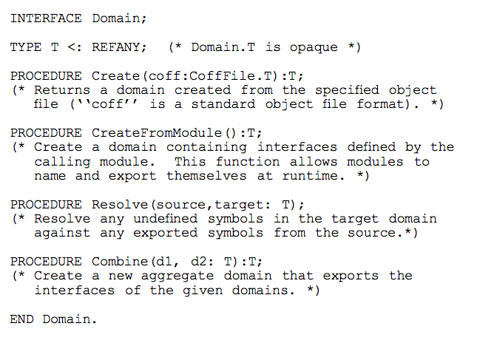
Logical protection domains -- mechanisms
Create:
Initialize with object file contents and export names
Resolve:
Names are resolved between a source and a target domain
Once resolved, access is at memory speeds
Combine
To create an aggregate domain
This is the key to spin – protection, extensibility and performance

Slide 23
Protection Model (I)
All kernel resources are referenced by capabilities [tickets]
SPIN implements capabilities directly through the use of pointers
Compiler prevents pointers to be forged or dereferenced in a way inconsistent with its type at compile time:
No run time overhead for using a pointer

Slide 24
Protection Model (II)
A pointer can be passed to a user-level application through an externalized reference:
Index into a per-application table of safe references to kernel data structures
Similar to file descriptors, or socket descriptors in unix
Protection domains define the set of names accessible to a given execution context

Slide 25
Spin
File
System
CPU scheduler
File
System
Memory manager
Memory manager
Network
CPU scheduler
spin
IPC, Address
Spaces, …
Hardware, managed by OS

Slide 26
Spin Mechanisms for Events
Spin extension model is based on events and handlers
Which provide for communication between the base and the extensions
Events are routed by the Spin Dispatcher to handlers
Handlers are typically extension code called as a procedure by the dispatcher
One-to-one, one-to-many or many-to-one
All handlers registered to an event are invoked
Guards may be used to control which handler is used

Slide 27
Event example
Direct transfer from network to frame buffer
Support of active networks
In kernel handling of HTTP requests
Support of Remote Procedure Call (RPC)
Pre-cursor to packet filters!

Slide 28
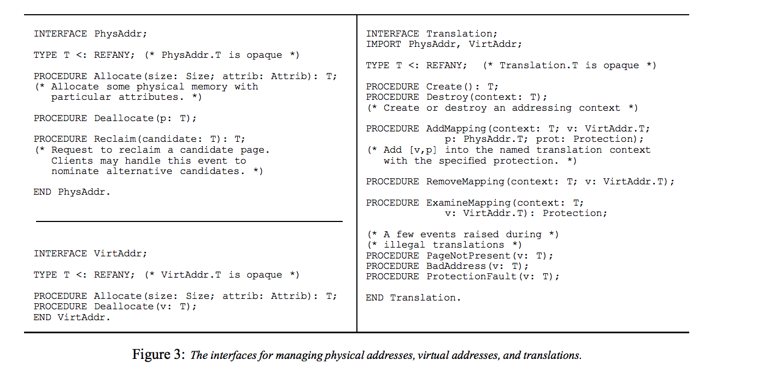
Default Core services in SPIN
Memory management (of memory allocated to the extension)
Physical address
Allocate, deallocate, reclaim
Virtual address
Allocate, deallocate
Translation
Create/destory AS, add/remove mapping
Event handlers
Page fault, access fault, bad address

Slide 29
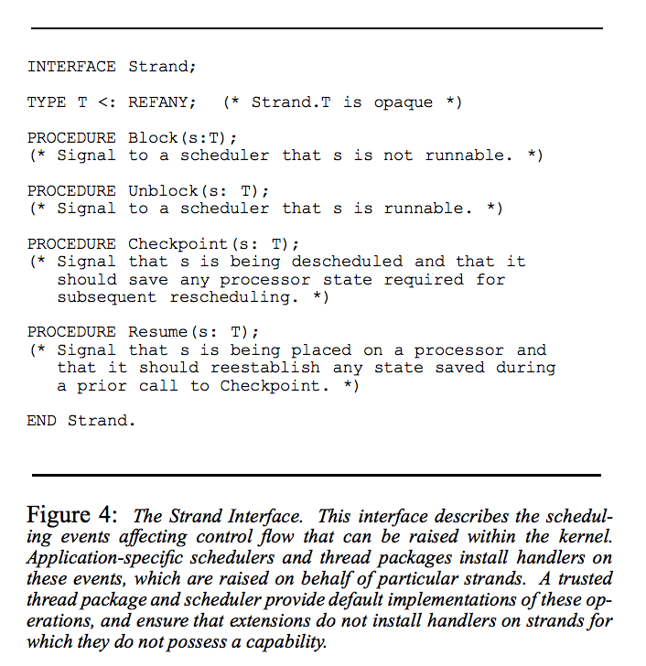
CPU Scheduling
Spin abstraction: strand
Semantics defined by extension
Event handlers
Block, unblock, checkpoint, resume
Spin global scheduler
Interacts with extension threads package

Slide 30
Experiments
Don’t worry, I wont go through them
In the OS community, you have to demonstrate what you are proposing
They built SPIN, extensions and applications that use them
Microbenchmarks to evaluate individual mechanisms
Focus on performance and size
Reasonable size, and substantial performance advantages even relative to a mature monolithic kernel

Slide 31
Conclusions
Extensibility, protection and performance
Extensibility and protection provided by language/compiler features and run-time checks
Instead of hardware address spaces
…which gives us performance—no border crossing
Who are we trusting? Consider application and Spin
How does this compare to Exo-kernel?

