Slide 1
Monolithic Kernels, Sleeping Beauties, and Processes
CS202, Advanced Operating Systems
(Some slides from Hung-Wei Tseng, and Heng Yin)

Slide 2




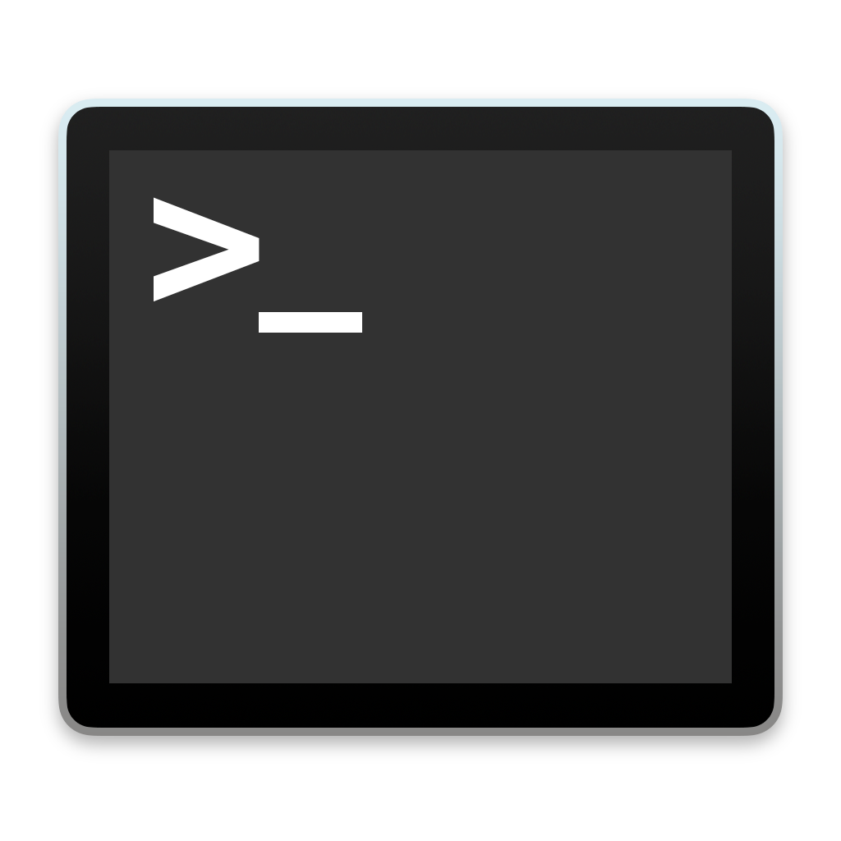



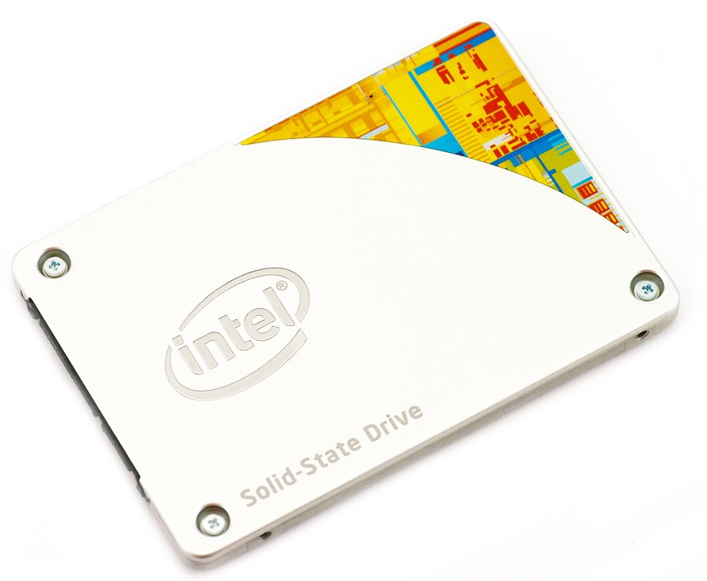
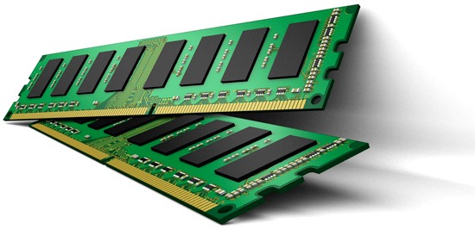
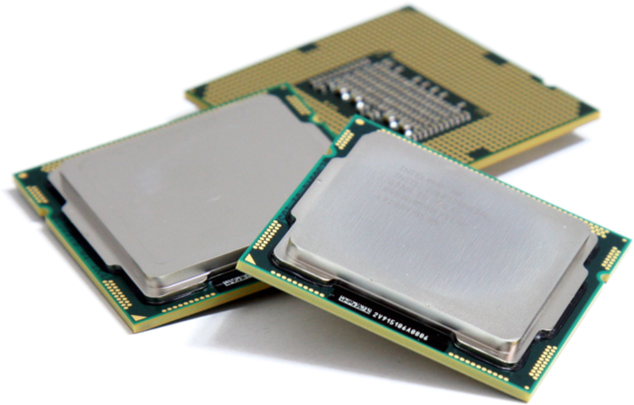
The goal of an OS
Virtualization and Abstraction:
Operating System

Slide 3
Recap: What modern operating systems support?
Virtualize hardware/architectural resources
  Easy for programs to interact with hardware resources
  Share hardware resource among programs
  Protect programs from each other (security)
Execute multithreaded programs concurrently
  Support multithreaded programming model
  Execute multithreaded programs efficiently
Store data persistently
  Store data safely
  Secure

Slide 4
Recap: How processor executes a program
The program counter (PC) tells where the upcoming instruction is in the memory
Processor fetches the instruction, decode the instruction, execute the instruction, present the instruction results according to clock signals
The processor fetches the next instruction whenever it’s safe to do so
Processor
instruction memory
clock
120007a30: 0f00bb27 ldah gp,15(t12)
120007a34: 509cbd23 lda gp,-25520(gp)
120007a38: 00005d24 ldah t1,0(gp)
120007a3c: 0000bd24 ldah t4,0(gp)
120007a40: 2ca422a0 ldl t0,-23508(t1)
120007a44: 130020e4 beq t0,120007a94
120007a48: 00003d24 ldah t0,0(gp)
120007a4c: 2ca4e2b3 stl zero,-23508(t1)
120007a50: 0004ff47 clr v0
120007a54: 28a4e5b3 stl zero,-23512(t4)
120007a58: 20a421a4 ldq t0,-23520(t0)
120007a5c: 0e0020e4 beq t0,120007a98
120007a60: 0204e147 mov t0,t1
120007a64: 0304ff47 clr t2
120007a68: 0500e0c3 br 120007a80
PC

Slide 5
Monolithic Kernel/Sleeping Beauty
Sleeping beauty: Direct Controlled Execution
  Program running directly on hardware
But I thought that is insecure?
  Yes! We hide anything dangerous in the OS
  Program has to ask for permission
    System calls
OS is an event handler
  Any event occurs, hardware securely traps to OS
  OS figures out who woke it up and handles the situation

Slide 6
System Calls
For a user program to do something “privileged” (e.g., I/O) it must call an OS procedure
  Known as crossing the protection boundary, or a protected procedure call
Hardware provides a system call instruction that:
  Causes an exception, which invokes a kernel handler
    Passes a parameter determining the system routine to call
  Saves caller state (PC, regs, mode) so it can be restored
    Why save mode?
  Returning from system call restores this state

Slide 7
System Call
emacs: read()
Trap to kernel mode, save state
User mode
Kernel mode
Restore state, return to user level, resume execution
Trap handler
Find read handler
read() kernel routine

Slide 8
Categorizing Events
 | Unexpected | Deliberate
Synchronous | fault | syscall trap
Asynchronous | interrupt | software interrupt
Interrupts signal asynchronous events
  I/O hardware interrupts
  Software and hardware timers

Slide 9
Timer
The key to a timesharing OS
The fallback mechanism by which the OS reclaims control
  Timer is set to generate an interrupt after a period of time
    Setting timer is a privileged instruction
    When timer expires, generates an interrupt
      Handled by the OS, forcing a switch from the user program
    Basis for OS scheduler (more later…)
Also used for time-based functions (e.g., sleep())
Notes:
Prevents infinite loops
OS can always regain control from erroneous or malicious programs that try to hog CPU

Slide 10
The goal of an OS
Operating System

Slide 11




The idea of an OS: virtualization
Operating System
API
API
API
API
API
API
API
API
CPU
CPU
CPU
CPU
CPU
CPU
CPU
CPU
Memory
Memory
Memory
Memory
Memory
Memory
Memory
Memory
I/O
I/O
I/O
I/O
I/O
I/O
I/O
I/O

Slide 12
The idea: virtualization
The operating system presents an illusion of a virtual machine to each running program and maintains architectural states of a von Neumann machine
    Processor
    Memory
    I/O
Each virtualized environment accesses architectural facilities through some sort of application programming interface (API)
Dynamically map those virtualized resources into physical resources

Slide 13
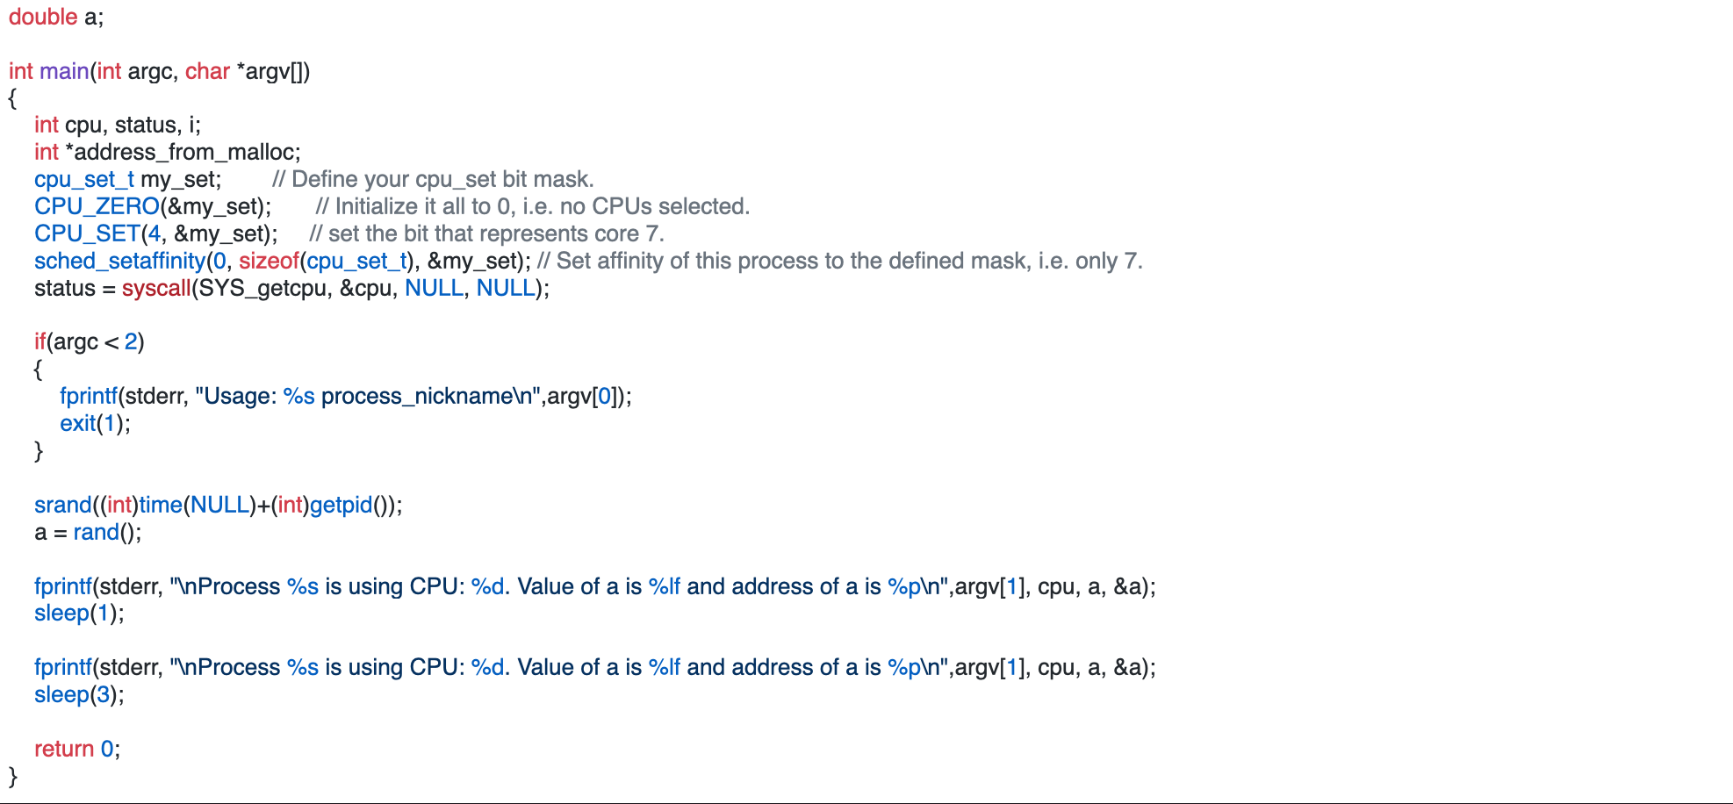
Demo, Virtualization
getcpu system call to retrieve the executing CPU ID
create a random number
print the value of a and address of a
print the value of a and address of a again after sleep

Slide 14
Virtualization Demo

Slide 15
Why virtualization
How many of the following statement is true about why operating systems virtualize running programs?
  Virtualization can help improve the utilization and the throughput of the underlying hardware
  Virtualization may allow the system to execute more programs than the number of physical processors installed in the machine
  Virtualization may allow a running program or running programs to use more than install physical memory
  Virtualization can improve the latency of executing each program
  0
  1
  2
  3
  4
Notes:
Virtualization
https://www.polleverywhere.com/multiple_choice_polls/2wjzRjNYxWqXpc1JTiDcs?display_state=chart&activity_state=opened&state=opened&flow=Engagement&onscreen=persist

Slide 16
Why virtualization
How many of the following statement is true about why operating systems virtualize running programs?
  Virtualization can help improve the utilization and the throughput of the underlying hardware
  Virtualization may allow the system to execute more programs than the number of physical processors installed in the machine
  Virtualization may allow a running program or running programs to use more than install physical memory
  Virtualization can improve the latency of executing each program
  0
  1
  2
  3
  4
Make programs less machine-dependent

Slide 17
Virtualizing the CPU: Processes
Operating System
API
API
API
API
API
API
API
API
CPU
CPU
CPU
CPU
CPU
CPU
CPU
CPU
Process
Memory
Memory
Memory
Memory
Memory
Memory
Memory
Memory
I/O
I/O
I/O
I/O
I/O
I/O
I/O
I/O

Slide 18
The Process
The process is the OS abstraction for execution
  It is the unit of execution
  It is the unit of scheduling
A process is a program in execution
  Programs are static entities with the potential for execution
  Process is the animated/active program
    Starts from the program, but also includes dynamic state
    As the representative of the program, it is the “owner” of other resources (memory, files, sockets, …)
How does the OS implement this abstraction?
  How does it share the CPU?

Slide 19
Process Components
A process contains all the state for a program in execution
  An address space containing
    Static memory:
      The code and input data for the executing program
    Dynamic memory:
      The memory allocated by the executing program
      An execution stack encapsulating the state of procedure calls
  Control registers such as the program counter (PC)
  A set of general-purpose registers with current values
  A set of operating system resources
    Open files, network connections, etc.
A process is named using its process ID (PID)
Notes:
PID is an example of how OS resources are exposed to programmers.
We cannot just provide a pointer to the resource in the OS. There are at least two reasons to see why this is a bad idea:
--The program should be portable, so the pointers must be relevant across any operating system. Each OS may use different objects and the structure of any object assumed by the program is not likely to apply universally, making the code not portable. The OS may not be even part of the process image, so a pointer will not work for some operating systems.
--We do not want to expose the structure of the OS to the program.
To deal with this issue, operating systems offer named identifiers for all their resources/abstractions. We use file descriptors, socket descriptors, PIDs, etc… Usually these are simple integers. The OS maintains tables to map these numbers to the internal objects they represent.

Slide 20
Address Space (memory abstraction)
0xFFFFFFFF
Stack
SP
Dynamic
Address
Space
Heap
(Dynamic Memory Alloc)
Static Data
(Data Segment)
Static
Code
(Text Segment)
PC
0x00000000
Notes:
The memory address space (or address space for short) is the most important resource that a process owns.
The stack can be thought of as dynamic memory that is managed by the compiler. Every time you call a function, a stack frame is allocated with space for all the local variables in the function. The deallocation happens when you return from the function in which case the stack shrinks to the previous function frame.
The heap is where space is allocated when you malloc/new and deallocated when you free. There heap code (for malloc/new) is typically user level code. It manages a list of the free available space and tries to find a space for every allocation request (for example, a previously allocated space that was freed). If there is no space, it asks the OS for additional memory, making the heap grow upwards.

Slide 21
What the OS must track for a process?
Which of the following information does the OS need to track for each process?
  Stack pointer
  Program counter
  Process state
  Registers
  All of the above

Slide 22
What the OS must track for a process?
Which of the following information does the OS need to track for each process?
  Stack pointer
  Program counter
  Process state
  Registers
  All of the above
You also need to keep other process information like an unique process id, process states, I/O status, and etc…

Slide 23
Processes

Slide 24
OS Abstractions
Applications
Process
File system
Virtual memory
Operating System
CPU
Hardware
Disk
RAM
Today, we start discussing the first abstraction that enables us to virtualize
(i.e., share) the CPU – processes!

Slide 25
The Process
The process is the OS abstraction for execution
  It is the unit of execution
  It is the unit of scheduling
A process is a program in execution
  Programs are static entities with the potential for execution
  Process is the animated/active program
    Starts from the program, but also includes dynamic state
    As the representative of the program, it is the “owner” of other resources (memory, files, sockets, …)
How does the OS implement this abstraction?
  How does it share the CPU?

Slide 26
Process Components
A process contains all the state for a program in execution
  An address space containing
    Static memory:
      The code and input data for the executing program
    Dynamic memory:
      The memory allocated by the executing program
      An execution stack encapsulating the state of procedure calls
  Control registers such as the program counter (PC)
  A set of general-purpose registers with current values
  A set of operating system resources
    Open files, network connections, etc.
A process is named using its process ID (PID)
Notes:
PID is an example of how OS resources are exposed to programmers.
We cannot just provide a pointer to the resource in the OS. There are at least two reasons to see why this is a bad idea:
--The program should be portable, so the pointers must be relevant across any operating system. Each OS may use different objects and the structure of any object assumed by the program is not likely to apply universally, making the code not portable. The OS may not be even part of the process image, so a pointer will not work for some operating systems.
--We do not want to expose the structure of the OS to the program.
To deal with this issue, operating systems offer named identifiers for all their resources/abstractions. We use file descriptors, socket descriptors, PIDs, etc… Usually these are simple integers. The OS maintains tables to map these numbers to the internal objects they represent.

Slide 27
Address Space (memory abstraction)
0xFFFFFFFF
Stack
SP
Dynamic
Address
Space
Heap
(Dynamic Memory Alloc)
Static Data
(Data Segment)
Static
Code
(Text Segment)
PC
0x00000000
Notes:
The memory address space (or address space for short) is the most important resource that a process owns.
The stack can be thought of as dynamic memory that is managed by the compiler. Every time you call a function, a stack frame is allocated with space for all the local variables in the function. The deallocation happens when you return from the function in which case the stack shrinks to the previous function frame.
The heap is where space is allocated when you malloc/new and deallocated when you free. There heap code (for malloc/new) is typically user level code. It manages a list of the free available space and tries to find a space for every allocation request (for example, a previously allocated space that was freed). If there is no space, it asks the OS for additional memory, making the heap grow upwards.

Slide 28
Process Execution State
A process is born, executes for a while, and then dies
The process execution state that indicates what it is currently doing
  Running: Executing instructions on the CPU
    It is the process that has control of the CPU
    How many processes can be in the running state simultaneously?
  Ready: Waiting to be assigned to the CPU
    Ready to execute, but another process is executing on the CPU
  Waiting: Waiting for an event, e.g., I/O completion
    It cannot make progress until event is signaled (disk completes)
Notes:
Having seen the state the process encapsulates, lets now see how the process behaves within the system to implement the processor virtualization and give users the illusion of a program that is always running.

Slide 29
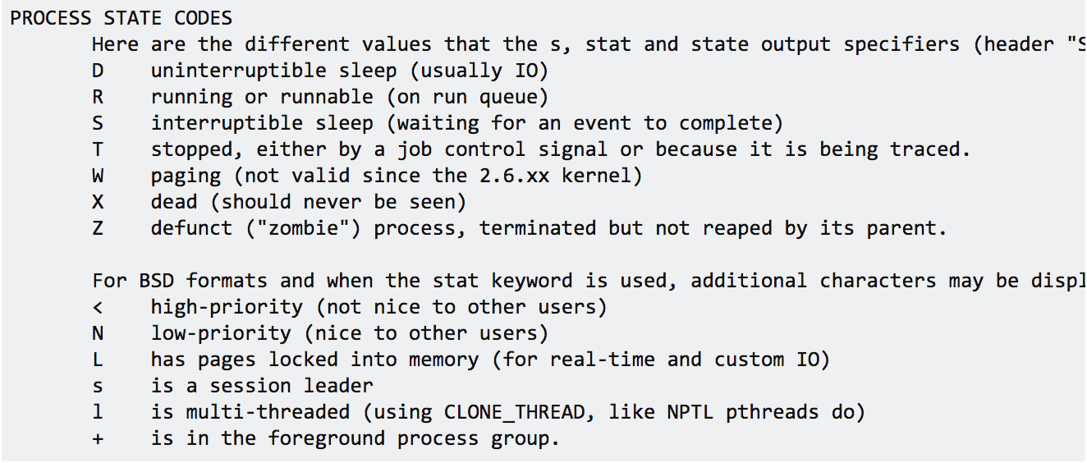
Execution state (cont’d)
As a process executes, it moves from state to state
  Unix “ps -x”: STAT column indicates execution state
  What state do you think a process is in most of the time?
  How many processes can a system support?

Slide 30
Execution State Graph
Create Process
New
Ready
I/O Done
Unschedule Process
Schedule Process
Waiting
I/O, Page Fault, etc.
Terminated
Running
Process Exit

Slide 31
How does the OS support this model?
Three issues:
How does the OS represent a process in the kernel?
  The OS data structure representing each process is called the Process Control Block (PCB)
2. How do we pause and restart processes?
  We must be able to save and restore the full machine state
3. How do we keep track of all the processes in the system?
  A lot of queues!
Notes:
Next we look at how the OS implements the process execution model. This includes (1) what data structures it uses and how it uses them; (2) how does it pause and unpause processes so that it can multiplex the use of the CPU; and (3) scheduling (which is a topic for later): how do we pick a process to run among the available processes.

Slide 32
PCB Data Structure
PCB also is where OS keeps all of a process’ hardware execution state when the process is not running
    Process ID (PID)
    Execution state
    Hardware state: PC, SP, regs
    Memory management
    Scheduling
    Accounting
    Pointers for state queues
    Etc.
This state is everything that is needed to restore the hardware to the same configuration it was in when the process was switched out of the hardware

Slide 33
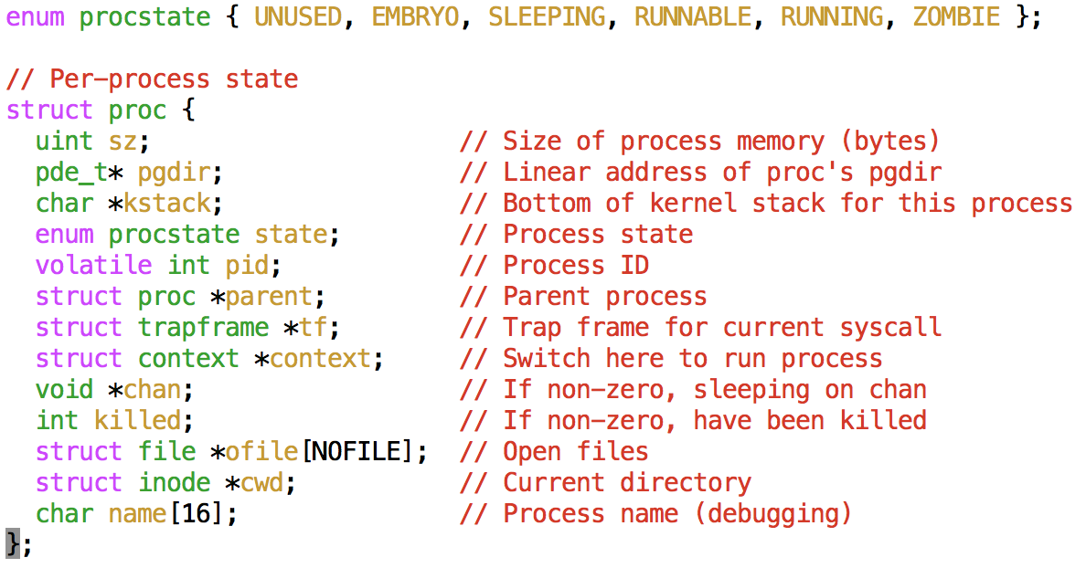
Xv6 struct proc

Slide 34
How to pause/restart processes?
When a process is running, its dynamic state is in memory and some hardware registers
  Hardware registers include Program counter, stack pointer, control registers, data registers, …
  To be able to stop and restart a process, we need to completely restore this state
When the OS stops running a process, it saves the current values of the registers (usually in PCB)
When the OS restarts executing a process, it loads the hardware registers from the stored values in PCB
Changing CPU hardware state from one process to another is called a context switch
  This can happen 100s or 1000s of times a second!

Slide 35
How does the OS track processes?
The OS maintains a collection of queues that represent the state of all processes in the system
Typically, the OS at least one queue for each state
  Ready, waiting, etc.
Each PCB is queued on a state queue according to its current state
As a process changes state, its PCB is unlinked from one queue and linked into another

Slide 36
State Queues
Ready Queue
Firefox PCB
X Server PCB
Outlook PCB
Disk I/O Queue
Emacs PCB
ls PCB
Console Queue
Sleep Queue
There may be many wait queues, one for each type of wait (disk, console, timer, network, etc.)
.
.
.

