Slide 1
Docker
Some slides from Martin Meyer
Notes:
Vagrant Box:
https://bitbucket.org/inftec/vagrant-playground/branch/docker-demo
VM: \\192.168.0.200\Public\2014-12-18 Workshop Docker
DEPRECATED:
Preparation:
Windows: Install boot2docker: https://github.com/boot2docker/boot2docker
Optional: Clean images and containers from installation
Pull required Images
docker pull ubuntu
docker pull training/webapp

Slide 2
Agenda
What is Docker from an OS organization perspective?
Docker vs. Virtual Machine
History, Status, Run Platforms
Use cases

Slide 3
What is Docker?
Docker is an open-source project that automates the deployment of applications inside software containers, by providing an additional layer of abstraction and automation of operating system–level virtualization on Linux.
[Source: en.wikipedia.org]

Slide 4
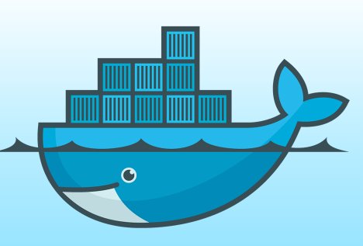
Docker: Name
[www.docker.com]
docker [naut.]: der Dockarbeiter, der Hafenarbeiter
Source: leo.org
Provide a uniformed wrapper around a software package: «Build, Ship and Run Any App, Anywhere» [www.docker.com]
Similar to shipping containers: The container is always the same, regardless of the contents and thus fits on all trucks, cranes, ships, ...

Slide 5
Containers
Virtualize the OS, not the full machine
Container sits on host OS kernel, and some shared binaries
These are read only
Sharing OS resources significantly reduces footprint
Containers are lightweight – megabytes in size
Smaller snapshots, can have many more on one physical machine
VMs are an order of magnitude or more larger
Take longer to launch, etc…

Slide 6
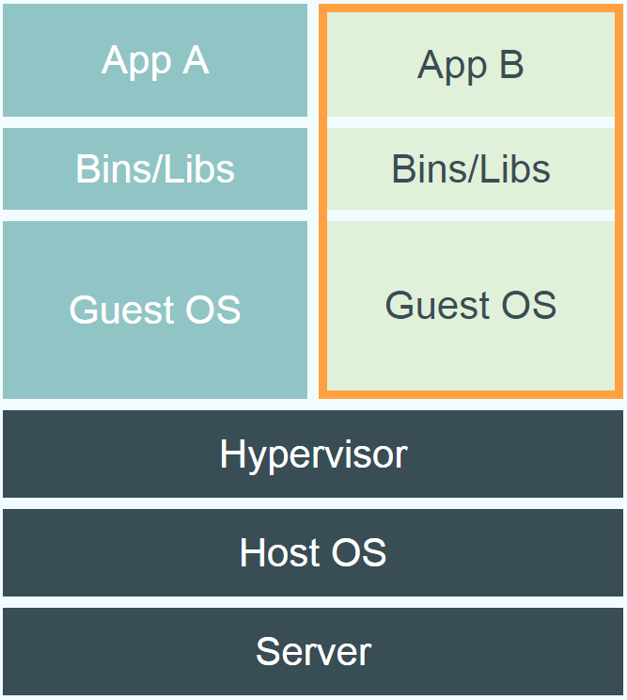
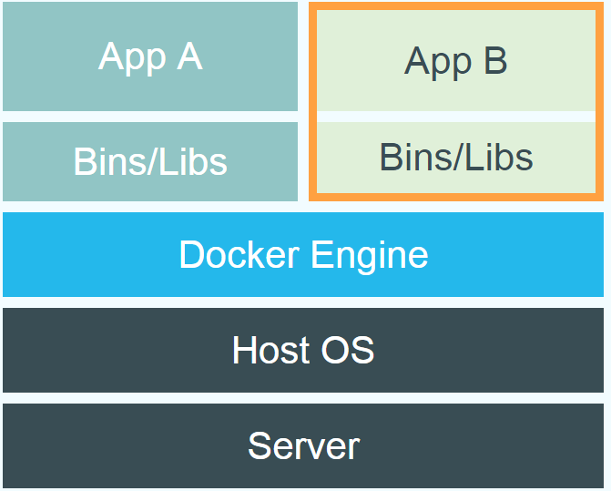
Docker vs. Virtual Machine
Source: https://www.docker.com/whatisdocker/
Notes:
Virtual Machines
Each virtualized application includes not only the application - which may be only 10s of MB - and the necessary binaries and libraries, but also an entire guest operating system - which may weigh 10s of GB.
Docker
The Docker Engine container comprises just the application and its dependencies. It runs as an isolated process in userspace on the host operating system, sharing the kernel with other containers. Thus, it enjoys the resource isolation and allocation benefits of VMs but is much more portable and efficient.
Docker provides base images that contain OS installations we can start from: The OS is not more than an application running on the Kernel...

Slide 7
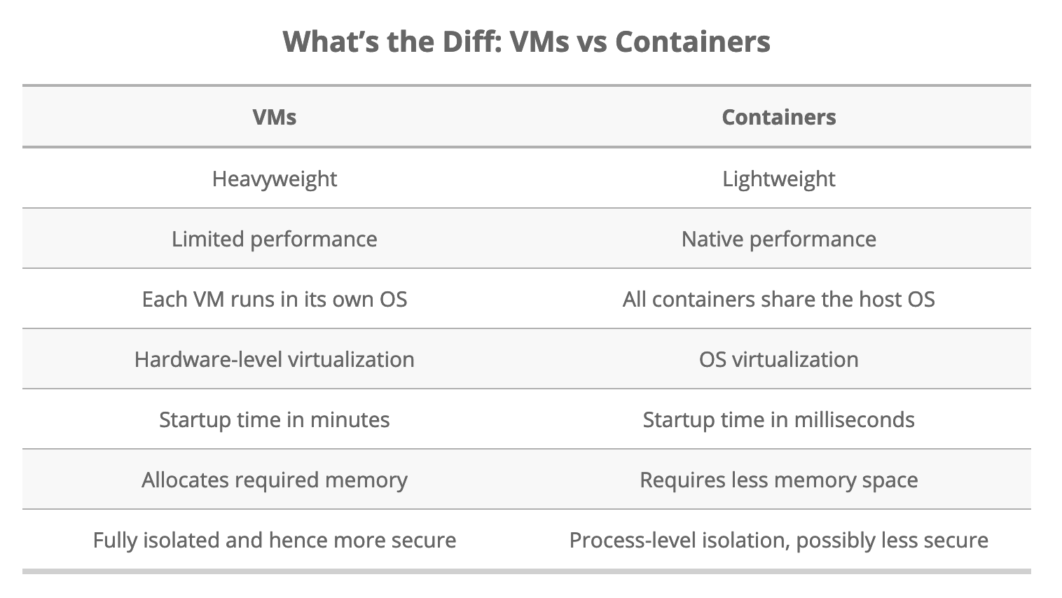

Slide 8
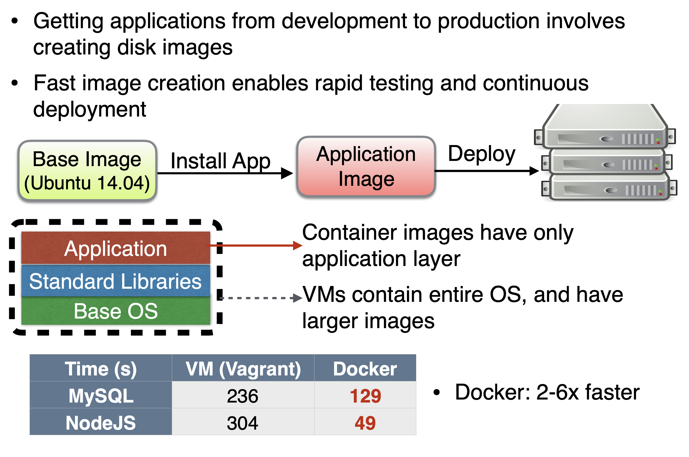
Performance comparison

Slide 9
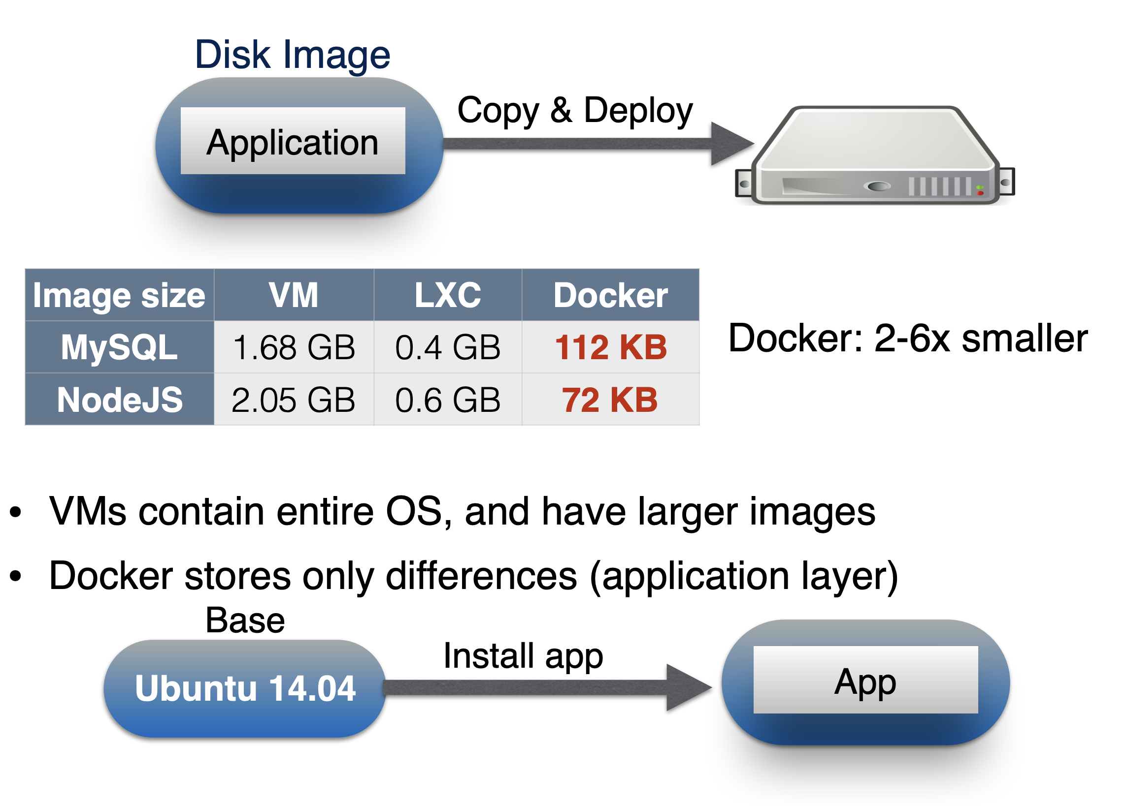
Size comparison
Notes:
Source: Middleware 16 paper/presentation comparing containers to virtualization under different scenarios (competing, adversarial, etc…)

Slide 10
Additional discussion points
Name spaces, and unix jail
VMs include a separate OS image, adding complexity to all stages of development lifecycle
Limits portability between clouds and data centers
Performance isolation:
Unix cgroups can provide isolation for CPU, memory, I/O and network
Notes:
Windows: http://www.zdnet.com/docker-cto-why-microsofts-docker-plans-for-windows-will-matter-to-you-7000035150/
"That's why the result of the Microsoft announcement will not allow a container that runs on Linux to run seamlessly on Windows or vice versa. But that's OK because in the context of distributed applications that's not what developers are asking for."

Slide 11
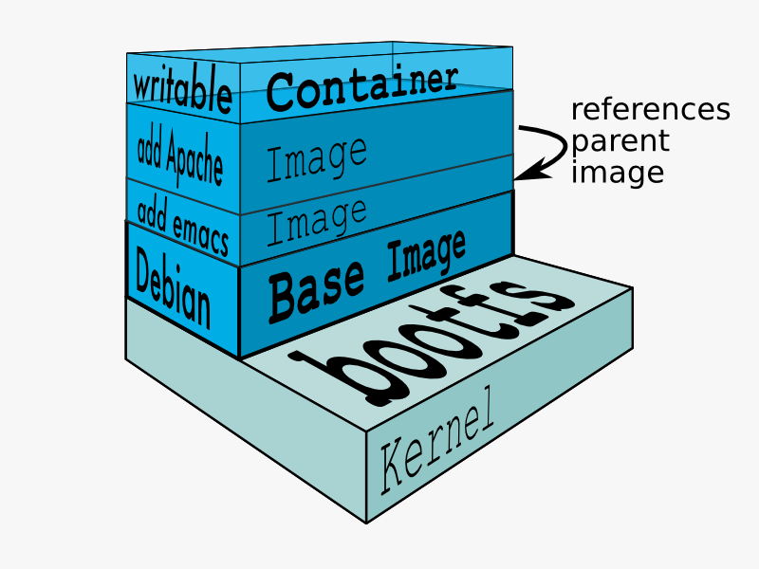
Docker Technology
libvirt: Platform Virtualization
LXC (LinuX Containers): Multiple isolated Linux systems (containers) on a single host
Layered File System
[Source: https://docs.docker.com/terms/layer/]

Slide 12
Docker History
2013-03: Releases as Open Source
2013-09: Red Hat collaboration (Fedora, RHEL, OpenShift)
2014-03: 34th most starred GitHub project
2014-05: JAX Innovation Award (most innovative open technology)

Slide 13
Terminology - Image
Persisted snapshot that can be run
images: List all local images
run: Create a container from an image and execute a command in it
tag: Tag an image
pull: Download image from repository
rmi: Delete a local image
This will also remove intermediate images if no longer used

Slide 14
Terminology - Container
Runnable instance of an image
ps: List all running containers
ps –a: List all containers (incl. stopped)
top: Display processes of a container
start: Start a stopped container
stop: Stop a running container
pause: Pause all processes within a container
rm: Delete a container
commit: Create an image from a container
Notes:
docker run --rm to remove container after termination

Slide 15
Image vs. Container
Base Image
ubuntu:latest
run
Container
cid1
base image
cmd → new state
New Image
iid1
commit
Container
cid1
run
Container
cid2
Container
cid3
Container
cid4

Slide 16
Dockerfile
Create images automatically using a build script: «Dockerfile»
Can be versioned in a version control system like Git along with all dependencies
Docker Hub can automatically build images based on dockerfiles on Github

Slide 17
Docker Use Cases
Development Environment
Environments for Integration Tests
Quick evaluation of software
Microservices
Multi-Tenancy
Unified execution environment (dev → test → prod (local, VM, cloud, ...)

Slide 18
Use-case: scientific reproducibility
Dependency hell
Less than 50% of software could be built or installed
Difficult to reproduce computational environment
Imprecise documentation
Difficult to figure out how to install
Code rot
Software dependencies change, affecting results
Barriers to adoption and reuse
Difficulty to coordinate build tools/package managers

Slide 19
Use case: scientific reproducibility
Dependency hell
Docker! Container includes everything!
Imprecise documentation
Dockerfiles keep record of dependencies
Code rot
versioning
Barriers to adoption and reuse
Argues that docker provides features to help with that

Slide 20
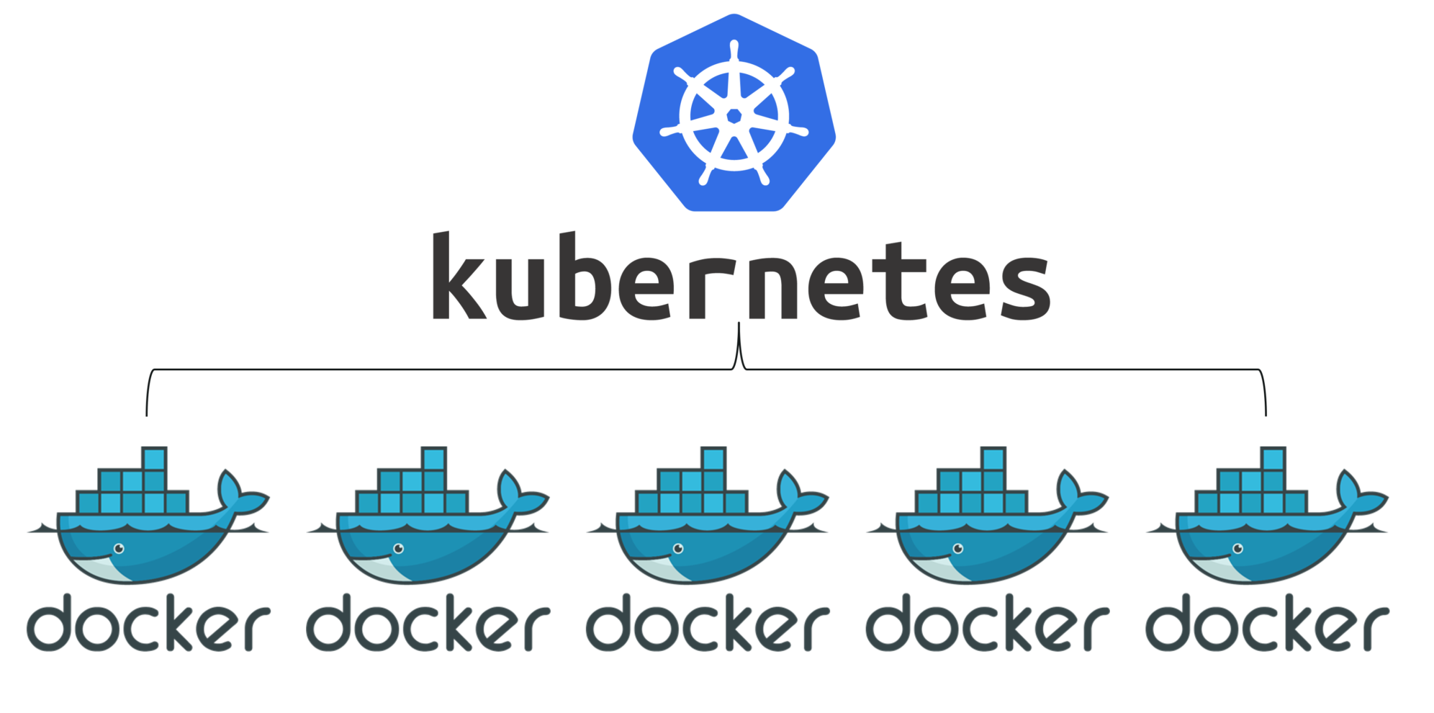
Use case 2: Kubernetes/Microservices
How to use containers to provide services on the cloud?
Rapid ramp up enables micro-services

Slide 21
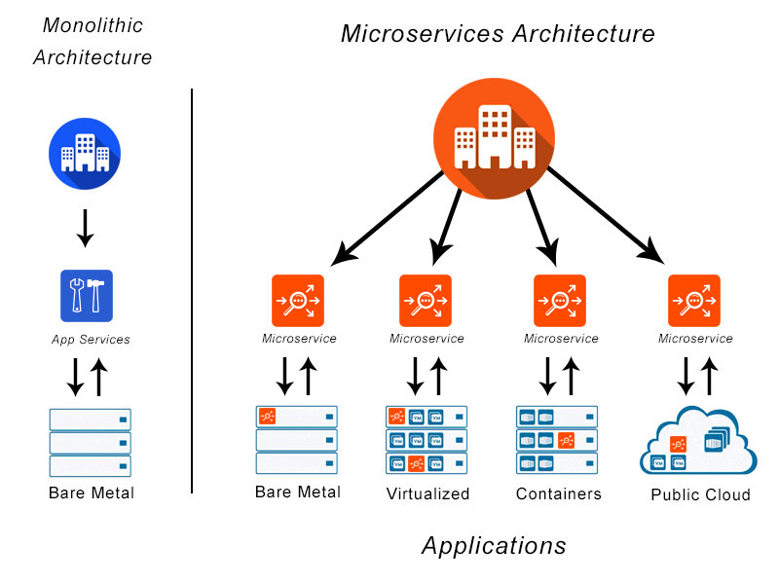
What are microservices?

Slide 22
Notes:
Image credit: sensi.io

