Slide 1
Advanced Operating Systems (CS 202) OS Evolution and Organization
Notes:
Credit: Heng reformatted original slides to white background/style and made some changes
DOS slide and some ideas from Hung-Wei
Various images from sources on the web—not sure I have correct individual credit for each.

Slide 2
Operating Systems Models
Our first topic will explore OS models
Why do Operating Systems look the way they do?
What drives the decisions? What else is possible?
To set the table
Today, we will do a walk through historical evolution of OS
Next (next time), we will overview traditional/modern OS organization (monolithic kernel)

Slide 3
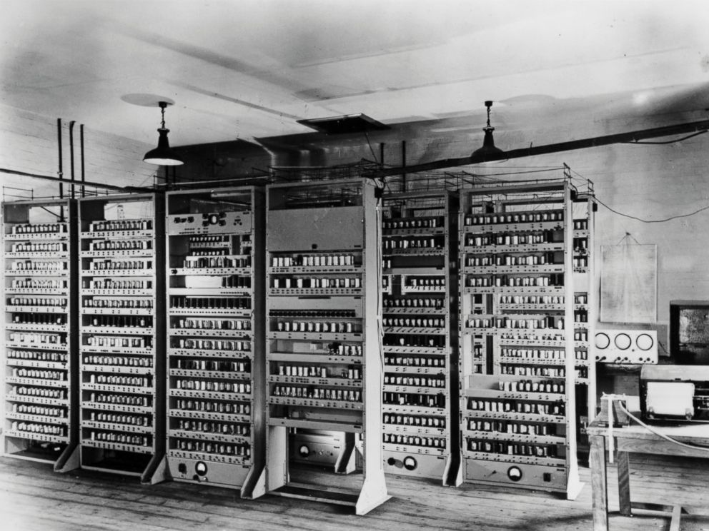
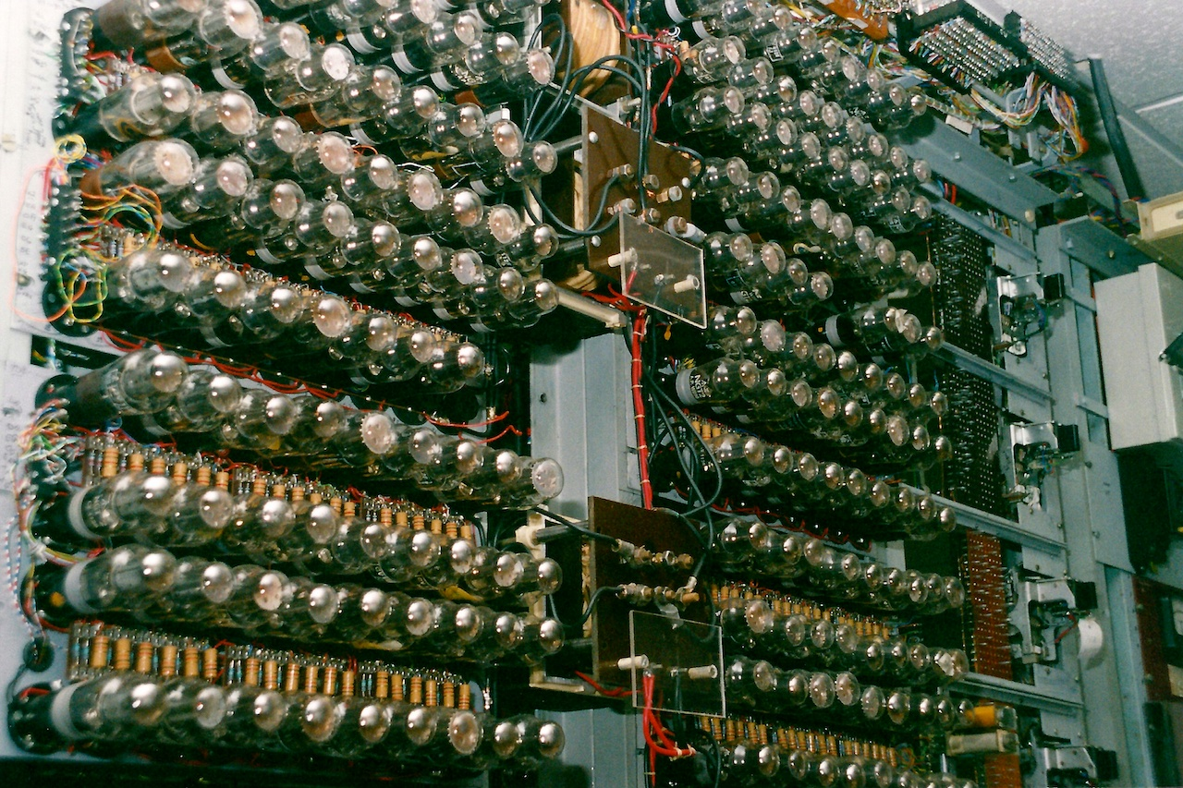
Dawn of computing
Pre 1950 : the very first electronic computers
valves and relays
single program with dedicated function
Example: Colossus (1943)
Pre 1960 : stored program valve machines
single job at a time; OS is a program loader
Example (EDSAC, 1949; Maurice Wilkes receives Turing award)
Notes:
Left picture is EDSAC, 1949, arguably first van nuemann computer. Right is the Colossus computer, one of the earliest vacuum tube computers

Slide 4
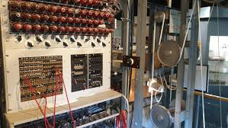
Phase 0 of OS Evolution (40s to 1955)
No OS
Computers are exotic, expensive, large, slow experimental equipment
Program in machine language and using plugboards
User sits at console: no overlap between computation, I/O, user thinking, etc..
Program manually by plugging wires in
Goal: number crunching for missile computations
Imagine programming that way
Painful and slow

Slide 5
OS progress in this period
Libraries of routines that are common
Including those to talk to I/O devices
Punch cards (enabling copying/exchange of these libraries) a big advance!
Pre-cursor to OS

Slide 6
Phase 1: 1955-1970
Computers expensive; people cheap
Use computers efficiently – move people away from machine
OS becomes a batch monitor
Loads a job, runs it, then moves on to next
If a program fails, OS records memory contents somewhere
More efficient use of hardware but increasingly difficult to debug

Slide 7
Batch systems on mainframe computers
collections of jobs made up into a batch
example: IBM 1401/7094
card decks spooled onto magnetic tape and from tape to printer
example: English Electric Leo KDF9
32K 48-bit words, 2μsec cycle time
punched paper-tape input ‘walk-up’ service or spooling via mag tape
IBM 7094, thought to be first computer singing (1961)
https://youtu.be/yIwhx3NQSLg

Slide 8
Advances in technology in this stage
Data channels and interrupts
Allow overlap of I/O and computing
Buffering and interrupt handling done by OS
Spool (buffer) jobs onto “high speed” drums

Slide 9
Phase 1, problems
Utilization is low (one job at a time)
No protection between jobs
Short jobs wait behind long jobs
So, we can only run one job at a time
Coordinating concurrent activities
Still painful and slow (but less so?)

Slide 10
Advances in OS in this period
Hardware provided memory support (protection and relocation)
Multiprogramming (not to be confused with time sharing)
Scheduling: let short jobs run first
OS must manage interactions between concurrent things
Starts emerging as a field/science
OS/360 from IBM first OS designed to run on a family of machines from small to large

Slide 11
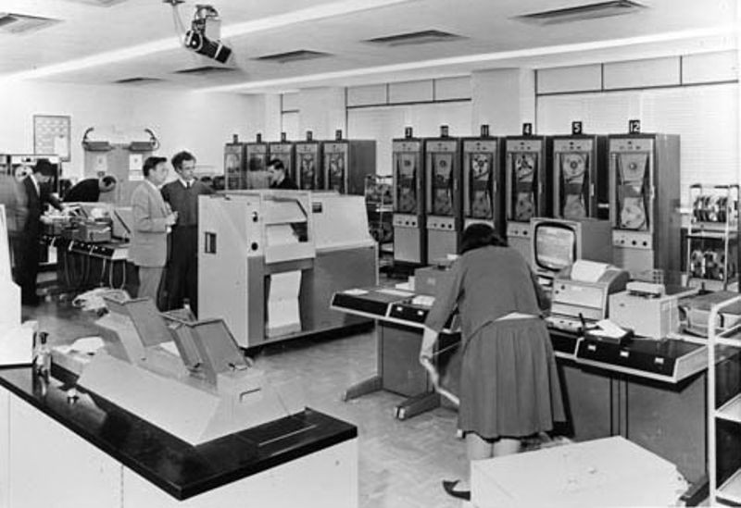
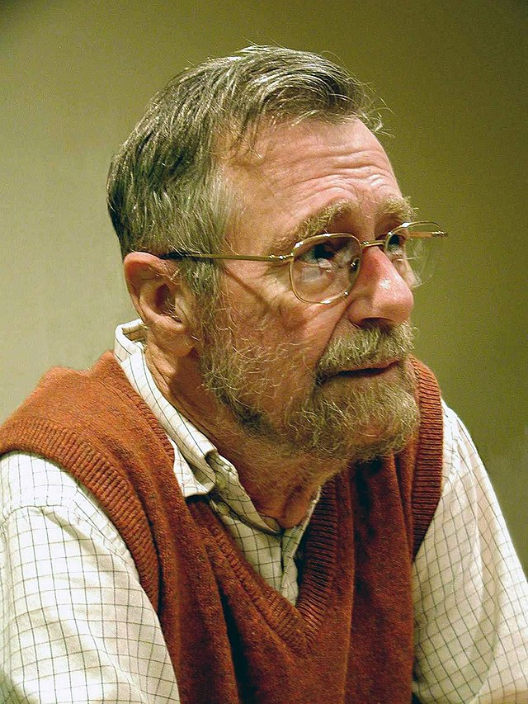
Some important projects
Atlas computer/OS from Manchester U. (late 50s/early 60s)
First recognizable OS
Separate address space for kernel
Early virtual memory
THE Multiprogramming system (early 60s)
Introduced semaphores
Attempt at proving systems correct; interesting software engineering insights
Project lead by Dijkstra (Turing award winner)
Notes:
Atlas picture from computer history museum (https://www.computerhistory.org/timeline/1962/)

Slide 12
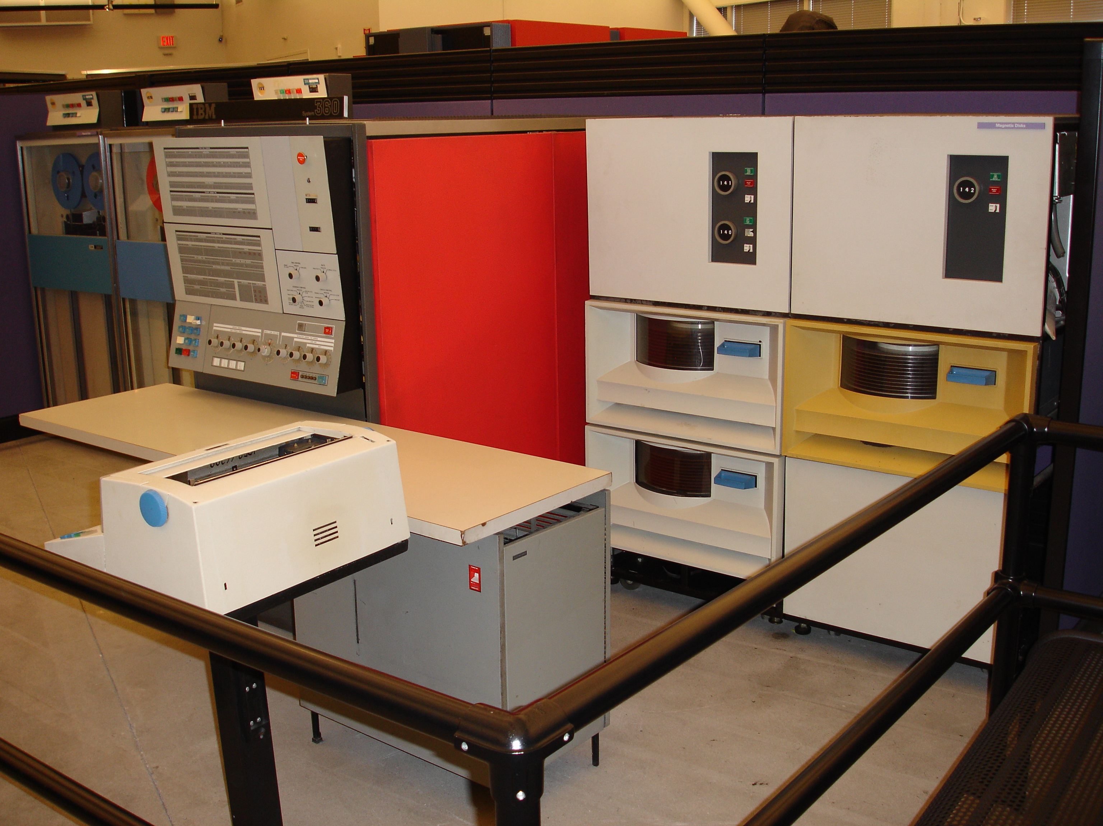
Not all is smooth
Operating systems didn’t really work
No software development or structuring tools; written in assembly
OS/360 introduced in 1963 but did not really work until 1968
Reported on in mythical man month
Extremely complicated systems
5-7 years development time typical
Written in assembly, with no structured programming
Birth of software engineering?
Notes:
Image credit: hackaday (https://hackaday.com/2017/12/11/the-ibm-pc-that-broke-ibm/ibm_system360_model_30/)

Slide 13
Phase 2: 1970s
Computers and people are expensive
Help people be more productive
Interactive time sharing: let many people use the same machine at the same time
Emergence of minicomputers
Terminals are cheap
Keep data online on fancy file systems
Attempt to provide reasonable response times (Avoid thrashing)

Slide 14
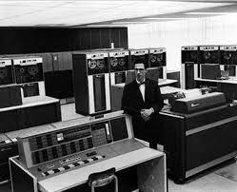
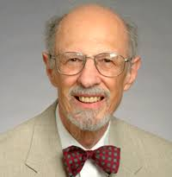
Important advances and systems
Compatible Time-Sharing System (CTSS)
MIT project (demonstrated in 1961)
One of the first time sharing systems
Corbato won Turing award in 1990
Pioneered much of the work in scheduling
Motivated MULTICS

Slide 15
MULTICS
Jointly developed by MIT, Bell Labs and GE
Envisioned one main computer to support everyone
People use computing like a utility like electricity – sound familiar? Ideas get recycled
Many many fundamental ideas: protection rings, hierarchical file systems, devices as files, …
Building it was more difficult than expected
Technology caught up

Slide 16
Unix appears
Ken Thompson, who worked on MULTICS, wanted to use an old PDP-7 laying around in Bell labs
He and Dennis Ritchie built a system designed by programmers for programmers
Originally in assembly. Rewritten in C
If you notice for the paper, they are defending this decision
However, this is a new and important advance: portable operating systems!
Shared code with everyone (particularly universities)
1983 Turing Award for unix
Ken Thompson
Dennis M. Ritchie

Slide 17
Unix (cont’d)
Berkeley added support for virtual memory for the VAX
DARPA selected Unix as its networking platform in arpanet
Unix became commercial
…which eventually lead Linus Torvald to develop Linux

Slide 18
Some important ideas in Unix
OS written in a high level language
OS portable across hardware platforms
Computing is no longer a pipe stove/vertical system
Pipes
E.g., grep foo file.txt | wc -l
Mountable file systems
Many more (we’ll talk about unix later)

Slide 19
Phase 3: 1980s
Computers are cheap, people expensive
Put a computer in each terminal
CP/M from DEC first personal computer OS (for 8080/85) processors
IBM needed software for their PCs, but CP/M was behind schedule
Approached Bill Gates to see if he can build one
Gates approached Seattle computer products, bought 86-DOS and created MS-DOS
Goal: finish quickly and run existing CP/M software
OS becomes subroutine library and command executive

Slide 20
Disk Operating System (DOS)
Introduced in 1981 for IBM PC based on 8086/8088
Only 640KB memory available for applications
No virtual memory
Need quite a few tricks (EMS, XMS, QEMM, and etc.) to use all memory that you installed on the computer
No multi-user, no multi-tasking, no multi-threading
Notorious 8.3 filename restrictions
No GUI
Now the command line environment of Windows
Windows is originally a graphic user interface running on DOS — like X-Window

Slide 21
New advances in OS
PC OS was a regression for OS
Stepped back to primitive phase 1 style OS leaving the cool developments that occurred in phase 2
Academia was still active, and some developments still occurred in mainframe and workstation space
Eventually, Windows, Linux, MacOS, took over
Phase 2 OS’ making it to PCs
GUIs!

Slide 22
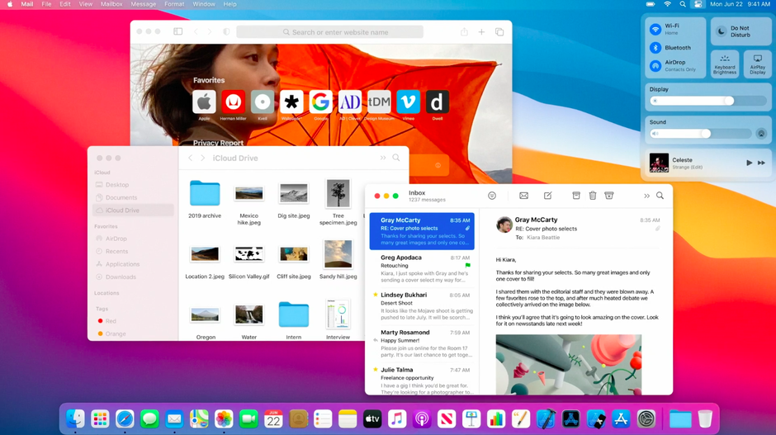
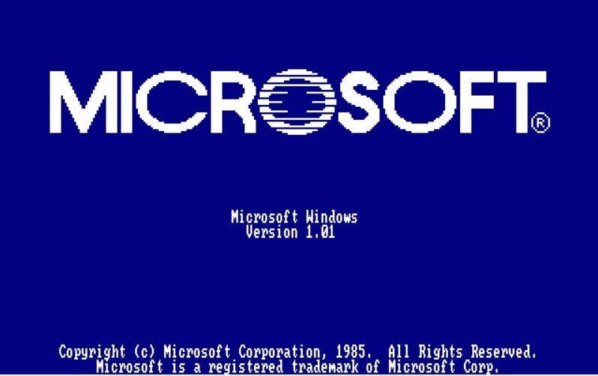
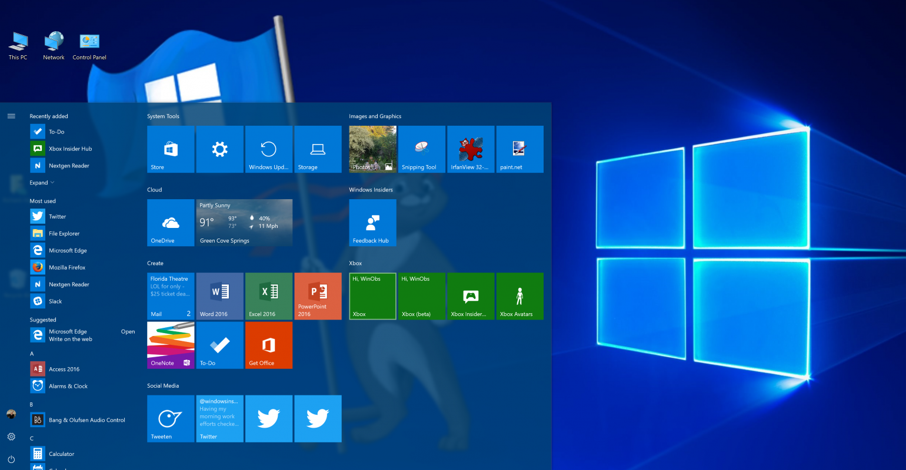

Slide 23
Phase 4: Networked systems 1990s to 2010s
Machines can talk to each other
its all about connectivity
We want to share data not hardware
Networked applications drive everything
Web, email, messaging, social networks, …
Protection and multiprogramming less important for personal machines
But more important for servers

Slide 24
Phase 4, continued
Market place continued horizontal stratification
ISPs (service between OS and applications)
Information is a commodity
Advertising a new marketplace
New network based architectures
Client server
Clusters
Grids
Distributed operating systems
Cloud computing (or is that phase 5?)

Slide 25
New problems
Large scale
Google file system, mapreduce, …
Concurrency at large scale
ACID (Atomicity, Consistency, Isolation and Durability) in Internet Scale systems
Very large delays
Partitioning
Security and Privacy

Slide 26
Phase 5: 2010s -- ??
New generation?
Mobile devices that are powerful
Sensing: location, motion, …
Cyberphysical systems
Machine learning everywhere
Computing evolving beyond networked systems
But OS for them looks largely the same
Is that a good idea?

