Slide 1
LFS, NFS

Slide 2
Log-Structured File System
Radically different file system design
Technology motivations:
  CPUs outpacing disks: I/O is bottleneck
  Most disk traffic writes due to caching
Problems with (then) current file systems:
  Lots of little writes
  Synchronous: wait for disk in too many places – makes it hard to win much from RAIDs, too little concurrency
  5 seeks to create a new file: (rough order): i-node create, data write, directory entry, i-node finalize, directory i-node (not to mention bitmap update)

Slide 3
LFS Basic Idea
Log all data and metadata with efficient, large, sequential writes
  Do not update blocks in place – just write new versions in the log
Treat the log as the truth, but keep an index on its contents
Not necessarily good for reads, but trends help
  Rely on a large memory to provide fast access through caching
Data layout on disk has “temporal locality” (good for writing), rather than “logical locality” (good for reading)
  Why is this a better? Because caching helps reads but not writes!

Slide 4
LFS vs. UFS
inode
directory
data
inode map
file1
file2
dir1
dir2
Unix File
System
dir1
dir2
Blocks written to
create two 1-block
files: dir1/file1 and
dir2/file2, in UFS and
LFS
Log
Log-Structured
File System
file1
file2

Slide 5
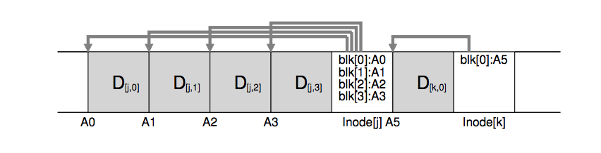
Basic idea
  Buffer and write updates together sequentially
  Good for the disk
  Example above, writes to two different files were written together (along with the new version of i-node)
  How much should we buffer?
    What happens if too much? If too little?
But how do we find a file later??
  All problems in CS solved with another level of indirection ☺

Slide 6
Devil is in the details
Two potential problems:
  Log retrieval on cache misses – how do we find the data?
  Wrap-around: what happens when end of disk is reached?
    No longer any big, empty runs available
    How to prevent fragmentation?

Slide 7
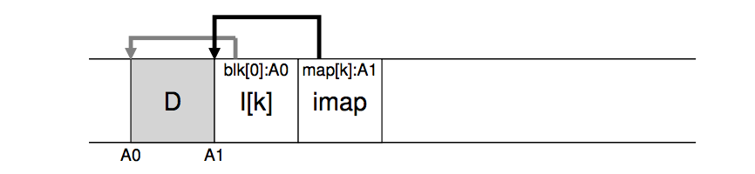
i-node map
A map keeping track of the location of i-nodes
Anytime an i-node is written to disk, the imap is updated
  But is that any better? In a second
Most of the time the imap is in memory, so access is fast
Updated imap is saved as part of the log!
  but how do we find it!

Slide 8
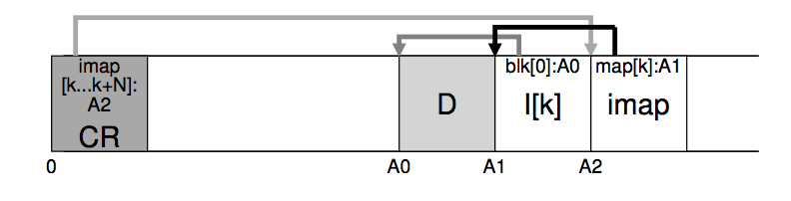
Final piece to the solution
Checkpoint region is written to point to the location of the imap
  Also serves as an indicator of a stable point in the file system for crash recovery
So, to read a file from LFS:
  Read the CR, use it to read and cache the imap
  After that, it is identical to FFS
  Are reads fast?

Slide 9
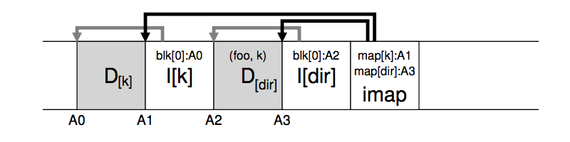
What about directories?
When a file is updated, its inode changes (new copy)
  We need to update the directory inode (also creating a copy)
  We need to update its parent directory
Ugh….what to do?
  Inode map helps with that too – just keep track of inode number and resolve it through inode map

Slide 10
LFS Disk Wrap-Around/Garbage collection
Compact live info to open up large runs of free space
  Problem: long-lived information gets copied over-and-over
Thread log through free spaces
  Problem: disk fragments, causing I/O to become inefficient again
Solution: segmented log
  Divide disk into large, fixed-size segments
  Do compaction within a segment; thread between segments
  When writing, use only clean segments (i.e. no live data)
  Occasionally clean segments
  Try to collect long-lived info into segments that never need to be cleaned
  Note there is not free list or bit map (as in FFS), only a list of clean segments
    Related: TRIM command for SSDs

Slide 11
LFS Segment Cleaning
Which segments to clean?
  Keep estimate of free space in each segment to help find segments with lowest utilization
  Always start by looking for segment with utilization=0, since those are trivial to clean…
  If utilization of segments being cleaned is U:
    write cost = (total bytes read & written)/(new data written) = 2/(1-U) (unless U is 0)
    write cost increases as U increases: U = .9 => cost = 20!
    Need a cost of less than 4 to 10; => U of less than .75 to .45

Slide 12
Evaluation Results

Slide 13
Is this a good paper?
What were the authors’ goals?
What about the evaluation/metrics?
Did they convince you that this was a good system/approach?
Does the system/approach meet the “Test of Time” challenge?
  WAFL commercial file system based on LFS
  Most SSD file systems are log structured
How would you review this paper today?

Slide 14
DESIGN AND IMPLEMENTATION OF THE SUN NETWORK FILESYSTEM
R. Sandberg, D. Goldberg
S. Kleinman, D. Walsh, R. Lyon
Sun Microsystems

Slide 15
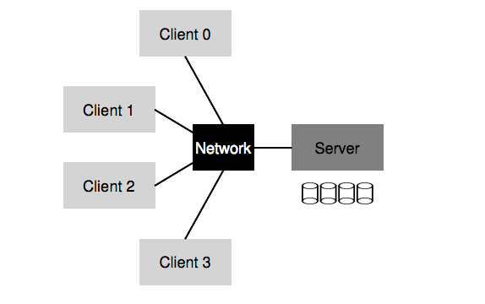
What is NFS?
First commercially successful network file system:
  Developed by Sun Microsystems for their diskless workstations
  Designed for robustness and “adequate performance”
  Sun published all protocol specifications
  Many many implementations

Slide 16
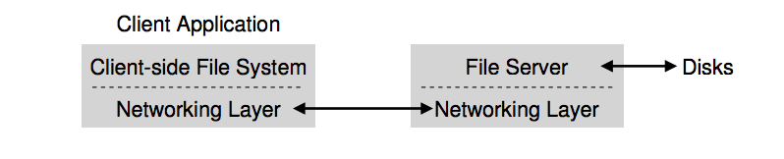
Overview and Objectives
Fast and efficient crash recovery
  Why do crashes occur?
To accomplish this:
  NFS is stateless – key design decision
    All client requests must be self-contained
  The virtual filesystem interface
    VFS operations
    VNODE operations

Slide 17
Additional objectives
Machine and Operating System Independence
  Could be implemented on low-end machines of the mid-80’s
Transparent Access
  Remote files should be accessed in exactly the same way as local files
UNIX semantics should be maintained on client
  Best way to achieve transparent access
“Reasonable” performance
  Robustness and preservation of UNIX semantics were much more important

Slide 18
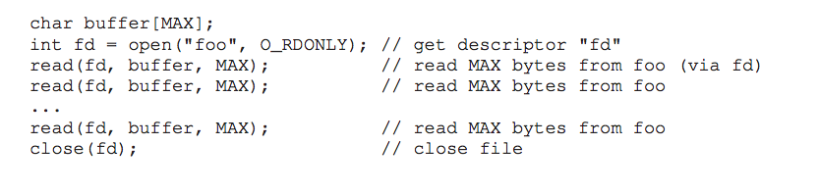
Example
What if the client simply passes the open request to the server?
  Server has state
  Crash causes big problems
Three important parts
  The protocol
  The server side
  The client side

Slide 19
The protocol (I)
Uses the Sun RPC mechanism and Sun eXternal Data Representation (XDR) standard
Defined as a set of remote procedures
Protocol is stateless
  Each procedure call contains all the information necessary to complete the call
  Server maintains no “between call” information

Slide 20
Advantages of statelessness
Crash recovery is very easy:
  When a server crashes, client just resends request until it gets an answer from the rebooted server
  Client cannot tell difference between a server that has crashed and recovered and a slow server
Client can always repeat any request

Slide 21
NFS as a “Stateless” Service
A classical NFS server maintains no in-memory hard state.
    The only hard state is the stable file system image on disk.
  no record of clients or open files
  no implicit arguments to requests
    E.g., no server-maintained file offsets: read and write requests must explicitly transmit the byte offset for each operation.
  no write-back caching on the server
  no record of recently processed requests
  etc., etc....
Statelessness makes failure recovery simple and efficient.

Slide 22
Consequences of statelessness
Read and writes must specify their start offset
  Server does not keep track of current position in the file
  User still use conventional UNIX reads and writes
Open system call translates into several
lookup calls to server
No NFS equivalent to UNIX close system call

Slide 23
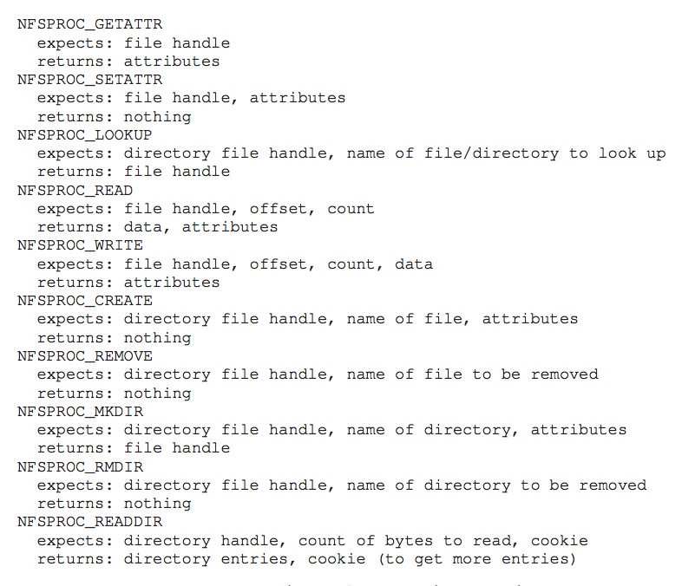
Important pieces of protocol

Slide 24
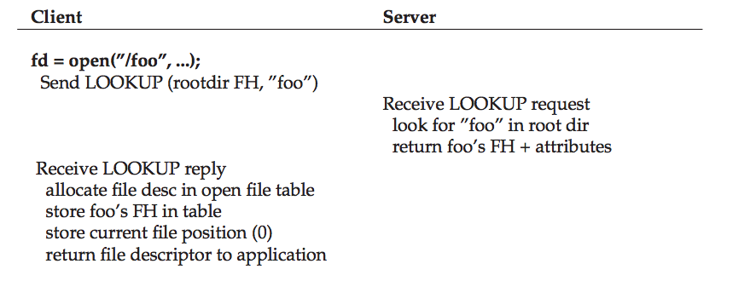
From protocol to distributed file system
Client side translates user requests to protocol messages to implement the request remotely
Example:

Slide 25
The lookup call (I)
Returns a file handle instead of a file descriptor
  File handle specifies unique location of file
    Volume identifier, inode number and generation number
lookup(dirfh, name) returns (fh, attr)
  Returns file handle fh and attributes of named file in directory dirfh
  Fails if client has no right to access directory dirfh

Slide 26
The lookup call (II)
  One single open call such as
    fd = open(“/usr/joe/6360/list.txt”)
  will be result in several calls to lookup
  lookup(rootfh, “usr”) returns (fh0, attr)
  lookup(fh0, “joe”) returns (fh1, attr)
  lookup(fh1, “6360”) returns (fh2, attr)
  lookup(fh2, “list.txt”) returns (fh, attr)
Why all these steps?
  Any of components of /usr/joe/6360/list.txt
  could be a mount point
  Mount points are client dependent and mount information is kept above the lookup() level

Slide 27
Server side (I)
Server implements a write-through policy
  Required by statelessness
  Any blocks modified by a write request (including i-nodes and indirect blocks) must be written back to disk before the call completes

Slide 28
Server side (II)
File handle consists of
  Filesystem id identifying disk partition
  I-node number identifying file within partition
  Generation number changed every time
  i-node is reused to store a new file
Server will store
  Filesystem id in filesystem superblock
  I-node generation number in i-node

Slide 29
Client side (I)
Provides transparent interface to NFS
Mapping between remote file names and remote file addresses is done a server boot time through remote mount
  Extension of UNIX mounts
  Specified in a mount table
  Makes a remote subtree appear part of a local subtree

Slide 30
Remote mount
Client tree
/
Server subtree
usr
rmount
bin
After rmount, root of server subtree
can be accessed as /usr

Slide 31
Client side (II)
Provides transparent access to
  NFS
  Other file systems (including UNIX FFS)
New virtual filesystem interface supports
  VFS calls, which operate on whole file system
  VNODE calls, which operate on individual files
Treats all files in the same fashion

Slide 32
Client side (III)
User interface is unchanged
UNIX system calls
VNODE/VFS
Common interface
Other FS
NFS
UNIX FS
RPC/XDR
disk
LAN

Slide 33
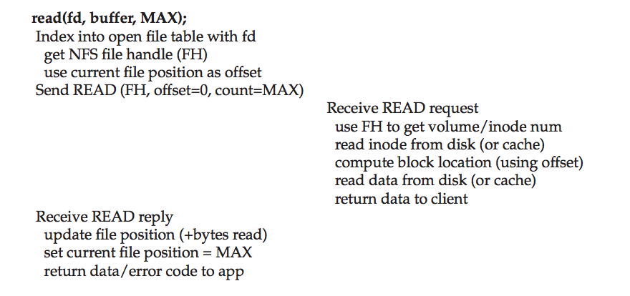
More examples

