Slide 1
Filesystems (II)
FFS, LFS

Slide 2
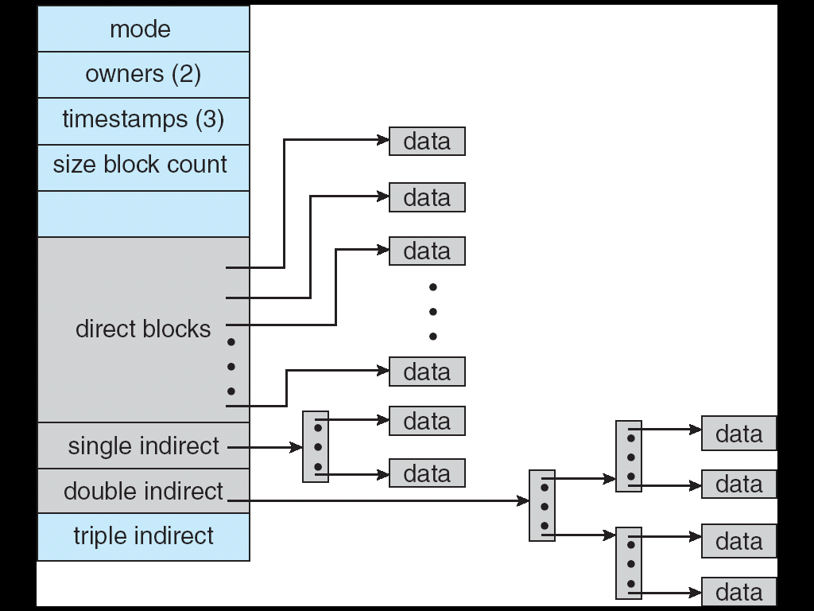
Zooming in on i-node
i-node: structure for per-file
metadata (unique per file)
  contains: ownership, permissions,
  timestamps, about 10 data-block
  pointers
  i-nodes form an array, indexed by
  “i-number” – so each i-node has a
  unique i-number
  Array is explicit for FFS, implicit for
  LFS (its i-node map is cache of
  i-nodes indexed by i-number)
Indirect blocks:
  i-node only holds a small number of data block pointers (direct pointers)
  For larger files, i-node points to an indirect block containing
  1024 4-byte entries in a 4K block
  Each indirect block entry points to a data block
  Can have multiple levels of indirect blocks for even larger files

Slide 3
Unix Inodes and Path Search
Unix Inodes are not directories
Inodes describe where on disk the blocks for a file are placed
  Directories are files, so inodes also describe where the blocks for directories are placed on the disk
Directory entries map file names to inodes
  To open “/one”, use Master Block to find inode for “/” on disk
  Open “/”, look for entry for “one”
  This entry gives the disk block number for the inode for “one”
  Read the inode for “one” into memory
  The inode says where first data block is on disk
  Read that block into memory to access the data in the file
This is why we have open in addition to read and write
Every file/directory operation typically involves many I/O operations!

Slide 4
Caching and read ahead
Unix file system implemented two additional optimizations
Caching: keep a buffer cache in memory
  Locality = avoid cost of expensive I/O
  Even a relatively small cache makes a difference
Read ahead: read the whole file (into cache) when it is opened
  Many files accessed sequentially
  Limited by cache size

Slide 5
A naïve implementation

Slide 6
What’s wrong with original unix FS?
Original UNIX FS was simple and elegant, but slow
Could only achieve about 20 KB/sec/arm; ~2% of 1982 disk bandwidth
Problems:
  Blocks too small
    512 bytes (matched sector size)
  Consecutive blocks of files not close together
    Yields random placement for mature file systems
  i-nodes far from data
    All i-nodes at the beginning of the disk, all data after that
  i-nodes of directory not close together
  no read-ahead
    Useful when sequentially reading large sections of a file

Slide 7
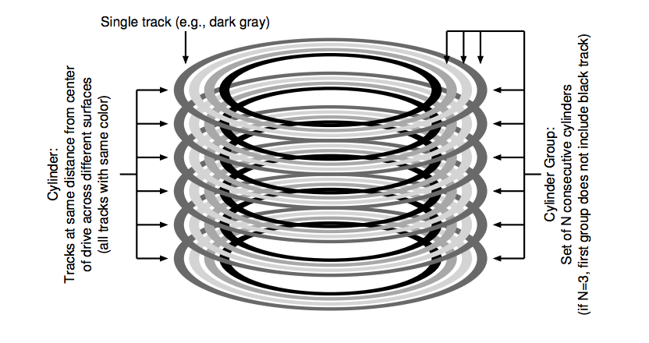
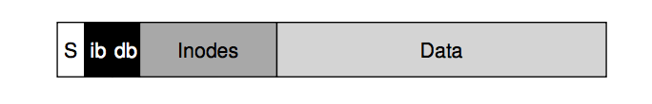
FFS Changes -- Locality is important
Aspects of new file system:
  4096 or 8192 byte block size (why not larger?)
  large blocks and small fragments
  disk divided into cylinder groups
  each contains superblock, i-nodes, bitmap of free blocks, usage summary info
  Note that i-nodes are now spread across the disk:
    Keep i-node near file, i-nodes of a directory together (shared fate)
  Cylinder groups ~ 16 cylinders, or 7.5 MB
  Cylinder headers spread around so not all on one platter

Slide 8
FFS Locality Techniques
Goals
  Keep directory within a cylinder group, spread out different directories
  Allocate runs of blocks within a cylinder group, every once in a while switch to a new cylinder group (jump at 1MB)
Layout policy: global and local
  Global policy allocates files & directories to cylinder groups – picks “optimal” next block for block allocation
  Local allocation routines handle specific block requests – select from a sequence of alternative if need to

Slide 9
FFS Results
20-40% of disk bandwidth for large reads/writes
10-20x original UNIX speeds
Size: 3800 lines of code vs. 2700 in old system
10% of total disk space unusable (except at 50% performance price)
Could have done more; later versions do
Watershed moment for OS designers– File system matters

Slide 10
FFS Summary
3 key features:
  Parameterize FS implementation for the hardware it’s running on
  Measurement-driven design decisions
  Locality “wins”
Major flaws:
  Measurements derived from a single installation
  Ignored technology trends
A lesson for the future: don’t ignore underlying hardware characteristics
Contrasting research approaches: improve what you’ve got vs. design something new

Slide 11
File operations still expensive
How many operations (seeks) to create a new file?
  New file, needs a new inode
  But at least a block of data too
  Check and update the inode and data bitmap (eventually have to be written to disk)
  Not done yet – need to add it to the directory (update the directory inode and the directory data block – may need to split if its full)…
  Whew!! How does all of this even work?
So what is the advantage?
  Not removing any operations
  Seeks are just shorter…

Slide 12
Crash consistency/Journaling
Problem:
  Recall: file ops can cause multiple disk ops
    Example, add a block to a file
  With cache, and block reordering what happens on a crash?
    Any subset of the ops may have been committed to disk
    Disk state is inconsistent
      File checkers where a critical part of the OS
Solution: Journaling
  Log intended ops in a journal – commit them
  Once committed, start disk ops
  Once committed, mark log as done
  How does this solve the problem?

Slide 13
Log-Structured/Journaling File System
Radically different file system design
Technology motivations:
  CPUs outpacing disks: I/O becoming more-and-more of a bottleneck
  Large RAM: file caches work well, making most disk traffic writes
Problems with (then) current file systems:
  Lots of little writes
  Synchronous: wait for disk in too many places – makes it hard to win much from RAIDs, too little concurrency
  5 seeks to create a new file: (rough order)
    file i-node (create)
    file data
    directory entry
    file i-node (finalize)
    directory i-node (modification time)
    (not to mention bitmap updates)

Slide 14
LFS Basic Idea
Log all data and metadata with efficient, large, sequential writes
  Do not update blocks in place – just write new versions in the log
Treat the log as the truth, but keep an index on its contents
Not necessarily good for reads, but trends help
  Rely on a large memory to provide fast access through caching
Data layout on disk has “temporal locality” (good for writing), rather than “logical locality” (good for reading)
  Why is this a better? Because caching helps reads but not writes!

Slide 15
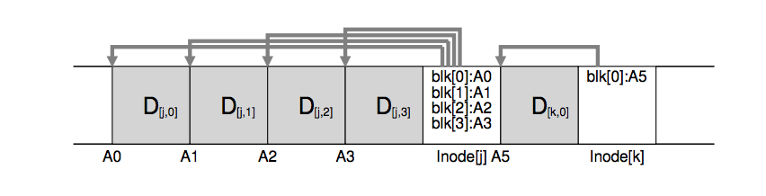
Basic idea
We buffer all updates, and write them together in one big sequential write
  Good for the disk
  Example above, writes to two different files were written together (along with the new version of i-node) in one write
  How much should we buffer?
    What happens if too much? If too little?
But how do we find a file??
  All problems in CS solved with another level of indirection ☺

Slide 16
Devil is in the details
Two potential problems:
  Log retrieval on cache misses – how do we find the data?
  Wrap-around: what happens when end of disk is reached?
    No longer any big, empty runs available
    How to prevent fragmentation?

Slide 17
LFS vs. UFS
inode
directory
data
inode map
file1
file2
dir1
dir2
Unix File
System
dir1
dir2
Blocks written to
create two 1-block
files: dir1/file1 and
dir2/file2, in UFS and
LFS
Log
Log-Structured
File System
file1
file2

Slide 18
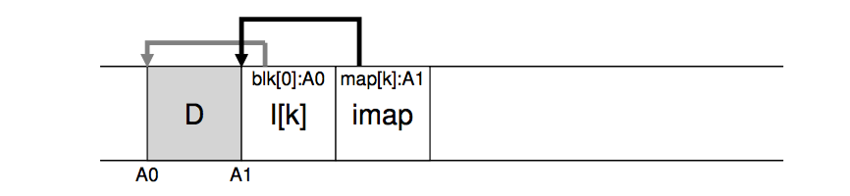
i-node map
A map keeping track of the location of i-nodes
Anytime an i-node is written to disk, the imap is updated
  But is that any better? In a second
Most of the time the imap is in memory, so access is fast
Updated imap is saved as part of the log!
  but how do we find it!

Slide 19
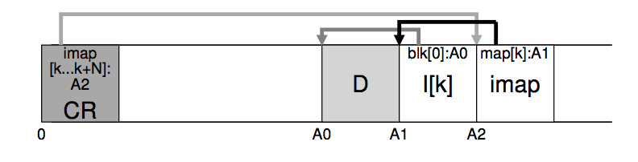
Final piece to the solution
Checkpoint region is written to point to the location of the imap
  Also serves as an indicator of a stable point in the file system for crash recovery
So, to read a file from LFS:
  Read the CR, use it to read and cache the imap
  After that, it is identical to FFS
  Are reads fast?

Slide 20
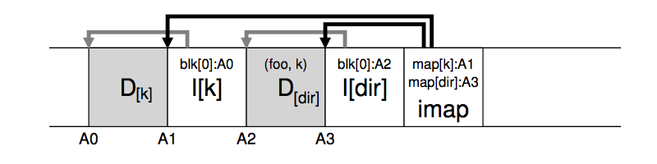
What about directories?
When a file is updated, its inode changes (new copy)
  We need to update the directory inode (also creating a copy)
  We need to update its parent directory
Ugh….what to do?
  Inode map helps with that too – just keep track of inode number and resolve it through inode map

Slide 21
LFS Disk Wrap-Around/Garbage collection
Compact live info to open up large runs of free space
  Problem: long-lived information gets copied over-and-over
Thread log through free spaces
  Problem: disk fragments, causing I/O to become inefficient again
Solution: segmented log
  Divide disk into large, fixed-size segments
  Do compaction within a segment; thread between segments
  When writing, use only clean segments (i.e. no live data)
  Occasionally clean segments: read in several, write out live data in compacted form, leaving some fragments free
  Try to collect long-lived info into segments that never need to be cleaned
  Note there is not free list or bit map (as in FFS), only a list of clean segments

Slide 22
LFS Segment Cleaning
Which segments to clean?
  Keep estimate of free space in each segment to help find segments with lowest utilization
  Always start by looking for segment with utilization=0, since those are trivial to clean…
  If utilization of segments being cleaned is U:
    write cost = (total bytes read & written)/(new data written) = 2/(1-U) (unless U is 0)
    write cost increases as U increases: U = .9 => cost = 20!
    Need a cost of less than 4 to 10; => U of less than .75 to .45
How to clean a segment?
  Segment summary block contains map of the segment
  Must list every i-node and file block
  For file blocks you need {i-number, block #}
  Through i-map you check if this block is still being used for the (i-number, block #)

Slide 23
Evaluation Results

Slide 24
Is this a good paper?
What were the authors’ goals?
What about the evaluation/metrics?
Did they convince you that this was a good system/approach?
Does the system/approach meet the “Test of Time” challenge?
How would you review this paper today?

