Slide 1
File systems/Persistence Introduction CS202
Credit: some slides by John Kubiatowicz and Anthony D. Joseph

Slide 2
Study plan for next ~2-3 weeks
Today, perhaps some of next time: basics of file systems
Undergraduate material review
Important classical designs such as:
A Fast File System for UNIX Marshall Kirk McKusick, William N. Joy, Samuel J. Leffler and Robert S. Fabry. Appears in ACM Transactions on Computer Systems (TOCS), Vol. 2, No. 3, August 1984, pp 181-197
Log Structured File Systems (LFS), Ousterhout and Rosenblum
And WAFL
Network File system (NFS)
Distributed and Internet scale file systems
Other emerging topics

Slide 3
OS Abstractions
Applications
Process
File system
Virtual memory
Operating System
CPU
Hardware
Disk
RAM

Slide 4
Review: Magnetic Disk Characteristic
Track
Sector
Cylinder: all the tracks under the head at a given point on all surface
Read/write data is a three-stage process:
Seek time: position the head/arm over the proper track (into proper cylinder)
Rotational latency: wait for the desired sector to rotate under the read/write head
Transfer time: transfer a block of bits (sector) under the read-write head
Disk Latency = Queueing Time + Controller time + Seek Time + Rotation Time + Xfer Time
Highest Bandwidth:
Transfer large group of blocks sequentially from one track
Head
Cylinder
Platter
Software
Queue
(Device Driver)
Hardware
Controller
Media Time
(Seek+Rot+Xfer)
Request
Result
Notes:
To read write information into a sector, a movable arm containing a read/write head is located over each surface.
The term cylinder is used to refer to all the tracks under the read/write head at a given point on all surfaces.
To access data, the operating system must direct the disk through a 3-stage process.
(a) The first step is to position the arm over the proper track. This is the seek operation and the time to complete this operation is called the seek time.
(b) Once the head has reached the correct track, we must wait for the desired sector to rotate under the read/write head. This is referred to as the rotational latency.
(c) Finally, once the desired sector is under the read/write head, the data transfer can begin.
The average seek time as reported by the manufacturer is in the range of 12 ms to 20ms and is calculated as the sum of the time for all possible seeks divided by the number of possible seeks.
This number is usually on the pessimistic side because due to locality of disk reference, the actual average seek time may only be 25 to 33% of the number published.
+2 = 34 min. (Y:14)

Slide 5
Historical Perspective
1956 IBM Ramac — early 1970s Winchester
Developed for mainframe computers, proprietary interfaces
Steady shrink in form factor: 27 in. to 14 in.
Form factor and capacity drives market more than performance
1970s developments
5.25 inch floppy disk form factor (microcode into mainframe)
Emergence of industry standard disk interfaces
Early 1980s: PCs and first generation workstations

Slide 6
Mid 1980s: Client/server computing
Centralized storage on file server
accelerates disk downsizing: 8 inch to 5.25
Mass market disk drives become a reality
industry standards: SCSI, IPI, IDE
5.25 inch to 3.5 inch drives for PCs, End of proprietary interfaces
1990s: Laptops => 2.5 inch drives
2000s: Shift to perpendicular recording
2007: Seagate introduces 1TB drive
2009: Seagate/WD introduces 2TB drive
2014: Seagate announces 8TB drives;
60 TB by 2016 – market?
Other technologies – PCM, etc..

Slide 7
Disk History
Data
density
Mbit/sq. in.
Capacity of
Unit Shown
Megabytes
1973:
1. 7 Mbit/sq. in
140 MBytes
1979:
7. 7 Mbit/sq. in
2,300 MBytes
source: New York Times, 2/23/98, page C3, “Makers of disk drives crowd even mroe data into even smaller spaces”

Slide 8
Disk History
1989:
63 Mbit/sq. in
60,000 MBytes
1997:
1450 Mbit/sq. in
2300 MBytes
1997:
3090 Mbit/sq. in
8100 MBytes
source: New York Times, 2/23/98, page C3, “Makers of disk drives crowd even mroe data into even smaller spaces”

Slide 9
Seagate Enterprise (2015)
10TB! 800 Gbits/inch²
7 (3.5”) platters, 2 heads each
7200 RPM, 8ms seek latency
249/225 MB/sec read/write transfer rates
2.5million hours MTBF
256MB cache
$650

Slide 10
Disk vs. SSD

Slide 11
Gap is closing

Slide 12
60 TB SSD ($20,000)

Slide 13
Storage Performance & Price
 | Bandwidth (sequential R/W) | Cost/GB | Size
HHD | 50-100 MB/s | $0.05-0.1/GB | 2-4 TB
SSD¹ | 200-500 MB/s (SATA) 6 GB/s (PCI) | $1.5-5/GB | 200GB-1TB
DRAM | 10-16 GB/s | $5-10/GB | 64GB-256GB
¹http://www.fastestssd.com/featured/ssd-rankings-the-fastest-solid-state-drives/
BW: SSD up to x10 than HDD, DRAM > x10 than SSD
Price: HDD x30 less than SSD, SSD x4 less than DRAM

Slide 14
File system abstractions
How do users/user programs interact with the file system?
Files
Directories
Links
Protection/sharing model
Accessed and manipulated by a virtual file system set of system calls
File system implementation:
How to map these abstractions to the storage devices
Alternatively, how to implement those system calls

Slide 15
File system basics
Virtual file system abstracts away concrete file system implementation
Isolates applications from details of the file system
Linux vfs interface includes:
creat(name)
open(name, how)
read(fd, buf, len)
write(fd, buf, len)
sync(fd)
seek(fd, pos)
close(fd)
unlink(name)

Slide 16
Disk Layout Strategies
Files span multiple disk blocks
How do you find all of the blocks for a file?
1. Contiguous allocation
Like memory
Fast, simplifies directory access
Inflexible, causes fragmentation, needs compaction
2. Linked structure
Each block points to the next, directory points to the first
Bad for random access patterns
3. Indexed structure (indirection, hierarchy)
An “index block” contains pointers to many other blocks
Handles random better, still good for sequential
May need multiple index blocks (linked together)

Slide 17
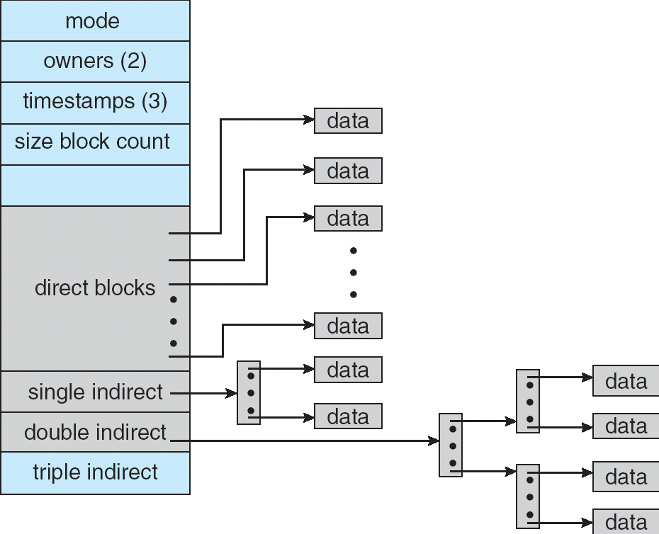
Zooming in on i-node
i-node: structure for per-file metadata (unique per file)
contains: ownership, permissions, timestamps, about 10 data-block pointers
i-nodes form an array, indexed by “i-number” – so each i-node has a unique i-number
Array is explicit for FFS, implicit for LFS (its i-node map is cache of i-nodes indexed by i-number)
Indirect blocks:
i-node only holds a small number of data block pointers (direct pointers)
For larger files, i-node points to an indirect block containing 1024 4-byte entries in a 4K block
Each indirect block entry points to a data block
Can have multiple levels of indirect blocks for even larger files

Slide 18
Unix Inodes and Path Search
Unix Inodes are not directories
Inodes describe where on disk the blocks for a file are placed
Directories are files, so inodes also describe where the blocks for directories are placed on the disk
Directory entries map file names to inodes
To open “/one”, use Master Block to find inode for “/” on disk
Open “/”, look for entry for “one”
This entry gives the disk block number for the inode for “one”
Read the inode for “one” into memory
The inode says where first data block is on disk
Read that block into memory to access the data in the file
This is why we have open in addition to read and write

Slide 19
File systems for SSDs?
Different properties
Random access (no seek/rotational latencies)
Writes are expensive (erase/update full block)
Limited write cycles
Can just treat them as a block device and run regular file system on top of them
Does that work?
Turns out log structured systems perfect fit!
Virtually all file systems for flash are log structured
What about other technologies?

Slide 20
FFS – whats wrong with original unix FS?
Original UNIX FS was simple and elegant, but slow
Could only achieve about 20 KB/sec/arm; ~2% of 1982 disk bandwidth
Problems:
Blocks too small
512 bytes (matched sector size)
Consecutive blocks of files not close together
Yields random placement for mature file systems
i-nodes far from data
All i-nodes at the beginning of the disk, all data after that
i-nodes of directory not close together
no read-ahead
Useful when sequentially reading large sections of a file

Slide 21
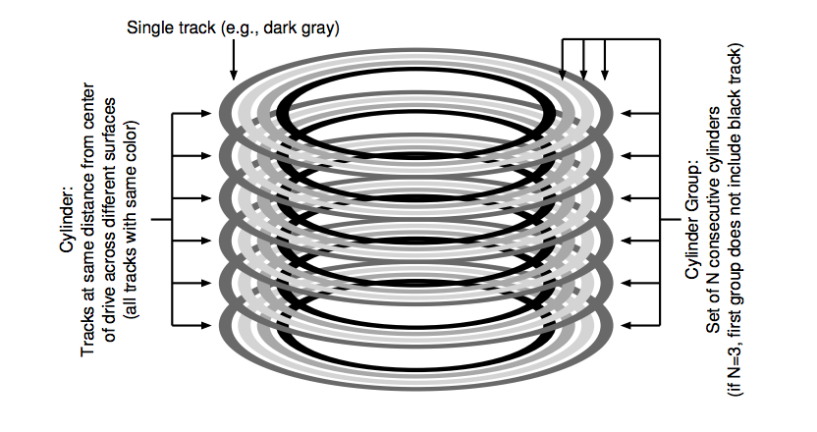
FFS Changes -- Locality is important
Aspects of new file system:
4096 or 8192 byte block size (why not larger?)
large blocks and small fragments
disk divided into cylinder groups
each contains superblock, i-nodes, bitmap of free blocks, usage summary info
Note that i-nodes are now spread across the disk:
Keep i-node near file, i-nodes of a directory together (shared fate)
Cylinder groups ~ 16 cylinders, or 7.5 MB
Cylinder headers spread around so not all on one platter

Slide 22
FFS Locality Techniques
Goals
Keep directory within a cylinder group, spread out different directories
Allocate runs of blocks within a cylinder group, every once in a while switch to a new cylinder group (jump at 1MB)
Layout policy: global and local
Global policy allocates files & directories to cylinder groups – picks “optimal” next block for block allocation
Local allocation routines handle specific block requests – select from a sequence of alternative if need to

Slide 23
FFS Results
20-40% of disk bandwidth for large reads/writes
10-20x original UNIX speeds
Size: 3800 lines of code vs. 2700 in old system
10% of total disk space unusable (except at 50% performance price)
Could have done more; later versions do
Watershed moment for OS designers– File system matters

Slide 24
FFS Summary
3 key features:
Parameterize FS implementation for the hardware it’s running on
Measurement-driven design decisions
Locality “wins”
Major flaws:
Measurements derived from a single installation
Ignored technology trends
A lesson for the future: don’t ignore underlying hardware characteristics
Contrasting research approaches: improve what you’ve got vs. design something new

Slide 25
File operations still expensive
How many operations (seeks) to create a new file?
New file, needs a new inode
But at least a block of data too
Check and update the inode and data bitmap (eventually have to be written to disk)
Not done yet – need to add it to the directory (update the directory inode and the directory data block – may need to split if its full)…
Whew!! How does all of this even work?
So what is the advantage?
Not removing any operations
Seeks are just shorter…

Slide 26
BREAK

Slide 27
Log-Structured/Journaling File System
Radically different file system design
Technology motivations:
CPUs outpacing disks: I/O becoming more-and-more of a bottleneck
Large RAM: file caches work well, making most disk traffic writes
Problems with (then) current file systems:
Lots of little writes
Synchronous: wait for disk in too many places – makes it hard to win much from RAIDs, too little concurrency
5 seeks to create a new file: (rough order)
file i-node (create)
file data
directory entry
file i-node (finalize)
directory i-node (modification time)
(not to mention bitmap updates)

Slide 28
LFS Basic Idea
Log all data and metadata with efficient, large, sequential writes
Do not update blocks in place – just write new versions in the log
Treat the log as the truth, but keep an index on its contents
Not necessarily good for reads, but trends help
Rely on a large memory to provide fast access through caching
Data layout on disk has “temporal locality” (good for writing), rather than “logical locality” (good for reading)
Why is this a better? Because caching helps reads but not writes!

Slide 29
Basic idea
We buffer all updates, and write them together in one big sequential write
Good for the disk
Example above, writes to two different files were written together (along with the new version of i-node) in one write
How much should we buffer?
What happens if too much? If too little?
But how do we find a file??
All problems in CS solved with another level of indirection ☺

Slide 30
Devil is in the details
Two potential problems:
Log retrieval on cache misses – how do we find the data?
Wrap-around: what happens when end of disk is reached?
No longer any big, empty runs available
How to prevent fragmentation?

Slide 31
LFS vs. UFS
inode
directory
data
inode map
file1
file2
dir1
dir2
Unix File
System
dir1
dir2
Blocks written to
create two 1-block
files: dir1/file1 and
dir2/file2, in UFS and
LFS
Log
Log-Structured
File System
file1
file2

Slide 32
i-node map
A map keeping track of the location of i-nodes
Anytime an i-node is written to disk, the imap is updated
But is that any better? In a second
Most of the time the imap is in memory, so access is fast
Updated imap is saved as part of the log!
but how do we find it!

Slide 33
Final piece to the solution
Checkpoint region is written to point to the location of the imap
Also serves as an indicator of a stable point in the file system for crash recovery
So, to read a file from LFS:
Read the CR, use it to read and cache the imap
After that, it is identical to FFS
Are reads fast?

Slide 34
What about directories?
When a file is updated, its inode changes (new copy)
We need to update the directory inode (also creating a copy)
We need to update its parent directory
Ugh….what to do?
Inode map helps with that too – just keep track of inode number and resolve it through inode map

Slide 35
LFS Disk Wrap-Around/Garbage collection
Compact live info to open up large runs of free space
Problem: long-lived information gets copied over-and-over
Thread log through free spaces
Problem: disk fragments, causing I/O to become inefficient again
Solution: segmented log
Divide disk into large, fixed-size segments
Do compaction within a segment; thread between segments
When writing, use only clean segments (i.e. no live data)
Occasionally clean segments: read in several, write out live data in compacted form, leaving some fragments free
Try to collect long-lived info into segments that never need to be cleaned
Note there is not free list or bit map (as in FFS), only a list of clean segments

Slide 36
LFS Segment Cleaning
Which segments to clean?
Keep estimate of free space in each segment to help find segments with lowest utilization
Always start by looking for segment with utilization=0, since those are trivial to clean…
If utilization of segments being cleaned is U:
write cost = (total bytes read & written)/(new data written) = 2/(1-U) (unless U is 0)
write cost increases as U increases: U = .9 => cost = 20!
Need a cost of less than 4 to 10; => U of less than .75 to .45
How to clean a segment?
Segment summary block contains map of the segment
Must list every i-node and file block
For file blocks you need {i-number, block #}
Through i-map you check if this block is still being used for the (i-number, block #)

Slide 37
Is this a good paper?
What were the authors’ goals?
What about the evaluation/metrics?
Did they convince you that this was a good system/approach?
Were there any red-flags?
What mistakes did they make?
Does the system/approach meet the “Test of Time” challenge?
How would you review this paper today?

