Slide 1
Advanced Operating Systems
(CS 202)
Distributed OS– intro and discussion

Slide 2
Overview
Hardware is changing, so software must too
  Multicores are here to stay
  Architectures are heterogeneous
  Applications are unpredictable unlike specialized systems
How do operating systems scale?
Do we need new OS architectures?

Slide 3
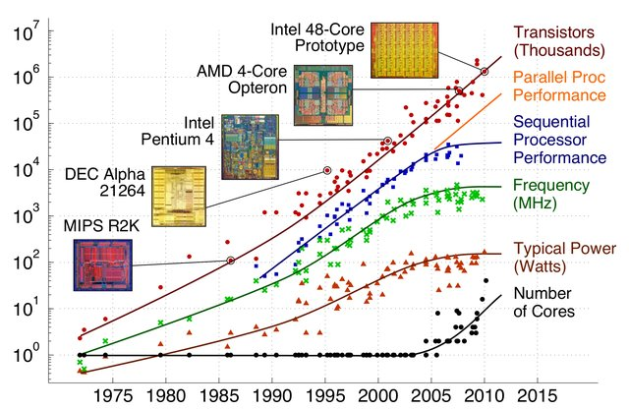
Landscape at that time
Moore’s law still here
  barely (10nm->7nm->?)
Dennard’s scaling ended
  Power wall
We have transistors, but can’t power them
  Dark silicon
  Can be used for important applications such as security
Doubling moves to number of cores?
  Common wisdom at the time

Slide 4
Landscape/motivation
Systems are diverse
  different implementations require different tradeoffs
    Can we continue to optimize the OS to the hardware?
Cores are increasingly diverse
  Different general purpose cores
  Accelerators and specialized processors
  Typically cannot share an OS with such differences
More cores—scalability?
  Interconnects matter: within cores and across cores

Slide 5
What has gone on before?
Early on, locks were not so expensive
  Just use them
Hardware evolved, memory expensive
  Large caches
  Cache coherence
  NUMA machines
  Increasing gap between memory and processor
  Shared memory expensive!

Slide 6
Older SMP OS projects
E.g., Tornado
Locality matters
Customize OS to underlying hardware
  But now we have high diversity
  Cannot have one size fit all
Use replication as an optimization
Still good principles

Slide 7
What we will cover
Many argue that we need new models
  Sharing is bad, try to have per core data structures
  Multikernel/Barrelfish paper as a representative
Linux scalability paper shows that maybe conventional OS model still works
We will look at OS for extreme heterogeneity and resource disaggregation (LegoOS)
  Multi-kernel influenced ideas

Slide 8
Barrelfish Motivation
Messages cost less than shared memory
  Surprising? Why?
  Needham et al showed they are duals
    But cost depends on system structure
    As we scale up, messages more efficient than shared memory
May have to give up cache coherence
  To scale! Already seeing some
Messages getting easier (OS’s respond to interrupts/messages)

Slide 9
Discussion
Well written paper, with very nice motivation
  But also deep and full of technical meat
  Just won test of time award at SOSP
“Barrelfish is a point in the multikernel desgin space”
  – others possible
Heavy influence from earlier work
  Isolating hardware specific primitives
  Customizing implementation for them
  Let OS manage them

Slide 10
Discussion continued
Processes as dispatchers (similar to scheduler activations)
Capability based management of memory
  Similar to exo-kernel
Supporting shared address space
  Share hardware page tables? Or
  Replicate and maintain consistency?

Slide 11
What actually happened
Did not have exponential growth of cores
  So, traditional OS’s continue to limp with some updates (see linux scalability paper)
  Accelerators/GPUs second class citizens
Barrelfish open source/downloadable
  Backed by industry, actively developed
Big impact on OS research
  Basis for LegoOS
Inspired/was used in commercial products
  Arrakis, FlexiNet, LXD, …
https://www.sigops.org/2021/fish-in-a-barrel-an-insiders-retrospective-of-the-sosp09-multikernel-paper/

