Slide 1
Advanced Operating Systems (CS 202) Read Copy Update (RCU)
(some slides from Dan Porter)

Slide 2
Linux Synch. Primitives
Technique | Description | Scope
Per-CPU variables | Duplicate a data structure among CPUs | All CPUs
Atomic operation | Atomic read-modify-write instruction | All
Memory barrier | Avoid instruction re-ordering | Local CPU
Spin lock | Lock with busy wait | All
Semaphore | Lock with blocking wait (sleep) | All
Seqlocks | Lock based on access counter | All
Local interrupt disabling | Forbid interrupt on a single CPU | Local
Local softirq disabling | Forbid deferrable function on a single CPU | Local
Read-copy-update (RCU) | Lock-free access to shared data through pointers | All
Also Read-write locks

Slide 3
Why are we reading this paper?
Example of a synchronization primitive that is:
Lock free (mostly/for reads)
Tuned to a common access pattern
Making the common case fast
What is this common pattern?
A lot of reads
Writes are rare
Prioritize writes
Stale copies are short lived – time heals all wounds
Ok to read a slightly stale copy
But that can be fixed too

Slide 4
Readers/Writers (review)
// number of readers
int readcount = 0;
// mutual exclusion to readcount
Semaphore mutex = 1;
// exclusive writer or reader
Semaphore w_or_r = 1;
writer {
wait(w_or_r); // lock out readers
Write;
signal(w_or_r); // up for grabs
}
reader {
wait(mutex); // lock readcount
readcount += 1; // one more reader
if (readcount == 1)
wait(w_or_r); // synch w/ writers
signal(mutex); // unlock readcount
Read;
wait(mutex); // lock readcount
readcount -= 1; // one less reader
if (readcount == 0)
signal(w_or_r); // up for grabs
signal(mutex); // unlock readcount
}
Naïve implementation – can be done using just atomic instructions

Slide 5
Lock free data structures
Do not require locks
Good if contention is rare
But difficult to create and error prone
RCU is a mixture
Concurrent changes to pointers a challenge for lock-free
RCU serializes writers using locks
Win if most of our accesses are reads

Slide 6
Example of lock free synchronization
Compare _readers with prev_readers
if equal swap with new_readers
Return 1 if swap successful, 0 if not
All Atomic
Credit: https://yizhang82.dev/lock-free-rw-lock

Slide 7
Concurrent access of linked list (without synchronization)
Lock free linked lists using compare and swap, J. Valois, ACM PODC, 1995

Slide 8
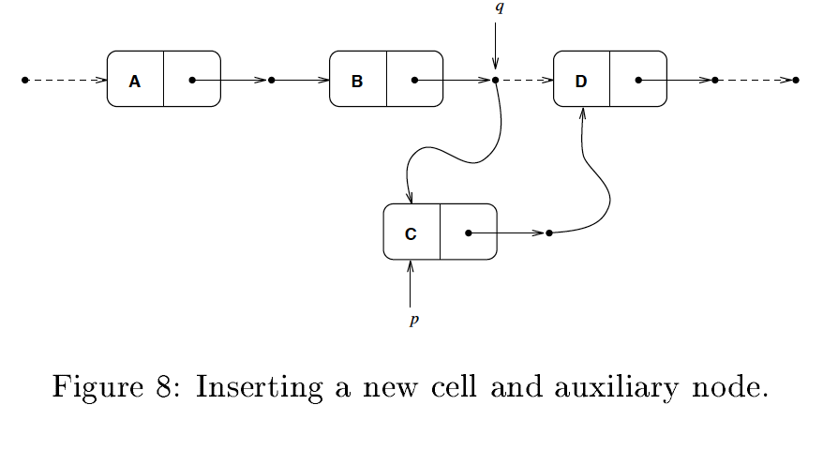
Delete is more complicated, but doable; can do other data structures as well

Slide 9
Traditional OS locking designs
poor concurrency
Especially if mostly reads
Fail to take advantage of event-driven nature of operating systems
Locks have acquire and release cost
Use atomic operations which are expensive
Can dominate cost for short critical regions
Locks become the bottleneck

Slide 10
Why RCU?
Notes:
From RCU a decade later paper, recommended reading on class website

Slide 11
Race Between Teardown and Use of Service
Can fix with locking, but we have to use the lock every operation

Slide 12
Read-Copy Update Handling Race
When
Cannot be context switched inside RCU
quiescent state

Slide 13
Read-copy update works when
divide an update into two phases
proceed on stale data for common-case operations (e.g. continuing to handle operations by a module being unloaded)
destructive updates are very infrequent.
Often used to update linked lists
Which are used all over kernels

Slide 14
Typical RCU update sequence
Replace pointers to a data structure with pointers to a new version
Is this replacement atomic?
Wait for all previous reader to complete their RCU read-side critical sections.
at this point, there cannot be any readers who hold reference to the old data structure, so it now may safely be reclaimed.

Slide 15
Delete implementation
Phase 1
Schedule phase 2
after quiescence

Slide 16
Read-Copy Deletion (delete B)

Slide 17
the first phase of the update
18

Slide 18
Read-Copy Deletion
When
Implemented through the call_rcu()

Slide 19
Read-Copy Deletion

Slide 20
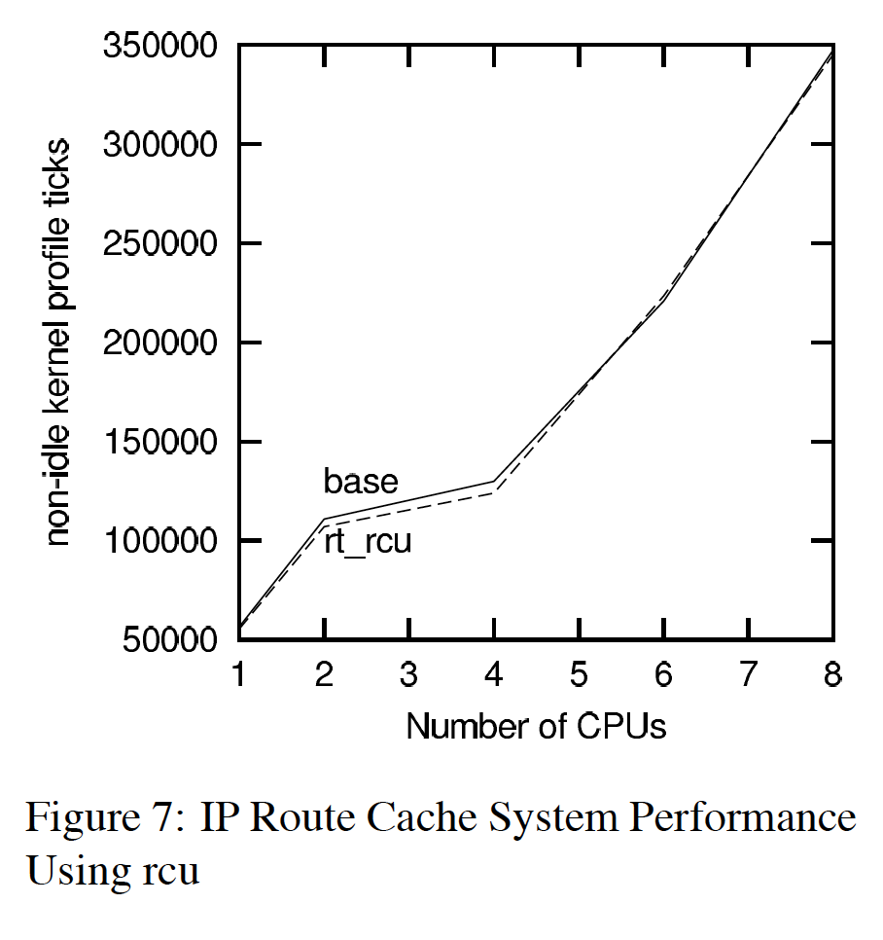
Applied to linux route cache update
Specific workload; overall speedup not that high; up to 30% speedup for other kernel functions

Slide 21
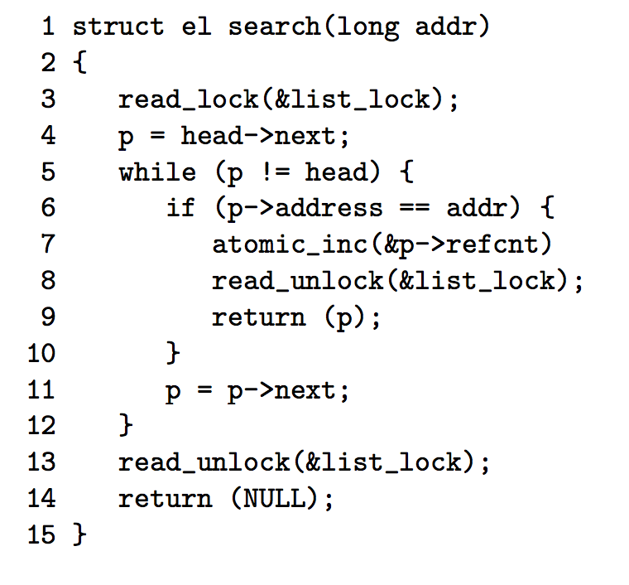
Read-Copy Search

Slide 22
Assumptions
Read intensive
the update fraction f < 1/ |CPU|
Grace period
reading tasks can see stale data
requires that the modification be compatible with lock-free access
linked-list insertion, deletion, and replacement are compatible

Slide 23
Simple Implementation
Wait_for_rcu()
waits for a grace period to expire
Kfree_rcu()
waits for a grace period before freeing a specified block of memory.

Slide 24
How to detect quiescence?
Idea of grace periods
Readers of old information will eventually leave
Exploit context switches
Threads do not hold OS locks across context switches
How do we identify?
Paper goes into many alternatives and evaluates them (polling; counters; …)
Batching to reduce cost
Force context switch?
Expensive and some tasks are not preemptible

Slide 25
Read-Copy Update Grace Period
non-preemptible kernel execution
Quiescent state execution
Is it important to detect grace period quickly?

Slide 26
Simple Grace-Period Detection
Schedule a thread on each CPU to ensure quiescense

Slide 27
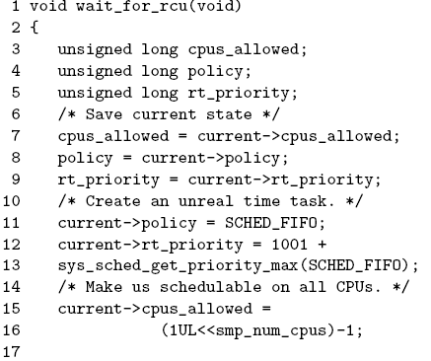
wait_for_rcu() I

Slide 28
wait_for_rcu() II

Slide 29
Implementations of Quiescent State
simply execute onto each CPU in turn.
use context switch, execution in the idle loop, execution in user mode, system call entry, trap from user mode as the quiescent states.
voluntary context switch as the sole quiescent state
tracks beginnings and ends of operations

Slide 30
Implementation (polling/counter)
Poll to figure out when safe to delete
Generation counter for each RCU region
Generation updated on write
Track readers of each generation
Every read increments generation counter going in
And decrements it going out
Quiescence = counter is zero

Slide 31
call_rcu() latency
Notes:
Rcu poll better by far, especially under low number of clients/rcu calls. The paper says that x-rcu/rcu are good for high number of calls because their performance does not suffer, but really that is true for rcu poll as well, so maybe it is just a dominant strategy

Slide 32
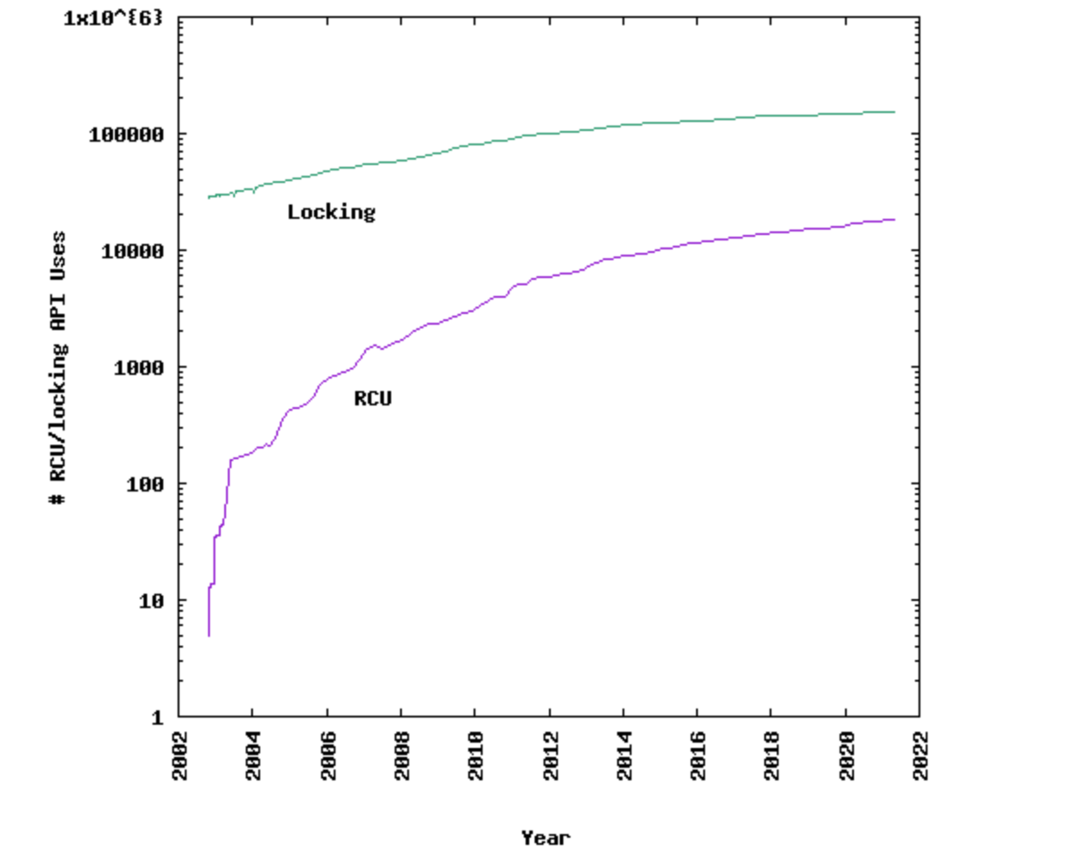
RCU usage in Linux
Source: http://www.rdrop.com/users/paulmck/RCU/linuxusage.html

Slide 33
RCU as percentage of all locking in linux
Source: http://www.rdrop.com/users/paulmck/RCU/linuxusage.html

Slide 34
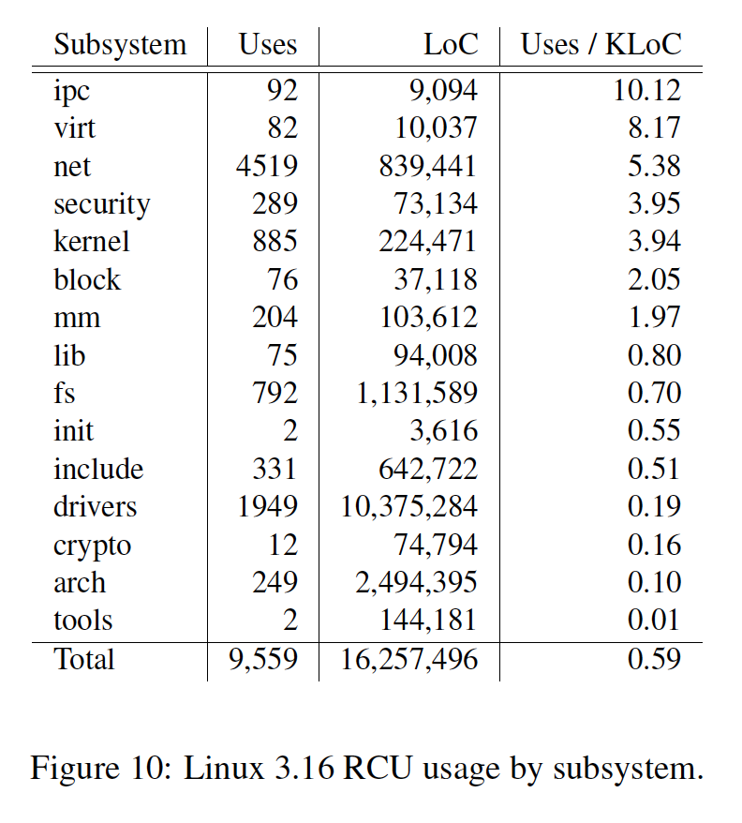
RCU Usage

Slide 35
Discussion of paper
Really challenging paper to read
Written by OS hackers (good thing!)
Mixes fundamentals and implementations
We have to try to step back and identify them
Too many ideas/alternatives
Better just to focus on one or two?
Back end of the paper is a survey
What are your thoughts?

Slide 36
SeqLock
Another special synchronization primitive
Goal is to avoid writer starvation in reader writer locks
Has a lock and a sequence number
Lock for writers only
Writer increments sequence number after acquiring lock and before releasing lock
Readers do not block
But can check sequence number

Slide 37
Shortcomings
Does not work in a preemptible kernel unless preemption is suppressed in all read-side critical sections
Cannot be called from an interrupt handler
Should not be called while holding a spinlock or with interrupts disabled
Relatively slow

Slide 38
Addressing
The K42 and Tornado implementations of RCU are such that read-side critical sections can block as well as being preempted—solve 1
Call_rcu() --solve 2、3
Kfree_rcu() --solve 2、3
High-Performance Design for RCU –solve 2、3、4

Slide 39
K42 and Tornado implementations of RCU
maintain two generation counters
current generation
non-current generation
Operations (next page)

Slide 40
Operation
An Operation begins
increment the current counter
store a pointer to that counter in the task
the operation ends
Decrement generation counter
Periodically, non-current generation is checked to see if it is zero
Reverse current and non-current generations
A token is handed from one CPU to next
The token returns to a given CPU
All operations across the entire system have terminated.

Slide 41
Non-Blocking Grace-Period Detection
Queues callbacks onto a
list
invoke all the pending callbacks after forcing
a grace period

Slide 42
High-Performance Design
defer frees of kmem_cache_alloc() memory
detects and identifies overly long lock-hold durations
“Batching" grace-period-measurement requests
Maintaining per-CPU request lists
Providing a less-costly algorithm for measuring grace-period duration.

Slide 43
Simple Deferred Free
a simple implementation of a deferred-free function named kfree_rcu()
low performance
kfree_rcu()→wait for rcu()

