Slide 1
CSE 153
Design of Operating Systems
Winter 2023
Lecture 22: File system – optimizations and advanced topics

Slide 2
There’s more to filesystems ☺
Standard Performance improvement techniques
Alternative important File systems
  FFS: Unix Fast File system
  JFS: making File systems reliable
  LFS: Optimizing write performance
Improve the performance/reliability of disk drives?
  RAID
Generalizations
  Network file systems
  Distributed File systems
  Internet scale file systems

Slide 3
Improving Performance
Disk reads and writes take order of milliseconds
  Very slow compared to CPU and memory speeds
How to speed things up?
  File buffer cache
  Cache writes
  Read ahead

Slide 4
File Buffer Cache
Applications exhibit significant locality for reading and writing files
Idea: Cache file blocks in memory to capture locality
  This is called the file buffer cache
  Cache is system wide, used and shared by all processes
  Reading from the cache makes a disk perform like memory
  Even a 4 MB cache can be very effective
Issues
  The file buffer cache competes with VM (tradeoff here)
  Like VM, it has limited size
  Need replacement algorithms again (LRU usually used)

Slide 5
Caching Writes
On a write, some applications assume that data makes it through the buffer cache and onto the disk
  As a result, writes are often slow even with caching
Several ways to compensate for this
  “write-behind”
    Maintain a queue of uncommitted blocks
    Periodically flush the queue to disk
    Unreliable
  Battery backed-up RAM (NVRAM)
    As with write-behind, but maintain queue in NVRAM
    Expensive
  Log-structured file system
    Always write next block after last block written
    Complicated

Slide 6
Read Ahead
Many file systems implement “read ahead”
  FS predicts that the process will request next block
  FS goes ahead and requests it from the disk
  This can happen while the process is computing on previous block
    Overlap I/O with execution
  When the process requests block, it will be in cache
  Compliments the disk cache, which also is doing read ahead
For sequentially accessed files can be a big win
  Unless blocks for the file are scattered across the disk
  File systems try to prevent that, though (during allocation)

Slide 7
FFS, JFS, LFS, RAID
Now we’re going to look at some example file and storage systems
  BSD Unix Fast File System (FFS)
  Journaling File Systems (JFS)
  Log-structured File System (LFS) – Not going to cover
  Redundant Array of Inexpensive Disks (RAID)

Slide 8
Fast File System
The original Unix file system had a simple, straightforward implementation
  Easy to implement and understand
  But very poor utilization of disk bandwidth (lots of seeking)
BSD Unix folks did a redesign (mid 80s) that they called the Fast File System (FFS)
  Improved disk utilization, decreased response time
  McKusick, Joy, Leffler, and Fabry
Now the FS to which all other Unix FS’s are compared
Good example of being device-aware for performance

Slide 9
Data and Inode Placement
Original Unix FS had two placement problems:
1. Data blocks allocated randomly in aging file systems
  Blocks for the same file allocated sequentially when FS is new
  As FS “ages” and fills, need to allocate into blocks freed up when other files are deleted
  Problem: Deleted files essentially randomly placed
  So, blocks for new files become scattered across the disk
2. Inodes allocated far from blocks
  All inodes at beginning of disk, far from data
  Traversing file name paths, manipulating files, directories requires going back and forth from inodes to data blocks
Both of these problems generate many long seeks

Slide 10
Cylinder Groups
BSD FFS addressed these problems using the notion of a cylinder group
  Disk partitioned into groups of cylinders
  Data blocks in same file allocated in same cylinder
  Files in same directory allocated in same cylinder
  Inodes for files allocated in same cylinder as file data blocks
Free space requirement
  To be able to allocate according to cylinder groups, the disk must have free space scattered across cylinders
  10% of the disk is reserved just for this purpose
    Only used by root – this is why “df” may report >100%

Slide 11
Other Problems
Small blocks (1K) caused two problems:
  Low bandwidth utilization
  Small max file size (function of block size)
Fix: Use a larger block (4K)
  Very large files, only need two levels of indirection for 2^32
  Problem: internal fragmentation
  Fix: Introduce “fragments” (1K pieces of a block)
Problem: Media failures
  Replicate master block (superblock)
Problem: Device oblivious
  Parameterize according to device characteristics

Slide 12
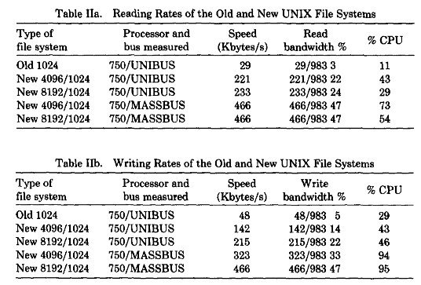
The Results

Slide 13
Problem: crash consistency
Updates to data and meta data are not atomic
Consider, what happens when you delete a file
  Remove directory entry
  Remove the inode(s)
  Remove the data blocks
  Mark the free map (for all the i-node and data blocks you freed)
  What happens if you crash somewhere in the middle?

Slide 14
Journaling File Systems
Journaling File systems make updates to a log
  Log plans for updates to a journal first
  When a crash happens you can replay the journal to restore consistency
What if we crash when writing journal?
  Problem. Possible solution, bracket the changes
    Introduce checksum periodically
    Replay only parts where there is checksum that matches
Journal choices (regular file? Special partition?)
Log meta-data and data?

Slide 15
Log-structured File System
The Log-structured File System (LFS) was designed in response to two trends in workload and technology:
  1. Disk bandwidth scaling significantly (40% a year)
    While seek latency is not
  2. Large main memories in machines
    Large buffer caches
    Absorb large fraction of read requests
    Can use for writes as well
    Coalesce small writes into large writes
LFS takes advantage of both of these to increase FS performance
  Rosenblum and Ousterhout (Berkeley, 1991)

Slide 16
FFS Problems
LFS also addresses some problems with FFS
  Placement is improved, but still have many small seeks
    Possibly related files are physically separated
    Inodes separated from files (small seeks)
    Directory entries separate from inodes
  Metadata requires synchronous writes
    With small files, most writes are to metadata (synchronous)
    Synchronous writes very slow

Slide 17
LFS Approach
Treat the disk as a single log for appending
  Collect writes in disk cache, write out entire collection in one large disk request
    Leverages disk bandwidth
    No seeks (assuming head is at end of log)
  All info written to disk is appended to log
    Data blocks, attributes, inodes, directories, etc.
Looks simple, but only in abstract

Slide 18
LFS Challenges
LFS has two challenges it must address for it to be practical
  1. Locating data written to the log
    FFS places files in a location, LFS writes data “at the end”
  2. Managing free space on the disk
    Disk is finite, so log is finite, cannot always append
    Need to recover deleted blocks in old parts of log

Slide 19
LFS: Locating Data
FFS uses inodes to locate data blocks
  Inodes pre-allocated in each cylinder group
  Directories contain locations of inodes
LFS appends inodes to end of the log just like data
  Makes them hard to find
Approach
  Use another level of indirection: Inode maps
  Inode maps map file #s to inode location
  Location of inode map blocks kept in checkpoint region
  Checkpoint region has a fixed location
  Cache inode maps in memory for performance

Slide 20
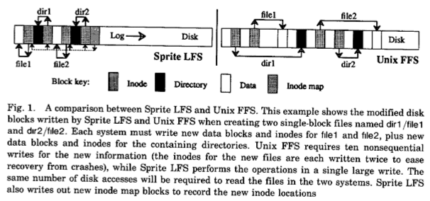
LFS Layout

Slide 21
LFS: Free Space Management
LFS append-only quickly runs out of disk space
  Need to recover deleted blocks
Approach:
  Fragment log into segments
  Thread segments on disk
    Segments can be anywhere
  Reclaim space by cleaning segments
    Read segment
    Copy live data to end of log
    Now have free segment you can reuse
Cleaning is a big problem
  Costly overhead

Slide 22
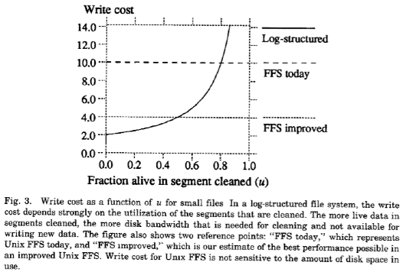
Write Cost Comparison
Write cost of 2 if 20% full
Write cost of 10 if 80% full

Slide 23
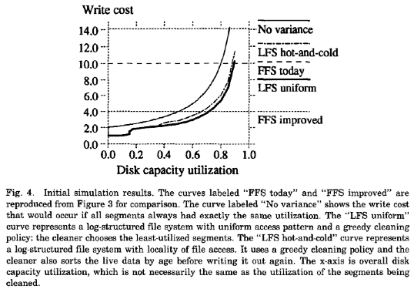
Write Cost: Simulation

Slide 24
RAID
Redundant Array of Inexpensive Disks (RAID)
  A storage system, not a file system
  Patterson, Katz, and Gibson (Berkeley, 1988)
Idea: Use many disks in parallel to increase storage bandwidth, improve reliability
  Files are striped across disks
  Each stripe portion is read/written in parallel
  Bandwidth increases with more disks

Slide 25
RAID

Slide 26
RAID Challenges
Small files (small writes less than a full stripe)
  Need to read entire stripe, update with small write, then write entire stripe out to disks
Reliability
  More disks increases the chance of media failure (MTBF)
Turn reliability problem into a feature
  Use one disk to store parity data
    XOR of all data blocks in stripe
  Can recover any data block from all others + parity block
  Hence “redundant” in name
  Introduces overhead, but, hey, disks are “inexpensive”

Slide 27
RAID with parity
+
+
+
=

Slide 28
RAID Levels
In marketing literature, you will see RAID systems advertised as supporting different “RAID Levels”
Here are some common levels:
  RAID 0: Striping
    Good for random access (no reliability)
  RAID 1: Mirroring
    Two disks, write data to both (expensive, 1X storage overhead)
  RAID 2,3 and 4: bit, byte and block level parity. Rarely used.
  RAID 5, 6: Floating parity
    Parity blocks for different stripes written to different disks
    No single parity disk, hence no bottleneck at that disk
  RAID “10”: Striping plus mirroring
    Higher bandwidth, but still have large overhead
    See this on PC RAID disk cards

Slide 29
Other file system topics
Network File systems (NFS)
  Can a file system be shared across the network
  The file system is on a single server, the clients access it remotely
Distributed file systems: Can a file system be stored (and possibly replicated) across multiple machines
  What if they are geographically spread?
  Hadoop Distributed File System (HDFS), Google File System (GFS)
File systems is an exciting research area
  Take cs202 if interested!

Slide 30
Summary
UNIX file system
  Indexed access to files using inodes
FFS
  Improve performance by localizing files to cylinder groups
JFS
  Improve reliability by logging operations in a journal
LFS
  Improve write performance by treating disk as a log
  Need to clean log complicates things
RAID
  Spread data across disks and store parity on separate disk

