Slide 1
CSE 153
Design of Operating Systems
Winter 2023
Lecture 19: File Systems (1)—Disk drives

Slide 2
OS Abstractions
Applications
Process
File system
Virtual memory
Operating System
CPU
Hardware
Disk
RAM

Slide 3
File Systems Agenda
First we’ll discuss properties of physical disks
  Structure, Performance
  Scheduling
Then we’ll discuss how to build file systems (next time)
  Abstraction:
    Files
    Directories
    Sharing
    Protection
  Implementation
    File System Layouts
    File Buffer Cache
    Read Ahead

Slide 4
Disks and the OS
Disks/SSDs are messy physical devices:
  Disks: errors, bad blocks, missed seeks, etc.
  SSD: limited wear cycles, block erase/write, …
OS hides this mess from higher level software
  Low-level device control (initiate a disk read, etc.)
Os provides Higher-level abstractions (e.g., files)
  OS maps them to the device and implements policies for
    Performance, reliability, protection, …
Notes:
The OS may provide different levels of disk access to different clients
Physical disk (surface, cylinder, sector)
Logical disk (disk block #)
Logical file (file block, record, or byte #)

Slide 5
Disk vs. SSD

Slide 6
Gap is closing

Slide 7
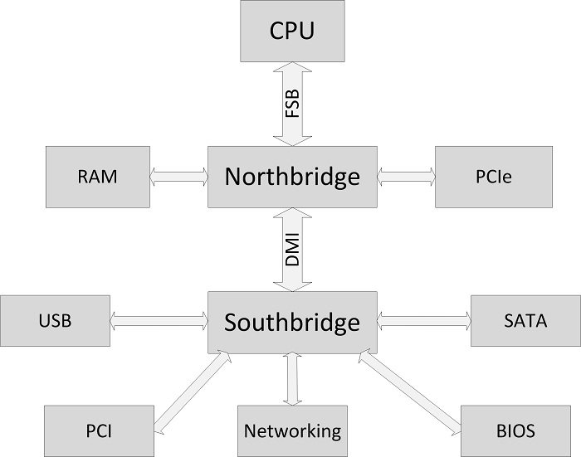
I/O and disk in the system
Notes:
Logical view of a modern motherboard

Slide 8
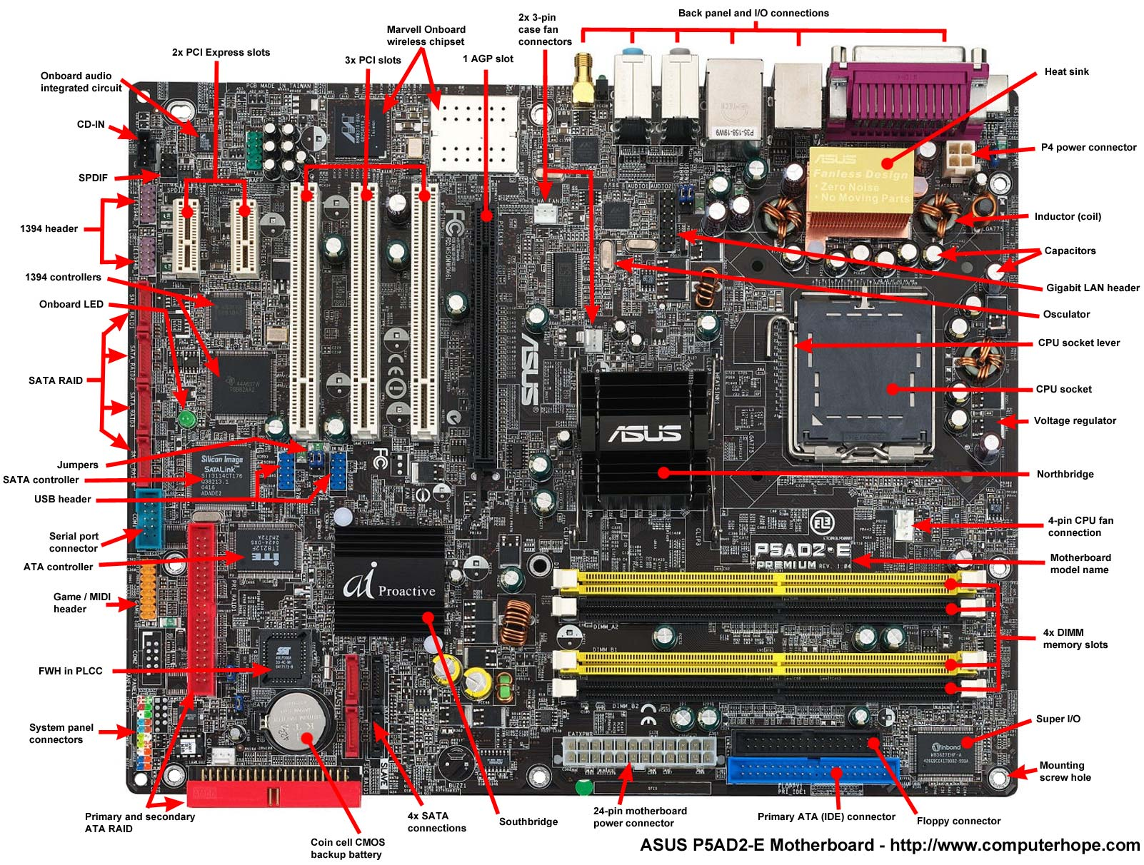
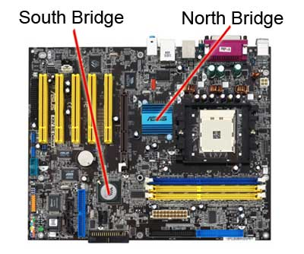
Motherboard
Notes:
Image from computerhope.com – this is a slightly older motherboard (it has AGP rather than PCI-e bus)

Slide 9
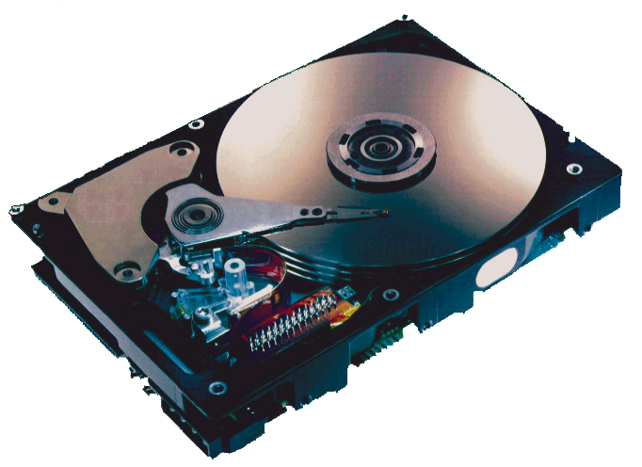
What’s Inside A Disk Drive?
Spindle
Arm
Platters
Actuator
Electronics
(including a
processor
and memory!)
SCSI
connector
Image courtesy of Seagate Technology

Slide 10
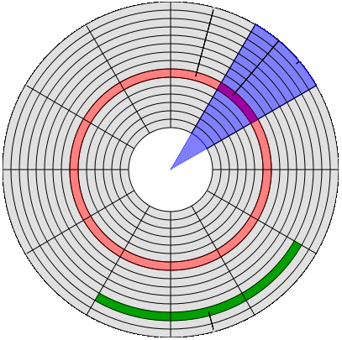
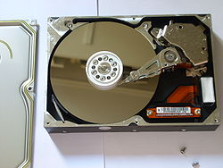
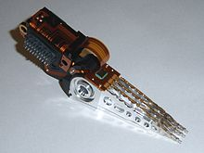
Physical Disk Structure
Disk components
  Platters
  Surfaces
  Tracks
  Sectors
  Cylinders
  Arm
  Heads
Arm
Surface
Cylinder
Heads
Platter
Arm
Sector
(512 bytes)
Track

Slide 11
Disk Geometry
Disks consist of platters, each with two surfaces.
Each surface consists of concentric rings called tracks.
Each track consists of sectors separated by gaps.
Tracks
Surface
Track k
Gaps
Spindle
Sectors

Slide 12
Disk Geometry (Muliple-Platter View)
Aligned tracks form a cylinder.
Cylinder k
Surface 0
Platter 0
Surface 1
Surface 2
Platter 1
Surface 3
Surface 4
Platter 2
Surface 5
Spindle

Slide 13
Disk Capacity
Capacity: maximum number of bits that can be stored.
Capacity is determined by these technology factors:
  Recording density (bits/in): number of bits that can be squeezed into a 1 inch segment of a track.
  Track density (tracks/in): number of tracks that can be squeezed into a 1 inch radial segment.
  Areal density (bits/in2): product of recording and track density.
Modern disks partition tracks into disjoint subsets called recording zones
  Each track in a zone has the same number of sectors, determined by the circumference of innermost track.
  Each zone has a different number of sectors/track

Slide 14
Computing Disk Capacity
Capacity = (# bytes/sector) x (avg. # sectors/track) x
(# tracks/surface) x (# surfaces/platter) x
(# platters/disk)
Example:
  512 bytes/sector
  300 sectors/track (on average)
  20,000 tracks/surface
  2 surfaces/platter
  5 platters/disk
Capacity = 512 x 300 x 20000 x 2 x 5
= 30,720,000,000
= 30.72 GB

Slide 15
Disk Operation (Single-Platter View)
The disk surface
spins at a fixed
rotational rate
The read/write head
is attached to the end
of the arm and flies over
the disk surface on
a thin cushion of air.
spindle
spindle
spindle
spindle
spindle
By moving radially, the arm can position the read/write head over any track.

Slide 16
Disk Operation (Multi-Platter View)
Read/write heads
move in unison
from cylinder to cylinder
Arm
Spindle

Slide 17
Disk Structure - top view of single platter
Surface organized into tracks
Tracks divided into sectors
Notes:
Goal:
Show the inefficeincy of current disk requests.
Conveyed Ideas:
Rotational latency is wasted time that can be used to service tasks
Background Information:
None.
Slide Background:
None.
Kill text and arrows

Slide 18
Disk Access
Head in position above a track
Notes:
Goal:
Show the inefficeincy of current disk requests.
Conveyed Ideas:
Rotational latency is wasted time that can be used to service tasks
Background Information:
None.
Slide Background:
None.
Kill text and arrows

Slide 19
Disk Access
Rotation is counter-clockwise
Notes:
Goal:
Show the inefficeincy of current disk requests.
Conveyed Ideas:
Rotational latency is wasted time that can be used to service tasks
Background Information:
None.
Slide Background:
None.
Kill text and arrows

Slide 20
Disk Access – Read
About to read blue sector
Notes:
Goal:
Show the inefficeincy of current disk requests.
Conveyed Ideas:
Rotational latency is wasted time that can be used to service tasks
Background Information:
None.
Slide Background:
None.
Kill text and arrows

Slide 21
Disk Access – Read
After BLUE read
After reading blue sector
Notes:
Goal:
Show the inefficeincy of current disk requests.
Conveyed Ideas:
Rotational latency is wasted time that can be used to service tasks
Background Information:
None.
Slide Background:
None.
Kill text and arrows

Slide 22
Disk Access – Read
After BLUE read
Red request scheduled next
Notes:
Goal:
Show the inefficeincy of current disk requests.
Conveyed Ideas:
Rotational latency is wasted time that can be used to service tasks
Background Information:
None.
Slide Background:
None.
Kill text and arrows

Slide 23
Disk Access – Seek
After BLUE read
Seek for RED
Seek to red’s track
Notes:
Goal:
Show the inefficeincy of current disk requests.
Conveyed Ideas:
Rotational latency is wasted time that can be used to service tasks
Background Information:
None.
Slide Background:
None.
Kill text and arrows

Slide 24
Disk Access – Rotational Latency
After BLUE read
Seek for RED
Rotational latency
Wait for red sector to rotate around
Notes:
Goal:
Show the inefficeincy of current disk requests.
Conveyed Ideas:
Rotational latency is wasted time that can be used to service tasks
Background Information:
None.
Slide Background:
None.
Kill text and arrows

Slide 25
Disk Access – Read
After BLUE read
Seek for RED
Rotational latency
After RED read
Complete read of red
Notes:
Goal:
Show the inefficeincy of current disk requests.
Conveyed Ideas:
Rotational latency is wasted time that can be used to service tasks
Background Information:
None.
Slide Background:
None.
Kill text and arrows

Slide 26
Disk Access – Service Time Components
After BLUE read
Seek for RED
Rotational latency
After RED read
Data transfer
Seek
Rotational
latency
Data transfer
Notes:
Goal:
Show the inefficeincy of current disk requests.
Conveyed Ideas:
Rotational latency is wasted time that can be used to service tasks
Background Information:
None.
Slide Background:
None.
Kill text and arrows

Slide 27
Disk Access Time
Average time to access some target sector approximated by :
  Taccess = Tavg seek + Tavg rotation + Tavg transfer
Seek time (Tavg seek)
  Time to position heads over cylinder containing target sector.
  Typical Tavg seek is 3—9 ms
Rotational latency (Tavg rotation)
  Time waiting for first bit of target sector to pass under r/w head.
  Tavg rotation = 1/2 x 1/RPMs x 60 sec/1 min
  Typical Tavg rotation = 7200 RPMs
Transfer time (Tavg transfer)
  Time to read the bits in the target sector.
  Tavg transfer = 1/RPM x 1/(avg # sectors/track) x 60 secs/1 min.

Slide 28
Disk Access Time Example
Given:
  Rotational rate = 7,200 RPM
  Average seek time = 9 ms.
  Avg # sectors/track = 400.
Derived:
  Tavg rotation = 1/2 x (60 secs/7200 RPM) x 1000 ms/sec = 4 ms.
  Tavg transfer = 60/7200 RPM x 1/400 secs/track x 1000 ms/sec = 0.02 ms
  Taccess = 9 ms + 4 ms + 0.02 ms
Important points:
  Access time dominated by seek time and rotational latency.
  First bit in a sector is the most expensive, the rest are free.
  SRAM access time is about 4 ns/doubleword, DRAM about 60 ns
    Disk is about 40,000 times slower than SRAM,
    2,500 times slower then DRAM.

Slide 29
Disks Heterogeneity
Seagate Barracuda 3.5" (workstation)
  capacity: 250 - 750 GB
  rotational speed: 7,200 RPM
  sequential read performance: 78 MB/s (outer) - 44 MB/s (inner)
  seek time (average): 8.1 ms
Seagate Cheetah 3.5" (server)
  capacity: 73 - 300 GB
  rotational speed: 15,000 RPM
  sequential read performance: 135 MB/s (outer) - 82 MB/s (inner)
  seek time (average): 3.8 ms
Seagate Savvio 2.5" (smaller form factor)
  capacity: 73 GB
  rotational speed: 10,000 RPM
  sequential read performance: 62 MB/s (outer) - 42 MB/s (inner)
  seek time (average): 4.3 ms

Slide 30
Logical Disk Blocks
Modern disks present a simpler abstraction:
  The set of available sectors is modeled as a sequence of b-sized logical blocks (0, 1, 2, ...)
Mapping between logical and actual (physical) sectors
  Maintained by a device called disk controller.
  Converts requests for logical blocks into (surface,track,sector)
  Allows controller to set aside spare cylinders for each zone.
  Accounts for the difference in “formatted capacity” and “maximum capacity”.

Slide 31
I/O Bus
CPU chip
Register file
ALU
System bus
Memory bus
Main
memory
Bus interface
I/O
bridge
I/O bus
Expansion slots for
other devices such
as network adapters.
USB
controller
Graphics
adapter
Disk
controller
Mouse
Keyboard
Monitor
Disk

Slide 32
Reading a Disk Sector (1)
Register file
CPU initiates a disk read by writing a command, logical block number, and destination memory address to a port (address) associated with disk controller.
ALU
CPU chip
Main
memory
Bus interface
I/O bus
USB
controller
Graphics
adapter
Disk
controller
mouse
keyboard
Monitor
Disk

Slide 33
Reading a Disk Sector (2)
Register file
ALU
Disk controller reads the sector and performs a direct memory access (DMA) transfer into main memory.
CPU chip
Main
memory
Bus interface
I/O bus
USB
controller
Graphics
adapter
Disk
controller
Mouse
Keyboard
Monitor
Disk

Slide 34
Reading a Disk Sector (3)
Register file
ALU
When the DMA transfer completes, the disk controller notifies the CPU with an interrupt (i.e., asserts a special “interrupt” pin on the CPU)
CPU chip
Main
memory
Bus interface
I/O bus
USB
controller
Graphics
adapter
Disk
controller
Mouse
Keyboard
Monitor
Disk

Slide 35
Disk Interaction
Specifying disk requests requires a lot of info:
  Cylinder #, surface #, track #, sector #, transfer size…
Older disks required the OS to specify all of this
  The OS needed to know all disk parameters
Modern disks are more complicated
  Not all sectors are the same size, sectors are remapped, etc.
Current disks provide a higher-level interface (SCSI)
  The disk exports its data as a logical array of blocks [0…N]
    Disk maps logical blocks to cylinder/surface/track/sector
  Only need to specify the logical block # to read/write
  But now the disk parameters are hidden from the OS

Slide 36
Disk Scheduling
Because seeks are so expensive (milliseconds!), OS schedules requests that are queued waiting for the disk
  FCFS (do nothing)
    Reasonable when load is low
    Does nothing to minimize overhead of seeks
  SSTF (shortest seek time first)
    Minimize arm movement (seek time), maximize request rate
    Favors middle blocks, potential starvation of blocks at ends
  SCAN (elevator)
    Service requests in one direction until done, then reverse
    Long waiting times for blocks at ends
  C-SCAN
    Like SCAN, but only go in one direction (typewriter)

Slide 37
Disk Scheduling (2)
In general, unless there are request queues, disk scheduling does not have much impact
  Important for servers, less so for PCs
Modern disks often do the disk scheduling themselves
  Disks know their layout better than OS, can optimize better
  Ignores, undoes any scheduling done by OS

Slide 38
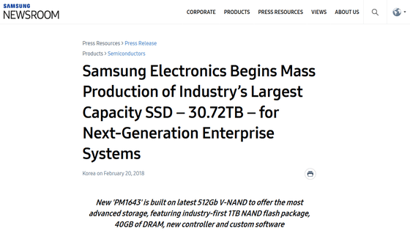
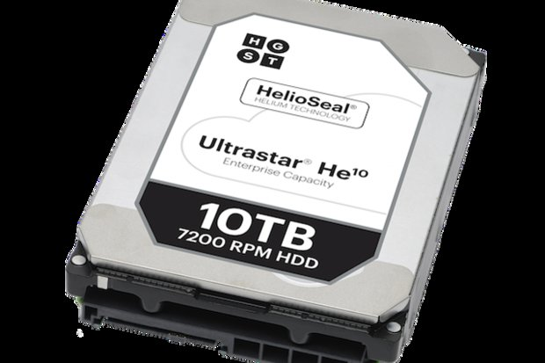
Recent: Seagate Enterprise
10TB! 800 Gbits/inch²
7 (3.5”) platters, 2 heads each
7200 RPM, 8ms seek latency
249/225 MB/sec read/write transfer rates
2.5million hours MTBF
256MB cache
MSRP ~$500

Slide 39
Storage Performance & Price
 | Bandwidth (sequential R/W) | Cost/GB | Size
HHD | 50-100 MB/s | $0.05-0.1/GB | 2-4 TB
SSD¹ | 200-500 MB/s (SATA) 6 GB/s (PCI) | $1.5-5/GB | 200GB-1TB
DRAM | 10-16 GB/s | $5-10/GB | 64GB-256GB
¹http://www.fastestssd.com/featured/ssd-rankings-the-fastest-solid-state-drives/
BW: SSD up to x10 than HDD, DRAM > x10 than SSD
Price: HDD x30 less than SSD, SSD x4 less than DRAM

Slide 40
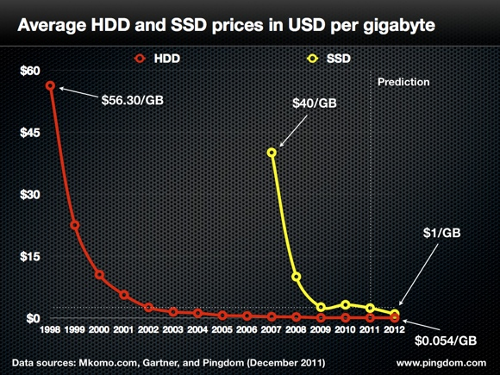
Contrarian View
A lot of file system ideas tied to disk drives are no longer relevant?

Slide 41
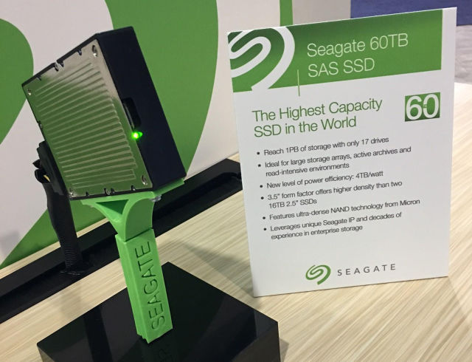
60 TB SSD ($20,000)

