Slide 1
CSE 153 Design of Operating Systems Winter 23
Lecture 18/19: Page Replacement

Slide 2
Memory Management
Memory management systems
Physical and virtual addressing; address translation
Techniques: Partitioning, paging, segmentation
Page table size, TLBs, VM tricks
Policies
Page replacement algorithms (3)

Slide 3
Demand Paging (OS)
We use demand paging (similar to other caches):
Pages loaded from disk when referenced
Pages may be evicted to disk when memory is full
Page faults trigger paging operations
What is the alternative to demand paging?
Some kind of prefetching
Lazy vs. aggressive policies in systems

Slide 4
Demand Paging (Process)
Demand paging when a process first starts up
When a process is created, it has
A brand new page table with all valid bits off
No pages in memory
When the process starts executing
Instructions fault on code and data pages
Faulting stops when all necessary code and data pages are in memory
Only code and data needed by a process needs to be loaded
This, of course, changes over time…

Slide 5
Page Replacement
When a page fault occurs, the OS loads the faulted page from disk into a page frame of memory
At some point, the process has used all of the page frames it is allowed to use
This is likely (much) less than all of available memory
When this happens, the OS must replace a page for each page faulted in
It must evict a page to free up a page frame
Written back only if it is has been modified (i.e., “dirty”)!

Slide 6
Page replacement policy
What we discussed so far (page faults, swap, page table structures, etc…) is mechanisms
Page replacement policy: determine which page to remove when we need a victim
Does it matter?
Yes! Page faults are super expensive
Getting the number down, can improve the performance of the system significantly

Slide 7
Considerations
Page replacement support has to be simple during memory accesses
They happen all the time, we cannot make that part slow
But it can be complicated/expensive when a page fault occurs – why?
Reason 1: if we are successful, this will be rare
Reason 2: when it happens we are paying the cost of I/O
I/O is very slow: can afford to do some extra computation
Worth it if we can save some future page faults
What makes a good page replacement policy?

Slide 8
Locality to the Rescue
Recall that virtual memory works because of locality
Temporal and spatial
Work at different scales: for cache, at a line level, for VM, at page level, and even at larger scales
All paging schemes depend on locality
What happens if a program does not have locality?
High cost of paging is acceptable, if infrequent
Processes usually reference pages in localized patterns, making paging practical

Slide 9
Evicting the Best Page
Goal is to reduce the page fault rate
The best page to evict is the one never touched again
Will never fault on it
Never is a long time, so picking the page closest to “never” is the next best thing
Evicting the page that won’t be used for the longest period of time minimizes the number of page faults
Proved by Belady
We’re now going to survey various replacement algorithms, starting with Belady’s

Slide 10
Belady’s Algorithm
Belady’s algorithm
Idea: Replace the page that will not be used for the longest time in the future
Optimal? How would you show?
Problem: Have to predict the future
Why is Belady’s useful then?
Use it as a yardstick/upper bound
Compare implementations of page replacement algorithms with the optimal to gauge room for improvement
If optimal is not much better, then algorithm is pretty good
What’s a good lower bound?
Random replacement is often the lower bound

Slide 11
First-In First-Out (FIFO)
FIFO is an obvious algorithm and simple to implement
Maintain a list of pages in order in which they were paged in
On replacement, evict the one brought in longest time ago
Why might this be good?
Maybe the one brought in the longest ago is not being used
Why might this be bad?
Then again, maybe it’s not
We don’t have any info to say one way or the other
FIFO suffers from “Belady’s Anomaly”
The fault rate might actually increase when the algorithm is given more memory (very bad)

Slide 12
Least Recently Used (LRU)
LRU uses reference information to make a more informed replacement decision
Idea: We can’t predict the future, but we can make a guess based upon past experience
On replacement, evict the page that has not been used for the longest time in the past (Belady’s: future)
When does LRU do well? When does LRU do poorly?
Implementation
To be perfect, need to time stamp every reference (or maintain a stack) – much too costly
So we need to approximate it

Slide 13
Approximating LRU
LRU approximations use the PTE reference bit
Keep a counter for each page
At regular intervals, for every page do:
If ref bit = 0, increment counter
If ref bit = 1, zero the counter
Zero the reference bit
The counter will contain the number of intervals since the last reference to the page
The page with the largest counter is the least recently used
Some architectures don’t have a reference bit
Can simulate reference bit using the valid bit to induce faults

Slide 14
LRU Approximation
Reference bits
LRU counter
 | P1 | P2 | P3 | P4
t = 0 | 0 | 0 | 0 | X
t = 1 | 0 | 1 | 0 | X
t = 2 | 0 | 0 | 0 | X
t = 3 | 0 | 0 | 1 | X
t = 4 | 0 | 0 | 0 | X
t = 5 | X | 0 | 0 | 1
 | P1 | P2 | P3 | P4
t = 0 | 0 | 0 | 0 | -
t = 1 | 0 | 0 | 0 | -
t = 2 | 1 | 0 | 1 | -
t = 3 | 1 | 0 | 1 | -
t = 4 | 2 | 1 | 0 | -
t = 5 | - | 1 | 0 | 0
Problem: Overhead of one counter value per page

Slide 15
LRU Clock (Not Recently Used)
Not Recently Used (NRU) – Used by Unix
Replace page that is “old enough”
Arrange all of physical page frames in a big circle (clock)
A clock hand is used to select a good LRU candidate
Sweep through the pages in circular order like a clock
If the ref bit is off, it hasn’t been used recently
What is the minimum “age” if ref bit is off?
If the ref bit is on, turn it off and go to next page
Arm moves quickly when pages are needed
Low overhead when plenty of memory
If memory is large, “accuracy” of information degrades
What does it degrade to?
One fix: use two hands (leading erase hand, trailing select hand)

Slide 16
LRU Clock
P3: 1
P3: 0
P2: 1
P4: 0
P2: 0
P4: 0
P1: 1
P5: 1
P1: 0
P5: 1
P8: 0
P6: 0
P8: 1
P6: 0
P7: 0
P7: 0

Slide 17
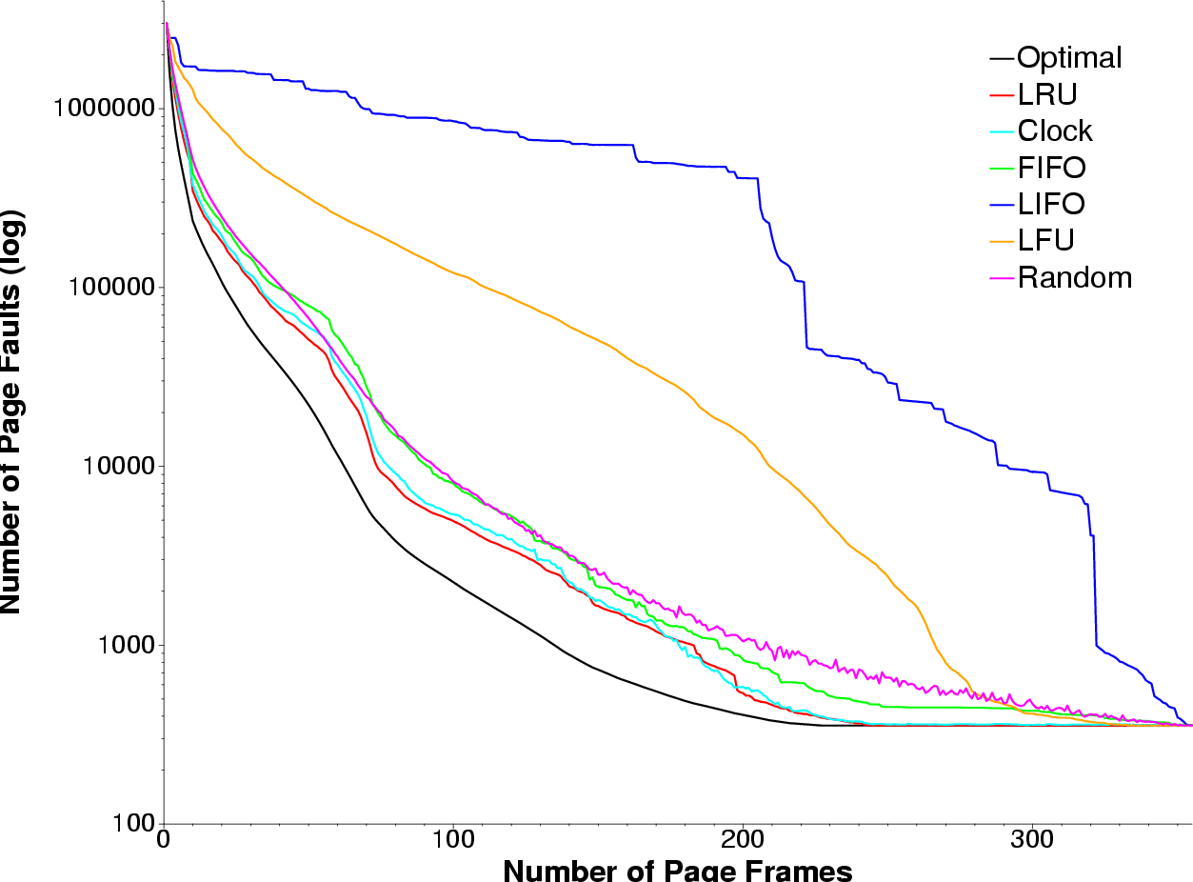
Example: gcc Page Replace

Slide 18
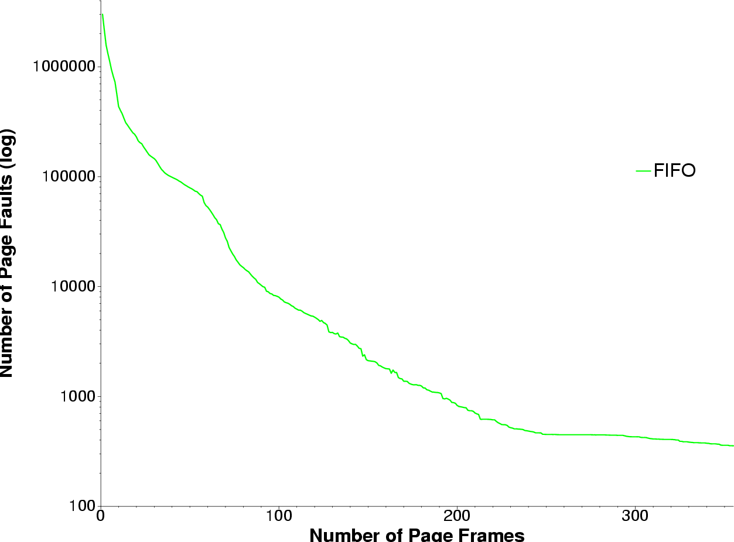
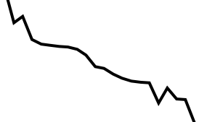
Example: Belady’s Anomaly

Slide 19
Other ideas
Victim buffer
Add a buffer (death row!) we put a page on when we decide to replace it
Buffer is FIFO
If you get accessed while on death row – clemency!
If you are the oldest page on death row – replacement!

Slide 20
Fixed vs. Variable Space
In a multiprogramming system, we need a way to allocate memory to competing processes
Problem: How to determine how much memory to give to each process?
Fixed space algorithms
Each process is given a limit of pages it can use
When it reaches the limit, it replaces from its own pages
Local replacement
Some processes may do well while others suffer
Variable space algorithms
Process’ set of pages grows and shrinks dynamically
Global replacement
One process can ruin it for the rest

Slide 21
Working Set Model
A working set of a process is used to model the dynamic locality of its memory usage
Defined by Peter Denning in 60s
Definition
WS(t,w) = {set of pages P, such that every page in P was referenced in the time interval (t, t-w)}
t – time, w – working set window (measured in page refs)
A page is in the working set (WS) only if it was referenced in the last w references

Slide 22
Working Set Size
The working set size is the number of pages in the working set
The number of pages referenced in the interval (t, t-w)
The working set size changes with program locality
During periods of poor locality, you reference more pages
Within that period of time, the working set size is larger
Intuitively, want the working set to be the set of pages a process needs in memory to prevent heavy faulting
Each process has a parameter w that determines a working set with few faults
Denning: Don’t run a process unless working set is in memory

Slide 23
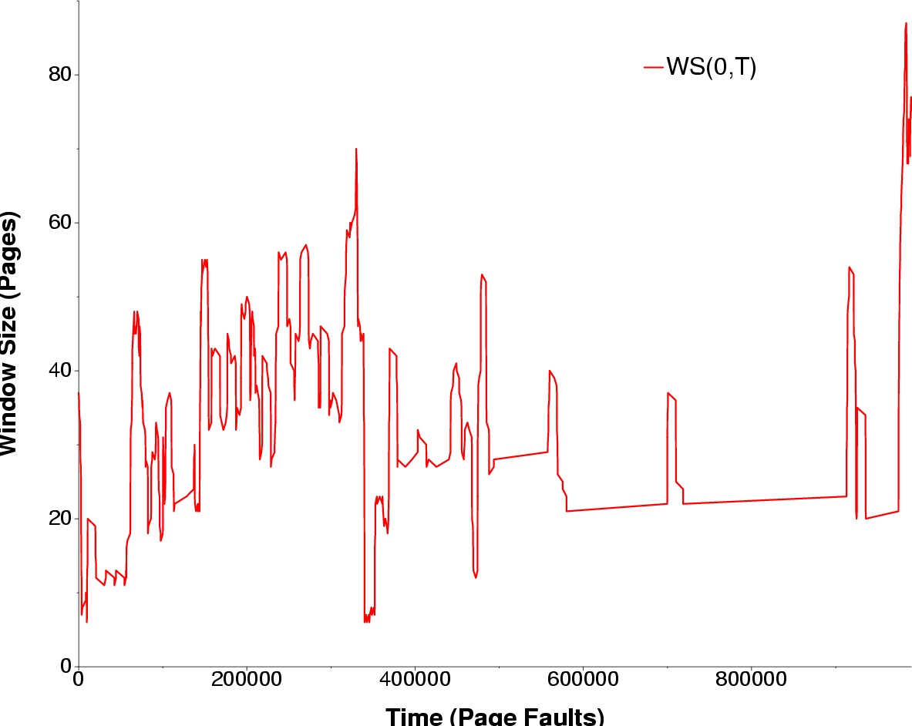
Example: gcc Working Set

Slide 24
Working Set Problems
Problems
How do we determine w?
How do we know when the working set changes?
Too hard to answer
So, working set is not used in practice as a page replacement algorithm
However, it is still used as an abstraction
The intuition is still valid
When people ask, “How much memory does Firefox need?”, they are in effect asking for the size of Firefox’s working set

Slide 25
Page Fault Frequency (PFF)
Page Fault Frequency (PFF) is a variable space algorithm that uses a more ad-hoc approach
Monitor the fault rate for each process
If the fault rate is above a high threshold, give it more memory
So that it faults less
But not always (FIFO, Belady’s Anomaly)
If the fault rate is below a low threshold, take away memory
Should fault more
But not always
Hard to use PFF to distinguish between changes in locality and changes in size of working set

Slide 26
Thrashing
Page replacement algorithms avoid thrashing
When most of the time is spent by the OS in paging data back and forth from disk
No time spent doing useful work (making progress)
In this situation, the system is overcommitted
No idea which pages should be in memory to reduce faults
Could just be that there isn’t enough physical memory for all of the processes in the system
Ex: Running Windows95 with 4 MB of memory…
Possible solutions
Swapping – write out all pages of a process
Buy more memory

Slide 27
Summary
Page replacement algorithms
Belady’s – optimal replacement (minimum # of faults)
FIFO – replace page loaded furthest in past
LRU – replace page referenced furthest in past
Approximate using PTE reference bit
LRU Clock – replace page that is “old enough”
Working Set – keep the set of pages in memory that has minimal fault rate (the “working set”)
Page Fault Frequency – grow/shrink page set as a function of fault rate
Multiprogramming
Should a process replace its own page, or that of another?

