Slide 1
CSE 153
Design of Operating Systems
Winter 2023
Lecture 12: Deadlock

Slide 2
Today: Deadlock—the deadly embrace!
Synchronization– we can easily shoot ourselves in the foot
  Incorrect use of synchronization can block all processes
  You have likely been intuitively avoiding this situation already
Consider: processes that use multiple critical sections/need different resources
  If one process tries to access a resource that a second process holds, and vice-versa, they can never make progress
We call this situation deadlock, and we’ll look at:
  Definition and conditions necessary for deadlock
  Representation of deadlock conditions
  Approaches to dealing with deadlock

Slide 3
Deadlock Definition
Deadlock is a problem that can arise:
  When processes compete for access to limited resources
  When processes are incorrectly synchronized
Definition:
  Deadlock exists among a set of processes if every process is waiting for an event that can be caused only by another process in the set
Process 1
Process 2
lockA->Acquire();
…
lockB->Acquire();
lockB->Acquire();
…
lockA->Acquire();

Slide 4
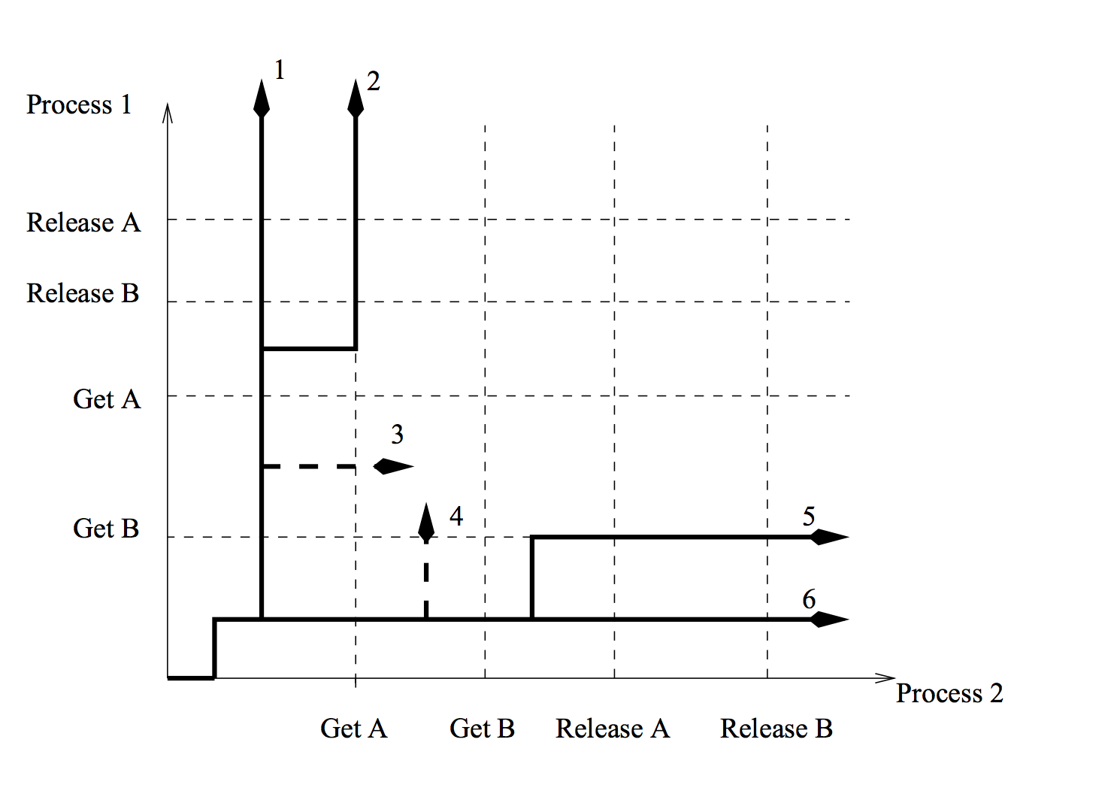
Deadlock Example (2)
Whether deadlock occurs
or not depends on the
order of operations!

Slide 5
Deadlock and Resources
There are two kinds of resources: consumable and reusable
  Consumable resources are generated and destroyed by processes: e.g., a process waiting for a message from another process
  Reusable resources are allocated and released by processes: e.g., locks on files
Deadlock with consumable resources is usually treated as a correctness issue (e.g., proofs) or with timeouts
From here on, we only consider reusable resources

Slide 6
Conditions for Deadlock
Deadlock can exist if and only if the following four conditions hold simultaneously:
  1. Mutual exclusion – At least one resource must be held in a non-sharable mode
  2. Hold and wait – There must be one process holding one resource and waiting for another resource
  3. No preemption – Resources cannot be preempted (critical sections cannot be aborted externally)
  4. Circular wait – There must exist a set of processes [P₁, P₂, P₃,…,P_{n}] such that P₁ is waiting for P₂, P₂ for P₃, etc.

Slide 7
Dining Lawyers
Each lawyer needs two chopsticks to eat.
Each grabs chopstick on the right first.
Notes:
An abstract way of looking at it: dining lawyers
Example: Dining philosophers -> lawyers, because it makes philosophers sound stupid. Lawyers really are stupid. Of course, I said this, and then someone in the class came up and asked me for recommendation for law school -- "I know you hate lawyers, but ..." Maybe we should make it: dining politicians!
Analogy with real life. Dining lawyers, draw circle with five plates Eating at a really cheap Chinese restaurant, with not enough chopsticks to go around.
What if they all grab their chopstick at the same time?
Won’t always get deadlock – depends on the precise order of execution.

Slide 8
Lets get formal for a minute
Deadlock can be described using a resource allocation graph (RAG)
The RAG consists of a set of vertices P={P₁, P₂, …, P_{n}} of processes and R={R₁, R₂, …, R_{m}} of resources
  A directed edge from a process to a resource, P_{i}→R_{i}, means that P_{i} has requested R_{j}
  A directed edge from a resource to a process, R_{i}→P_{i}, means that R_{j} has been allocated to P_{i}
  Each resource has a fixed number of units
If the graph has no cycles, deadlock cannot exist
If the graph has a cycle, deadlock may exist

Slide 9
RAG Example
P₁
P₁
R₃
R₁
R₁
R₃
P₂
P₂
P₃
P₃
P₄
R₂
R₂
A cycle…and deadlock!
Same cycle…but no deadlock. Why?

Slide 10
A Simpler Case
If all resources are single unit and all processes make single requests, then we can represent the resource state with a simpler waits-for graph (WFG)
The WFG consists of a set of vertices P={P₁, P₂, …, P_{n}} of processes
  A directed edge P_{i}→P_{j} means that P_{i} has requested a resource that P_{j} currently holds
If the graph has no cycles, deadlock cannot exist
If the graph has a cycle, deadlock exists

Slide 11
Dealing With Deadlock
There are four approaches for dealing with deadlock:
  Ignore it – how lucky do you feel?
  Prevention – make it impossible for deadlock to happen
  Avoidance – control allocation of resources
  Detection and Recovery – look for a cycle in dependencies

Slide 12
Deadlock Prevention
Prevention – Ensure that at least one of the necessary conditions cannot happen
  Mutual exclusion
    Make resources sharable (not generally practical)
  Hold and wait
    Process cannot hold one resource when requesting another
  Preemption
    OS can preempt resource (costly)
  Circular wait
    Impose an ordering (numbering) on the resources and request them in order (popular implementation technique)

Slide 13
Deadlock prevention
One shot allocation: ask for all your resources in one shot; no more resources can be requested
  What ingredient does this prevent?
  Comments?
Preemption
  Nice: Give up a resource if what you want is not available
  Aggressive: steal a resource if what you want is not available
Hierarchical allocation:
  Assign resources to classes
  Can only ask for resources from a higher number class than what you hold now

Slide 14
Deadlock Avoidance
Prevention can be too conservative – can we do better?
Avoidance
  Provide information in advance about what resources will be needed by processes
  System only grants resource requests if it knows that deadlock cannot happen
  Avoids circular dependencies
Tough
  Hard to determine all resources needed in advance
  Good theoretical problem, not as practical to use

Slide 15
Banker’s Algorithm
The Banker’s Algorithm is the classic approach to deadlock avoidance for resources with multiple units
1. Assign a credit limit to each customer (process)
  Maximum credit claim must be stated in advance
2. Reject any request that leads to a dangerous state
  A dangerous state is one where a sudden request by any customer for the full credit limit could lead to deadlock
  A recursive reduction procedure recognizes dangerous states
3. In practice, the system must keep resource usage well below capacity to maintain a resource surplus
  Rarely used in practice due to low resource utilization

Slide 16
Possible System States

Slide 17
Banker’s Algorithm Simplified
OK
OK
OK
UNSAFE
3
3
3
3
3
3
3
3
P₁
P₂
P₁
P₂
P₁
P₂
P₁
P₂

Slide 18
Detection and Recovery
Detection and recovery
  If we don’t have deadlock prevention or avoidance, then deadlock may occur
  In this case, we need to detect deadlock and recover from it
To do this, we need two algorithms
  One to determine whether a deadlock has occurred
  Another to recover from the deadlock
Possible, but expensive (time consuming)
  Implemented in VMS
  Run detection algorithm when resource request times out

Slide 19
Deadlock Detection
Detection
  Traverse the resource graph looking for cycles
  If a cycle is found, preempt resource (force a process to release)
Expensive
  Many processes and resources to traverse
Only invoke detection algorithm depending on
  How often or likely deadlock is
  How many processes are likely to be affected when it occurs

Slide 20
Deadlock Recovery
Once a deadlock is detected, we have two options…
1. Abort processes
  Abort all deadlocked processes
    Processes need to start over again
  Abort one process at a time until cycle is eliminated
    System needs to rerun detection after each abort
2. Preempt resources (force their release)
  Need to select process and resource to preempt
  Need to rollback process to previous state
  Need to prevent starvation

Slide 21
Deadlock Summary
Deadlock occurs when processes are waiting on each other and cannot make progress
  Cycles in Resource Allocation Graph (RAG)
Deadlock requires four conditions
  Mutual exclusion, hold and wait, no resource preemption, circular wait
Four approaches to dealing with deadlock:
  Ignore it – Living life on the edge
  Prevention – Make one of the four conditions impossible
  Avoidance – Banker’s Algorithm (control allocation)
  Detection and Recovery – Look for a cycle, preempt or abort

