Slide 1
CS 153
Design of Operating Systems
Winter 2023
Lecture 2: Historical perspective

Slide 2
Questions we started considering last time
Why do we need operating systems course?
Why do we need operating systems?
What does an operating system need to do?
Looking back, looking forward.

Slide 3
Roles an OS plays
Beautician that hides all the ugly low level details so that anyone can use a machine (e.g., smartphone!)
Wizard that makes it appear to each program that it owns the machine and shares resources while making them seem better than they are
Referee that arbitrates the available resources between the running programs efficiently, safely, fairly, and securely
  Managing a million crazy things happening at the same time is part of that – concurrency
Elephant that remembers all your data and makes it accessible to you -- persistence

Slide 4
More technically…
Abstraction: defines a set of logical resources (objects) and well-defined operations on them (interfaces)
Virtualization: Isolates and multiplexes physical resources via spatial and temporal sharing
Access Control: who, when, how
  Scheduling (when): efficiency and fairness
  Permissions (how): security and privacy
Persistence: how to keep and share data

Slide 5
Some Questions to Ponder
What is part of an OS? What is not?
  Is the windowing system part of an OS? Java? Apache server? Compiler? Firmware?
Popular OS’s today include Windows, Linux, and OS X
  How different/similar do you think these OSes are?
Somewhat surprisingly, OSes change all of the time
  Consider the series of releases of Windows, Linux, OS X…
  What are the drivers of OS change?
  What are the most compelling issues facing OSes today?
Notes:
1) Windowing system: want students to think about Windows GUI (often thought of as part) vs. X11 (just another process)
also how this impacts design; Unix has had many windowing systems, but wouldn’t think to have multiple on Windows
1.1) Apache Web server? HTTP protocol? Compiler, linker, loader, runtime? Device firmware?
2.1) Our OSes have a crazy lineage: NT/XP/Vista has features from VMS, Mach, Windows; OS X from BSD, Mach, NextStep, MacOS; Linux from BSD, Mach – they generate fervently religious debates, but from a number of perspectives are actually similar and incestuous
2.2) They are both similar and different – depends on your perspective, how you compare
Compare by API: Unix syscall API vs. Win32 → very different
Compare by portabilitiy: how tough is it to port an application from one OS to another? → rather similar, actually (Emacs port to NT anecdote)
Compare by metaphor: what are the semantics, metaphors they provide? → quite similar: seq processes, VM, files, sockets, etc., all the same stuff!
3.2) drivers of change: new features, hardware, application requirements
3.3) compelling issues today: security, virtualization

Slide 6
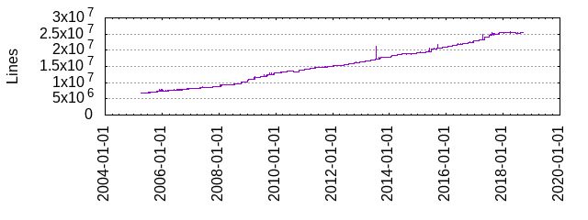
Pondering Cont’d
How many lines of code in an OS?
  Windows 10: 50M
    Vista (2006): 50M (XP + 10M)
    What is largest kernel component?
  OS X (2006): 86M
  Linux: 25 million (grew 250K in 2018!)
What does this mean (for you)?
  OSes are useful for learning about software complexity
    The mythical man month
    KDE (X11): 4M
    Browser : 2M+, …
  If you become a developer, you will face complexity
    Including lots of legacy code
Notes:
Device drivers largest kernel component
http://www.dwheeler.com/sloc/

Slide 7
Questions for today

Slide 8
A brief history—Phase 0
In the beginning, OS is just runtime libraries
  A piece of code used/sharable by many programs
  Abstraction: reuse magic to talk to physical devices
  Avoid bugs
User scheduled an exclusive time where they would use the machine
User interface was switches and lights, eventually punched cards and tape
  An interesting side effect: less bugs

Slide 9
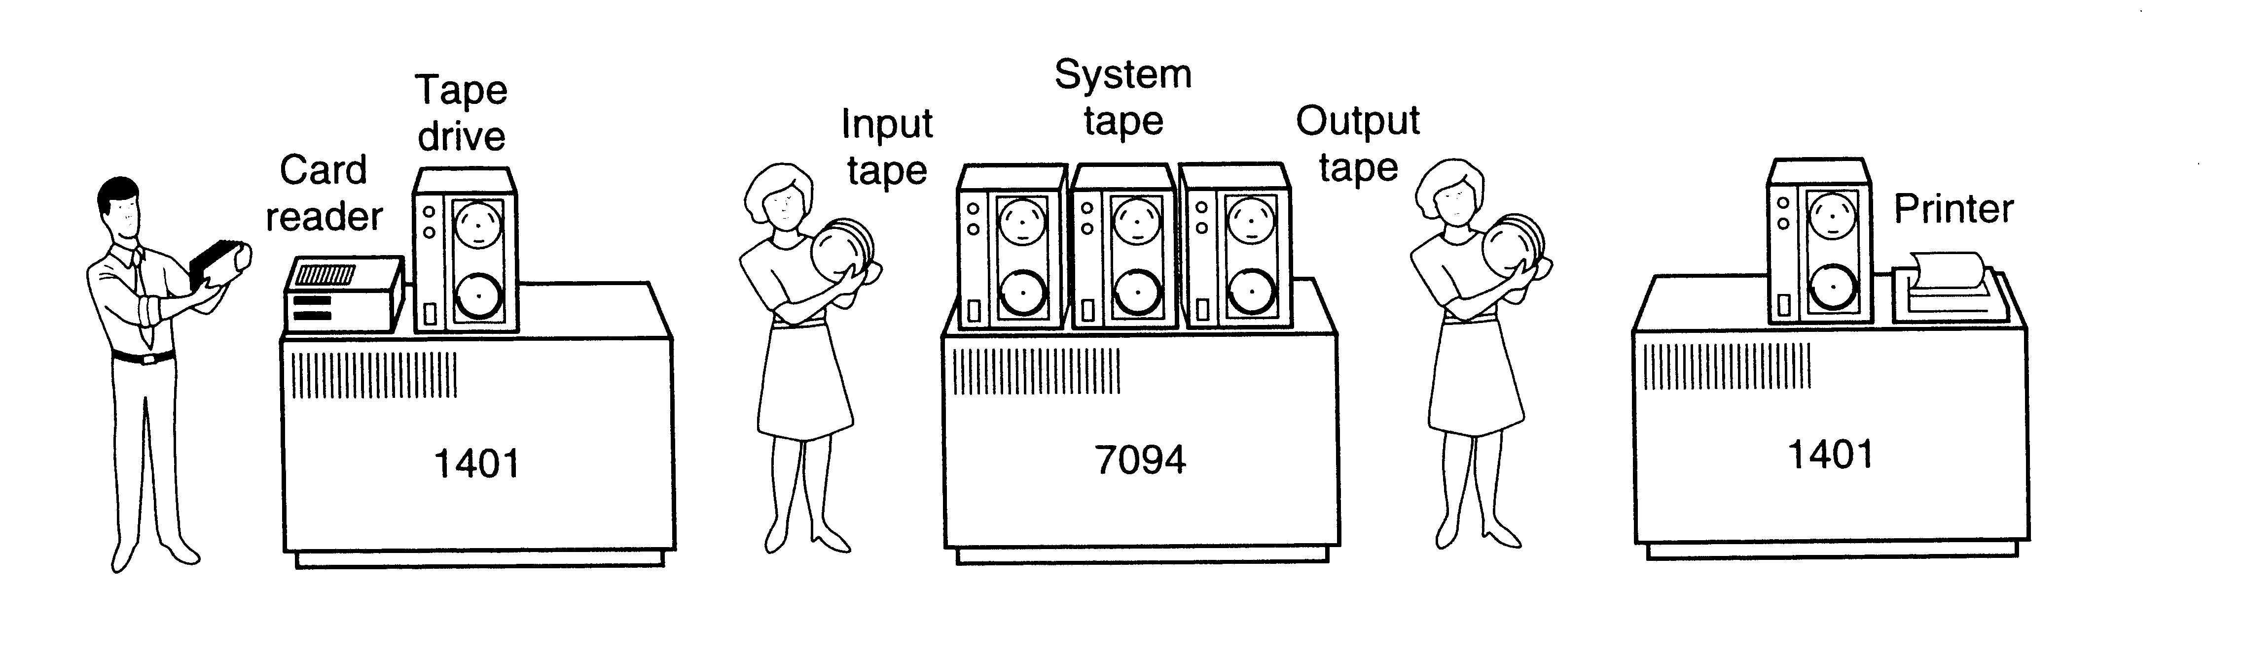
Phase 1: Batch systems (1955-1970)
Computers expensive; people cheap
  Use computers efficiently – move people away from machine
OS in this period became a program loader
    Loads a job, runs it, then moves on to next
    More efficient use of hardware but increasingly difficult to debug
      Still less bugs ☺

Slide 10
Advances in OS in this period
SPOOLING/Multiprogramming
  Simultaneous Peripheral Operation On-Line (SPOOL)
    Non-blocking tasks
    Copy document to printer buffer so printer can work while CPU moves on to something else
  Hardware provided memory support (protection and relocation)
  Scheduling: let short jobs run first
  OS must manage interactions between concurrent things
OS/360 from IBM first OS designed to run on a family of machines from small to large

Slide 11
Phase 1, problems
Utilization is low (one job at a time)
No protection between jobs
  But one job at a time, so?
Short jobs wait behind long jobs
Coordinating concurrent activities
People time is still being wasted
Operating Systems didn’t really work
  Birth of software engineering

Slide 12
Phase 2: 1970s – Time sharing, Unix, Persistence
Computers and people are expensive
  Help people be more productive
Interactive time sharing: let many people use the same machine at the same time
  CTSS/Multics projects at MIT
  Corbato got Turing award for this idea
Emergence of minicomputers
  Terminals are cheap
Persistence: Keep data online on fancy file systems

Slide 13
Unix appears
Ken Thompson, who worked on MULTICS, wanted to use an old PDP-7 laying around in Bell labs
  He and Dennis Richie built a system designed by programmers for programmers
Originally in assembly. Rewritten in C
  In their paper describing unix, they defend this decision!
  However, this is a new and important advance: portable operating systems!
Shared code with everyone (particularly universities)
  Start of open source?

Slide 14
Unix (cont’d)
Berkeley added support for virtual memory for the VAX
  Unix BSD
DARPA selected Unix as its networking platform in arpanet
Unix became commercial
  …which eventually lead Linus Torvald to develop Linux

Slide 15
Age of the Microprocesor
Intel 8086, 1978

Slide 16
Phase 3: 1980s -- PCs
Computers are cheap, people expensive
  Put a computer in each terminal
  CP/M from DEC first personal computer OS (for 8080/85) processors
  IBM needed software for their PCs, but CP/M was behind schedule
  Approached Bill Gates to see if he can build one
  Gates approached Seattle computer products, bought 86-DOS and created MS-DOS
  Goal: finish quickly and run existing CP/M software
  OS becomes subroutine library and command executive

Slide 17
Phase 4: Networked/distributed systems--1990s to now?
Its all about connectivity
Enables parallelism but performance is not goal
Goal is communication/sharing
  Requires high speed communication
  We want to share data not hardware
Networked applications drive everything
  Web, email, messaging, social networks, …

Slide 18
New problems
Large scale
  Google file system, mapreduce, …
Parallelism on the desktop (multicores)
Heterogeneous systems, IoT
  Real-time; energy efficiency
Security and Privacy

Slide 19
Phase 5
Computing evolving beyond networked systems
  Cloud computing, IoT, Drones, Cyber-physical systems, computing everywhere
Hardware accelerators, heterogeneous systems, end of Moore’s Law, Hardware democratization/Open source HW
New workloads: AI, Blockchain, …
New generation?
  But what is it?
    …and what problems will it bring?

Slide 20
Where are we headed next?
How is the OS structured? Is it a special program? Or something else?
  How do other programs interact with it?
How does it protect the system?
  What does the architecture/hardware need to do to support it?

