Slide 1
CS/EE 217
GPU Architecture and Parallel Programming
Lecture 9 Atomic Operations and Histogramming

Slide 2
Objective
To understand atomic operations
  Read-modify-write in parallel computation
  Use of atomic operations in CUDA
  Why atomic operations reduce memory system throughput
  How to avoid atomic operations in some parallel algorithms
Histogramming as an example application of atomic operations
  Basic histogram algorithm
  Privatization

Slide 3
A Common Collaboration Pattern
Multiple bank tellers count the total amount of cash in the safe
Each grab a pile and count
Have a central display of the running total
Whenever someone finishes counting a pile, add the subtotal of the pile to the running total
A bad outcome
  Some of the piles were not accounted for

Slide 4
A Common Parallel Coordination Pattern
Multiple customer service agents serving customers
Each customer gets a number
A central display shows the number of the next customer who will be served
When an agent becomes available, he/she calls the number and he/she adds 1 to the display
Bad outcomes
  Multiple customers get the same number
  Multiple agents serve the same number

Slide 5
A Common Arbitration Pattern
Multiple customers booking air tickets
Each
  Brings up a flight seat map
  Decides on a seat
  Update the the seat map, mark the seat as taken
A bad outcome
  Multiple passengers ended up booking the same seat

Slide 6
Atomic Operations
thread1:
Old ← Mem[x]
New ← Old + 1
Mem[x] ← New
thread2:
Old ← Mem[x]
New ← Old + 1
Mem[x] ← New
If Mem[x] was initially 0, what would the value of Mem[x] be after threads 1 and 2 have completed?
  What does each thread get in their Old variable?
The answer may vary due to data races. To avoid data races, you should use atomic operations

Slide 7
Timing Scenario #1
Time | Thread 1 | Thread 2
1 | (0) Old ← Mem[x]
2 | (1) New ← Old + 1
3 | (1) Mem[x] ← New
4 |  | (1) Old ← Mem[x]
5 |  | (2) New ← Old + 1
6 |  | (2) Mem[x] ← New
Thread 1 Old = 0
Thread 2 Old = 1
Mem[x] = 2 after the sequence

Slide 8
Timing Scenario #2
Time | Thread 1 | Thread 2
1 |  | (0) Old ← Mem[x]
2 |  | (1) New ← Old + 1
3 |  | (1) Mem[x] ← New
4 | (1) Old ← Mem[x]
5 | (2) New ← Old + 1
6 | (2) Mem[x] ← New
Thread 1 Old = 1
Thread 2 Old = 0
Mem[x] = 2 after the sequence

Slide 9
Timing Scenario #3
Time | Thread 1 | Thread 2
1 | (0) Old ← Mem[x]
2 | (1) New ← Old + 1
3 |  | (0) Old ← Mem[x]
4 | (1) Mem[x] ← New
5 |  | (1) New ← Old + 1
6 |  | (1) Mem[x] ← New
Thread 1 Old = 0
Thread 2 Old = 0
Mem[x] = 1 after the sequence

Slide 10
Timing Scenario #4
Time | Thread 1 | Thread 2
1 |  | (0) Old ← Mem[x]
2 |  | (1) New ← Old + 1
3 | (0) Old ← Mem[x]
4 |  | (1) Mem[x] ← New
5 | (1) New ← Old + 1
6 | (1) Mem[x] ← New
Thread 1 Old = 0
Thread 2 Old = 0
Mem[x] = 1 after the sequence

Slide 11
Atomic Operations –
To Ensure Good Outcomes
thread1:
Old ← Mem[x]
New ← Old + 1
Mem[x] ← New
thread2:
Old ← Mem[x]
New ← Old + 1
Mem[x] ← New
Or
thread2:
Old ← Mem[x]
New ← Old + 1
Mem[x] ← New
thread1:
Old ← Mem[x]
New ← Old + 1
Mem[x] ← New

Slide 12
Without Atomic Operations
Mem[x] initialized to 0
thread1:
Old ← Mem[x]
New ← Old + 1
Mem[x] ← New
thread2:
Old ← Mem[x]
New ← Old + 1
Mem[x] ← New
Both threads receive 0
Mem[x] becomes 1

Slide 13
Atomic Operations in General
Performed by a single ISA instruction on a memory location address
  Read the old value, calculate a new value, and write the new value to the location
The hardware ensures that no other threads can access the location until the atomic operation is complete
  Any other threads that access the location will typically be held in a queue until its turn
  All threads perform the atomic operation serially

Slide 14
Atomic Operations in CUDA
Function calls that are translated into single instructions (a.k.a. intrinsics)
  Atomic add, sub, inc, dec, min, max, exch (exchange), CAS (compare and swap)
  Read CUDA C programming Guide 4.0 for details
Atomic Add
  int atomicAdd(int* address, int val);
  reads the 32-bit word old pointed to by address in global or shared memory, computes (old + val), and stores the result back to memory at the same address. The function returns old.

Slide 15
More Atomic Adds in CUDA
Unsigned 32-bit integer atomic add
  unsigned int atomicAdd(unsigned int* address, unsigned int val);
Unsigned 64-bit integer atomic add
  unsigned long long int atomicAdd(unsigned long long int* address, unsigned long long int val);
Single-precision floating-point atomic add (capability > 2.0)
  float atomicAdd(float* address, float val);

Slide 16
Histogramming
A method for extracting notable features and patterns from large data sets
  Feature extraction for object recognition in images
  Fraud detection in credit card transactions
  Correlating heavenly object movements in astrophysics
  …
Basic histograms - for each element in the data set, use the value to identify a “bin” to increment

Slide 17
A Histogram Example
In sentence “Programming Massively Parallel Processors” build a histogram of frequencies of each letter
A(4), C(1), E(1), G(1), …
How do you do this in parallel?

Slide 18
Iteration #1 – 1st letter in each section
P
R
O
G
R
A
M
M
I
N
G
M
A
S
S
I
V
E
L
Y
P
Thread 0
Thread 1
Thread 2
Thread 3
1
2
1
A
B
C
D
E
F
G
H
I
J
K
L
M
N
O
P
Q
R
S
T
U
V

Slide 19
Iteration #2 – 2nd letter in each section
P
R
O
G
R
A
M
M
I
N
G
M
A
S
S
I
V
E
L
Y
P
Thread 0
Thread 1
Thread 2
Thread 3
1
1
1
3
1
1
A
B
C
D
E
F
G
H
I
J
K
L
M
N
O
P
Q
R
S
T
U
V

Slide 20
Iteration #3
P
R
O
G
R
A
M
M
I
N
G
M
A
S
S
I
V
E
L
Y
P
Thread 0
Thread 1
Thread 2
Thread 3
1
1
1
1
3
1
1
1
1
A
B
C
D
E
F
G
H
I
J
K
L
M
N
O
P
Q
R
S
T
U
V

Slide 21
Iteration #4
P
R
O
G
R
A
M
M
I
N
G
M
A
S
S
I
V
E
L
Y
P
Thread 0
Thread 1
Thread 2
Thread 3
1
1
1
1
1
3
1
1
1
1
2
A
B
C
D
E
F
G
H
I
J
K
L
M
N
O
P
Q
R
S
T
U
V

Slide 22
Iteration #5
P
R
O
G
R
A
M
M
I
N
G
M
A
S
S
I
V
E
L
Y
P
Thread 0
Thread 1
Thread 2
Thread 3
1
1
1
1
1
3
1
1
2
2
2
A
B
C
D
E
F
G
H
I
J
K
L
M
N
O
P
Q
R
S
T
U
V

Slide 23
What is wrong with the algorithm?

Slide 24
Objective
To learn practical histogram programming techniques
  Basic histogram algorithm using atomic operations
  Privatization

Slide 25
What is wrong with the algorithm?
Reads from the input array are not coalesced
  Assign inputs to each thread in a strided pattern
  Adjacent threads process adjacent input letters
P
R
O
G
R
A
M
M
I
N
G
M
A
S
S
I
V
E
L
Y
P
Thread 0
Thread 1
Thread 2
Thread 3
1
1
1
1
A
B
C
D
E
F
G
H
I
J
K
L
M
N
O
P
Q
R
S
T
U
V

Slide 26
Iteration 2
All threads move to the next section of input
P
R
O
G
R
A
M
M
I
N
G
M
A
S
S
I
V
E
L
Y
P
Thread 0
Thread 1
Thread 2
Thread 3
1
1
2
1
1
2
A
B
C
D
E
F
G
H
I
J
K
L
M
N
O
P
Q
R
S
T
U
V

Slide 27
A Histogram Kernel
The kernel receives a pointer to the input buffer
Each thread process the input in a strided pattern
__global__ void histo_kernel(unsigned char *buffer,
long size, unsigned int *histo)
{
int i = threadIdx.x + blockIdx.x * blockDim.x;
// stride is total number of threads
int stride = blockDim.x * gridDim.x;

Slide 28
More on the Histogram Kernel
// All threads handle blockDim.x * gridDim.x
// consecutive elements
while (i < size) {
atomicAdd( &(histo[buffer[i]]), 1);
i += stride;
}
}

Slide 29
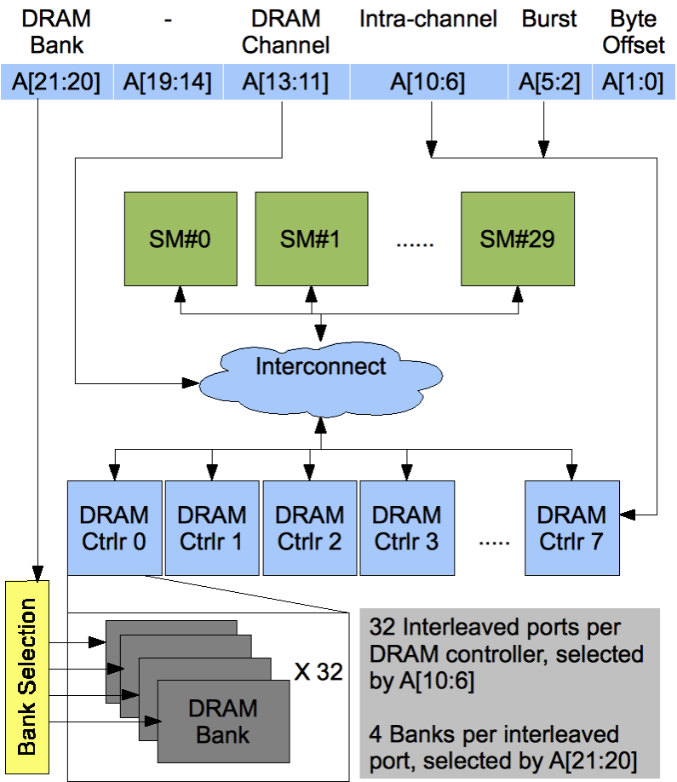
Atomic Operations on DRAM
An atomic operation starts with a read, with a latency of a few hundred cycles

Slide 30
Atomic Operations on DRAM
An atomic operation starts with a read, with a latency of a few hundred cycles
The atomic operation ends with a write, with a latency of a few hundred cycles
During this whole time, no one else can access the location

Slide 31
Atomic Operations on DRAM
Each Load-Modify-Store has two full memory access delays
  All atomic operations on the same variable (RAM location) are serialized
time
internal routing
internal routing
DRAM delay
DRAM delay
DRAM delay
..
transfer delay
transfer delay
atomic operation N
atomic operation N+1

Slide 32
Latency determines throughput of atomic operations
Throughput of an atomic operation is the rate at which the application can execute an atomic operation on a particular location.
The rate is limited by the total latency of the read-modify-write sequence, typically more than 1000 cycles for global memory (DRAM) locations.
This means that if many threads attempt to do atomic operation on the same location (contention), the memory bandwidth is reduced to < 1/1000!

Slide 33
You may have a similar experience in supermarket checkout
Some customers realize that they missed an item after they started to check out
They run to the isle and get the item while the line waits
  The rate of check is reduced due to the long latency of running to the isle and back.
Imagine a store where every customer starts the check out before they even fetch any of the items
  The rate of the checkout will be 1 / (entire shopping time of each customer)

Slide 34
Hardware Improvements (cont.)
Atomic operations on Fermi L2 cache
  medium latency, but still serialized
  Global to all blocks
  “Free improvement” on Global Memory atomics
time
internal routing
..
data transfer
data transfer
atomic operation N
atomic operation N+1

Slide 35
Hardware Improvements
Atomic operations on Shared Memory
  Very short latency, but still serialized
  Private to each thread block
  Need algorithm work by programmers (more later)
time
internal routing
..
data transfer
atomic operation N
atomic operation N+1

Slide 36
Atomics in Shared Memory Requires Privatization
Create private copies of the histo[] array for each thread block
__global__ void histo_kernel(unsigned char *buffer,
long size, unsigned int *histo)
{
__shared__ unsigned int histo_private[256];
if (threadIdx.x < 256) histo_private[threadidx.x] = 0;
__syncthreads();

Slide 37
Build Private Histogram
int i = threadIdx.x + blockIdx.x * blockDim.x;
// stride is total number of threads
int stride = blockDim.x * gridDim.x;
while (i < size) {
atomicAdd( &(histo_private[buffer[i]), 1);
i += stride;
}

Slide 38
Build Final Histogram
// wait for all other threads in the block to finish
__syncthreads();
if (threadIdx.x < 256)
atomicAdd( &(histo[threadIdx.x]), histo_private[threadIdx.x] );
}

Slide 39
More on Privatization
Privatization is a powerful and frequently used techniques for parallelizing applications
The operation needs to be associative and commutative
  Histogram add operation is associative and commutative
The histogram size needs to be small
  Fits into shared memory
What if the histogram is too large to privatize?

Slide 40
Other Atomic operations
atomicCAS (int *p, int cmp, int val)
  CAS = compare and swap
    //atomically perform the following
    int old = *p;
    if(cmp == old) *p = v;
    return old;
AtomicExch – unconditional version of CAS
    int old = *p;
    *p = v;
    return old
What are these used for?

Slide 41
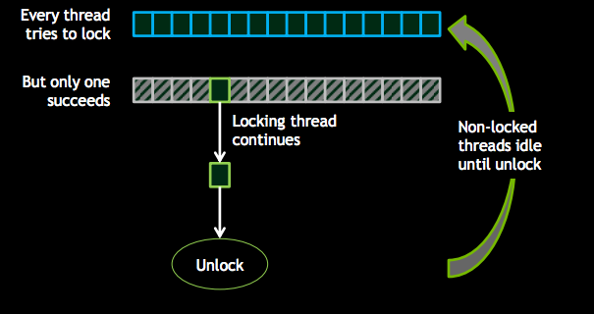
Locking causes control divergence in GPUs
Divergence deadlock if locking thread idles

Slide 42
Alternatives to locking?
Lock-free algorithms/data structures
  Update a private copy
  Try to atomically update a global data structure using compare and swap or similar
  Retry if failed
  Need data structures that support this kind of operation
Wait-free algorithms/data structures
  Similar to histogramming – don’t wait, but atomic update
  But applies only to some algorithms

Slide 43
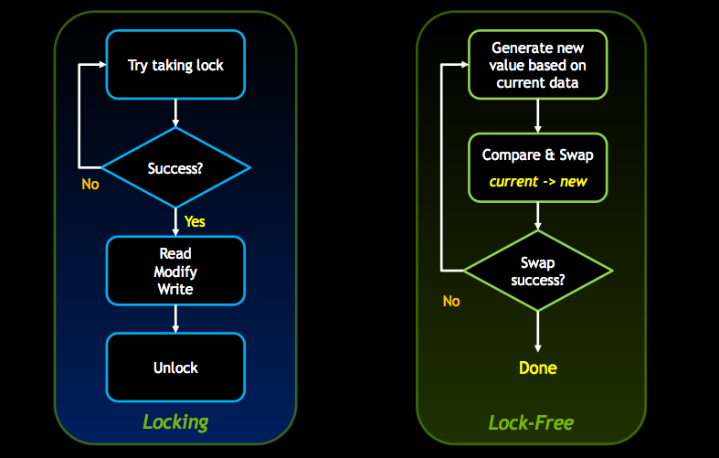
Lock free vs. locking
Example from Nvidia presentation at GTC 2013

Slide 44
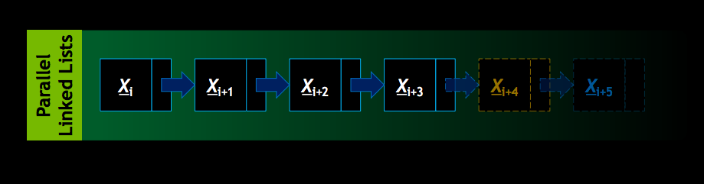
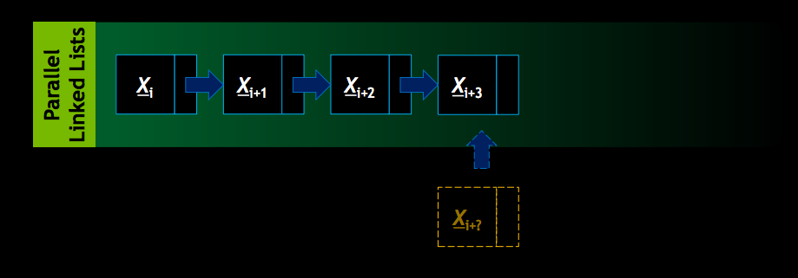
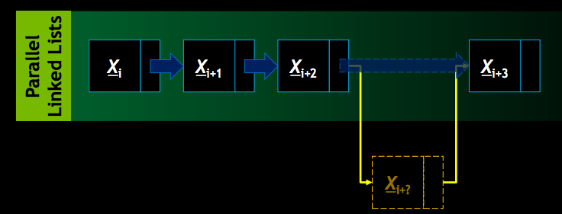
Parallel Linked List Example

Slide 45
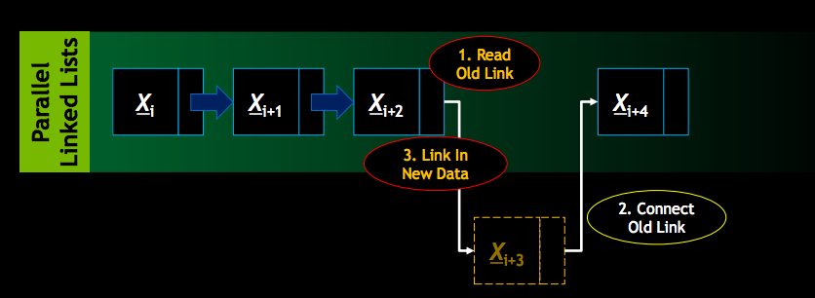

Slide 46
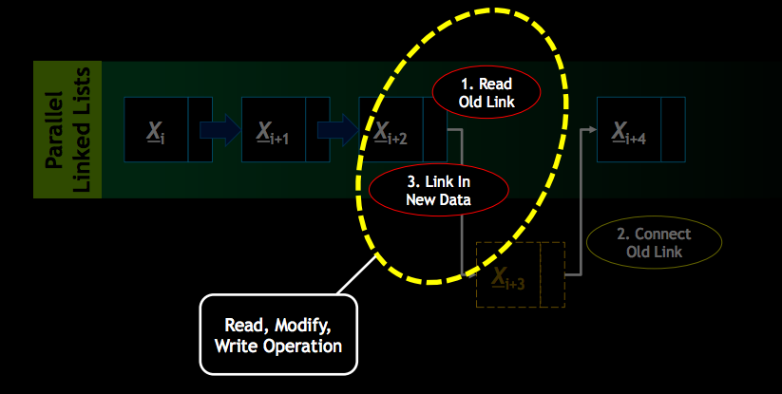

Slide 47
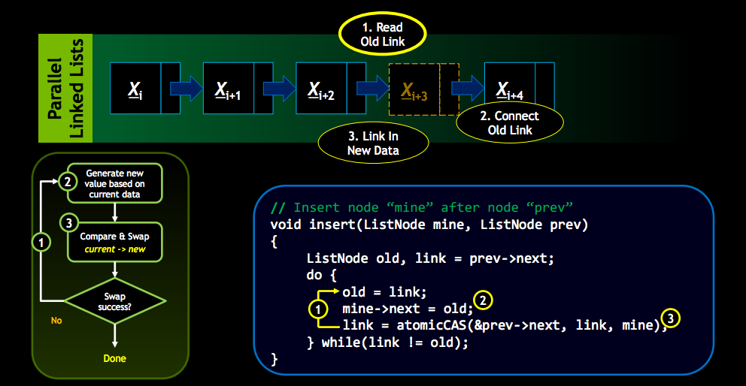

Slide 48
ANY MORE QUESTIONS?

