Slide 1
CS/EE217
GPU Architecture and Parallel Programming
Lecture 8
Parallel Computation Patterns – Parallel Scan (Prefix Sum)

Slide 2
Objective
To master parallel Scan (Prefix Sum) algorithms
  frequently used for parallel work assignment and resource allocation
  A key primitive to in many parallel algorithms to convert serial computation into parallel computation
  Based on reduction tree and reverse reduction tree
To learn the concept of double buffering

Slide 3
(Inclusive) Scan (Prefix-Sum) Definition
Definition: The scan operation takes a binary associative operator ⊕, and an array of n elements
[x₀, x₁, …, x_{n-1}],
and returns the prefix-sum array
[x₀, (x₀ ⊕ x₁), …, (x₀ ⊕ x₁ ⊕ … ⊕ x_{n-1})].
Example: If ⊕ is addition, then the scan operation on the array [3 1 7 0 4 1 6 3],
would return [3 4 11 11 15 16 22 25].

Slide 4
A Inclusive Scan Application Example
Assume that we have a 100-inch bread to feed 10
We know how much each person wants in inches
  [3 5 2 7 28 4 3 0 8 1]
How do we cut the bread quickly?
How much will be left
Method 1: cut the sections sequentially: 3 inches first, 5 inches second, 2 inches third, etc.
Method 2: calculate prefix-sum array
  [3, 8, 10, 17, 45, 49, 52, 52, 60, 61] (39 inches left)

Slide 5
Typical Applications of Scan
Scan is a simple and useful parallel building block
  Convert recurrences from sequential :
  for(j=1;j<n;j++) out[j] = out[j-1] + f(j);
  into parallel:
  forall(j) { temp[j] = f(j) };
  scan(out, temp);
Useful for many parallel algorithms:
radix sort
quicksort
String comparison
Lexical analysis
Stream compaction
Polynomial evaluation
Solving recurrences
Tree operations
Histograms
Etc.

Slide 6
Other Applications
Assigning camp slots
Assigning farmer market space
Allocating memory to parallel threads
Allocating memory buffer to communication channels
…

Slide 7
An Inclusive Sequential Scan
Given a sequence [x₀, x₁, x₂, ... ]
Calculate output [y₀, y₁, y₂, ... ]
Such that y₀ = x₀
y₁ = x₀ + x₁
y₂ = x₀ + x₁+ x₂
…
Using a recursive definition
y_{i} = y_{i − 1} + x_{i}

Slide 8
An Sequential C Implementation
y[0] = x[0];
for (i = 1; i < Max_i; i++) y[i] = y [i-1] + x[i];
Computationally efficient:
N additions needed for N elements - O(N)!

Slide 9
A Naïve Inclusive Parallel Scan
Assign one thread to calculate each y element
Have every thread to add up all x elements needed for the y element
y₀ = x₀
y₁ = x₀ + x₁
y₂ = x₀ + x₁+ x₂
“Parallel programming is easy as long as you do not care about performance.”

Slide 10
Parallel Inclusive Scan using
Reduction Trees
Calculate each output element as the reduction of all previous elements
  Some reduction partial sums will be shared among the calculation of output elements
  Based on hardware added design by Peter Kogge and Harold Stone at IBM in the 1970s – Kogge-Stone Trees

Slide 11
A Slightly Better Parallel Inclusive Scan Algorithm
T | 3 | 1 | 7 | 0 | 4 | 1 | 6 | 3
Load input from
global memory into
shared memory array T
Each thread loads one value from the input
(global memory) array into shared memory array T.

Slide 12
A Kogge-Stone Parallel Scan Algorithm
T | 3 | 1 | 7 | 0 | 4 | 1 | 6 | 3
(previous slide)
Iterate log(n)
times, stride from 1 to ceil(n/2.0). Threads stride to n-1 active: add pairs of elements that are stride elements apart.
Stride = 1
T | 3 | 4 | 8 | 7 | 4 | 5 | 7 | 9
Thread 5
Active threads: stride to n-1 (n-stride threads)
Thread j adds elements j and j-stride from T and writes result into shared memory buffer T
Each iteration requires two syncthreads
  syncthreads(); // make sure that input is in place
  float temp = T[j] + T[k - stride];
Iteration #1
Stride = 1

Slide 13
A Kogge-Stone Parallel Scan Algorithm
T | 3 | 1 | 7 | 0 | 4 | 1 | 6 | 3
(previous slide)
Iterate log(n)
times, stride from 1 to ceil(n/2.0). Threads stride to n-1 active: add pairs of elements that are stride elements apart.
Stride = 1
T | 3 | 4 | 8 | 7 | 4 | 5 | 7 | 9
Active threads: stride to n-1 (n-stride threads)
Thread j adds elements j and j-stride from T and writes result into shared memory buffer T
Each iteration requires two syncthreads
  syncthreads(); // make sure that input is in place
  float temp = T[j] + T[j - stride];
  syncthreads(); // make sure that previous output has been consumed
  T[j] = temp;
Iteration #1
Stride = 1

Slide 14
A Kogge-Stone Parallel Scan Algorithm
T | 3 | 1 | 7 | 0 | 4 | 1 | 6 | 3
…
Iterate log(n)
times, stride from 1 to ceil(n/2.0). Threads stride to n-1 active: add pairs of elements that are stride elements apart.
Stride = 1
T | 3 | 4 | 8 | 7 | 4 | 5 | 7 | 9
Stride = 2
T | 3 | 4 | 11 | 11 | 12 | 12 | 11 | 14
Iteration #2
Stride = 2

Slide 15
A Kogge-Stone Parallel Scan Algorithm
T | 3 | 1 | 7 | 0 | 4 | 1 | 6 | 3
Load input from
global memory to
shared memory.
Iterate log(n)
times, stride from 1 to ceil(n/2.0). Threads stride to n-1 active: add pairs of elements that are stride elements apart.
Write output from shared memory to device memory
Stride = 1
T | 3 | 4 | 8 | 7 | 4 | 5 | 7 | 9
Stride = 2
T | 3 | 4 | 11 | 11 | 12 | 12 | 11 | 14
Stride = 4
T | 3 | 4 | 11 | 11 | 15 | 16 | 22 | 25
Iteration #3
Stride = 4

Slide 16
Double Buffering
Use two copies of data T0 and T1
Start by using T0 as input and T1 as output
Switch input/output roles after each iteration
  Iteration 0: T0 as input and T1 as output
  Iteration 1: T1 as input and T0 and output
  Iteration 2: T0 as input and T1 as output
This is typically implemented with two pointers, source and destination that swap their contents from one iteration to the next
This eliminates the need for the second syncthreads

Slide 17
A Double-Buffered
Kogge-Stone Parallel Scan Algorithm
T0 | 3 | 1 | 7 | 0 | 4 | 1 | 6 | 3
(previous slide)
Iterate log(n)
times, stride from 1 to ceil(n/2.0). Threads stride to n-1 active: add pairs of elements that are stride elements apart.
Stride = 1
T1 | 3 | 4 | 8 | 7 | 4 | 5 | 7 | 9
Thread 5
Active threads: stride to n-1 (n-stride threads)
Thread j adds elements j and j-stride from T and writes result into shared memory buffer T
Each iteration requires only one syncthreads
  syncthreads(); // make sure that input is in place
  float destination[j] = source[j] + source[j - stride];
  temp = destination; destination = source; source = temp;
Iteration #1
Stride = 1

Slide 18
Work Efficiency Analysis
A Kogge-Stone scan kernel executes log(n) parallel iterations
  The steps do (n-1), (n-2), (n-4),..(n- n/2) add operations each
  Total # of add operations: n * log(n) - (n-1) → O(n*log(n)) work
This scan algorithm is not very work efficient
  Sequential scan algorithm does n adds
  A factor of log(n) hurts: 20x for 1,000,000 elements!
  Typically used within each block, where n ≤ 1,024
A parallel algorithm can be slow when execution resources are saturated due to low work efficiency

Slide 19
Objective
To master parallel scan (prefix sum) algorithms
  Work-efficiency vs. latency
  Brent-Kung Tree Algorithm
  Hierarchical algorithms

Slide 20
A Kogge-Stone Parallel Scan Algorithm
T | 3 | 1 | 7 | 0 | 4 | 1 | 6 | 3
Stride = 1
T | 3 | 4 | 8 | 7 | 4 | 5 | 7 | 9
Stride = 2
T | 3 | 4 | 11 | 11 | 12 | 12 | 11 | 14
Stride = 4
T | 3 | 4 | 11 | 11 | 15 | 16 | 22 | 25

Slide 21
Improving Efficiency
A common parallel algorithm pattern:
Balanced Trees
  Build a balanced binary tree on the input data and sweep it to and from the root
  Tree is not an actual data structure, but a concept to determine what each thread does at each step
For scan:
  Traverse down from leaves to root building partial sums at internal nodes in the tree
    Root holds sum of all leaves
  Traverse back up the tree building the scan from the partial sums

Slide 22
Brent-Kung Parallel Scan
- Reduction Step
x₀
x₁
x₂
x₃
x₄
x₅
x₆
x₇
+
+
+
+
Time
∑x_{0..}x₁
∑x_{2..}x₃
∑x_{4..}x₅
∑x_{6..}x₇
+
+
∑x_{0..}x₃
∑x_{4..}x₇
+
In place calculation
∑x_{0..}x₇
Final value after reduce

Slide 23
Inclusive Post Scan Step
x₀
∑x_{0..}x₁
x₂
∑x_{0..}x₃
x₄
∑x_{4..}x₅
x₆
∑x_{0..}x₇
+
∑x_{0..}x₅
Move (add) a critical value to a central location where it is needed

Slide 24
Inclusive Post Scan Step
x₀
∑x_{0..}x₁
x₂
∑x_{0..}x₃
x₄
∑x_{4..}x₅
x₆
∑x_{0..}x₇
+
∑x_{0..}x₅
+
+
+
∑x_{0..}x₂
∑x_{0..}x₄
∑x_{0..}x₆

Slide 25
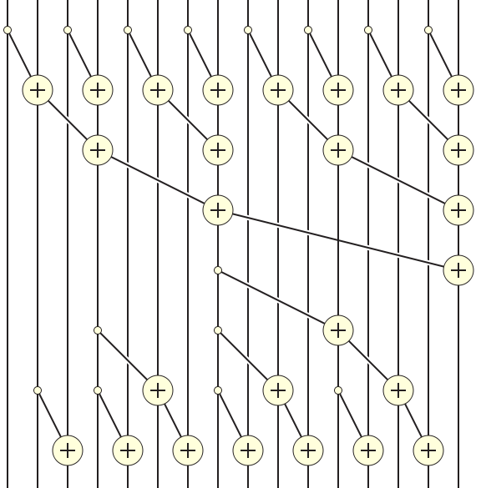
Putting it Together

Slide 26
Reduction Step Kernel Code
// float T[BLOCK_SIZE] is in shared memory
int stride = 1;
while(stride < BLOCK_SIZE)
{
int index = (threadIdx.x+1)*stride*2 - 1;
if(index < BLOCK_SIZE)
scan_array[index] += scan_array[index-stride];
stride = stride*2;
__syncthreads();
}

Slide 27
Reduction Step Kernel Code
// float T[BLOCK_SIZE] is in shared memory
int stride = 1;
while(stride < BLOCK_SIZE)
{
int index = (threadIdx.x+1)*stride*2 - 1;
if(index < BLOCK_SIZE)
T[index] += T[index-stride];
stride = stride*2;
__syncthreads();
}
// threadIdx.x+1 = 1, 2, 3, 4….
// stride = 1, index =

Slide 28
Putting it together

Slide 29
Post Scan Step
int stride = BLOCK_SIZE/2;
while(stride > 0)
{
int index = (threadIdx.x+1)*stride*2 - 1;
if(index < BLOCK_SIZE)
{
T[index+stride] += T[index];
}
stride = stride / 2;
__syncthreads();
}

Slide 30
Work Analysis
The parallel Inclusive Scan executes 2* log(n) parallel iterations
  log(n) in reduction and log(n) in post scan
  The iterations do n/2, n/4,..1, 1, …., n/4. n/2 adds
  Total adds: 2* (n-1) → O(n) work
The total number of adds is no more than twice of that done in the efficient sequential algorithm
  The benefit of parallelism can easily overcome the 2X work when there is sufficient hardware

Slide 31
A couple of details
Brent-Kung uses half the number of threads compared to Kogge-Stone
  Each thread should load two elements into the shared memory
Brent-Kung takes twice the number of steps compared to Kogge-Stone
  Kogge-Stone is more popular for parallel scan with blocks in GPUs

Slide 32
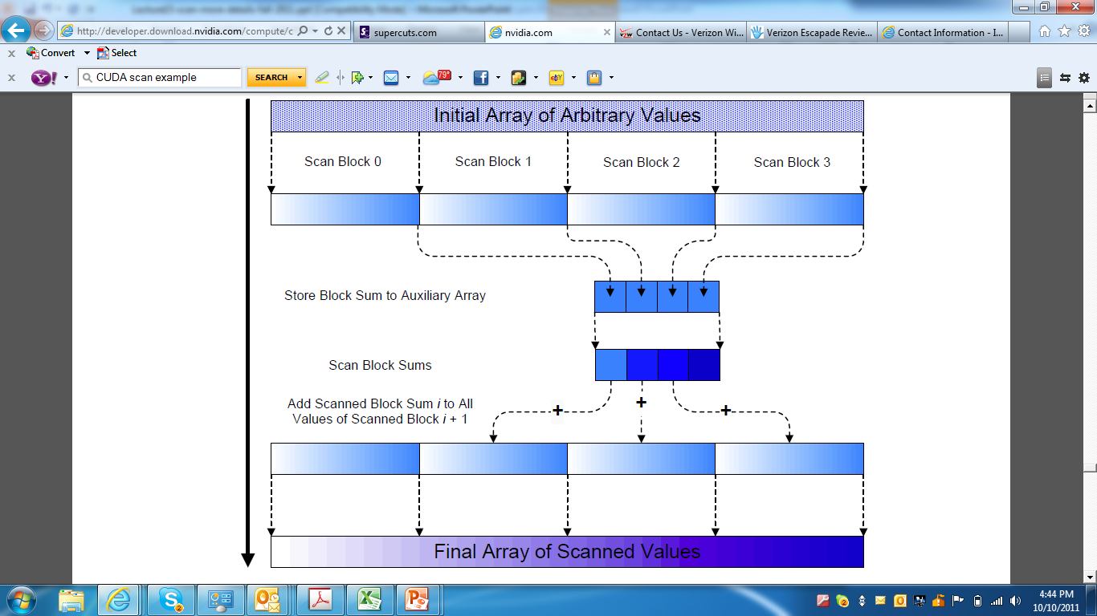
Overall Flow of Complete Scan
A Hierarchical Approach

Slide 33
Using Global Memory Contents in CUDA
Data in registers and shared memory of one thread block are not visible to other blocks
To make data visible, the data has to be written into global memory
However, any data written to the global memory are not visible until a memory fence. This is typically done by terminating the kernel execution
Launch another kernel to continue the execution. The global memory writes done by the terminated kernels are visible to all thread blocks.

Slide 34
Overall Flow of Complete Scan
A Hierarchical Approach
Kernel
Kernel
Kernel

Slide 35
Working on Arbitrary Length Input
Build on the scan kernel that handles up to 2*blockDim.x elements
For Kogge-Stone, have each section of blockDim.x elements assigned to a block
Have each block write the sum of its section into a Sum array indexed by blockIdx.x
Run parallel scan on the Sum array
  May need to break down Sum into multiple sections if it is too big for a block
Add the scanned Sum array values to the elements of corresponding sections

Slide 36
(Exclusive) Scan Definition
Definition: The exclusive scan operation takes a binary associative operator ⊕, and an array of n elements
[x₀, x₁, …, x_{n-1}]
and returns the array
[0, x₀, (x₀ ⊕ x₁), …, (x₀ ⊕ x₁ ⊕ … ⊕ x_{n-2})].
Example: If ⊕ is addition, then the exclusive scan operation on [3 1 7 0 4 1 6 3],
would return [0 3 4 11 11 15 16 22].

Slide 37
Why Exclusive Scan
To find the beginning address of allocated buffers
Inclusive and Exclusive scans can be easily derived from each other; it is a matter of convenience
[3 1 7 0 4 1 6 3]
Exclusive [0 3 4 11 11 15 16 22]
Inclusive [3 4 11 11 15 16 22 25]

Slide 38
An Exclusive Post Scan Step
(Add-move Operation)
x₀
∑x_{0..}x₁
x₂
∑x_{0..}x₃
x₄
∑x_{4..}x₅
x₆
0
0
+
∑x_{0..}x₃

Slide 39
Exclusive Post Scan Step
x₀
∑x_{0..}x₁
x₂
∑x_{0..}x₃
x₄
∑x_{4..}x₅
x₆
0
0
+
∑x_{0..}x₃
+
+
0
∑x_{0..}x₁
∑x_{0..}x₃
∑x_{0..}x₅
+
+
+
+
0
x₀
∑x_{0..}x₁
∑x_{0..}x₂
∑x_{0..}x₃
∑x_{0..}x₄
∑x_{0..}x₅
∑x_{0..}x₆

Slide 40
Exclusive Post Scan Step
if (threadIdx.x == 0) T[2*blockDim.x-1] = 0;
int stride = BLOCK_SIZE;
while(stride > 0)
{
int index = (threadIdx.x+1)*stride*2 - 1;
if(index < 2* BLOCK_SIZE)
{
float temp = T[index+stride];
T[index+stride] += T[index];
T[index] = temp;
}
stride = stride / 2;
__syncthreads();
}

Slide 41
Exclusive Scan Example – Reduction Step
T | 3 | 1 | 7 | 0 | 4 | 1 | 6 | 3
Assume array is already in shared memory

Slide 42
Reduction Step (cont.)
T | 3 | 1 | 7 | 0 | 4 | 1 | 6 | 3
Stride 1
Iteration 1, n/2 threads
T | 3 | 4 | 7 | 7 | 4 | 5 | 6 | 9
Each corresponds to a single thread.
Iterate log(n) times. Each thread adds value stride elements away to its own value

Slide 43
Reduction Step (cont.)
T | 3 | 1 | 7 | 0 | 4 | 1 | 6 | 3
Stride 1
T | 3 | 4 | 7 | 7 | 4 | 5 | 6 | 9
Stride 2
Iteration 2, n/4 threads
T | 3 | 4 | 7 | 11 | 4 | 5 | 6 | 14
Each corresponds to a single thread.
Iterate log(n) times. Each thread adds value stride elements away to its own value

Slide 44
Reduction Step (cont.)
T | 3 | 1 | 7 | 0 | 4 | 1 | 6 | 3
Stride 1
T | 3 | 4 | 7 | 7 | 4 | 5 | 6 | 9
Stride 2
T | 3 | 4 | 7 | 11 | 4 | 5 | 6 | 14
Stride 4
Iteration log(n), 1 thread
T | 3 | 4 | 7 | 11 | 4 | 5 | 6 | 25
Each corresponds to a single thread.
Iterate log(n) times. Each thread adds value stride elements away to its own value.
Note that this algorithm operates in-place: no need for double buffering

Slide 45
Zero the Last Element
T | 3 | 4 | 7 | 11 | 4 | 5 | 6 | 0
We now have an array of partial sums. Since this is an exclusive scan,
set the last element to zero. It will propagate back to the first element.
Notes:
WMH: Does the work efficiency really matter? It seems that as long as the resources are not saturated, the less
Efficit algorithm may even run faster because it takes log(N) steps rather than 2*log(N)

Slide 46
Post Scan Step from Partial Sums
T | 3 | 4 | 7 | 11 | 4 | 5 | 6 | 0

Slide 47
Post Scan Step from Partial Sums (cont.)
T | 3 | 4 | 7 | 11 | 4 | 5 | 6 | 0
Stride 4
Iteration 1
1 thread
T | 3 | 4 | 7 | 0 | 4 | 5 | 6 | 11
Each corresponds to a single thread.
Iterate log(n) times. Each thread adds value stride elements away to its own value,
and sets the value stride elements away to its own previous value.

Slide 48
Post Scan From Partial Sums (cont.)
T | 3 | 4 | 7 | 11 | 4 | 5 | 6 | 0
Stride 4
T | 3 | 4 | 7 | 0 | 4 | 5 | 6 | 11
Stride 2
Iteration 2
2 threads
T | 3 | 0 | 7 | 4 | 4 | 11 | 6 | 16
Each corresponds to a single thread.
Iterate log(n) times. Each thread adds value stride elements away to its own value,
and sets the value stride elements away to its own previous value.

Slide 49
Post Scan Step From Partial Sums (cont.)
T | 3 | 4 | 7 | 11 | 4 | 5 | 6 | 0
Stride 4
T | 3 | 4 | 7 | 0 | 4 | 5 | 6 | 11
Stride 2
T | 3 | 0 | 7 | 4 | 4 | 11 | 6 | 16
Stride 1
Iteration log(n)
n/2 threads
T | 0 | 3 | 4 | 11 | 11 | 15 | 16 | 22
Each corresponds to a single thread.
Done! We now have a completed scan that we can write out to device memory.
Total steps: 2 * log(n).
Total work: 2 * (n-1) adds = O(n) Work Efficient!

Slide 50
A simpler exclusive scan kernel
Adapt an inclusive, work in-efficient scan kernel
Block 0:
  Thread 0 loads 0 into XY[0]
  Other threads load X[threadIdx.x-1] into XY[threadIdx.x]
All other blocks:
  All thread load X[blockIdx.x*blockDim.x+threadIdx.x-1] into XY[threadIdex.x]
Similar adaption for Brent-Kung kernel but pay attention that each thread loads two elements
  Only one zero should be loaded
  All elements should be shifted by only one position
Intellectual contribution vs. practical contribution

Slide 51
Any More Questions?
Read Chapter 8

