Slide 1
CS/EE 217: GPU Architecture and Parallel Programming
Convolution, (with a side of Constant Memory and Caching)

Slide 2
Objective
To learn convolution, an important parallel computation pattern
  Widely used in signal, image and video processing
  Foundational to stencil computation used in many science and engineering
Taking advantage of cache memories

Slide 3
Convolution Applications
A popular array operation used in signal processing, digital recording, image processing, video processing, and computer vision.
Convolution is often performed as a filter that transforms signals and pixels into more desirable values.
  Some filters smooth out the signal values so that one can see the big-picture trend
  Others like Gaussian filters can be used to sharpen boundaries and edges of objects in images..

Slide 4
Convolution Computation
An array operation where each output data element is a weighted sum of a collection of neighboring input elements
The weights used in the weighted sum calculation are defined by an input mask array, commonly referred to as the convolution kernel
  We will refer to these mask arrays as convolution masks to avoid confusion.
  The same convolution mask is typically used for all elements of the array.

Slide 5

Convolution definition
Convolution is to compute the response of linear time invariant system f(t)
for the given input signal g(t).
F(s)
G(s)
G(s)*F(s)
In frequency domain

Slide 6
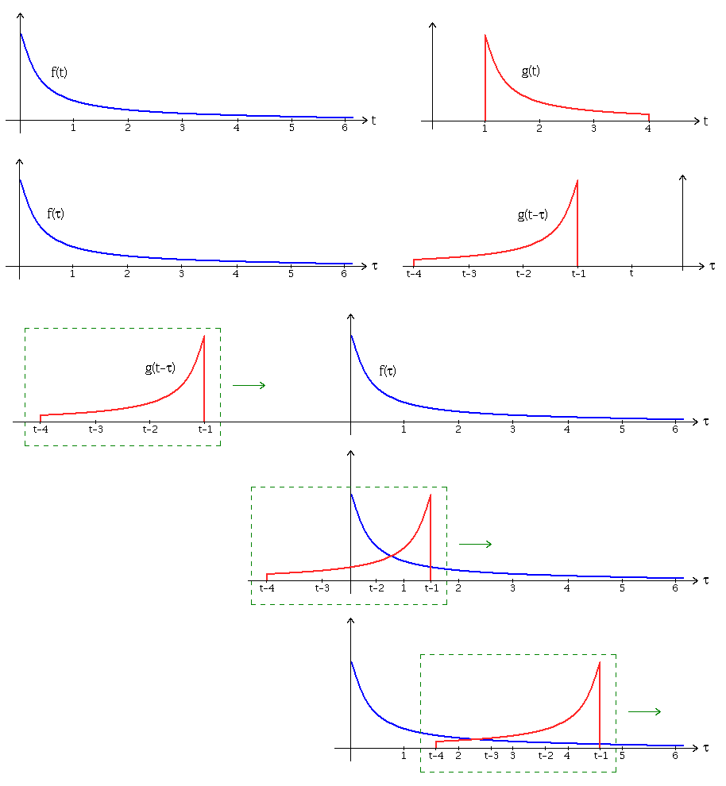
Convolution operation
From the Wikipedia page on convolution

Slide 7
1D Convolution Example
Commonly used for audio processing
  Mask size is usually an odd number of elements for symmetry (5 in this example)
Calculation of P[2]
N
N[0]
N[1]
N[2]
N[3]
N[4]
N[5]
N[6]
P
P[0]
P[1]
P[2]
P[3]
P[4]
P[5]
P[6]
1
2
3
4
5
6
7
3
8
57
16
15
3
3
M
M[0]
M[1]
M[2]
M[3]
M[4]
3
4
5
4
3
3
8
15
16
15

Slide 8
1D Convolution Example
- more on inside elements
Calculation of P[3]
N
N[0]
N[1]
N[2]
N[3]
N[4]
N[5]
N[6]
P
P[0]
P[1]
P[2]
P[3]
P[4]
P[5]
P[6]
1
2
3
4
5
6
7
3
8
57
76
15
3
3
M
M[0]
M[1]
M[2]
M[3]
M[4]
3
4
5
4
3
6
12
20
20
18

Slide 9
1D Convolution Boundary Condition
Calculation of output elements near the boundaries (beginning and end) of the input array need to deal with “ghost” elements
  Different policies (0, replicates of boundary values, etc.)
N
N[0]
N[1]
N[2]
N[3]
N[4]
N[5]
N[6]
P
P[0]
P[1]
P[2]
P[3]
P[4]
P[5]
P[6]
0
1
2
3
4
5
6
7
3
38
57
16
15
3
3
Filled in
M
M[0]
M[1]
M[2]
M[3]
M[4]
3
4
5
4
3
0
4
10
12
12

Slide 10
A 1D Convolution Kernel with Boundary Condition Handling
This kernel forces all elements outside the image to 0
__global__ void convolution_1D_basic_kernel(float *N, float *M, float *P,
int Mask_Width, int Width) {
int i = blockIdx.x*blockDim.x + threadIdx.x;
float Pvalue = 0;
int N_start_point = i - (Mask_Width/2);
for (int j = 0; j < Mask_Width; j++) {
if (N_start_point + j >= 0 && N_start_point + j < Width) {
Pvalue += N[N_start_point + j]*M[j];
}
}
P[i] = Pvalue;
}

Slide 11
2D Convolution
N
P
1
2
3
4
5
6
7
1
2
3
4
5
2
3
4
5
6
7
8
2
3
4
5
6
3
4
5
6
7
8
9
3
4
321
6
7
4
5
6
7
8
5
6
4
5
6
7
8
5
6
7
8
5
6
7
5
6
7
8
5
6
7
8
9
0
1
2
7
8
9
0
1
2
3
M
1
4
9
8
5
1
2
3
2
1
4
9
16
15
12
2
3
4
3
2
3
4
5
4
3
9
16
25
24
21
2
3
4
3
2
8
15
24
21
16
1
2
3
2
1
5
12
21
16
5

Slide 12
2D Convolution Boundary Condition
N
P
1
2
3
4
5
6
7
1
2
3
4
5
2
3
4
5
6
7
8
112
3
4
5
6
3
4
5
6
7
8
9
3
4
5
6
7
4
5
6
7
8
5
6
4
5
6
7
8
5
6
7
8
5
6
7
5
6
7
8
5
6
7
8
9
0
1
2
7
8
9
0
1
2
3
M
0
0
0
0
0
1
2
3
2
1
0
0
4
6
6
2
3
4
3
2
3
4
5
4
3
0
0
10
12
12
2
3
4
3
2
0
0
12
12
10
1
2
3
2
1
0
0
12
10
6

Slide 13
2D Convolution – Ghost Cells
0
0
0
0
0
N
P
0
3
4
5
6
0
2
3
4
5
0
3
5
6
7
179
0
1
1
3
1
0
0
0
0
0
1
2
3
2
1
0
9
16
15
12
0
ghost cells
2
3
4
3
2
3
4
5
4
3
0
8
15
16
15
(apron cells, halo cells)
M
2
3
4
3
2
0
9
20
18
14
1
2
3
2
1
0
2
3
6
1

Slide 14
Access Pattern for M
M is referred to as mask (a.k.a. kernel, filter, etc.)
  Elements of M are called mask (kernel, filter) coefficients
Calculation of all output P elements need M
M is not changed during kernel
Bonus - M elements are accessed in the same order when calculating all P elements
M is a good candidate for Constant Memory

Slide 15
Programmer View of CUDA Memories
(Review)
Each thread can:
  Read/write per-thread registers (~1 cycle)
  Read/write per-block shared memory (~5 cycles)
  Read/write per-grid global memory (~500 cycles)
  Read/only per-grid constant memory (~5 cycles with caching)
Grid
Block (0, 0)
Block (1, 0)
Shared Memory/L1 cache
Shared Memory/L1 cache
Registers
Registers
Registers
Registers
Thread (0, 0)
Thread (1, 0)
Thread (0, 0)
Thread (1, 0)
Host
Global Memory
Constant Memory
Notes:
Global, constant, and texture memory spaces are persistent across kernels called by the same application.

Slide 16
Memory Hierarchies
If every time we needed a piece of data, we had to go to main memory to get it, computers would take a lot longer to do anything
On today’s processors, main memory accesses take hundreds of cycles
One solution: Caches
Notes:
Use backpack analogy

Slide 17
Cache - Cont’d
In order to keep cache fast, it needs to be small, so we cannot fit the entire data set in it
The chip
Processor
regs
L1 Cache
L2 Cache
Main Memory
Notes:
Use back pack analogy here

Slide 18
Cache - Cont’d
Cache is unit of volatile memory storage
A cache is an “array” of cache lines
Cache line can usually hold data from several consecutive memory addresses
When data is requested from memory, an entire cache line is loaded into the cache, in an attempt to reduce main memory requests
Notes:
Cache is transparent vs scratchpad which isn’t

Slide 19
Caches - Cont’d
Some definitions:
  Spatial locality: is when the data elements stored in consecutive memory locations are access consecutively
  Temporal locality: is when the same data element is access multiple times in short period of time
Both spatial locality and temporal locality improve the performance of caches

Slide 20
Scratchpad vs. Cache
Scratchpad (shared memory in CUDA) is another type of temporary storage used to relieve main memory contention.
In terms of distance from the processor, scratchpad is similar to L1 cache.
Unlike cache, scratchpad does not necessarily hold a copy of data that is also in main memory
It requires explicit data transfer instructions, whereas cache doesn’t

Slide 21
Cache Coherence Protocol
A mechanism for caches to propagate updates by their local processor to other caches (processors)
The chip
Processor
Processor
Processor
regs
regs
…
regs
L1 Cache
L1 Cache
L1 Cache
Main Memory
Notes:
Use back pack analogy here.
n computing, cache coherence refers to the consistency of data stored in local caches of a shared resource.
When clients in a system maintain caches of a common memory resource, problems may arise with inconsistent data. This is particularly true of CPUs in a multiprocessing system. Referring to the "Multiple Caches of Shared Resource" figure, if the top client has a copy of a memory block from a previous read and the bottom client changes that memory block, the top client could be left with an invalid cache of memory without any notification of the change. Cache coherence is intended to manage such conflicts and maintain consistency between cache and memory.

Slide 22
CPU and GPU have different caching philosophy
CPU L1 caches are usually coherent
  L1 is also replicated for each core
  Even data that will be changed can be cached in L1
  Updates to local cache copy invalidates (or less commonly updates) copies in other caches
  Expensive in terms of hardware and disruption of services (cleaning bathrooms at airports..)
GPU L1 caches are usually incoherent
  Avoid caching data that will be modified

Slide 23
How to Use Constant Memory
Host code allocates, initializes variables the same way as any other variables that need o be copied to the device
Use cudaMemcpyToSymbol(dest, src, size) to copy the variable into the device memory
This copy function tells the device that the variable will not be modified by the kernel and can be safely cached.

Slide 24
More on Constant Caching
Each SM has its own L1 cache
  Low latency, high bandwidth access by all threads
However, there is no way for threads in one SM to update the L1 cache in other SMs
  No L1 cache coherence
Grid
Block (0, 0)
Block (1, 0)
Shared Memory/L1 cache
Shared Memory/L1 cache
Registers
Registers
Registers
Registers
Thread (0, 0)
Thread (1, 0)
Thread (0, 0)
Thread (1, 0)
Host
Global Memory
Constant Memory
This is not a problem if a variable is NOT modified by a kernel.
Notes:
Global, constant, and texture memory spaces are persistent across kernels called by the same application.

Slide 25
Using Constant memory
When declaring variables, use __const__ <type> restrict
For example:
__global__ void convolution_2D_kernel(float *P, float *N, int height, int width, int channels,
__const__ float restrict *M)
In this case, we are telling the compiler that M is constant and eligible for caching

Slide 26
Tiled Convolution

Slide 27
Objective
To learn about tiled convolution algorithms
  Some intricate aspects of tiling algorithms
  Output tiles versus input tiles

Slide 28
Tiled 1D Convolution Basic Idea
P
0
1
2
3
4
5
6
7
8
9
10
11
12
13
14
15
N
0
1
2
3
4
5
6
7
8
9
10
11
12
13
14
15
Tile 0
ghost
0
1
2
3
4
5
Tile 1
2
3
4
5
6
7
8
9
halo
Tile 2
6
7
8
9
10
11
12
13
Tile 3
10
11
12
13
14
15
ghost
Notes:
Elements that are involved in multiple tiles and loaded by multiple blocks are commonly referred to as halo elements. In this example, n = 2, the mask window size is 2n+1.

Slide 29
Loading the left halo
n = 2
N
0
1
2
3
4
5
6
7
8
9
10
11
12
13
14
15
halo_index_left = 2
i =6
N_ds
2
3
4
5
6
7
8
9
int n = Mask_Width/2;
int halo_index_left = (blockIdx.x - 1)*blockDim.x + threadIdx.x;
if (threadIdx.x >= blockDim.x - n) {
N_ds[threadIdx.x - (blockDim.x - n)] =
(halo_index_left < 0) ? 0 : N[halo_index_left];
}
Notes:
n is the half of the tile width n = Mask_width/2.
In the first statement, we map the thread index to the element index into the previous tile with the expression (blockIdx.x-1)*blockDim. x1+ threadIdx.x.
We then pick only the last n threads to load the needed left halo elements using the condition in the if statement. For example, In Figure 8.6, blockDim.x equals 4 and n equals 2;only threads 2 and 3 will be used. Threads 0 and 1 will not load any thing due to the failed condition.

Slide 30
Loading the internal elements
n = 2
N
0
1
2
3
4
5
6
7
8
9
10
11
12
13
14
15
halo = 2
i =6
N_ds
2
3
4
5
6
7
8
9
N_ds[n + threadIdx.x] = N[blockIdx.x*blockDim.x + threadIdx.x];
Notes:
n is the half of the tile width n = Mask_width/2. So for internal elements, we need to shift the position by n.

Slide 31
Loading the right halo
n = 2
N
0
1
2
3
4
5
6
7
8
9
10
11
12
13
14
15
i =6
halo_index_right = 10
N_ds
2
3
4
5
6
7
8
9
int halo_index_right = (blockIdx.x + 1)*blockDim.x + threadIdx.x;
if (threadIdx.x < n) {
N_ds[n + blockDim.x + threadIdx.x] =
(halo_index_right >= Width) ? 0 : N[halo_index_right];
}
Notes:
For the the right halo element, the position is shifted to n + blockDim, which is the mask width,.

Slide 32
__global__ void convolution_1D_basic_kernel(float *N, float *P, int Mask_Width,
int Width) {
int i = blockIdx.x*blockDim.x + threadIdx.x;
__shared__ float N_ds[TILE_SIZE + MAX_MASK_WIDTH - 1];
int n = Mask_Width/2;
int halo_index_left = (blockIdx.x - 1)*blockDim.x + threadIdx.x;
if (threadIdx.x >= blockDim.x - n) {
N_ds[threadIdx.x - (blockDim.x - n)] =
(halo_index_left < 0) ? 0 : N[halo_index_left];
}
N_ds[n + threadIdx.x] = N[blockIdx.x*blockDim.x + threadIdx.x];
int halo_index_right = (blockIdx.x + 1)*blockDim.x + threadIdx.x;
if (threadIdx.x < n) {
N_ds[n + blockDim.x + threadIdx.x] =
(halo_index_right >= Width) ? 0 : N[halo_index_right];
}
__syncthreads();
float Pvalue = 0;
for(int j = 0; j < Mask_Width; j++) {
Pvalue += N_ds[threadIdx.x + j]*M[j];
}
P[i] = Pvalue;
}
Notes:
Now, each thread will use the use N_ds[threadIdx.x] through N_ds[thread[Idx.x+Mask_Width-1]. Note that the halo elements has shift the N_ds element position by n already.

Slide 33
Shared Memory Data Reuse
N_ds
2
3
4
5
6
7
8
9
Mask_Width is 5
Element 2 is used by thread 4 (1X)
Element 3 is used by threads 4, 5 (2X)
Element 4 is used by threads 4, 5, 6 (3X)
Element 5 is used by threads 4, 5, 6, 7 (4X)
Element 6 is used by threads 4, 5, 6, 7 (4X)
Element 7 is used by threads 5, 6, 7 (3X)
Element 8 is used by threads 6, 7 (2X)
Element 9 is used by thread 7 (1X)

Slide 34
Ghost Cells
N
0
0
N[0]
N[1]
N[2]
N[3]
N[4]
N[5]
N[6]
0
0
P[0]
P[1]
P[2]
P[3]
P[4]
P[5]
P[6]

Slide 35
__global__ void convolution_1D_basic_kernel(float *N, float *P, int Mask_Width,
int Width) {
int i = blockIdx.x*blockDim.x + threadIdx.x;
__shared__ float N_ds[TILE_SIZE];
N_ds[threadIdx.x] = N[i];
__syncthreads();
int This_tile_start_point = blockIdx.x * blockDim.x;
int Next_tile_start_point = (blockIdx.x + 1) * blockDim.x;
int N_start_point = i - (Mask_Width/2);
float Pvalue = 0;
for (int j = 0; j < Mask_Width; j ++) {
int N_index = N_start_point + j;
if (N_index >= 0 && N_index < Width) {
if ((N_index >= This_tile_start_point)
&& (N_index < Next_tile_start_point)) {
Value += N_ds[threadIdx.x+j-(Mask_Width/2)]*M[j];
} else {
Pvalue += N[N_index] * M[j];
}
}
}
P[i] = Pvalue;
}
Notes:
Simple tiled 1D convolution – general caching or using L2 cache to avoid using halo elements. In this case, you need to read from both shared memory (N_ds) and the global memory N[] directly and hope N[] is cached in L2.
For statement: Value += N_ds[threadIdx.x+j-(Mask_Width/2)]*M[j]; the offset (Mask_Width/2) is needed as we compute the convolution from i–n to i+n for the N[i]

Slide 36
2D convolution with Tiling P
Use a thread block to calculate a tile of P
  Thread Block size determined by the TILE_SIZE

Slide 37
Tiling N
Each element in the tile is used in calculating up to MASK_SIZE * MASK_SIZE P elements (all elements in the tile)
3
4
5
6
7
3
4
5
6
7
3
4
5
6
7
2
3
4
5
6
2
3
4
5
6
2
3
4
5
6
1
2
3
4
5
1
2
3
4
5
1
2
3
4
5
2
3
5
6
7
2
3
5
6
7
2
3
5
6
7
0
1
1
3
1
0
1
1
3
1
0
1
1
3
1
3
4
5
6
7
3
4
5
6
7
3
4
5
6
7
2
3
4
5
6
2
3
4
5
6
2
3
4
5
6
1
2
3
4
5
1
2
3
4
5
1
2
3
4
5
2
3
5
6
7
2
3
5
6
7
2
3
5
6
7
0
1
1
3
1
0
1
1
3
1
0
1
1
3
1
Notes:
For instance, element 3 are used in the 6 examples (should include more). So in general, it is KERNEL_SIZE*KERNEL_SIZE

Slide 38
High-Level Tiling Strategy
Load a tile of N into shared memory (SM)
  All threads participate in loading
  A subset of threads then use each N element in SM
TILE_SIZE
KERNEL_SIZE
KERNEL_SIZE
TILE_SIZE

Slide 39
Output Tiling and Thread Index (P)
Use a thread block to calculate a tile of P
  Each output tile is of TILE_SIZE for both x and y
col_o = blockIdx.x * TILE_SIZE + tx;
row_o = blockIdx.y*TILE_SIZE + ty;

Slide 40
Input tiles need to be larger than output tiles.
3
4
5
6
7
2
3
4
5
6
1
2
3
4
5
2
3
5
6
7
Input Tile
0
1
1
3
1
Output Tile
3
4
5
6
7
2
3
4
5
6
1
2
3
4
5
2
3
5
6
7
0
1
1
3
1
Notes:
The reason for this is that we don’t use ghost elements in this case. Instead, we use concept of input tiles

Slide 41
Dealing with Mismatch
Use a thread block that matches input tile
  Each thread loads one element of the input tile
  Some threads do not participate in calculating output
    There will be if statements and control divergence

Slide 42
Setting up blocks
#define O_TILE_WIDTH 12
#define BLOCK_WIDTH (O_TILE_WIDTH + 4)
dim3 dimBlock (BLOCK_WIDTH, BLOCK_WIDTH);
dim3 dimGrid ((imageWidth – 1)/O_TILE_WIDTH + 1,
(imageHeight-1)/O_TILE_WIDTH+1, 1);
In general, block width = Tile width + mask width – 1;

Slide 43
Using constant memory for mask
Since mask is used by all threads and not modified:
  All threads in a warp access the same locations at every time
  Take advantage of the cachable constant memory!
  Magnify memory bandwidth without consuming shared memory
Syntax:
__global__ void convolution_2D_kernel (float *P,
*float N, height, width, channels,
const float __restrict__ *M) {

Slide 44
Shifting from output coordinates to input coordinates
Output tile
for thread (0,0)
Input tile
for thread (0,0)
Notes:
So the input tiles will cover the output tiles with mask_width/2 as the green boundary size.

Slide 45
Shifting from output coordinates to input coordinate
int tx = threadIdx.x;
int ty = threadIdx.y;
int row_o = blockIdx.y * TILE_SIZE + ty;
int col_o = blockIdx.x * TILE_SIZE + tx;
int row_i = row_o - 2; //MASK_SIZE/2
int col_i = col_o - 2; //MASK_SIZE/2

Slide 46
Threads that loads halos outside N should return 0.0

Slide 47
Taking Care of Boundaries
float output = 0.0f;
if((row_i >= 0) && (row_i < N.height) &&
(col_i >= 0) && (col_i < N.width) ) {
Ns[ty][tx] = N.elements[row_i*N.width + col_i];
}
else{
Ns[ty][tx] = 0.0f;
}

Slide 48
Some threads do not participate in calculating output.
if(ty < TILE_SIZE && tx < TILE_SIZE){
for(i = 0; i < MASK_SIZE; i++) {
for(j = 0; j < MASK_SIZE; j++) {
output += Mc[i][j] * Ns[i+ty][j+tx];
}
}

Slide 49
Some threads do not write output
if(row_o < P.height && col_o < P.width)
P.elements[row_o * P.width + col_o] = output;

Slide 50
In General
BLOCK_SIZE is limited by the maximum number of threads in a thread block
Input tile sizes could be could be k*TILE_SIZE + (MASK_SIZE-1)
  For 1D convolution – what is it for 2D convolution?
  By having each thread to calculate k input points (thread coarsening)
  k is limited by the shared memory size
MASK_SIZE is decided by application needs

Slide 51
Any MORE QUESTIONS?
Read Chapter 8

Slide 52
Some Header File Stuff for M
#define KERNEL_SIZE 5
// Matrix Structure declaration
typedef struct {
unsigned int width;
unsigned int height;
unsigned int pitch;
float* elements;
} Matrix;

Slide 53
AllocateMatrix
// Allocate a device matrix of dimensions height*width
// If init == 0, initialize to all zeroes.
// If init == 1, perform random initialization.
// If init == 2, initialize matrix parameters, but do not allocate memory
Matrix AllocateMatrix(int height, int width, int init)
{
Matrix M;
M.width = M.pitch = width;
M.height = height;
int size = M.width * M.height;
M.elements = NULL;

Slide 54
AllocateMatrix() (Cont.)
// don't allocate memory on option 2
if(init == 2) return M;
M.elements = (float*) malloc(size*sizeof(float));
for(unsigned int i = 0; i < M.height * M.width; i++)
{
M.elements[i] = (init == 0) ? (0.0f) :
(rand() / (float)RAND_MAX);
if(rand() % 2) M.elements[i] = - M.elements[i]
}
return M;
}

Slide 55
Host Code
// global variable, outside any function
__constant__ float Mc[KERNEL_SIZE][KERNEL_SIZE];
…
// allocate N, P, initialize N elements, copy N to Nd
Matrix M;
M = AllocateMatrix(KERNEL_SIZE, KERNEL_SIZE, 1);
// initialize M elements
….
cudaMemcpyToSymbol(Mc, M.elements,
KERNEL_SIZE*KERNEL_SIZE*sizeof(float));
ConvolutionKernel<<<dimGrid, dimBlock>>>(Nd, Pd);

