Slide 1
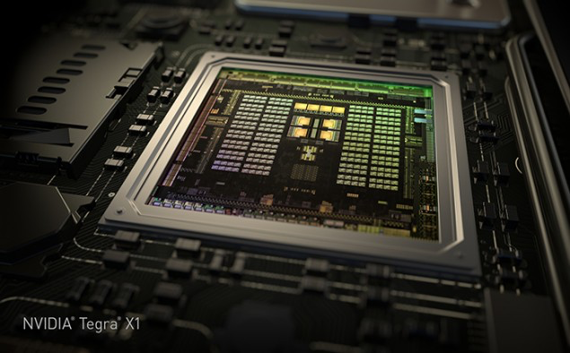
GPU Computing Architecture
/
HiPEAC Summer School, July 2015
Tor M. Aamodt
aamodt@ece.ubc.ca
University of British Columbia
NVIDIA Tegra X1 die photo

Slide 2

Discrete GPUs (in Desktops, Clouds, Data Centers)
General Purpose Computation:
3D Graphics
(in Desktops)

Slide 3
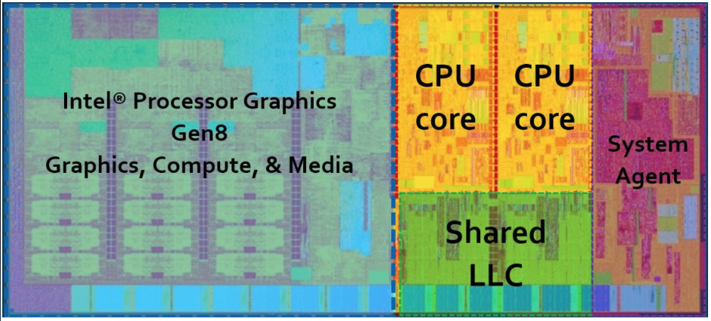
Integrated GPUs:
(in Desktop, Laptops, Mobile SOCs)
Graphics
Computation
Embedded GPUs in CPS systems

Slide 4
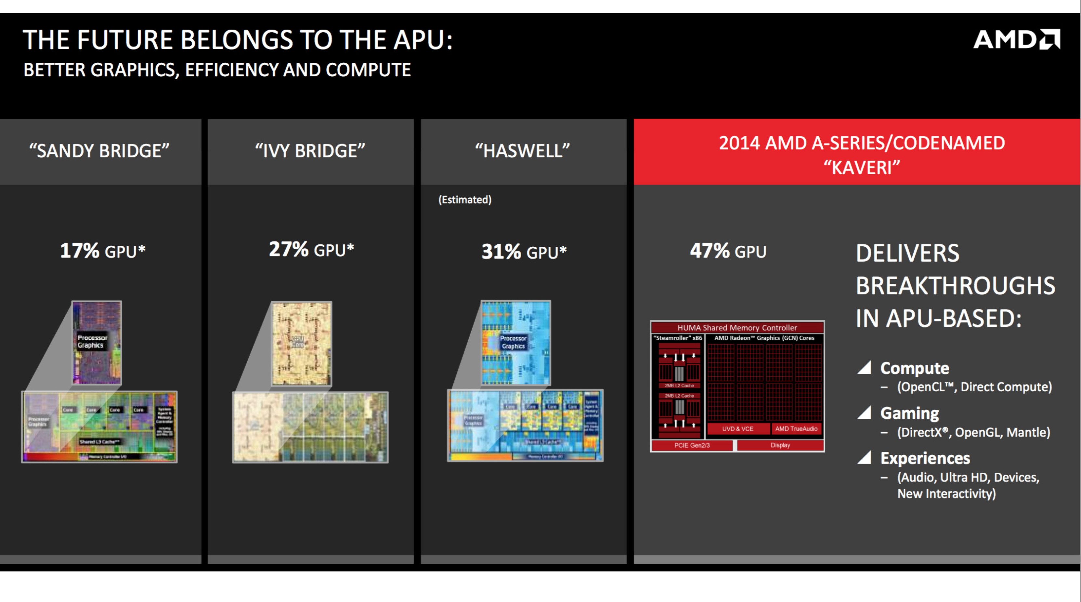
GPUs are everywhere
Source: APU Keynote

Slide 5
Early GPU History
– 1981: IBM PC Monochrome Display Adapter (2D)
– 1996: 3D graphics (e.g., 3dfx Voodoo)
– 1999: register combiner (NVIDIA GeForce 256)
– 2001: programmable shaders (NVIDIA GeForce 3)
– 2002: floating-point (ATI Radeon 9700)
– 2005: unified shaders (ATI R520 in Xbox 360)
– 2006: compute (NVIDIA GeForce 8800)

Slide 6
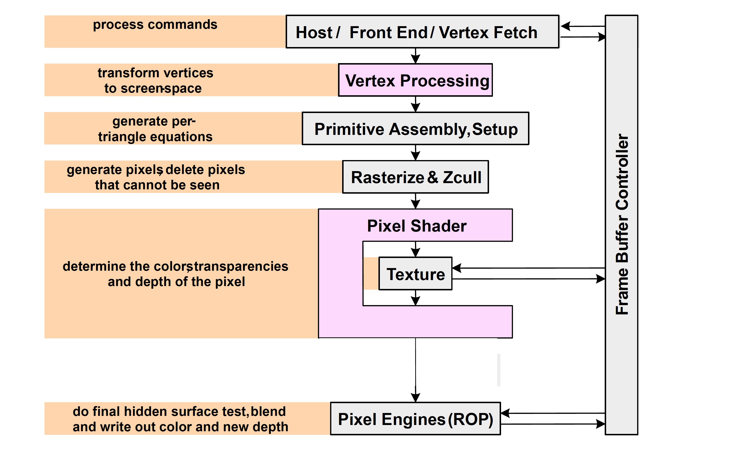
GPU: the life of a triangle
(graphics pipeline)
[David Kirk / Wen-mei Hwu]

Slide 7

Pixel color result of shader program

Slide 8
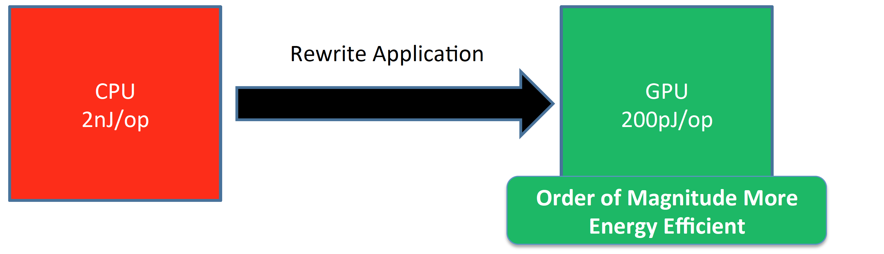
Why use a GPU for computing?
• GPU uses larger fraction of silicon for computation than CPU.
• At peak performance GPU uses order of magnitude less energy per operation than CPU.
e.g., paper in ISCA 2010 shows average
speedup for throughput bound applica?ons
over core i7 is 2.5 x
However, application must perform well

Slide 9
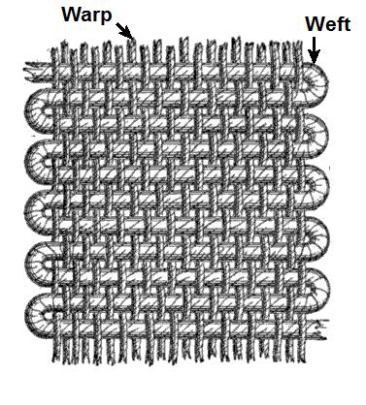
SIMT Execution Model
Programmers sees MIMD threads (scalar)
GPU bundles threads into warps (wavefronts) and runs them in lockstep on SIMD hardware
An NVIDIA warp groups 32 consecutive threads together (AMD wavefronts group 64 threads together)
Aside: Why “Warp”? In the textile industry, the term “warp” refers to “the threads stretched lengthwise in a loom to be crossed by the weft” [Oxford Dictionary].
[https://en.wikipedia.org/wiki/Warp_and_woof]
Notes:
MIMD = multiple-instruction, multiple-data

Slide 10
Execution Model Review

Slide 11
SIMT Execution Model
Challenge: How to handle branch operations when different threads in a warp follow a different path through program?
Solution: Serialize different paths.
foo[] = {4,8,12,16};
A
T1
T2
T3
T4
A: v = foo[threadIdx.x];
B: if (v < 10)
C: v = 0;
else
D: v = 10;
E: w = bar[threadIdx.x]+v;
B
T1
T2
T3
T4
C
Time
T1
T2
D
T3
T4
E
T1
T2
T3
T4
Notes:
MIMD = multiple-instruction, multiple-data

Slide 12
GPU Memory Address Spaces
GPU has three address spaces to support increasing visibility of data between threads: local, shared, global
In addition two more (read-only) address spaces: Constant and texture.

Slide 13
Local (Private) Address Space
Each thread has own “local memory” (CUDA) “private memory” (OpenCL).
0x42
Note: Location at address 100 for thread 0 is different from location at address 100 for thread 1.
Contains local variables private to a thread.

Slide 14
Global Address Spaces
Each thread in the different thread blocks (even from different kernels) can access a region called “global memory” (CUDA/OpenCL).
Commonly in GPGPU workloads threads write their own portion of global memory. Avoids need for synchronization—slow; also unpredictable thread block scheduling.
thread block X
thread block Y
0x42

Slide 15
Shared (Local) Address Space
Each thread in the same thread block (work group) can access a memory region called “shared memory” (CUDA) “local memory” (OpenCL).
Shared memory address space is limited in size (16 to 48 KB).
Used as a software managed “cache” to avoid off-chip memory accesses.
Synchronize threads in a thread block using __syncthreads();
thread block
0x42

Slide 16
Review: Bank Conflicts
To increase bandwidth common to organize memory into multiple banks.
Independent accesses to different banks can proceed in parallel
Bank 0
Bank 1
Bank 0
Bank 1
Bank 0
Bank 1
0
2
4
6
1
3
5
7
0
2
4
6
1
3
5
7
0
2
4
6
1
3
5
7
Example 1: Read 0, Read 1
(can proceed in parallel)
Example 2: Read 0, Read 3
(can proceed in parallel)
Example 3: Read 0, Read 2
(bank conflict)

Slide 17
Shared Memory Bank Conflicts
__shared__ int A[BSIZE];
…
A[threadIdx.x] = … // no conflicts
0
32
64
96
1
33
65
97
2
34
66
98
31
63
95
127

Slide 18
Shared Memory Bank Conflicts
__shared__ int A[BSIZE];
…
A[2*threadIdx.x] = // 2-way conflict
0
32
64
96
1
33
65
97
2
34
66
98
31
63
95
127

Slide 19
CUDA Streams
CUDA (and OpenCL) provide the capability to overlap computation on GPU with memory transfers using “Streams” (Command Queues)
A Stream orders a sequence of kernels and memory copy “operations”.
Operations in one stream can overlap with operations in a different stream.

Slide 20
How Can Streams Help?
Serial:
Streams:
cudaMemcpy(H2D)
kernel<<<>>>
cudaMemcpy(D2H)
GPU idle
GPU busy
GPU idle
cudaMemcpy(H2D)
K0
DH0
K1
DH1
Savings
K2
DH2
Time
http://on-demand.gputechconf.com/gtc-express/2011/presentations/StreamsAndConcurrencyWebinar.pdf

Slide 21
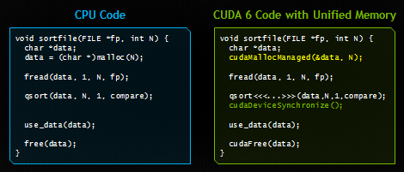
Recent Features in CUDA
Dynamic Parallelism (CUDA 5): Launch kernels from within a kernel. Reduce work for e.g., adaptive mesh refinement.
Unified Memory (CUDA 6): Avoid need for explicit memory copies between CPU and GPU
http://devblogs.nvidia.com/parallelforall/unified-memory-in-cuda-6/
See also, Gelado, et al. ASPLOS 2010.

Slide 22
GPU Instruction Set Architecture (ISA)
NVIDIA defines a virtual ISA, called “PTX” (Parallel Thread eXecution)
PTX is Reduced Instruction Set Architecture (e.g., load/store architecture)
Virtual: infinite set of registers (much like a compiler intermediate representation)
PTX translated to hardware ISA by backend compiler (“ptxas”). Either at compile time (nvcc) or at runtime (GPU driver).
ISA vs. ABI.

Slide 23
Some Example PTX Syntax
Registers declared with a type:
.reg .pred p, q, r;
.reg .u16 r1, r2;
.reg .f64 f1, f2;
ALU operations
add.u32 x, y, z; // x = y + z
mad.lo.s32 d, a, b, c; // d = a*b + c
Memory operations:
ld.global.f32 f, [a];
ld.shared.u32 g, [b];
st.local.f64 [c], h
Compare and branch operations:
setp.eq.f32 p, y, 0; // is y equal to zero?
@p bra L1 // branch to L1 if y equal to zero
https://docs.nvidia.com/cuda/parallel-thread-execution/index.html

Slide 24
Part 2: Generic GPGPU Architecture

Slide 25
Extra resources
GPGPU-Sim 3.x Manualhttp://gpgpu-sim.org/manual/index.php/GPGPU-Sim_3.x_Manual

Slide 26
GPU Microarchitecture Overview
Single-Instruction, Multiple-Threads
GPU
SIMT Core Cluster
SIMT Core Cluster
SIMT Core Cluster
SIMT
Core
SIMT
Core
SIMT
Core
SIMT
Core
SIMT
Core
SIMT
Core
Interconnection Network
Memory
Partition
Memory
Partition
Memory
Partition
GDDR5
GDDR5
Off-chip DRAM
GDDR5

Slide 27
GPU Microarchitecture
Companies tight lipped about details of GPU microarchitecture.
Several reasons:
  Competitive advantage
  Fear of being sued by “non-practicing entities”
  The people that know the details too busy building the next chip
Model described next, embodied in GPGPU-Sim, developed from: white papers, programming manuals, IEEE Micro articles, patents, microbenchmarks/reverse engineering.

Slide 28
GPGPU-Sim v3.x w/ SASS
Correlation
~0.976
12

Slide 29
GPU Microarchitecture Overview
GPU
SIMT Core Cluster
SIMT Core Cluster
SIMT Core Cluster
SIMT
Core
SIMT
Core
SIMT
Core
SIMT
Core
SIMT
Core
SIMT
Core
Interconnection Network
Memory
Partition
Memory
Partition
Memory
Partition
GDDR3/GDDR5
GDDR3/GDDR5
Off-chip DRAM
GDDR3/GDDR5

Slide 30
Inside a SIMT Core
SIMT
Front End
Reg
File
SIMD Datapath
Fetch
Decode
Memory Subsystem
Icnt.
Network
Schedule
Branch
SMem
L1 D$
Tex $
Const$
SIMT front end / SIMD backend
Fine-grained multithreading
  Interleave warp execution to hide latency
  Register values of all threads stays in core

Slide 31
Inside an “NVIDIA-style” SIMT Core
SIMT Front End
SIMD Datapath
Branch Target PC
Fetch
SIMT-Stack
Scheduler 1
Scheduler 3
ALU
Valid[1:N]
Active
ALU
I-Buffer
Pred.
ALU
Mask
ALU
I-Cache
Decode
Issue
Operand
Scheduler 2
Collector
Score
MEM
Board
Done (WID)
Three decoupled warp schedulers
Scoreboard
Large register file
Multiple SIMD functional units

Slide 32
Fetch + Decode
Arbitrate the I-cache among warps
  Cache miss handled by fetching again later
Fetched instruction is decoded and then stored in the I-Buffer
  1 or more entries / warp
  Only warp with vacant entries are considered in fetch
Score-
PC
Decode
Board
A
1
PC
v
Inst. W1
r
R
2
e
B
PC
3
v
Inst. W2
r
h
c
v
Inst. W3
r
a
C
-
I
o
Selection
T
To
Fetch
Issue
Valid[1:N]
Issue
ARB
Fetch
Valid[1:N]
I-Buffer
I-Cache
Decode

Slide 33
Instruction Issue
Select a warp and issue an instruction from its
I-Buffer for execution
  Scheduling: Greedy-Then-Oldest (GTO)
  GT200/later Fermi/Kepler:
  Allow dual issue (superscalar)
  Fermi: Odd/Even scheduler
  To avoid stalling pipeline might
  keep instruction in I-buffer until
  know it can complete (replay)

Slide 34
Review: In-order Scoreboard
Scoreboard: a bit-array, 1-bit for each register
  If the bit is not set: the register has valid data
  If the bit is set: the register has stale data
    i.e., some outstanding instruction is going to change it
Issue in-order: RD ← Fn (RS, RT)
  If SB[RS] or SB[RT] is set → RAW, stall
  If SB[RD] is set → WAW, stall
  Else, dispatch to FU (Fn) and set SB[RD]
Complete out-of-order
  Update GPR[RD], clear SB[RD]
Scoreboard
Register File
0
Regs[R1]
1
Regs[R2]
0
Regs[R3]
0
Regs[R31]
[Gabriel Loh]
Notes:
H&P-style notation

Slide 35
Example
+
Code
ld r7, [r0]
mul r6, r2, r5
add r8, r6, r7
Scoreboard
Instruction Buffer
Index 0
Index 1
Index 2
Index 3
i0 i1 i2 i3
Warp 0
r7 | - | - | -
- | - | - | -
r7 | r6 | - | -
- | - | - | -
r7 | r6 | r8 | -
- | - | - | -
r7 | r6 | r8 | -
- | - | - | -
r7 | - | r8 | -
- | - | - | -
r7 | - | r8 | -
- | - | - | -
- | - | r8 | -
- | - | - | -
Warp 0
- | - | - | -
- | - | - | -
ld r7, [r0] | 0 | 0 | 0 | 0
ld r7, [r0] | 0 | 0 | 0 | 0
mul r6, r2, r5 | 0 | 0 | 0 | 0
ld r7, [r0] | 0 | 0 | 0 | 0
mul r6, r2, r5 | 0 | 0 | 0 | 0
add r8, r6, r7 | 1 | 1 | 0 | 0
ld r7, [r0] | 0 | 0 | 0 | 0
mul r6, r2, r5 | 0 | 0 | 0 | 0
add r8, r6, r7 | 1 | 1 | 0 | 0
ld r7, [r0] | 0 | 0 | 0 | 0
add r8, r6, r7 | 1 | 0 | 0 | 0
ld r7, [r0] | 0 | 0 | 0 | 0
add r8, r6, r7 | 1 | 0 | 0 | 0
add r8, r6, r7 | 0 | 0 | 0 | 0
Warp 1
Warp 1

Slide 36
SIMT Using a Hardware Stack
Stack approach invented at Lucasfilm, Ltd in early 1980’s
Version here from [Fung et al., MICRO 2007]
Stack
A
A/1111
Reconv. PC
Next PC
Active Mask
TOS
TOS
TOS
TOS
-
-
-
-
-
-
-
G
A
E
E
B
E
E
1111
1111
1111
1111
1111
1111
1111
E
E
D
D
0110
TOS
E
D
0110
0110
B
B/1111
TOS
TOS
E
E
C
E
1001
1001
C/1001
D/0110
C
D
F
Thread Warp
Common PC
E
E/1111
Thread
1
Thread
2
Thread
3
Thread
4
G
G/1111
A
B
C
D
E
G
A
Time
SIMT = SIMD Execution of Scalar Threads

Slide 37
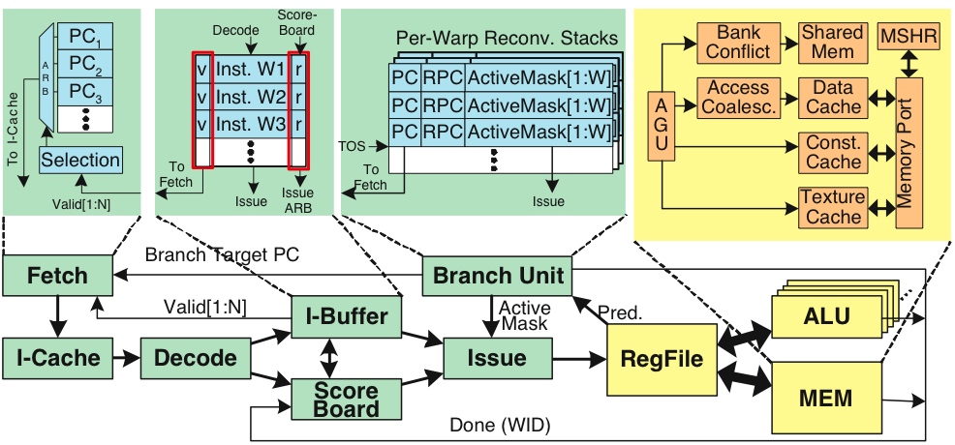
Register File
32 warps, 32 threads per warp, 16 x 32-bit registers per thread = 64KB register file.
Need “4 ports” (e.g., FMA) greatly increase area.
Alternative: banked single ported register file. How to avoid bank conflicts?

Slide 38
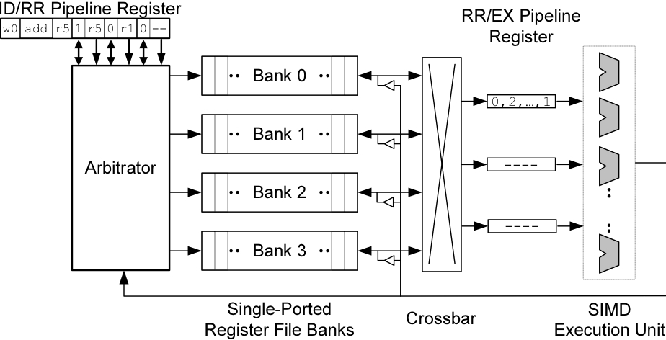
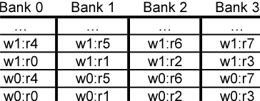
Banked Register File
Strawman microarchitecture:
Register layout:

Slide 39
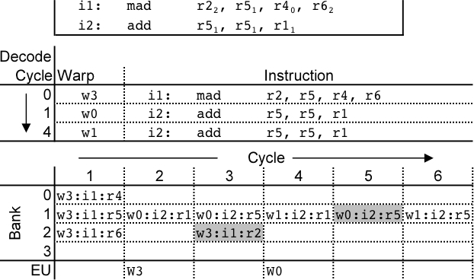
Register Bank Conflicts
warp 0, instruction 2 has two source operands in bank 1: takes two cycles to read.
Also, warp 1 instruction 2 is same and is also stalled.
Can use warp ID as part of register layout to help.

Slide 40
Operand Collector
Bank 0
Bank 1
Bank 2
Bank 3
R0
R1
R2
R3
R4
R5
R6
R7
R8
R9
R10
R11
…
…
…
…
add.s32 R3, R1, R2;
No Conflict
mul.s32 R3, R0, R4;
Conflict at bank 0
Term “Operand Collector” appears in figure in NVIDIA Fermi Whitepaper
Operand Collector Architecture (US Patent: 7834881)
  Interleave operand fetch from different threads to achieve full utilization

Slide 41
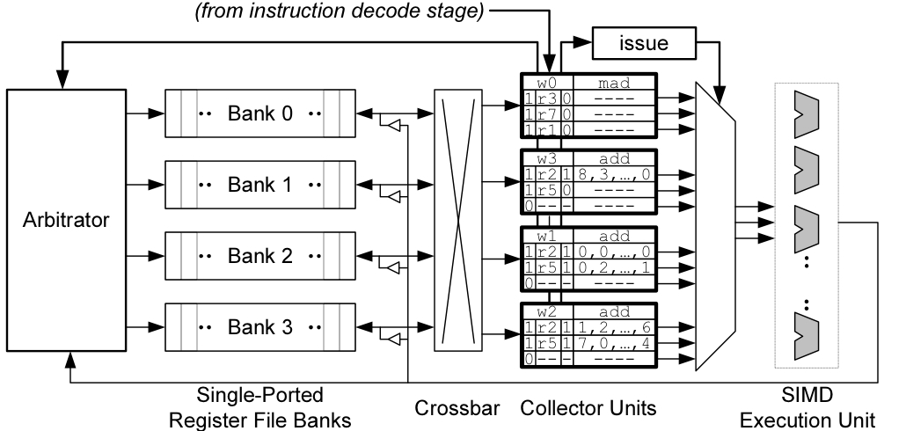
Operand Collector (1)
Issue instruction to collector unit.
Collector unit similar to reservation station in tomasulo’s algorithm.
Stores source register identifiers.
Arbiter selects operand accesses that do not conflict on a given cycle.
Arbiter needs to also consider writeback (or need read+write port)

Slide 42
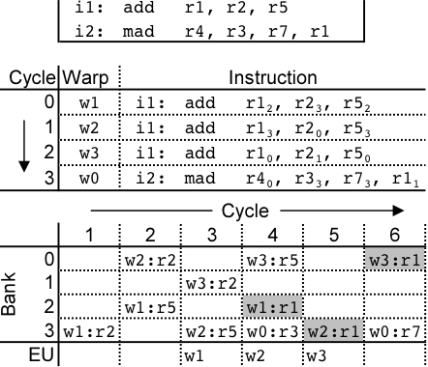
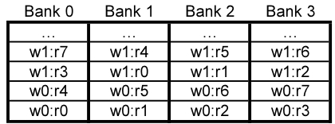
Operand Collector (2)
Combining swizzling and access scheduling can give up to ~ 2x improvement in throughput

Slide 43
Warp Scheduling Basics

Slide 44
Loose Round Robin (LRR)
Goes around to every warp
and issue if ready (R)
If warp is not ready (W),
skip and issue next ready warp
Issue: Warps all run at the same speed,
potentially all reaching memory access
phase together and stalling.
All Warps
R
R
W
R
R
R
W
. . .
R
Select
Execution Units

Slide 45
Two-level (TL)
Warps are grouped into two groups:
  Pending warps
  (potentially waiting on long latency instr.)
  Active warps
  (Ready to execute)
  Warps move between Pending and Active groups
Within the Active group, issue LRR
Goal: Overlap warps performing computation
with warps performing memory access
Pending Warps
P
P
P
P
P
P
P
. . .
P
Active Warps
A
A
A
. . .
A
Select
Execution Units

Slide 46
Greedy-then-oldest (GTO)
Schedule from a single warp until it stalls
Then pick the oldest warp
(time warp assigned to core)
Goal: Improve cache locality for
greedy warp
All Warps
R
R
W
R
R
R
W
. . .
R
Select
Execution Units

