Slide 1
Automatic Detection of Excessive Glycemic Variability for Diabetes Management
Matthew Wiley, Razvan Bunescu, Cindy Marling,
Jay Shubrook and Frank Schwartz
School of Electrical Engineering and Computer Science
Appalachian Rural Health Institute Diabetes and Endocrine Center
Athens, Ohio, USA

Slide 2
Diabetes
Body fails to effectively produce and/or use insulin
Treated and managed with blood glucose control

Slide 3
Diabetes
Body fails to effectively produce and/or use insulin
Treated and managed with blood glucose control
346 million people world wide
Two major types:
Type I
Type II

Slide 4
Poor Control Increases Risk of Complications
Foot Ulcers
Angina
Heart Attack
Coronary Bypass
Surgery
Stroke
Blindness
Amputation
Dialysis
Kidney
Transplant
Albuminuria
Macular Edema
Proliferative
Retinopathy
Periodontal Disease
Impotence
Gastroparesis
Depression
RISK
Microalbuminuria
Mild Retinopathy
Mild Neuropathy
Good
CONTROL
Poor

Slide 5
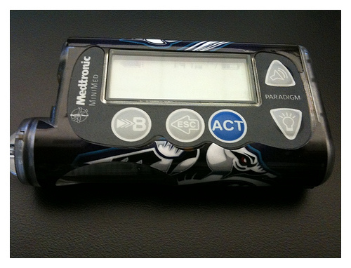
Administering Insulin
Type I patients must administer insulin
Injection
Insulin Pump
Insulin Pump

Slide 6
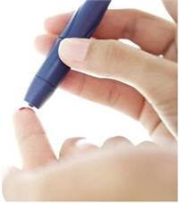
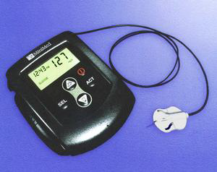
Continuous Glucose Monitoring
Two approaches to monitoring:
Fingersticks
Continuous Glucose Monitoring (CGM) sensors
Fingerstick
CGM Sensor

Slide 7
Data Overload
CGM sensors record values every 5 or 10 minutes

Slide 8
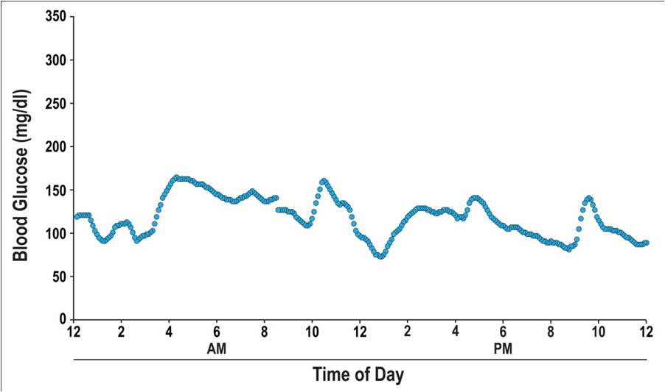
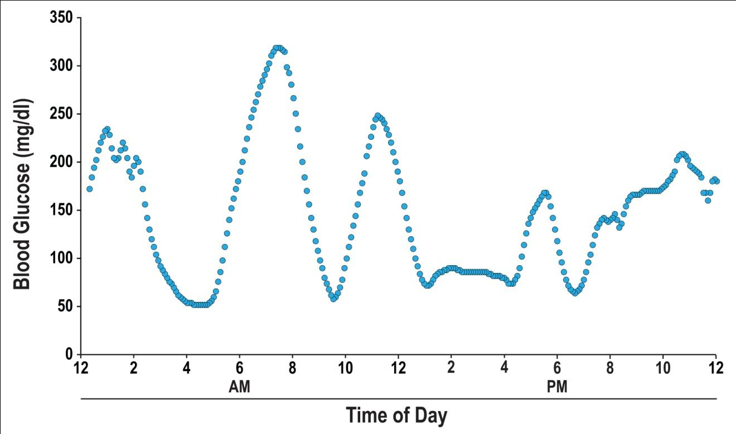
Excessive Glycemic Variability
Characterized by fluctuations in blood glucose
Patients are not yet routinely screened
Acceptable Glycemic Variability
Excessive Glycemic Variability

Slide 9
Background
Preliminary work:
Two physicians individually classified 400 plots
Naïve Bayes classifier: 85% accuracy

Slide 10
Background
Preliminary work:
Two physicians individually classified 400 plots
Naïve Bayes classifier: 85% accuracy
Three orthogonal directions:
Smoothing of blood glucose data
Feature engineering
Evaluation of other classifiers

Slide 11
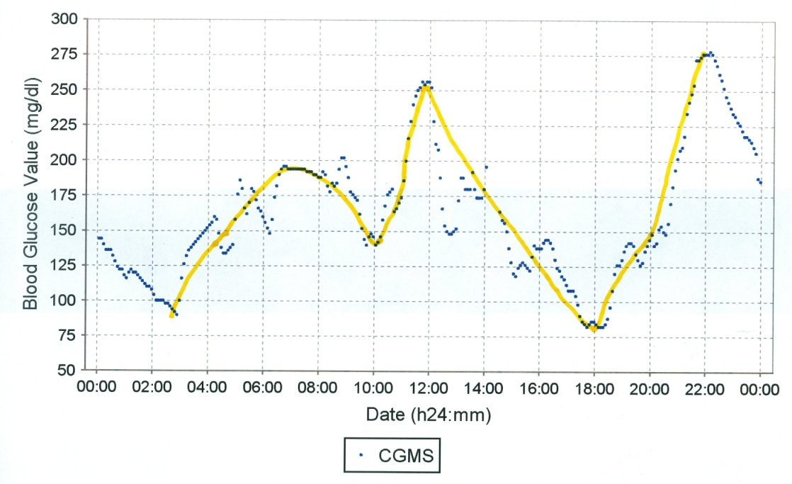
Smoothing Blood Glucose Data
Sensors record at ±20% accuracy
Physicians implicitly smooth noise

Slide 12
Smoothing Blood Glucose Data
Several smoothing methods were investigated:
Moving averages
Polynomial regression
Discrete Fourier transform filter
Cubic spline interpolation
Cubic spline identified as the best match

Slide 13
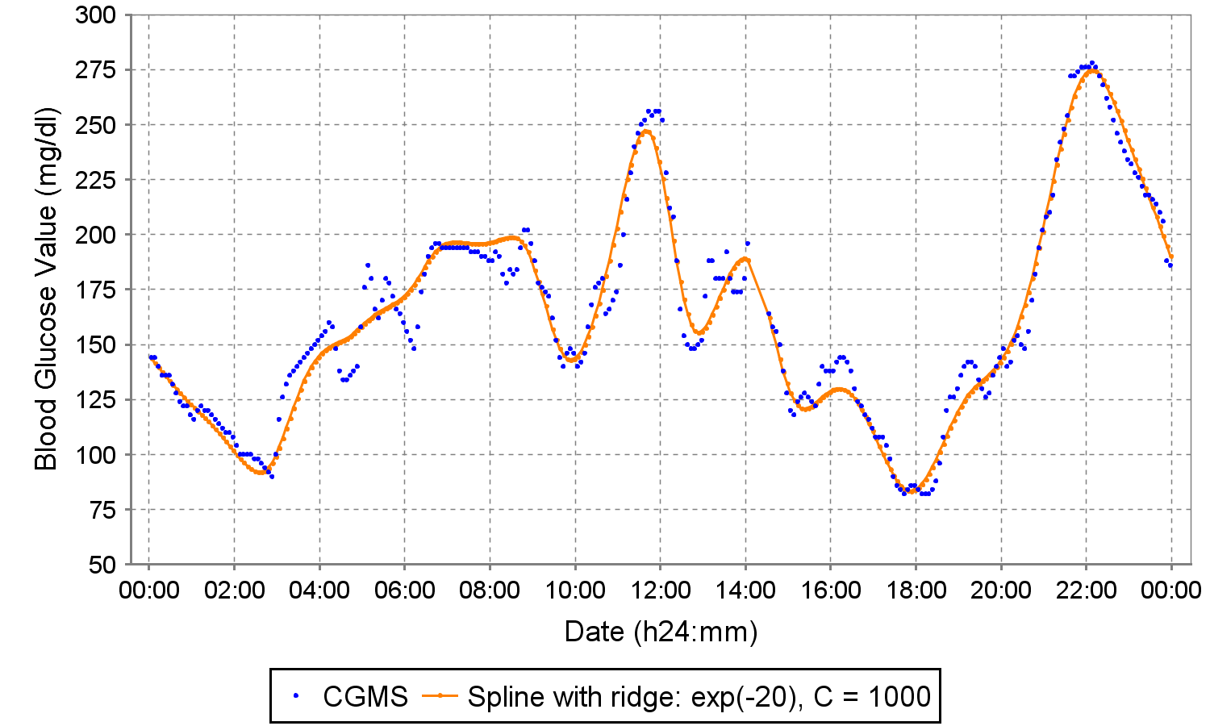
Cubic Spline Interpolation
Two reasons:
Smooth curves
Significant points
Doctor
Spline

Slide 14
Feature Engineering
Several features were investigated in this work:
Mean Amplitude of Glycemic Excursions (MAGE)
Distance Traveled
Excursion Frequency
Standard Deviation
Area Under the Curve
Roundness Ratio
Bending Energy
Eccentricity
Amplitudes of DFT frequencies
Two dimensional central moments
Direction Codes

Slide 15
Feature Selection
Two methods are reported:
t-Test filter
Greedy backward elimination
Both raw and smooth data

Slide 16
Feature Selection
Two methods are reported:
t-Test filter
Greedy backward elimination
Both raw and smooth data
Out of the four feature sets selected:
No feature appeared in all four sets
Eccentricity and bending energy were never selected

Slide 17
Experimental Evaluation
Three classifiers compared:
Naïve Bayes (NB)
Support Vector Machines (SVM)
Multilayer Perceptron (MP)

Slide 18
Experimental Evaluation
Three classifiers compared:
Naïve Bayes (NB)
Support Vector Machines (SVM)
Multilayer Perceptron (MP)
Evaluated with 10-fold cross validation
Tuned with development dataset
Features from feature selection
Both raw and smooth data

Slide 19
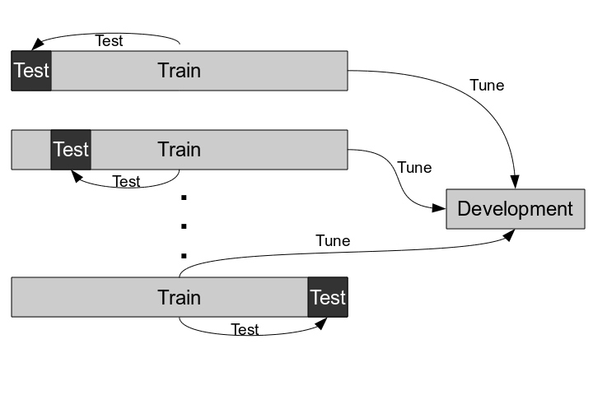
Visual Overview of Evaluation

Slide 20
Results
NB with raw data: 87.1%
Same settings as preliminary work – the baseline
t-test filter:
SVM with smoothed data: 92.8%
Greedy backward elimination:
MP with smoothed data: 93.8%

Slide 21
Results
NB with raw data: 87.1%
Same settings as preliminary work – the baseline
t-test filter:
SVM with smoothed data: 92.8%
Greedy backward elimination:
MP with smoothed data: 93.8%
Overall:
Additional features helped
Smoothed data helped

Slide 22
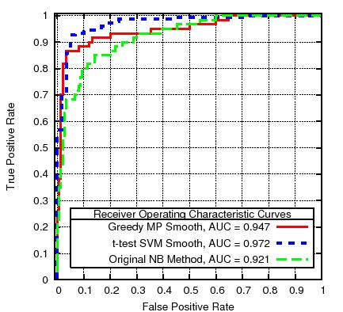
Comparison of ROC Curves for Best Classifiers

Slide 23
Future Work
This experiment was constrained by the dataset size
Potentially suboptimal parameters and features
Collecting more data is a high priority

Slide 24
Future Work
This experiment was constrained by the dataset size
Potentially suboptimal parameters and features
Collecting more data is a high priority
Plans for a “5-star” ordinal scheme
Alleviate disagreements between annotators
Opportunity to further improve accuracy

Slide 25
From Bench to Bedside
Integration with current CGM management systems
Glucose sensors are in common use as a diagnostic tool
Some patients use glucose sensors year round
Manufacturers already provide reporting

Slide 26
From Bench to Bedside
Integration with current CGM management systems
Glucose sensors are in common use as a diagnostic tool
Some patients use glucose sensors year round
Manufacturers already provide reporting
Development of a screen for routine clinical use
Identify at risk patients in the clinical setting
Completion of the intended application

Slide 27
Acknowledgements
National Science Foundation
Medtronic
Ohio University
Our Dedicated Research Nurses
My Fellow Graduate Research Assistants
Over 50 Anonymous Patients with Type 1 Diabetes on Insulin Pump Therapy

Slide 28
Thanks!
Questions?

