Slide 1
GPU Architecture

Slide 2
Notes:
Poll Title: How do you feel today? https://www.polleverywhere.com/multiple_choice_polls/1dDXUPAIrphlTz7LGV2eI?flow=Default&onscreen=persist

Slide 3
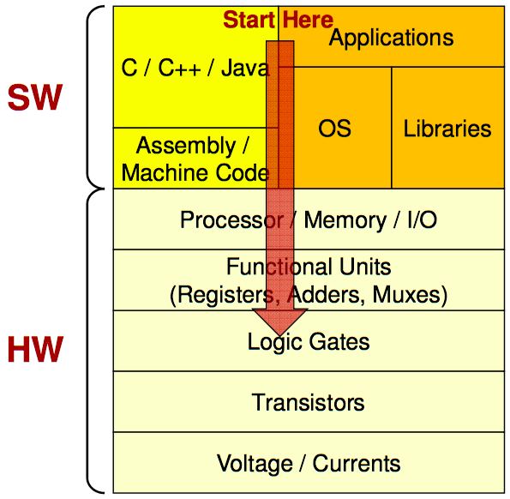
Software informs Hardware
Efficiency through understanding how each level interacts
Design hardware for common case applications
This is hardware specialization

Slide 4
Graphics Applications – The pipeline
Many stages for graphics applications
Involve many different operations

Slide 5
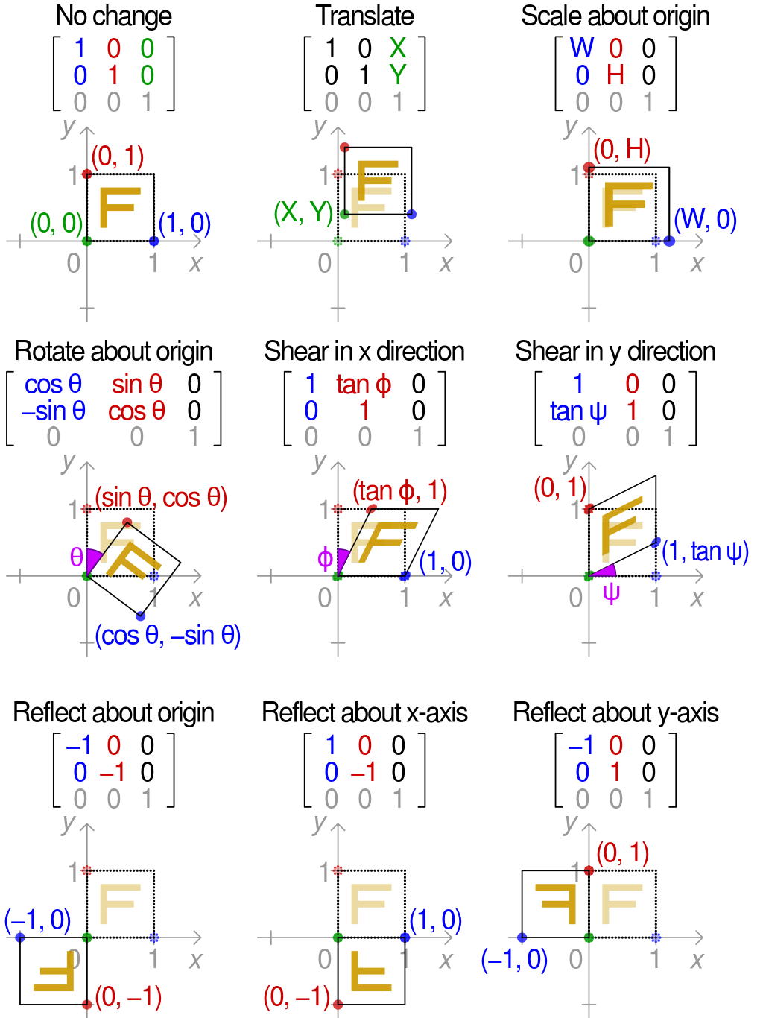
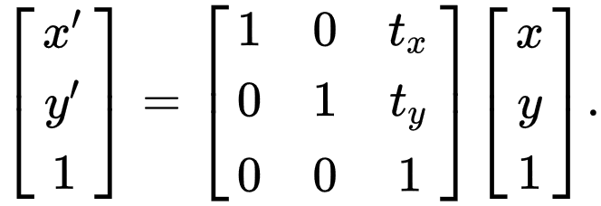
Graphics Applications – Vertex Transformation
Transform defined through matrix multiplication
A single operation is then applied to all affected vertices

Slide 6
Single Instruction Multiple Data
Matrix Multiplication can be classified as SIMD paradigm
A single instruction stream is applied to multiple separate data structures
How do we handle multiple data threads within hardware?

Slide 8
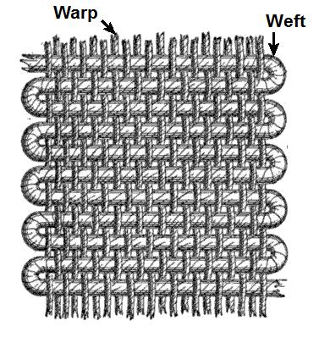
Jacquard Loom
Multiple Vertical Threads are grouped into a Warp
Horizontal Weft is weaved through the warp in a single operation

Slide 10
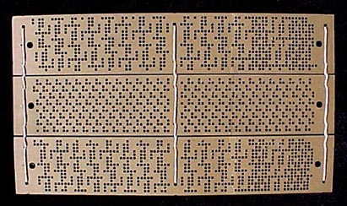
Jacquard Loom
Complex patterns are created by selecting which threads are lifted
Jacquard Loom shows the efficiency of operating on multiple threads in one cycle

Slide 11
Back to Modern Computers
Threads are executing the same instruction but on different data

Slide 12
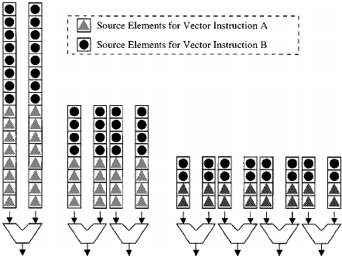
Vector Processors
Increase the number of ALU hardware units
Increasing the number of datapaths per functional unit reduces the execution time, as more element operations can be processed concurrently.

Slide 13
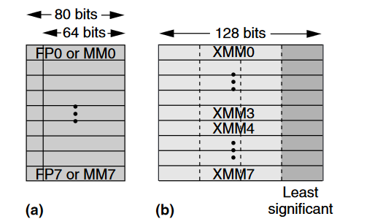
Vector Processors
Increase size (width) of registers
Increasing number of datapaths requires more data to be accessed within a single cycle

Slide 14
The Von-Neumann Model with SIMD units
Duplicate Processing Unit to support vector instructions
Still share a single control unit
Memory
I/O
Processing Unit
Reg
File
ALU
Control Unit
PC
IR
Single Instruction Multiple Data
(SIMD)
Single Instruction Multiple Data
(SIMD)
Notes:
Insert von-neumann schematic here

Slide 15
Handling multiple Warps
A single SIMD unit can handle multiple Warps
Scheduling policy tells which one will be executed next
Fine-Grained Scheduling (Round Robin)
Course-Grained Scheduling (Greedy than Oldest)

Slide 16
Key Takeaways
Vector processor are SIMD units
Increasing number of datapaths requires more data to be accessed within a single cycle
Unit of execution and scheduling is a vector instruction with multiple data
Therefore threads are grouped into a single warp
Proccing units are duplicated but share a control unit

Slide 17
Notes:
Poll Title: Are there any drawback other than area from having a larger SIMD unit? i.e. a SIMD unit with 32, 64, or 128 ALUs https://www.polleverywhere.com/free_text_polls/ffU7blNcVenZXV0ySdewj

Slide 18
GPU Microarchitecture Overview
Single-Instruction, Multiple-Threads
GPU
SIMT Core Cluster
SIMT Core Cluster
SIMT Core Cluster
SIMT
Core
SIMT
Core
SIMT
Core
SIMT
Core
SIMT
Core
SIMT
Core
Interconnection Network
Memory
Partition
Memory
Partition
Memory
Partition
GDDR5
GDDR5
Off-chip DRAM
GDDR5

Slide 19
Streaming Multiprocessors are SIMD Processors
Control unit for instruction fetch, decode, and control is shared among multiple processing units
Control overhead is minimized
Memory
I/O
Processing Unit
Shared Memory
Register
File
ALU
Control Unit
PC
IR
Processor (SM)
Notes:
Insert von-neumann schematic here

Slide 20
SIMD Execution Among Threads in a Warp
All threads in a warp must execute the same instruction at any point in time
Also called SIMT execution model
This works efficiently if all threads follow the same control flow path
All if-then-else statements make the same decision
All loops iterate the same number of times
Notes:
WARP_SIZE

Slide 21
GPU Microarchitecture Overview
GPU
SIMT Core Cluster
SIMT Core Cluster
SIMT Core Cluster
SIMT
Core
SIMT
Core
SIMT
Core
SIMT
Core
SIMT
Core
SIMT
Core
Interconnection Network
Memory
Partition
Memory
Partition
Memory
Partition
GDDR3/GDDR5
GDDR3/GDDR5
Off-chip DRAM
GDDR3/GDDR5

Slide 22
Inside a SIMT Core
SIMT
Front End
Reg
File
SIMD Datapath
Fetch
Decode
Memory Subsystem
Icnt.
Network
Schedule
Branch
SMem
L1 D$
Tex $
Const$
SIMT front end / SIMD backend
Fine-grained multithreading
Interleave warp execution to hide latency
Register values of all threads stays in core

Slide 23
Inside a pipelined SIMT Core
SIMT Front End
SIMD Datapath
Branch Target PC
Fetch
SIMT-Stack
Scheduler 1
Scheduler 3
ALU
Valid[1:N]
Active
ALU
I-Buffer
Pred.
ALU
Mask
ALU
I-Cache
Decode
Issue
Operand
Scheduler 2
Collector
Score
MEM
Board
Done (WID)
Three decoupled warp schedulers
Scoreboard
Large register file
Multiple SIMD functional units

Slide 24
Fetch + Decode
Arbitrate the I-cache among warps
Cache miss handled by fetching again later
Fetched instruction is decoded and then stored in the I-Buffer
1 or more entries / warp
Only warp with vacant entries are considered in fetch
Score-
PC
Decode
Board
A
1
PC
v
Inst. W1
r
R
2
e
B
PC
3
v
Inst. W2
r
h
c
v
Inst. W3
r
a
C
-
I
o
Selection
T
To
Fetch
Issue
Valid[1:N]
Issue
ARB
Fetch
Valid[1:N]
I-Buffer
I-Cache
Decode

Slide 25
Instruction Issue
Select a warp and issue an instruction from its I-Buffer for execution
Scheduling: Greedy-Then-Oldest (GTO)
GT200/later Fermi/Kepler: Allow dual issue (superscalar)
Fermi: Odd/Even scheduler
To avoid stalling pipeline might
keep instruction in I-buffer until
know it can complete (replay)

Slide 26
Execution
SIMD Datapath
Multiple SIMD units
Separate Warps can be executing in-flight simultaneously
SIMT-Stack
ALU
Active
ALU
ALU
Mask
ALU
Issue
Operand
Collector
MEM

Slide 27
Key Takeaways
Streaming Multiprocessors are “Core” blocks of GPUs
They contain multiple SIMD units
Support for Multithreading of warps
SIMT
Front End
Reg
File
SIMD Datapath
Fetch
Decode
Memory Subsystem
Icnt.
Network
Schedule
Branch
SMem
L1 D$
Tex $
Const$

Slide 28
Notes:
Poll Title: What are the benefits from multiple smaller SMs over a single large SM? https://www.polleverywhere.com/free_text_polls/1aPXXHp3VOulAIHzpewFE

Slide 29
How should we program for this architecture?
How do we organize thread execution?
GPU
SIMT Core Cluster
SIMT Core Cluster
SIMT Core Cluster
SM
SIMT
Core
SIMT
Core
SIMT
Core
SIMT
Core
SIMT
Core
Interconnection Network
Memory
Partition
Memory
Partition
Memory
Partition
GDDR5
GDDR5
Off-chip DRAM
GDDR5

Slide 30
Vector Operations
Assign a thread to each element of an array
One thread operates on a single element
Tid 0
Tid 1
Tid 2
Tid N-1
vector A
A[0]
A[1]
A[2]
…
A[N-1]
vector B
B[0]
B[1]
B[2]
…
B[N-1]
op
op
op
op
vector C
C[0]
C[1]
C[2]
…
C[N-1]

Slide 31
Arrays of Parallel Threads
A CUDA kernel is executed by a grid (array) of threads
All threads in a grid run the same kernel code (Single Program Multiple Data)‏
Each thread has indexes that it uses to compute memory addresses and make control decision
However this is not scalable with large arrays or matricies
Nothing inherent with id to map to a specific SM to execute
0
1
2
254
255
…
i = threadIdx.x;
C[i] = A[i] + B[i];
…

Slide 32
Thread Blocks: Scalable Cooperation
Divide thread array into multiple blocks
Thread Blocks become Unit of scheduling to an SM
Can easily scale to different number of SMs
Thread Block 0
Thread Block 1
Thread Block N-1
0
1
2
254
255
0
1
2
254
255
0
1
2
254
255
…
…
…
i = blockIdx.x * blockDim.x + threadIdx.x;
C[i] = A[i] + B[i];
i = blockIdx.x * blockDim.x + threadIdx.x;
C[i] = A[i] + B[i];
i = blockIdx.x * blockDim.x + threadIdx.x;
C[i] = A[i] + B[i];
…
…
…
…

Slide 33
Transparent Scalability
Each block can execute in any order relative to others.
Hardware is free to assign blocks to any processor at any time
A kernel scales to any number of parallel processors
Device
Device
Thread grid
Block 0
Block 1
Block 2
Block 3
Block 0
Block 1
Block 2
Block 3
Block 0
Block 1
time
Block 4
Block 5
time
Block 2
Block 3
Block 6
Block 7
Block 4
Block 5
Block 6
Block 7
Block 4
Block 5
Block 6
Block 7

Slide 34
blockIdx and threadIdx
Each thread uses indices to decide what data to work on
blockIdx: 1D, 2D, or 3D
threadIdx: 1D, 2D, or 3D
Simplifies memory addressing when processing multidimensional data
Image processing
Solving PDEs on volumes
…
device
Grid
Block (0, 0)
Block (0, 1)
Block (1, 0)
Block (1, 1)
Block (1,1)
(1,0,0)
(1,0,1)
(1,0,2)
(1,0,3)
Thread
(0,0,0)
Thread
(0,0,1)
Thread
(0,0,2)
Thread
(0,0,3)
Thread
(0,0,0)
Thread
(0,1,3)
Thread
(0,1,0)
Thread
(0,1,1)
Thread
(0,1,2)

Slide 35
Executing Thread Blocks
SM
Threads are assigned to Streaming Multiprocessors (SM) in block granularity
SM maintains thread/block idx #s
SM manages/schedules thread execution
t0 t1 t2 … tm
SP
Blocks
Shared
Memory

Slide 36
Warps as Scheduling Units
Each Block is executed as 32-thread Warps
An implementation decision, not part of the CUDA programming model
Warps are scheduling units in SM
Threads in a warp execute in SIMD
If 3 blocks are assigned to an SM and each block has 256 threads, how many Warps are there in an SM?
Each Block is divided into 256/32 = 8 Warps
There are 8 * 3 = 24 Warps

Slide 37
Key Takeaways
Threads are grouped into Thread blocks
ThreadID and Block ID can be 3 dimensional
Thread Blocks are the unit of scheduling at the SM level
device
Grid
Block (0, 0)
Block (0, 1)
Block (1, 0)
Block (1, 1)
Block (1,1)
(1,0,0)
(1,0,1)
(1,0,2)
(1,0,3)
Thread
(0,0,0)
Thread
(0,0,1)
Thread
(0,0,2)
Thread
(0,0,3)
Thread
(0,0,0)
Thread
(0,1,3)
Thread
(0,1,0)
Thread
(0,1,1)
Thread
(0,1,2)

