Slide 1
Architecture Basics

Slide 2

Notes:
Poll Title: Vote now!
https://www.polleverywhere.com/multiple_choice_polls/wcq5En6fEYAQb5s8eCy9E?flow=Default&onscreen=persist

Slide 3
Logistics
My office hours poll
  https://www.when2meet.com/?8957819-seuwX
TA Office hours
  3-5 pm on Fridays

Slide 4
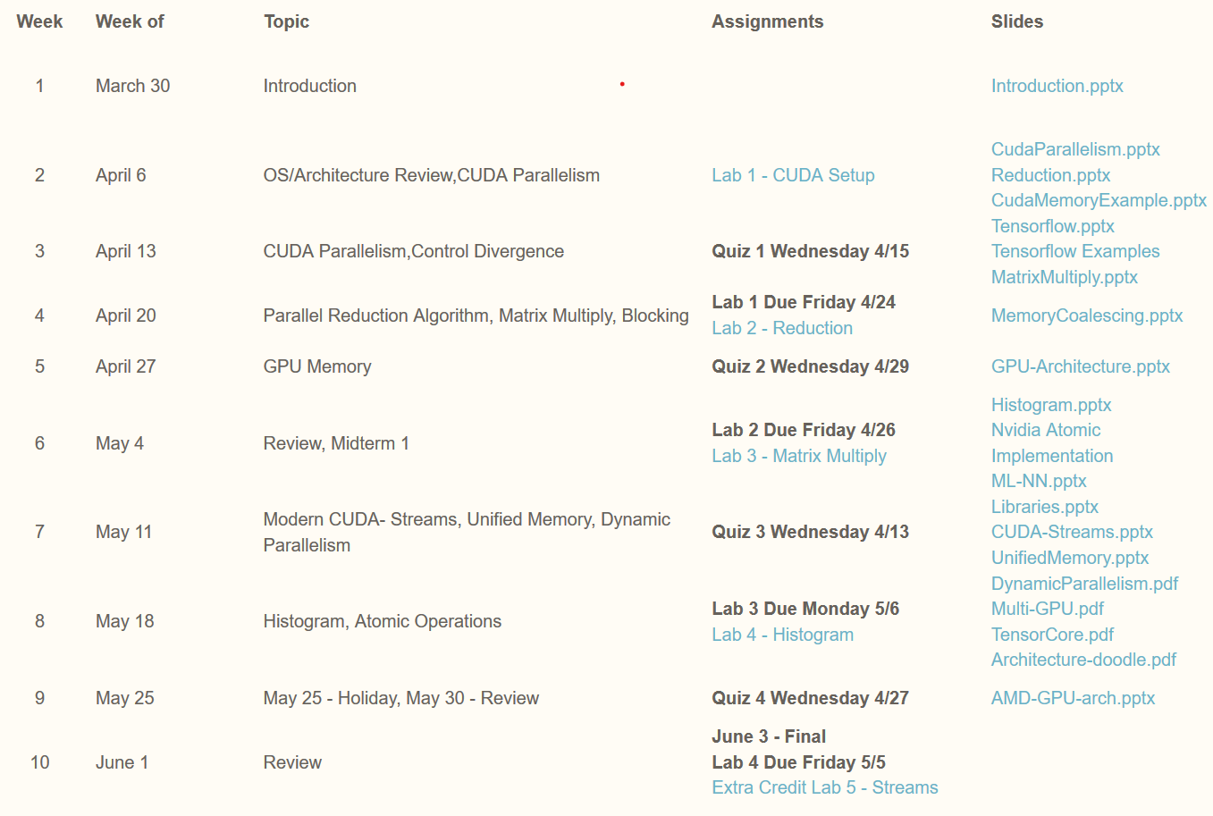
Current Schedule – Subject to change
4 quizzes
5 labs
1 midterm
1final
No final project
Labs: 20%
Midterm: 25%
Final: 25%
Quizes: 20%
Class Participation & Discussion: 10%

Slide 5
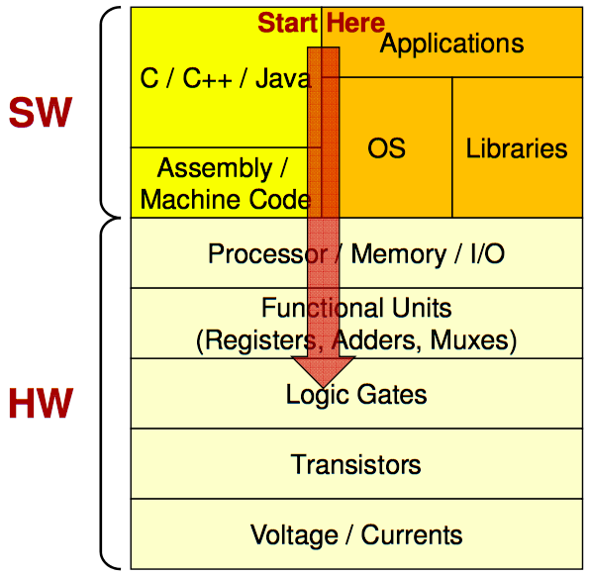
Software-Hardware stack
Computer Architecture spans the connection between hardware and software
Efficiency through understanding how each level interacts
Hardware design informs software design and vice versa
Credit:: Mark Redekopp, USC

Slide 6
Path to GPU computing
GPU Programming
GPU Architecture

Slide 7
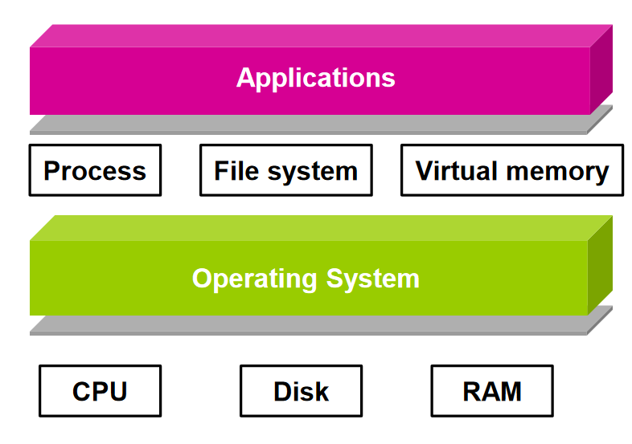
The Process in Operating Systems
The Process is the OS abstraction for execution
  Unit of execution
  Unit of scheduling
It is a program in execution
This can introduce overheads when handling many processes

Slide 8
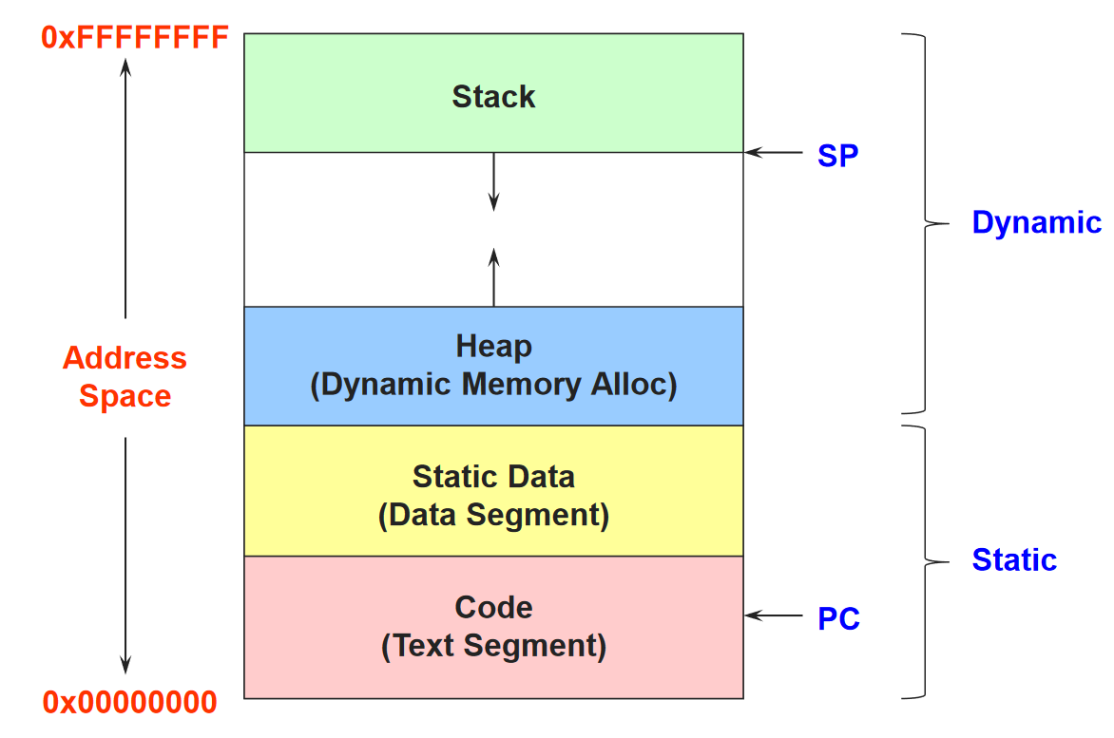
The Process in Operating Systems
It contains all the state for a program in execution
An Address space containing:
  Static Memory
    Code and input data for the program
  Dynamic Memory
    Allocated memory
    Execution stack
A set of control and general purpose registers

Slide 9
Process vs Thread
Separate execution and resource container roles
  The thread defines a sequential execution stream within a process (PC, SP, registers)
  The process defines the address space, resources, and general process attributes (everything but threads)
Threads become the unit of scheduling
  Processes are now the containers in which threads execute
  Processes become static, threads are the dynamic entities
Source: https://www.cs.uic.edu/~jbell/CourseNotes/OperatingSystems/4_Threads.html

Slide 10
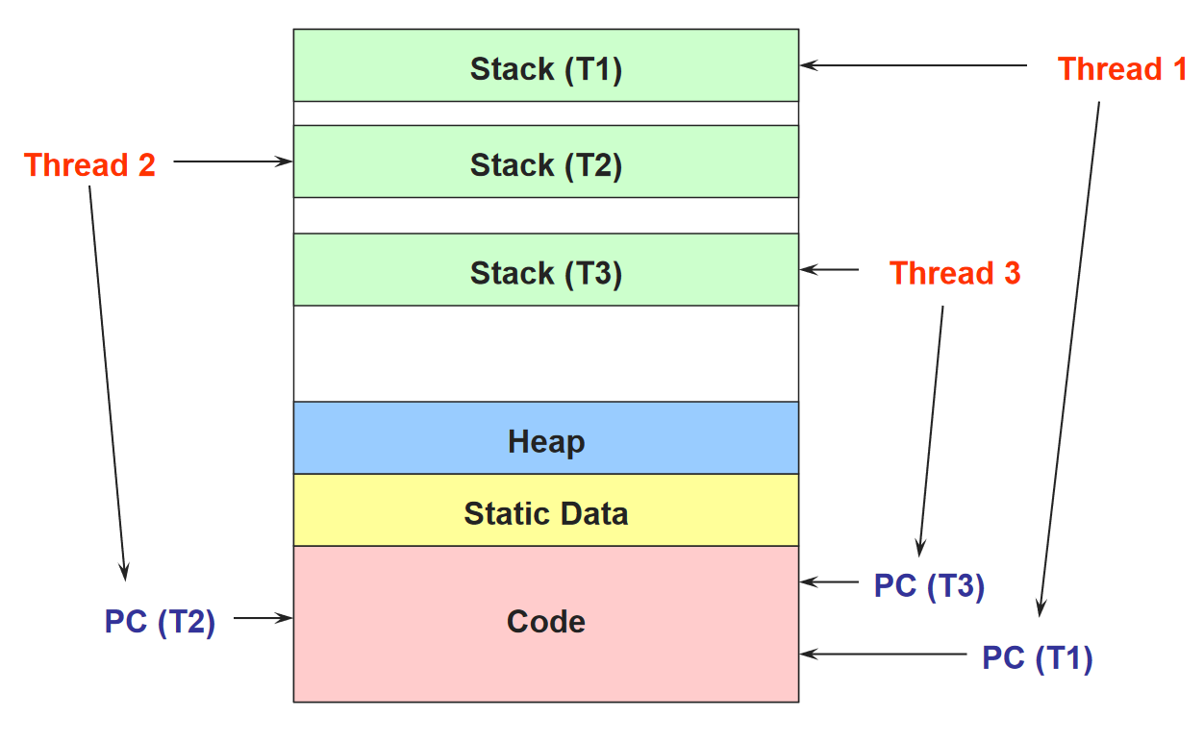
Process vs Thread
Separating threads and processes makes it easier to support multithreaded applications
Concurrency (multithreading) can be very useful
  Improving program structure
  Handling concurrent events (e.g., Web requests)
  Writing parallel programs

Slide 11
Takeaway for this Class
A thread is a single unit of execution
With its own control flow and data (i.e. Program Counter and Registers)
But shares the address space with the entire program (process)
This means that it can communicate and synchronize with other threads

Slide 12
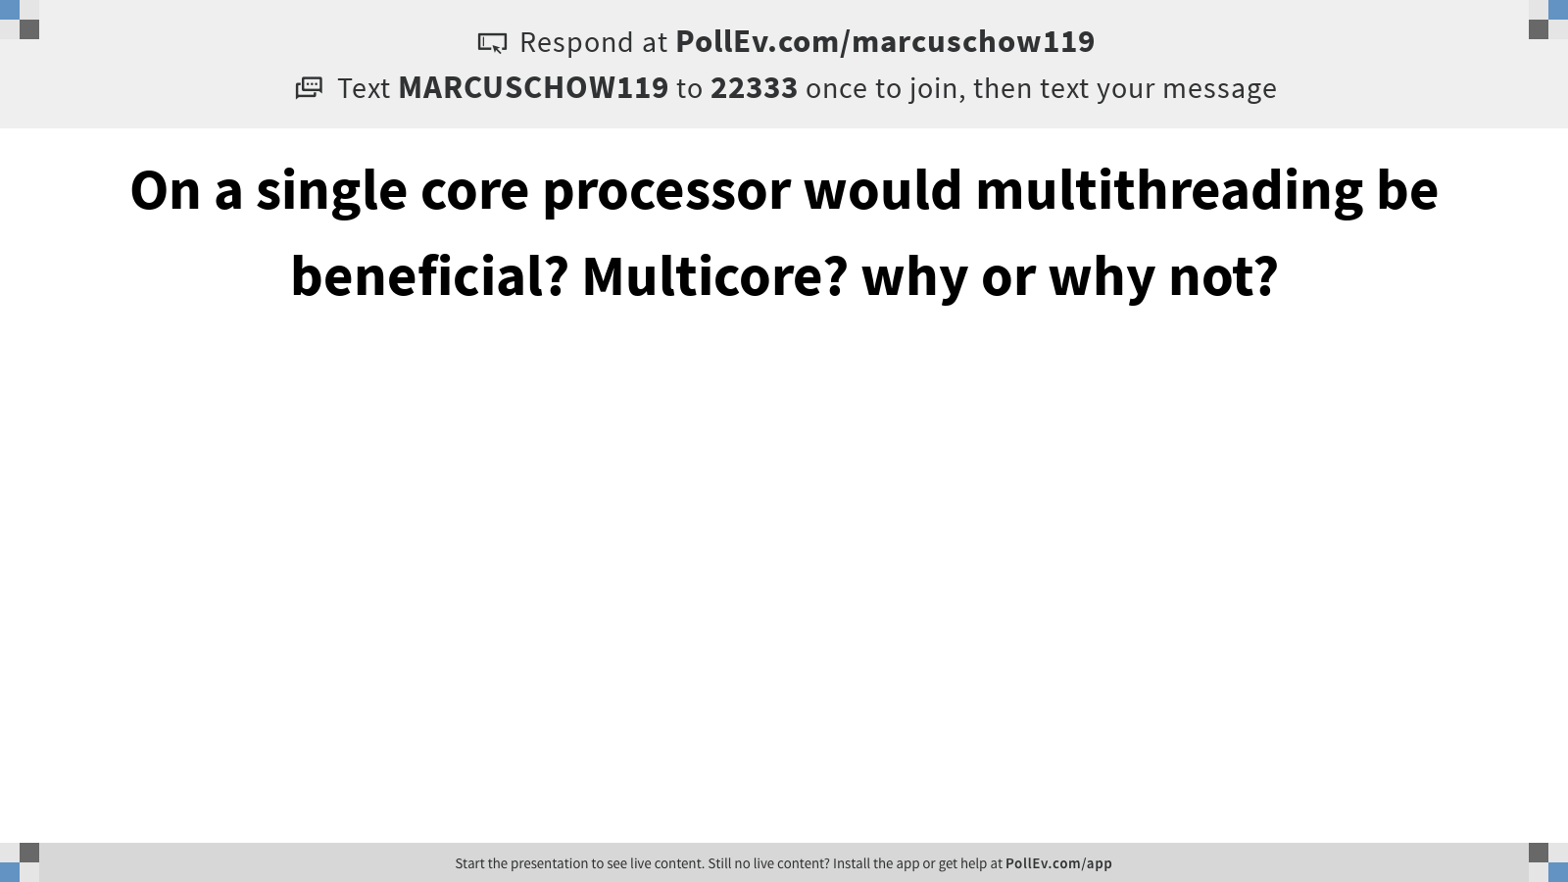
Notes:
Poll Title: On a single core processor would multithreading be beneficial? Multicore? why or why not?
https://www.polleverywhere.com/free_text_polls/2wlDw9lhLKTLceBE4scLw

Slide 13
Moving down the stack
Strip away software thread abstraction
How are threads handled in hardware?

Slide 14
A Thread as a Von-Neumann Processor
Von-Neumann Processor is an abstract diagram of a computer
Contains 4 units
  Processing Unit
  Control Unit
  Memory
  I/O
Memory
I/O
Processing Unit
Reg
File
ALU
Control Unit
PC
IR
Notes:
Insert von-neumann schematic here

Slide 15
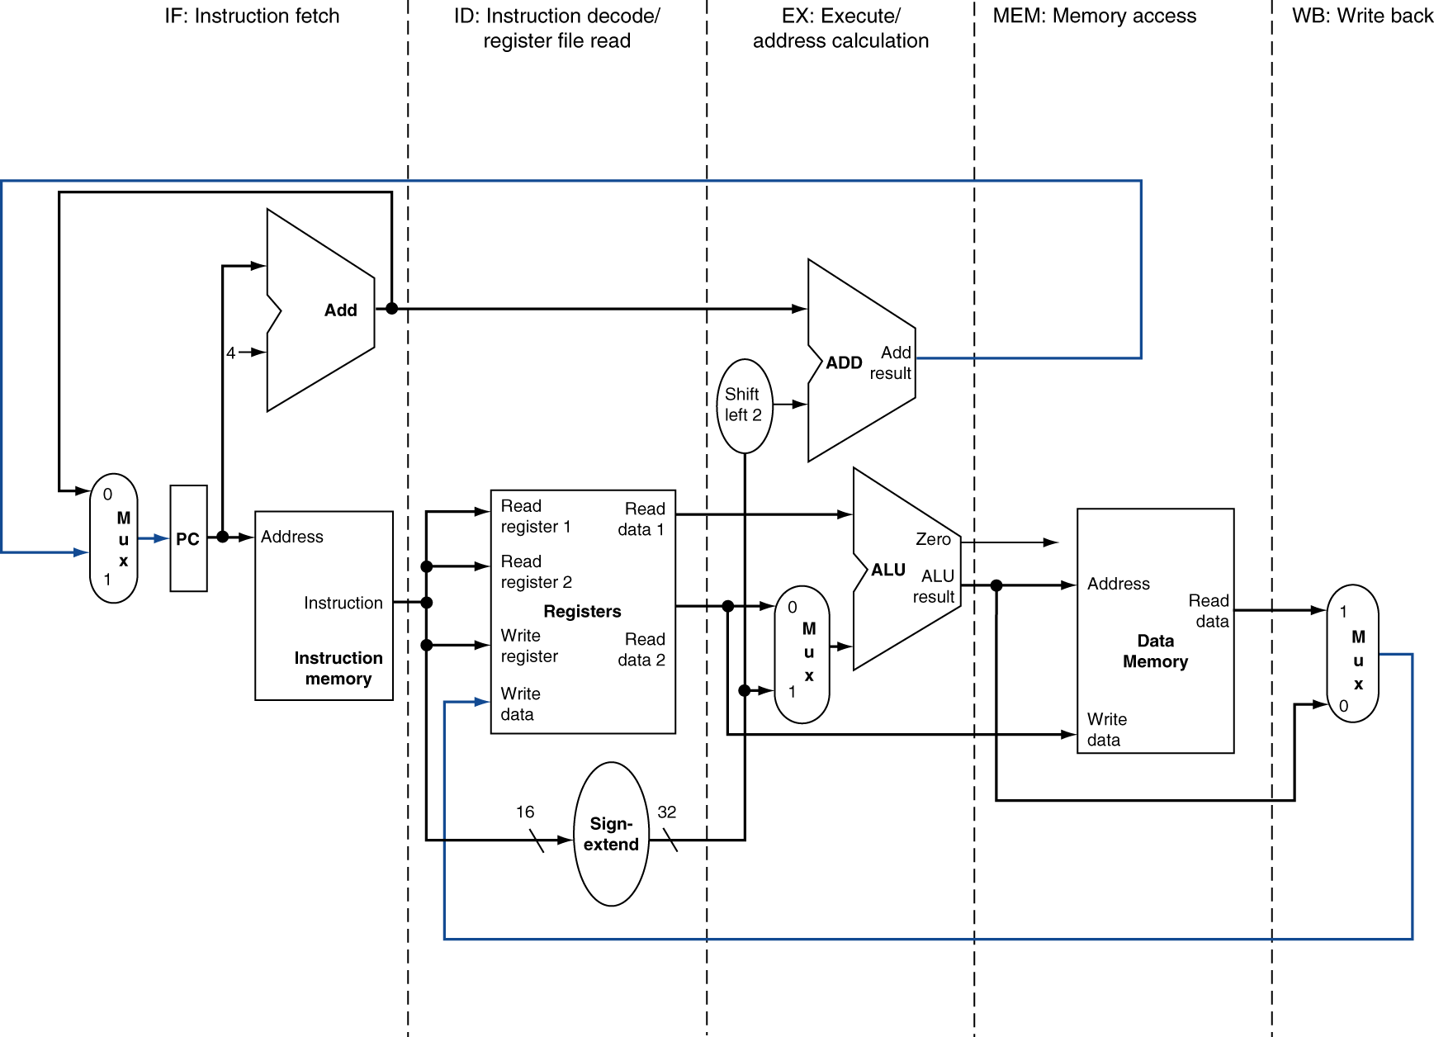
5-stage pipeline Processing Unit

Slide 16
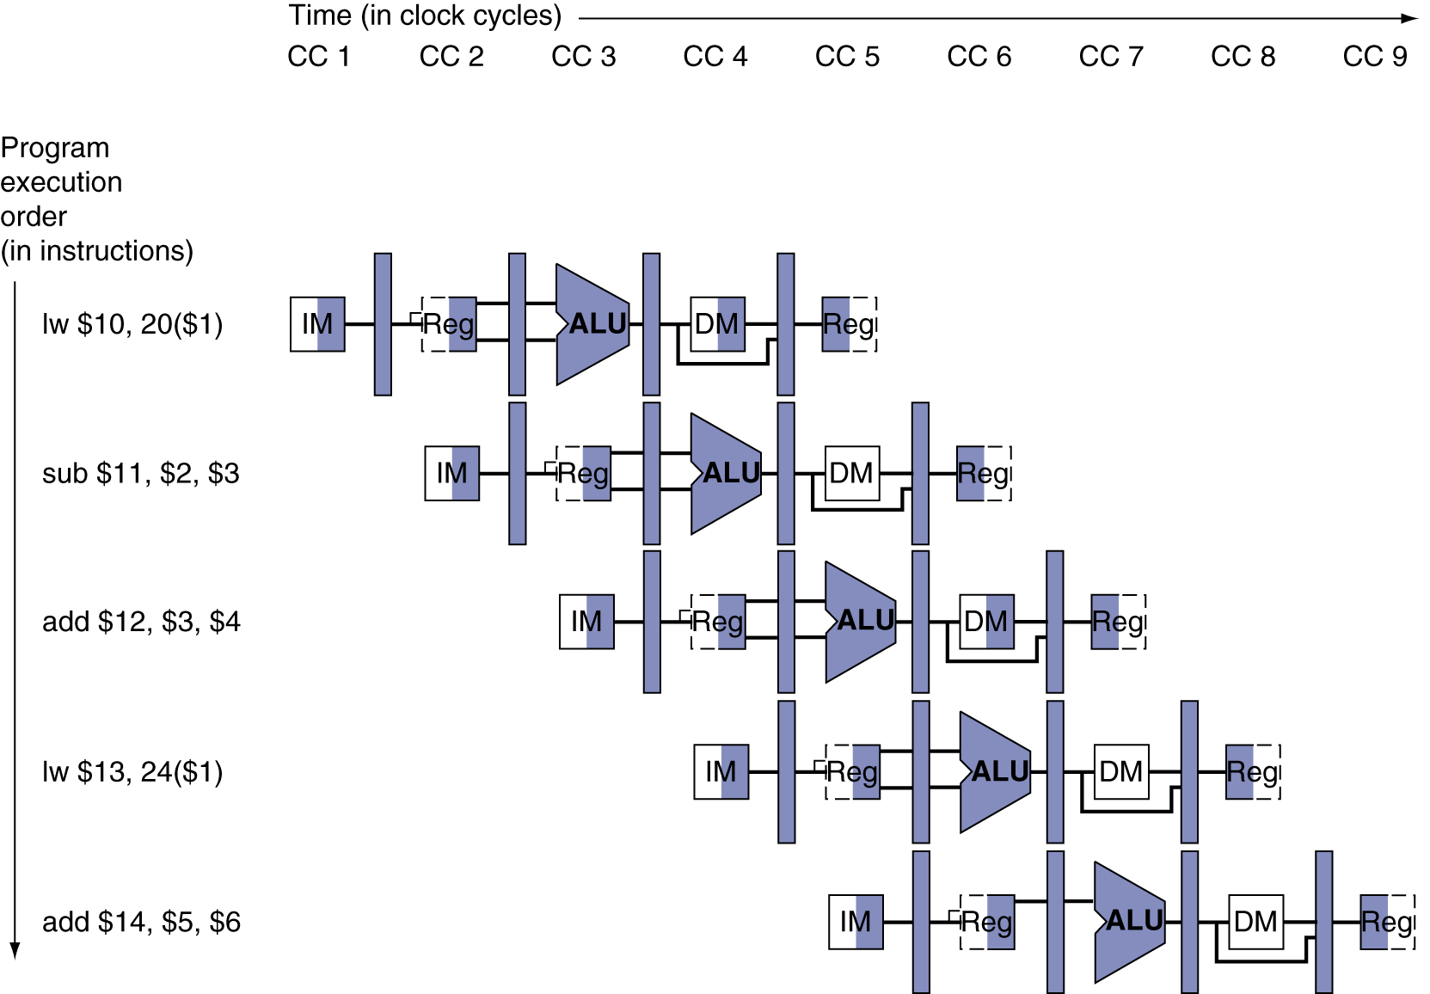
Multi-Cycle Pipeline Diagram

Slide 17
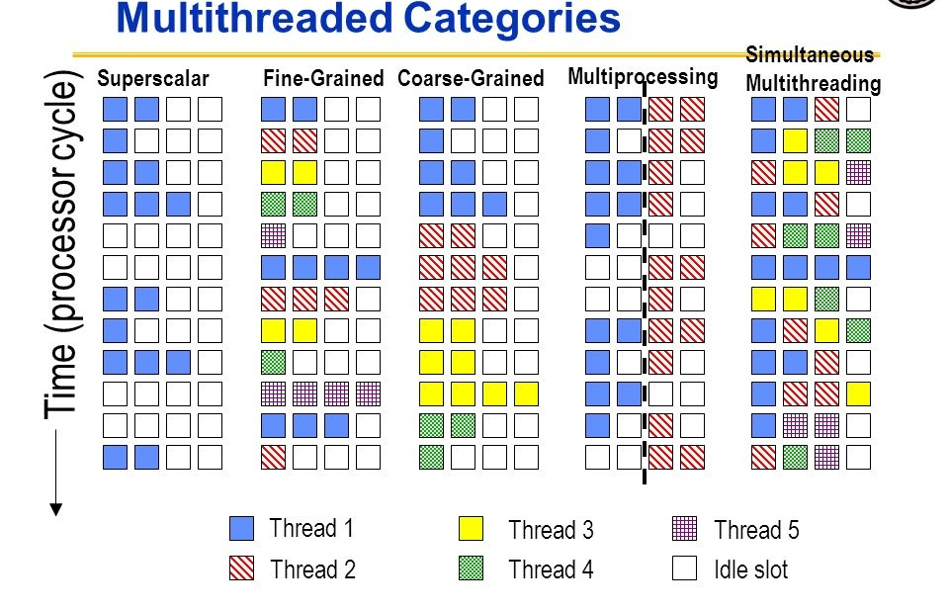
Handling multiple threads
A single compute unit can handle multiple threads
Scheduling policy tells which one will be executed next

Slide 18

Notes:
Poll Title: If you wanted to speedup a serial program, would a processor with SMT help?
https://www.polleverywhere.com/free_text_polls/g4fNcjRUxWJIe7JmEBpq2

Slide 19
Takeaway for this Class
Execution Unit is pipelined
  Multiple instructions can be inflight at the same time
Instructions are done in stages
  Fetch, Decode, Execute, Memory, Writeback
When handling multiple threads need to determine when to schedule a thread for sending down the pipeline
CPUs are latency orientated, can execute a single thread very quickly

Slide 20
Von-Neumann Processor Memory Unit
Von-Neumann Processor is an abstract diagram of a computer
Contains 4 units
  Processing Unit
  Control Unit
  Memory
  I/O
Memory
I/O
Processing Unit
Reg
File
ALU
Control Unit
PC
IR
Notes:
Insert von-neumann schematic here

Slide 21
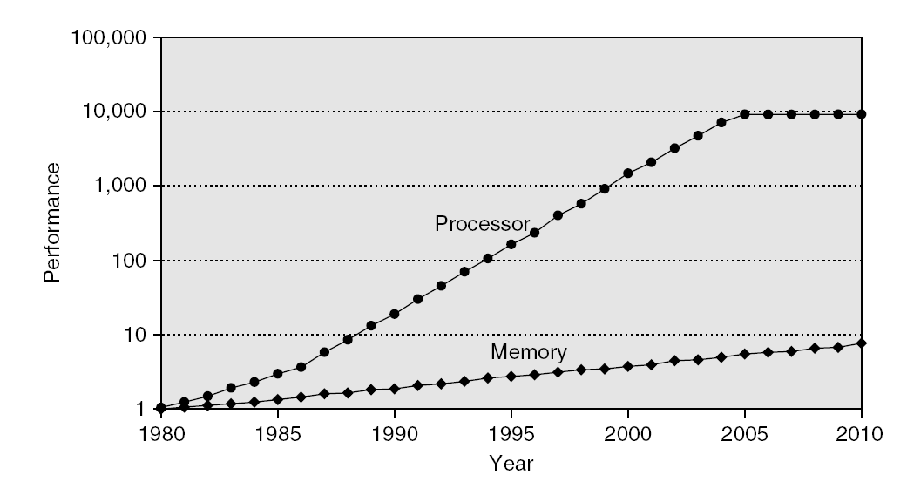
Memory Unit Performance Gap
Memory Performance Gap means the CPU is underutilized while it waits for data
The memory wall

Slide 22






Memory Systems
How can we supply the CPU with enough data to keep it busy?
We will focus on memory issues,
  which are frequently bottlenecks that limit the performance of a system.
Ideal memory: large, fast and cheap
Processor
Memory
Input/Output
Storage | Speed | Cost | Capacity | Delay | Cost/GB
Static RAM | Fastest | Expensive | Smallest | 0.5 – 2.5 ns | $1,000’s
Dynamic RAM | Slow | Cheap | Large | 50 – 70 ns | $10’s
Hard disks | Slowest | Cheapest | Largest | 5 – 20 ms | $0.1’s

Slide 23
How to Create the Illusion of Big and Fast
Memory hierarchy – put small and fast memories closer to CPU, large and slow memories further away

Slide 24
Introducing caches
Introducing a cache – a small amount of fast, expensive memory.
  The cache goes between the processor and the slower, dynamic main memory.
  It keeps a copy of the most frequently used data from the main memory.
Memory access speed increases overall, because we’ve made the common case faster.
  Reads and writes to the most frequently used addresses will be serviced by the cache.
  We only need to access the slower main memory for less frequently used data.
CPU
A little static
RAM (cache)
Lots of
dynamic RAM

Slide 25
Typical Memory Hierarchy
Principle of locality:
A program accesses a relatively small portion of the address space at a time
Two different types of locality:
  Temporal locality: if an item is referenced, it will tend to be referenced again soon
  Spatial locality: if an item is referenced, items whose addresses are close tend to be referenced soon

Slide 26
The principle of locality
Why does the hierarchy work?
Because most programs exhibit locality, which the cache can take advantage of.
  The principle of temporal locality says that if a program accesses one memory address, there is a good chance that it will access the same address again.
  The principle of spatial locality says that if a program accesses one memory address, there is a good chance that it will also access other nearby addresses.

Slide 27
How caches take advantage of locality
First time the processor reads from an address in main memory, a copy of that data is also stored in the cache.
  The next time that same address is read, we can use the copy of the data in the cache instead of accessing the slower dynamic memory.
  So the first read is a little slower than before since it goes through both main memory and the cache, but subsequent reads are much faster.
This takes advantage of temporal locality—commonly accessed data is stored in the faster cache memory.
By storing a block (multiple words) we also take advantage of spatial locality
CPU
A little static
RAM (cache)
Lots of
dynamic RAM

Slide 28
Temporal locality in instructions
Loops are excellent examples of temporal locality in programs.
  The loop body will be executed many times.
  The computer will need to access those same few locations of the instruction memory repeatedly.
For example:
  Each instruction will be fetched over and over again, once on every loop iteration.
Loop: lw $t0, 0($s1)
add $t0, $t0, $s2
sw $t0, 0($s1)
addi $s1, $s1, -4
bne $s1, $0, Loop

Slide 29
Temporal locality in data
Programs often access the same variables over and over, especially within loops. Below, sum and i are repeatedly read and written.
Commonly-accessed variables can sometimes be kept in registers, but this is not always possible.
  There are a limited number of registers.
  There are situations where the data must be kept in memory, as is the case with shared or dynamically-allocated memory.
sum = 0;
for (i = 0; i < MAX; i++)
sum = sum + f(i);

Slide 30
Spatial locality in instructions
Nearly every program exhibits spatial locality, because instructions are usually executed in sequence — if we execute an instruction at memory location i, then we will probably also execute the next instruction, at memory location i+1.
Code fragments such as loops exhibit both temporal and spatial locality.
sub $sp, $sp, 16
sw $ra, 0($sp)
sw $s0, 4($sp)
sw $a0, 8($sp)
sw $a1, 12($sp)

Slide 31
Spatial locality in data
Programs often access data that is stored contiguously.
  Arrays, like a in the code on the top, are stored in memory contiguously.
  The individual fields of a record or object like employee are also kept contiguously in memory.
sum = 0;
for (i = 0; i < MAX; i++)
sum = sum + a[i];
employee.name = “Homer Simpson”;
employee.boss = “Mr. Burns”;
employee.age = 45;

Slide 32
Definitions: Hits and misses
A cache hit
  occurs if the cache contains the data that we’re looking for. Hits are good, because the cache can return the data much faster than main memory.
A cache miss
  occurs if the cache does not contain the requested data. This is bad, since the CPU must then wait for the slower main memory.
There are two basic measurements of cache performance.
  The hit rate is the percentage of memory accesses that are handled by the cache.
  The miss rate (1 - hit rate) is the percentage of accesses that must be handled by the slower main RAM.
  Typical caches have a hit rate of 95% or higher, so in fact most memory accesses will be handled by the cache and will be dramatically faster.

Slide 33
Takeaway for this Class
Caches are used to hide the latency of slow memory
Caches work through spatial and temporal locality
You should be thinking of these localities when programming
Threads share the same cache

Slide 34
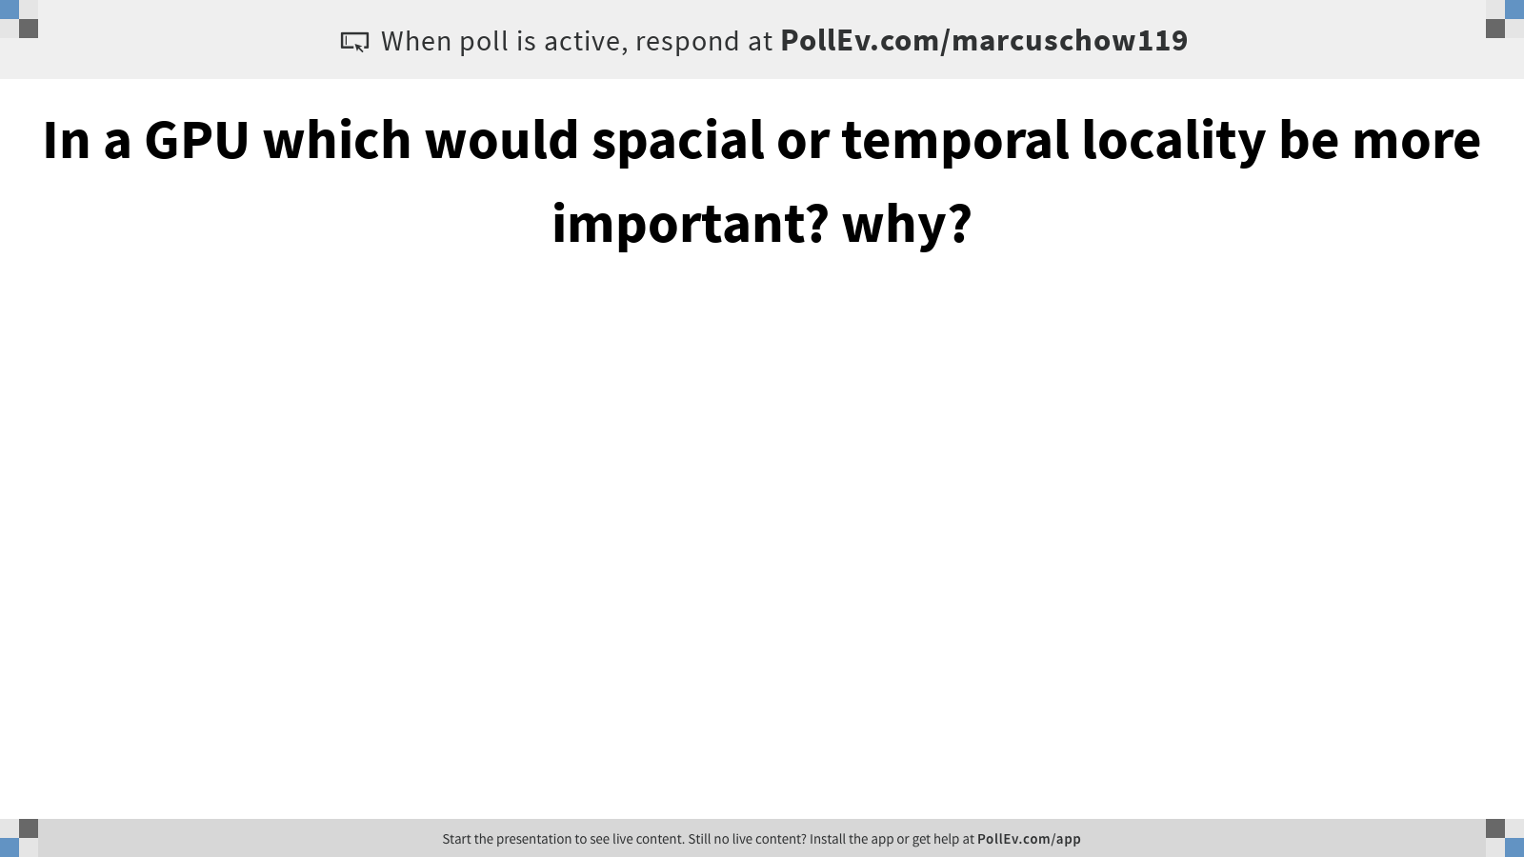
Notes:
Poll Title: In a GPU which would spacial or temporal locality be more important? why?
https://www.polleverywhere.com/free_text_polls/Vm6VupaF2TLZ73rFravsx

Slide 35
A Thread as a Von-Neumann Processor
Memory
I/O
Processing Unit
Reg
File
ALU
Control Unit
PC
IR
Notes:
Insert von-neumann schematic here

Slide 36
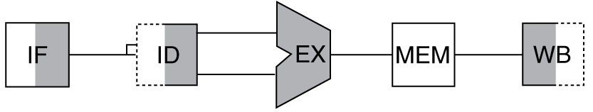
Abstracted CPU
Memory (Off-chip DRAM)
L3 Data Cache
L2 Data Cache
Core
Core
Core
I-$
RF
D-$
RF
. . .
Instr. Cache
Register File
L1 Data Cache
Data
Path
Core
Core

Slide 37
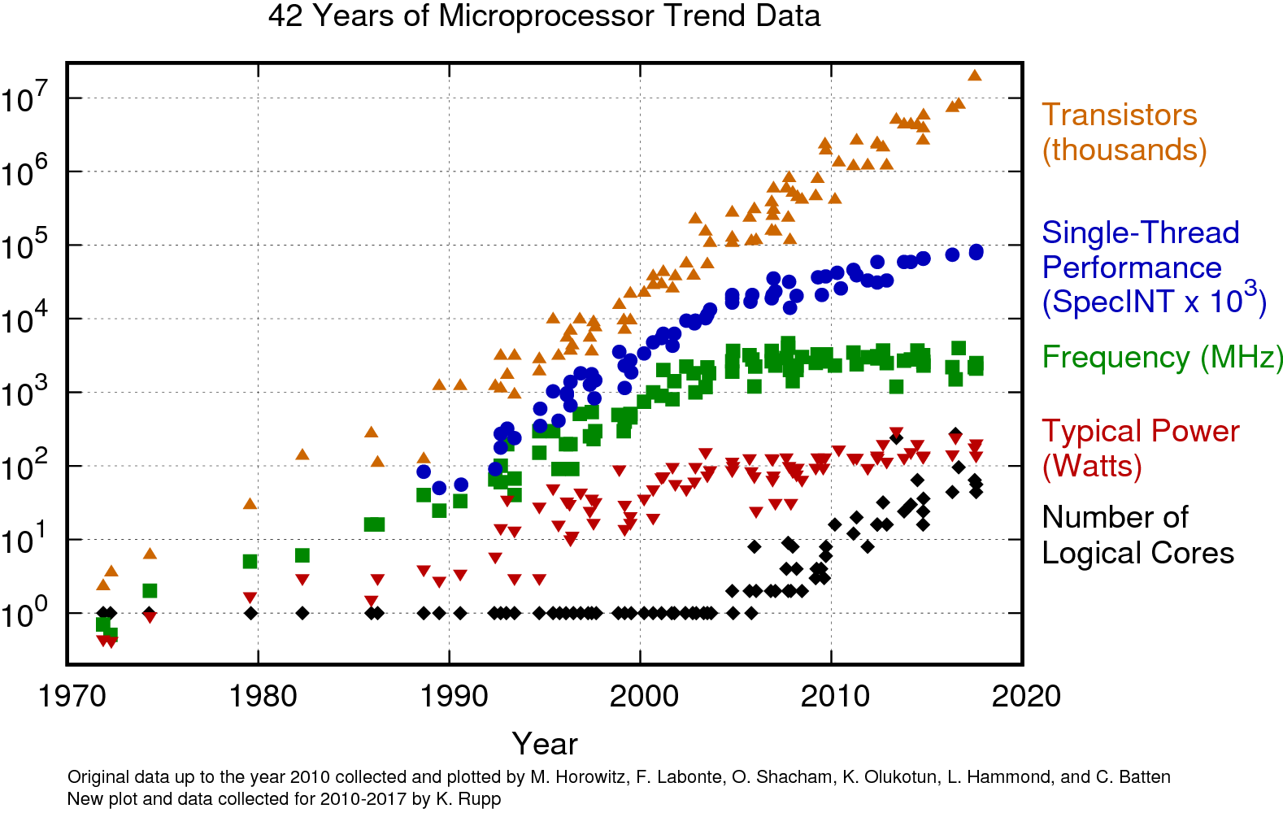
Moving away from traditional CPU Design

Slide 38
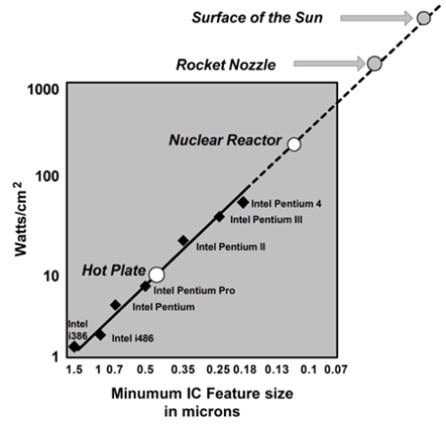
We’ve hit a power wall

Slide 39
Limits of CPU Designs
Modern computer architecture is limited by:
Process Technology / Transistor density (End of Moore’s Law)
Power (End of Dennard Scaling)
Temperature

Slide 40
Get more performance through specialization
CPUs are general-purpose
Easy to program but trades off efficiency
To gain performance push as much down to hardware
This is where we get specialized hardware
General-purpose
(Easier to program)
Single-core
CPU
Multi-core
CPU
GPU
FPGA
ASIC
Specialized
Energy-efficient

Slide 41
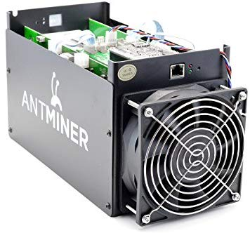
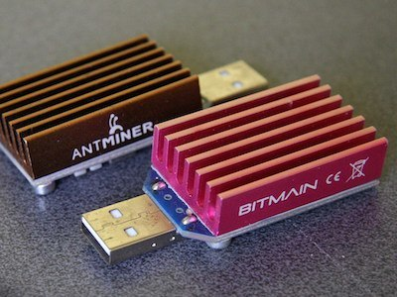
Examples of Specialization
Bitcoin Mining

Slide 42
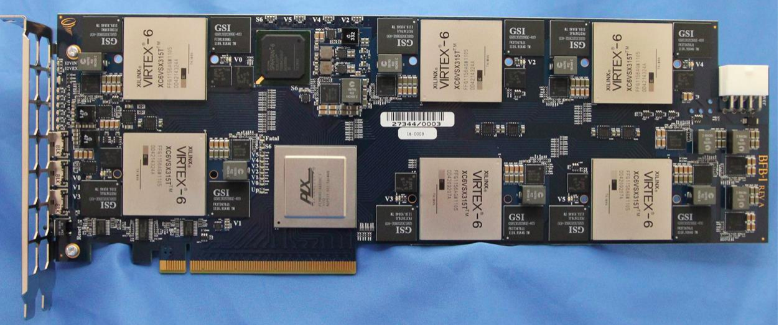
Examples of Specialization
Microsoft Catapult

Slide 43
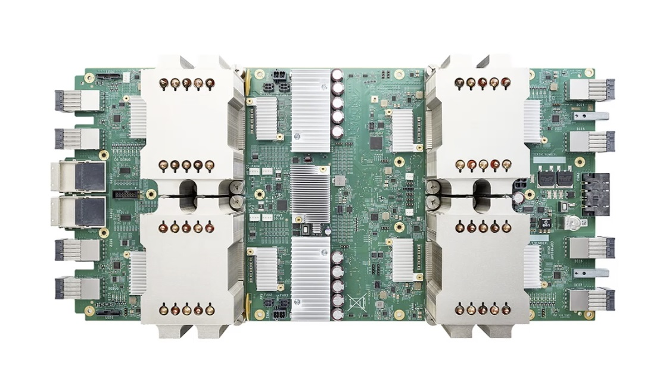
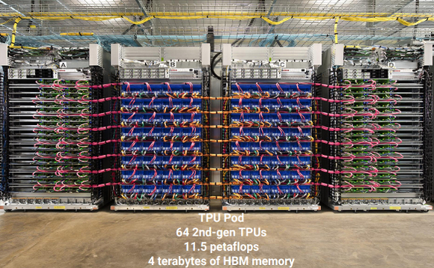
Examples of Specialization
Google TPU - Tensor Processing Unit

Slide 44
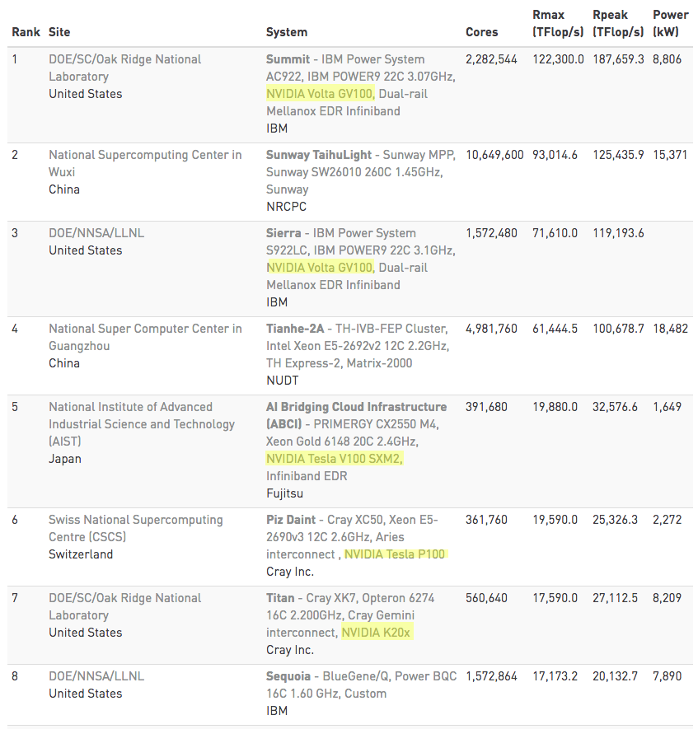
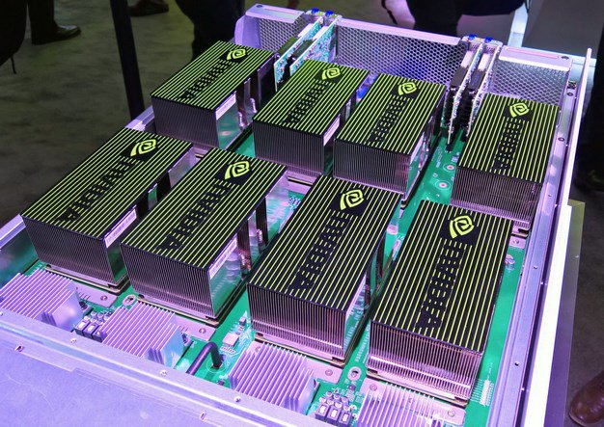
Examples of Specialization
GPUs - Supercomputers

