Slide 1
CS/EE 147 – GPU Computing and Programming
Introduction
Marcus Chow
mchow009@ucr.edu

Slide 2
Welcome!

Slide 3
About Me
Marcus Chow
They / Them Pronouns
A 4th year Ph.D. student in CS
Goal to be a Professor
Currently teaching in Camarillo
Care for your health and safety

Slide 4
About Me but Academics
University of California, Merced
BS Computer Science ’16
University of California, Riverside
MS Computer Science ’18
4th year Pd.D. student

Slide 5
About Me but Academics
Interned for NSF Research Experience for Undergrade at Texas State University
Research Co-Op at AMD for last two falls

Slide 6
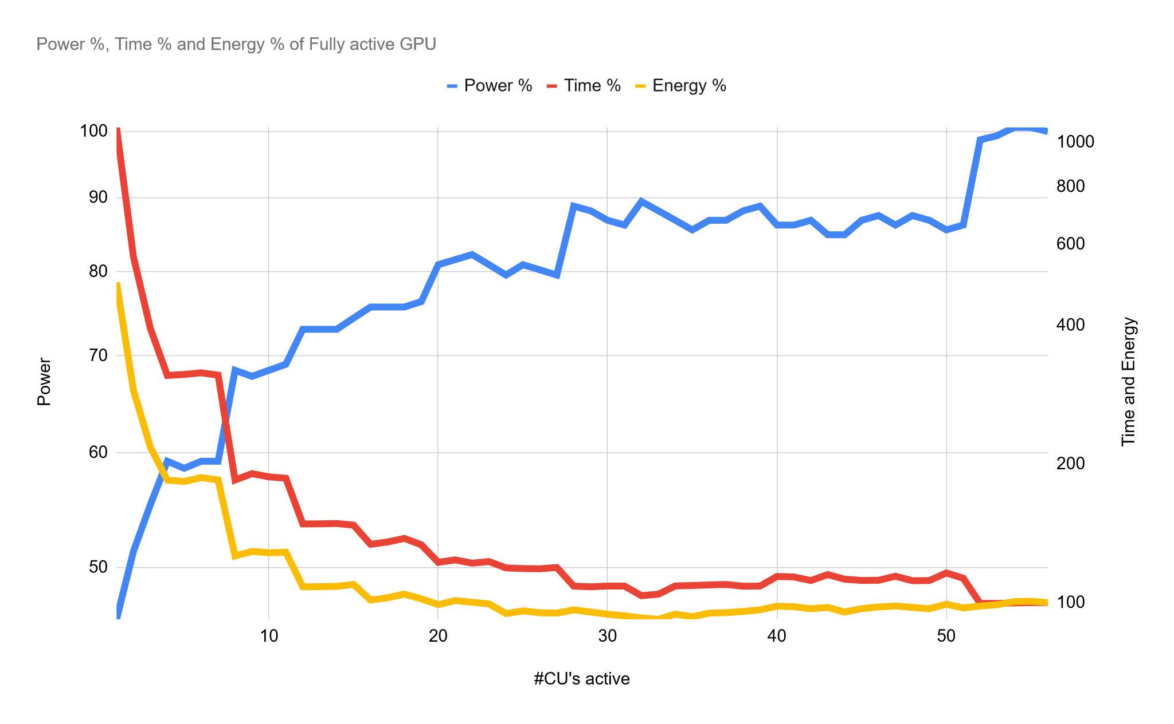
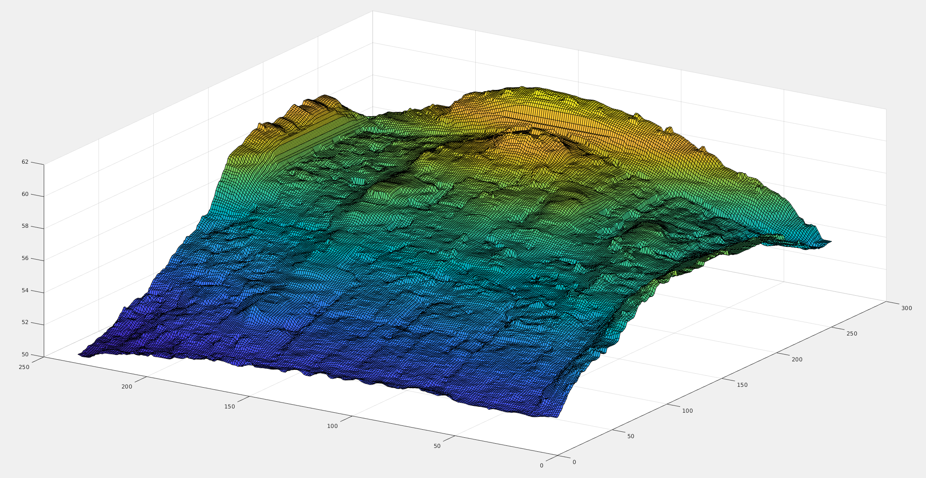
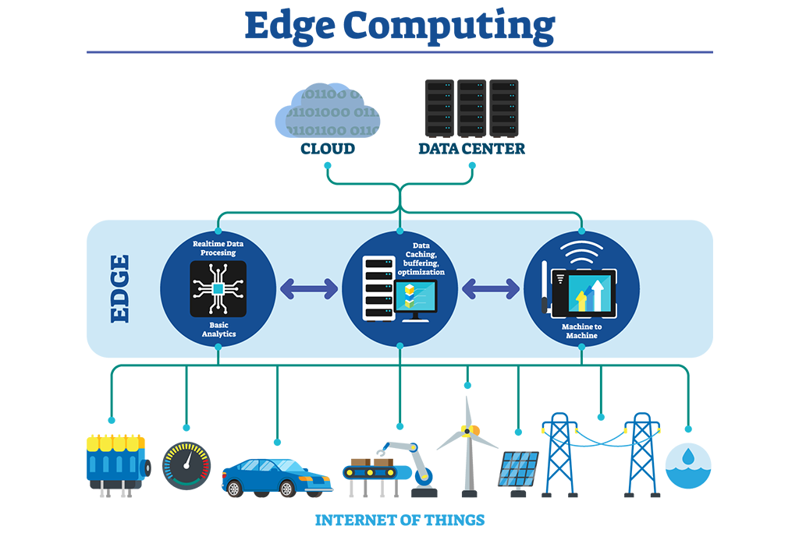
About Me but Research
Architectures for Sustainable Computing
Creating a Power and Thermal Model for GPUs
Edge Computing Runtimes
Energy Proportional Datacenter GPU

Slide 7
Tell Me About You!

Slide 8
Notes:
Poll Title: Introduction https://www.polleverywhere.com/surveys/SOHo9qYWhrAaKqSdyk7dJ

Slide 9
What is this Course?

Slide 10
Course Goals
Learn about calculating performance characteristics
Understanding the motivation why the GPU is used at all
How the motivation influenced the design of GPU architecture
How the design of the architecture leads to specific programming paradigms
How to program “Optimal” programs using these paradigms
Technical subjects
principles and patterns of parallel algorithms
processor architecture features and constraints
programming API, tools and techniques

Slide 11
Logistics
Course Website
https://www.cs.ucr.edu/~mchow009/teaching/cs147/winter20/
Check often for announcements
Assignments/Projects
iLearn (iLearn.ucr.edu)
Discussion/Help
Nectir https://ucr.nectir.io/group/eecs147
ENGR Account Setup
https://ucr.nectir.io/group/eecs147

Slide 12
Attendance/Grading
Attendance
You are expected to attend all lectures.
Online participation is Vital
Please turn on your cameras during class
Grade Breakdown
Homework/Labs: 20%
Exam and Final: 30%
Project: 30%
Class Participation: 10%
Quizzes and Discussion 10%

Slide 13
Lab Policies
3 slip days
15% penalty per late day
All labs/projects are due at the end of the due date (midnight)
Projects should be uploaded to iLearn and github classroom

Slide 14
Contact
Instructor: Marcus Chow
Email: mchow009@ucr.edu
Homepage: https://www.cs.ucr.edu/~mchow009/
Office: Online
Office Hours: TBH
TA: Mohammadreza Rezvana
Email: mrezv002@ucr.edu
Office Hours: TBD

Slide 15
Discussion for Wednesday
Why do you think we teach this class at all? The reason why we use GPUs today
Think about why you wanted to take this class? Deeper than course requirement

Slide 16
GPU Introduction

Slide 17
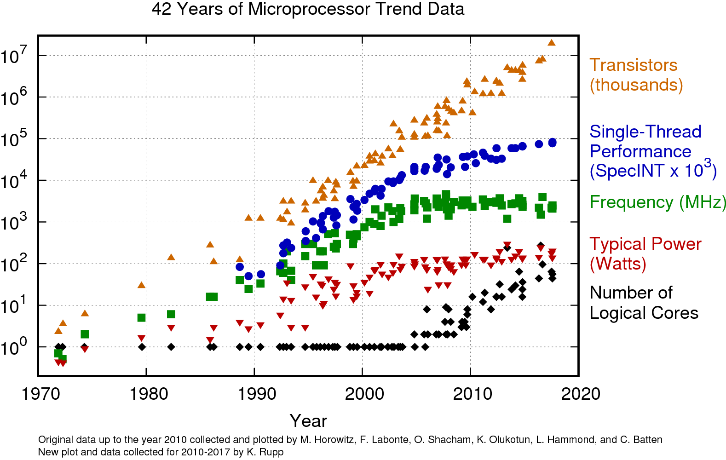

Slide 18
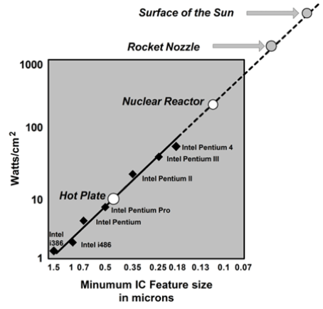

Slide 19
Modern computer architecture is limited by:
Process Technology / Transistor density (End of Moore’s Law)
Power (End of Dennard Scaling)
Temperature

Slide 20
General-purpose (Easier to program)
Single-core CPU
Multi-core CPU
GPU
FPGA
ASIC
Specialized
Energy-efficient

Slide 21
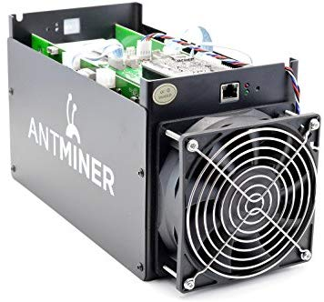
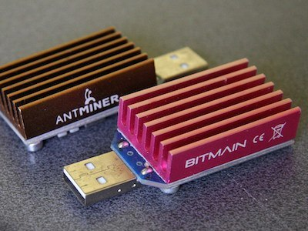
Examples of Specialization
Bitcoin Mining

Slide 22
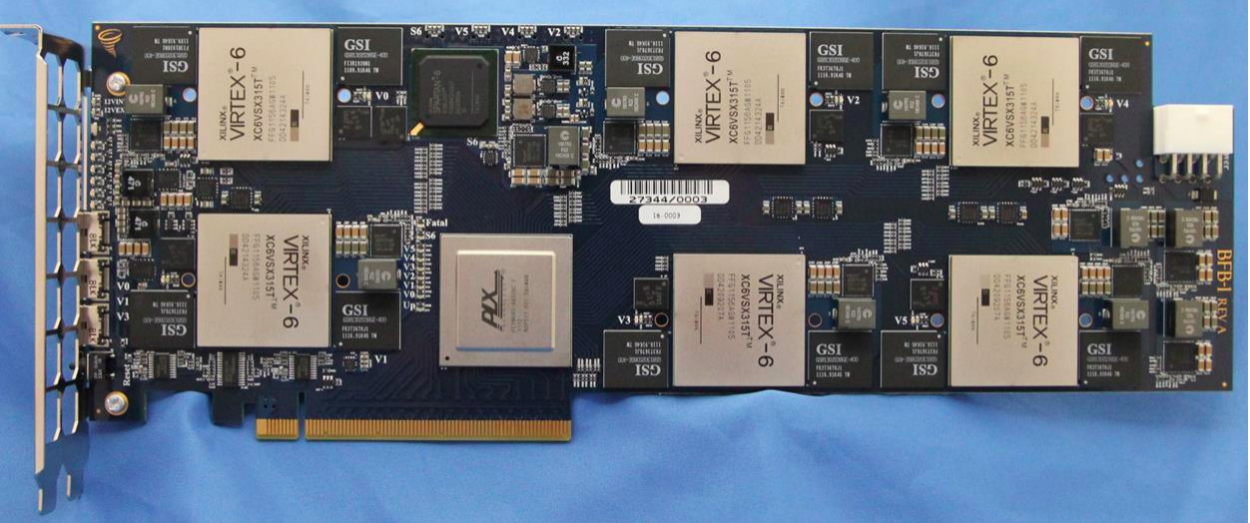
Examples of Specialization
Microsoft Catapult

Slide 23
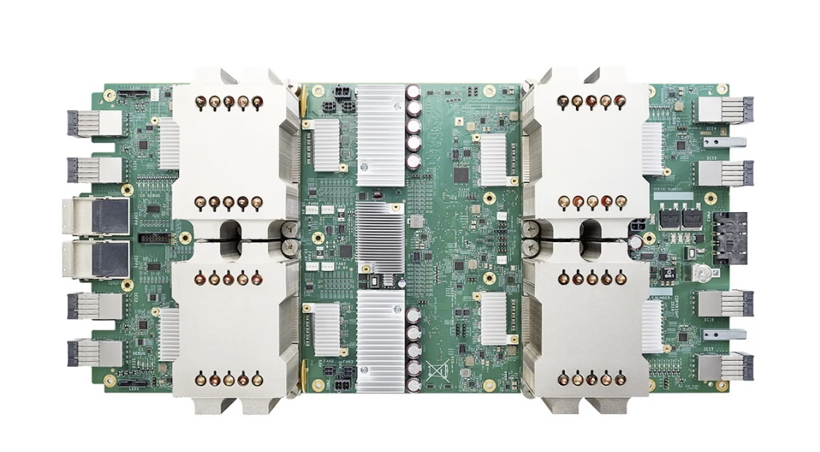
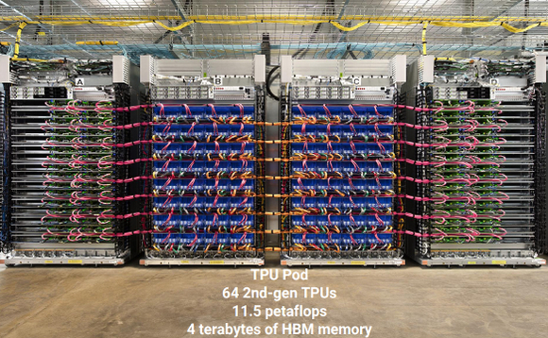
Examples of Specialization
Google TPU - Tensor Processing Unit

Slide 24
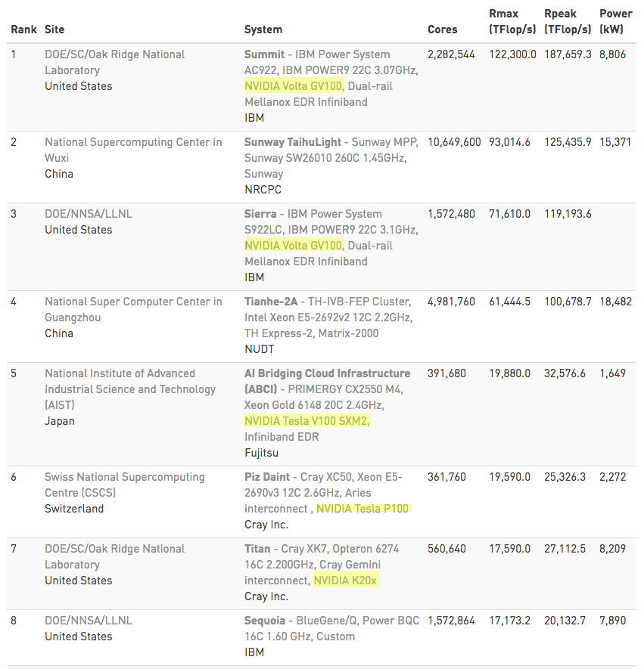
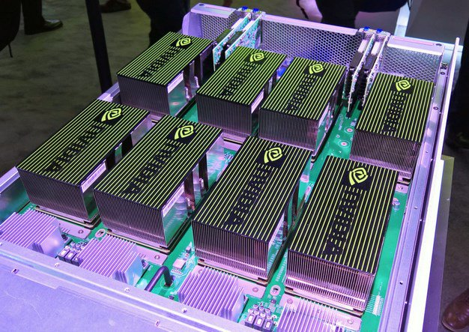
Examples of Specialization
GPUs - Supercomputers

