Slide 1
CommonGraph: Graph Analytics on Evolving Data
Mahbod Afarin Chao Gao Nael Abu-Ghazaleh Rajiv Gupta
ASPLOS’23

Slide 2
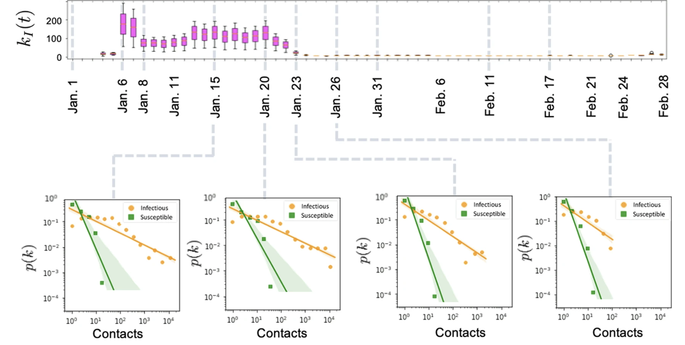
Evolving graph analytics
Use of temporal contact graphs to understand the evolution of COVID-19 through contact tracing data, Nature Communication Physics, Nov. ‘22
A graph that dynamically changes in time
Additions and deletions
Answer a query over a time window
Can involve many snapshots of the graph
Has many applications

Slide 3
Query Evaluation Over An Evolving Graph
Shortest Path Between A and B
Shortest Path Between A and B
Shortest Path Between A and B
A
B
A
B
A
B
Graph at Time $t$
Graph at Time $t+1$
Graph at Time $t+2$
Add 5 Edges
Delete 5 Edges
Add 3 Edges
Delete 4 Edges

Slide 4
Naïve Approach: Reevaluate at every step
Reevaluation of full graph is computationally expensive
Many vertices are not affected by the change
Full
Computation
Query
edge addition,
deletion
Full
Computation
Query

Slide 5
Incremental Recomputation
Reuse vertex states from previous evaluation
Approximate states for the initial states of new evaluations
Faster convergence
Reduced Computation
Full
Computation
Query
edge addition,
deletion
approximate
states
Incremental
Computation
Query

Slide 6
Example: Edge Addition
B
7
7
An added edge is equivalent to an update processed late
2
A
C
2
E
3
8
6
5
D
5
13 → 13
∞ → 7
14
E
B
7 → 5
13 → 12
3 → 3
A | B | C | D | E
Expected Values
0 | 5 | 3 | 8 | 5
New Values
0 | 5 | 3 | 8 | 5
∞ → 0
7
B
E
C
12
14
A
3
C
initial event
∞ → 3
D
8 → 8
8
D
E
15
C
13
∞ → 8
∞ → 13
3 → 3
12 → 5
3 → 3
E
7
C
Edge addition event
5

Slide 7
Deletions are trickier
Edge deletions are more complex to handle
A deleted edge already carried updates through it
The affected vertices remain in incorrect state
The updates through a deleted edge must be reverted
B
7
7
2
A
C
2
E
3
8
6
5
D
13 → 13
∞ → 7
14
E
B
7 → 5
13 → 12
3 → 3
∞ → 0
7
B
E
C
12
14
A
3
C
initial event
∞ → 3
D
8 → 8
8
D
E
15
C
13
∞ → 8
∞ → 13
3 → 3

Slide 8
Deletions are trickier
Reduce (Apply) function is monotonic
Vertex value cannot revert from an event.
Vertex must be reset, so that new events can update it
B
7
7
2
A
C
2
E
3
8
6
5
D
13 → 13
∞ → 7
14
E
B
7 → 5
13 → 12
3 → 3
A | B | C | D | E
Expected Values
0 | 7 | 15 | 8 | 13
Computed Values
0 | 5 | 3 | 8 | 12
∞ → 0
7
B
E
C
12
14
A
3
C
initial event
∞ → 3
D
8 → 8
8
D
E
15
C
13
∞ → 8
∞ → 13
3 → 3
3 → ∞
3 → 3
∞
C
Edge deletion event

Slide 9
Deletions are trickier
Resetting the destination vertex is not enough
Other impacted vertices will not revert
All vertices impacted by this edge must be reset
B
7
7
2
A
C
2
E
3
8
6
5
D
13 → 13
∞ → 7
14
E
B
7 → 5
13 → 12
3 → 3
A | B | C | D | E
Expected Values
0 | 7 | 15 | 8 | 13
Computed Values
0 | 5 | ∞ | 8 | 12
∞ → 0
7
B
E
C
12
14
A
3
C
initial event
∞ → 3
D
8 → 8
8
D
E
15
C
13
∞ → 8
∞ → 13
3 → 3
3 → ∞
∞
B
5 → 5
∞
C
Edge deletion event
∞
D
8 → 8

Slide 10
Insight 1: Deletions significantly more expensive than additions
SSSP
Deletions much more expensive than additions

Slide 11
Evolving Graph Query Evaluation
Naïve Approach
Solve query on each snapshot independently.
Streaming
Update the query solution for one snapshot to get the solution for the next snapshot.
CommonGraph!
Start from common subgraph among all snapshots

Slide 12
CommonGraph
Common Graph: Common edges between two snapshots
-D
+A
Solve on common graph
Graph at Time $t$
Graph at Time $t+1$
+D
Streaming additions only to get either graph
+A
No more deletions!
CommonGraph

Slide 13
Generalizing Common Graph
-D1
-D2
+A1
+D1
+A2
+A1
+A2
+D2
Graph at Time $t$
Graph at Time $t+1$
Graph at Time $t+2$
Intermediate
CommonGraph $1$
Intermediate
CommonGraph $2$
+D2
+A1
CommonGraph

Slide 14
Overall query execution
$$G_{t}$$
$$G_{t+1}$$
$$G_{t+2}$$
$$G_{t}$$
$$G_{t+1}$$
$$G_{t+2}$$
$$4 add$$
$$ICG_{1}$$
$$ICG_{2}$$
$$ICG_{1}$$
$$ICG_{2}$$
Streamed twice
$$G_{c}$$
$$G_{c}$$
Direct hop
Work Sharing

Slide 15
Which edges to use for work sharing?
$$G_{i}$$
$$G_{i+1}$$
$$G_{i+2}$$
$$G_{i+3}$$
Step1: Creating Triangular Grid
Step3: Bypass nodes with indegree and outdegree of 1
$$Δ_{+}^{7}$$
$$Δ_{+}^{8}$$
$$Δ_{+}^{9}$$
$$Δ_{+}^{10}$$
$$Δ_{+}^{11}$$
$$Δ_{+}^{12}$$
$${ICG}_{1}$$
$${ICG}_{2}$$
$${ICG}_{3}$$
$$Δ_{+}^{3}$$
$$Δ_{+}^{4}$$
$$Δ_{+}^{5}$$
$$Δ_{+}^{6}$$
$${ICG}_{4}$$
$${ICG}_{5}$$
$$G_{i}$$
$$G_{i+1}$$
$$G_{i+2}$$
$$G_{i+3}$$
$$G_{i}$$
$$G_{i+1}$$
$$G_{i+2}$$
$$G_{i+3}$$
$$Δ_{+}^{1}$$
$$Δ_{+}^{2}$$
$$Δ_{+}^{7}$$
$$Δ_{+}^{8}$$
$$Δ_{+}^{9}$$
$$Δ_{+}^{10}$$
$$Δ_{+}^{11}$$
$$Δ_{+}^{12}$$
$$G_{c}$$
$$Δ_{+}^{7}$$
$$Δ_{+}^{8}$$
$$Δ_{+}^{11}$$
$$Δ_{+}^{12}$$
$${ICG}_{1}$$
$${ICG}_{2}$$
$${ICG}_{3}$$
$${ICG}_{1}$$
$${ICG}_{3}$$
$$Δ_{+}^{4}$$
$$Δ_{+}^{5}$$
$$Δ_{+}^{6}$$
Step2: Identify Steiner Tree
$$Δ_{+}^{3}$$
$${ICG}_{4}$$
$${ICG}_{5}$$
$${Δ_{+}^{1}+Δ}_{+}^{3}$$
$${Δ_{+}^{2}+Δ}_{+}^{6}$$
$$Δ_{+}^{1}$$
$$Δ_{+}^{2}$$
$$G_{c}$$
$$G_{c}$$

Slide 16
Evaluated Systems
Shared Memory System
56 Intel Xeon E5-2680 processor
520GB memory
g++ 7.3.1
CentOS Linux 7
Five Graph processing algorithms
Breadth First Search
Single Source Widest Path
Single Source Narrowest Path
Single Source Shortest Path
Virterbi
CommonGraph Setup
50 consecutive snapshots
75,000 batch size
Four real-world graphs
LiveJournal (LJ)
DBpediaLinks (DL)
WikipediaLinks (Wen)
Twitter (TTW)

Slide 17
Speedup of Direct Hop and Work-Sharing Algorithm over KickStarter
CommonGraph achieves $1.38× − 8.17×$improvement in performance over Kickstarter across multiple benchmarks.

Slide 18
Sensitivity to the Different Number of Snapshots
TTW-SSWP
For the fewer number of snapshots, the Direct-Hop algorithm works better than Work-Sharing.
Work-Sharing outperforms Direct-Hop when we increase the number of snapshots beyond 23 to 35 for different benchmarks.

Slide 19
Sensitivity to Batch Size
TTW-SSWP
For the bigger batch size, the direct-hop algorithm works better compared to the work-sharing, and for the smaller number of the batch size, the work-sharing works better.

Slide 20
Sensitivity of Performance to the Ratio of Additions and Deletions
As greater percentage of deletion updates are considered, the speedup of Direct-Hop over KickStarter increases.

Slide 21
Higher opportunity for parallelism

Slide 22
Conclusions
Common graph is a new abstraction for streaming graph processing
Converts deletes to additions
Identifies and leverages common sub-computation
Exposes parallelism
Substantially outperforms Kickstarter
Several remaining optimizations, and opportunities

