Slide 1
Lecture 9
Byzantine Failures and CAP Theorem

Slide 2
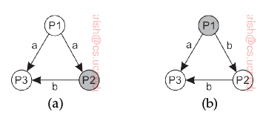
Byzantine Failures
Arbitrary patterns of failures – not just crash failures.
Specifically → inconsistent messages.
  Primary exhibiting Byzantine behavior → sending different messages to different replicas.
  Backup exhibiting Byzantine behavior → sending message inconsistent from the input from primary.

Slide 3
Byzantine agreement
BA1: Every non-faulty backup process stores the same value.
BA2: If primary is non-faulty, then every non-faulty backup process stores exactly what the primary had sent.
  If primary is non-faulty BA1 → BA2

Slide 4
What is needed ?
Under these assumptions, at least 3k + 1 members are needed to reach consensus if k members can fail.
  Our assumptions are there is a primary P and backups B₁ B₂ …. B_{n-1}

Slide 5
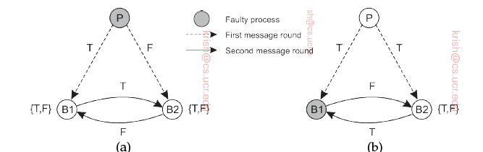
Having 3k processes is not enough
Let us assume k = 1
Consider the following:
  Case (a) primary fails; Case (b) back up fails

Slide 6
Having 3k cases is not enough
In Case (a) primary sends T to one backup and F to one backup.
  Each backup forwards what is received to the other.
  Thus, each has {T,F} –conclusion cannot be drawn.
In Case (b), B1 flips the primary’s message and relays a wrong (F) message to B2. B2 relays the correct message to B1. Again easy to see – no conclusion.

Slide 7
Extension to general case
For k > 1, use a simple reduction method.
Group the processes into three disjoint sets each containing at most n/3 members.
Simulate actions – each set S_{i} represents all members of its group.
  Thus, all members of a group are faulty or not faulty.
  Easy to see that this is similar to the example with k=1.

Slide 8
Having 3k+1 processes is enough
We will only show this for the case k = 1.
A similar but more cumbersome analysis possible for k = 2.
We will consider two cases :
  Primary is faulty
  Backup is faulty

Slide 9
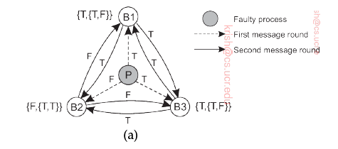
Consensus with 4 processes: Faulty primary
Processes forward what they receive to others.
In first round, P sends T to B1 and F to B2 and T to B3.
Each backup sends what they have to others.
Easy to see that at the end of the second round, each backup has {T, T, F}.
  Thus, a consensus of T is reached.

Slide 10
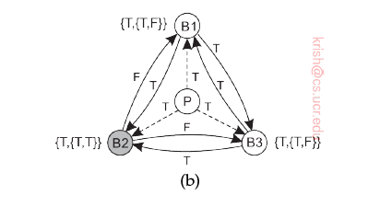
Consensus with 4 processes: Faulty backup
Non faulty primary sends T to all backups.
Faulty B2 sends F, while non-faulty B1 and B3 send T.
We see that the two non-faulty backups have {T,T,F}.

Slide 11
Asssumptions
For crash failures (2k+1) processes to come to consensus in presence of k failures.
However, the assumption is that the delay is bounded – message is received within some finite time.
  But what is this finite time ?
If processes do not operate in a lock step mode i.e., they are asynchronous, then hard to say what latency is incurred in receiving messages.

Slide 12
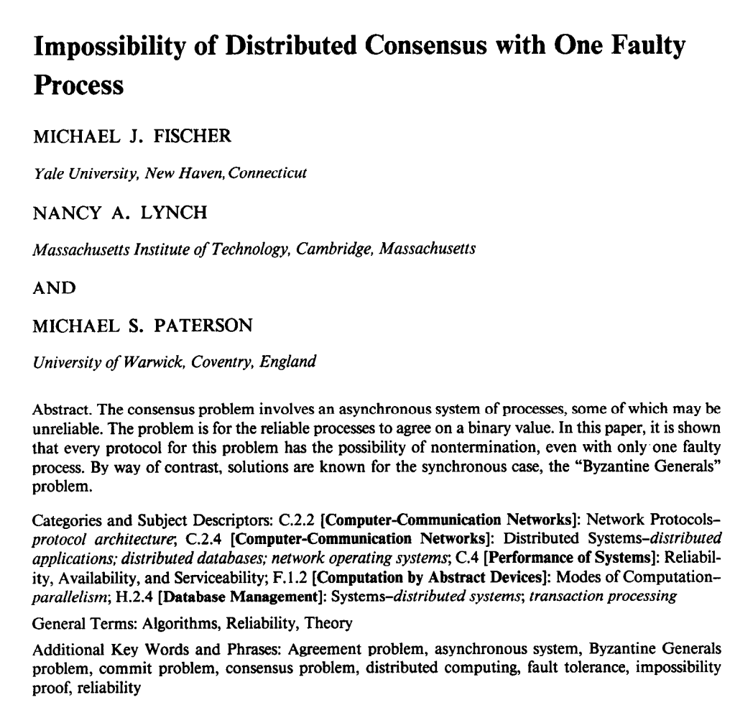
FLP Impossibility Result
In asynchronous model, distributed consensus impossible if even one process may fail
Holds even for “weak” consensus (i.e., only some process needs to learn, not all)
Holds even for only two states: 0 and 1

Slide 13
FLP Impossibility Result
Intuition: Cannot distinguish failures from slowness
  May not hear from process that has deciding vote
Implication:
  Choose safety or liveness
    Liveness → availability
How to get both safety and liveness?
  Need failure detectors (partial synchrony)
?
A
B
A
B

Slide 14
Recap: some terms
Consistency: Every read receives the most recent write or an error
Availability : Every read receives a response (not error) but no guarantee it is most recent.
Partition tolerance : System operates in spite of arbitrary number of message losses or delays between the replicas.

Slide 15

CAP Theorem
Pick any two: Consistency (C), Availability (A), and Partition-Tolerance (P)
  In practice, choose between CP and AP
Replica
Replica
Replica
Replica
Replica

Slide 16
What does this mean?
When partition occurs:
Cancel the operation
  Decreases availability but ensures consistency
Proceed with the operation
  Ensures availability at the cost of inconsistency

Slide 17
PACELC
Extension of CAP to include the impact of latency.
If partition,
  Choose availability vs. consistency
Else,
  Choose latency vs. consistency
Unifies two separate tradeoffs that we have talked about
R
R
R
R
R

Slide 18
Why should you care?
Can identify when system designers over-claim
Explicitly reason about tradeoffs when designing systems
Example: Should you choose AP or CP?

Slide 19
Impact on Consistency
When a replica receives a read or write, when can it respond without violating linearizability?
  If it is in a majority partition
If we want any replica to always serve clients
  Can we provide any consistency guarantees?
Example of such a RSM?

Slide 20
Example Scenario
Calendar application running on smartphones
  Each entry has time and set of participants
Local copy of calendar on every phone
  No master copy
Phone has only intermittent connectivity
  Cellular data expensive while roaming
  WiFi not available everywhere
  Bluetooth has very short range

Slide 21
Format of Updates
Goal: Automatic conflict resolution when replicas sync with each other
What would work?
  “10AM meeting, 4901 BBB, EECS 498 staff”
  “1 hour meeting at 10AM if room and participants free, else 11AM, 4901 BBB, EECS 498 staff”

Slide 22
Example Execution
Node A asks for meeting M1 at 10 AM, else 11 AM
Node B asks for meeting M2 at 10 AM, else 11 AM
X syncs with A, then B
Y syncs with B, then A
X will put meeting M1 at 10:00
Y will put meeting M1 at 11:00
Replicas can’t apply updates in order received

Slide 23
Ordering of Updates
All replicas must apply updates in same order
How to achieve consistent ordering despite intermittent connectivity?
Lamport clock!

Slide 24
Ordering of Updates
Recap of Lamport clocks:
  Every update associated with timestamp of the form (local timestamp T, originating node ID)
  a < b if a.T < b.T, or (a.T = b.T and a.ID < b.ID)
Updates with timestamps in our example:
  〈701, A〉: A asks for meeting M1 at 10 AM, else 11 AM
  〈770, B〉: B asks for meeting M2 at 10 AM, else 11 AM

Slide 25
Another Example Execution
〈701, A〉: A asks for meeting M1 at 10 AM, else 11 AM
〈700, B〉: Delete meeting M1
  B’s clock was slow
Now, delete will be ordered before add
How to prevent this?
  Lamport clocks preserve causality

Slide 26
Example Execution
〈701, A〉: A asks for meeting M1 at 10 AM, else 11 AM
〈770, B〉: B asks for meeting M2 at 10 AM, else 11 AM
Pre-sync database state:
  A has M1 at 10 AM
  B has M2 at 10 AM
After A receives and applies update from B:
  A has M1 at 10AM and M2 at 11AM
How can B apply update from A?
  B already has M2 at 10AM

Slide 27
Solution: Roll back and replay
B needs to “roll back” its state, and re-run ops in the correct order
So, in the user interface, displayed calendar entries are tentative at first
  B’s user saw M2 at 10 AM, then it moved to 11 AM
Takeaways:
  Need to maintain log of updates
  Sync updates between replicas not state

Slide 28
How to sync, quickly?
A
B
B tells A: highest timestamp for every node
  e.g., “X 30, Y 40”
  In response, A sends all X's updates after 〈-,30,X〉, and all Y's updates after 〈-,40,Y〉
How to sync
without state
exchange
proportional to
size of log?
〈-,10, X〉
〈-,10, X〉
〈-,20, Y〉
〈-,20, Y〉
〈-,30, X〉
〈-,30, X〉
〈-,40, X〉
〈-,40, Y〉
Version vector

Slide 29
Consistency semantics
Can a calendar entry ever be considered no longer tentative?
Eventual consistency:
  If no new updates, all replicas eventually converge to same state

Slide 30
Committing Updates
Implications of ordering updates using timestamp:
  Never know whether some write from the past may yet reach your node
  So all entries in log must be tentative forever
  All nodes must store entire log forever
How to mark calendar entries as committed?
How to garbage collect updates to prune the log?

Slide 31
Committing Updates
Update with timestamp (T, ID) is stable if higher timestamp update received from every node
Problem?
  Disconnected replica prevents others from declaring updates stable
Solution:
  Pick one of the replicas as primary
  Primary determines order of updates
  Desirable properties of primary?

Slide 32
Committing Updates
At any replica:
  Stable state
  Log of tentatively ordered updates (order based on Lamport clock timestamps)
Upon sync with primary
  Receive updates in order
  Apply updates to stable state and prune log
Any constraints in order chosen by primary?
  Must respect causality

