Slide 1
Lecture 8
Paxos and Consensus

Slide 2
Availability of P/B-based RSM
When is RSM unavailable to serve requests?
Replica is down but viewservice yet to detect
How to …
  … make RSM tolerant to network partitions?
  … ensure that operations don’t block even if some machines are unavailable?

Slide 3
Analogy
US Senate needs to pass laws
Senators are often on travel
  Common case: Not all senators present
How to pass laws successfully?

Slide 4
RSM via Consensus
Key idea: Apply an update if majority of replicas commit to it
If 2f+1 replicas, need f+1 to commit
Why majority? Why not fewer or more?
Remaining replicas cannot accept some other update

Slide 5
Context for Today’s Lecture
Say all replicas are in sync with each other
First: Among several concurrent new updates, how to pick next update to apply?
Later: How to apply all updates in a consistent order at all replicas?

Slide 6
Strawman Approaches
Every client proposes its value to all replicas
Every replica accepts first proposal received
Value accepted by majority is applied
Why might this not work?
Every client tags its proposal with seq number
Every replica collects proposals and accepts lowest seq number proposal
Why might this not work?

Slide 7
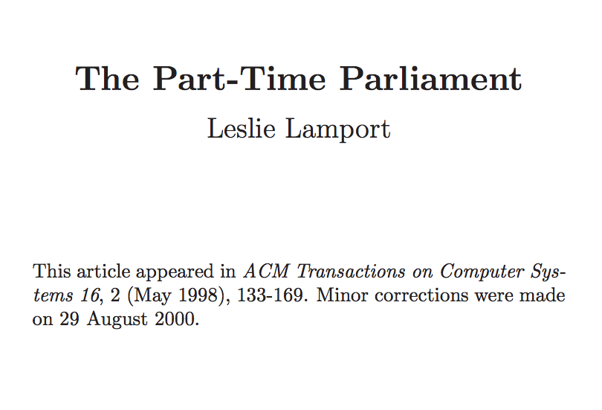
Paxos
Original paper submitted in 1990
  Tells mythical story of Greek island of Paxos with “legislators” and “current law” passed through parliamentary voting protocol
Widely used in industry today

Slide 8
Desirable Properties
Safety
  “No bad things happen”
  System never reaches an undesirable state
Liveness
  “Good things eventually happen”
  System makes progress eventually
Tradeoff between consistency and latency

Slide 9
Desired Properties of Solution
Safety:
  Accept a value only if accepted by a majority
  Accept a value only if proposed by some client
Liveness:
  If any values are proposed, one of them will eventually be accepted
  If a value is accepted, all replicas will eventually discover that it was chosen

Slide 10
Roles of a Process
Three conceptual roles
  Proposers propose values
  Acceptors accept values; chosen if majority accept
  Learners learn the outcome (chosen value)
In reality, a process can play any/all roles
Roles in bank account example?
Roles in US Senate example?

Slide 11
Paxos Overview
Three phases within each round
Prepare Phase:
  Proposer sends a unique proposal number to all acceptors
  Waits to get commitment from majority of acceptors
Accept Phase:
  Proposer sends proposed value to all acceptors
  Waits to get proposal accepted by majority
Learn Phase:
  Learners discover value accepted by majority

Slide 12
Paxos State
Every acceptor maintains three values:
  n_{p} → highest proposal number promised to accept
  n_{a} → highest proposal number accepted
  v_{a} → value accepted (operation)
This state must persist across restarts
Learners can re-discover accepted value (if any) from acceptors

Slide 13
Paxos Phase 1
Proposer:
  Choose unique proposal number n
  Send <prepare, n> to all acceptors
Acceptors:
  If n > n_{p}
    n_{p} = n ← promise not to accept any new proposals n’ < n
    If no prior proposal accepted
      Reply < promise, n, Ø >
    Else
      Reply < promise, n, (n_{a ,} v_{a}) >
  Else
    Reply < prepare-failed >

Slide 14
Prepare Phase
P1
A1
A2
A3
P2
n=2
n=1
n=3
np=_
np=_
np=_
np=2
np=2
np=1
np=3
np=3

Slide 15
Paxos Phase 1
Proposer:
  Choose unique proposal number n
  Send <prepare, n> to all acceptors
Acceptors:
  If n > n_{p}
    n_{p} = n ← promise not to accept any new proposals n’ < n
    If no prior proposal accepted
      Reply < promise, n, Ø >
    Else
      Reply < promise, n, (n_{a ,} v_{a}) >
  Else
    Reply < prepare-failed >
How to pick unique proposal number?
Why all? Why not majority?
← What else is worth including?
Notes:
It is worth telling who the proposal was from (so the proposer can update).

Slide 16
Paxos Phase 2
Proposer:
  Once received promises from majority of acceptors,
    v’ = v_{a} returned with highest n_{a}, if exists, else own v
    Send <accept, (n, v’)> to acceptors
Acceptors:
  Upon receiving (n, v), if n ≥ n_{p},
    Accept proposal and notify learner(s)
      n_{a} = n_{p} = n
      v_{a} = v
When would majority not promise?
Why not stop if v_{a} != v?
Notes:
When they have already made a previous promise.
No responses might mean loss of messages.

Slide 17
Accept Phase
P1 (v1)
A1
A2
A3
P2 (v2)
n=1
n=1
v=v1
n=2
n=2
v=v1
Notes:
When A2 responds to V2, it indicates that it promised value v1.

Slide 18
Accept Phase
P1 (v1)
A1
A2
A3
P2 (v2)
n=1
n=1
v=v1
n=2
n=2
v=v2
Notes:
No promise made in this case. So the value will be v2.

Slide 19
Accept Phase
P1 (v1)
A1
A2
A3
P2 (v2)
n=1
n=1
v=v1
n=2
n=2
v=v1
Notes:
Again, promise is made for v1.

Slide 20
Paxos: Sample Execution
Acceptor1: P1 A1-X P2
Acceptor2: P1 A1-X P2 P3
Acceptor3: P1 A1-X P3

Slide 21
Paxos: Sample Execution
Acceptor1: P1 A1-X P3 A3-X
Acceptor2: P1 P2 A1-X P3 A2-Y A3-X
Acceptor3: P2 A2-Y

Slide 22
Paxos: Sample Execution
Acceptor1: P1 A1-X
Acceptor2: P1 A1-X P2
Acceptor3: P2

Slide 23
Paxos: Sample Execution
Acceptor1: P1 A1-X
Acceptor2: P1 A1-X P2 A2-X
Acceptor3: P2 A2-X

Slide 24
Paxos: Sample Execution
Acceptor1: P1
Acceptor2: P1 A1-X P2
Acceptor3: P2

Slide 25
Paxos: Sample Execution
Acceptor1: P1
Acceptor2: P1 A1-X P2 A2-X
Acceptor3: P2 A2-X

Slide 26
Paxos: Sample Execution
Acceptor1: P1 A1-X
Acceptor2: P1 P2
Acceptor3: P2

Slide 27
Paxos: Sample Execution
Acceptor1: P1 A1-X
Acceptor2: P1 P2 A2-Y
Acceptor3: P2 A2-Y

Slide 28
Paxos is safe
Intuition: Once proposal with value v accepted, then every higher-numbered proposal issued by any proposer has value v
Majority of acceptors accept (n, v):
v is decided
Next prepare request with proposal n+1

Slide 29
Desired Properties of Solution
Safety:
  Accept a value only if accepted by a majority
  Accept a value only if proposed by some client
Liveness:
  If any values are proposed, one of them will eventually be accepted
  If a value is accepted, all replicas will eventually discover that it was chosen

Slide 30
Race condition leads to liveness problem
Process 0
Process 1
Completes phase 1 with proposal n0
Starts and completes phase 1 with proposal n1 > n0
Performs phase 2, acceptors reject
Retries and completes phase 1 with proposal n2 > n1
Performs phase 2, acceptors reject
… can go on indefinitely …

Slide 31
Paxos: Race condition
Acceptor1: P1 A1-X P3
Acceptor2: P1 P2 A1-X P3 A2-Y P4
Acceptor3: P2 A2-Y P4
How to fix this?

Slide 32
Fixes to liveness problem
When proposal fails, back off for a random period of time before retrying
Pre-determined ordering of proposers
  Negative response from acceptor includes ID of proposer to whom the acceptor has committed
  Back off period chosen based on ordering
Note co-operative nature of protocol

Slide 33
Why two phases?
Liveness problem is partly due to two phases
  Between one proposer’s Prepare and Accept phases, n_p updated by another proposer
Alternate design:
  Proposer sends propose messages to all acceptors
  Retry with higher proposal no. if majority don’t accept
Problem?
  Once a value is accepted by majority, we don’t want another value accepted by a majority

Slide 34
Paxos: Three Phases
Prepare Phase:
  Proposer gets commitment from majority of acceptors
Accept Phase:
  Proposer sends proposed value to all acceptors
  Waits to get proposal accepted by majority
Learn Phase:
  Learners discover value accepted by majority

Slide 35

Paxos in Action
P L
A L
R
A L
R
R
A L
R
R
A L
A L

Slide 36
Paxos Phase 3
Goal: For all learners to discover if any value was accepted by majority
Potential approaches:
  Proposer who has proposal accepted by majority of acceptors informs all learners
  Acceptor broadcasts to all learners whenever it accepts any value
  Acceptors notify distinguished learner, which informs others

Slide 37
Paxos Phase 3
Learners mimic proposers
Discover value accepted by each acceptor in response to prepare messages

Slide 38
Paxos: Sample Execution
Acceptor1: P1 A1-X P2
Acceptor2: P1 A1-X P2 P3
Acceptor3: P1 A1-X P3

Slide 39
RSM with Paxos
Log of updates at every replica
  Replicas execute updates in order in log
Use Paxos to come to consensus about each slot of the log

Slide 40
RSM with Paxos
Slots in log
Proposals / ballots

Slide 41
RSM with Paxos
Example: updates from MapReduce workers submitted to replicated Master
Whenever an update is submitted:
  Attempt to get update accepted to a particular slot in replicated log
  If unsuccessful, retry proposing to higher slot
Challenge: Must guess slot at end of log

Slide 42
RSM with Paxos
e1: an operation is accepted to i^{th} slot in log
e2: i^{th} operation is executed at all replicas
Arbitrarily large delay between events e1 and e2
Consequence: Local state at any replica differs from state of replicated log

Slide 43
Comparing with P/B Replication
P
B
B
B
B

Slide 44
Comparing with P/B Replication
P L
A L
Benefit of Paxos:
  Need only majority of replicas to be up
Downside of Paxos?
  Need two rounds of inter-replica communication
R
A L
R
R
A L
R
R
A L
A L

Slide 45
Leader-based Paxos
P L
A L
R
A L
R
R
A L
R
R
A L
A L

Slide 46
Leader-based Paxos
Pick one of the acceptors as the leader
All clients submit proposals to leader
Leader can directly skip to Accept phase because no contention
Learn phase executed asynchronously
How to pick a leader?
  Paxos!
Drawbacks compared to leaderless Paxos?
  Leader may be far from client

