Slide 1
Lecture 14
Speculative Paxos

Slide 2
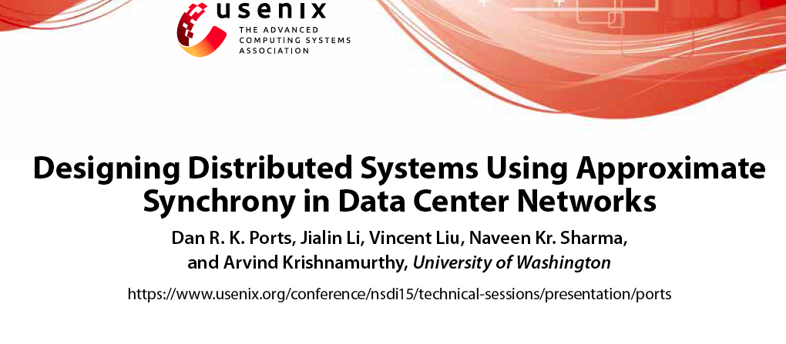

Slide 3
Premise
Many distributed systems are designed independently from the underlying network.
Thus, they assume worst case situations
  Completely asynchronous
Many distributed applications today are deployed on data centers
  Network predictable and reliable
Can we synergize the distributed system design with the network to improve performance?

Slide 4
Key contributions
MOM: Mostly ordered multicast
  Tries to redesign multicast so that notifications arrive at recipients in order
    Remember that multicasting is a key primitive in many distributed systems (e.g., communications among replicas)
  Gives almost total ordering.
Based on this – one can realize speculative Paxos
  Commit before full consensus (as with Paxos or leader-based Paxos)
  Because of MOM – very few cases require reconciliation or repair

Slide 5
Data center attributes
Predictable: Structured topologies → easier to understand routes and latencies.
Reliable : Packet losses are rare.
Extensible
  Use of technologies such as software-defined networking (SDN) allows flexibility in routing and in-network processing (using VMs or containers) of packets.
Why do we care? → Can help choose routes so as to obtain ordered multicast.

Slide 6
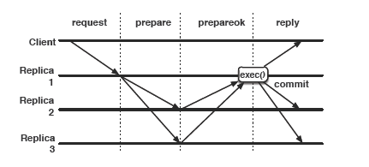
Recall : Leader based Paxos
Throughput suffers because of the load on the leader.
If leader fails, a replica needs to take over as leader.

Slide 7
Network structure
A single administrative domain and an OpenFlow type SDN controller
  Allows implementation of customized forwarding rules.
Organized structure of multi-rooted trees of switches
  Leaves are top-of-rack switches (to which all machines on the rack connect to)
  Top of rack switches connect to an intermediate tier of switches called “aggregation tier”
  These in turn connect to a “core tier” at the top level.
Control messages can be prioritized (both for transmissions and avoiding drops)
  So latencies and losses of coordination messages can be drastically reduced.

Slide 8
Where are the replicas?
Google’s spanner and similar systems use one replica group per shard.
Hundreds of thousands of shards per data center.
Replicas that belong to a group may be on different racks but typically belong to the same cluster
  To simplify cluster management and scheduling.

Slide 9
Mostly-ordered Multicast Goal
We don’t want to go with a dedicated leader.
  As discussed, it leads to bottlenecks and delays among other things.
How to provide ordered commits (even if in some “rare” cases, we need to fix things) ?
Mostly-ordered multicasts!
  To set the tone we first see what we mean by “totally ordered multicast”

Slide 10
Totally ordered multicast
Clients communicate simultaneously with a group of N receivers (here, replicas)
If process n_{i} processes message m before m’, then any other node n_{j} that receives m’ must process m before m’.
  Ensuring this property holds during failures – is a problem equivalent to that of consensus.
MOM considers a relaxed version – i.e., the above requirement does not have to hold in every case.

Slide 11
Mostly-ordered multicast property
The requirement for total ordered multicast is satisfied with high frequency
Occasionally the following ordering violations can occur:
  n_{j} processes m after m’
  n_{j} does not process m at all (because it was lost)
While it can be implemented using a best-effort network primitive, takes advantage of network properties.
  However, application code must handle ordering violations due to failures.

Slide 12
Principles of MOM
Topology awareness → ensure that all multicast messages traverse same number of links.
  Eliminates reordering due to path dilation
High prioritization → Highest QoS class
  Eliminate reordering due to queuing delays
  Packet drops due to congestion
In network serialization → route through a single root switch
  Eliminate non-failure related reordering

Slide 13
Example
Clients C₁ and C₂ communicating with a multicast group N₁, N₂ and N₃. The three receivers share a multicast IP address.
  This address is not shared by sub-nets.

Slide 14
Example continued
Message from the client sent to root switch S1 or S2.
The root switch makes 3 copies and sends it down
  All the three copies traverse same number of links.
  The flexible routing can be realized using SDN
  Fault tolerance by routing around failure (if enough redundant paths) or changing root if needed (see paper)

Slide 15
Other attributes
Even if one of the root switches is more congested than the other, the prioritization comes to the rescue.
  If S2 is more congested than S1, it is ok since both prioritize the MOM messages.
But still some variations can occur. So this is handled using in-network serialization i.e., use same top level switch.
  Acts as a serialization point – the order in which this switch sees the messages is the order in which they are sent.

Slide 16
MOM and consensus
How should MOM’s properties affect how consensus is achieved ?
What does it give us?
  Approximate synchrony → strong ordering during the common case, but this strong ordering property can be violated during occasional failures.
How do we take advantage of this ?
  Speculative Paxos

Slide 17
Basics
Speculative Paxos is a state machine replication protocol.
Common case :
  Rely on MOM
  Speculatively execute requests (before agreement is reached).
    Minimum latency (only two message delays)
    High throughput → no need to communicate between replicas on each request.
  Reconciliation via rollback when there are inconsistent operations.

Slide 18
What does it guarantee ?
Linearizability if there are no more than f failures.
Operations appear in consistent sequential order.
  Each operation sees the effect of the operation before it.

Slide 19
Speculative execs
Replicas execute operations before agreement is reached.
Upon receiving the speculative Paxos library makes the speculative execution upcall to the application.
  Attributes are the operation and a sequence number.
When there is a failed speculation a rollback is invoked to undo the most recent operations and return to a known state
  Informs application about all operations/sequence numbers to be rolled back.
Commit upcalls for those previous speculative operations that are never going to be rolled back.

Slide 20
Failure model
Crash failures.
Remains correct under the same assumptions as Paxos or Viewstamped replication
  2f +1 replicas will provide safety as long there are no more than f replica failures.
Liveness as long as messages are repeatedly sent and eventually delivered before the recipients time out.
  Same as Paxos
  This requirement is necessary because of FLT theorem (impossibility of consensus in an asynchronous system).

Slide 21
Protocols
Speculative Paxos consists of three protocols.
Normal execution : Speculative processing commits requests efficiently.
  Messages are ordered
  Less than f/2 replicas have failed
Synchronization : Verify that replicas have speculatively executed the same requests in the same order.
Reconciliation: Ensures progress when requests are delivered out of order or when between f/2 and f replicas have failed.

Slide 22
Replica states
NORMAL : Allow speculative processing of new operations.
RECONCILIATION: The reconciliation protocol is being applied (more later).
RECOVERY : Failed replica is reconstructing state.
RECONFIGURATION: Updates to replica memberships.

Slide 23
Replica log
Log is a sequence of operations executed by the replica
  Each has a sequence number.
  State is either SPECULATIVE or COMMITTED
    All COMMITTED operations precede SPECULATIVE operations.
Each log entry has a summary hash
  A hash of the previous summary and current operation
    Why ?
Two replicas that agree on a summary for an entry n, have the same ordering of operations up to that entry.
Standard checkpointing can help truncate logs

Slide 24
View service
System moves through a series of views
  Each has a view number and leader
  Leader can be selected using round robin ordering (recall election)
  Leader’s role is to mainly co-ordinate synchronization and reconciliation.

Slide 25
Speculative Processing
Client requests an operation
Speculative Paxos library sends request to all replicas
  client ID, operation, request identifier
  Using the MOM primitive --so mostly operations are ordered.
Replicas speculatively execute request and send “SPECULATIVE-REPLY” messages to the clients.
Client checks to see if (a superquorum) responds and if they do, commit transaction.
  The operation needs to be consistent across replicas in terms of the current operation and a summary hash (which ensures that the order upto this transaction) are identical across replicas.

Slide 26
Failure or Success
If responses don’t match (i.e., there is no superquorum) or if there aren’t sufficient responses before a time out, the client initiates a reconciliation.
Note if there is a success, the replicas don’t know that the operation has committed
  This is taken care of later in reconciliation
    Even if there are failures, the operation is not rolled back.

Slide 27
Why not just a quorum ?
This is because of speculative execution.
Let us say instead of a superquorum we only needed quorum (f+1).
Let us say the client only got exactly f+1 responses.
  Let the other f speculatively applied some other transaction.
The client commits the transaction, but the replicas have only done it speculatively.
  So if even one fails, the recovery protocol cannot distinguish the order.

Slide 28
How does superquorum help?
Now we can have only < (f/2) replicas apply some other transaction.
So even if another (f/2) fail from those in the superquorum we have (f+1) replicas applying the operation correctly.
  We can still tolerate f failures.
This helps establish correct order during reconciliation.

Slide 29
Synchronization
Since during the speculative processing the replicas do not know that a superquorum has committed to the operation, they need to do so.
They do this via a leader initiated -- periodic synchronization – say every t seconds.
A synchronization message has the current view number, the highest sequence number in the log (including speculative transactions) and the hash associated with the summary log.
Leader commits if there are more than a superquorum of replicas that agree on these.
  Confirms to all replicas (learning in Paxos – so that everyone can commit)
    If no superquorum, go to reconciliation.

Slide 30
Divergence
Reconciliation is invoked whenever there is a divergence across replicas
  Sequence number of operations, or hash summary.
Every replica stops processing new client requests and enters reconciliation phase.
They send reconciliation messages to each other and to the leader.
The leader will now need to take up the complex process of reconciling inconsistent replica logs.

Slide 31
Reconciliation messages
Contain the view “v” for which the reconciliation is needed.
The view “v_{l}” (prior) for which the status was normal.
The logs of that replica

Slide 32
Merging of logs – step 1
The leader needs to get messages from “f” replicas.
It considers the logs with the highest v_{l} and retains all the entries upto that point.
  These entries are viewed as normal and thus need to be maintained (previous reconciliations are respected).
Notes:
Together (f+1) including leader.

Slide 33
Merging of logs – Steps 2, 3, 4
Selects the log with the most COMMITTED entries.
  These operations are known to have succeeded, so they are added to the combined log in COMMITTED state.
Starting with next sequence number, check if the majority have the same summary hash for that number.
  If yes, add to log in SPECULATIVE state
  Repeat for each sequence number
Gather other entries (sequence numbers), choose an order add to log in speculative state.

Slide 34
Final step
Leader starts a new view and sends this log with that new view number to all replicas.
When replicas receive, they install the new log
  Roll back operations that are not in the new log
  Execute operations in ascending order according to the log.
Now the new state is set to normal and the replica starts speculative processing of new requests.
  See paper for discussion on ensuring progress (liveness).

