Slide 1
Lecture 13
Bitcoin and Blockchains

Slide 2
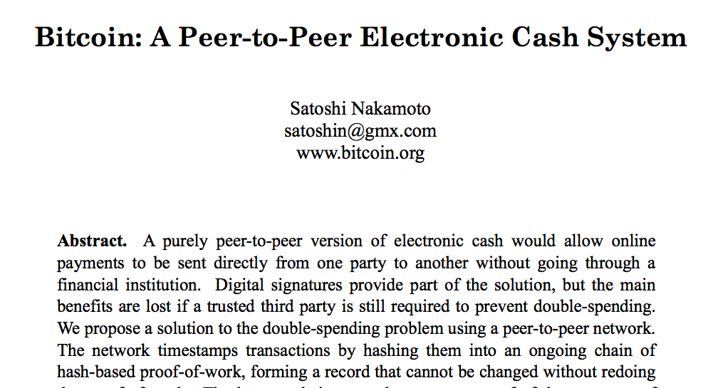
Cryptocurrency is becoming popular

Slide 3
Properties of Digital Currency
Say Bob pays for purchase with digital coins
What properties must seller check about coins?
  Valid (i.e., not forged)
  Not already spent
  Owned by Bob (i.e., not stolen)
How do shopping portals check these today?
Rely on bank, Visa, Mastercard, …

Slide 4
Eliminating Centralized Trust
Imagine public ledger of transactions
  Every transaction (“A paid $X to B”) in ledger
Benefits:
  Any user cannot spend more money than earned
How to achieve such a public ledger?
Paxos log?
Any user can propose transaction between any pair of users!

Slide 5
Encryption and Hashing
Every user has (public key, private key) pair
Enc(m, pub_{u}): can decrypt only with priv_{u}
Sign(m, priv_{u}): can use pub_{u} to verify signature
Cryptographic hash function:
  Hard to infer value given hash(value)

Slide 6
Preventing Theft
Represent coin transfer from Alice to Bob as:
  T = pub_{Bob}, sign(hash(T’), priv_{Alice})
  T’ is transaction via which Alice acquired this coin
When Bob transfers coin to Charlie later:
  T” = pub_{Charlie}, sign(hash(T), priv_{Bob})
  Anyone can use pub_{Bob} from T to verify signature
What would it take to spend another user’s cash?
Notes:
Note that the pub_Charlie indicates that only the private key that Charlie owns can be used to decrypt the currency. The output of the transaction is a currency --

Slide 7
Transactions
Note that the previous slide shows how transactions are crafted.
The output of the transaction is the currency.
  The precision of the output of the transaction limits the extent to which the currency can be subdivided.
    Smallest unit is satoshi and 10⁸ satoshis is one bitcoin.
As seen in the previous slide, each output also consists of some indicator of the public key needed to redeem the currency.

Slide 8
Public Ledger
Distributed system comprising 1000s of nodes
Broadcast transactions; valid if majority report
No money stolen unless private key leaks
How to identify majority? Majority of IP addrs?
What can Mallory do if she controls majority?
  Export different views of ledger to different users
  Double spending!
Sybil attack: Same user runs many nodes

Slide 9
Desired Properties of Ledger
Strongly consistent
  All users must see the same set of transactions
Append-only
  Can only add transactions
  Cannot remove transactions

Slide 10
Bitcoin: Key Idea
Every node must do work to participate
  Called mining
  Essentially relates to solving a puzzle –whoever solves it first is able to add its block after others have verified.

Slide 11
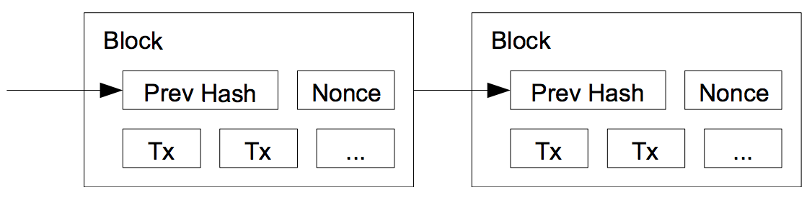
Structure of Bitcoin Ledger
Each miner picks a set of transactions for new block
Links to previous block by including its hash
Pick nonce for header

Slide 12
Bitcoin: Proof of work
The puzzle is : Find nonce such that
hash (nonce || prev_hash || block data) < target
i.e., hash has certain number of leading 0’s
At any time, all nodes in race to identify nonce for next block
Target set such that new block every 10 minutes
Incentive for any node to participate?

Slide 13
Coping with Forks
prev: H( )
prev: H( )
prev: H( )
prev: H( )
prev: H( )
txn 5
txn 6
txn 7
txn 8
txn 9
prev: H( )
txn 6’
“Correct” nodes accept longest chain (most difficult to break computationally)
  Older a block, the “safer” it is from being deleted
Common practice: Transaction 6 blocks deep “committed” (no formal grounding).

Slide 14
Block confirmation
Consensus is gradual – so users must wait for transactions to be accepted.
During a fork one of the branches will be eventually discarded after miners converge on the other.
If the two branches include “conflicting” transactions , one may be included in the longest chain.
  However, if the other chain later surpasses, it may have to be revoked.
  Sometimes could result in double spending (although rare).
If majority of miners follow default protocol, Bitcoin avoids these issues.

Slide 15
Randomized leader election
Each time a nonce is found:
  New leader elected for past epoch (~10 min)
  Leader decides which transactions comprise block
Probability of a node selected as leader?
  Proportional to node’s % of global hashing power
    Because more likely to solve the puzzle.
    Miners could get paid a part of the transaction fees (transactions fees also eliminates flooding of small transactions).

Slide 16
Scaling Bitcoin
Scaling limitations
  1 block = 1 MB max (~ 2000 transactions)
  1 block every 10 mins → 3-4 txns / sec
Visa peak load comparison
  Typically 2,000 txns / sec
  Peak load in 2013: 47,000 txns / sec
Joining requires full download of ledger
High energy consumption

Slide 17
Impact of Bitcoin
Idea of public ledger (called blockhain) widely applicable
  Remove dependence on centralized trust
Impact of using blockchain to create digital currency
  Various new directions have emerged (but we won’t cover).

