Slide 1
Lecture 13
Reliable Group Communications/Transactions

Slide 2
Need for reliable group communications
All processes (replicas) should agree to the same transaction.
Reliable delivery of messages from a coordinator to replicas.
  Easy way: Send and wait for ACK (e.g., using TCP) but results in blocking at coordinator
  ACK implosion: All the receivers send ACKs overwhelming the sender.

Slide 3
Reliable Multicast
Receivers keep track of sequence numbers of transmissions and only NACK missing messages.
A hierarchy is possible – a group of receivers with a coordinator each.
  Coordinator performs reliable multicast to all receivers.
Key issue: What happens when nodes fail ?

Slide 4
Distributed Transactions
Partitioning of state necessary to scale
Partitioning results in the need for transactions
  Atomically execute operations across shards
Examples:
  Add meeting to calendars of two participants
  Transfer money from one account to another
  Looking up balance of two accounts

Slide 5
Concurrency + Serializability
Execution of transactions:
Externally visible effects:
T₁
T₂
T₃
T₂
T₁
T₃

Slide 6
Example of Serializability
Concurrent execution of transactions:
  T1: Transfer $10 from Alice to Bob
  T2: Read balance in Alice’s and Bob’s accounts
  Initial balance of $100 in both accounts
Permissible outputs for T2:
  (Alice: $100, Bob: $100) or (Alice: $90, Bob: $110)
Invalid outputs for T2:
  (Alice: $90, Bob: $100) or (Alice: $100: Bob: $110)

Slide 7
Atomic multicast
Client contacts replica P for an update.
P multicasts the update to all other replicas.
If P crashes before multicast completes:
  Some members may have received others may not!
Requirement: Either all non-faulty members perform the update (equivalent to P crashing after) or none do (equivalent to P crashing before)

Slide 8
Group views
Atomic multicasting of a message “M” is uniquely associated with a group G (Group view)
  Processes to which M is to be delivered.
Key question: What happens if the group changes in between (a new process Q joins or leaves group)?
A “view change” takes place that announces this.
However, M needs to be either delivered to all processes in group G before the view change is executed.

Slide 9
Virtual Synchrony
A message multicast to a group view G is delivered to each non-faulty process in G.
If the sender of the message crashes:
  the message is either delivered to all the remaining processes; or,
  ignored by all of them
If these properties are satisfied, the reliable multicast is said to be virtually synchronous.

Slide 10
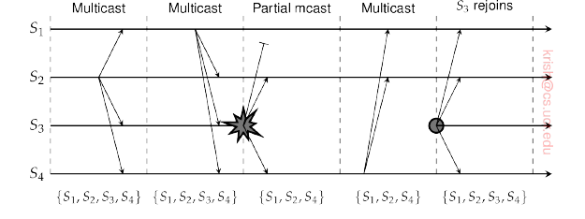
Example
If virtual synchrony is satisfied, message not delivered to S2 and S4 after S3 crashes.

Slide 11
Categorization
Unordered
FIFO ordered
Causally ordered
Total ordered multicasts: messages are delivered in same order to all members.
  The commits are consistent across all members.

Slide 12
Distributed commit
Distributed commit problem is having an operation performed by all members of a process group or none at all.
  Note: reliable multicasting is only delivery of a message.
One phase commit: Coordinator tells participants whether or not to locally perform the operation.
Drawback: If a candidate fails to perform the operation no way of telling the coordinator!

Slide 13
Two phase commit protocol (2PC)
Cooridinator sends a VOTE-REQUEST to participants
Each participant, upon receipt, either sends VOTE-COMMIT or VOTE-ABORT.
Coordinator collects votes; if all commit, sends a GLOBAL-COMMIT; else, sends a GLOBAL-ABORT
Participants who voted for commit, waits and does what the coordinator finally says.

Slide 14
Issues
Failures can cause issues with the basic 2PC protocol.
For example, a process may crash – and other processes may indefinitely wait for a message from that process.

Slide 15
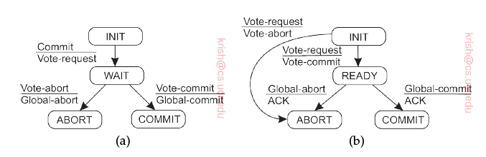
2PC -- FSMs
(a) The FSM for the coordinator
(b) The FSM for the participant.

Slide 16
Exiting from blocking states
A participant may be blocked in the INIT state
  Times out and issues VOTE-ABORT if no VOTE-REQUEST is received.
A coordinator maybe blocked in the WAIT state.
  Times out and issues GLOBAL-ABORT if not all votes are collected within a certain time.
A participant maybe blocked in the READY state – waiting for the results of the global vote.
  Now the participant cannot simply time out and abort.
  Needs to find out what was actually sent by the coordinator.
  Either block until coordinator recovers (delays) or
  Contact another participant to check if a COMMIT or ABORT was received.

Slide 17
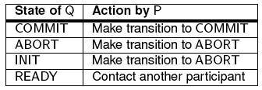
Blocked Participant in READY
If Q is in INIT state – it means it did not receive even the VOTE-REQUEST – thus, P should abort.
If Q is in the READY state also it has the same issue as P – so contact another participant.
  If all participants are in READY, no choice but to wait for the coordinator to recover.

Slide 18
Crashes
State information stored into persistent storage for recovery upon crashes.
When participant crashes in READY, does not know whether to abort or commit upon recovery
  In INIT, COMMIT or ABORT states this problem doesn’t arise.
  Needs to contact other participants
Coordinator needs to record
  WAIT state – retransmit VOTE-REQUEST upon recovery.
  Decision (COMMIT or ABORT) – which is retransmitted upon recovery.

Slide 19
Achieving Serializability
When is concurrent execution of transactions safe?
  Data read/written is disjoint
When must two transactions execute in order?
  Intersection in data read/written
Solution for serializability:
  Fine-grained locks
  Transaction coordinator first acquires locks for all data
  Execute transaction and release locks

Slide 20
Two Phase Locking
TC
Lock
Abort
P1
P2
P3
Transaction aborted since P2 did not commit to lock

Slide 21
Two Phase Locking
Can we reduce latency for read-only transactions?
TC
Lock
Commit
P1
P2
P3
Return data in first round if lock not held

Slide 22
Optimizing Read-Only Txns
Concurrent execution of transactions:
  T1: Transfer $10 from Alice to Bob
  T2: Read balance in Alice’s and Bob’s accounts
  Initial balance of $100 in both accounts
Problematic sequence of concurrent execution?
  TC2 reads Alice’s account balance as $100
  TC1 executes 2PL to acquire locks on both accounts, transfer $10, and release locks
  TC2 reads Bob’s account balance as $110

Slide 23
Lock-free Read-Only Txns
TC1
Read
P1
P2
Lock
Commit
TC2

Slide 24
Fault Tolerance of 2PL
TC1
Lock
Commit
P1
P2
Lock
Commit
TC2

Slide 25
Fault Tolerance of 2PL
Okay to commit after timeout?
TC
Lock
Commit
P1
P2
P3

Slide 26
Fault Tolerance of 2PL
TC
Lock
Abort
P1
P2
P3

Slide 27
Fault Tolerance of 2PL
TC
Lock
Commit
P1
P2
P3
When can we garbage collect transaction log?

Slide 28
Garbage Collection
Lock acquisition in node log:
  Node receives commit from TC and writes to its log
Commit operation in TC log:
  After all nodes say transaction committed
Commit operation in node log:
  Upon applying operation to local state

Slide 29
Fault Tolerance
Transaction cannot succeed if any partition unavailable
TC
Lock
Abort
P1
P2
P3

