Slide 1
Lecture 11
DHTs and Amazon Dynamo

Slide 2
Scaling up
Assumption so far: All replicas have entire state
Example: Every replica has value for every key
What we need instead:
Partition state
Map partitions to servers

Slide 3
Partitioning state
Modulo hashing
Apply hash function to key
Compute modulo to # of servers (N)
Store (key, value) pair at hash(key) mod N
Example:
Store student’s transcripts across 4 servers
Hash function = (Year of birth) mod 4
Hash function = (Date of birth) mod 4
Problem: Skew in load across servers

Slide 4
Problem for modulo hashing: Changing number of servers
h(x) = x + 1 (mod 4)
Add one machine: h(x) = x + 1 (mod 5)
Server
4
3
Keys remapped to new nodes → Need to transfer values
2
1
0
5
7
10
11
27
29
36
38
40
Object serial number

Slide 5
Consistent Hashing
Represent hash space as a circle
Partition keys across servers
Assign every server a random ID
Hash server ID
Server responsible for keys between predecessor and itself
How to map a key to a server?
Hash key and execute read/write at successor
0
S₂
12
4
S₁
S₃
Shard
8
S₄

Slide 6
Adding/Removing Nodes
0
S₂
S₅
0
S₂
S₅
0
12
4
12
4
12
4
S₁
S₁
S₁
S₃
S₃
S₃
S₄
8
S₄
S₄
8
8
Minimizes migration of state upon change in set of servers
Server addition: New server splits successor’s shard
Server removal: Successor takes over shard

Slide 7
Virtual nodes
Each server gets multiple (say v) random IDs
Each ID corresponds to a virtual node
If N servers with v virtual nodes per server, each virtual node owns 1/(vN)^{th} of hash space
Larger v → better load balancing
Vary v across servers to account for heterogeneity

Slide 8
Virtual nodes
S_{1.1}
0
S_{2.2}
14
12
4
S_{1.3}
S_{2.1}
8
S_{1.2}
What happens upon server failure?
v successors take over
Each now stores (v+1)/v×1/N^{th} of hash space

Slide 9
Using Consistent Hashing
How does client map keys to servers?
Server
Front-end
Client
Server
Front-end
Server
Front-ends must agree on set of active servers

Slide 10
Distributed Hash Table
Scalable lookup of node responsible for any key
Scale to thousands (or even millions) of nodes
No one node knows all nodes in the system
Example usage:
Trackerless BitTorrent
Key = File content hash
Value = IP addresses of nodes that have file content

Slide 11
Successor pointers
Downside of
approach?
N120
N10
O(N) Lookup
N105
N32
K80
K80
N90
N60
K80
If you don’t have value for key, forward to succ.

Slide 12
Efficient lookups
What’s required to enable O(1) lookups?
Every node must know all other nodes
Need to convert linear search to binary search
Idea: Maintain log(N) pointers to other nodes
Called finger table
Pointer to node ½-way across hash space
Pointer to node ¼-way across hash space
…

Slide 13
Finger tables
i’th entry at node n points to successor of hash(n)+2^i
# of entries = # of bits in hash value
Binary lookup tree rooted at every node
Threaded through others’ finger tables
¼
½
1/8
1/16
1/32
1/64
N80

Slide 14
Finger tables
Node n
Succ of
hash(n)
Succ of
hash(n)+2
Succ of
hash(n)+2²
Succ of
hash(n)+(max hash)/2
How to recursively use finger tables to locate node for key k?

Slide 15
Lookup with finger table
Lookup(key k, node n)
look in local finger table for
highest f s.t. hash(f) < hash(k)
if f exists
call Lookup(k, f) // next hop
else
return n’s successor // done
Modulo
arithmetic

Slide 16
Lookups take O(log N) hops
N5
N10
N110
K19
N20
N99
N32
Lookup(K19)
N80
N60

Slide 17
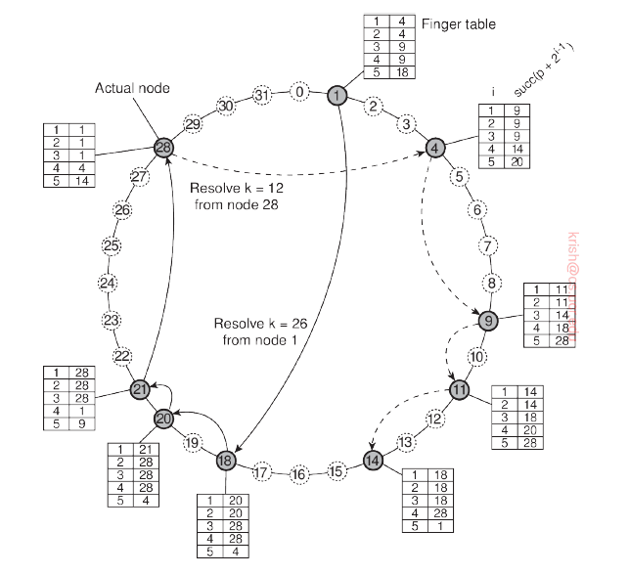
Example
Resolving key 26 from node 1 and key 12 from node 28 using DHTs in Chord (using finger tables)

Slide 18
Is log(N) lookup fast or slow?
For a million nodes, it’s 20 hops
If each hop takes 50 ms, lookups take a second
If each hop has 10% chance of failure, it’s a couple of timeouts
So log(N) is better than O(N) but not great

Slide 19
Handling churn in nodes
Need to update finger tables upon addition or removal of nodes
Hard to preserve consistency in the face of these changes

Slide 20
Amazon Dynamo
Added to “Hall of Fame” at SOSP’17
Rumored to be underpinning of Amazon S3’s architecture

Slide 21
Dynamo settings
Setting:
Tens of millions of customers
Data spread across tens of thousands of servers
Example use case: Store shopping carts
Goals:
High availability
Low latency
Consistency takes a hit

Slide 22
Consistent Hashing in Dynamo
Recall: Consistent hashing maps value for key to successor in hash space
Replicate value for every key at N nodes
N clockwise successors of key
Execution of writes
Write received by coordinator (successor of key)
Coordinator forwards to successors
Notes:
There are N successors. So immediate successor forwards to a set of subsequent successors. In case of failures, the following successors take over.

Slide 23
Replication in Dynamo
N120
N10
N105
N32
K21
N90
N60
Notes:
In this example, 2 replicas. The key is first hashed to N32 (>21). Then two additional nodes store the associated data.

Slide 24
Using Consistent Hashing
Server
Front-end
Client
Server
Front-end
Server
Notes:
Via the front end, the value written to one server which corresponds to key.

Slide 25
Consistent Hashing in Dynamo
What would it take to make this work?
Server
Server
Server
Client
Server
Server
1-hop DHT
Notes:
In this example, the value written to one server corresponding to key, and two other servers in addition.

Slide 26
Gossip
Once per second, each server contacts a randomly chosen other server
Servers exchange their lists of known servers
Including virtual node IDs

Slide 27
Sloppy quorums
N replicas for every key
Higher durability with greater N
Serving reads and writes:
Coordinator forwards request to first N-1 reachable successors
Waits for response from R or W to replicas
How to maximize availability/minimize latency?
Low R and/or low W
How to ensure read sees last committed write?
R+W > N
Notes:
Client has a list of N prioritized servers. The servers are chosen from this list. If they aren’t available, randomly chosen. First question – availability over consistency; and in the second consistency over availability.

Slide 28
Latency/availability over consistency
N = 3, W = 1, R = 1
k: x
k: x
A
k: y
k: x
B
C
Get(k)
Put(k, y)
Client1
Client2
Notes:
In this example, R+W < N

Slide 29
Consistency over latency/availability
N = 3, W = 2, R = 2
How to tell which of R copies read is latest version?
k: y
k: x
k: x
A
k: y
B
C
Put(k, y)
Get(k)
Client1
Client2
Notes:
Here the condition is satisfied (R+W >N).

Slide 30
Vector clocks
Store a vector clock with each key-value pair
What we have discussed previously:
Vector with # of components = # of servers
Not scalable
Dynamo’s adaptation of vector clocks:
List of (coordinator node, counter) pairs
Example: [(A, 1), (B, 3), …]

Slide 31
Vector clocks
N = 3, W = 2, R = 2
([A, 1])
([A, 1], (B, 1))
([A, 1])
([A, 1], (B, 1))
k: x
k: y
k: y
A
k: x
C
B
Put(k, x)
Put(k, y)
Client1
Client2

Slide 32
Vector clocks in Dynamo
Consider following scenario:
Client1 executes PUT(k, v1)
Client2 executes GET(k) and gets v1
Client2 executes PUT(k, v2)
How can vector clocks help in recognizing that okay to garbage collect v1?
When responding to a GET, Dynamo returns the vector clock for value returned
Client includes vector clock in subsequent PUT

Slide 33
Automatic conflict resolution
put handled by node A
written to A and C
v1 [(A,1)]
put handled by node B
written to B and C
v2 [(A,1), (B,1)]
v2 > v1, so Dynamo automatically drops v1 at C

Slide 34
App-specific conflict resolution
put handled by node A
v1 [(A,1)]
put handled by node B
put handled by node C
v2 [(A,1), (B,1)]
v3 [(A,1), (C,1)]
v2 || v3, so client must perform reconciliation
Client reads v2, v3; writes with [(A,1), (B,1), (C,1)]
v4 [(A,2), (B,1), (C,1)]

Slide 35
Dynamo’s client interface
Client interface:
Get(key) → value
Put(key, value)
Get(key) → List of <value, context> pairs
Returns one value or multiple conflicting values
Context describes version(s) of value(s)
Put(key, value, context)
Context indicates which versions this version supersedes or merges

Slide 36
Trimming version vectors
Many nodes may process Puts to same key
Version vectors may grow arbitrarily long
Dynamo’s clock truncation scheme
Dynamo stores time of modification with each version vector entry
When version vector > 10 nodes long, Dynamo drops node that least recently processed key
Problems with truncation?
False concurrency
Notes:
Sometimes some ordered updates may be missed, leading to false sense of concurrency.

Slide 37
Impact of clock truncation
put handled by node A
v1 [(A,1)]
put handled by node B
v2 [(A,1), (B,1)]

